Slide 1
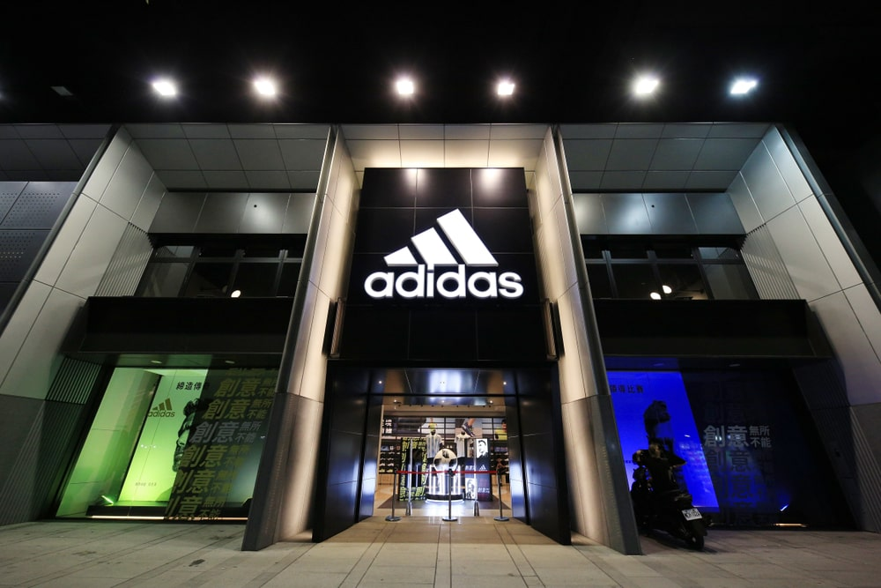
CRM & BI-Driven Strategy to Optimize Regional Sales Performance
A Case Study on Adidas
Presented by: Varun Sai Yandapalli
Institution: National College of Ireland
Student ID: 23325836

Slide 2

Business Context & Objectives
Business Challenge:
Underperformance in South, Southeast, and Midwest U.S. markets
Declining regional sales and low online penetration
Weak customer engagement and loyalty scores
Strategic Objectives:
Enhance customer engagement via CRM automation
Increase sales and loyalty in targeted regions
Deliver real-time, data-driven insights through dashboards

Slide 3




Role & Technological Framework
Project Role:
As a Business Analyst, Led data analysis, CRM system design, dashboard development, and integration
Tools & Technologies:
Python (EDA, Preprocessing)
Power BI (Dashboards)
Salesforce (CRM Automation)
PostgreSQL (Data Warehouse)

Slide 4

Exploratory Data Analysis & SWOT Summary
Key Data Insights:
- Sales ≠ Profit in weak regions
- Midwest & South show low loyalty and high costs
- Product misalignment in weak markets
SWOT Summary:
Strengths: Global brand, omnichannel presence
Weaknesses: Low digital sales in target regions
Opportunities: Personalization, CRM optimization
Threats: Retail decline, competition

Slide 5
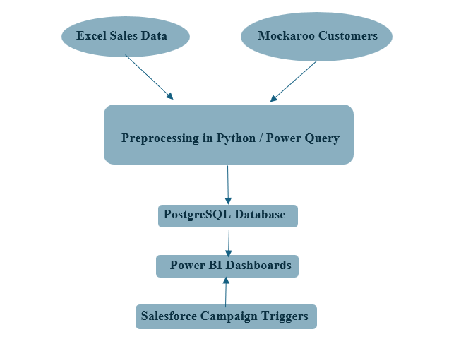
Integrated System Architecture
ARCHITECTURE FLOW:

Slide 6
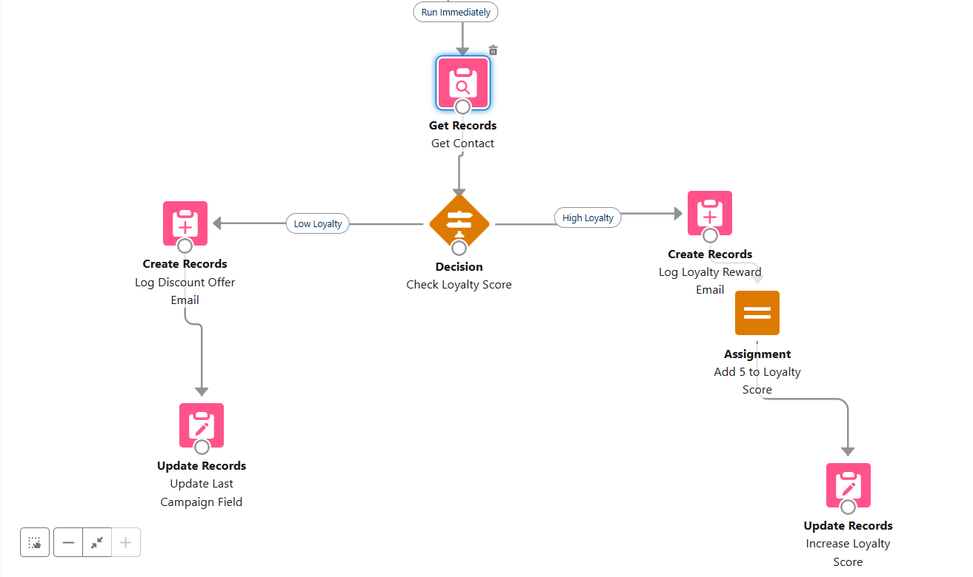
CRM Automation Workflows
Workflow A - Low Loyalty (<50):
Trigger: Discount Email
Action: Boost loyalty & log campaign
Workflow B - High Loyalty (≥50):
Trigger: Reward Email
Action: Increase loyalty
Custom Fields:
Loyalty_Score__c
Last_Campaign_Sent__c
Region__c

Slide 7

Business Dashboards Overview
Dashboard 1: Overall Sales
Region & channel performance
Monthly trends
Dashboard 2: Region Analysis
Loyalty, margin, sales vs. profit
Dashboard 3: Post-CRM Impact
Sales uplift, loyalty gain, open/click rates

Slide 8
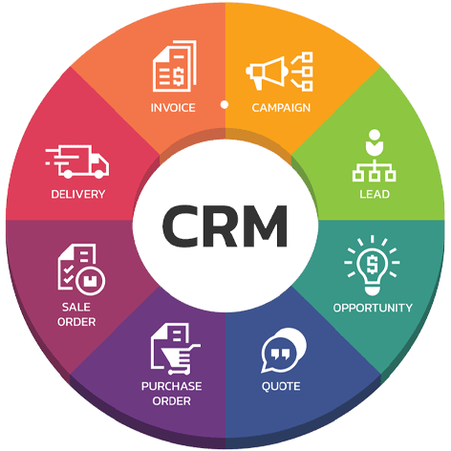
Impact Analysis & Metrics
CRM Impact Summary:
Avg Loyalty Score: 41.2 → 54.6 (+13.4 pts)
CRM Sales: $1.32M → $1.72M (+$404K)
Open Rate: 48.2%
Click Rate: 24.5%
Regional Highlights:
South: Sales boost
Southeast: Loyalty gain

Slide 9

Key Learnings & Challenges
Lessons Learned:
BI + CRM integration = Efficiency
Schema-first design is critical
Challenges:
Complex CRM flows
Testing with mock data
Future Improvements:
Predictive modeling
A/B testing
SMS & social media channels

Slide 10

Conclusion & Strategic Outcomes
Outcomes:
Scalable CRM automation
Real-time insights via dashboards
Boosted loyalty & sales in target regions
Future Vision:
Predictive analytics
Real-time personalization
Omnichannel expansion

