Slide 1
Maker web service
Your genome annotated

Slide 2
Step 1: Login
Enter your login credentials
Before you can login, you have to register

Slide 3
Step 2: add a maker job
Your name and email. Your email id would be used for all communications
You have to add a job to your cart

Slide 4
Step 2: add a maker job
Your name and email. Your email id would be used for all communications
You have to add a job to your cart

Slide 5
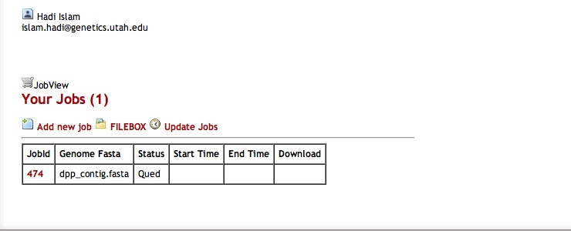
Step 3: Download
After adding the job, You will be directed to your job view
Clicking ‘update jobs’ will give you current status of your job
You can review your job details by clicking the job id

Slide 6
Maker job details

Slide 7
FILEBOX details

Slide 8
Maker web service systems interaction schema.

