Slide 1

WIDE CHRONICLE JOBS
Smith Yando
LC00017001697
What is it
Supervised by: Dr. Pawan Kumar Sharma

Slide 2
WIDE CHRONICLE JOBS
What is it
Smith Yando
LC00017001697

Slide 3
WIDE CHRONICLE JOBS
Key Features:
Strong and secured User Authentication and Profiles
Job Listings and Applications
Search and Filter
Account Selection for either Seller Or Buyer
Messaging System
Notification
Freelancing Platform
Develop a platform that enables freelancers to secure steady, fulfilling work and advance their careers.
Streamline the hiring process for clients, making it more efficient to locate and oversee top-quality talent.
What is it

Slide 4
WIDE CHRONICLE JOBS
Objective
Key Features:
Strong and secured User Authentication and Profiles
Job Listings and Applications
Search and Filter
Account Selection for either Seller Or Buyer
Messaging System
Notification
To create a platform that connects freelancers with clients.
To facilitate the process of finding and hiring freelance talent.
To provide a user-friendly interface for both freelancers and clients to chat
Freelancing Platform
Develop a platform that enables freelancers to secure steady, fulfilling work and advance their careers.
Streamline the hiring process for clients, making it more efficient to locate and oversee top-quality talent.

Slide 5

Objective
WIDE CHRONICLE JOBS
To create a platform that connects freelancers with clients.
To facilitate the process of finding and hiring freelance talent.
To provide a user-friendly interface for both freelancers and clients to chat
Key Features:
Strong and secured User Authentication and Profiles
Job Listings and Applications
Search and Filter
Account Selection for either Seller Or Buyer
Messaging System
Notification
Literature Review
Upwork
Fiverr
Freelancer.com
Collaborative Work Theory
1.1.1. Gig Economy Trends

Slide 6
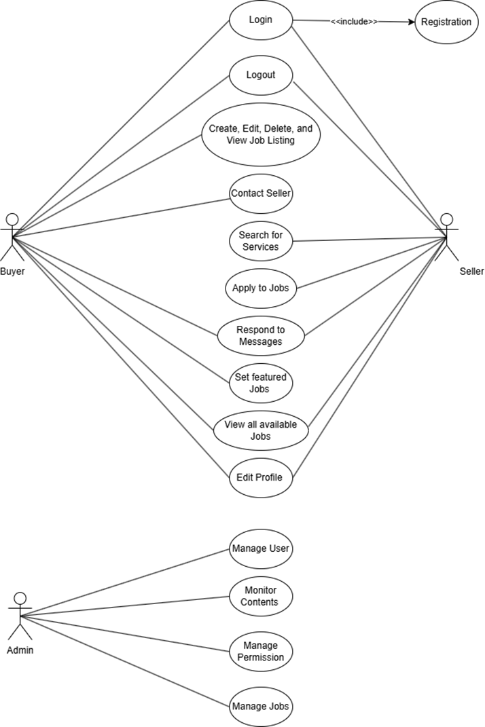
Objective
To create a platform that connects freelancers with clients.
To facilitate the process of finding and hiring freelance talent.
To provide a user-friendly interface for both freelancers and clients to chat
Literature Review
Use Case Diagram
Upwork
Fiverr
Freelancer.com
Collaborative Work Theory
Gig Economy Trends

Slide 7
Objective
To create a platform that connects freelancers with clients.
To facilitate the process of finding and hiring freelance talent.
To provide a user-friendly interface for both freelancers and clients to chat
Literature Review
Use Case Diagram
Upwork
Fiverr
Freelancer.com
Collaborative Work Theory
1.1.1. Gig Economy Trends

Slide 8
Literature Review
Use Case Diagram
Upwork
Fiverr
Freelancer.com
Collaborative Work Theory
1.1.1. Gig Economy Trends

Slide 9
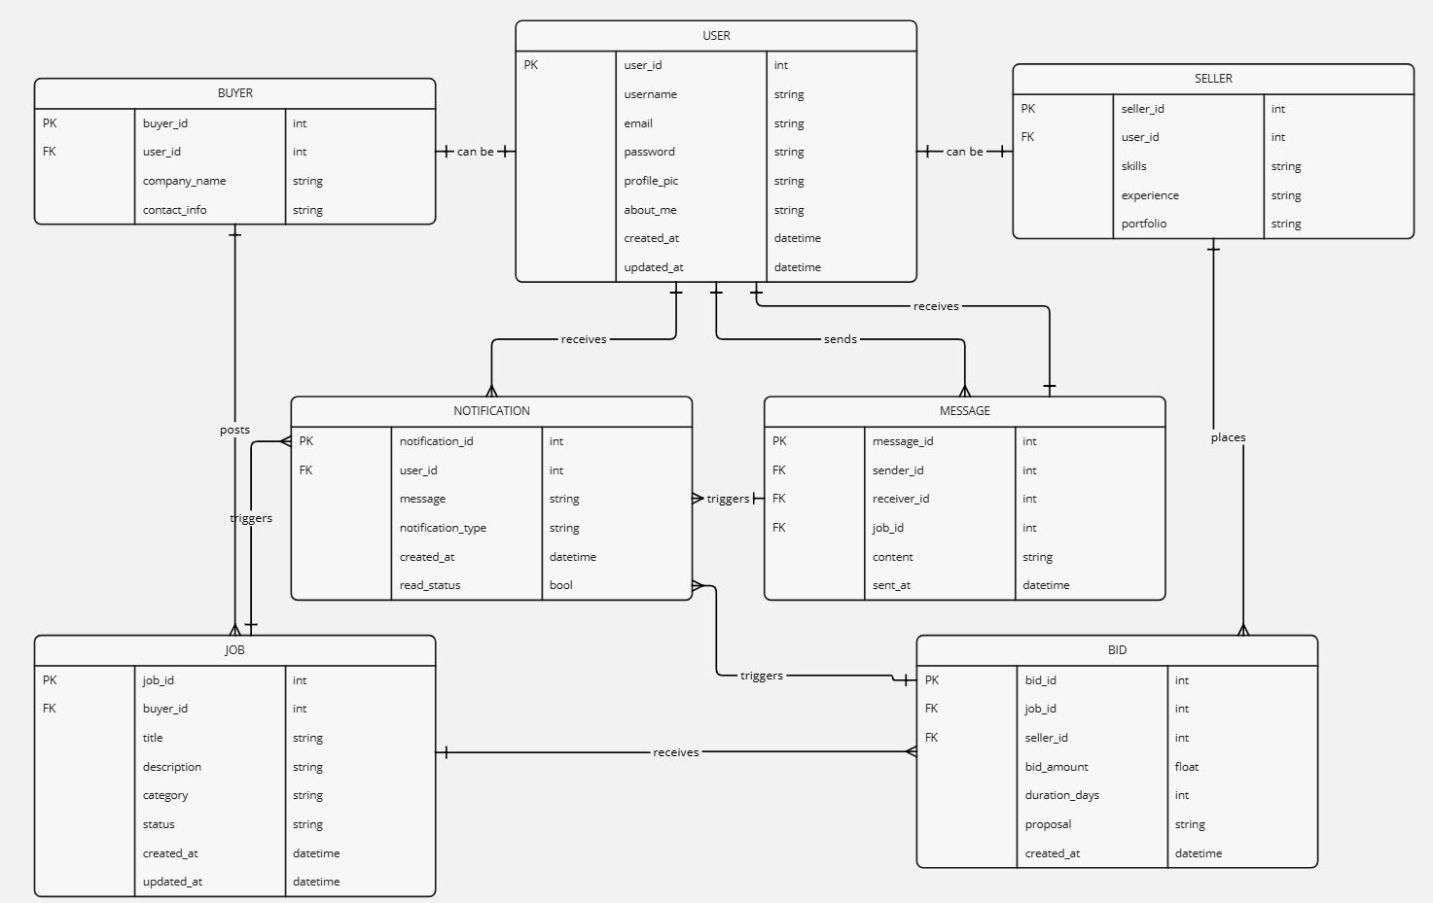
Literature Review
Use Case Diagram
ER-Diagram
Upwork
Fiverr
Freelancer.com
Collaborative Work Theory
1.1.1. Gig Economy Trends

Slide 10
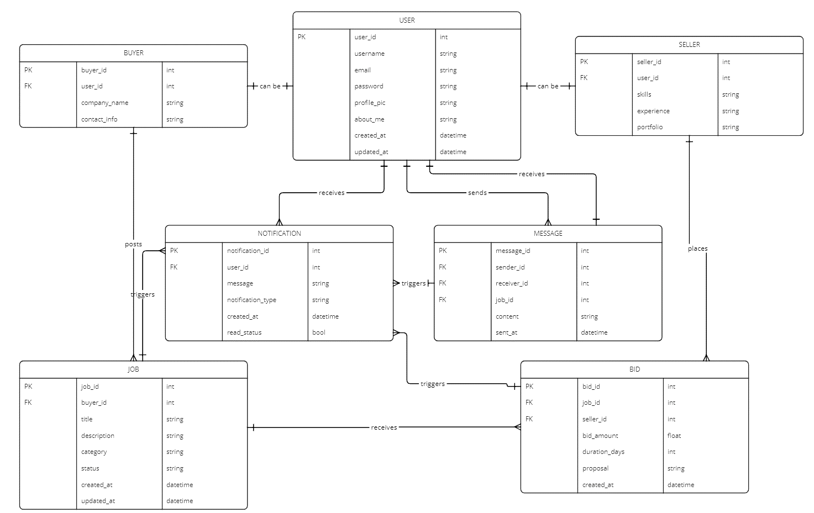
ER-Diagram

Slide 11
ER-Diagram

Slide 12
ER-Diagram

Slide 13
ER-Diagram

Slide 14
ER-Diagram

Slide 15
ER-Diagram

Slide 16
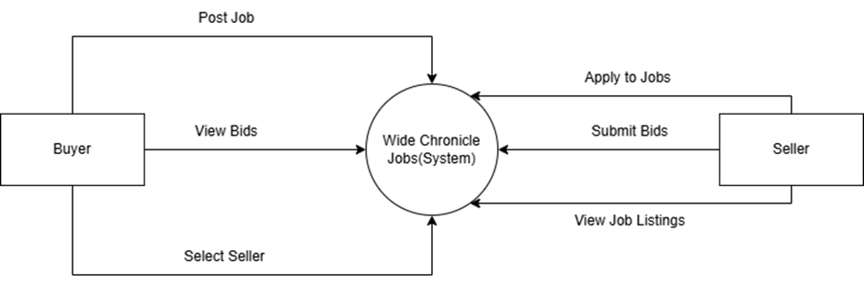
Context Diagram
ER-Diagram

Slide 17

Live Demo
Context Diagram
https://tinyurl.com/3duht7n8

Slide 18
Conclusion and Future Recommendation
Live Demo
Context Diagram
Payment integration
Advanced filtering and search
Ratings and reviews for jobs and sellers
https://tinyurl.com/3duht7n8

Slide 19
Conclusion and Future Recommendation
Question Answer Session
Payment integration
Advanced filtering and search
Ratings and reviews for jobs and sellers
Wide Chronicle Jobs aims to streamline freelancing job postings and hiring
Focus on user-friendly experience and efficient job management
Mainly focusing on Students to build the professional Career .
Live Demo
https://tinyurl.com/3duht7n8

Slide 20
Conclusion and Future Recommendation
Payment integration
Advanced filtering and search
Ratings and reviews for jobs and sellers
Wide Chronicle Jobs aims to streamline freelancing job postings and hiring
Focus on user-friendly experience and efficient job management
Mainly focusing on Students to build the professional Career .
Thank You
Question Answer Session

Slide 21
Thank You
Question Answer Session

