Slide 1

Knowledge 4

Slide 2
First-Order Logic: Deduction

Slide 3
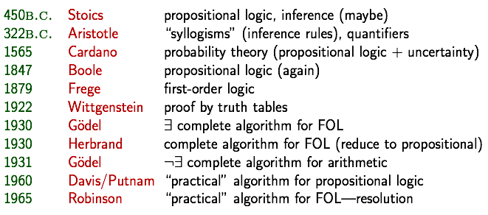
A brief history of reasoning

Slide 4
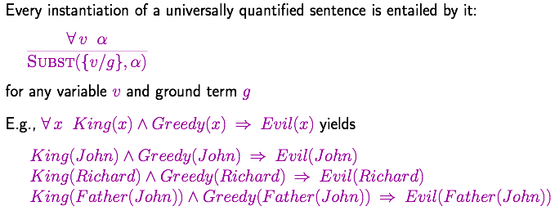
Universal Instantiation (UI)

Slide 5
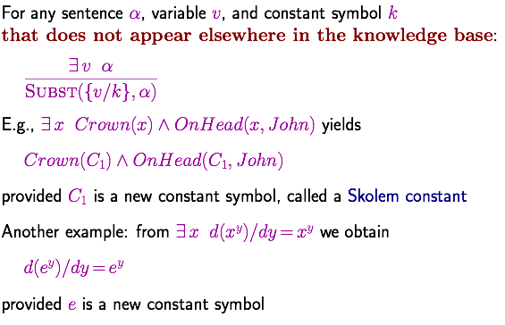
Existential Instantiation (EI)

Slide 6
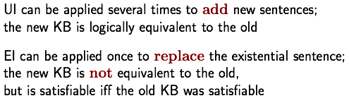
Instantiation
Inferentially equivalent

Slide 7
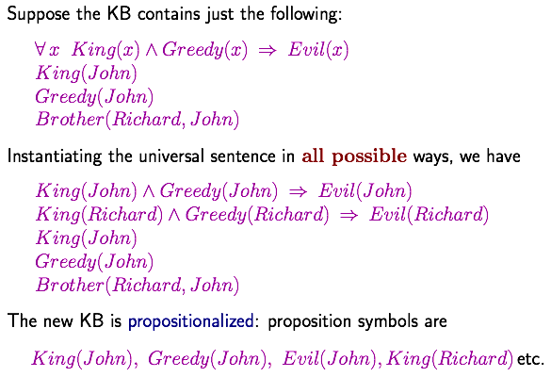
Reduction to propositional inference

Slide 8
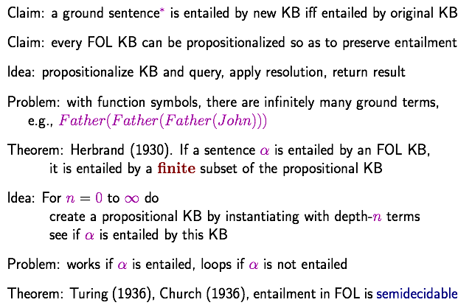
Reduction to propositional inference
Inferentially equivalent

Slide 9
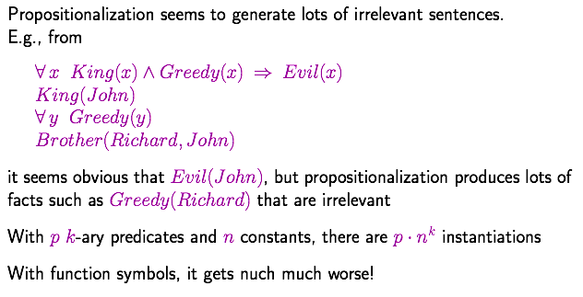
Problems with propositionalization

Slide 10
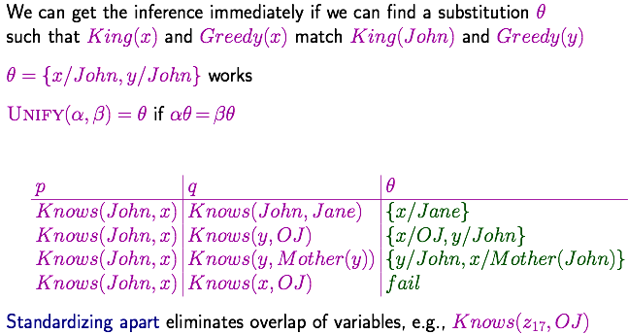
Unification

Slide 11
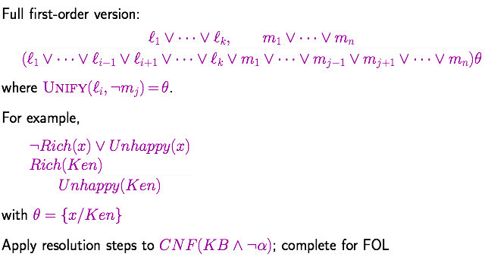
Resolution: brief summary

Slide 12
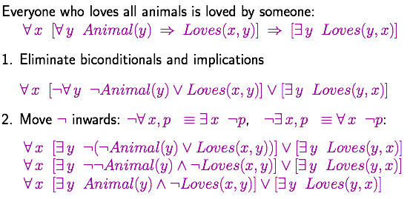
Conversion to CNF

Slide 13
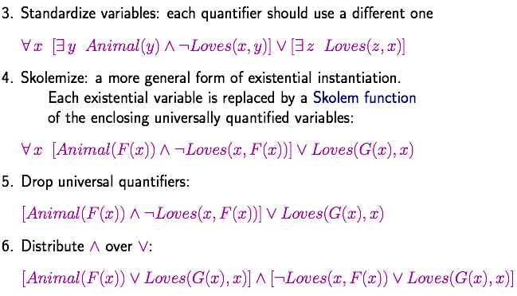
Conversion to CNF

Slide 14
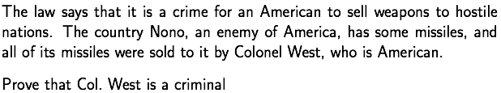
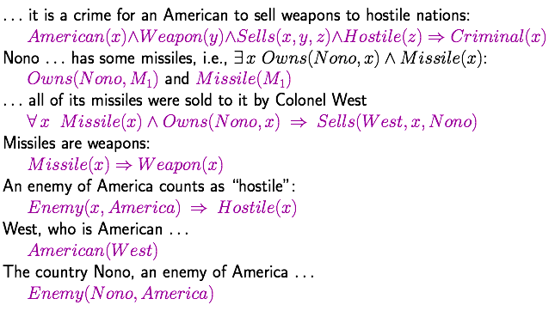
Example knowledge base

Slide 15
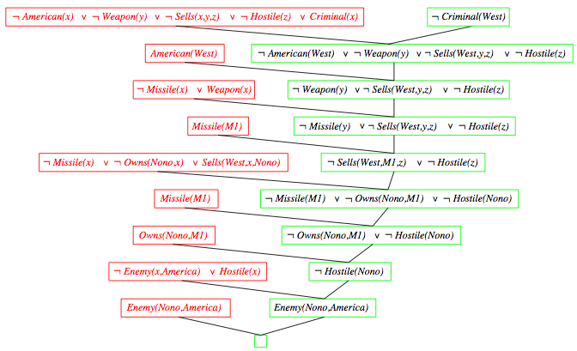
Resolution proof
¬

Slide 16
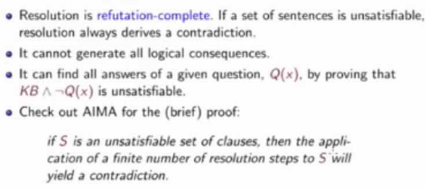
Completeness of FOL resolution
反驳

Slide 17
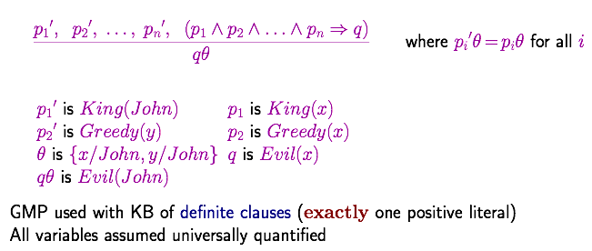
Generalized Modus Ponens (GMP)
（前件推理）

Slide 18
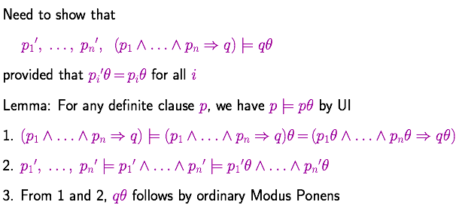
Soundness of GMP

Slide 19
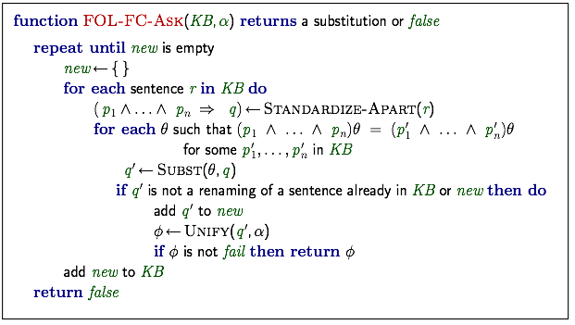
Forward chaining algorithm

Slide 20
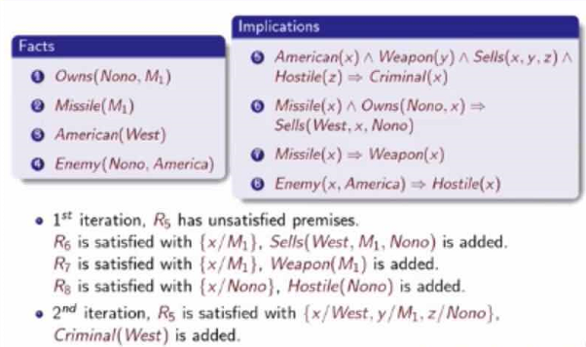
Forward chaining proof

Slide 21
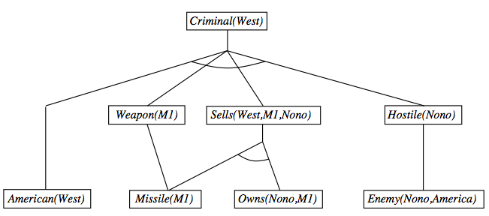
Forward chaining proof

Slide 22
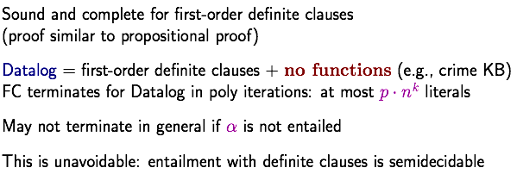
Properties of forward chaining
with functions

Slide 23
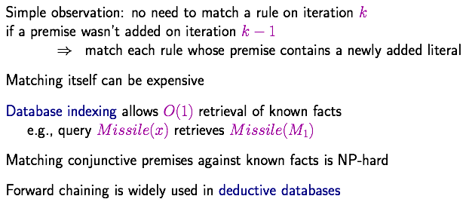
Efficiency of forward chaining

Slide 24
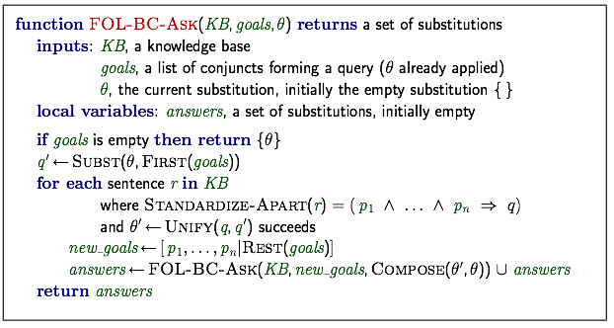
Backward chaining algorithm

Slide 25
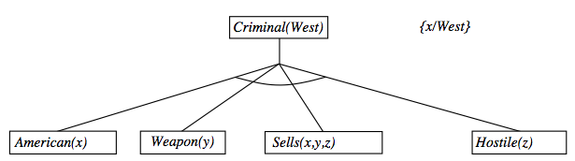
Backward chaining example

Slide 26
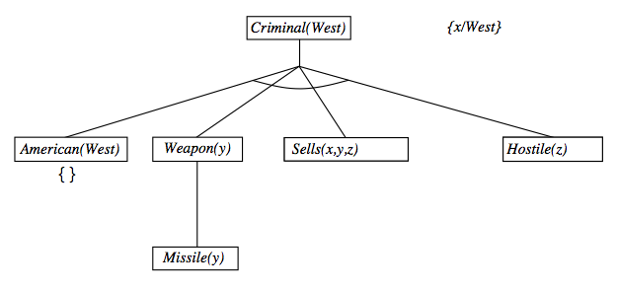
Backward chaining example

Slide 27
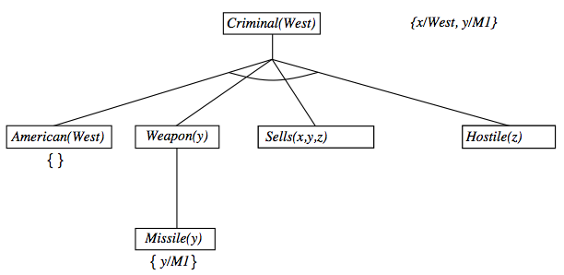
Backward chaining example

Slide 28
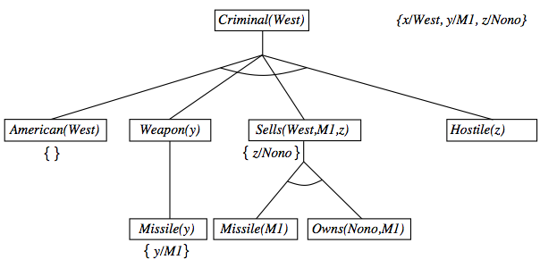
Backward chaining example

Slide 29
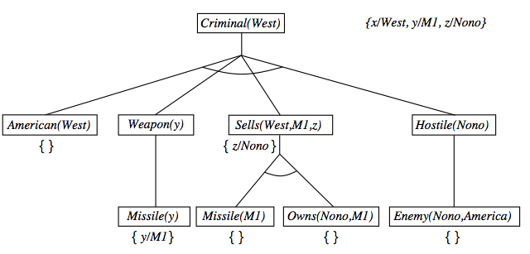
Backward chaining example

Slide 30
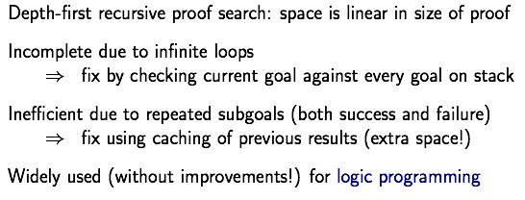
Properties of backward chaining
AND-OR search: AND for all premises; OR (multiple unifiers) since the goal query can be proved by any rules.

Slide 31
Logic Programming: Prolog

Slide 32
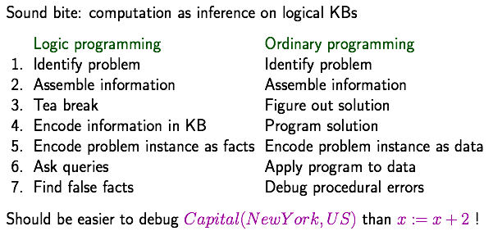
Logic programming

Slide 33
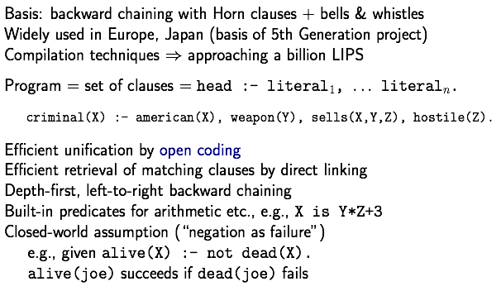
Prolog systems
如果

Slide 34
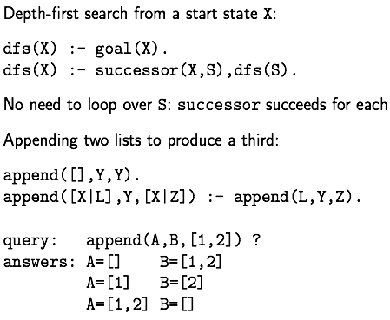
Prolog examples
第二个input放到第一个的右面

Slide 35
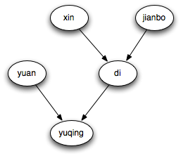
Prolog example
Homework
member(1,[1,2,3,4,5])
member(3,[1,2,3,4,5]) 要求：给出一个集合，列出其所有元素
subset([2,4],[1,2,3,4,5]) 要求：给出一个集合，列出其所有子集
query: grandfather(X,yuqing)?
male(di).
male(jianbo).
female(xin).
female(yuan).
female(yuqing).
father(jianbo,di).
father(di,yuqing).
mother(xin,di).
mother(yuan,yuqing).
grandfather(X,Y):-father(X,Z),father(Z,Y).
grandmother(X,Y):-mother(X,Z),father(Z,Y).
daughter(X,Y):-father(X,Y),female(Y).

Slide 36
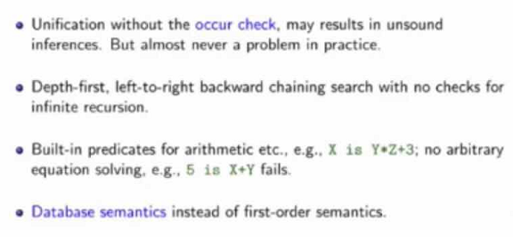

Prolog systems

Slide 37
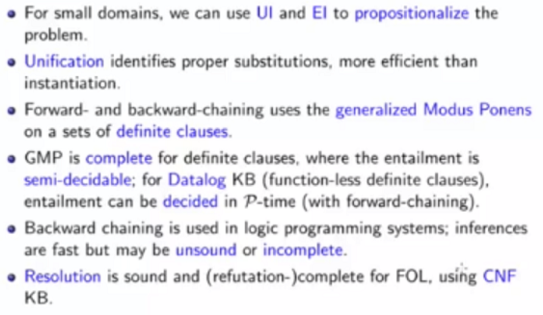
Summary

