Slide 1
Power Shell 指令
Cd C:\Users\SPUSER\Documents\web
npm run build # 產生 dist/
Remove-Item -Recurse -Force docs # 刪舊 docs
Copy-Item -Recurse dist docs # 複製 dist → docs
git add docs
git commit -m "deploy"
git push origin main

Slide 2


Slide 3
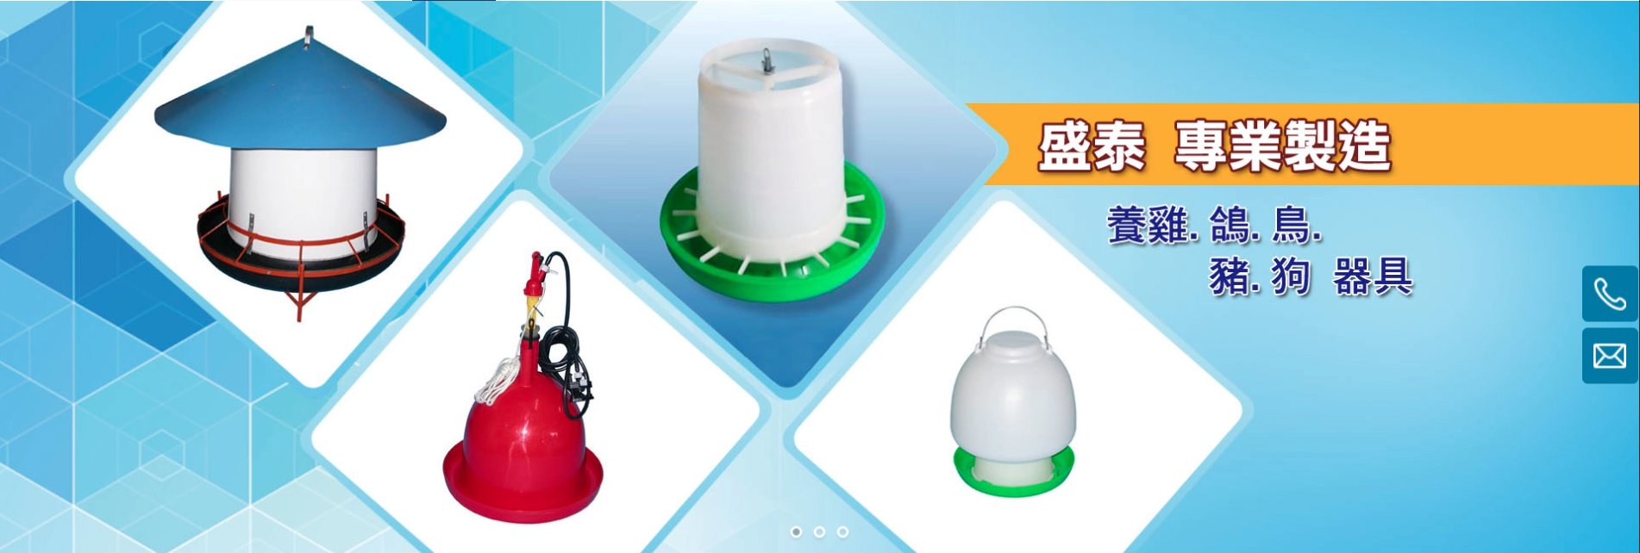

Slide 4


Slide 5
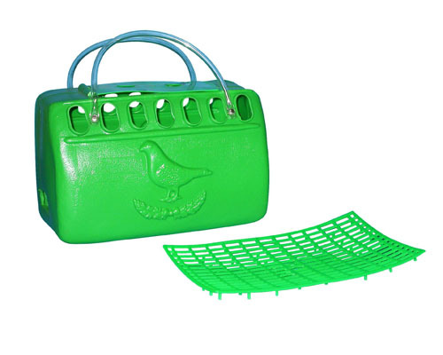

Slide 6
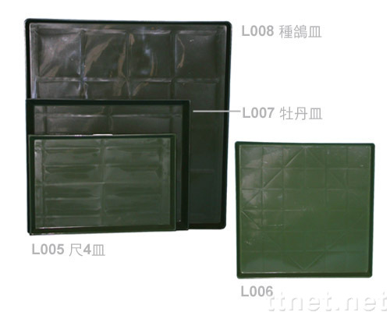
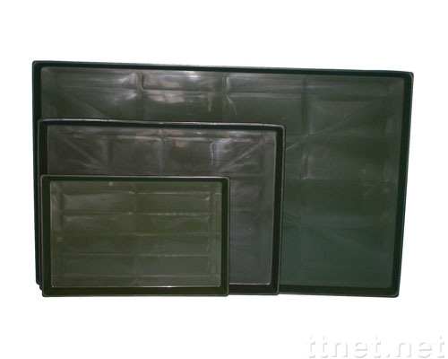


L008 種鴿皿
Y003
L007 牡丹皿
Y007
Y008
L005 尺四皿
L006 九官皿

