Slide 1


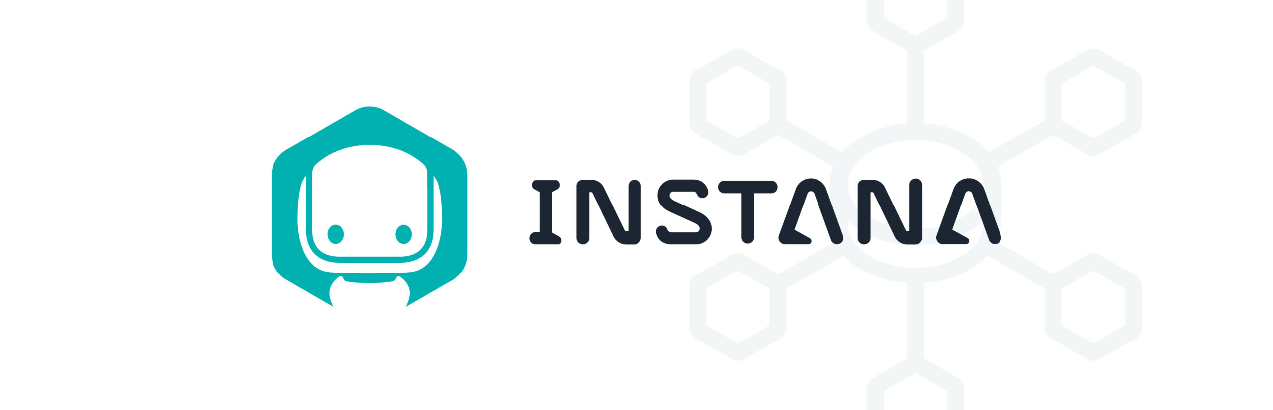






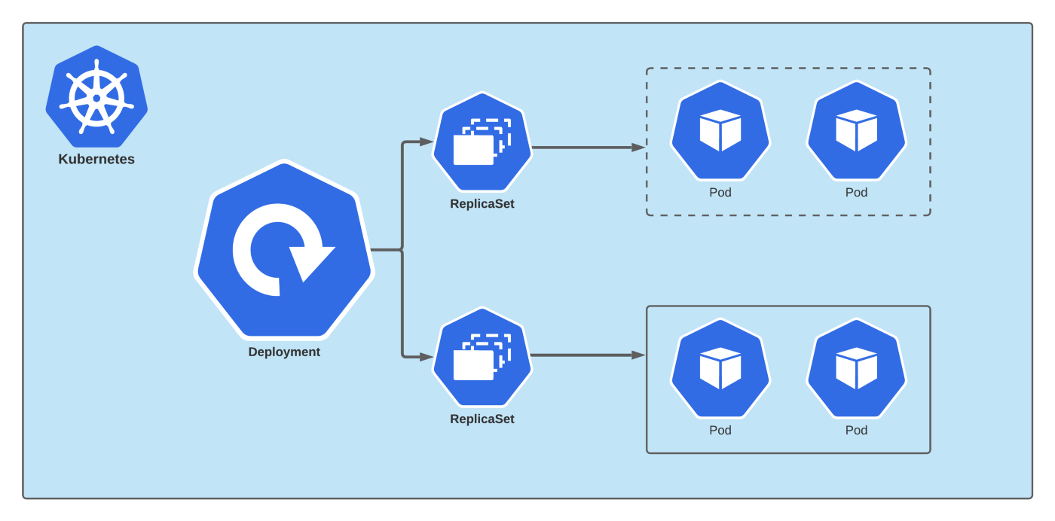

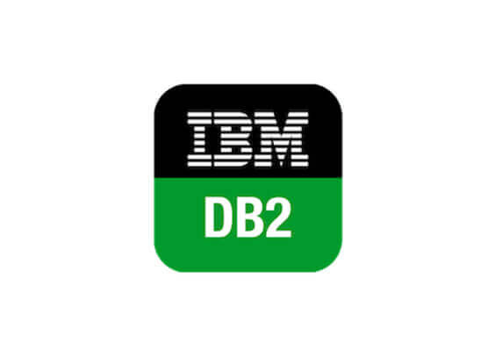

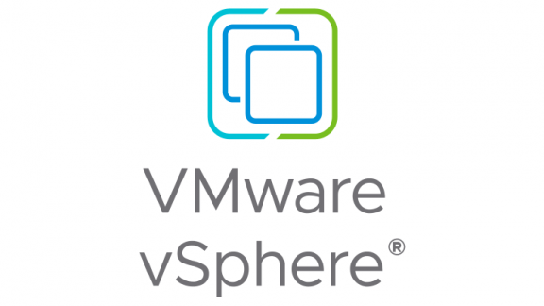

Environment Architecture
Ansible Tower
QOTD
Cloud Pak for Watson AIOps – Event Manager
Cloud Pak for Watson AIOps – AI Manager

