Slide 1


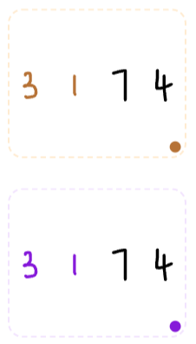
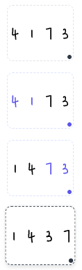


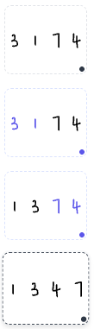
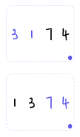
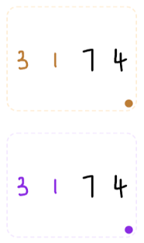







































Data
Compare
Swap
value
index
param
Data
Compare
Swap
[3,1,7，4]
is_bigger(3,1)
True
False
i=0
compare_and_swap(a[i],a[i+1])
Compare & Swap
compare_and_swap(3,1)
swap(3,1)
swap(3,1)
compare_and_swap(3,7)
i=1
is_bigger(3,7)
True
False
compare_and_swap(a[i],a[i+1])
compare_and_swap(7,4)
compare_and_swap(3,1)
^
i=2
[1, 3, 4, 7]
if :
compare_and_swap(a[i],a[i+1])
Done
is_bigger(3,1)
Data
Compare
Swap
[3,1,7，4]
True
swap(3,1)
True
is_bigger(3,1)
True
False
value
index
param
False
do nothing
d
compare_and_swap(a[0],a[1])
b
compare_and_swap(3,1)
compare_and_swap(a[1],a[2])
Compare & Swap
compare_and_swap(3,7)
compare_and_swap(a[2],a[3])
Data
Compare
Swap
[3,1,7，4]
compare_and_swap(7,4)
Compare & Swap
is_bigger(3,1)
True
False
c
compare_and_swap(3,1)
a
swap(3,1)
compare_and_swap
value
index
param
compare_and_swap(3,7)
compare_and_swap
compare_and_swap
compare_and_swap(7,2)
compare_and_swap(3,1)
Bubble up
bubble_up([3,1,7,2])
^
[1, 3, 2, 7]
Data
Compare
Swap
[3,1,7，4]
for i = 0 to 2 :
compare_and_swap(3,7)
True
compare_and_swap(3,1)
is_bigger(3,1)
True
False
i=0
swap(3,1)
i=1
compare_and_swap(3,7)
i=2
compare_and_swap(7,2)
compare_and_swap(7,4)
is_bigger(3,7)
True
False
False
bubble_up([1,3,2])

Slide 2


















Data
Compare
Swap
[3,1,4]
Data
Compare
Swap
Compare & Swap
compare_and_swap(3,1)
is_bigger(3,1)
True
False
value
index
param
i=0
compare_and_swap(7,4)
compare_and_swap(a[i],a[i+1])
swap(3,1)
swap(3,1)
[1, 3, 4, 7]
i=2
compare_and_swap(a[i],a[i+1])
Done
compare_and_swap(3,1)
^
if :
is_bigger(3,1)
d
Data
Compare
Swap
[3,1,4]
value
index
param
is_bigger(3,1)
True
False
True
swap(3,1)
compare_and_swap(a[0],a[1])
True
False
do nothing
a
compare_and_swap(a[2],a[3])
Compare
Swap
b
Compare & Swap
compare_and_swap(4,1)
c
compare_and_swap(7,3)
Compare & Swap
compare_and_swap(3,1)
Data
Compare
Swap
[3,1,4]
compare_and_swap(7,4)
value
index
param
is_bigger(3,1)
True
False
compare_and_swap(4,1)
[1, 4, 3, 7]
swap(3,1)
compare_and_swap(7,3)

