Slide 1


Pedagogical Counterexample Generation for Early Programming Education
Yang Wu
PhD Student yang.wu@inf.ethz.ch
Supervisor:
Prof. Dr. April Wang
Prof. Dr. Clément Pit-Claudel
Notes:
Good afternoon everyone. I am Yang Wu, and today I will present my dissertation proposal: Pedagogical Counterexample Generation for Early Programming Education.

Slide 2
How do learners change their mental model of understanding?
Conceptual Change Theory [1]
0
v=v =0
₀
f = g
₀
g
F= f - g = ma,
v-v
a=
t
0
Why does the ball fall after reaching the peak?
f > g
g
Conceptual change intervention
Student initial model
Scientific model
[1] DiSessa A A. A history of conceptual change research [M]. 2014.
Notes:
(Tosses a ball in the air, catches it, and looks at the audience.)
Imagine you throw a ball upward. It rises, reaches the highest point, and falls.
If you ask a student why, they’ll usually say: "Your throw gave the ball an upward force. As it rises, that force weakens, until it balances gravity at the top. Then, gravity wins."
It sounds reasonable because in daily life, motion needs a push.
////But if Newton were here, he’d laugh.
According to his second law, if the upward force and gravity balance at the top, the net force is zero.
A net force of zero means zero acceleration.
Since the ball has already stopped at the top, with no acceleration... The ball should just stay there. Floating in mid-air, forever. But why it falls.
////To fix this, the learner must change their model. They need to realize that after release, gravity is the only force acting on the ball.
////This is conceptual change: moving from the idea that the "throwing force stays with the ball," to realizing it vanishes the moment the ball leaves your hand.
////That question "Why does it fall?" becomes the intervention. It forces the student to rewrite their mental model.

Slide 3



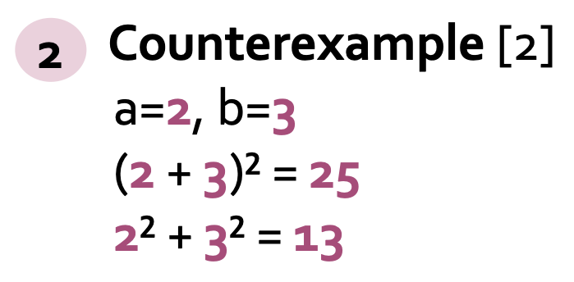
Conceptual Change Intervention
Math: (a + b)² = ?
Student mental model
(a + b)² = a² + b²
Text change [1]
1
(a + b)² = a² + 2ab + b²
Student example
a=0, b=1,
(0 + 1)² = 1
0² + 1² = 1
Okay, why?
It works!
Hmm, my assumption doesn’t hold in this case
[1] Kreinsen M, Grospietsch F, Schulz S. Towards Conceptual Change in Computer Science Education: an Introduction to Conceptual Change Texts[C]//Proceedings of the 19th WiPSCE Conference on Primary and Secondary Computing Education Research. 2024: 1-2.
[2] Tupouniua J G. Differentiating between counterexamples for supporting students’ algorithmic thinking[J]. Asian Journal for Mathematics Education, 2022, 1(4): 475-493.
Notes:
This kind of conceptual change also applies to mathematics.
For example, a learner may think: when we square a sum, we can just square each part separately.
If a=0,b=1, both results are the same.
So from the learner’s perspective, the rule seems to work.
Now, how can we intervene?
One way is a text-based change. We can simply show the correct formula
But the learner may still ask: okay, why? It may not convince them why their own idea fails.
Another intervention is to give a counterexample with 2 and 3, the two results are different.
Here, the learner can immediately see: my rule does not hold in this case.
This is why counterexamples can be powerful for conceptual change: they create a concrete conflict between what the learner believes and what actually happens.

Slide 4



Which one is a better counterexample?
Student mental model
(a + b)² = a² + b²
Student example
a=0, b=1,
(0 + 1)² = 1
0² + 1² = 1
Counterexample
Counterexample
A
B
a=28, b=36
(28 + 36)² = 4096
28² + 36² = 2080
a=1, b=1
(1 + 1)² = 4
1² + 1² = 2
Too many changes
I see the point
Notes:
So, if counterexamples are useful, does any counterexample work?
Here are two possible counterexamples. But which one would you choose?
A is valid, but the large numbers may distract learners with calculation.
So B is better for learning: it is minimal, easy to compare, and helps the learner see why their model fails.

Slide 5
Theoretical Foundation
Pedagogical Counterexample
Productive Failure Theory [1]
Conceptual Change Theory [2]
Formative Feedback Theory [3]
[1] Productive failure: https://lse.ethz.ch/research/productive-failure.html from Prof. Manu Kapur
[2] Conceptual Change Theory: Posner, G.J., Strike, K.A., Hewson, P.W. and Gertzog, W.A. (1982), Accommodation of a scientific conception: Toward a theory of conceptual change. Sci. Ed., 66: 211-227. https://doi.org/10.1002/sce.3730660207
[3] Formative feedback: https://teachingcommons.stanford.edu/teaching-guides/foundations-course-design/feedback-and-assessment/formative-assessment-and-feedback
Notes:
So from these examples, my focus is not just counterexamples in general, but pedagogical counterexamples, designed to support learning.
The broader motivation comes from Productive Failure. learners first struggle, then receive support to make sense of that struggle. Here, the counterexample makes the failure concrete by showing where their current idea breaks.
This connects most directly to Conceptual Change Theory: the problem is not only a wrong answer, but a mental model that works in some cases and fails in others. A counterexample makes this failure visible and gives learners a reason to revise.
Additionally, we draw on Formative Feedback theory: , especially Narciss’s model. feedback should not only say right or wrong, but help learners see the gap, reflect, and revise.
——————————————————————————
The broader motivation comes from Productive Failure. Learners can benefit from first struggling with a problem, and then receiving support that helps them make sense of that struggle. In our case, the counterexample makes the failure concrete, it gives learners a specific case where their current idea breaks.
This connects most directly to Conceptual Change Theory. The key issue is not just a wrong answer, but an intuitive mental model that works in some cases and fails in others. A counterexample can support conceptual change by making this failure visible and creating a reason to revise the model.
We additionally draw on Formative Feedback, especially Narciss’s model of feedback for interactive learning tasks. Feedback is not just a right-or-wrong signal; it gives learners information about the gap between their current state and the goal, and helps them reflect and revise.

Slide 6
Research Gap
Pedagogical Counterexample
Physics [1]
Math [2]
Computer Science ?
···
[1] DiSessa A A, Sherin B L. What changes in conceptual change?[J]. International journal of science education, 1998, 20(10): 1155-1191.
[2] Tupouniua J G. Differentiating between counterexamples for supporting students’ algorithmic thinking[J]. Asian Journal for Mathematics Education, 2022, 1(4): 475-493.
Notes:
Pedagogical counterexamples have been widely discussed in domains like physics and mathematics. But in computer science education, this idea is still less developed. Counterexamples are often used as practice materials, but rarely studied as something we can generate and design for learning

Slide 7
Research questions
RQ1
What forms of counterexamples are meaningful in early programming contexts ?
RQ2
How does counterexample-based feedback affect learning outcomes in early programming education?
RQ3
How can systems generate counterexamples that are not only technically valid but also pedagogically useful ?
Notes:
So from this research gap, my dissertation focuses on two questions.
First, what forms of counterexamples are meaningful in early programming contexts ?
My first two work packages focus more on the design of counterexamples for computational thinking and early programming behavior.
Second, How can systems generate counterexamples that are not only technically valid but also pedagogically useful ?
My last two work packages focus more on the generation and evaluation.

Slide 8
Outline of this presentation
Research Context & Motivation
Theoretical Lens
Research Questions
Work Package1
Work Package2
Work Package3
Work Package4
Notes:
So far, I have talked about why pedagogical counterexamples matter, the theories that support this idea, and the research questions.
Now I will move to the four work packages.
Today, I will mainly focus on package 1, which is the work I have developed over the past half year. Package 2 is currently in progress, and. Package 3 and 4 outline the next steps for the dissertation.

Slide 9
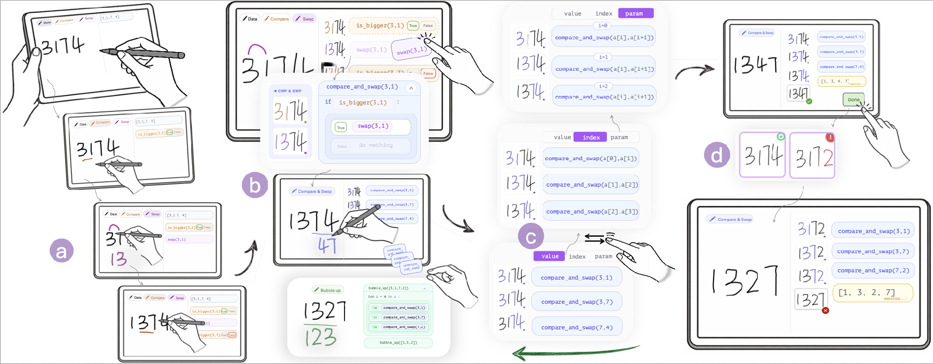
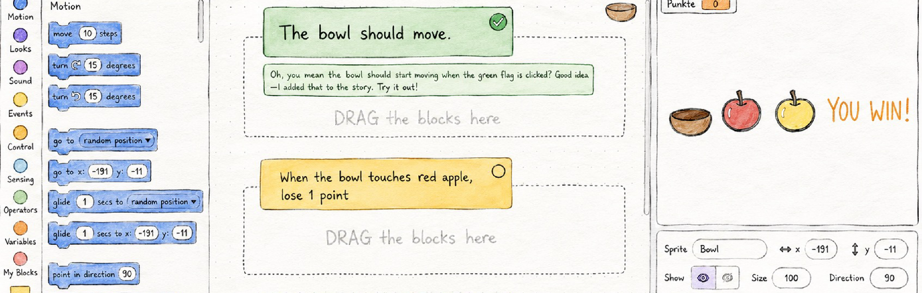
Work Packages Overview
WP1 Programming Algorithms
WP2 Programming Interactive Systems
Accepted by UIST 26, 1st year
Under review by CHI 27, 1st year
Design
Counterexamples for Sketch-Based Algorithmic Reasoning
Educator-Co-Designed AI Support for Scratch Programming
Extending SketchMind from Iterative to Recursive Algorithms
UIST 27
2nd year
Playable Counterexamples for Programming Interactive Programs
CHI 27
2nd year
Learning
WP3 Pedagogical Value
Large-scale Evaluation, Learning Outcome, Controlled Study
ICER, SIGCSE 2nd, 3rd year
Effects of Counterexample-Based Feedback on Learning
WP4 Counterexample Generation
Generation
LLM-based
Fuzzing
SMT Solver
Hybrid Method
ISSTA, OOPSLA
3rd, 4th year
Technical Comparison of Generation Methods across Domains
Notes:
Package 1 focuses on sketch-based algorithmic reasoning, where counterexamples reveal gaps in learners’ understanding of algorithm traces and intermediate states. Package 2 explore the idea to interactive programming systems, such as Scratch. Here, counterexamples become playable scenarios that show mismatches between the learner’s intended behavior and the actual program behavior. These 2 work packages explore the design space.
Package 3 focuses on learning. It asks whether counterexample-based feedback actually improves learners’ understanding and learning outcomes in larger-scale studies.
Package 4 focuses on generation. It compares different generation methods and studies the trade-off between technical validity and pedagogical usefulness.

Slide 10
WP1: Counterexamples for Sketch-Based Algorithmic Reasoning
Learning example: bubble sort
Counterexample
3 1 7 4
3 1 7 4
8
3 > 1, swap
3 > 1, swap
8
↓
↓
1 3 7 4
1 3 7 4
8
7 > 4, swap
7 > 4, swap
↓
↓
1 3 4 7
1 3 4 7
8
The array is sorted! ✓
The array is not sorted! ✖️
Notes:
Let me first introduce WP1 with a bubble sort learning case.
Bubble sort compares neighboring elements and swaps them. After each round, the largest element moves toward the end of the array.
Here, the student is sorting the array.
- They compare the first pair
- and swap them.
- Then they compare the last pair
- and swap them.
- In this case, the final array happens to be sorted.
But the reasoning is incomplete, because the student skips the middle pair.
- So what would be a good counterexample here?
- - We only change the first number from three to eight.
-Then we replay the student’s exact sketch steps.
Now the final array is not sorted
- and exposes the missing middle comparison.

Slide 11
WP1: Counterexamples for Sketch-Based Algorithmic Reasoning
Interaction flow
Unsorted
Check result
Sorted
Check process
Correct
Finish
Sketch reasoning
Replay
Generate Counterexample
Incorrect
Notes:
Here's the interaction flow.
First, Students sketch their reasoning,
- and the system checks the result.
- If the result is wrong, students revise their sketch.
- If the result is correct, the system checks the reasoning process.
- When the process is incomplete, the system generates a counterexample
- and replays it through the student’s own sketch.
- The cycle continues until both the result and the process are correct.

Slide 12
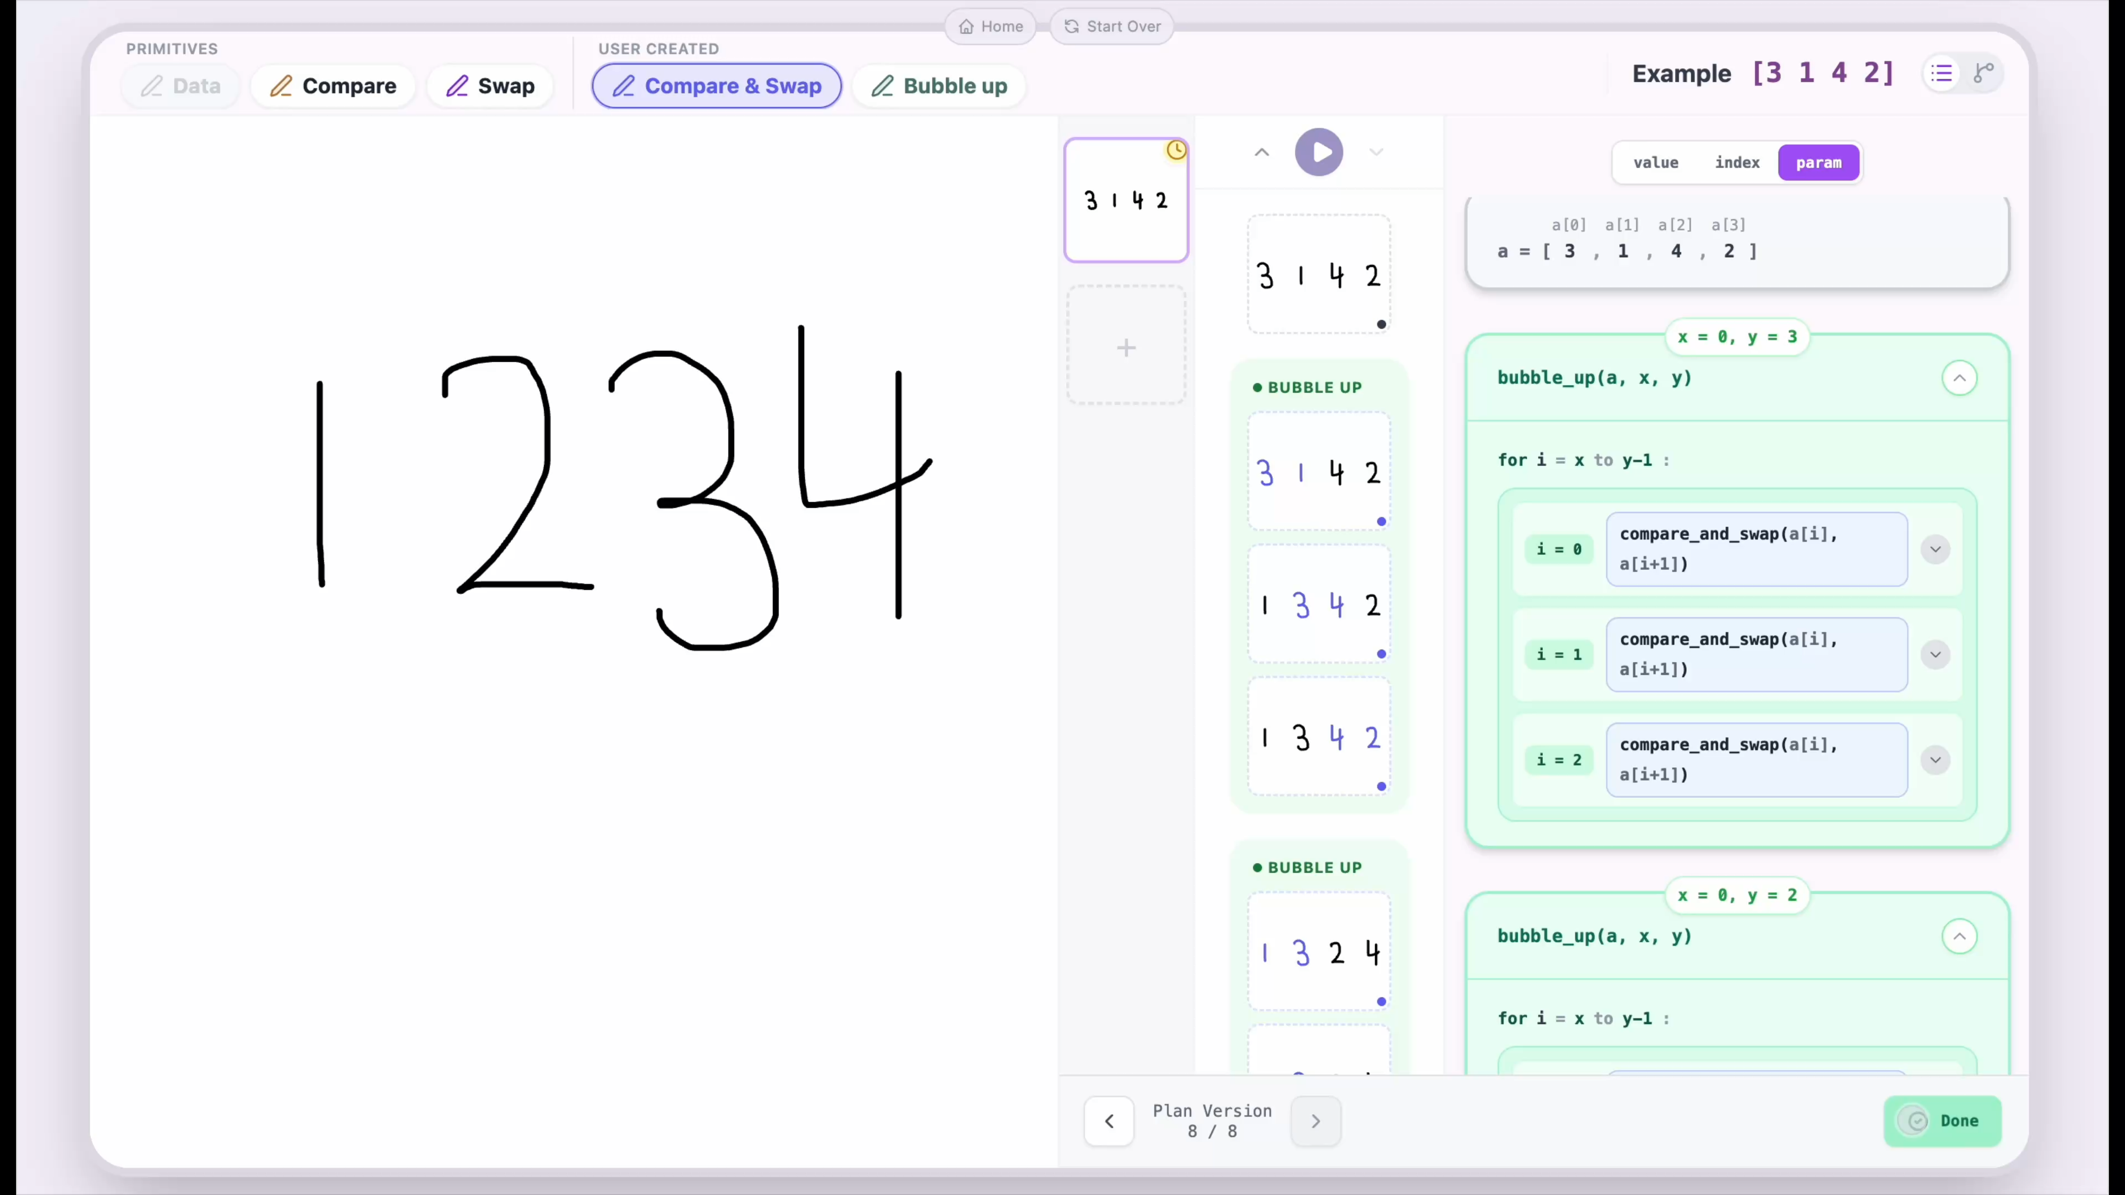
WP1: Counterexamples for Sketch-Based Algorithmic Reasoning
12
Notes:
Let's see how it looks in our system. On the left, students can sketch their reasoning directly. On the right, the system translates these sketches into structured algorithm steps.
When students feel they have finished, they click Done.
-The system checks and generates a counterexample

Slide 13
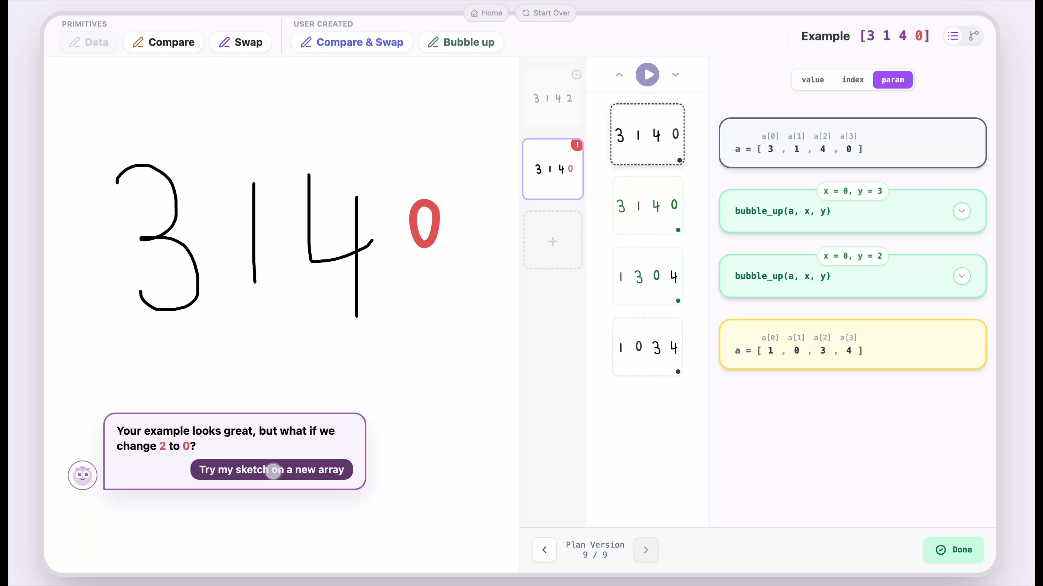
WP1: Counterexamples for Sketch-Based Algorithmic Reasoning
13
Notes:
Then the counterexample replays through the student’s own steps. In this case, the student can quickly notice that they only finished 2 rounds of bubbling up

Slide 14
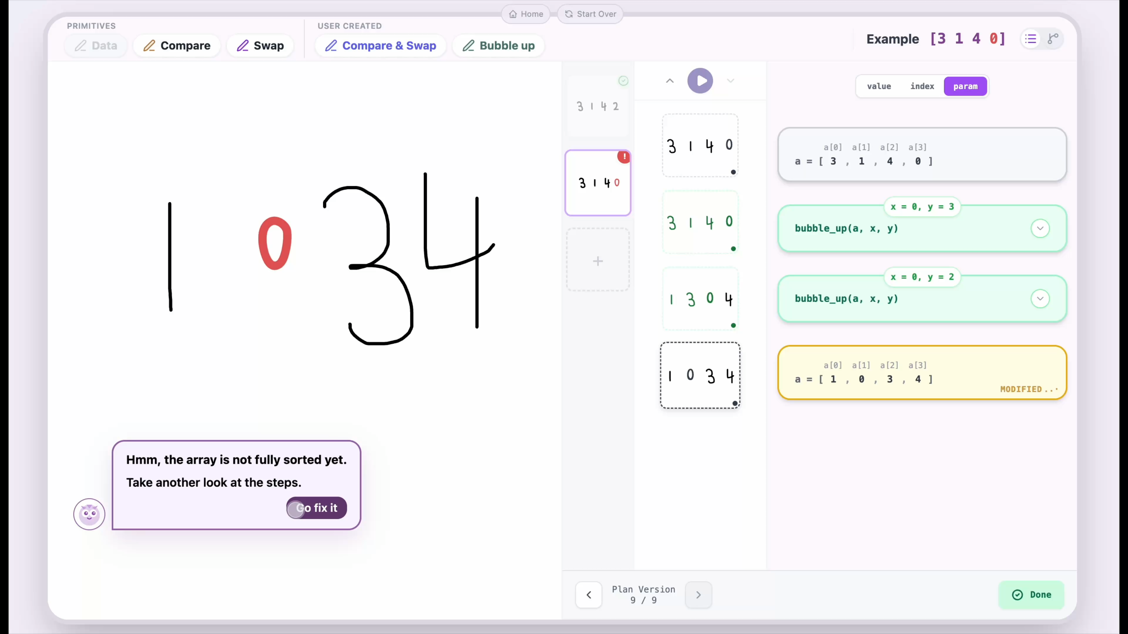
WP1: Counterexamples for Sketch-Based Algorithmic Reasoning
14
Notes:
They can then go back and add the missing round using a bubble-up pen.

Slide 15
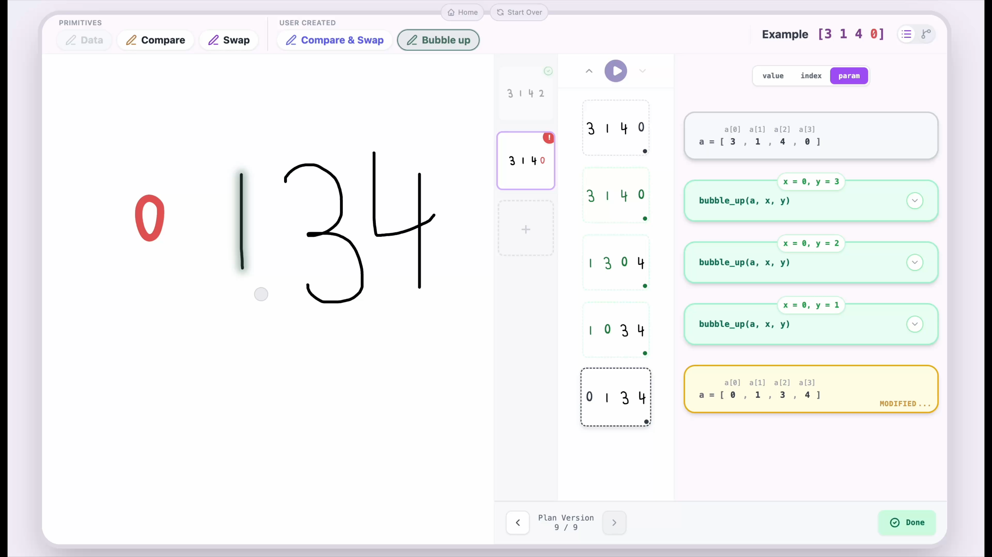
WP1: Counterexamples for Sketch-Based Algorithmic Reasoning
15
Notes:
Now they complete the reasoning

Slide 16
WP1: Counterexamples for Sketch-Based Algorithmic Reasoning
How to generate a pedagogical counterexample?
✓
!
3
1
7
4
her example
3
1
7
2
counterexample
[3, 1, 7, 4]
[3, 1, 7,
2
The change is minimal.
]
compare_and_swap(3, 1)
True
compare_and_swap(3, 1)
True
compare_and_swap(3, 7)
False
compare_and_swap(3, 7)
False
Her previous steps stay valid.
compare_and_swap(7, 4)
compare_and_swap(7,
2
True
)
True
[1, 3, 4, 7]
sorted
[1, 3,
2
, 7]
not sorted
The new input needs more steps.
Notes:
Let's look more closely at that counterexample. What makes it useful? We want to help learners see where they went wrong without confusing them. First, we want the change to be minimal. Second, all of her earlier steps remain valid. Third, the new example needs additional steps to finish.

Slide 17
WP1: Counterexamples for Sketch-Based Algorithmic Reasoning
Step 1: turn every Bubble Sort step into a fact.
[
3
1
7
4
]
a0
a1
a2
a3
HER PLAN
REFERENCE PLAN
FACT
pass 1
C&S(a0, a1)
3 vs 1
C&S(a0, a1)
a0 > a1
C&S(a1, a2)
3 vs 7
C&S(a1, a2)
a0 ≤ a2
C&S(a2, a3)
7 vs 4
C&S(a2, a3)
a2 > a3
pass 2
missing
C&S(a0, a1)
a1 ≤ a0
missing
C&S(a1, a2)
a0 ≤ a3
pass 3
missing
C&S(a0, a1)
a1 ≤ a0
Note:
C&S
=
compare_and_swap
Notes:
We build those conditions in three steps. First, we formalize every Bubble Sort step into a fact. We compare her plan with the reference plan, naive Bubble Sort, and see that her plan misses passes 2 and 3. Each step of the reference plan gives a fact about the input values: whether that step swaps or not. On her example, all of these facts hold, so missing passes 2 and 3 does not change her result.

Slide 18
WP1: Counterexamples for Sketch-Based Algorithmic Reasoning
Step 2: keep her steps, flip one she missed, change little.
Her previous steps stay valid.
The new input needs more steps.
The change is minimal.
[
3
1
7
4
]
a0
a1
a2
a3
FACT
NEW CONDITION
pass 1
a0 > a1
→
KEEP
a0 > a1
a0 ≤ a2
→
KEEP
a0 ≤ a2
a2 > a3
→
KEEP
a2 > a3
a1 ≤ a0
a1 > a0
pass 2
→
FLIP
a1 > a0
✗ clashes with a0 > a1
a0 ≤ a3
→
FLIP
a0 > a3
✓ Bubble Sort must swap here, in pass 2
a1 ≤ a0
a1 > a0
pass 3
→
FLIP
a1 > a0
✗ clashes with a0 > a1
1. fewest numbers changed
(+ (ite (= a0 3) 0 1) …)
minimize
2. then smaller changes
(+ (abs (- a0 3)) …)
3. then smaller values
(+ a0 a1 a2 a3)
Notes:
Second, we decide which facts to keep and which one to flip. Her pass 1 is correct, so we keep those three facts. This is our second requirement: her previous steps stay valid. For the steps she skipped, we try flipping one fact at a time, so that Bubble Sort has to do something she didn't. We drop the flips that conflict with her earlier steps. The one left forces a swap in pass 2, a step she is missing. That is our third requirement: the new input needs more steps. Finally, our first requirement: the change should be minimal. We ask for the fewest numbers changed, then smaller changes, then smaller values.

Slide 19
WP1: Counterexamples for Sketch-Based Algorithmic Reasoning
Step 3: Z3 searches for the smallest change.
Her previous steps stay valid.
The new input needs more steps.
The change is minimal.
2 · KEEP
[3, 1, 7,
2
]
change 2
sum 13 ✓
a0 > a1
a0 ≤ a2
a2 > a3
[
[
5
5
, 1, 7, 4]
, 1, 7, 4]
change 2
change 2
sum 17
[
[
6
6
, 1, 7, 4]
3 · FLIP
, 1, 7, 4]
change 3
a0 > a3
Z3
→
→
three candidates: 1 position changed
1 · minimize, in order
constraint solver
HER PLAN ON IT
(+ (ite (= a0 3) 0 1) …)
fewest numbers changed
!
(+ (abs (- a0 3)) …)
then smaller changes
3
1
7
2
not sorted
(+ a0 a1 a2 a3)
then smaller values
Notes:
Third, we give these three blocks to Z3, a constraint solver. Think of it as a calculator for conditions: it finds numbers that satisfy all of them, and among those, the best one by our minimal goals. It first finds three candidates, each changing only one position. Then it keeps the smallest change: a change of 2. Finally, it picks the smallest values: 3, 1, 7, 2. Now we have found a counterexample: her plan leaves it not sorted.

Slide 20
WP1: Counterexamples for Sketch-Based Algorithmic Reasoning
Preliminary User Study:
Familiar with bubble sort
Don’t know pancake sort
N = 15 Learners
Familiarization
Exploration
Usability Survey &
Semi-structured Interviews
Bubble sort task
Pancake sort task
N = 5 Instructor
Algorithm video
Algorithm video
Pen-and-paper
Pen-and-paper
Quantitative analysis
(UMUX-Lite, NASA-TLX, and
feature ratings)
Qualitative analysis
To identify patterns of regulation
Our tool
Our tool
Post-task questionnaire
20
Notes:
-For the user study, we conducted a preliminary study with 20 participants, including 15 learners and 5 instructors.
-The study had two stages. First, participants worked on a Bubble Sort task, which helped them become familiar with the tool.
-Then, they moved to an exploration stage with Pancake Sort, a new algorithm.
-In both stages, participants watched a short video, sketched their reasoning on paper, and then used our tool.
-After the Pancake Sort task, they also completed a post-task questionnaire.
-Finally, all participants completed a survey and a semi-structured interview.
-This study focused mainly on usability, rather than learning outcomes. Overall, participants rated the system reasonably well in terms of both usefulness and usability.

Slide 21

WP1: Counterexamples for Sketch-Based Algorithmic Reasoning
Try our tool
Ideally on a laptop/iPad
Executable Tracing Reusable Pens Progressive Abstraction Counterexample Generation
21
Notes:
For more details please check our tool

Slide 22
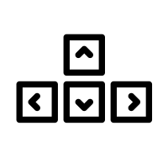

WP2: Playable Counterexamples for Programming Interactive System
8
Press right arrow near the wall
Action
Input [3, 1, 7, 4]
Student Mental Model
Student Mental Model
->
->
->
->
Compare 8, 1
Swap 8, 1
Compare 7, 4
Swap 7, 4
8 > 1
1 8 7 4
7 > 4
1 8 4 7
->
Missing: compare the middle pair
Missing: If touches wall -> Stop
Output [1, 8, 4, 7]
The ball moves through the wall
Actual Behavior
Sketch-Based Algorithmic Reasoning
Programming Interactive System
Notes:
In WP1, we start from sketch-based algorithmic reasoning.
- what is the counterpart of this in an interactive programming system?
In WP2, the “input” is no longer just data like an array.
- It becomes a playable action scenario.
For example, the action is pressing the right arrow near the wall
the learner’s plan only says “move right when pressing right arrow”
but misses the condition “stop at the boundary.”
- When we play this action, the actual behavior is:
the ball moves through the wall.
So in WP2, a counterexample should be a playable interaction that exposes a missing step in the learner’s mental model

Slide 23
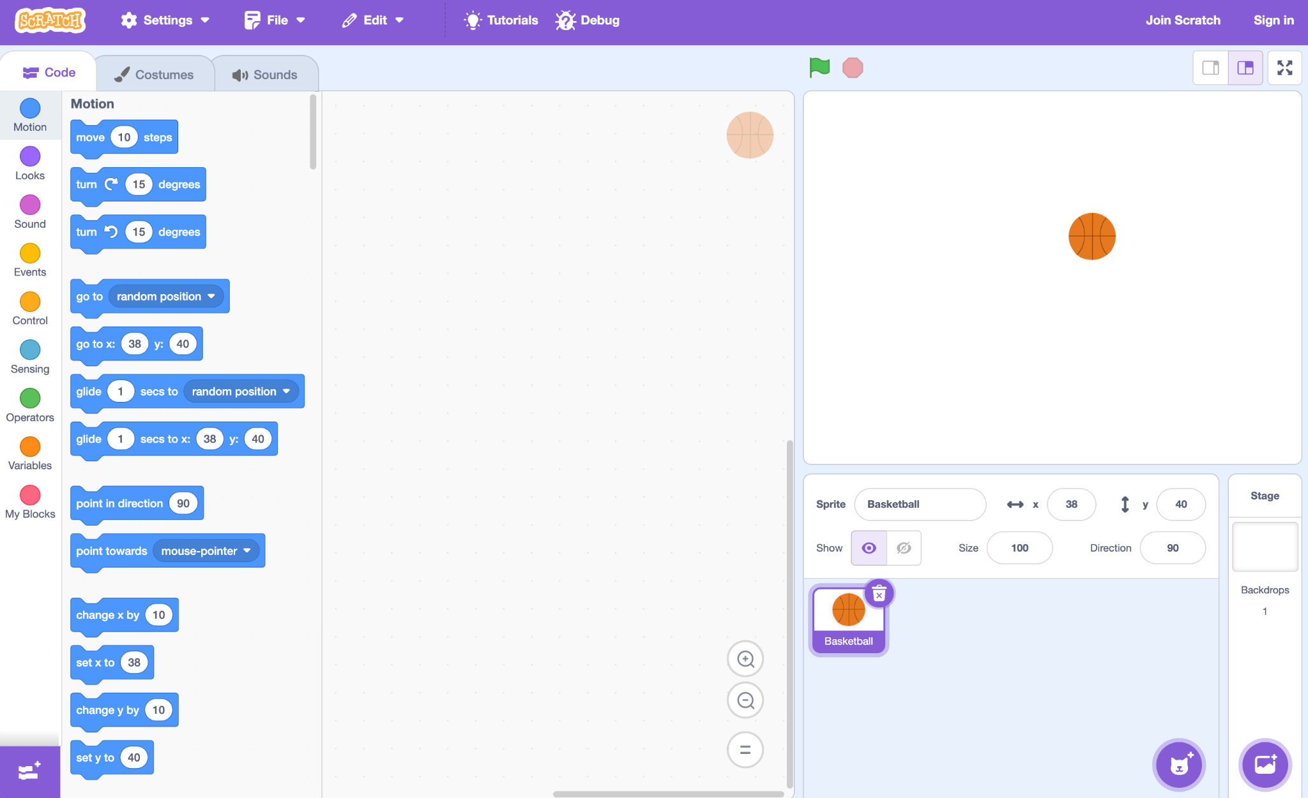

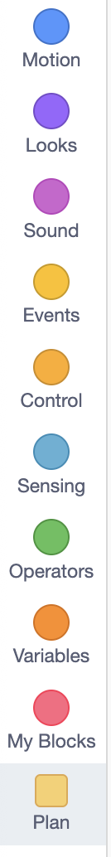


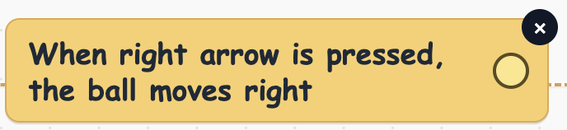
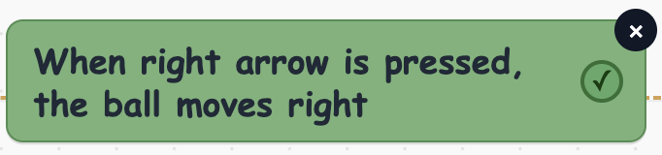
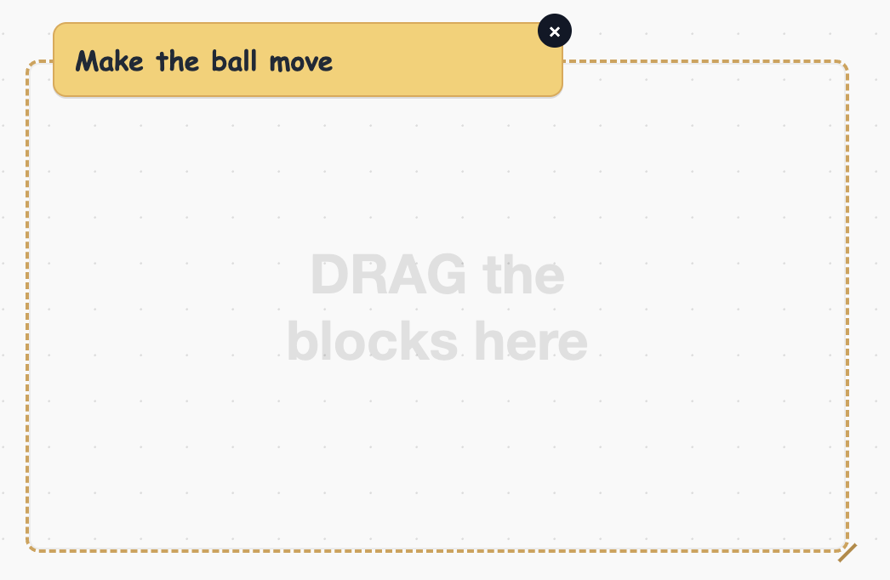
WP2: Playable Counterexamples for Programming Interactive System
4
3
2
1
5
X
Notes:
Here, the student’s initial plan is: “When the right arrow is pressed, the ball moves right.”
This sounds reasonable, but it does not specify what should happen near the boundary.
- So after excuting their plan,
- the system gives a playable counterexample: keep pressing the right arrow 5 times, the ball moves out of the stage.

Slide 24
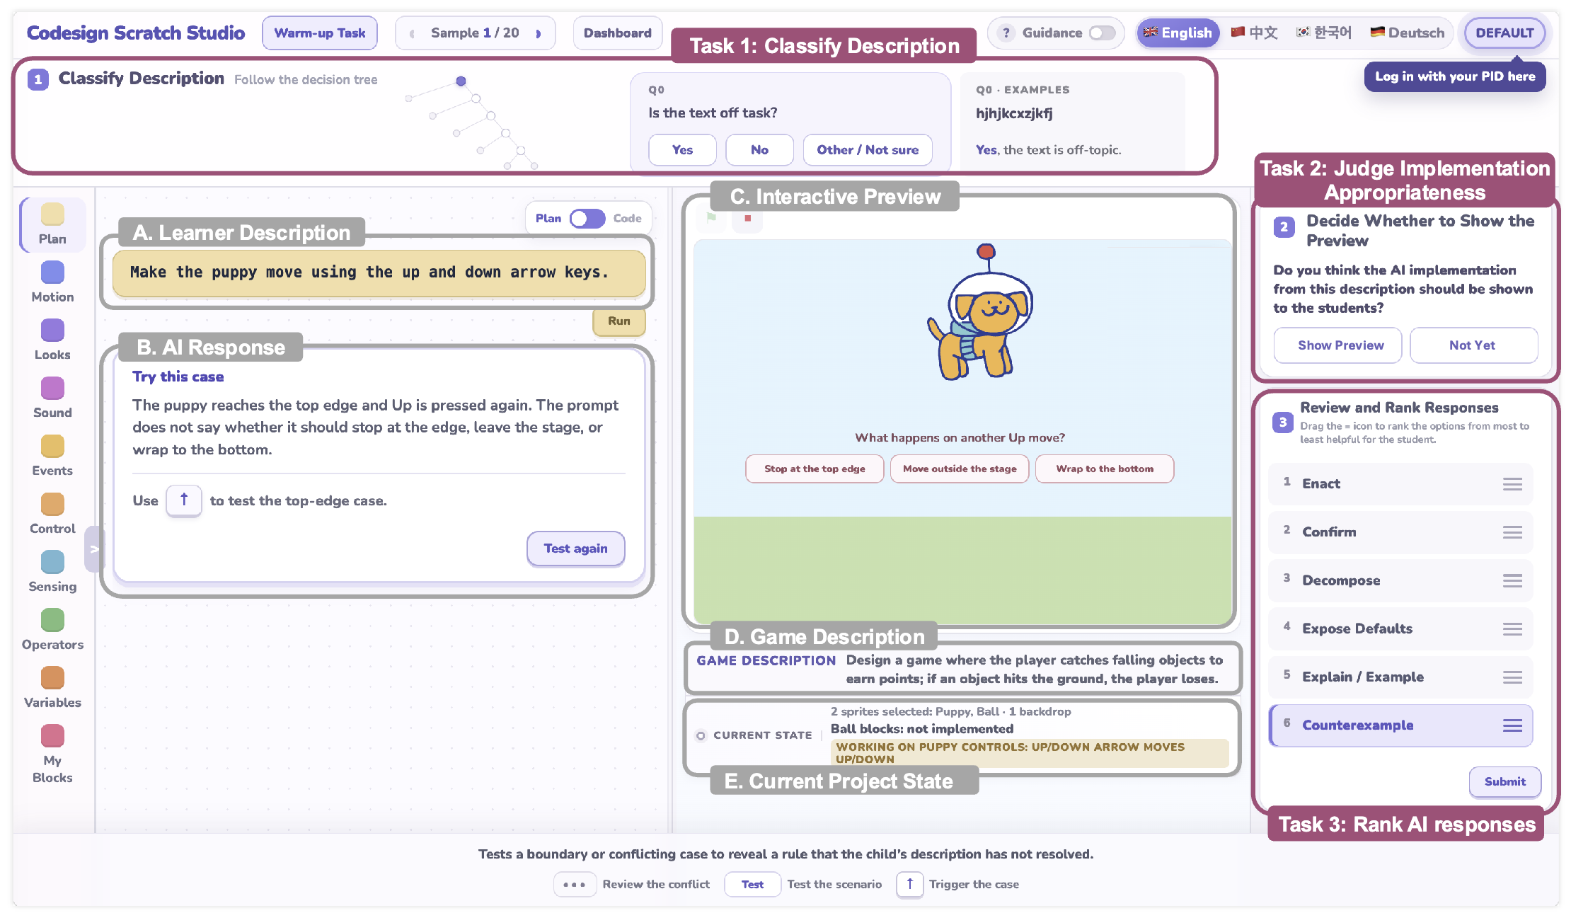
WP2: Playable Counterexamples for Programming Interactive System
Notes:
Then the student revises the plan by adding: “but stop at the boundary.”
- Now the ball still moves right when the right arrow is pressed, but it stops at the wall. So the behavior matches the intended interaction.

Slide 25
Work Packages Overview
WP1 Programming Algorithms
WP2 Programming Interactive Systems
Accepted by UIST 26, 1st year
Under review by CHI 27, 1st year
Design
Counterexamples for Sketch-Based Algorithmic Reasoning
Educator-Co-Designed AI Support for Scratch Programming
Extending SketchMind from Iterative to Recursive Algorithms
UIST 27
2nd year
Playable Counterexamples for Programming Interactive Programs
CHI 27
2nd year
Learning
WP3 Pedagogical Value
Large-scale Evaluation, Learning Outcome, Controlled Study
ICER, SIGCSE 2nd, 3rd year
Effects of Counterexample-Based Feedback on Learning
WP4 Counterexample Generation
Generation
LLM-based
Fuzzing
SMT Solver
Hybrid Method
ISSTA, OOPSLA
3rd, 4th year
Technical Comparison of Generation Methods across Domains
Notes:
Package 1 focuses on sketch-based algorithmic reasoning, where counterexamples reveal gaps in learners’ understanding of algorithm traces and intermediate states. Package 2 explore the idea to interactive programming systems, such as Scratch. Here, counterexamples become playable scenarios that show mismatches between the learner’s intended behavior and the actual program behavior. These 2 work packages explore the design space.
Package 3 focuses on learning. It asks whether counterexample-based feedback actually improves learners’ understanding and learning outcomes in larger-scale studies.
Package 4 focuses on generation. It compares different generation methods and studies the trade-off between technical validity and pedagogical usefulness.

Slide 26
WP3: Pedagogical Value of Counterexample-Based Feedback
Classroom evaluation, Between-group controlled experiment
Target group: [years] [major] student, [course]
Power analysis
treatment
N ≈ [TBD]
Counterexample
enabled
Invited to take part in study
Pre-test
Task
Post-test
Semi-structured Interviews
Counterexample
not enabled
control
Notes:
So for WP3, we move beyond the earlier lab study to a controlled between-group study in a more realistic classroom setting
Students first take a pre-test, then they are assigned to either a counterexample-enabled condition or a baseline condition, complete the learning task, and finally take a post-test and interviews. Details of the feature work will be decided later.

Slide 27
WP4: Technical Comparison of Counterexample Generation Methods
✓ support, △ limited, ✗ weak or not guaranteed
Method | Known cases | Hidden cases | Trace control | Minimal change | Correctness guarantee | Natural language input | Less effort | Fast speed
Unit Test | ✓ | ✗ | ✗ | ✗ | ✓ | ✗ | △ | ✓
Fuzzing | ✗ | ✓ | ✗ | ✗ | ✓ | ✗ | ✓ | ✓
SMT-Solver | ✗ | ✓ | ✓ | ✓ | ✓ | ✗ | △ | ✓
LLM-based | ✗ | △ | △ | △ | ✗ | ✓ | ✓ | ✗
Hybrid | ✓ | ✓ | ✓ | ✓ | ✓ | ✓ | △ | △
Notes:
Hybrid methods combine flexible generation with formal validation, so they can produce useful and reliable counterexamples, but they require more system design and integration effort.

Slide 28
Yang Wu
PhD Student
https://yang-emily.github.io/
Pedagogical Counterexample Generation
for Early Programming Education
WP1 Programming Algorithms
WP2 Programming Interactive Systems
Accepted by UIST 26, 1st year
Under review by CHI 27, 1st year
Design
Counterexamples for Sketch-Based Algorithmic Reasoning
Educator-Co-Designed AI Support for Scratch Programming
Extending SketchMind from Iterative to Recursive Algorithms
UIST 27
2nd year
Playable Counterexamples for Programming Interactive Programs
CHI 27
2nd year
Learning
WP3 Pedagogical Value
Large-scale Evaluation, Learning Outcome, Controlled Study
ICER, SIGCSE 2nd, 3rd year
Effects of Counterexample-Based Feedback on Learning
WP4 Counterexample Generation
Generation
LLM-based
Fuzzing
SMT Solver
Hybrid Method
ISSTA, OOPSLA
3rd, 4th year
Technical Comparison of Generation Methods across Domains
28
Notes:
Thank you for listening, and I’m happy to take any questions.

Slide 29
Backup Slides

Slide 30
WP1: Counterexamples for Sketch-Based Algorithmic Reasoning
A = [a0, a1, a2, a3]
Get
counterexample
A = [a0, a1, a2, a3]
LLM?
Input [3, 1, 7, 4]
SMT Solver
Input [8, 1, 7, 4]
Compared with ground truth to get constraints
1. Preserved trace
->
->
->
->
3 > 1
1 3 7 4
7 > 4
1 3 4 7
a0 > a1
a1 a0 a2 a3
a2 > a3
a1 a0 a3 a2
Student Mental Model
Student Mental Model
->
->
->
->
->
->
->
->
Compare 3, 1
Swap 3, 1
Compare 7, 4
Swap 7, 4
3 > 1
1 3 7 4
7 > 4
1 3 4 7
Compare 8, 1
Swap 8, 1
Compare 7, 4
Swap 7, 4
8 > 1
1 8 7 4
7 > 4
1 8 4 7
Skip: compare 8 7
2. Trigger uncovered path
a0 > a2
3. Minimize change
minimize |{ a0 != 3, a1 !=1, a2 != 7, a3 != 4 }|
Output [1, 3, 4, 7]
Output [1, 8, 4, 7]
Notes:
Let me return to the bubble sort example to illustrate it. The learner sorts [3, 1, 7, 4] by comparing only the first pair and the last pair. This happens to produce the correct output, but it skips the middle comparison.
We use an SMT solver to generate a nearby input, first we preserve the learner’s previous comparisons, second we expose the skipped comparison, and third we change the original input as little as possible.
Only one value changes, but applying the same learner strategy now gives unsorted output. This urges the student looking into missing comparison

Slide 31
WP3: Pedagogical Value of Counterexample-Based Feedback
Pre-test survey
During treatment phase
Post-test survey
Semi-structured Interviews
- One algorithm reasoning problem
- Filter students who already know the target algorithm
- Identify students who have not yet learned the algorithm
- Counterexamples/test triggered and viewed, Time to edit, Edit sequences
- Blind tinkering vs targeted revision
- Whether edits address the failing path
- Multiple-choice concept questions
- Complete partially written code
- How students interpreted feedback
- How feedback influenced their debugging strategy
Quantitative analysis
Multiple-linear regression
Mann-Whitney’s U test
Qualitative analysis
To identify Mental model revision patterns
Notes:
This slide gives more detail about WP3, where I evaluate the pedagogical value of counterexample-based feedback.
The study starts with a pre-test survey. The goal is to understand students’ prior programming knowledge and filter students based on whether they already know the target algorithm. This helps us identify learners who have not yet learned the algorithm and are therefore suitable for the study.
During the treatment phase, students work on one algorithm reasoning problem. We log how they interact with the feedback: whether counterexamples or tests are triggered and viewed, how long it takes them to edit after feedback, and what their edit sequences look like. From these logs, we can compare blind tinkering with more targeted revision, and check whether their edits address the failing path exposed by the counterexample.
After the task, students complete a post-test survey, including multiple-choice concept questions and partially completed code problems. These measure conceptual understanding and coding performance.
Finally, I will conduct semi-structured interviews to understand how students interpreted the feedback and how it influenced their debugging strategy.
For analysis, I plan to combine quantitative methods, such as multiple linear regression and Mann-Whitney U tests, with qualitative analysis of interviews and interaction traces. The goal is to identify patterns of mental model revision.

Slide 32
Timeline and Submission Plan
Timeline of WPs
  WP1: Counterexamples for Sketch-Based Algorithmic Reasoning:
    Submitted to UIST 2026, backup CHI 2026 (1st year)
  WP2: Playable Counterexamples for Scratch Programming:
    CHI, UIST (1st 2nd year)
  WP3: Pedagogical Value of Counterexample-Based Feedback:
    ICER, SIGCSE (2nd 3rd year)
  WP4: Technical Comparison of Counterexample Generation Methods:
    ISSTA, OOPSLA (3rd 4th year)
Communities: HCI (CHI, UIST), CE (SIGCSE, ICER), SE/PL (ISSTA, OOPSLA)
Notes:
Finally, this is my timeline and submission plan. The plan is to complete roughly one work package each year, with target venues across HCI, computing education, and programming languages

