Slide 1
SketchMind: Supporting Algorithmic Reasoning through Executable Sketching

Slide 2

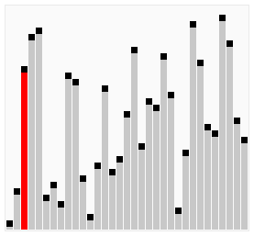
The bubble-sort algorithm on a sequence of integers. For each pass, the swaps performed and the sequence after the pass are shown.
• In the first pass, once the largest element is reached, it keeps on being swapped until it gets to the last position of the sequence.
• In the second pass, once the second largest element is reached, it keeps on being swapped until it gets to the second-to-last position of the sequence.
• In general, at the end of the ith pass, the right-most i elements of the sequence (that is, those at indices from n − 1 down to n − i) are in final position.
—— Goodrich, M. T.,《Data Structures and Algorithms in C++》
——Bubble sort animation, Wikimedia Commons
Notes:
When students learn a new algorithm, they are often taught through step-by-step descriptions and visual animations. An algorithm is essentially a recipe — a sequence of steps to follow.
However, understanding an algorithm is not just about reading or watching.
Students need to mentally walk through the steps to truly digest them.
At this stage, they may not yet know how to implement the algorithm in code,
and are just beginning to build an understanding of how algorithms work.

Slide 3
When students learn an algorithm, how do we know they actually understand it?
Notes:
So how can they tell whether they truly understand it?

Slide 4
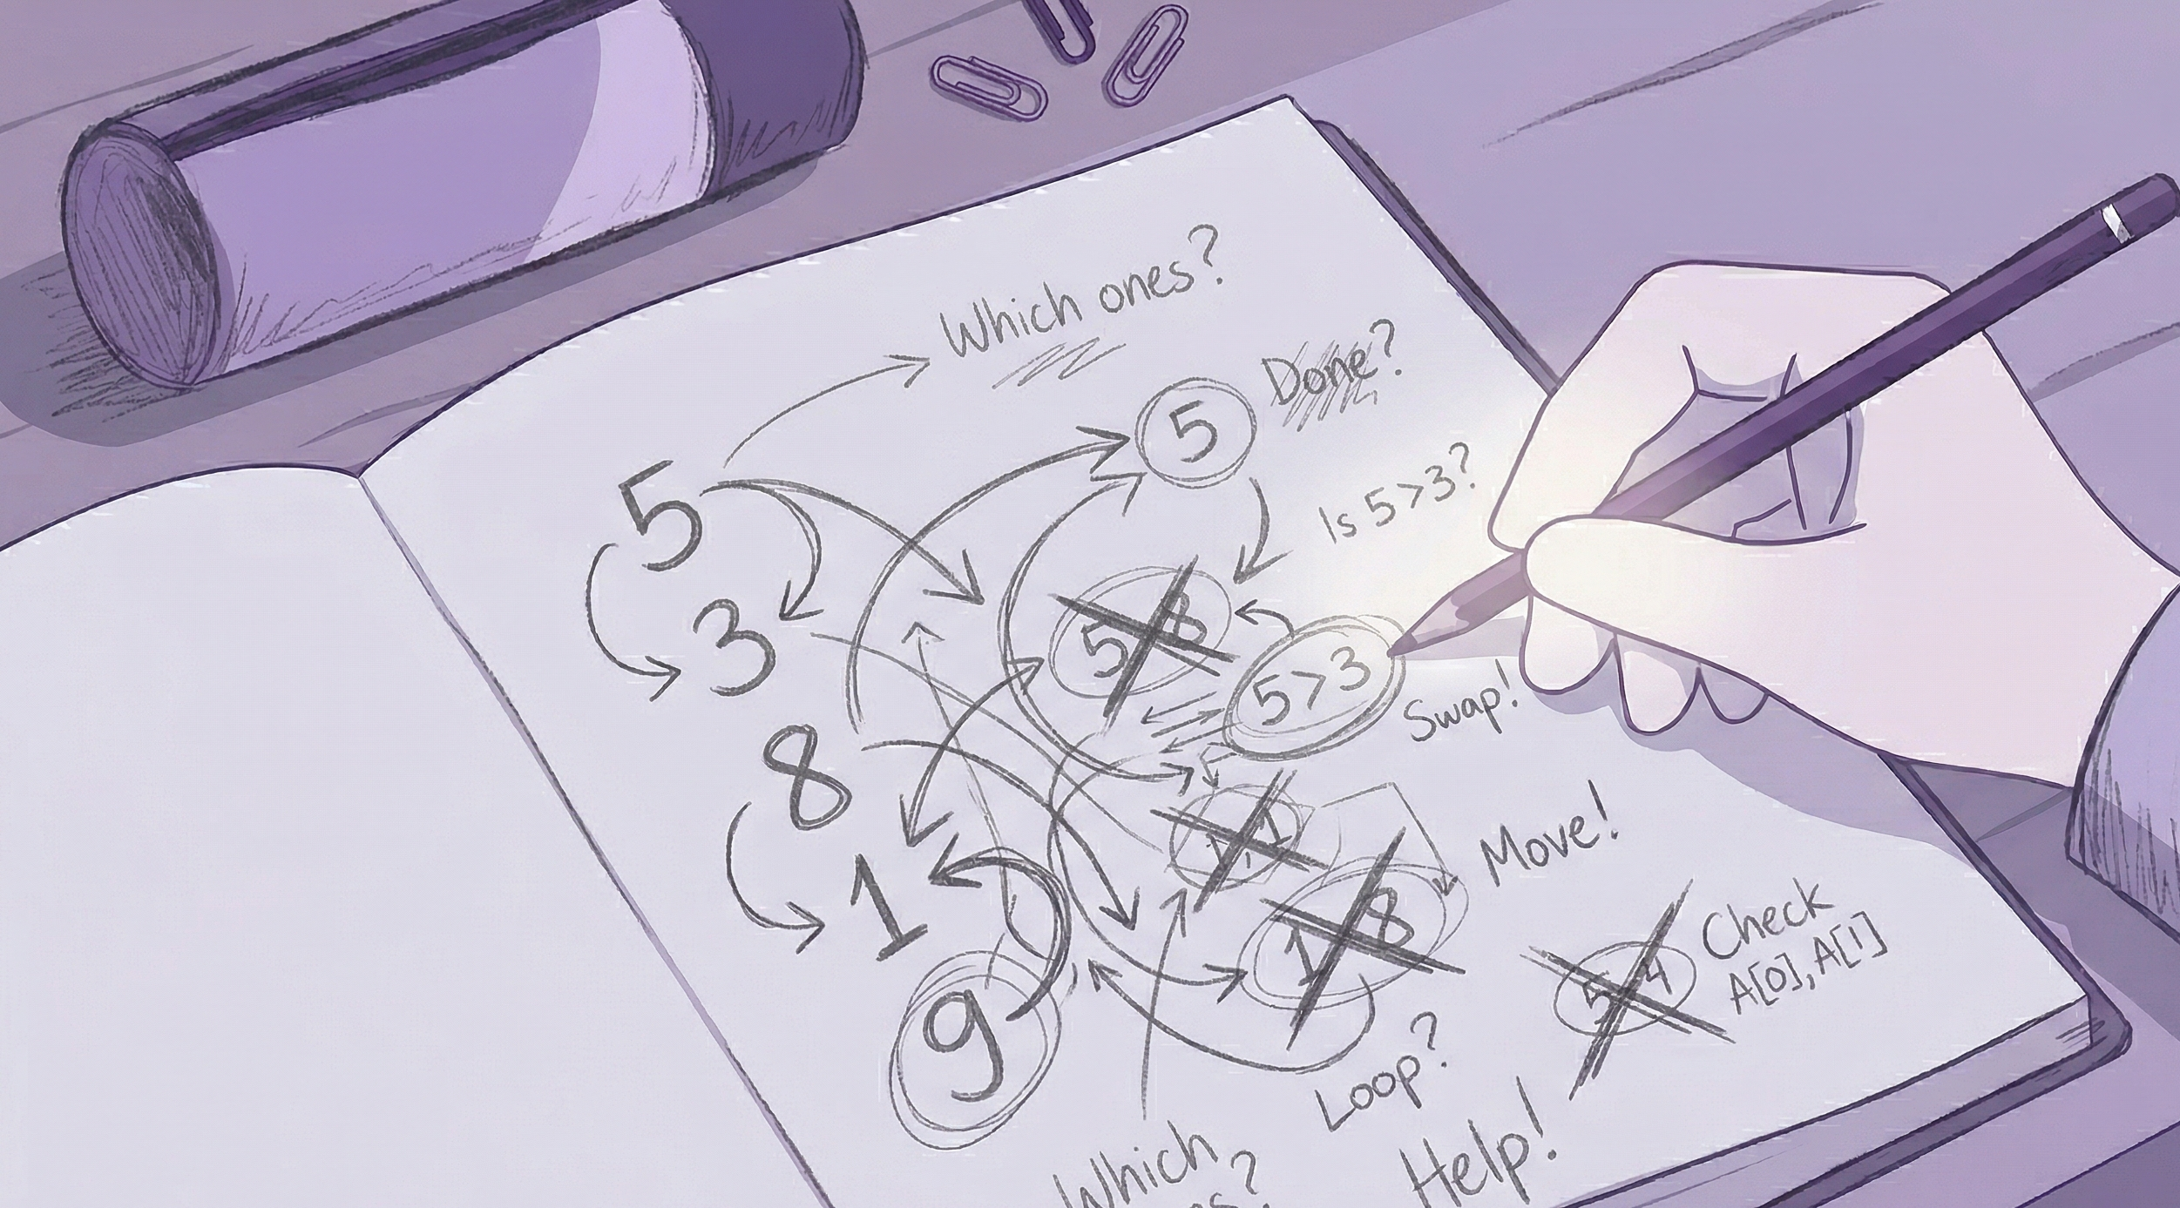
Notes:
One common way to check their understanding is to work through the algorithm on a concrete example, sketching each step along the way.

Slide 5
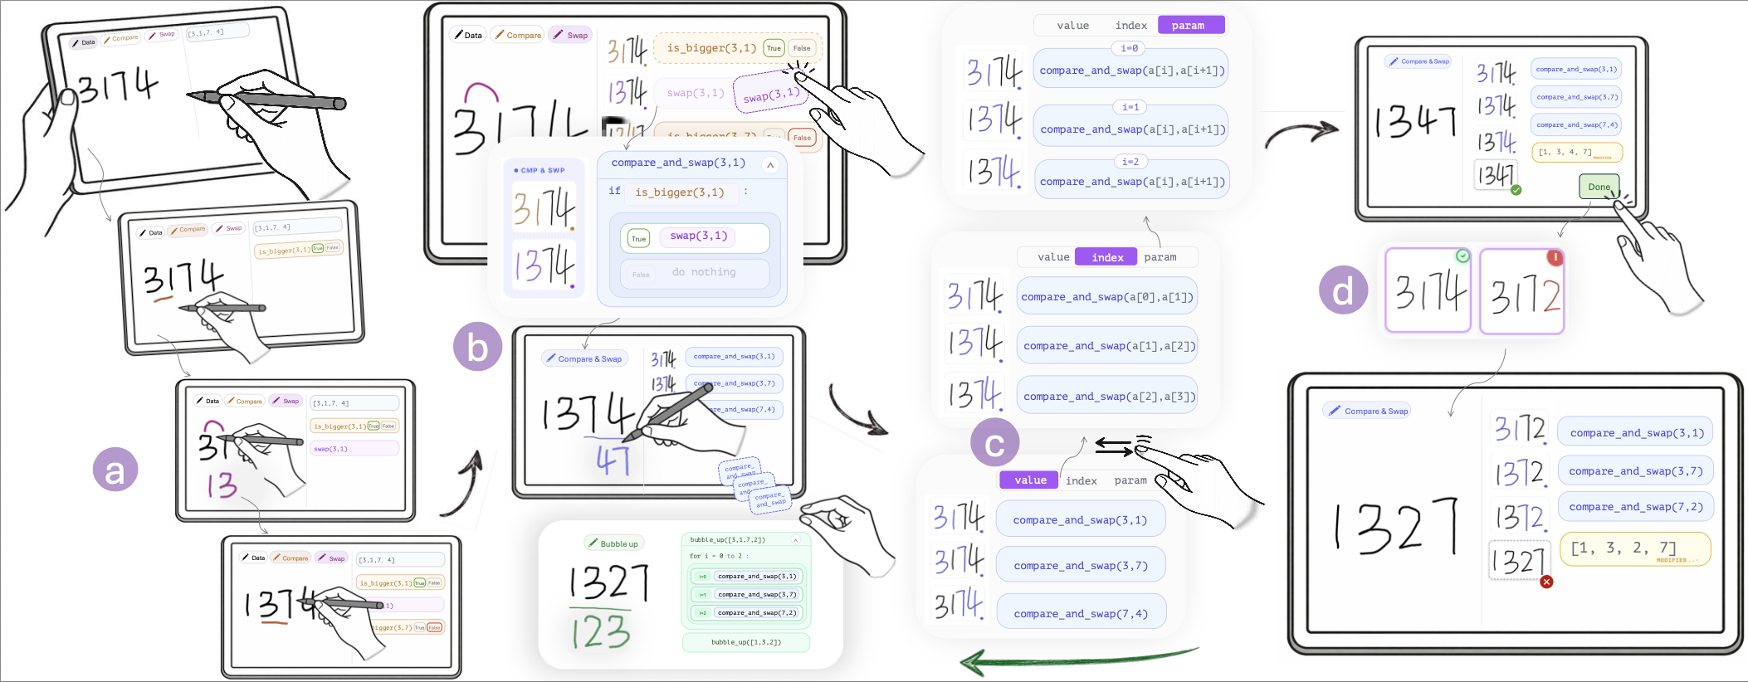
Supporting Algorithmic Reasoning through Executable Sketching
Executable Tracing Reusable Pens Progressive Abstraction Counterexample Generation
Notes:
In this context, we present SketchMind,
which helps users externalize, execute, and check their understanding of a given algorithm.

Slide 6




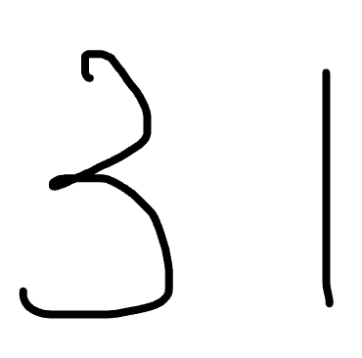
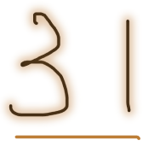




a) Executable Tracing
Data
Compare
Swap
[3, 1]
is_bigger(3,1)
True
False
swap(3,1)
Notes:
First, SketchMind supports executable tracing.
Users can use different pen tools to execute operations in real time.
In Bubble Sort, we provide a toolbox of primitives, such as compare and swap.

Slide 7

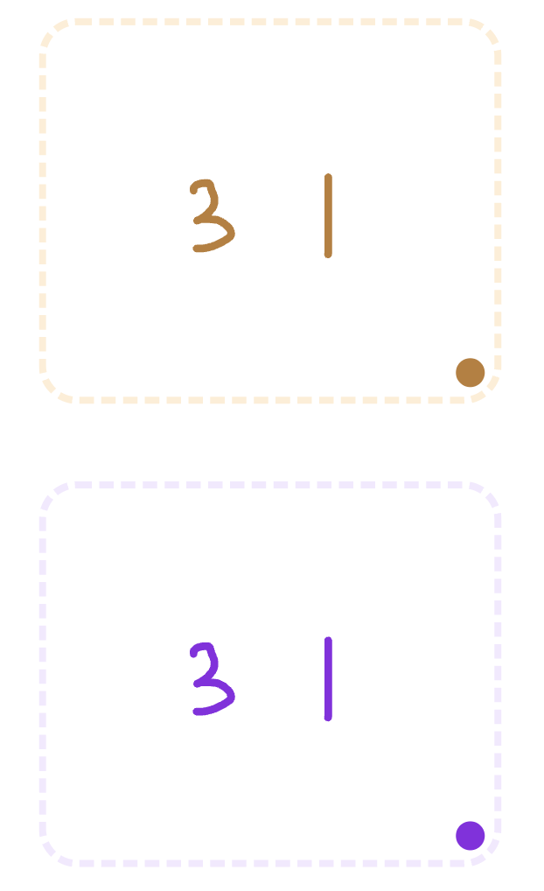
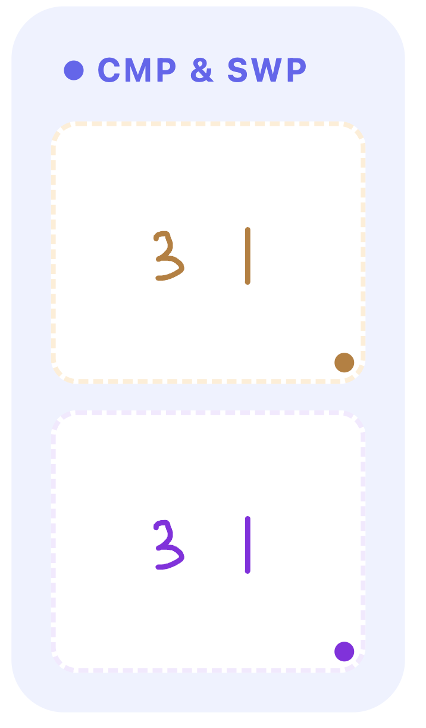


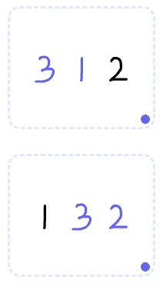
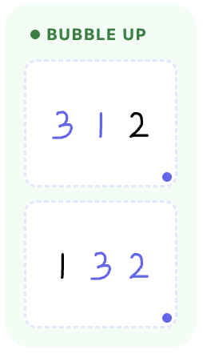
b) Reusable Pens
PRIMITIVES
Compare
Swap
USER CREATED
Compare & Swap
compare_and_swap(3,1)
^
is_bigger(3,1)
True
False
is_bigger(3,1)
if :
swap(3,1)
True
swap(3,1)
swap(3,1)
True
False
do nothing
USER CREATED
Compare & Swap
USER CREATED
Bubble up
bubble_up([3,1,2])
^
compare_and_swap(3,1)
for i = 0 to 1 :
compare_and_swap
(3,2)
True
compare_and_swap(3,1)
i=0
compare_and_swap(3,2)
i=1
compare_and_swap(3,2)
Notes:
Building on this, SketchMind allows users to merge steps into higher-level logic,
such as if-else conditions or loops,
which can then be reused as new tools.

Slide 8
c) Progressive Abstraction
value
index
param
value
index
param
value
index
param
i=0
compare_and_swap(3,1)
^
compare_and_swap(a[0],a[1])
^
compare_and_swap(a[i],a[i+1])
^
if :
If :
If :
is_bigger(3,1)
is_bigger(a[0],a[1])
is_bigger(a[i],a[i+1])
True
swap(3,1)
True
swap(a[0],a[1])
True
swap(a[i],a[i+1])
True
True
True
False
do nothing
False
do nothing
False
do nothing
Notes:
To support progressive abstraction,
SketchMind provides three views: concrete values, indices, and parameters.

Slide 9
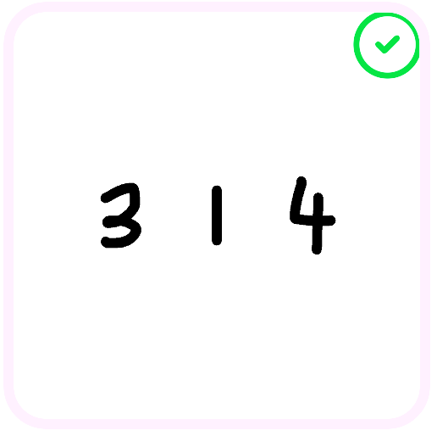
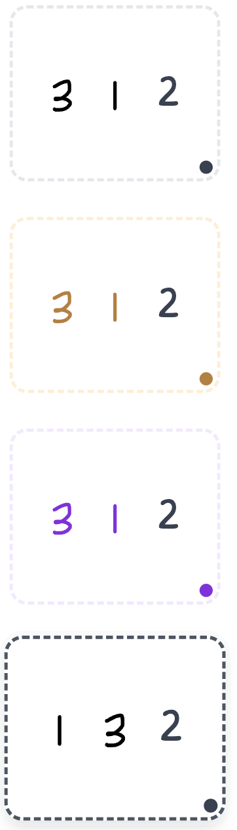
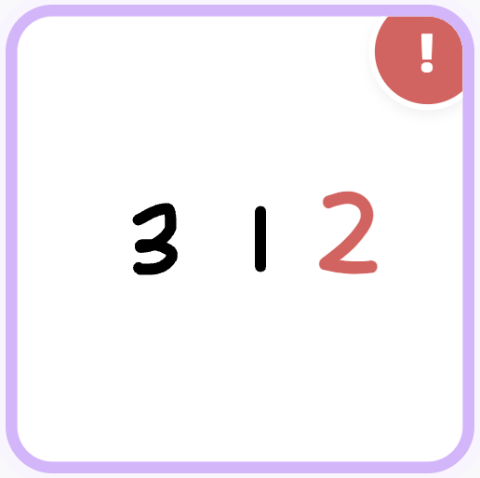

d) Counterexample Generation
[3,1,2]
is_bigger(3,1)
True
False
swap(3,1)
[1,3,2]
Notes:
Once the user clicks Done, the system checks the result.
If the output appears correct but the logic is flawed,
SketchMind generates a counterexample.

Slide 10
d) Counterexample Generation
Previous example
Counterexample
Required Properties
[ 3, 1, 4 ]
[ 3, 1, 2 ]
is_bigger(3,1)
True
False
is_bigger(3,1)
True
False
All of the student’s previous steps are still valid.
swap(3,1)
swap(3,1)
On the new example, additional steps are required.
[1,3,4]
Current
[1,3,2]
Current
Notes:
To show that the previous example does not complete all required passes, we generate a counterexample with two properties.
First, all of the student’s earlier steps remain valid.
Second, the new example requires additional steps to finish.
This helps reduce student confusion while still exposing the mistake.
We use a logic solver to construct this counterexample.

Slide 11
Supporting Algorithmic Reasoning through Executable Sketching
Notes:
For more details about SketchMind,
please refer to our paper.

Slide 12
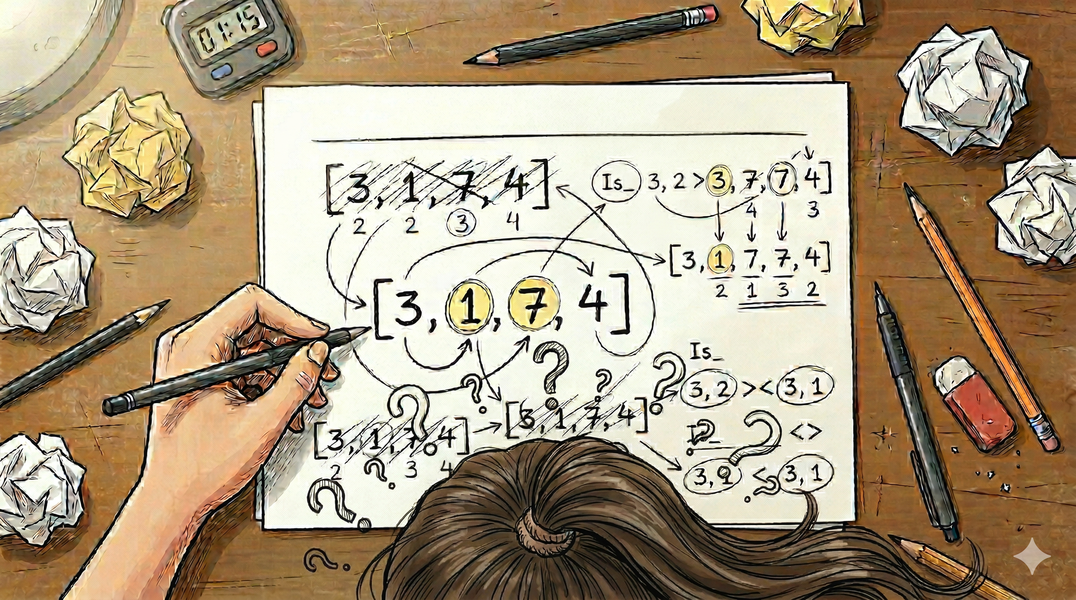
[0:00-1:30] Motivation example (total 90’)
[Visual: Alice scribbling on paper, messy arrays, crossed-out numbers accumulating]
Draw in a blank paper
Notes:
When learning algorithms, we often begin with pen-and-paper tracing—manually simulating how data changes step by step.
Let’s follow Alice, a student learning Bubble Sort with an input array:
A = [3, 1, 7, 4].
She starts by comparing 3 and 1…
crosses out the old array… rewrites a new one…
then continues with the next pair.

Slide 13
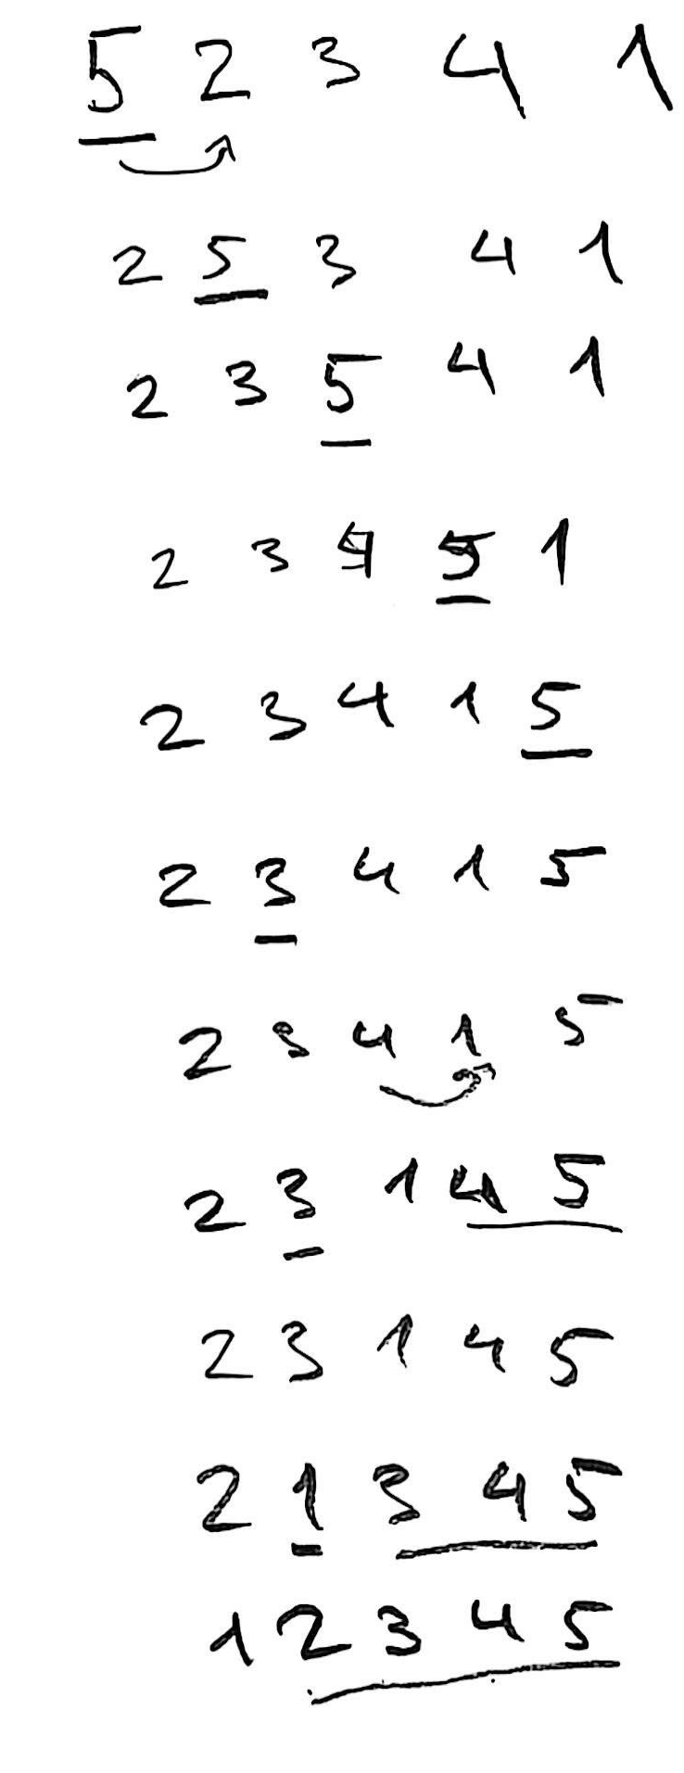
Challenge 1: Trace Explosion 20-30‘
[Visual: paper becomes increasingly cluttered]
Notes:
As the process continues, her page fills with scratched-out numbers and fragmented states.
To cope, Alice starts skipping steps or compressing operations
but now, mistakes can easily go unnoticed.

Slide 14
Challenge 2: Abstraction Leap 20-30‘
[Visual: Alice pauses, staring at a wall of numbers.
She tries to draw a bracket or an arrow to show a "pattern," but her pen just hovers. The page is just lines of digits with no clear structure or logic.]
Notes:
Alice senses she is repeating the same actions, but she struggles to describe the pattern.
Her handwriting has become a puzzle, just rows of numbers without structure,
making it impossible to see the logic or how the steps connect.

Slide 15
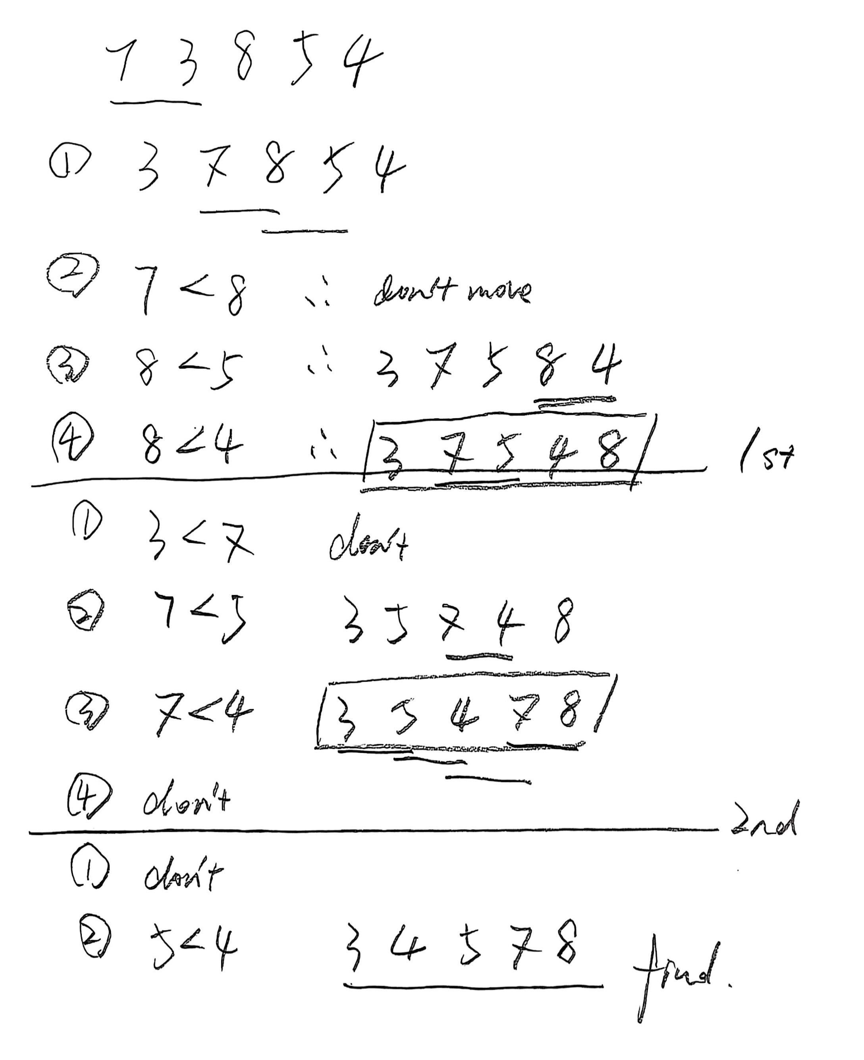
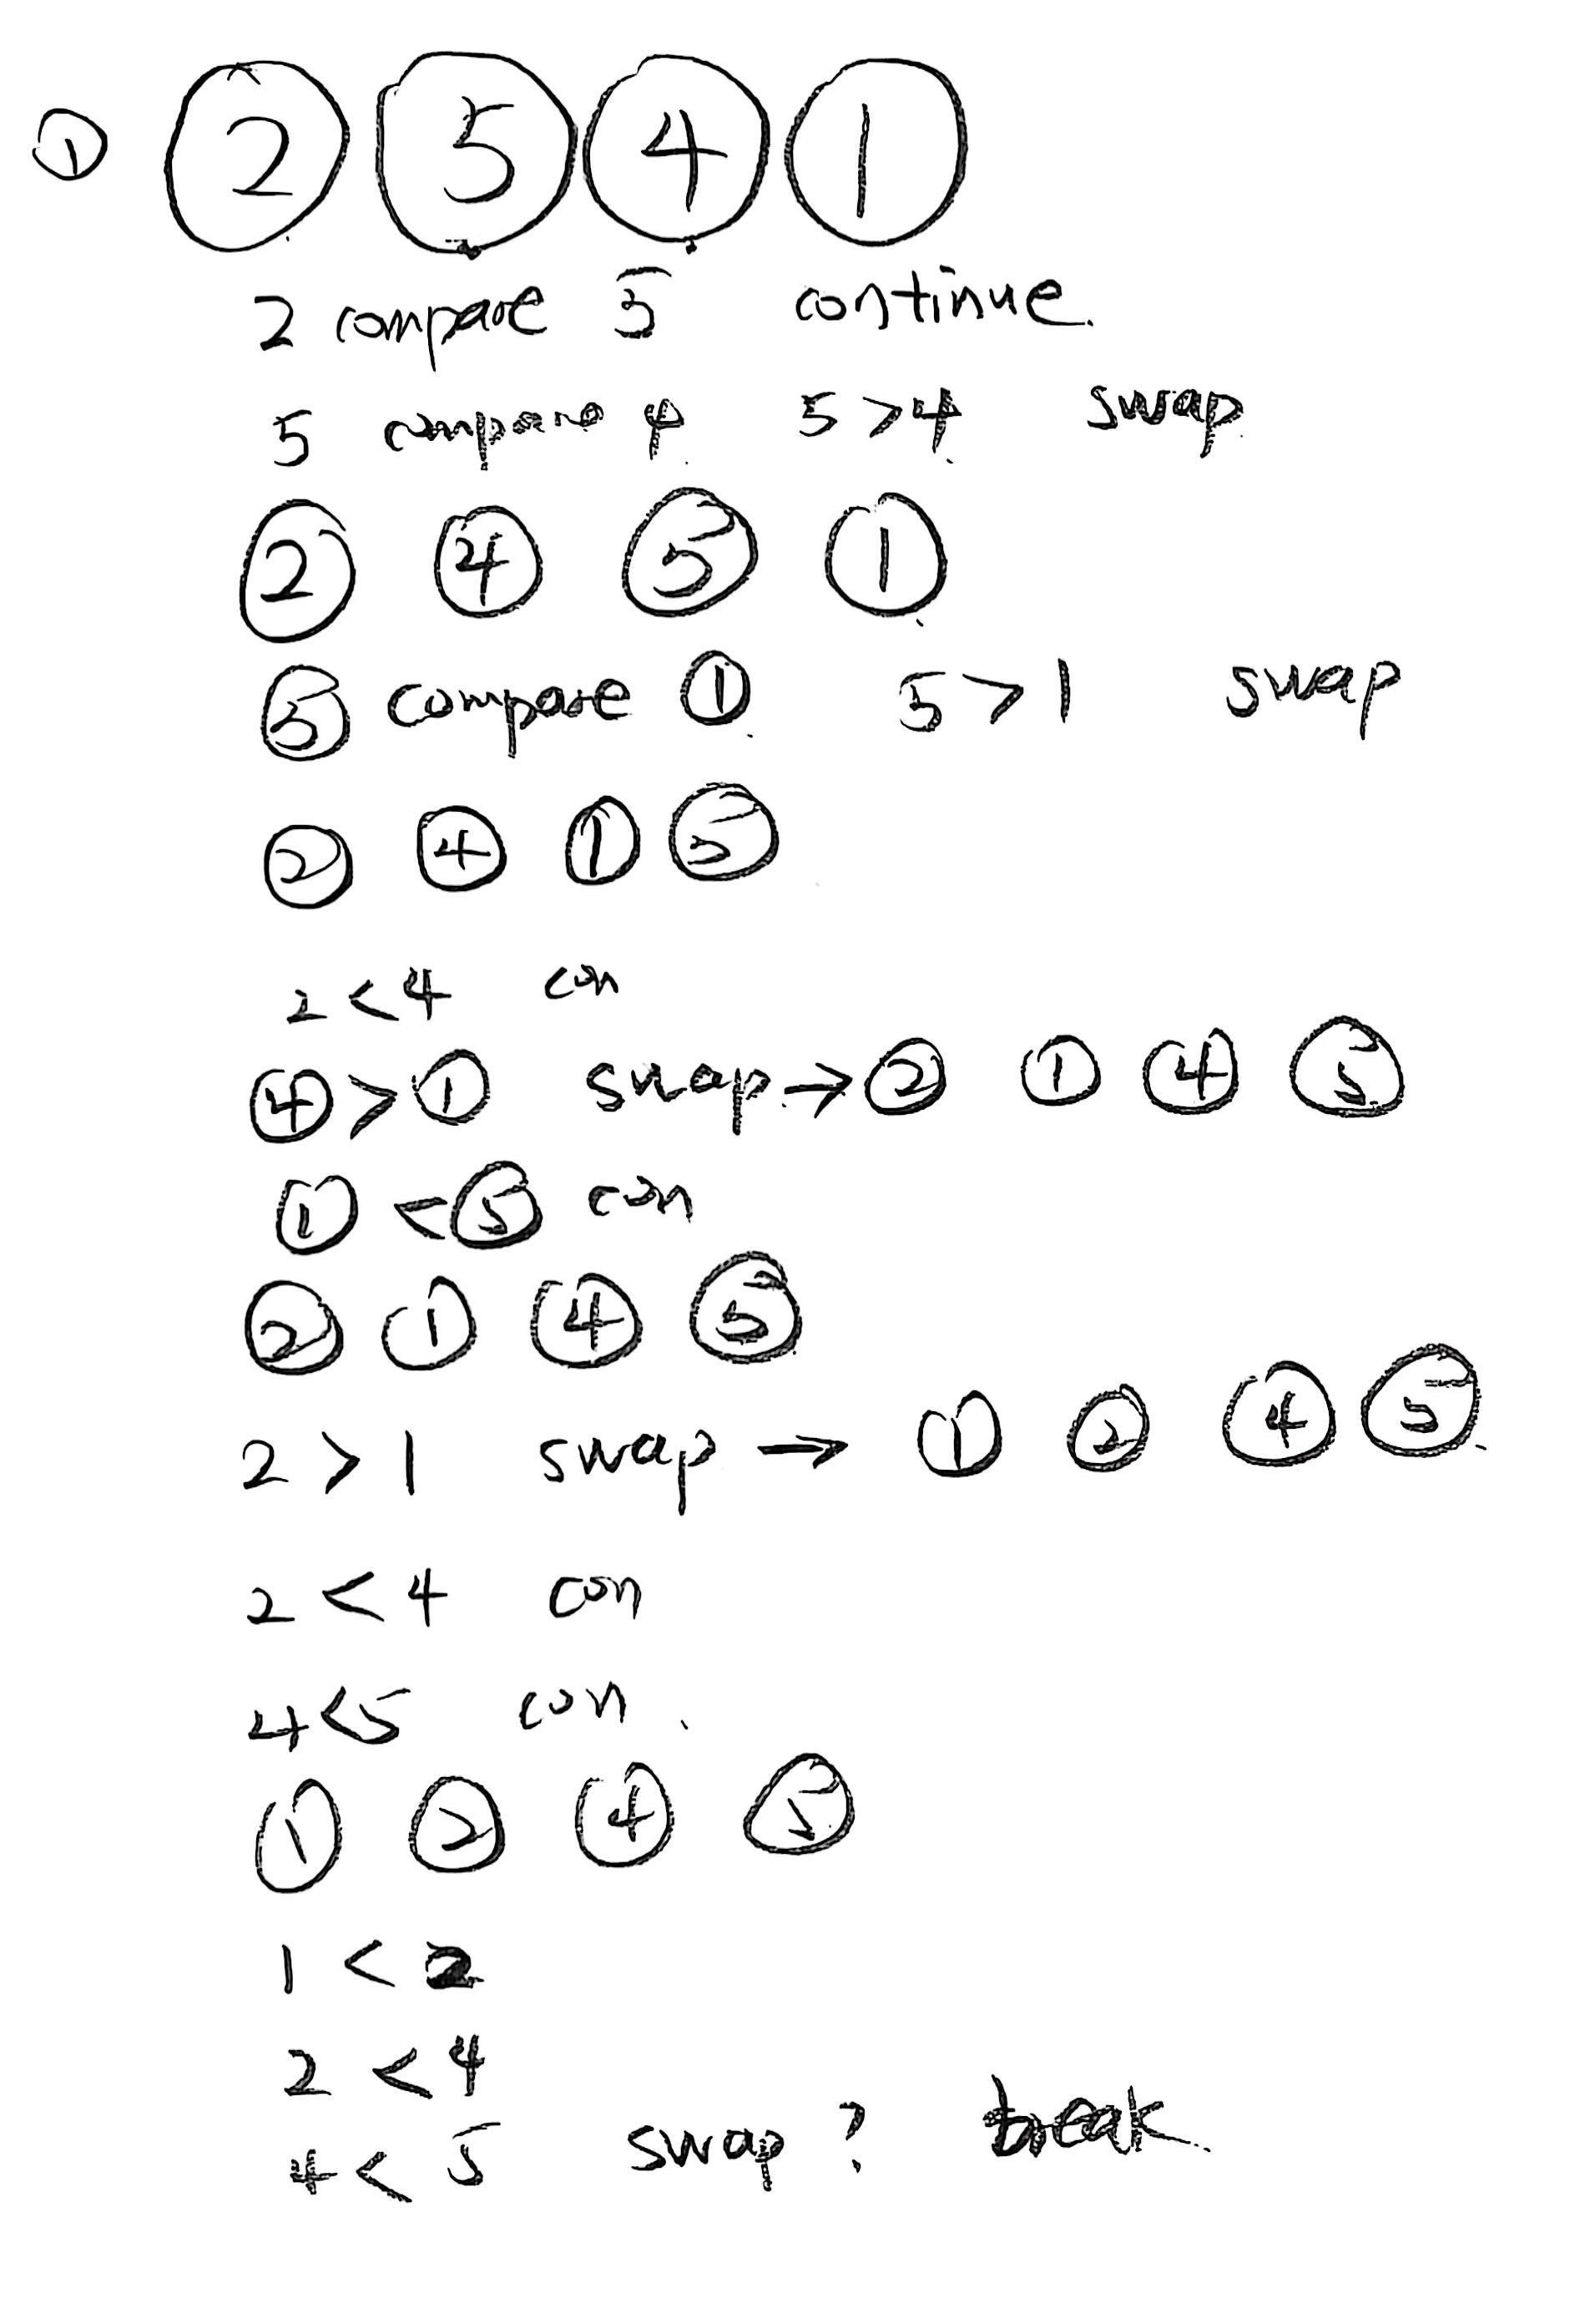
Challenge 3: Instance Overfitting 20-30‘
[Visual: Alice finishes one pass. The array looks sorted.
She draws a large checkmark.]
Notes:
After one pass, the array looks sorted. So Alice find Bubble Sort only needs one pass.
But this conclusion is based on a single example, her reasoning fails to generalize.

Slide 16
[3,1,7,4]
pass p = 0
pass p = 1
pass p = 2
i = 0
i = 1
i = 2
i = 0
i = 1
i = 0
compare
a[i]>a[i+1]?
compare
a[i]>a[i+1]?
compare
a[i]>a[i+1]?
compare
a[i]>a[i+1]?
compare
a[i]>a[i+1]?
compare
a[i]>a[i+1]?
swap?
swap?
swap?
swap?
swap?
swap?

