Slide 1
创新研究课程 科研项目短课

Slide 2
Course Syllabus 课程大纲
Content 内容 | 课时 | 课程说明 | 课后练习 | 备注
Version control – Git & Github, learn to write ReadMe | 3 |  | Write a readme file and upload to Github | README: https://classroom.udacity.com/courses/ud777 Git: https://classroom.udacity.com/courses/ud123 Github: https://classroom.udacity.com/courses/ud456 https://classroom.udacity.com/courses/ud775
Latex for scientific writing | 3 |  | Download CVPR latex template and upload to Github | The Not So Short Introduction to Latex (PDF)
Python tutorial | 3 |  | Finish a demo script and upload to Github | http://cs231n.github.io/python-numpy-tutorial/
Computer Vision and Opencv | 3 |  | Finish a demo script and upload to Github | http://cs231n.stanford.edu/ https://docs.opencv.org/3.4/d9/df8/tutorial_root.html https://www.pyimagesearch.com/2014/11/17/non-maximum-suppression-object-detection-python https://www.pyimagesearch.com/2015/02/16/faster-non-maximum-suppression-python/
Visual Tracking | 3 |  | Finish a demo script and upload to Github
Introduction to deep learning | 3 |  | -- | https://www.coursera.org/learn/ai-for-everyone/

Slide 3
Today’s agenda:
Visual detection and tracking.
-- flappy bird, a demo (30 mins)
https://github.com/stevenwudi/gesture_demo_flappy_bird : flappy_bird_game_with_hand_cv2.py
Brief introduction of deep learning (30 mins)
Final assignment (20 mins)

Slide 4
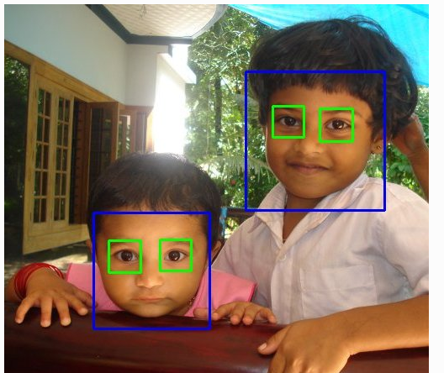
Note for assignment for Week 4
Upload the OpenCV face detected photo and name it as “your_name.py” (Di_WU.py” ) to the AI_Precourse\Week4_OpenCV folder
Only two files is enough (without .xml file)!

Slide 5
Brief introduction to Deep Learning
https://www.fast.ai/

Slide 6
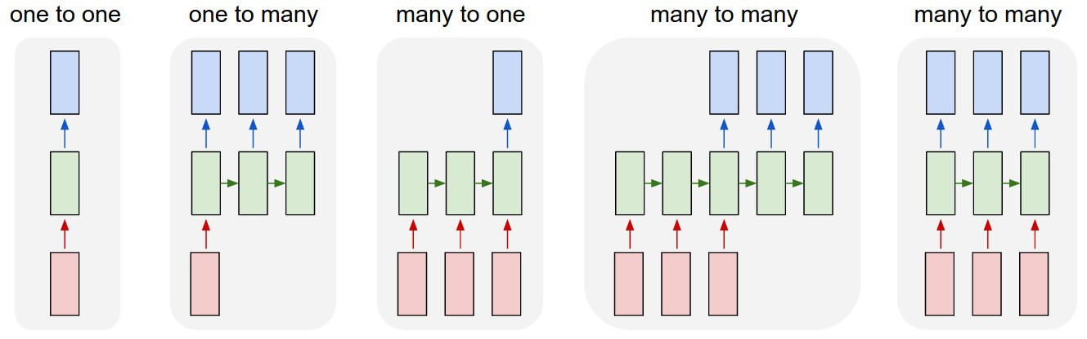
多种神经网络：
时序神经网络的引入
Visualizing and Understanding Recurrent Networks,
Andrej Karpathy, Justin Johnson, Li Fei-fei ICLR2016 workshop
Notes:
Sequences. Depending on your background you might be wondering: What makes Recurrent Networks so special
Each rectangle is a vector and arrows represent functions (e.g. matrix multiply). Input vectors are in red, output vectors are in blue and green vectors hold the RNN's state (more on this soon). From left to right: (1) Vanilla mode of processing without RNN, from fixed-sized input to fixed-sized output (e.g. image classification). (2) Sequence output (e.g. image captioning takes an image and outputs a sentence of words). (3) Sequence input (e.g. sentiment analysis where a given sentence is classified as expressing positive or negative sentiment). (4) Sequence input and sequence output (e.g. Machine Translation: an RNN reads a sentence in English and then outputs a sentence in French). (5) Synced sequence input and output (e.g. video classification where we wish to label each frame of the video). Notice that in every case are no pre-specified constraints on the lengths sequences because the recurrent transformation (green) is fixed and can be applied as many times as we like.
A glaring limitation of Vanilla Neural Networks (and also Convolutional Networks) is that their API is too constrained: they accept a fixed-sized vector as input (e.g. an image) and produce a fixed-sized vector as output (e.g. probabilities of different classes). Not only that: These models perform this mapping using a fixed amount of computational steps (e.g. the number of layers in the model). The core reason that recurrent nets are more exciting is that they allow us to operate over sequences of vectors: Sequences in the input, the output, or in the most general case both.

Slide 7

https://pytorch.org/

Slide 8
KEY FEATURES & CAPABILITIES
Hybrid Front-End
Distributed Training
Python-First
Tools & Libraries
Notes:
A new hybrid front-end seamlessly transitions between eager mode and graph mode to provide both flexibility and speed.
Scalable distributed training and performance optimization in research and production is enabled by the torch.distributed backend.
Deep integration into Python allows popular libraries and packages to be used for easily writing neural network layers in Python.
A rich ecosystem of tools and libraries extends PyTorch and supports development in computer vision, NLP and more.

Slide 9
Final Assignment

Slide 10
Final Assignment
开放作业，鼓励合作分工，知识互补
Deadline: 05-29 号 （下周三）
组员人数： 3人一个小组。
要求：
2页PDF(用Latex编写）
口头报告(10分钟)， PPT.
(Optional) 现场演示
Create a subfolder and name the subfolder under AI_Precourse\Week6_Final_assignment\Your_group_number

Slide 11
小组 | 组员1 | 组员2 | 组员3
1 | 李宝伟 | 张子垚 | 何湛辉
2 | 刘俊麟 | 祝瑞 | 吴浩邦
3 | 黄华振 | 黄少聪 | 陈凯鹏
4 | 杨佳锐
5 | 邱增镇 | 林家颖

