Slide 1
SpZip: Architectural Support for Effective Data Compression In Irregular Applications
Yifan Yang, Joel S. Emer, Daniel Sanchez
ISCA 2021
Session 12B (June 16, 2021 at 8 PM EDT)
Notes:
Hi! My name is Yifan Yang. It is my great pleasure to present SpZip: Architectural Support for Effective Data Compression In Irregular Applications. This work is done in collaboration with Professor Joel Emer, and Professor Daniel Sanchez at MIT. ©

Slide 2
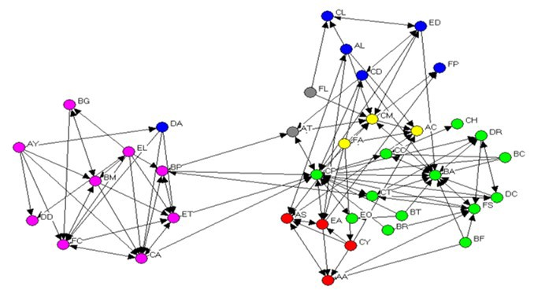
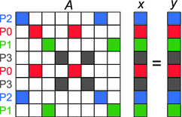
Irregular applications are challenging
Irregular applications, such as graph analytics and sparse linear algebra, are an increasingly important workload domain
Irregular applications have large memory footprint and low compute intensity, so they are memory bound
Data compression is an attractive approach to accelerate irregular applications
Practical support for compression requires hardware acceleration
Graph analytics
Sparse linear algebra
Notes:
Irregular applications, like © graph analytics and © sparse linear algebra, are an increasingly important workload domain.
© However, irregular applications usually operate on large inputs that don’t fit on chip and have low compute intensity. Therefore, they are memory bound.
© Data compression is an attractive approach to alleviate this memory bottleneck.
Compression can reduce memory traffic if the application saturates memory bandwidth. If the application is memory latency bound, data compression could also improve performance by enabling a larger effective cache capacity.
However, the overhead of software compression offsets the benefit of data compression. © Practical support for compression requires hardware acceleration. ©

Slide 3
SpZip contributions
Offloading both data access and decompression
Access
Access
Access
Compute
Core
Notes:
SpZip’s hardware has two unique features that differentiate it with prior work.
© First, the hardware offloads both the data access and decompression from the CPU core. © As we can see on the right, in order to get the data from the cyan array and perform computation, © the core need to access this three level data structure. This actually illustrates the memory access pattern in graph applications, where the blue and yellow arrays represent the graph adjacency matrix and the cyan array represents the vertex data. Suppose we introduce data compression to the yellow array at the middle, because it’s usually the largest data structure in the application ©

Slide 4
SpZip contributions
Offloading both data access and decompression
Compressed
Decoupled execution to hide latency
Programmable hardware
A set of simple operators that are composed to express the traversal and decompression of many data structures
Dataflow Configuration Language (DCL)
Access
Access
Decompress
Compute
Access
Offloaded
Fetcher
Core
Notes:
© an extra step of decompression happens after accessing it. This adds critical path latency and may degrade performance. © The SpZip specialized fetcher offloads the data access and decompression as a whole. © Therefore, the hardware could leverage decoupled execution to run ahead of the core. Both memory access and decompression latencies can be hidden. Prior compressed memory hierarchy systems didn’t exploit decoupled execution and are unable to hide decompression latency.
© Second, the hardware is programmable so that SpZip can offload traversal and decompression of data structures in various applications and compression formats. This programmability differentiates SpZip with prior prefetchers, which only support a few predefined memory access patterns. © We identify a set of simple composable operators. These operators could be composed to construct a pipeline to express the traversal and decompression of different data structures in different formats. We call this the Dataflow Configuration Language (DCL). And the programmable hardware implements the DCL operator pipeline. © The example on the right is already presented in the form of DCL, with one access operator accessing one level in this data structure. A decompression operator decodes the middle level compressed data. Arbitrary composition of the DCL access and decompression operator allows us to express the traversal and decompression of data structures in various applications and compression formats. I will present more details of DCL next. ©

Slide 5
Dataflow Configuration Language (DCL) overview
A DCL program expresses the traversal, decompression and compression of data structures in irregular applications
DCL program is an acyclic graph of composable operators
Hardware connects operators using queues to exploit pipeline parallelism
Compressed
Access
Core
Access
Access
Decompress
Access
DCL pipeline for PageRank
Notes:
© A DCL program expresses the traversal, decompression and compression of data structures in irregular applications and the SpZip hardware will execute the DCL program.
© The DCL program is an acyclic graph of composable operators. © Below shows the example pipeline we’ve seen in the previous slides, which traverses a two level data structure with the second level being compressed.
© The hardware connects operators using queues to exploit pipeline parallelism, so that stalling at one pipeline stage will not affect the rest.
Moreover, we can construct a more complex pipeline to express the traversal of multiple inter-related data structures in real applications.
Here is an example based on a graph algorithm, PageRank, © we now have a new purple array © which is always traversed with the blue array at the same time. Therefore, © the purple access operator could share the same input queue as the blue access operator. © Next we introduce an additional data structure, the array in cyan, © which is indexed by the decompressed content in the yellow array. © The DCL for the new array reuses the output of the decompression operator to drive the new access operator.
© This resulting pipeline expresses the traversal of all three data structures in PageRank.
In summary, we could use the result or intermediate content of existing pipeline as the input of new operators to fetch new data structures.
© The core can then consume the output queue of the DCL pipeline and carry out computation on those fetched and decompressed data. ©

Slide 6
SpZip Overview
SpZip augments each core with two programmable units: fetcher and compressor
The fetcher accelerates data structure traversal and decompression
Main Memory
Cache hierarchy
LLC
L2
L2
L1
L1
…
Fetcher
Compressor
Fetcher
Compressor
Core
Core
The compressor compresses newly generated data before storing it off-chip
Fetcher and compressor communicate with the core through queues to exploit decoupled execution
Notes:
We now introduce SpZip’s hardware design. SpZip augments each CPU core with a programmable fetcher and compressor, which add 0.2% area to a core.
© The fetcher accelerates data structure traversal and decompression, which has been our focus so far.
© SpZip hardware also accelerates data compression in the compressor. It compresses newly generated data before storing it off-chip.
Fetcher and compressor issue conventional cache line requests and do not require cache modifications.
© Fetcher and compressor communicate with the core through queues to exploit decoupled execution. The core then consumes the output queue of the fetcher and uses the data in computation. ©

Slide 7
SpZip fetcher microarchitecture
Access Unit and Decompression Unit implement DCL operators
Scratchpad holds queues between operators
Queues between operators allow dataflow execution
L2
Fetcher
Access Unit
Decomp. Unit
Scheduler
Access
Delta
BPC
ctxt 0
…
ctxt 1
ctxt 2
…
Scratchpad
q0
q1
q2
qn
Core
Notes:
Here is the fetcher microarchitecture. The SpZip fetcher implements DCL program which traverses and decompresses data structures in irregular applications.
© The access unit implements the DCL access operator. © The decompression unit supports the decoding of two existing efficient compression format, delta encoding and BPC encoding.
© An internal scratchpad holds the queues between DCL operators.
© Using queues between DCL operators allows dataflow execution to improve traversal and decompression throughput. ©

Slide 8
SpZip fetcher is programmable
Scratchpad is configurable to support variable numbers and sizes of queues
DCL operators are time-multiplexed on the same physical unit
Scheduler holds operator contexts and chooses which operator to fire each cycle
L2
Fetcher
Access Unit
Decomp. Unit
Scheduler
Access
Delta
BPC
ctxt 0
…
ctxt 1
ctxt 2
…
Scratchpad
q0
q1
q2
qn
Core
Access
Access
Decompress
Notes:
The SpZip fetcher is programmable to support arbitrary DCL programs.
© First of all, the scratchpad is configurable so that it can support variable numbers and sizes of queues.
© Second, multiple DCL operators are time-multiplexed on the same physical unit. © The scheduler holds operator contexts and chooses which operator to fire each cycle dynamically.
© Below shows the DCL pipeline we’ve used in the previous slides. © The two access operators are time multiplexed on the same physical access unit. The same is true if we have multiple decompression operators in a program. In our profiling, one physical unit can offer sufficient memory level parallelism.
By configuring the scheduler with different operator contexts, the SpZip fetcher can execute arbitrary DCL programs. ©

Slide 9
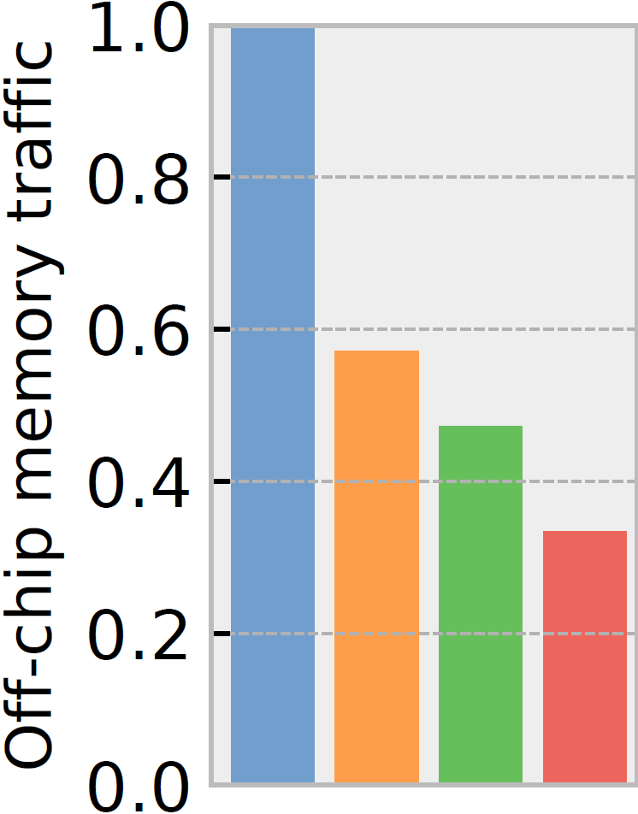
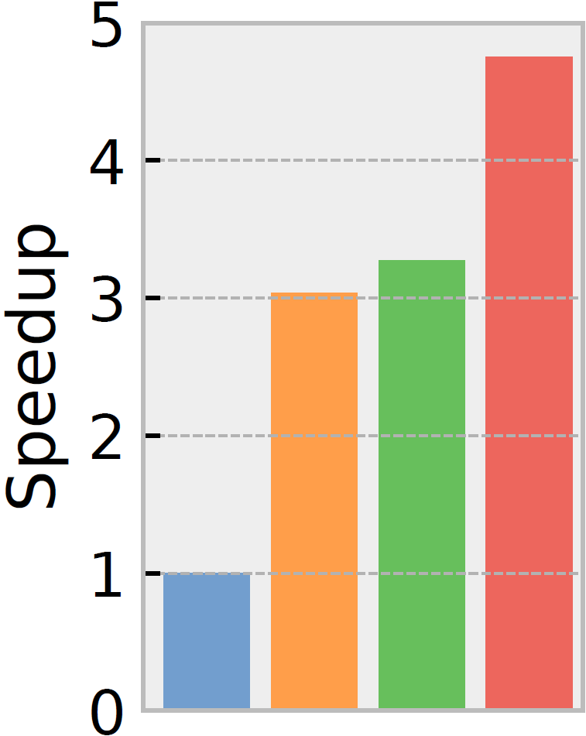
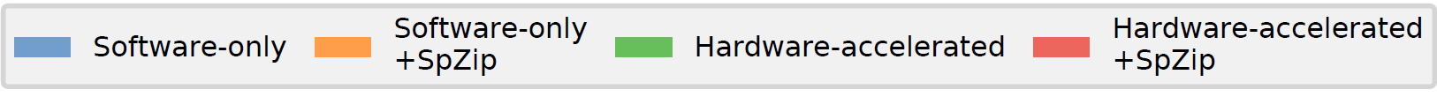
SpZip improves performance and reduces traffic
ZSim simulated
16 OOO core
51.2GB/s BW
Irregular applications
PageRank, PageRank Delta, Connected Components, Radii Estimation, BFS, Degree Counting, SPMV
1.5x
1.7x
1.4x
3.0x
Notes:
SpZip is evaluated on a zsim simulated 16 OOO core system with 51.2GB/s main memory bandwidth.
© 7 irregular applications are evaluated on large real world inputs.
SpZip’s data compression and decoupled fetching are very effective on irregular applications.
© SpZip reduces off-chip memory traffic of prior software only system by 1.7x and © accelerates it by 3.0x on average.
© Over prior hardware accelerated system, © SpZip reduces traffic by 1.4x and © achieves 1.5x speedup.

Slide 10
See full talk & paper for more details
DCL specification and examples
Programmable compressor design
Additional evaluation results
Impact of preprocessing
Benefits over compressed memory hierarchies
Impact of decoupled fetching vs data compression
Notes:
We have many more details in the full talk and paper, including DCL specification and examples, the programmable compressor design.
We also present additional evaluation results in the paper.

Slide 11
Thanks For Your Attention!
ISCA 2021
Session 12B (June 16, 2021 at 8 PM EDT)
Notes:
Thank you! And I’m happy to take questions.

Slide 12
Backup slides

Slide 13
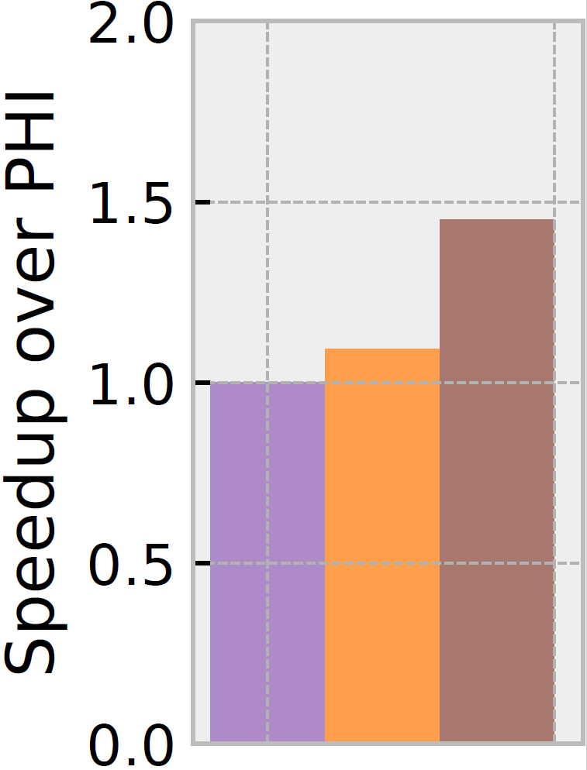
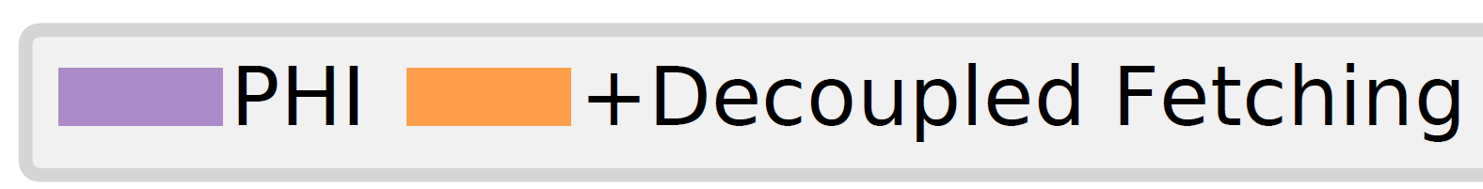
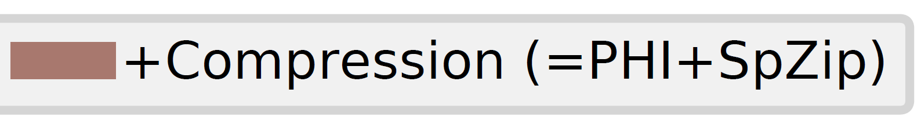
Decoupled fetching vs data compression
For PHI, data compression helps more than decoupled fetching
For Push, decoupled fetching helps more

Slide 14
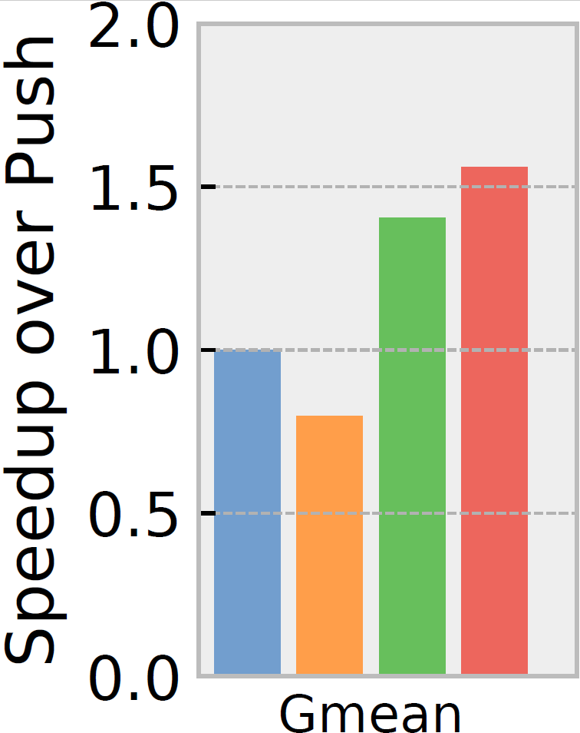
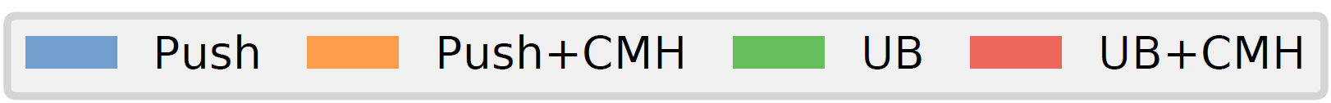
SpZip works better than CMH on irregular applications
Compressed Memory Hierarchy (CMH)
BDI[PACT’12] LLC
LCP[MICRO’13] main memory

Slide 15
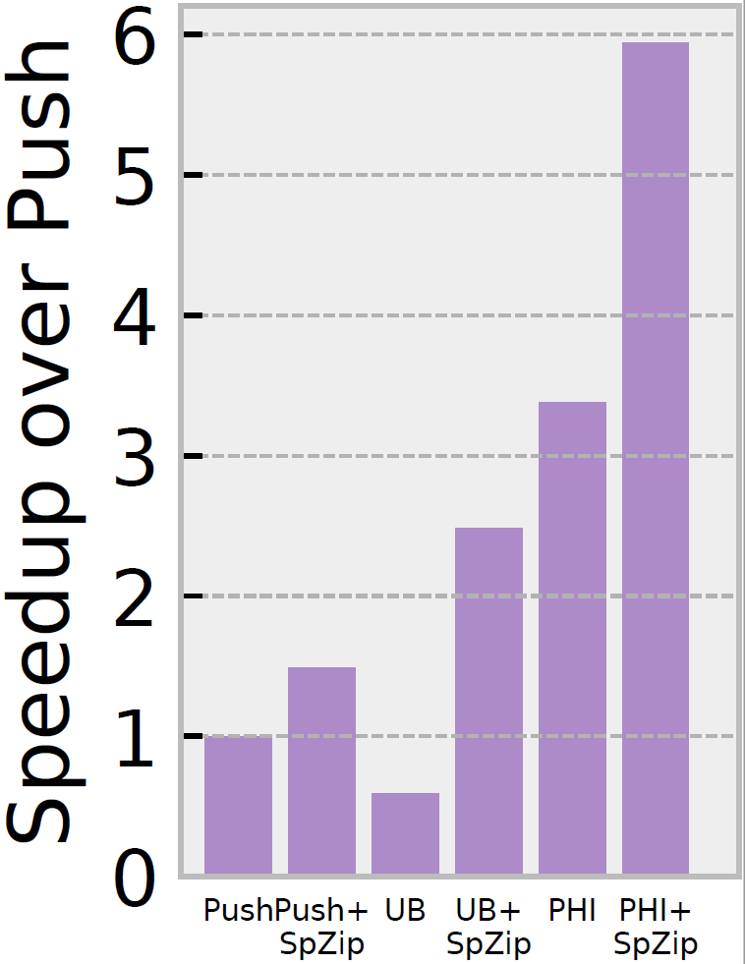
Performance with preprocessing
Preprocessing improves locality and helps compression

Slide 16
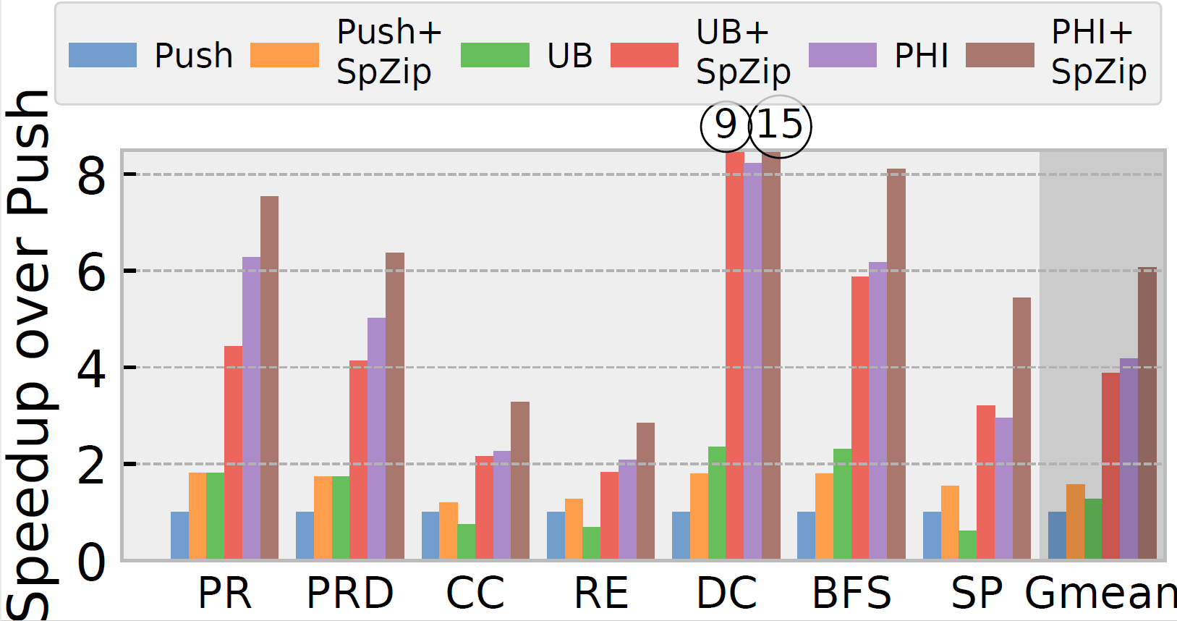
Per application performance

Slide 17
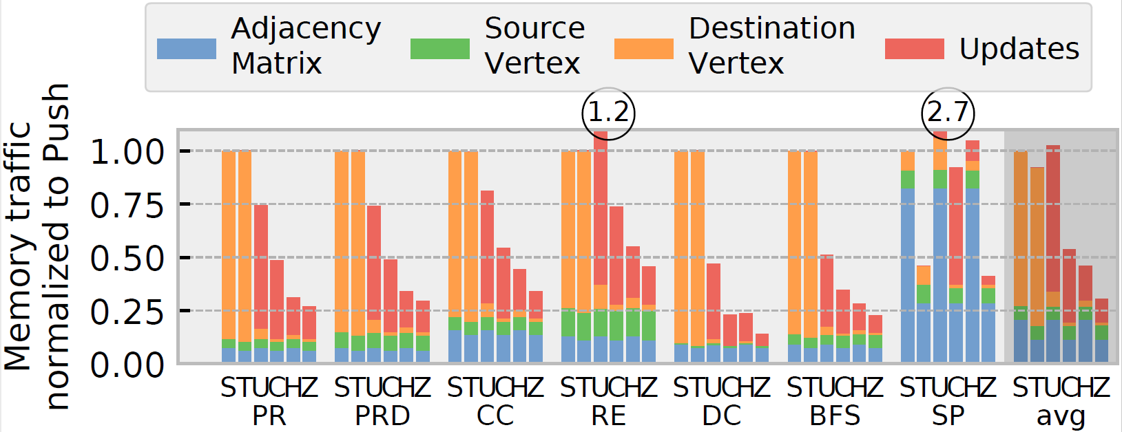
Per application memory traffic breakdown

Slide 18
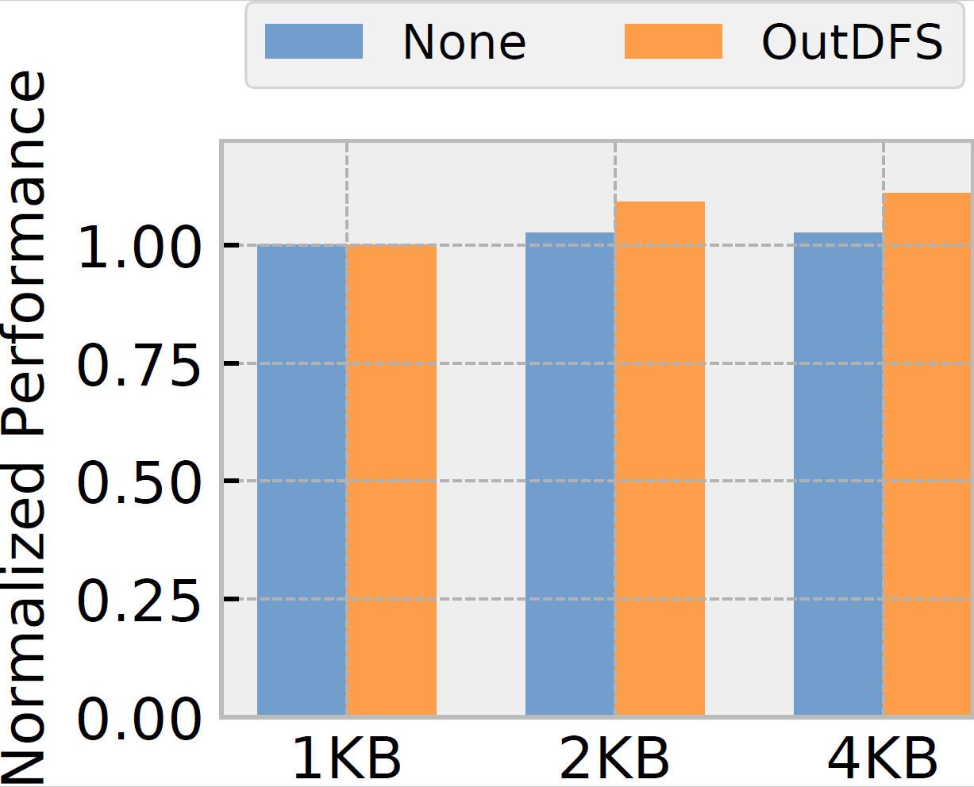
Sensitivity to the scratchpad size

Slide 19
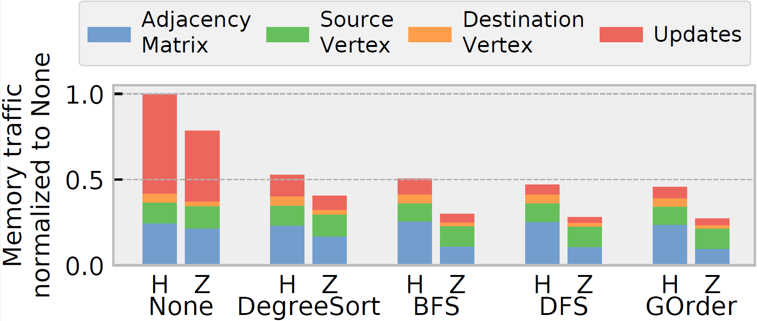
Impact of preprocessing

Slide 20
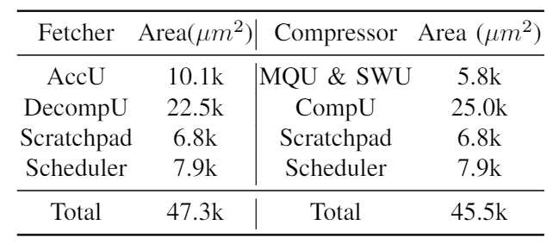
SpZip area breakdown
RTL synthesis using 45nm FreePDK45 library
0.2% of an Intel Haswell core (scaled to the same technology node)

