Slide 1
GraphABCD: Scaling Out Graph Analytics with Asynchronous Block Coordinate Descent
Yifan Yang, Zhaoshi Li, Yangdong Deng, Zhiwei Liu, Shouyi Yin, Shaojun Wei, Leibo Liu
ISCA2020
Notes:
Hi, my name is Yifan Yang. I’m going to present our paper GraphABCD: Scaling Out Graph Analytics with Asynchronous Block Coordinate Descent.

Slide 2
Executive Summary
G=(V[], E[])
while !converge(G):
iteration++
for v in V[]:
//do something
Aim to reduce runtime of iterative graph algorithm
= #_of_iterations × runtime_per_iteration
A
1
4
D
B
Bellman-Ford
3
1
Dijkstra
1
E
C
5
Fewer iterations,
Higher runtime per iteration
Notes:
In this paper we aim to reduce the runtime of iterative graph algorithm.
A pseudocode of iterative graph algorithm is shown on the right. For every iteration, it traverses all of the vertices in the graph and perform some computation on the graph. The algorithm terminates if a convergence criteria is met.
Therefore, the runtime of iterative graph algorithm can be roughly decomposed into two parts. Number of iterations times runtime per iteration.
Different implementations of the same iterative graph algorithm exhibits different behaviors on these two components.
We will use single source shortest path as an example.
[click] Suppose we would like to compute the shortest distance with source vertex A.
[click] The bellman-ford variant of SSSP algorithm takes 4 iteration to finish.
The Y axis stands for number of vertices which still haven’t find its shortest path from the source vertex.
[click] However, the Dijkstra implementation of the same algorithm only needs 1 iteration of compute.
[click] Dijkstra has fewer iterations but higher runtime per iteration, because it’s less paralleled than bellman-ford.
How to jointly optimize number of iterations and runtime per iteration systematically is the problem we tackle in this paper.
[click]
[click] For example, the Dijkstra implementation of single source shortest path algorithm [click] consumes fewer iteration but has [click] high runtime overhead per iteration.
On the contrary, [click] the bellman-ford variant of the same algorithm is highly parallel, [click] resulting in shorter runtime per iteration but [click] at a cost of more iterations.
Give an example
6 vertex graph, SSSP, dijikstra, bellman-ford
A graph, y axis : number of unconverged vertex, x axis number of iteration
A horizontal line show at some state Dijkstra is faster than bellman-ford, and parallelism is different

Slide 3
Executive Summary
G=(V[], E[])
while !converge(G):
iteration++
for v in V[]:
//do something
Aim to reduce runtime of iterative graph algorithm
= #_of_iterations × runtime_per_iteration
Solution: introduce Block Coordinate Descent (BCD) execution model, an execution model for optimization algorithm, to graph analytics
BCD theory reduces #_of_iterations
BCD enables efficient asynchronous processing by minimizing synchronization overhead to reduce runtime_per_iteration
Evaluation demonstrates geo-mean speedup of 2.0x
Notes:
Give an example
6 vertex graph, SSSP, dijikstra, bellman-ford
A graph, y axis : number of unconverged vertex, x axis number of iteration
A horizontal line show at some state Dijkstra is faster than bellman-ford, and parallelism is different
[click] Our solution is by introducing a novel execution model block coordinate descent to graph analytics.
Block coordinate descent execution model, or BCD for short, is originally designed for optimization algorithm.
We port BCD to graph domain and leverage its insights to jointly optimize number of iterations and runtime per iteration.
[click] Specifically, the theory of BCD gives us insights on how to effectively reduce number of iterations.
[click] Furthermore, BCD also enables efficient asynchronous graph processing by minimizing synchronization overhead to reduce runtime per iteration.
[click] Our evaluation shows that by leveraging these two insights of BCD, our system achieves geo-mean speedup of 2x on runtime of graph applications.

Slide 4
Outline
Motivation
Block Coordinate Descent (BCD) Execution Model
GraphABCD System
Evaluation
Conclusion

Slide 5
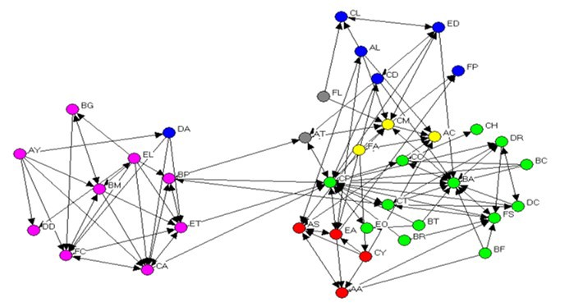
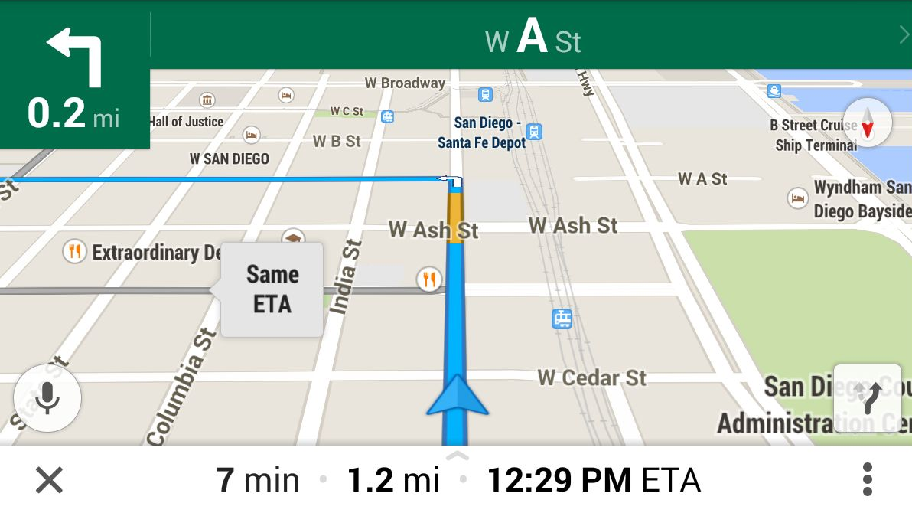
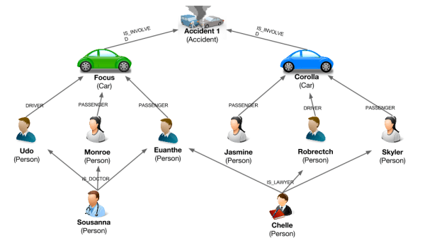
Accelerating graph analytics is vital
Various application domains
Social network analysis
Navigation
Fraud detection
runtime = #_of_iterations × runtime_per_iteration
Notes:
Graph analytic has a lot of application domains, such as social network analysis, navigation, fraud detection and so on.
Therefore, accelerating graph analytics is vital to ensure the high performance of these applications.
As we explained in the previous slides, the runtime of graph algorithm can be broadly characterized into number of iterations times runtime per iteration.
This gives us two potential directions [click] in order to improve the performance of iterative graph algorithms.

Slide 6
Improving convergence rate can effectively reduce execution time
A
1
4
D
Bellman-Ford
B
3
Dijkstra
1
1
E
C
5
Fewer iterations,
higher convergence rate
Prior system improves convergence rate in a case-by-case manner
GraphLab, PowerGraph, Galois, Wonderland
Motivation 1: A systematic approach to analyzing and optimizing the convergence rate of iterative graph algorithms is imperative
Notes:
The first direction is to reduce the number of iterations.
As we have seen before, Dijkstra consumes fewer iteration than bellman-ford on this example graph.
[click] This means the Dijkstra algorithm converges faster.
Therefore, reducing number of iteration is equivalent to improving the convergence rate. We will use these two terms interchangeably in this talk.
[click] Prior system mostly improves the convergence rate of graph analytics in a case by case manner. Like specially implement a Dijksra version of SSSP algorithm.
[click] A systematic approach to analyzing and optimizing the convergence rate of iterative graph algorithms is imperative.
Give the figure in executive summary. Bellman ford and dijktra
One line converge faster, another converge slower
X axis, more iteration, fewer iteration

Slide 7
Asynchronous execution can improve runtime per iteration
Prior work exploits hardware acceleration to improve per iteration performance
Gunrock (GPU), Foregraph (FPGA), Graphicionado (ASIC)
Limited performance due to frequent synchronization
Motivation 2: Algorithm and architectural support for asynchronicity are imperative for improving per iteration performance
Asynchronous execution enables graph analytics to efficiently scale out to heterogeneous system
Notes:
The second direction to reduce execution time is to improve per iteration performance of graph analytics.
Prior work exploits hardware acceleration to improve per iteration performance.
However, their performance is limited due to frequent synchronization and coordination within the system.
[click] Therefore, algorithm and architectural support for asynchronicity are imperative for improving per iteration performance.
[click] Moreover, asynchronous processing also allows us to efficiently exploit heterogeneity of the underlying systems.
For example, there might be host CPUs or other accelerators available in the system.
Therefore, graph analytics can cheaply scale out to heterogeneous system.

Slide 8



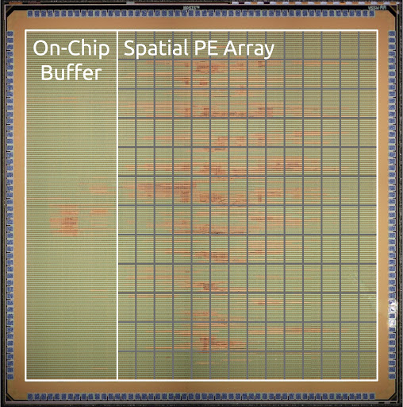
Our solution: introduce Block Coordinate Descent (BCD) execution model to graph analytics
Optimization
Problem Domain
Graph Analytics
PageRank
Linear Regression
Deep Learning
Algorithm
SSSP
CF
BSP
SGD
Execution Model
BCD
BCD
Galois-like
Hardware
CPU
GPU
FPGA
ASIC
CPU
GPU
FPGA
ASIC
Notes:
Our solution is to introduce block coordinate descent execution model to graph analytics.
I would like to illustrate on which level of the stack we are introducing our solution.
On the left we have the solution stack [click] for optimization problem.
[click] Linear regression and deep learning and two example algorithms for optimization problem.
Further down the stack we have [click] stochastic gradient descent SGD or block coordinate descent BCD execution model for these algorithms.
And [click] various underlying hardware to do the computation.
On the right we have the domain of [click] graph analytics.
Algorithms like [click] pagerank, SSSP, collaborative filtering are examples of graph algorithm.
The execution model are [click] bulk synchronous parallel BSP or Galois-like etc.
They can run on the [click] same underlying hardware.
Our solution brings BCD execution model which is designed for optimization [click] to graph analytics.
So that we can leverage all of the nice properties of BCD to reduce number of iterations and runtime per iteration.
[click] [click]

Slide 9
Our solution: introduce Block Coordinate Descent (BCD) execution model to graph analytics
Problem Domain
Graph Analytics
Configuring BCD design parameters reduces #_of_iterations
PageRank
Algorithm
SSSP
CF
BSP
Execution Model
BCD supports asynchronous processing by minimizing synchronization overhead to reduce runtime_per_iteration
BCD
Galois-like
Hardware
CPU
GPU
FPGA
ASIC
Notes:
BCD is able to address the two challenges we presented before.
[click] First, theoretical study of BCD from optimization community suggests that we can configure design parameters in BCD model to improve convergence rate.
Because BCD is a general execution model.
As long as the graph algorithms can be mapped to this execution model, they will automatically get the nice property of high convergence rate.
We don’t have to investigate them case by case.
[click] Second, BCD execution model intrinsically support asynchronous processing.
This can better utilize the underlying hardware, especially heterogeneous platform, by minimizing synchronization overhead to further reduce runtime per iteration.

Slide 10
Outline
Motivation
Block Coordinate Descent (BCD) Execution Model
GraphABCD System
Evaluation
Conclusion

Slide 11
Outline
Optimization
Problem Domain
Graph Analytics
PageRank
Linear Regression
Deep Learning
Algorithm
❷
SSSP
CF
❸
BSP
SGD
Execution Model
BCD
BCD
❶
Galois-like
Hardware
CPU
GPU
FPGA
ASIC
CPU
GPU
FPGA
ASIC
Notes:
We will split the explanation of BCD execution model in 3 steps.
[click] First, we will introduce how BCD execution model works in optimization domain.
[click] Second, we will show how we port BCD execution model to graph analytics.
[click] Finally, we will illustrate the way to map graph algorithms to BCD execution model.

Slide 12
Block Coordinate Descent (BCD) is an execution model for optimization algorithm
Optimization algorithm
Aim to find vector x to minimize objective function F(x)
BCD execution model updates vector x one block at a time iteratively until convergence
x
, …,
x_{n-2},x_{n-1},x_{n}]
=[x₁,x₂,x₃
, …,
Slice vector x into multiple blocks
=[x₁,x₂,x₃
x_{n-2},x_{n-1},x_{n}]
On every iteration, choose a specific block
x’
x’_{n-2},x’_{n-1},x’_{n}]
Apply updates to the block
Notes:
BCD is an execution model for optimization algorithm.
An optimization algorithm aims to find vector x to minimize objective function F(x).
[click] The BCD execution model iteratively updates the vector x until F(x) converges to its minimum value.
Specifically, [click] the BCD model first partitions the vector x [click] into multiple blocks.
[click] During every iteration, a specific block [click] is chosen.
[click] The elements in the selected block are updated according to [click] an update function and elements in all of the other block remain unchanged.
The algorithm terminates until elements in every block will not be updated anymore.
Therefore, BCD updates the vector x one block at a time until the objective function reaches it minimal point.
Slower animation

Slide 13
Porting BCD execution model to graph analytics
Vector x -> vertex value array v
x’
=[x₁,x₂,x₃
, …,
x’_{n-2},x’_{n-1},x’_{n}]
Notes:
We will now introduce the way to port BCD execution model from the field of optimization to graph analytics.
[click] Intuitively, the vector x we showed in the previous slide becomes the array of vertex values.
[click]

Slide 14

Porting BCD execution model to graph analytics
Vector x -> vertex value array v
Example SSSP objective function:
v’
=[v₁,v₂,v₃
, …,
v’_{n-2},v’_{n-1},v’_{n}]
Notes:
And the objective function can be constructed based on the specific graph problem. More details about how to construct the objectives can be found in the paper.
We will focus on how BCD executes in graph domain.
Add example SSSP objective function

Slide 15
Porting BCD execution model to graph analytics
Vector x -> vertex value array v
BCD execution:
Until Convergence
Partition Graph
Choose Block
Update Block
Vertex values
Adjacency
matrix
Processor
Graph
Notes:
This is the flow chart of how BCD executes.
We will use the following example to illustrate this.
[click] We have an array of vertex value and an adjacency matrix which represents the edges in the graph.
[click] BCD partitions the vertex array into blocks and adjacency matrix into chunks. All of the incoming edges of the vertex block is stored in the corresponding edge chunks.
On every iteration, [click] BCD selects and loads one block and its corresponding edge chunk from memory.
[click] It only applies update to the selected block and commits the updates back into memory.
The algorithm terminates until every vertex value converges.
More animation

Slide 16
Mapping iterative graph algorithm to BCD execution model
Until Convergence
Partition Graph
Choose Block
Update Block
G=(V[], E[])
while !converge(G):
b=choose_block(G)
for v in b:
tmp_depth=MAX
for ngh in v.ngh:
tmp_depth=min(tmp_depth,
ngh.depth+distance(v,ngh))
v.depth=tmp_depth
Notes:
We now show how iterative graph algorithms map to this BCD execution model.
[click] We use SSSP pseudocode as an example.
The partition graph stage is a pre-processing stage therefore it is not shown in the code.
[click] The algorithm starts by choosing one block in the graph.
It then traverse every vertex in the block either sequentially or in parallel.
[click] The algorithm computes the new vertex depth and updates the block accordingly.
[click] It then check whether the algorithm converges, if not, it will start a next iteration of choosing and updating blocks.
Now we’ve successfully port BCD execution model to graph analytics.
We are able to map graph algorithm to this execution model.
We can leverage all of the nice properties of BCD to accelerate graph analytics.

Slide 17
Design parameters of BCD execution model
Until Convergence
Partition Graph
Choose Block
Update Block
Block Selection Method
Block Update Method
Block Size
1
……
|V|
Cyclic
Priority
Gradient
Newton ……
Notes:
Three design parameters arises in the 3-stage BCD execution model.
[click] Block size describes how many vertices are allocated into one block. It can vary from a single vertex to the entire graph.
[click] Block selection method (which is usually called scheduling algorithm) specifies the strategy to select a block to perform BCD update in each iteration. It can be [click] a predefined fixed order (cyclic scheduling) or [click] a dynamically updated order (priority scheduling).
[click] Finally, block update method specifies the form of update function in BCD algorithm. It can be the form of gradient, newton or other complex approaches.
Different combinations of these 3 design parameters affects the convergence rate.

Slide 18
Using BCD to achieve high convergence rate
Insight 1: The combination of block size 1, priority block selection and gradient update allows the fastest convergence of graph algorithms.
Allows us to configure BCD execution model parameters to achieve higher convergence rate
Notes:
This leads to the first insight BCD offers.
Prior theoretical and empirical study states that a combination of [click] block size 1, [click] priority block selection and [click] gradient update allows the fastest convergence of graph algorithms.
Intuitively, this combination improves convergence rate by allowing the most important vertex update visible to the whole graph instantaneously.
[click] This allows us to configure BCD execution model parameters to achieve higher convergence rate and reduce overall runtime.

Slide 19
Async BCD improves runtime per iteration
Insight 2: BCD model can relax the requirements of synchronization of the system by implementing Asynchronous BCD model, whose convergence rate stays the same
Allows us to exploit heterogeneous platform to further improve runtime per iteration
We design GraphABCD, a heterogeneous Graph analytic framework with Asynchronous Block Coordinate Descent execution model
Notes:
The second insight of BCD is that it can help to improve runtime per iteration of graph processing system.
BCD execution model can relax the requirements of synchronization of the system by implementing Asynchronous BCD model.
The convergence rate of asynchronous BCD stays the same as synchronous BCD.
In asynchronous BCD model, blocks can be processed asynchronously without extra synchronization or coordination.
[click] This allows us to exploit pervasive heterogeneous platforms nowadays with minimal synchronization overhead to further improve runtime per iteration.
[click] Therefore, we design GraphABCD, a heterogeneous Graph analytic framework with Asynchronous Block Coordinate Descent execution model.

Slide 20
Outline
Motivation
Block Coordinate Descent (BCD) Execution Model
GraphABCD System
Evaluation
Conclusion

Slide 21
GraphABCD overview
We design GraphABCD, an Asynchronous graph analytic framework on CPU+Accelerator heterogeneous system
GraphABCD adopts BCD execution model jointly optimizes convergence rate and runtime per iteration
Selects suitable BCD design parameters to improve convergence rate
Scales out graph analytics asynchronously to heterogeneity to optimize runtime per iteration
Notes:
GraphABCD is an asynchronous graph analytic framework on cpu+accelerator heterogeneous system.
[click] GraphABCD adopts the BCD execution model.
It leverages the two insights of BCD to jointly optimize convergence rate and runtime per iteration.
[click] GraphABCD achieves high convergence rate by selecting the most suitable BCD design parameters when BCD execution model is implemented on real system.
[click] It further scales out graph analytics asynchronously to heterogenous plaform to optimize runtime per iteration.

Slide 22
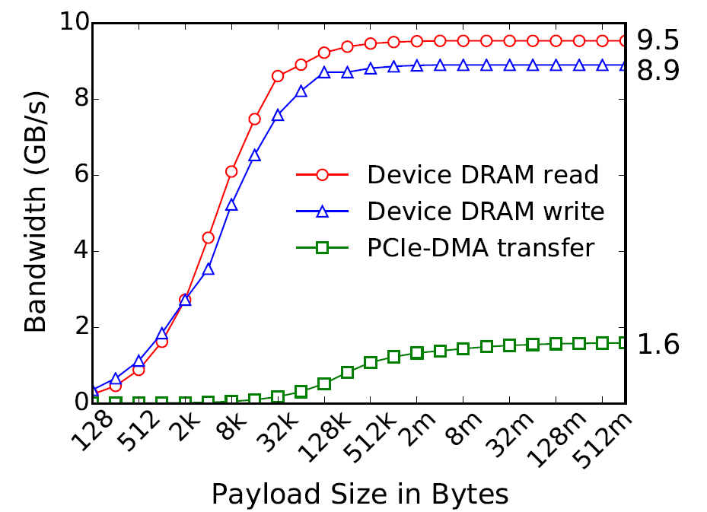
GraphABCD improves convergence rate
Tradeoff BCD design parameters for better hardware efficiency while maintaining high convergence rate
Use slightly larger block size for better utilizing bandwidth
[1]
Approximate theoretical priority block selection for hardware efficiency
[1] Choi, Young-kyu, et al. "A quantitative analysis on microarchitectures of modern CPU-FPGA platforms." Proceedings of the 53rd Annual Design Automation Conference. 2016.
Notes:
The first insight of BCD suggests the different execution model configurations to achieve the fastest convergence.
However, when we implement BCD on actual system, the theoretical fastest configuration may not be the ideal choice.
We need to tradeoff some design parameters for better hardware efficiency while maintaining high convergence rate.
[click] For example, the theoretical best choice is block size equals to 1.
GraphABCD uses a slightly larger block size.
This is because smaller block size requires fine-grain data movement.
As shown in this plot, as block size becomes smaller, the PCIe bandwidth utilization becomes lower.
[click] GraphABCD also supports priority block selection to further improve convergence rate.
The priority scheduling algorithm is derived from the theory and intuition from BCD.
It requires intense computation to maintain and update the priority.
Hence, we made some approximations of the original block selection algorithm to make it more hardware efficient while retaining its high convergence rate. More details can be found in the paper.
Add paper figure 4, one algorithm, one graph, two line
Smaller block size requires fine-grain cache prefetch, may not fully utilize bandwidth
Change priority motivation to hardware efficiency

Slide 23
GraphABCD scales out asynchronous BCD to heterogeneity to optimize runtime per iteration
Until Convergence
Choose Block
Update Block
Gather
Partition Graph
Apply
Split
Notes:
We now show how GraphABCD framework materializes the asynchronous BCD execution model we’ve seen before to hardware pipeline stages.
This allows GraphABCD to scale out to heterogeneous platforms to optimize runtime per iteration.
The update block stage is graph algorithm specific.
[click] We first split this stage into three stages: gather, apply, scatter.
[click] This is a widely adopted programming model for the update stage and is introduced in the PowerGraph paper.
[click] Note that the minimum unit operates in this pipeline is a vertex block.
[click] Therefore, multiple vertex blocks can operate on different pipeline stages to exploit pipeline parallelism.

Slide 24
Materialize asynchronous BCD into hw
Until Convergence
Partition Graph
Choose Block
Gather
Apply
Scatter
0
1
2
3
4
5
Partitioned blocks
Notes:
We now show how GraphABCD framework materializes the asynchronous BCD execution model we’ve seen before to hardware pipeline stages.
This allows GraphABCD to scale out to heterogeneous platforms to optimize runtime per iteration.
The update block stage is graph algorithm specific.
[click] We first split this stage into three stages: gather, apply, scatter.
[click] This is a widely adopted programming model for the update stage and is introduced in the PowerGraph paper.
[click] Note that the minimum unit operates in this pipeline is a vertex block.
[click] Therefore, multiple vertex blocks can operate on different pipeline stages to exploit pipeline parallelism.

Slide 25
Materialize asynchronous BCD into hw
Until Convergence
Partition Graph
Choose Block
Gather
Apply
Scatter
Control Intensive
Compute Intensive
Sequential Access
Compute Intensive
Sequential Access
Random Access
Notes:
Because BCD allows asynchronous processing of the graph, different pipeline stage can be allocated to heterogeneous computation resources in the system without extra inter-stage synchronization.
[click] Therefore, we allocate the compute-intensive/sequential memory access stages to accelerator, namely gather and apply.
[click] The control-intensive scheduler and random memory access-intensive scatter stages are allocated to cpu to fully exploit heterogeneous system.
[click]

Slide 26
Materialize asynchronous BCD into hw
Until Convergence
CPU
Partition Graph
Choose Block
Scatter
Gather
Apply
Accelerator
PE
Notes:
If the pipeline is duplicated multiple times, [click] we can further exploit data parallelism by processing multiple blocks in the same stage in parallel.
We further introduce the hybrid execution optimization.
If the GraphABCD system detects the CPU are under-utilized, [click] it will dynamically allocate the available CPU resources to execute the gather-apply stages in software to improve parallelism.
In this way, GraphABCD can scale the same computation kernel to heterogeneous resources in the system.

Slide 27
Hybrid execution scales the same computation kernel to heterogeneous resources
Until Convergence
CPU
Partition Graph
Choose Block
Scatter
Gather
Apply
Available CPU
Gather
Apply
Accelerator
PE
Notes:
We further introduce the hybrid execution optimization.
If the GraphABCD system detects the CPU are under-utilized, [click] it will dynamically allocate the available CPU resources to execute the gather-apply stages in software to improve parallelism.
In this way, GraphABCD can scale the same computation kernel to heterogeneous resources in the system.

Slide 28
Outline
Motivation
Block Coordinate Descent (BCD) Execution Model
GraphABCD System
Evaluation
Conclusion

Slide 29
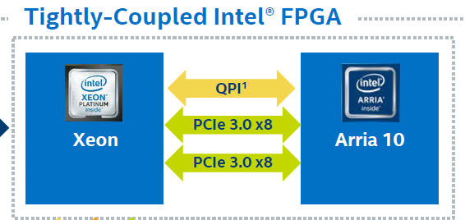
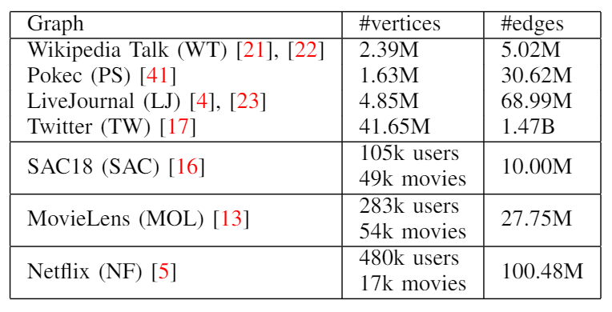
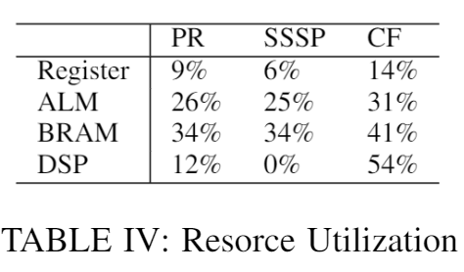
Experimental setup
Intel HARPv2 CPU+FPGA system
FPGA frequency 200MHz
Graph applications
PageRank (PR), Single Source Shortest Path (SSSP), Collaborative Filtering (CF)
7 real world graphs
Notes:
We prototype GraphABCD framework on Intel HARP2 CPU-FPGA heterogeneous system.
HARP2 system is consists of an intel xeon processor and a tightly coupled intel arria 10 FPGA.
There connection bandwidth is 12.8GB/s.
The accelerator logic is implemented on the FPGA at a frequency of 200MHz.
And the FPGA resource utilization is shown below.
[click] We test three graph applications, pagerank, single souece shortest path and collaborative filtering
on 7 real world graphs ranging from small graphs to large graphs.

Slide 30
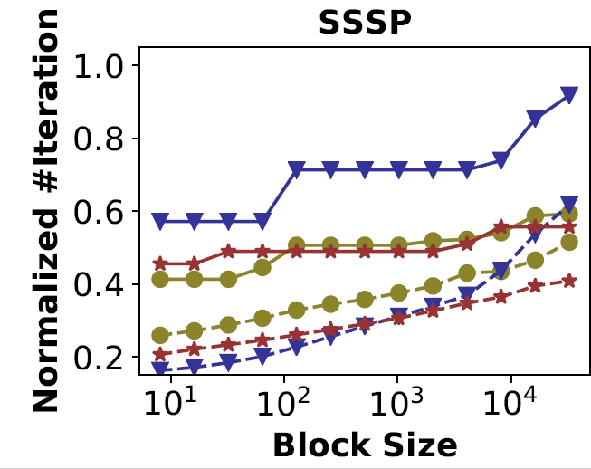
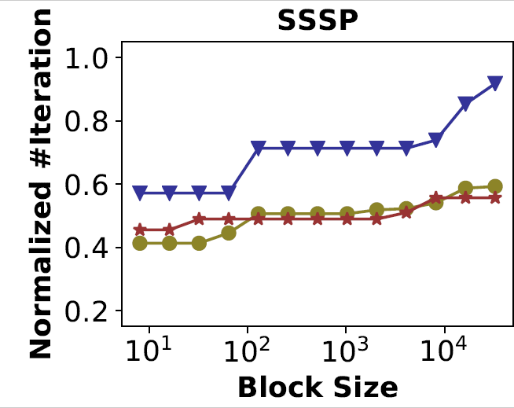
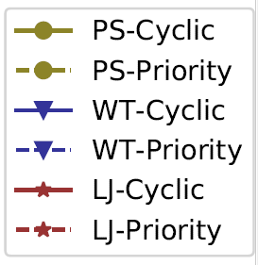
Convergence rate improvement up to 5x
Smaller block size converges faster
Priority block selection improves convergence rate
Notes:
We first evaluate how convergence rate will change by varying the block size and block selection method.
We test SSSP on 3 graphs and lower is better in the plot.
We can see that smaller block size results in fewer iterations, hence higher convergence rate.
This is done using cyclic block selection.
[click] Then, we conduct the same sweep using priority block selection and it is marked in dotted line.
Priority scheduling further improves convergence rate.
Overall, the convergence rate can be improved from 1.2x to 5x by tuning BCD design parameters.
Other algorithms like PageRank and collaborative filtering follow the similar trend.
Justify insight 1

Slide 31
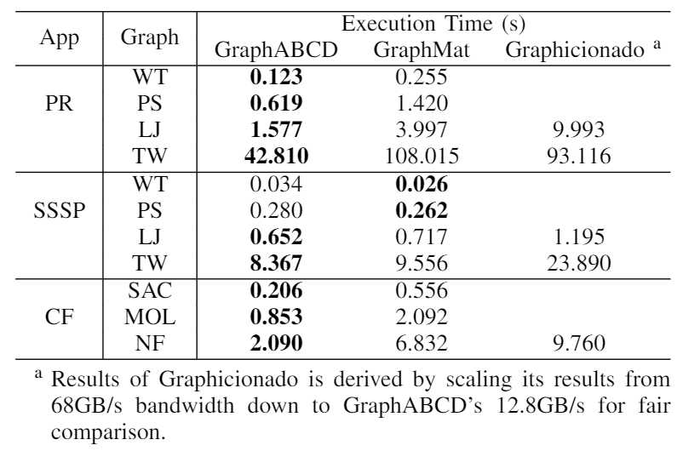
Comparison with GraphMat and Graphicionado
Geo-mean speedup of 2.0x on execution time and 4.8x on convergence rate over GraphMat
GraphMat leverages smaller block size optimization in SSSP
Notes:
We now compare the execution time of GraphABCD system against the state-of-the-art GraphMat framework and its ASIC implementation Graphicionado.
Overall, GraphABCD achieves a geo-mean speedup of 2x over GraphMat thanks to improved convergence rate and asynchronous processing.
GraphABCD improves convergence rate by an average of 4.8x over GraphMat because it adopts smaller block size and priority block selection.
[click] The reason why GraphMat is faster than GraphABCD on SSSP is because GraphMat reduces its block size in SSSP to improve convergence rate.

Slide 32
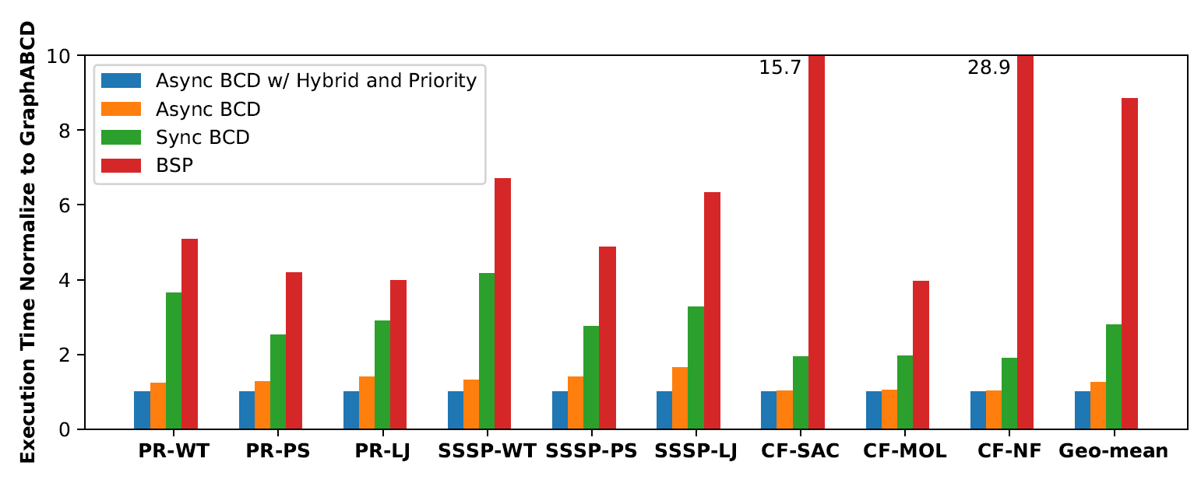
GraphABCD speedup breakdown
Bulk Synchronous Parallel (BSP) execution model baseline
Sync BCD model 3.2x
Async BCD model 2.2x
Async BCD model w/ hybrid and priority 1.27x
Notes:
We further breakdown GraphABCD speedup to see how asynchronous BCD execution model helps to improve performance.
Lower is better in this plot.
We start with the BSP execution model baseline.
BSP or bulk synchronous parallel is a popular synchronous execution model for graph analytics and is used by GraphMat and Graphicionado.
[click] We first reduce the block size of BSP and construct a synchronous BCD execution model baseline.
The better convergence rate caused by smaller block size results in a geo-mean of 3.2x improvement on execution time.
[click] If we further eliminate the synchronization barrier after the processing of each block, it becomes the asynchronous BCD execution model.
The asynchronous BCD framework achieves an average 2.2x speedup over synchronous BCD.
[click] Finally priority block selection and hybrid execution reduces runtime by another 27%.
Put data on the slides, use geo-mean

Slide 33
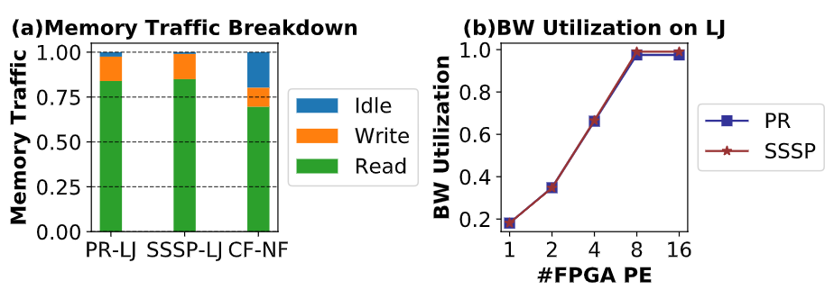
GraphABCD efficiently utilizes memory bandwidth
All of the FPGA memory accesses are sequential
GraphABCD utilizes nearly 100% of the memory bandwidth and is bottlenecked by it
Notes:
We further analyze the memory traffic between the CPU and FPGA accelerator.
We observe that all of the FPGA memory accesses are sequential.
This comes from our novel task allocation on heterogeneous system enabled by asynchronous BCD execution model.
[click] Further analysis shows that graphabcd utilizes nearly 100% of the memory bandwidth and is bottlenecked by it.
For future work we will address the bandwidth bottleneck of the system.

Slide 34
Outline
Motivation
Block Coordinate Descent (BCD) Execution Model
GraphABCD System
Evaluation
Conclusion

Slide 35
Conclusions
Jointly optimizing number of iterations and runtime per iteration is vital for high performance graph analytics
BCD reduces number of iterations by tuning its design parameters and reduces runtime per iteration by asynchronous processing
GraphABCD framework adopts the Asynchronous Block Coordinate Decent execution model and efficiently scales out graph analytics to heterogeneous platform
Future direction: leveraging more BCD propertied to optimize graph analytics
Notes:
Jointly optimizing number of iterations and runtime per iteration is vital for high performance graph analytics.
We tackle this problem by introducing Block Coordinate Descent (BCD) execution model to graph analytics.
[click] BCD reduces number of iterations by tuning its design parameters and reduces runtime per iteration by asynchronous processing.
[click] GraphABCD framework adopts the Asynchronous Block Coordinate Decent execution model and efficiently scales out graph analytics to heterogeneous platform.
[click] The BCD execution model opens up a new perspective of analyzing graph analytics.
Leveraging BCD properties studied by the optimization community could be an interesting future direction for high-performance graph analytics.
Thank you for watching this talk. Feel free to contact us if you have any questions or comments.
To conclude, we propose the block coordinate descent view of graph analytics.
The theory of BCD helps to improve convergence rate by selecting different BCD algorithmic design parameters.
BCD also enables asynchronous processing on the graph.
These two insights leads to the design and prototype of GraphABCD.
GraphABCD efficiently scales out graph analytics to heterogeneous platform with high performance.

