Slide 1
SpZip: Architectural Support for Effective Data Compression In Irregular Applications
Yifan Yang, Joel S. Emer, Daniel Sanchez
ISCA 2021
Session 12B (June 16, 2021 at 8 PM EDT)
Notes:
Hi! My name is Yifan Yang. It is my great pleasure to present SpZip: Architectural Support for Effective Data Compression In Irregular Applications. This work is done in collaboration with Professor Joel Emer, and Professor Daniel Sanchez at MIT. Please attend our live session on June 16th. ©

Slide 2
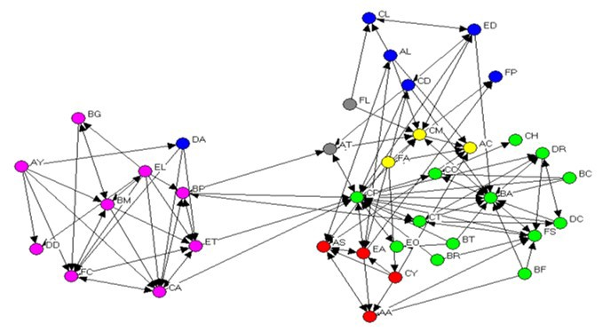
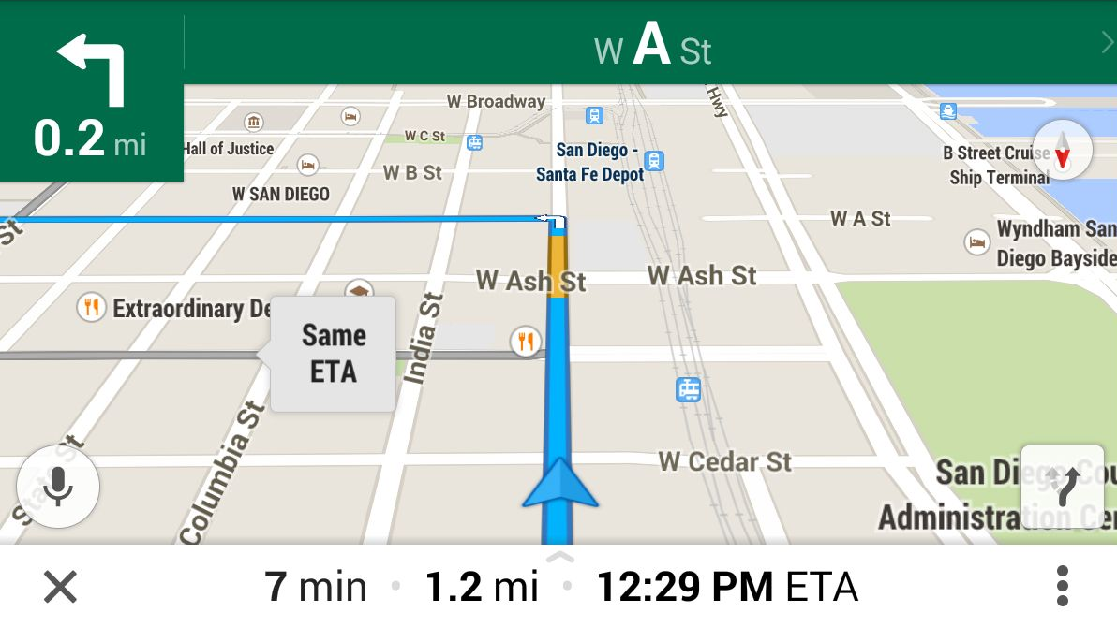
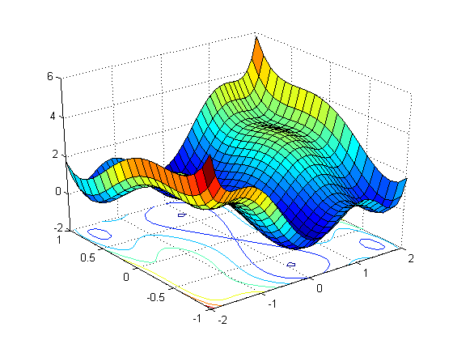
Irregular applications are memory bound
Irregular applications, such as graph analytics and sparse linear algebra, are an increasingly important workload domain
Irregular applications are often memory bound
Data compression is an attractive approach to accelerate irregular applications
Social network analysis
Navigation
Scientific computing
Notes:
Irregular applications, like graph analytics and sparse linear algebra, are an increasingly important workload domain. As they are widely used in © social network analysis, © navigation, © scientific computing, etc.
However, irregular applications have low computation to communication ratio. © They are often memory bound.
© Data compression is an attractive approach to alleviate this memory bottleneck.
Compression can reduce memory traffic if the application saturates memory bandwidth. If the application is memory latency bound, data compression could also improve performance by enabling a larger effective cache capacity. ©

Slide 3
Existing data compression solutions are not tailored for irregular applications
Hardware compression units for sequentially accessed long streams
e.g., IBM z15 [ISCA’20]
This work is optimized for indirect, data-dependent accesses to short streams
Compressed memory hierarchies support random accesses
e.g., VSC [ISCA’04]
Notes:
However, the overhead of software compression offsets the benefit of data compression. Existing hardware data compression solutions work poorly on irregular applications. Because they are not tailored for the memory access patterns in irregular applications. They are optimized for these two scenarios.
© First, dedicated hardware compression units, in IBM z15 processor for example, only support compressing sequentially accessed long streams.
© On the other end, prior compressed memory hierarchy designs, like VSC, support random accesses.
© The memory access patterns of irregular applications sit in the middle of these two extremes. They often have indirect, data-dependent accesses to single or short sequences of elements. I’ll explain the access pattern first. ©

Slide 4
Understanding access patterns in irregular applications
Graph Adjacency List
v0
v2
v3
vertices
neighbors
Notes:
This data structure has a 1-d array with each entry pointing to a variable sized chunk. The © adjacency list is an example instance of this data structure. It can be used to represent a graph. © The array on the left has one entry per vertex. Each entry points to a variable-sized chunk of memory that © holds the vertex neighbors, shown right.
Some applications must traverse the neighbors of a subset of vertices, in this example, © vertex 0, 2 and 3. Traversing neighbors of v0 requires © first accessing its entry in the vertices array to obtain the pointer to the neighbor list, © then sequentially traversing the neighbor list. © The same procedure is used to traverse © v2 and v3. ©

Slide 5
Existing data compression solutions are not tailored for irregular applications
Hardware compression units for sequentially accessed long streams
e.g., IBM z15 [ISCA’20]
This work is optimized for indirect, data-dependent accesses to short streams
Compressed memory hierarchies support random accesses
e.g., VSC [ISCA’04]
✘
✘
v0
v2
v3
vertices
neighbors
Limited compression gain on short streams
Data decompression increases critical path latency
Notes:
Now I’ll explain why existing data compression solutions work poorly on irregular applications with this indirect/data dependent access pattern.
© The hardware compression units use compression algorithm that extracts data correlations within the long stream, so they yield limited compression gain on these short streams.
© Compressed memory hierarchies also achieve limited benefits on irregular applications, because data decompression of each accessed element increases critical path access latency.©

Slide 6
Compressing data structures in irregular applications is hard
Challenge 1: Access and decompression are interleaved
Graph Adjacency List
vertex data
v0
v2
v3
Core
vertices
neighbors
access
access
access
Notes:
We identify two challenges of applying data compression to irregular applications due to this indirect, data-dependent memory access pattern.
© First, in irregular applications, the data access and decompression are interleaved.
In real applications, the traversal results of the graph adjacency list are used to access other data structures, © the corresponding neighbor vertex data for example. In this case, the © CPU core first © accesses the vertices array, © then the neighbor lists, © and finally the neighbor vertex data. Suppose we introduce data compression to the neighbor list. ©

Slide 7
Compressing data structures in irregular applications is hard
Challenge 1: Access and decompression are interleaved
Graph Adjacency List
vertex data
v0
v2
v3
Insight 1: Specialized hw to accelerate data access and decompression
Exploit decoupled execution to hide memory access and decompression latencies
Fetcher
Core
vertices
compressed
neighbors
access
access
decompress
access
Notes:
We need to © decompress it first before using it to index into the vertex data array. As you can see, the access and decompression are interleaved. This increases the memory access latency of the core.
© Therefore, specialized hardware is needed to accelerate both access and decompression of the data.
© SpZip introduces a hardware fetcher to offload the data access and decompression, and keeps only the computation work at the core. © The fetcher and core are also decoupled by queue so that the data access and decompression can run ahead, to hide their latencies. ©

Slide 8
Compressing data structures in irregular applications is hard
Challenge 2: Need to support various access patterns and compression formats
Insight 2: Programmable hardware
A pipeline consists of a set of composable operators expressing the traversal and decompression of data structures
Dataflow Configuration Language (DCL)
Graph Adjacency List
v0
v2
v3
Fetcher
Core
vertices
neighbors
Access
Access
Decompress
Notes:
Though we only show the access pattern of adjacency list in this example.
© In reality, data structures in irregular applications may have various access patterns and compression formats. A single fixed function hardware pipeline is not a good solution.
© SpZip solves this by leveraging a programmable hardware design. © We identify a set of fundamental composable operators. These operators could be used to construct a pipeline to express the traversal and decompression of different data structures in different formats. And the programmable hardware implements the operator pipeline.
© As shown on the right, the traversal of this two-level adjacency list can be represented as a pipeline of two access operators, with the first access operator accessing vertices array and the second operator accessing neighbor lists. If the user decides to compress the neighbor list, © SpZip’s support for that is as simple as appending a decompression operator after the second access operator.
The flexibility of these composable operators allows SpZip hardware to traverse and decompress data structures with various access patterns and compression formats. This programmability differentiates SpZip with prior prefetchers, which only support a few predefined memory access patterns.
© We propose Dataflow Configuration Language (DCL) to formally specify the pipeline and each operator. ©

Slide 9
Agenda
Motivation
SpZip Dataflow Configuration Language (DCL)
SpZip Design
Evaluation
Notes:
Now we’ll introduce the SpZip Dataflow Configuration Language. ©

Slide 10




Dataflow Configuration Language (DCL) overview
A DCL program expresses the traversal, decompression and compression of data structures in irregular applications
DCL program is an acyclic graph of composable operators
Operators are connected by queues to exploit pipeline parallelism
Memory access operator
$${{…;i}_{2};i}_{1}$$
Indir
$$…;A\left[i_{2}\right];A[i_{1}]$$
$$…;\left(i_{2}, j_{2}\right);(i_{1}, j_{1})$$
Range
$$…;A\left[j_{2}\text{−}1\right],…,A[i_{2}];A\left[j_{1}\text{−}1\right],…,A[i_{1}]$$
Decompress
…
…
Notes:
© A DCL program expresses the traversal, decompression and compression of data structures in irregular applications and the SpZip hardware will execute the DCL program.
© The DCL program is an acyclic graph of composable operators. Let’s look at some of them.
© Memory access operators traverse memory according to the given inputs. There are two types of them.
An indirection operator takes © a stream of indices i as input, and for each i, © it fetches and outputs A[i].
A range fetch operator takes © a stream of index pairs i, j as input, and for each pair, © it fetches and outputs A[i],A[i+ 1], to A[j−1].
© Decompression operator decodes the compressed input stream into uncompressed stream.
Multiple compression formats may be supported, each with a different decompression operator.
© Finally, operators are connected by queues to exploit pipeline parallelism maximizing throughput.
Composition of these operators could express the traversal and decompression of arbitrary data structures. DCL uses a different set of operators to represent the compression of data structures, please see the paper for details. ©

Slide 11
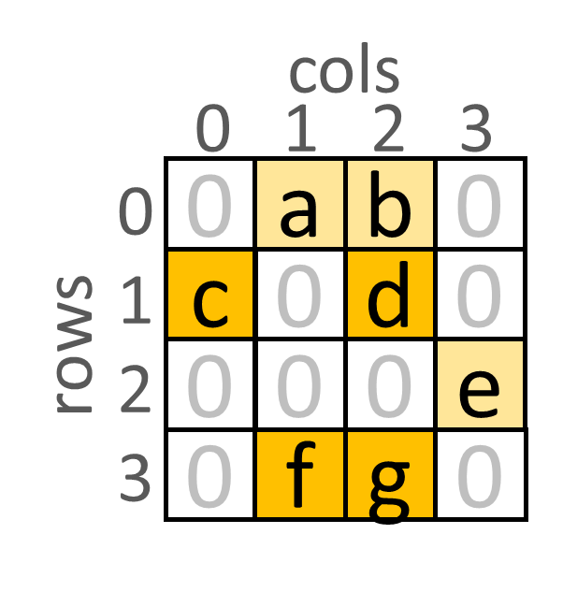
Traversing a sparse matrix in DCL
Compressed Sparse Row (CSR) format
0 1 2 3 4
in DCL
offsets
for i in range(numRows):
for {col, val} in
visit({col, val})
0
2
4
5
7
rows[offsets[i]:
offsets[i+1]]:
rows
1,a
2,b
0,c
2,d
3,e
1,f
2,g
in Core
{coordinate, value} pairs
Memory
1,a
2,b
2,d
4
0,c
2
0
offsets[2]
offsets[0]
offsets[1]
rows[3]
rows[1]
rows[2]
rows[0]
5
0
Range
Range
InputQ
Accessing offsers
OffsetsQ
Accessing rows
RowsQ
Notes:
As an example, now let’s see how DCL can be used to express the traversal of a typical data structure in irregular applications, a sparse matrix.
© The top left figure shows a 4 by 4 sparse matrix with 7 nonzero values. © It is stored as a Compressed Sparse Row (CSR) format in memory, which is a commonly used format for sparse data.
Note that the term compressed here mean the zero values are not explicitly stored. This is different from the data compression exploited in SpZip. We leverage entropy compression to reduce traffic, which works at bit level.
CSR uses two arrays, offsets and rows array. For each row index i, offsets[i] stores the starting location of the i-th row in the rows array. Each entry of the rows array stores the column coordinate of a nonzero element and its value.
© The pseudocode at the top right corner shows the traversal of the sparse matrix in CSR format. The top level for loop enumerates row index, and the second for loop retrieves the stream of coordinate value pair of each row. Finally, some visit function acts on the coordinate value pair.
© This DCL pipeline at the bottom express the traversal of the sparse matrix. It essentially uses two range fetch operator to encode the © two level for loop shown above. © And the CPU core executes the visit function. I’ll now walk through how this DCL pipeline works.
© To start the traversal, the core pushes an index pair 0,5 to the input queue, meaning a traversal of the whole matrix (the input pair can be changed to traverse a tile of the matrix). © The input is then consumed by the first range operator. © Then the operator starts accessing the first element of the offsets array, © the result value 0 is routed to the output queue of the first range operator. © Then the second offset © 2 is also retrieved.
At this moment, the second range operator can start execution. © It interprets the input as an index pair 0,2. This is exactly the offset needed to access the first row. © Therefore, the first entry © 1,a is pushed to the output queue, © followed by the second entry © 2,b.
At the same time, the first range operator continues to traverse the offsets array, © leveraging pipeline parallelism. © Offset 4 is obtained.
Moving back to the second range operator, when the first row is completed, © it drops the index 0, dequeues the offset 4 and construct another index pair 2, 4 by reusing index 2. © Now, it starts traversing the second row, © retrieving entry 0,c and © 2,d. Following similar procedures, the final matrix will be accessed and stored at the output queue of the DCL pipeline, so that the core can later consume them. In this way, the DCL is able to abstract the traversal of data structures by constructing a pipeline of DCL operators. ©

Slide 12
Traversing a sparse matrix in DCL
CSR format
0 1 2 3 4
in DCL
offsets
for i in range(numRows):
for {col, val} in
visit({col, val})
rows[offsets[i]:
offsets[i+1]]:
rows
row0
row1
row2
row3
in Core
uncompressed
Range
Range
InputQ
OffsetsQ
RowsQ
Notes:
Let’s abstract away the value of the matrix and make the DCL pipeline succinct for clarity. I’ll talk about how DCL expresses the decompression operation now.
Suppose we entropy compress each row of this sparse matrix individually. ©

Slide 13
Data decompression support in DCL
CSR with individually compressed rows
0 1 2 3 4
in DCL
offsets
for i in range(numRows):
for {col, val} in
visit({col, val})
rows[offsets[i]:
offsets[i+1]]:
decompress(
)
compressed
rows
row0
row1
row2
row3
in Core
compressed
Range
Range
Decompress
InputQ
OffsetsQ
Compressed
RowsQ
RowsQ
Notes:
For the pseudocode on the right, the change is fairly straightforward. After retrieving the compressed row in the second for loop, © we decompress it first and then enumerate its content.
This idea also applies to the DCL pipeline, where the content of the rows queue is compressed rows, © all we need to do is to append a decompression operator after the second range operator, so that the fetched compressed stream can be transformed into uncompressed stream.
We showed how DCL can be used to express the traversal and decompression of a single entropy compressed sparse matrix. In reality, a lot of irregular applications traverse multiple inter-related data structures. We will show next how DCL is designed to handle this situation using an example graph algorithm. ©

Slide 14
Using DCL in PageRank traversing multiple data structures
contribs
def PageRankIter(Graph g, Array scores,
Array contribs)
for src in range(g.numVertices):
for dst in decompress(g.neighs[g.offsets[src]:
g.offsets[src+1]]):
scores[dst] += contribs[src]
0 1 2 3 4
Graph adjacency matrix
offsets
compressed
neighs
compressed
scores
Source Vertex Data
ContribsQ
Core
Range
Compressed Adjacency Matrix
Range
Range
Decompress
InputQ
OffsetsQ
Compressed
NeighsQ
NeighsQ
Prefetch Destination Vertex Data
Indir
Notes:
Graphs are often represented as sparse matrix in CSR format, which is called graph adjacency matrix.
© The top right corner shows the psudocode of 1 iteration of PageRank algorithm on this graph, which aims to rank each vertex in the graph. The execution of PageRank involves three data structures, the graph adjacency matrix, © the source vertex data contribs array in purple, © and the destination vertex data scores array in cyan.
Identical to the traversal example we see in the previous slide, © the two level for loop in PageRank traverses the graph adjacency matrix. Therefore, we reuse © the DCL pipeline we’ve built so far to represent this traversal.
© PageRank traverses the contribs array and offsets array of the graph using the same index. In order to represent this access pattern, © we devote another range operator to fetch the source vertex data contribs array. This range operator shares the same input queue as adjacency matrix pipeline.
© PageRank traverses the graph adjacency matrix to obtain the neighbor vertex ids, and uses these ids to index into the scores array. Therefore, the DCL pipeline for the destination vertex data, the scores array, © uses the result of the adjacency matrix pipeline. It drives another indirection operator to prefetch the content of scores array.
PageRank applies atomic read-modify-write to the destination vertex data. Instead of fetching a read only copy of it, we only prefetch the data to the cache and let the core handle atomic operations.
The final DCL pipeline is able to traverse and decompress all three inter-related data structures in PageRank.
© The core can then consume the output queue of the DCL pipeline and carry out computation on those fetched and decompressed data. ©

Slide 15
Agenda
Motivation
SpZip Dataflow Configuration Language (DCL)
SpZip Design
Evaluation
Notes:
Now let’s see SpZip’s hardware design. ©

Slide 16
SpZip Overview
SpZip augments each CPU core with a programmable fetcher and compressor
The fetcher accelerates data structure traversal and decompression
Main Memory
LLC
L2
L2
…
L1
Fetcher
Compressor
L1
Fetcher
Compressor
Core
Core
The compressor compresses newly generated data before storing it off-chip
Fetcher and compressor issue conventional cache line requests
Notes:
SpZip augments each CPU core with a programmable fetcher and compressor.
© The fetcher accelerates data structure traversal and decompression, which has been our focus so far.
© SpZip hardware also accelerates data compression in the compressor. It compresses newly generated data before storing it off-chip.
© Fetcher and compressor issue conventional cache line requests and do not require cache modifications. ©

Slide 17
SpZip exploits decoupled execution
The fetcher and compressor communicate with core through queues to exploit decoupled execution
L1
Fetcher
Compressor
Core
The fetcher runs ahead of the core to traverse and decompress data, hiding memory access and decompression latencies
Notes:
The fetcher and compressor communicate with core through queues to exploit decoupled execution.
© The fetcher runs ahead of the core to traverse and decompress data, hiding memory access and decompression latencies. The core then consumes the output queue of the fetcher and uses the data in computation.
The fetcher and compressor also uses decoupled execution internally to leverage pipeline parallelism as we will see next. ©

Slide 18
SpZip fetcher microarchitecture
Access Unit and Decompression Unit implement DCL operators
Scratchpad holds queues between operators
Queues between operators allow pipeline parallelism
L2
Fetcher
Access Unit
Decomp. Unit
Scheduler
…
Range
Indir
Delta
BPC
ctxt 0
ctxt k
…
Scratchpad
q0
q1
q2
qn
Core
Notes:
Here is the fetcher microarchitecture. The SpZip fetcher implements DCL program which traverses and decompresses data structures in irregular applications.
© The access unit implements the DCL range and indirection operators. The decompression unit supports the decoding of two existing efficient compression format, delta encoding and BPC encoding.
© An internal scratchpad holds the queues between DCL operators.
© Using queues between DCL operators allow pipeline parallelism to improve traversal and decompression throughput. ©

Slide 19
SpZip fetcher is programmable
Scratchpad is configurable to support variable numbers and sizes of queues
DCL operators are time-multiplexed on the same physical unit
Scheduler holds operator contexts and chooses which operator to fire each cycle
L2
Fetcher
Access Unit
Decomp. Unit
Scheduler
…
Range
Indir
Delta
BPC
ctxt 0
ctxt k
…
Scratchpad
q0
q1
q2
qn
Core
ctxt 0
ctxt 1
Range
Range
Decompress
Range
Range
InputQ
OffsetsQ
Compressed
NeighsQ
NeighsQ
Notes:
The SpZip fetcher is programmable to support arbitrary DCL programs.
© First of all, the scratchpad is configurable so that it can support variable numbers and sizes of queues.
© Second, multiple DCL operators are time-multiplexed on the same physical unit. © Below shows the DCL pipeline we use to traverse the compressed sparse matrix. © The two range operators execute on the same physical access unit. They differentiate with each other by specifying © different input and output queue ids, so that the access unit can consume and generate data to the correct queues. © The same is true if we have multiple decompression operators in a program. In our profiling, one physical unit can offer sufficient memory level parallelism.
© The scheduler holds operator contexts. It chooses the next operator to fire dynamically, among ready ones. Example operator context includes the input output queue ids and the type of the operator. © The red and green boxes show the contexts of the two range operators.
By configuring the scheduler with different operator contexts, the SpZip fetcher can execute arbitrary DCL programs. ©

Slide 20
SpZip compressor overview
Compression uses a different set of DCL operators
Similar decoupled and programmable design as the fetcher
See paper for more details
StreamWr
MemQ
Compress
LLC
SWU
Compressor
MQU
Compress
Unit
Scheduler
…
ctxt 0
ctxt k
…
Scratchpad
q0
q1
q2
qn
Core
Notes:
The SpZip compressor supports © a different set of DCL operators in order to compress newly generated data.
© It adopts a similar decoupled and programmable design as the fetcher. Please see the paper for more details. ©

Slide 21
Agenda
Motivation
SpZip Dataflow Configuration Language (DCL)
SpZip Design
Evaluation
Notes:
Finally, let’s move onto the evaluation. ©

Slide 22
Evaluation Methodology
Event-driven simulation using ZSim
SpZip system
16 Haswell-like OOO cores
32 MB L3 cache
4 memory controllers (51.2GB/s)
SpZip adds 0.2% area overhead of per-core fetcher and compressor
Irregular applications
PageRank, PageRank Delta, Connected Components, Radii Estimation, BFS, Degree Counting, SPMV
Large real world inputs
Up to 100 million vertices
Up to 1 billion edges
Notes:
We evaluate SpZip using simulations on zsim.
© The simulated system has 16 Haswell-like OOO cores with 32 MB L3 cache. 4 memory controllers provide 51.2GB/s bandwidth. RTL synthesis shows the SpZip per-core fetcher and compressor only add 0.2% area overhead.
© 7 irregular applications are evaluated © on large real world inputs. ©

Slide 23
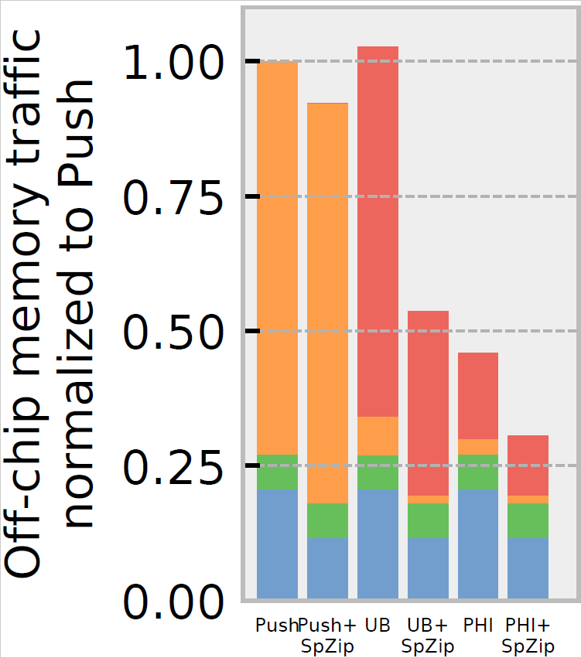
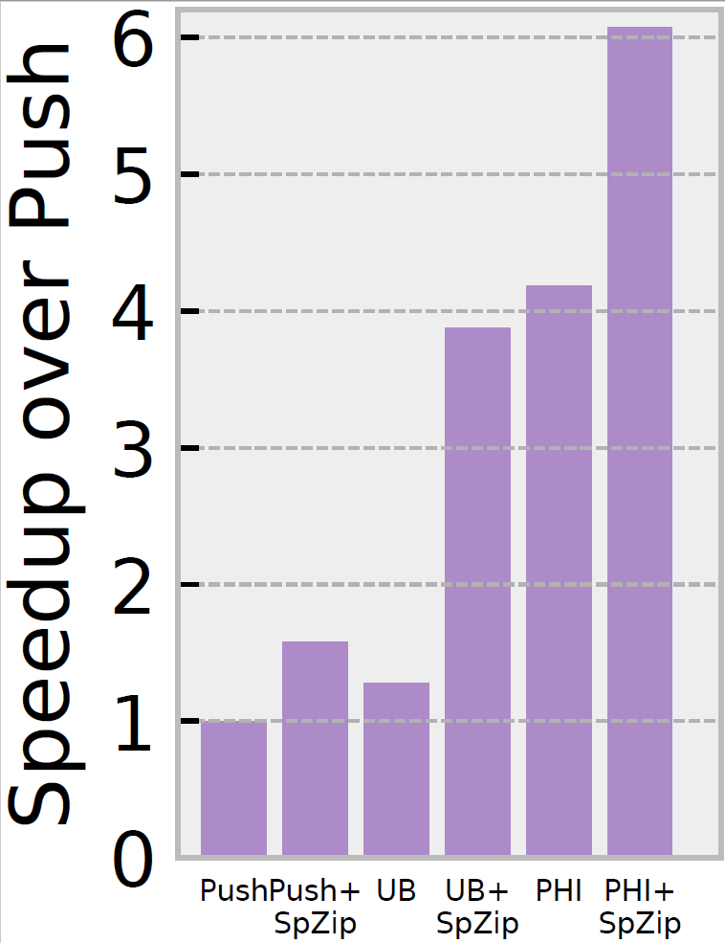
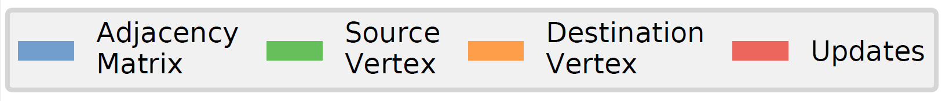
SpZip improves performance and reduces traffic
Notes:
For one application, there are multiple execution strategies. We evaluate 3 baseline execution strategies for irregular applications. SpZip works on all three execution strategies, but optimized strategies offer additional compression opportunities. Therefore, we augment SpZip with the three baselines and evaluate three additional schemes. On the left we have off-chip memory traffic breakdown by 4 data structures: the adjacency matrix, source vertex data, destination vertex data, and updates, lower is better. We report the performance on the right. The results are averaged across all applications and inputs.
Push is the basic execution strategy where each source vertex pushes and applies its update to destination vertices directly. The PageRank example we’ve seen before uses Push execution strategy.
Push’s traffic is dominated by destination vertex data.
© Push+Spzip doesn’t reduces memory traffic much, because the accesses to destination vertex data have poor locality and are hard to compress.
© However, it still accelerates Push by 1.6x through decoupled execution, which hides memory access latency.
Push suffers from poor locality accesses of destination vertex data. © Update Batching (UB), also known as propagation blocking, is a software execution strategy that improves the locality of Push. It converts the scattered accesses of destination vertex data into streams of updates.
© UB improves performance of Push by 30% due to better locality.
Because of the improved access locality of updates, they are sequentially accessed and therefore can be compressed very well.
© UB+SpZip drastically reduces traffic of updates and adjacency matrix through data compression.
© It is 3 times faster than UB thanks to compression.
Though UB improves access locality, it still saturates memory bandwidth. © PHI is a prior hardware technique which tries to reduce traffic of UB to further improve performance. It reduces the number of updates in UB by coalescing those updates in cache before they are streamed to the main memory.
© PHI achieves a similar speedup compared to UB+SpZip, but unlike SpZip, PHI requires modifications to the internals of the cache.
© Finally, SpZip is still able to compress all data structures in PHI and achieves the lowest traffic, 3.3x lower than Push.
© Therefore, PHI+SpZip further improves performance by 1.5x over PHI, making it the fastest among all execution strategies. It is 6.1x faster than Push on average. ©

Slide 24
See paper for
DCL support for compressing data structures
Programmable compressor design
Additional evaluation results
Impact of preprocessing
Benefits over compressed memory hierarchies
Impact of decoupled fetching vs data compression
Notes:
We’ve focused on the data decompression side of SpZip in this talk. The DCL and SpZip hardware also supports data compression with a different set of operators and hardware unit. Please refer to the paper for more details.
We also present additional evaluation results in the paper.

Slide 25
Conclusions
Irregular applications have indirect, data-dependent memory access patterns that make compression challenging
SpZip makes data compression practical for irregular applications
Decoupled execution hides memory access and decompression latencies
DCL and programmable design support wide range of data structures and compression formats
SpZip achieves significant speedups and memory traffic reductions on irregular applications
Notes:
To conclude, © Irregular applications have indirect, data-dependent memory access patterns that make compression challenging.
© We present SpZip, an architectural approach that makes data compression practical for irregular applications.
© SpZip leverages decoupled execution to hide memory access and decompression latencies.
© The novel Dataflow Configuration Language and programmable hardware design support a wide range of data structures and compression formats.
© SpZip achieves significant speedups and memory traffic reductions on irregular applications.

Slide 26
Thanks For Your Attention!
ISCA 2021
Session 12B (June 16, 2021 at 8 PM EDT)
Notes:
Thank you! And please join us for our live Q&A session on June 16th.

Slide 27
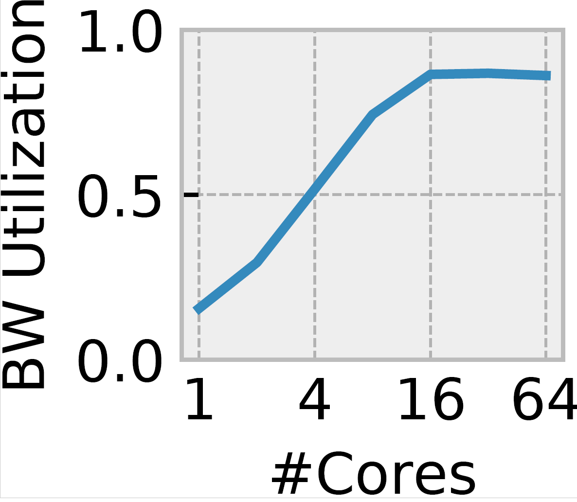
Irregular applications are memory bandwidth bound
Irregular applications, such as graph analytics and sparse linear algebra, are an increasingly important workload domain
Data compression is an attractive approach to accelerate irregular applications
Social network analysis
Navigation
Scientific computing
Irregular applications are memory bandwidth bound
Notes:
Irregular applications, like graph analytics and sparse linear algebra, are an increasingly important workload domain. As they are widely used in © social network analysis, © navigation, © scientific computing, etc.
© The figure on the right shows the memory bandwidth utilization of an irregular application PageRank on Graph uk2005. If we increase the number of cores from 1 to 64, the memory bandwidth is saturated at around 16 cores. We see similar behaviors on other applications.
© This suggests that irregular applications are memory bandwidth bound.
© Data compression is an attractive approach to alleviate this bandwidth bottleneck and therefore will accelerate irregular applications. ©

Slide 28
Data compression support in DCL (See paper for details)
Compressing one stream
Memory
Compress
StreamWr
InputQ
Compressed ChunkQ
Compressing multiple streams
Memory
…
Uncompressed streams
Compressed streams
…
MemQ
Compress
MemQ
InputQ
Uncompressed chunkQ
Compressed chunkQ
Notes:
We’ve so far focused on the decompression side of DCL. It also supports data compression. DCL is capable of expressing the compression of © single or © multiple streams of data. It requires a different set of DCL operators. Please see the paper for more details. ©

Slide 29
SpZip Overview
SpZip augments each CPU core with a programmable fetcher and compressor
Fetcher accelerates data structure traversal and decompression
Main Memory
LLC
L2
L2
…
L1
Fetch & Decompress
Compressor
L1
Fetch & Decompress
Compressor
Core
Core
Compressor compresses newly generated data before storing it off-chip
Fetcher and compressor interact with memory system through conventional load and store interface
Notes:
SpZip augments each CPU core with a programmable fetcher and compressor.
© Fetcher accelerates data structure traversal and decompression.
© Compressor compresses newly generated data before storing it off-chip.
© Fetcher and compressor interact with memory system through conventional load and store interface, which don’t modify the internals of the cache. ©

Slide 30
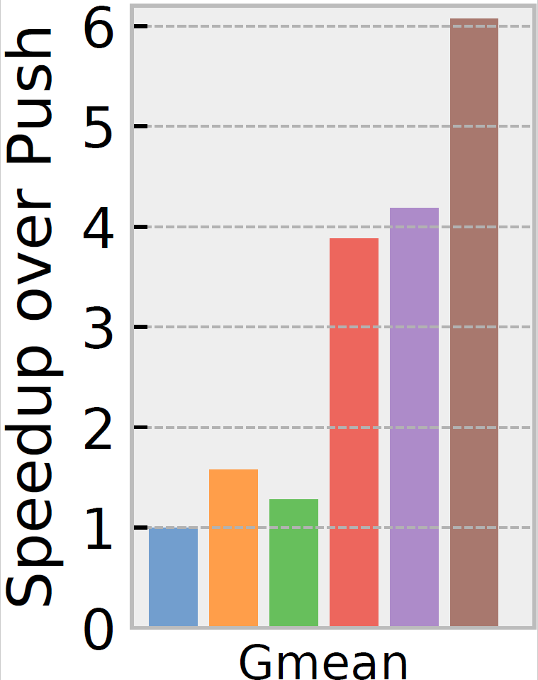

SpZip accelerates all baselines significantly
3 Baselines:
Push (Source-stationary): Each source vertices pushes and applies its update to neighbor vertices.
Update Batching (UB, or Propagation Blocking [IPDPS’17]): 2-phase software optimization to improve locality of Push. Buffer all updates from source vertex in the first phase. Reduce them according to destination vertex in the second phase.
PHI [MICRO’19]: Hardware technique builds on UB. Partially coalesce updates in cache in the first phase to reduce traffic.
Notes:
We show the performance numbers of 6 schemes, including 3 baselines execution strategies for irregular applications.
SpZip’s data compression is orthogonal to these baselines. Therefore, we augment SpZip with these three baselines and evaluate their performance.
Push or source stationary is the basic execution strategy where each source vertex pushes and applies its update to neighbor vertices directly. This is similar to the PageRank example we’ve seen before. The performance numbers are averaged across all applications and normalized to push.
© SpZip+Push accelerates Push by 1.6x through decoupled execution, which hides memory access latency.
© Update batching or propagation blocking is a 2-phase software optimization to improve the memory access locality of Push. It buffers all updates from source vertex in the first phase, then reduces them according to the destination vertex id in the second phase.
© UB improves performance by 30% due to better locality.
© SpZip+UB’s speedup is comparable with PHI thanks to traffic reduction by compression, but unlike PHI, SpZip does not modify the internals of cache.
© PHI is a prior hardware technique which builds on UB. It partially coalesces updates in cache in the first phase to reduce traffic.
© PHI further speeds up UB by 3.3x thanks to reduced memory traffic.
© SpZip+PHI further improves performance by 1.5x over PHI, making it the fastest among all execution strategies. It is 6.1x faster than Push on average. ©

Slide 31
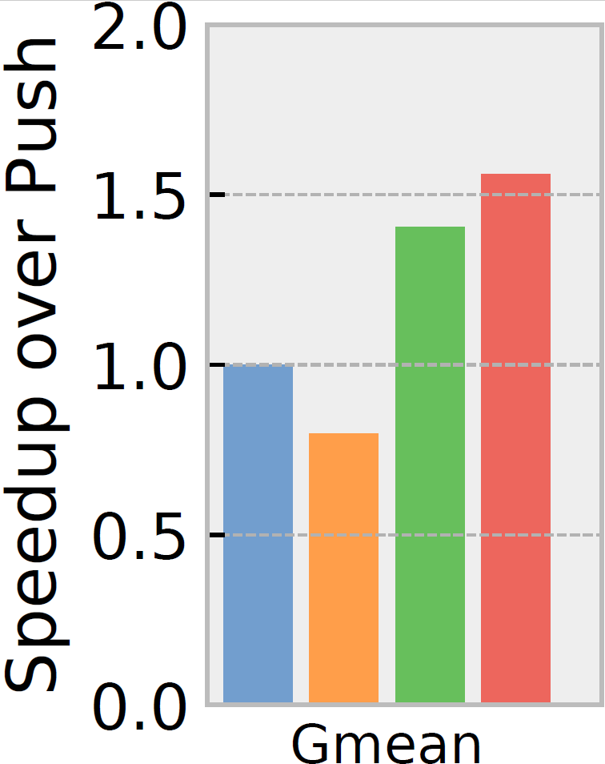
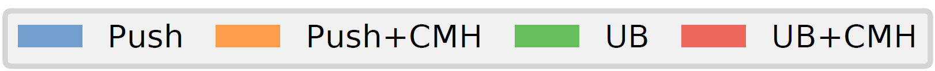
SpZip works better than CMH on irregular applications
Compressed Memory Hierarchy (CMH)
BDI[PACT’12] LLC
LCP[MICRO’13] main memory
Notes:
We also compare SpZip with prior compressed memory hierarchy system, with a BDI compressed LLC and LCP compressed main memory.
We evaluate the software only Push and UB with the same methodology.
© Push+CMH performs worse due to increased memory access and decompression latencies. CMH doesn’t exploit decoupling.
© UB+CMH speeds up UB by only 11% compared to 3x in SpZip. This is because the CMH’s data compression is not tailored for the access pattern of irregular applications and is not aware of application semantics. ©

