Slide 1
ISOSceles: Accelerating Sparse CNNs through Inter-Layer Pipelining
Yifan Yang, Joel S. Emer, Daniel Sanchez
HPCA 2023
Session 4A (February 28, 2023)
Notes:
Hi! My name is Yifan Yang. It is my great pleasure to present ISOSceles: Accelerating Sparse CNNs through Inter-Layer Pipelining. This work is done in collaboration with Professor Joel Emer, and Professor Daniel Sanchez at MIT. ©

Slide 2
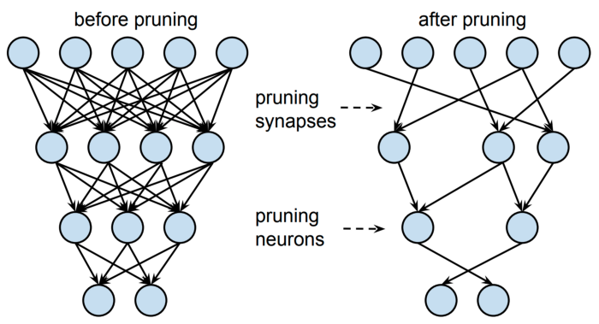
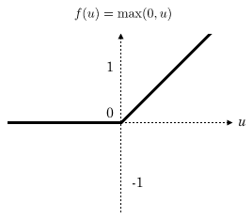
Sparsity improves CNN inference efficiency
CNNs show good performance at many tasks but require lots of compute
Leveraging sparsity significantly improve its efficiency
Reduce data movement by not storing/transferring zero values
Avoid ineffectual computation by skipping multiplies/adds with zero
Sparsity arises from two sources
×
×
Weight sparsity: pruning
Activation sparsity: ReLU, etc.
Notes:
© CNNs show good performance at many machine learning tasks but they require lots of compute. © If there is sparsity in the CNN, we can dramatically improve its efficiency. There are two ways of leveraging sparsity. © Data movement can be reduced by not storing or transferring zero values. In this example, white boxes represent zero values. We compress the sparse vector on the left to a smaller compressed sparse vector on the right, so that we do not need to store and transfer zero values. © We can also avoid ineffectual work by skipping multiplies and adds with zero. In this example we are doing a dot product of two sparse vectors. Only two out of 8 multiplications are effectual. Exploiting sparsity can save 75% of compute. © Fortunately, there are plenty of sparsity in CNNs from two sources. © Pruning results in weight sparsity © and activation functions like ReLU result in activation sparsity. ©

Slide 3


Challenges of sparse processing
Sparse CNNs have low data reuse due to lots of ineffectual work
Low arithmetic intensity: 10x lower in sparse ResNet-50 vs dense ResNet-50
Sparse CNN inference is bounded by data movement
activations
input
filter
input
filter
$$⊗$$
$$⊗$$
9 mul/input
2 mul/input
Most accelerators process CNNs layer by layer
Intermediate activations between layers are large and spilled off-chip
[MICRO 19]
(Ours)
Notes:
Eliminating ineffectual work is good, © but the down side is it reduces data reuse in sparse CNNs. In the example we show below, we are convolving input activation with filters. In the dense case on the left we have 9 multiplications per input. However, with sparsity, we only have 2 multiplications per input. The reuse factor of input is lowered. © In other words, this lowers the arithmetic intensity of CNN inference. For instance, sparsifying a ResNet-50 model reduces its arithmetic intensity by a factor of 10. © In the roofline analysis, the reduced arithmetic intensity pushes sparse CNN inference into memory bound region, which mandates us to find ways to reduce off-chip memory traffic in order to improve the performance of sparse CNNs. To do so we first need to find out the primary contributor of off-chip traffic. © Here we show the off-chip memory traffic breakdown by datatype of a state-of-the-art sparse accelerator SparTen. © We can see that input and output activation dominate traffic. © This is because these accelerators process CNNs layer by layer. © Intermediate activations between layers are so large and are therefore spilled off-chip. ©

Slide 4
Our solution
Key insight: pipelining the execution of multiple layers effectively reduces activation traffic
Intermediate activations are consumed immediately without spilling them off-chip
A dataflow, IS-OS, that allows efficient pipelining of sparse layers
A hardware accelerator, ISOSceles, that implements the dataflow
[MICRO 19]
(Ours)
Notes:
Our key insight is that pipelining the execution of multiple layers effectively reduces the activation traffic. © By directly forwarding the output activation of the previous layer to the next layer on-chip, we avoid the spilling and save traffic. © We first propose a dataflow called IS-OS, that allows efficient pipelining of multiple sparse layers. © We then design the ISOSceles hardware accelerator that implements this novel dataflow. © Therefore, ISOSceles leverages inter-layer pipelining and dramatically reduces activation traffic over sparten. Thanks to the reduced traffic in this memory bound application, ISOSceles is gmean 4.3x faster than SparTen. ©

Slide 5
IS-OS dataflow overview
Each layer consumes inputs and produces outputs in thin wavefronts
Input-stationary (IS): each input wavefront is fully used with all relevant filters before moving onto next wavefront
Output-stationary (OS): each output wavefront is fully accumulated before moving onto next wavefront
We call this dataflow input-stationary output-stationary (IS-OS)
Notes:
Through the animation below, we first show a simplified version of our IS-OS dataflow to give you an overview. We focus on the first layer as the dataflow is identical on all layers. All of the dimensions are marked with capital letters. Green represents the filters. Blue represents input activations and red represents output activations. © In our dataflow, each layer consumes inputs and produces outputs in this thin wavefront shape, advancing through the activation column dimension W and Q. As you can immediately see, the dataflow has two characteristics. © It is firstly input stationary, meaning that each input wavefront is fully used with all relevant filter weights before moving onto next input wavefront. We do not need to revisit the same input wavefront. © Similarly, the dataflow is output stationary, meaning that each output wavefront is fully accumulated before moving onto next wavefront. © So we call this the input-stationary output-stationary (IS-OS) dataflow. Naturally the next question you would ask is why does this dataflow allow inter-layer pipelining? © Now we show two layers. Layer 1 produces one output wavefront which becomes the input wavefront of layer 2. Because layer 2 is input stationary, it only needs the input wavefront once. Layer 1 could generate its output wavefront and directly forward that to layer 2 on-chip without needing to save a copy of it off-chip. Similarly, layer 2 generates its output activation in the same wavefront shape, which can be directly consumed by the next layer on-chip. In this way, all of the intermediate activations are generated and fully consumed on-chip. We only need to read the input activation of the first layer from off-chip and write the output activation of the last layer to off-chip, dramatically saving off-chip memory traffic. ©

Slide 6


Comparison with prior work
IS-OS dataflow
Fused-Layer^{[MICRO 16]} OS dataflow
Good input & output reuse
Poor input reuse
Small intermediate storage
Large intermediate storage
Sparsity friendly
Sparsity unfriendly
Notes:
There are prior work which tries to pipeline multiple layers and we’ll now compare it against our IS-OS dataflow. © Here we show the case where 4 sparse layers are pipelined. The grey area shows the input and output activation we consume and produce at each step. Because of the input activation sparsity, you can see in our example that only a fraction of pixels in each wavefront is non-zero. © Fused-Layer accelerator is a representative prior accelerator that tries to pipeline multiple layers. It is designed for dense CNN though. © Fused-Layer uses output stationary dataflow, which means that it intrinsically exhibits poor input reuse. © Our input stationary output stationary dataflow shows good reuse on both input and output activations. Secondly, due to the nature of convolution, output tiles are smaller than input tiles. Therefore, the activations consumed and produced at each step in fused layer form this pyramid like shape with the first layer having the largest activation tile. © This suggests that accelerator either needs to use large on-chip buffers to hold the activation values or recompute them. © Our dataflow, thanks to the wavefront shape, only needs small intermediate storage. © Finally, the fused layer dataflow is optimized for dense CNNs and shows random and irregular memory access patterns if the activation is sparse. Irregular accesses into sparse data structures are very expensive and inefficient. © Our IS-OS dataflow only has sequential traversal of the sparse input and output activation data and therefore is very efficient and sparsity friendly. ©

Slide 7
IS-OS dataflow details
Wavefront advances through channel dimension (C, K) and then column dimension (W, Q)
At each step, one input wavefront is consumed, one output wavefront is produced
Notes:
Now I’ll walk you through the details of our IS-OS dataflow. © Below we show a more realistic example over the previous one. Here we introduce the channel dimension C and K. © The wavefront is first advancing through channel dimension C and then column dimension W. Note that input and output wavefront channels don’t need to be in sync as there is no one to one correspondence between input channel and output channel in normal convolution. © At each step, one input wavefront is consumed with the corresponding filter weights in the same input channel C. One output wavefront is produced at each step. ©

Slide 8
IS-OS dataflow breakdown
Input wavefront
IS frontend
Partial results
OS backend
Output wavefront
Filters
pipeline
Small
pipeline
Notes:
We implement the IS-OS dataflow with two pipeline stages. © An input stationary frontend, IS, and an output stationary backend, OS. The IS frontend multiplies input wavefront with corresponding filters. It then partially accumulates and stores partial results to a partial result buffer. The OS backend then takes in partial results and fully accumulates output wavefronts from different locations in the buffer. The key insight here is we can © pipeline the frontend and backend so that © the partial result size is small. Finally, the output wavefront is forwarded on-chip to the next layer as its input wavefront. Next we will introduce the details of frontend and backend and its corresponding accelerator implementation called ISOSceles. ©

Slide 9
IS frontend and hardware implementation
Sequential traversal of sparse input activations and filters
Cartesian product between input wavefront and filter weights
Partial accumulation on filter width S dimension
Memory
Filter Buffer
IS Frontend
OS Backend
Fetch I
Fetch F
PE
Array
K*R streams
…
Partial results
Notes:
We now introduce the details of the IS frontend in conjunction with its hardware implementation. © A fetcher sequentially traverse sparse input activation wavefront by wavefront from off-chip memory enabled by the dataflow. The input stationary nature of the dataflow guarantees that input activations only need to be streamed on-chip once. © The frontend then fetches filter weights in the same input channel from the on-chip filter buffer. Because filters can be pruned to be very sparse, we can afford to buffer all of the filter weights on-chip. © Then the IS frontend multiplies each input activation with K*R*S filter weights in the cartesian product way in the PE array consisting of multiply and accumulate units. © The products are accumulated along the S dimension and buffer in partial result buffers. After S accumulation, the partial results contain K*R sequential streams waiting to be consumed by the backend. ©

Slide 10
OS backend and hardware implementation
Accumulation on filter height R dimension from non-contiguous partial result streams using merger
Output wavefront order transformation using high-radix merger
Sparse output wavefront written off-chip sequentially
Input can come from previous layer and output can go to next layer on-chip
Memory
Filter Buffer
IS Frontend
OS Backend
Fetch I
Write O
Fetch F
K-merge
POU
To next layer
From previous layer
PE
Array
R-merge
+
K*R streams
…
Partial results
Notes:
The OS backend finishes the partial results accumulation and produces output wavefront by wavefront. © For each output channel, the partial results need to be accumulated on the filter height R dimension, which means that the backend will merge and reduce R sparse non-contiguous partial result streams. The R merger and accumulator fetches, merges and reduces R corresponding streams from the partial result buffer. The traversal of each stream is sequential and efficient. Indexing into R partial result streams is non trivial and we will address this later with our NoC design. This produces output activation wavefront in the column Q first and channel K second order. © Because we need to keep the consistent input output wavefront order to allow arbitrary pipeline depth. A high-radix K merger serves as a transposition unit that transforms sparse output wavefront into channel K first and column Q second order, matching the input wavefront order of the next layer. The output activations finally goes through the point wise operation unit or POU, which performs operations like batch normalization and relu. © Similar to the input activation, the sparse output activations are also generated sequentially, admitting simple hardware implementations. The final output activation wavefront is written back to off-chip memory sequentially. © This implementation also supports pipelining multiple layers by having the input activation consuming wavefronts from previous layer on-chip and having output activation forwarded to the next layer on-chip. ©

Slide 11
Lanes and NoC overview
Each input pixel in the wavefront is processed mostly independently
Partition the hardware into lanes, each lane processes one activation row
NoC fan-in and fan-out are low
…
…
…
…
IS Frontend
OS Backend
I₄
Lane 4
Lane 4
O₄
I₅
Lane 5
Lane 5
O₅
I₆
Lane 6
Lane 6
O₆
…
…
…
…
Notes:
This hardware process input activation at wavefront granularity. An input activation wavefront is comprised of input pixels at different rows. © We observe that the processing of these pixels are largely independent. The same argument applies to output wavefront. © Therefore we partition the IS frontend and OS backend by lanes. Each frontend lane consumes one input pixel in a specific row in one step. Each backend lane produces one output pixel in a specific row in one step. These lanes in conjuncture consume and produce one wavefront per step. Cross lane communication is only needed when we accumulate partial results on the filter height R dimension in the backend. © With the lane architecture, each backend lane only needs to connect to 3-5 nearby frontend lane, so the NoC fan-in and fan-out of this cross-lane communication is low. ©

Slide 12
Pipelining multiple layers
Inter-layer queues hold intermediate activations
Time-multiplex PE array among layers to improve utilization
Dynamic scheduler ensures load balancing
Programmable interconnect enable flexible mapping of CNN models
IS Frontend
OS Backend
Scheduler
PE Context
Programmable Interconnect
Inter-layer queues
Notes:
So far we have introduced how the ISOSceles hardware processes one sparse CNN layer using the input stationary output-stationary dataflow. Now I will present the techniques that allows the accelerator to efficiently pipeline multiple layers on-chip. © We add the inter-layer queues to buffer the intermediate activations between layers. We observe that a single layer can not fully utilize the PE array. © So we propose to time-multiplex the PE array among all layers to improves its utilization and amortize the load variation induced by sparsity. © And a dynamic scheduler decides how many PEs to allocate to a layer every 100 cycles to ensure load balancing. © Finally, we introduce a programmable interconnect that allows diverse CNN models to be mapped to ISOSceles. ©

Slide 13
See paper for
Loop nest description of the IS-OS dataflow
Inter-lane communication in ISOSceles
Handling different layer sizes and types
Tiling, fully connected layer, depth-wise convolution, etc.
How to map sparse CNN models to ISOSceles
Notes:
We have many more details in the paper, including the precise loop nest description of the IS-OS dataflow, inter-lane communication in ISOSceles, how ISOSceles handles different layer sizes and types such as tiling, fully connected layer, and depth-wise convolution, and how to map sparse CNN models to ISOSceles. Please refer to the paper for more details. ©

Slide 14
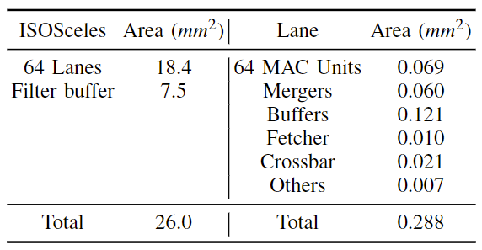
Evaluation Methodology
Modeled system
4096 8b MAC units
2MB on-chip buffer
64 lanes
128GB/s HBM
1GHz
Area breakdown of ISOSceles at 45nm technology
Baselines (scaled to ISOSceles resources)
Fused-Layer^{[MICRO 16]}: a dense accelerator using tiled inter-layer pipelining
SparTen^{[MICRO 19]}: a single-layer sparse accelerator
Benchmarks
ResNet-50, MobileNetV1, VGG-16, GoogLeNet with various levels of weight and activation sparsity
Pipeline as deep as hardware resource permits (2-15 layers)
Notes:
© We model ISOSceles in a cycle level simulator. The accelerator contains 4096 8b multiply and accumulate units, 2MB total on-chip buffer, 64 lanes, 128GB/s high bandwidth memory and runs at 1GHz. © We synthesize the system at 45nm technology. Results show that it’s a small accelerator. © We compare ISOSceles with two baselines. Both are scaled to match ISOSceles’s resources. Fused layer is a dense accelerator using tiled inter-layer pipelining. SparTen is a state-of-the-art single layer sparse accelerator. © We run 11 benchmarks, 6 ResNet-50, 2 MobileNetV1, 2 VGG-16, and 1 GoogLeNet with variable levels of weight and activation sparsity. We pipeline as deep as the hardware resource permits, which ranges from 2-15 layers for ISOSceles and fused layer. ©

Slide 15
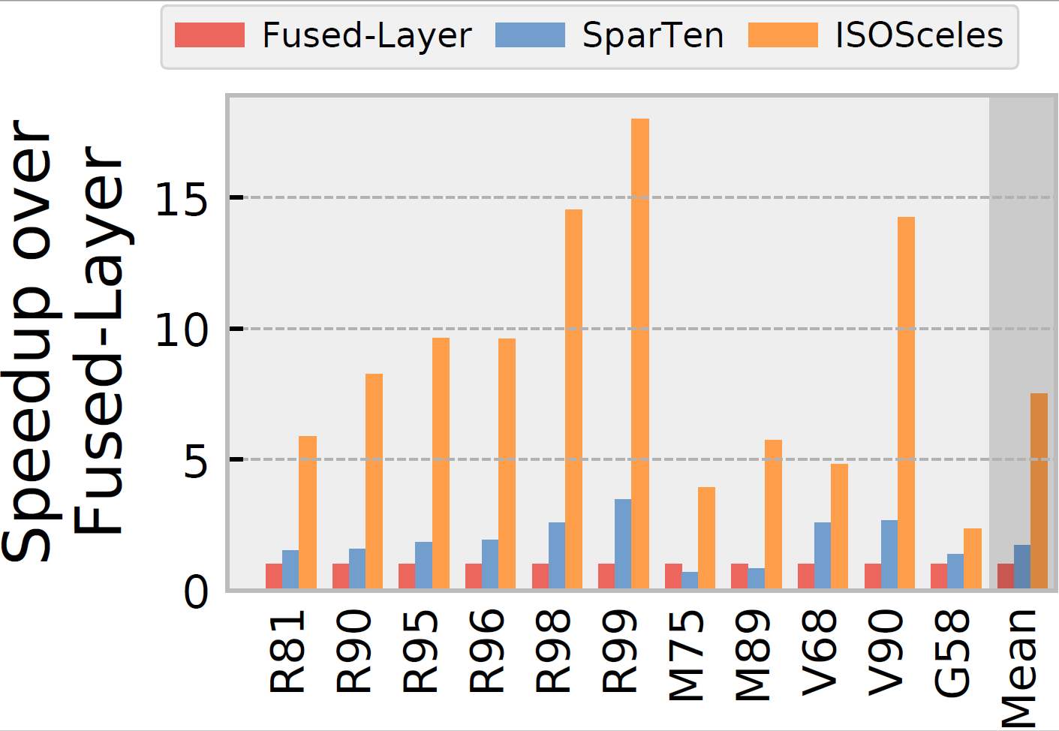
Speedup over Fused-Layer
7.5
1.7
Notes:
We first show the speedup of ISOSceles and SparTen over fused-layer. X axis is different sparse CNNs. By leveraging weight and activation sparsity, ISOSceles outperforms Fused-Layer by gmean 7.5x and SparTen outperforms Fused layer by 1.7x. This shows the huge performance potentials of leveraging sparsity. By leveraging inter-layer pipelining, ISOSceles outperforms SparTen by gmean 4.3x. Inter-layer pipelining effectively alleviates the memory bottleneck of sparse CNN accelerators. ©

Slide 16
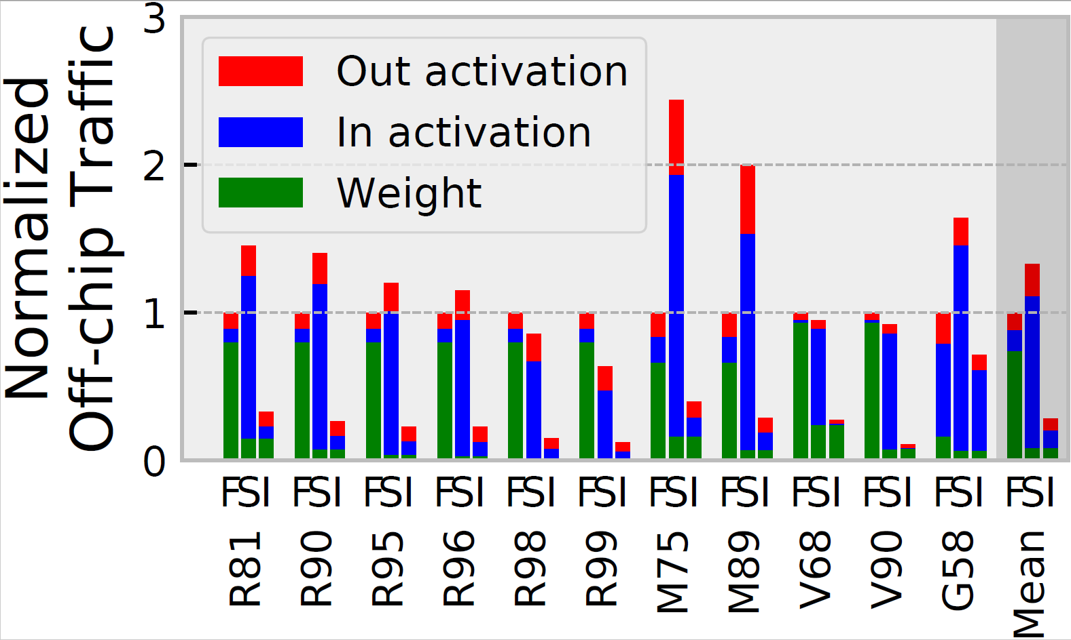
Off-chip traffic normalized to Fused-Layer
Notes:
Now we show the off-chip memory traffic normalized to fused layer. Lower is better. F is fused layer, S is sparten, I is ISOSceles. Traffic is broken down by datatypes, blue is input activation, green is filter weight and red is output activation. ISOSceles enjoys 3.6× less traffic than Fused-Layer, and 4.7× less traffic than SparTen, highlighting the synergy between inter-layer pipelining and sparsity. Thanks to pipelining, Fused-Layer features little activation traffic. But Fused-Layer is dominated by weight traffic shown in green, since weights are dense. SparTen has much lower weight traffic owing to its use of sparsity. But SparTen is dominated by activation traffic shown in blue and red since it does not pipeline layers. With the help of weight sparsity that reduces weight traffic and inter-layer pipelining that reduces activation traffic, ISOSceles enjoys the lowest traffic among all accelerators. ©

Slide 17
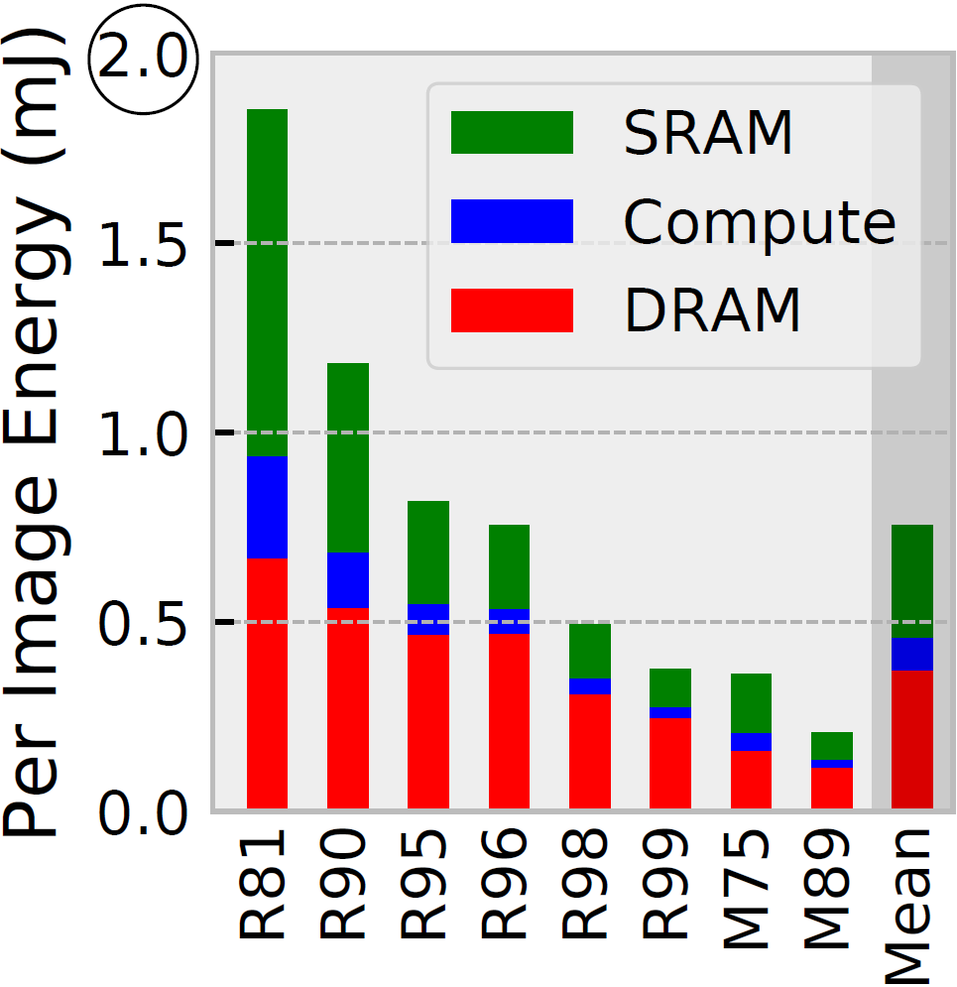
ISOSceles energy breakdown
Notes:
Finally, we show the energy per end-to-end inference on ResNet and MobileNet broken down by components. We use a commercial 12-14nm technology. Overall, DRAM energy dominates, especially for sparser networks. This shows that reducing DRAM traffic through inter-layer pipelining is the correct way to improve energy efficiency on sparse CNN inference. Without inter-layer pipelining, the other accelerators will be even more severely dominated by DRAM energy, even if their on-chip structures are simpler. ©

Slide 18
Conclusions
Sparse CNNs are memory bound due to limited data reuse
Inter-layer pipelining is an effective way to reduce traffic and improve performance of sparse CNN inference
The input-stationary output-stationary (IS-OS) dataflow allows pipelining with minimal intermediate state
The ISOSceles accelerator implements IS-OS dataflow and uses time-multiplexing to alleviate load imbalance
ISOSceles significantly outperforms state-of-the-art dense and sparse accelerators
Notes:
To conclude, © Sparse CNNs are memory bound due to limited data reuse.
© We have shown that inter-layer pipelining is an effective way to reduce traffic and improve performance of sparse CNN inference.
© We proposed the input-stationary output-stationary (IS-OS) dataflow allows pipelining multiple sparse CNN layers with minimal intermediate state.
© We also presented the the ISOSceles accelerator that implements IS-OS dataflow efficiently and uses time-multiplexing to alleviate load imbalance caused by sparsity.
© Evaluation shows that ISOSceles significantly outperforms state-of-the-art dense and sparse accelerators and dramatically reduces off-chip memory traffic. ©

Slide 19
Thanks For Your Attention!
Notes:
Thank you!

