Slide 1
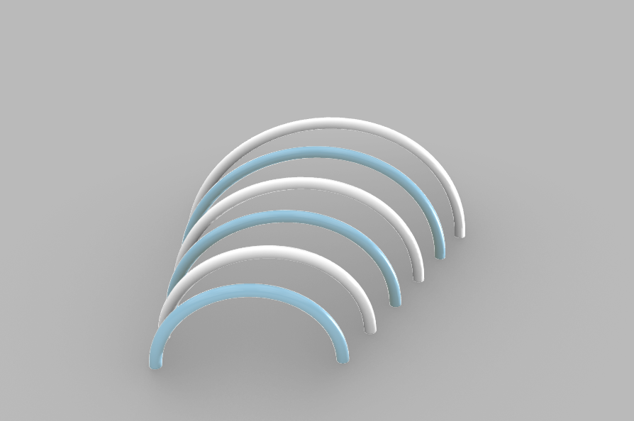
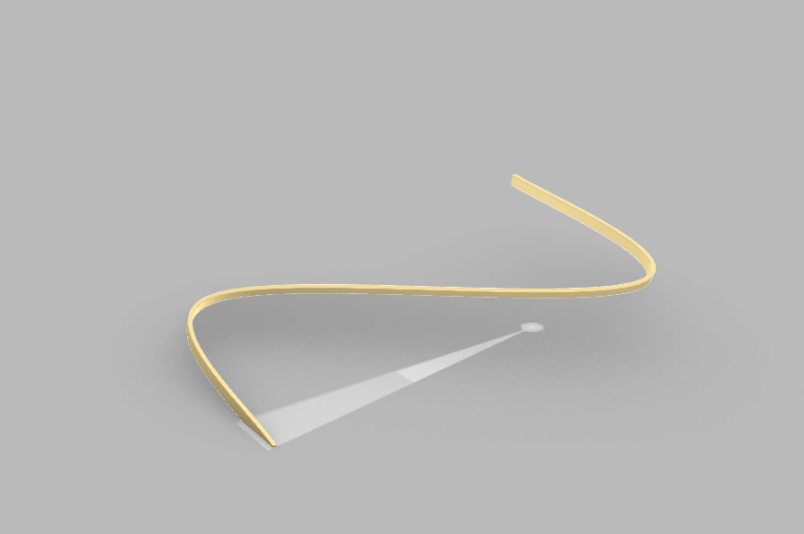
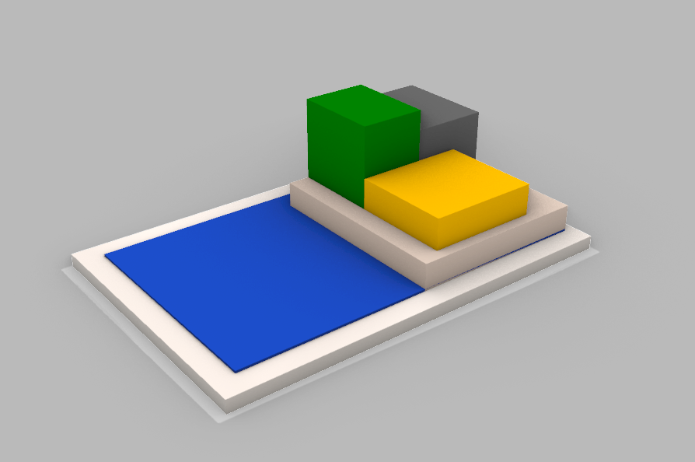
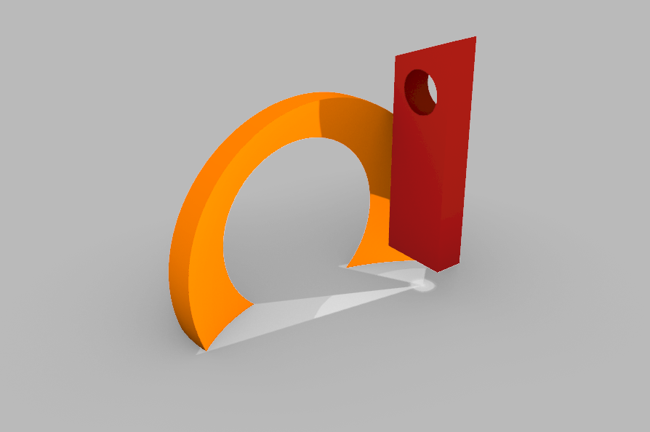
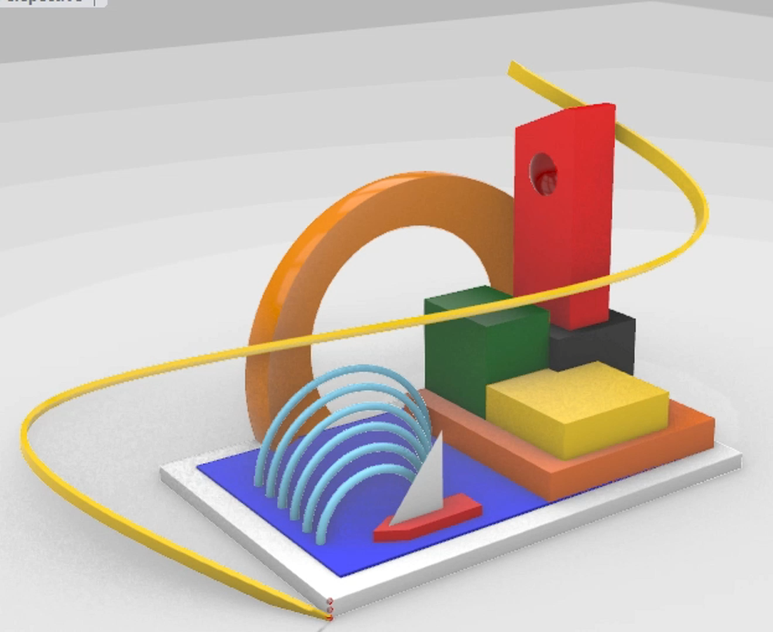
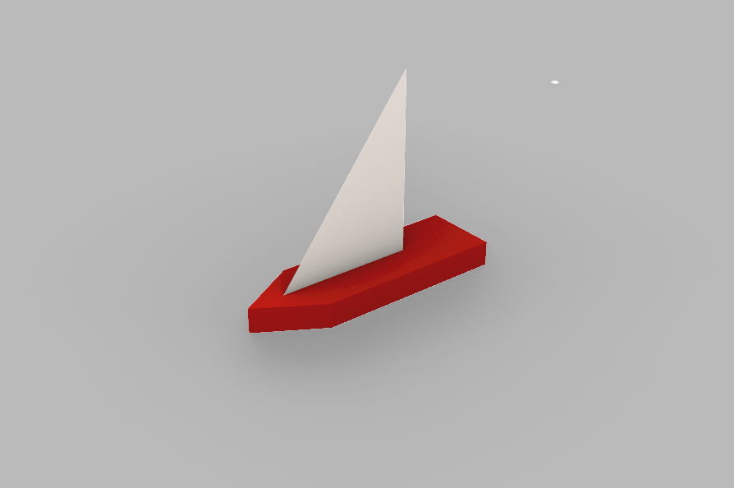
Beacon Coast
Zhaonan Yang - 03813465
wave
ribbon
island
PARAMETERS
Boat: Position
Waves: Number, spacing, scale factor
Horizon: Position and dimensions
Lighthouse: Rotation angle
Island: amplitude and frequency
Ribbon: Four control points, width and thickness
horizon& Lighthouse
RELATIONSHIPS
Boat: Changing the boat's X-position (x_b) drives the transformations of other components. ​
Waves: As (x_b) increases, the wave X-position shifts and the scale factor decreases, making the waves move and shrink.
Horizon: As (x_b) increases, the horizon Z-position decreases.
Lighthouse: As (x_b) increases, the rotation angle increases, causing the lighthouse to rotate around its vertical axis.
Island: As (x_b) increases, the sinusoidal vertical displacement changes, making the island move periodically up and down.
Ribbon: As (x_b) increases, the X-coordinates of the two middle control points change, continuously reshaping the ribbon.
boat
Notes:
If we let each parameter run over its allowed range, f produces a whole family of shapes. That family is the design space.

