Slide 1
Chapter 7: Deadlocks

Slide 2
Chapter 7: Deadlocks
The Deadlock Problem
System Model
Deadlock Characterization
Methods for Handling Deadlocks
Deadlock Prevention 比較消極 一開始設計就預防 程式資源使用比較沒效率
Deadlock Avoidance 程式資源分配比較積極 盡量最大化
Deadlock Detection 讓它發生 再偵測 再復原
Recovery from Deadlock ex停止其中幾個proc 或是收回某些資源可以解掉

Slide 3
Chapter Objectives
To develop a description of deadlocks, which prevent sets of concurrent processes from completing their tasks
To present a number of different methods for preventing or avoiding deadlocks in a computer system

Slide 4
The Deadlock Problem
A set of blocked processes each holding a resource and waiting to acquire a resource held by another process in the set
Example
System has 2 disk drives
P₁ and P₂ each holds one disk drive and each needs another one
Example
semaphores A and B, initialized to 1
P₀ P₁
wait (A); wait(B)
wait (B); wait(A)

Slide 5
Bridge Crossing Example
Traffic only in one direction
Each section of a bridge can be viewed as a resource
If a deadlock occurs, it can be resolved if one car backs up (preempt resources and rollback)
Several cars may have to be backed up if a deadlock occurs
Starvation is possible
Note – Most OSes do not prevent or deal with deadlocks

Slide 6
System Model
Resource types R₁, R₂, . . ., R_{m}
CPU cycles, memory space, I/O devices
Each resource type R_{i} has W_{i} instances.
Each process utilizes a resource as follows:
request ex 要硬碟多大 要檔案多少
use
release 還給OS

Slide 7
Deadlock Characterization
Deadlock can arise if four conditions hold simultaneously.
Mutual exclusion: only one process at a time can use a resource
Hold and wait: a process holding at least one resource is waiting to acquire additional resources held by other processes
No preemption: a resource can be released only voluntarily by the process holding it, after that process has completed its task
Circular wait: there exists a set {P₀, P₁, …, P_{n}} of waiting processes such that P₀ is waiting for a resource that is held by P₁, P₁ is waiting for a resource that is held by P₂, …, P_{n–1} is waiting for a resource that is held by P_{n}, and P_{n} is waiting for a resource that is held by P₀.
Notes:
ch6這四種情況分布在各個地方都說過了 四個要同時成立

Slide 8
Resource-Allocation Graph
A set of vertices V and a set of edges E.
V is partitioned into two types:
P = {P₁, P₂, …, P_{n}}, the set consisting of all the processes in the system
R = {R₁, R₂, …, R_{m}}, the set consisting of all resource types in the system
request edge – directed edge P₁ → R_{j}
assignment edge – directed edge R_{j} → P_{i}

Slide 9
Resource-Allocation Graph (Cont.)
Process
Resource Type with 4 instances
P_{i} requests instance of R_{j}
P_{i} is holding an instance of R_{j}
P_{i}
R_{j}
P_{i}
R_{j}

Slide 10
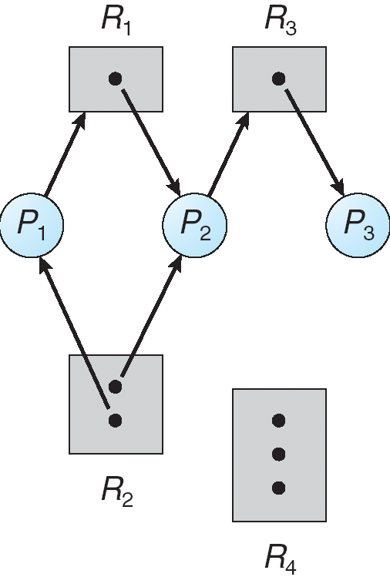
Example of a Resource Allocation Graph
Notes:
ok 依照前頁圖說 裡面的圓點就是那個resource有幾個instance

Slide 11
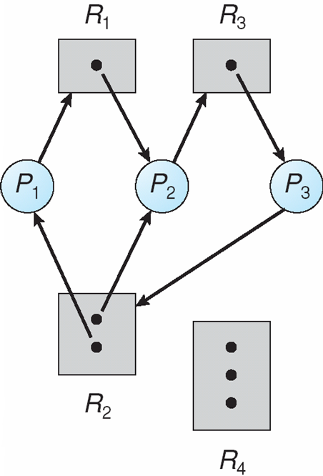
Resource Allocation Graph With A Deadlock
Notes:
p1>r1>p2>r3>p3>(點被占滿要不到)r2>p1 那個點能大於一個應該就是semap

Slide 12
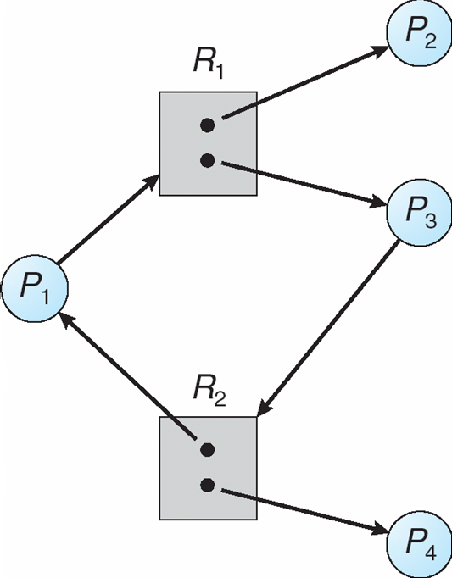
Graph With A Cycle But No Deadlock
Notes:
我是猜p2會用完r1給p1就可執行 p1跑完r2就釋放p3就能跑 Yes 因為另外有p2 4不在cycle 24執行完 resource給其他人就可繼續執行

Slide 13
Basic Facts
If graph contains no cycles ⇒ no deadlock
If graph contains a cycle ⇒
if only one instance per resource type(黑點都只有一個), then 一定deadlock
if several instances per resource type, possibility of 可能不一定deadlock

Slide 14
Methods for Handling Deadlocks
Ensure that the system will never enter a deadlock state
Allow the system to enter a deadlock state and then recover
Ignore the problem and pretend that deadlocks never occur in the system; used by most operating systems, including UNIX 使用者發現不動當機了會自己把deLo砍了
Notes:
ok

Slide 15
Deadlock Prevention保守
Restrain阻止 the ways request can be made
Mutual Exclusion – not required for sharable resources; must hold for nonsharable resources 沒辦法改變跳過
Hold and Wait – must guarantee that whenever a process requests a resource, it does not hold any other resources
Require process to request and be allocated all its resources before it begins execution, or allow process to request resources only when the process has none
Low resource utilization; starvation possible
一次拿全部所以後面用到的resource例如印表機也會先拿起來 所以效率比較差
Notes:
針對四個條件解決任一就不會DL 最後一點starvation是因為例如說 每次都沒辦法剛好拿到全部資源 就沒辦法執行

Slide 16
Deadlock Prevention (Cont.)
No Preemption –
If a process that is holding some resources requests another resource that cannot be immediately allocated to it, then all resources currently being held are released 沒辦法搶自己需要但在別人手中資源就手上資源全部釋放
Preempted resources are added to the list of resources for which the process is waiting
Process will be restarted only when it can regain its old resources , as well as the new ones that it is requesting
Circular Wait – impose a total ordering of all resource types, and require that each process requests resources in an increasing order of enumeration
Notes:
No Preemption 要嘛一次全拿到 要嘛一次都不拿
Circular Wait 把resource編號排序 由小到大排序 proc取用資源的時候是由小到大去拿

Slide 17
Deadlock Avoidance
Requires that the system has some additional a priority information available
Simplest and most useful model requires that each process declares the maximum number of resources of each type that it may need預先說好需要多少量
The deadlock-avoidance algorithm dynamically examines the resource-allocation state to ensure that there can never be a circular-wait condition
Resource-allocation state is defined by the number of available and allocated resources, and the maximum demands of the processes
Notes:
資源使用比prevention好

Slide 18
Safe State
When a process requests an available resource, system must decide if immediate allocation leaves the system in a safe state
System is in safe state if there exists a sequence <P₁, P₂, …, P_{n}> of ALL the processes in the systems such that
for each P_{i}, the resources that P_{i} can still request can be satisfied by currently available resources + resources held by all the P_{j}, with j < i
Notes:
第二點 是說 如果能找到一個關係 使得P1的資源使用執行完 給P2使用 P2使用完 給P3使用 P3可以繼續拿到所需的資源使用 並且用完再釋放給P4…. 一直下去
就代表system在Save State

Slide 19
Safe State
That is:
If P_{i} resource needs are not immediately available, then P_{i} can wait until all P_{j} have finished
When P_{j} is finished, P_{i} can obtain needed resources, execute, return allocated resources, and terminate
When P_{i} terminates, P_{i +1} can obtain its needed resources, and so on

Slide 20
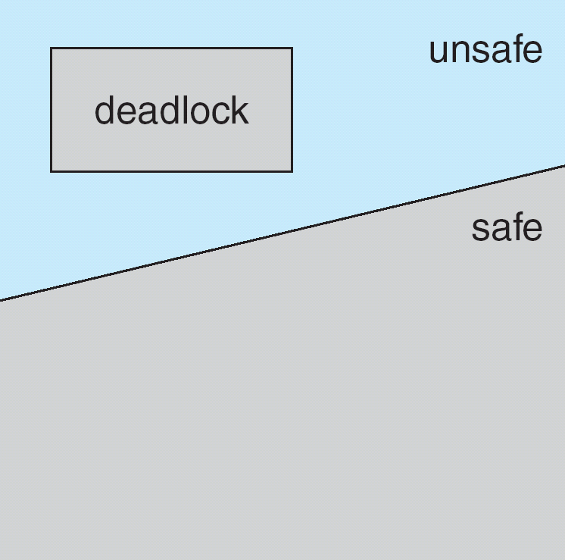
Basic Facts
If a system is in safe state ⇒ no deadlocks
If a system is in unsafe state ⇒ possibility of deadlock
Avoidance ⇒ ensure that a system will never enter an unsafe state.
Notes:
ok 7-4

Slide 21
Avoidance algorithms
Single instance of a resource type
Use a resource-allocation graph
Multiple instances of a resource type
Use the banker’s algorithm

Slide 22
Resource-Allocation Graph Scheme
Claim 宣稱將來需要 還沒真的提出來 edge P_{i} → R_{j} indicated that process P_{i} may request resource R_{j} ; represented by a dashed line
Claim edge converts to request edge when a process requests a resource
Request edge converted to an assignment edge when the resource is allocated to the process
When a resource is released by a process, assignment edge reconverts to a claim edge
Resources must be claimed a priori in the system

Slide 23
a priori
如何在研究假設中使用a priori、a posteriori、ex ante、ex post等 ...www.editing.tw › blog › progress › grammar-usage
2017年3月9日 - 回答： 多數人認為a priori意指「在試驗之前」，然而，事實並非如此。 a priori指的是「獨立於 ...
先驗在拉丁文中指「來自先前的東西」，或引申為「有經驗之前」。近代西方傳統中，認為先驗指無需經驗或先於經驗獲得的知識。它通常與後驗知識相比較，後驗指的是「有經驗之後」，即"需要經驗"。這一區分來自於中世紀邏輯所區分的兩種論證，從原因到結果的論證稱為「先驗的」，而從結果到原因的論證稱為「後驗的」。

Slide 24
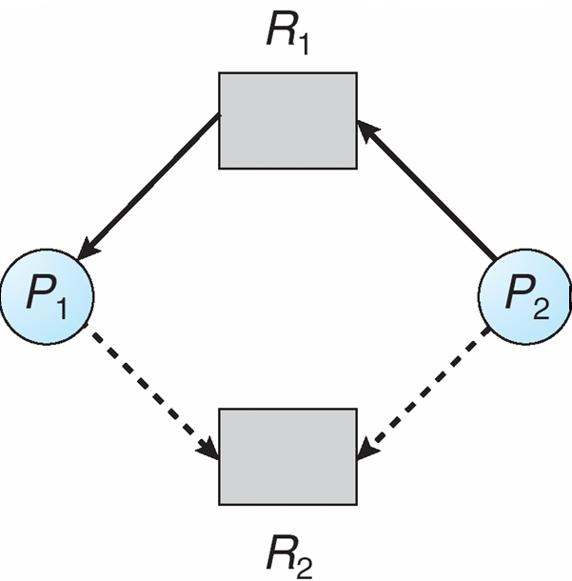
Resource-Allocation Graph
assignment edge
request edge
Claim edge P_{i} → R_{j}
Claim edge P_{i} → R_{j}

Slide 25
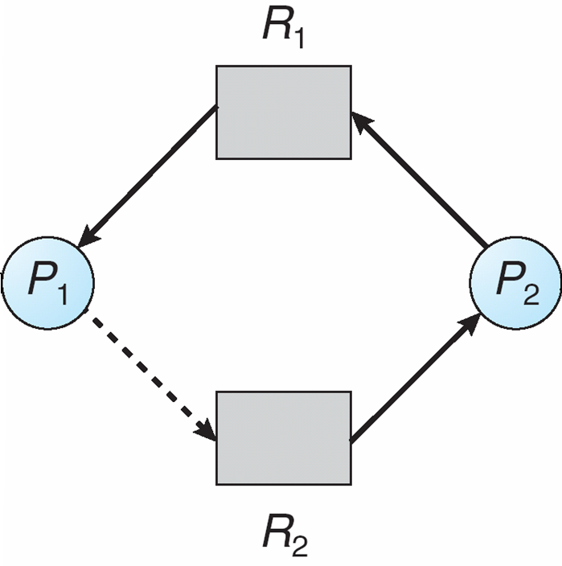
Unsafe State In Resource-Allocation Graph

Slide 26
Resource-Allocation Graph Algorithm
Suppose that process P_{i} requests a resource R_{j}
The request can be granted授權 only if converting the request edge to an assignment edge does not result in the formation of a cycle in the resource allocation graph
P₁ → R₂ accept
P₂→ R₂ reject, otherwise, a cycle is formed
Notes:
讚 虛線是未來可能需要 實線是proc已經提出需求 或r已經指派 右邊兩張圖 右一是初始狀態 右二是說如果虛線P2>R2還沒事 但是如果真的R2>P2那實虛線就形成有方向性cycle 就是unsafe了 圖一仔細看是沒有cycle的

Slide 27
Banker’s Algorithm
Multiple instances 前面的cycle判斷是單instance的 如果multi就算有迴圈也不一定會deaLo
Each process must a priori claim maximum use執行之前先提出每個resource最多會用到幾個
When a process requests a resource it may have to wait
When a process gets all its resources it must return them in a finite amount of time

Slide 28
Data Structures for the Banker’s Algorithm
Let n = number of processes, and
m = number of resources types.
Available(可用的res剩幾個): Vector of length m. If available [j] = k, there are k instances of resource type R_{j} available
Max(res需求最多是幾個): n x m matrix. If Max [i,j] = k, then process P_{i} may request at most k instances of resource type R_{j}
Allocation(已經給每個proc多少個res): n x m matrix. If Allocation[i,j] = k then P_{i} is currently allocated k instances of R_{j}
Need(proc還需要多少個): n x m matrix. If Need[i,j] = k, then P_{i} may need k more instances of R_{j} to complete its task Need [i,j] = Max[i,j] – Allocation [i,j]
Notes:
ok 好像在演算法看過 7-5

Slide 29
Safety Algorithm
1. Let Work and Finish be vectors of length m and n, respectively. Initialize:
Work可用剩多少 = Available
Finish 是否跑完\ [i] = false for i = 0, 1, …, n- 1
2. Find any i such that both:
(a) Finish 還沒跑完[i] = false
(b) Need_{i} ≤ Work (我= Available 需求<供給 –可跑完
If no such i exists, go to step 4
3. Work = Work + Allocation_{i} 跑完後回收資源 Finish[i] = true 跑完 go to step 2 繼續找下個跑
4. If Finish [i] == true for all i, then the system is in a safe state
Notes:
Safe State : 現有的r p狀態關係 上面四點是只要找到(存在)一種順序可以讓 I i+1 i+2 …. 可以依序跑完

Slide 30
Resource-Request Algorithm for Process P_{i}
Request_{i} = request vector for process P_{i}. If Request_{i} [j] = k then process P_{i} wants k instances of resource type R_{j}
1. If Request_{i} ≤ Need_{i} go to step 2. Otherwise, raise error condition, since process has exceeded its maximum claim
2. If Request_{i} ≤ Available, go to step 3. Otherwise P_{i} must wait, since resources are not available
3. Pretend先假設 to allocate requested resources to P_{i} (圖就是線轉過來需變實)by modifying the state as follows:
Available = AvAllocation_{i}ailable – Request;
Allocation_{i} = + Request_{i};
Need_{i} = Need_{i} – Request_{i};
再檢查 If safe ⇒ the resources are allocated to P_{i}
If unsafe ⇒ P_{i} must wait, and the old resource-allocation state is restored
Notes:
Need是事先設定的需求 Request是實際提出的 代上取解釋 就是Banker Algo

Slide 31
Example of Banker’s Algorithm
5 processes P₀ through P₄;
3 resource types:
A (10 instances), B (5instances), and C (7 instances)
Snapshot at time T₀:
Allocation Max Available
A B C A B C A B C
P₀ 0 1 0 7 5 3 3 3 2
P₁ 2 0 0 3 2 2
P₂ 3 0 2 9 0 2
P₃ 2 1 1 2 2 2
P₄ 0 0 2 4 3 3
Notes:
用聽的理解好了 簡言之 Need = Max - Alloca 下頁就 Need

Slide 32
Example (Cont.)
The content of the matrix Need is defined to be
Max – Allocation
Need Available
A B C A B C
P₀ 7 4 3 3 3 2
P₁ 1 2 2
P₂ 6 0 0
P₃ 0 1 1
P₄ 4 3 1
The system is in a safe state since the sequence
< P₁, P₃, P₄, P₂, P₀> satisfies safety criteria
Notes:
聽的 左邊是Need 右邊是目前Available 左邊的P1 P3 還可以Need < Avai 假設跑P1完成 res歸還 會變成5 3 2 因為P1前面只alloc 2 0 0 532又可以給P3直 這邊是上課假設 下一張又是另一種假設

Slide 33
Example: P₁ Request (1,0,2)
Check that Request ≤ Available (that is, (1,0,2) ≤ (3,3,2) ⇒ true)
Allocation Need Available
A B C A B C A B C
P₀ 0 1 0 7 4 3 2 3 0
P₁ 3 0 2 0 2 0
P₂ 3 0 1 6 0 0
P₃ 2 1 1 0 1 1
P₄ 0 0 2 4 3 1
Executing safety algorithm shows that sequence < P₁, P₃, P₄, P₀, P₂> satisfies safety requirement
Can request for (3,3,0) by P₄ be granted?
Can request for (0,2,0) by P₀ be granted?
Notes:
假設P1只拿 1 0 2 原本Avail 3 3 2 減完 就變 2 3 0 Alloc加上原本的 2 0 0變 3 0 2 need 變 Max 3 2 2 – 3 0 2 = 0 2 0 這樣子算是safe 因為資源可以讓p1執行完畢 資源就會還回來 Q1 P4 max 433 allox 002 need 431 假設又給他330 avai 原本332變 002 師是說這002就沒辦法滿足任何其他proc的需求 所以不是safe state 所以會拒絕 但是我看前面 safe state 描述是 滿足當前 當前跑完 資源還回 跑下一個 不用超前考慮一個 所以對這個說法存疑 之後補習遇到再看看

Slide 34
Deadlock Detection
Allow system to enter deadlock state
Detection algorithm
Recovery scheme
允許發生
相對於prevention 讓四個條件任一不成立根本不產生保守 會比較積極
avoidance是持續分配資源 並且每次檢查是否都在safe state
deadlock detection 允許發生 一直分配等到發生了再來re 所以不用像avoid平常一直檢查

Slide 35
Single Instance of Each Resource Type
Maintain wait-for graph
Nodes are processes
P_{i} → P_{j} if P_{i} is waiting for P_{j}
Periodically invoke an algorithm that searches for a cycle in the graph. If there is a cycle, there exists a deadlock
An algorithm to detect a cycle in a graph requires an order of n² operations, where n is the number of vertices in the graph 有空再去對一下找環的演算法 找一下是哪個演算法和複雜度大概的概念

Slide 36
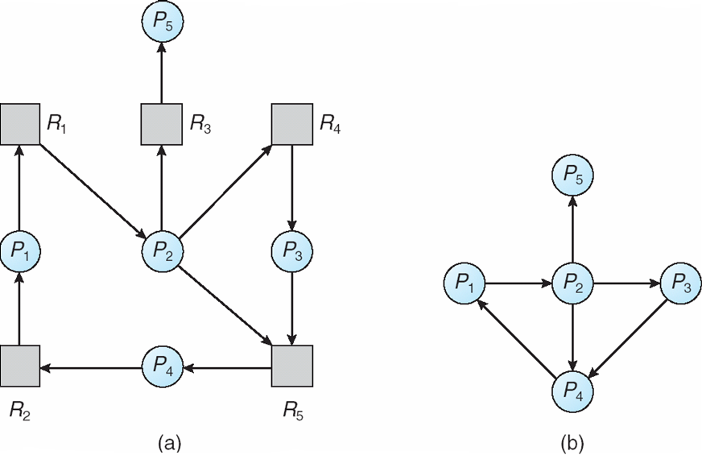
Resource-Allocation Graph and Wait-for Graph
Resource-Allocation Graph
Corresponding wait-for graph
Notes:
應該就把灰點去除掉 或看成邊 這邊每個res只有一instance所以可簡化為左邊 已有cycle所以有deadlock

Slide 37
of a Resource Type
Available: A vector of length m indicates the number of available resources of each type.
Allocation: An n x m matrix defines the number of resources of each type currently allocated to each process. 跟前面觀念完全相同
Request: An n x m matrix indicates the current request of each process. If Request [i, j] = k, then process P_{i} is requesting k more instances of resource type R_{j}.
Notes:
聽

Slide 38
Detection Algorithm
1. Let Work and Finish be vectors of length m and n, respectively Initialize:
(a) Work = Available
(b) For i = 1,2, …, n, if Allocation_{i} ≠ 0, then Finish[i] = false; otherwise, Finish[i] = true
2. Find an index i such that both:
(a) Finish[i] == false
(b) Request_{i} ≤ Work
If no such i exists, go to step 4
Notes:
感覺很像前面那個 Allocation == 0 不會引發deadlock > otherwise, Finish[i] = true 表不會引發deaLoc

Slide 39
Detection Algorithm (Cont.)
3. Work = Work + Allocation_{i 執行結束資源放回} Finish[i] = true go to step 2
4. If Finish[i] == false, for some i, 1 ≤ i ≤ n, then the system is in deadlock state. Moreover, if Finish[i] == false, then P_{i} is deadlocked
Algorithm requires an order of O(m x n²) operations to detect whether the system is in deadlocked state
Notes:
聽

Slide 40
Example of Detection Algorithm
Five processes P₀ through P₄; three resource types A (7 instances), B (2 instances), and C (6 instances)
Snapshot at time T₀:
Allocation Request Available
A B C A B C A B C
P₀ 0 1 0 0 0 0 0 0 0代表目前都分配完
P₁ 2 0 0 2 0 2
P₂ 3 0 3 0 0 0
P₃ 2 1 1 1 0 0
P₄ 0 0 2 0 0 2
Sequence <P₀, P₂, P₃, P₁, P₄> will result in Finish[i] = true for all i
Notes:
先找Request是0的 代表已經取的需要的資源可以繼續執行 所以P0 010 P2 303 執行完 共313回到avail 313就很好找到下一個要滿足分配的P 就可以往下進行順利跑完

Slide 41
Example (Cont.)
P₂ requests an additional instance of type C
Request
A B C
P₀ 0 0 0
P₁ 2 0 2
P₂ 0 0 1
P₃ 1 0 0
P₄ 0 0 2
State of system?
Can reclaim resources held by process P₀, but insufficient resources to fulfill other processes’ requests
Deadlock exists, consisting of processes P₁, P₂, P₃, and P₄
Notes:
一旦紅字變1 就沒辦法滿足了 因為P0跑完才還回去 010 沒辦法讓下一個任一滿足

Slide 42
Detection-Algorithm Usage
When, and how often, to invoke depends on:
How often a deadlock is likely to occur?
How many processes will need to be rolled back?
one for each disjoint解體 破碎 cycle
If detection algorithm is invoked arbitrarily(沒有頻繁檢查 任挑時間), there may be many cycles in the resource graph and so we would not be able to tell which of the many deadlocked processes “caused” the deadlock
Notes:
disjoint那邊就是分別形成了不同的多個cycle deaLo

Slide 43
Recovery from Deadlock: Process Termination
Abort all deadlocked processes
Abort one process at a time until the deadlock cycle is eliminated
In which order should we choose to abort?
Priority of the process
How long process has computed, and how much longer to complete
Resources the process has used
Resources process needs to complete
How many processes will need to be terminated
Is process interactive(花IO的) or batch(花CPU的)?
Notes:
ok 很常人想到的作法

Slide 44
Recovery from Deadlock: Resource Preemption 資源強制拿回來
Selecting a victim先挑一個 – minimize cost
Rollback 把它資源拿回來 重新啟動
return to some safe state, restart process for that state
Starvation 一直挑同一個p來犧牲取回資源
same process may always be picked as victim,
include number of rollbacks in cost factor
Notes:
以上是一些思考方向

Slide 45
End of Chapter 7

