Slide 1
Chapter 10 File-System

Slide 2
Chapter 10: File System
File Concept
Access Methods
Directory Structure
File-System Mounting
File Sharing
Protection 例如owner誰可讀可寫

Slide 3
Objectives
To explain the function of file systems
To describe the interfaces to file systems
To discuss file-system design tradeoffs, including
access methods(sequential 或random access),
file sharing,
file locking, and
directory structures
To explore file-system protection
Notes:
呼叫那些interface呼叫使用檔案系統

Slide 4
File Concept
Contiguous logical address space
logical連續 physical存在硬碟可能不連續 但user不用想那麼多
Types:
Data
numeric
character
binary
Program

Slide 5
File Structure
None - sequence of words, bytes 沒有特定格式 使用不方便速度慢 沒辦法迅速定位到特定的資訊
Simple record structure 一行行
Lines
Fixed length
Variable length
Complex Structures
Formatted document
Relocatable load file 程式可以放在記憶體不同位置 會有特定格式才能做到
Can simulate last two methods with first method by inserting appropriate control characters (CR, LF) carriage return/line feed(迴車 換行)
Who decides 檔案格式:
Operating system
Program

Slide 6
File Attributes
Name – only information kept in human-readable form
Identifier – unique tag (number) identifies file within file system ID 系統給的編號 系統用的
Type – needed for systems that support different types
Location – pointer to file location on device
Size – current file size
Protection – controls who can do reading, writing, executing
Time, date, and user identification – data for protection, security, and usage查字典 monitoring
Information about files are kept in the directory structure, which is maintained on the disk

Slide 7
File Operations
File is an abstract data type
Create
Write
Read
Reposition within file 要讀寫的位置
Delete
Truncate
Open(F_{i}) – search the directory structure on disk for entry F_{i}, and move the content of entry to memory
Close (F_{i}) – move the content of entry F_{i} in memory to directory structure on disk
Notes:
10-2

Slide 8
Open Files
Several pieces of data are needed to manage open files:
File pointer: pointer to last read/write location, per process that has the file open
File-open count: counter of number of times a file is open – to allow removal of data from open-file table when last process closes it 例如一個檔案被多個程序讀取
Disk location of the file: cache of data access information
Access rights: per-process access mode information
RWX

Slide 9
Open File Locking
Provided by some operating systems and file systems
Shared Lock: several processes can acquire the lock concurrently (like a reader lock)
Exclusive Lock: Only one process at a time can acquire such a lock (like a writer lock)
Mandatory義務的 or advisory 諮詢勸告的 file locking mechanisms:
Mandatory – Once a process acquires an exclusive lock, the OS will prevent any other process from accessing the locked file. (Windows)
Advisory – The OS will not prevent a process from acquiring access to a locked file. Rather, the process must be written so that it manually acquiring the lock before accessing the file. (UNIX)
Notes:
最後一點是 OS不會檔你去碰locked file 但寫程式的自己要注意要先取得lock

Slide 10
File Locking Example – Java API
import java.io.*;
import java.nio.channels.*;
public class LockingExample {
public static final boolean EXCLUSIVE = false;
public static final boolean SHARED = true;
public static void main(String arsg[]) throws IOException {
FileLock sharedLock = null;
FileLock exclusiveLock = null;
try {
RandomAccessFile raf = new RandomAccessFile("file.txt", "rw");
// get the channel for the file
FileChannel ch = raf.getChannel();
// this locks the first half of the file - exclusive
exclusiveLock = ch.lock(0零, raf.length()/2, EXCLUSIVE);
/** Now modify the data . . . */
// release the lock
exclusiveLock.release();
Notes:
這個例子含 寫入時exclusive / 讀取時shared lock

Slide 11
File Locking Example – Java API (cont)
// this locks the second half of the file - shared
sharedLock = ch.lock(raf.length()/2+1, raf.length(), SHARED);
/** Now read the data . . . */
// release the lock
sharedLock.release();
} catch (java.io.IOException ioe) {
System.err.println(ioe);
}finally {
if (exclusiveLock != null)
exclusiveLock.release();
if (sharedLock != null)
sharedLock.release();
}
}
}

Slide 12
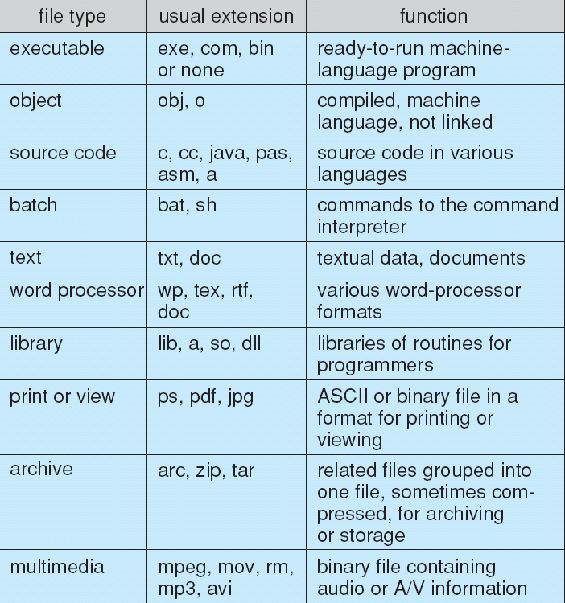
File Types – Name, Extension

Slide 13
Access Methods
Sequential Access
read next
write next
reset
都用pointer
Direct Access
read n
write n
position to n
read next
write next
rewrite n
n = relative block number

Slide 14
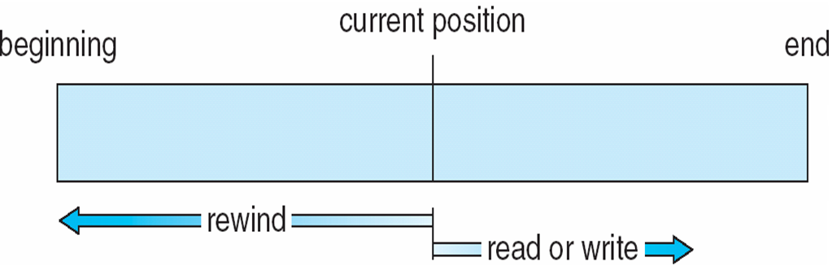
Sequential-access File
Notes:
rewind往回奏走 或reset 拉到最開始

Slide 15
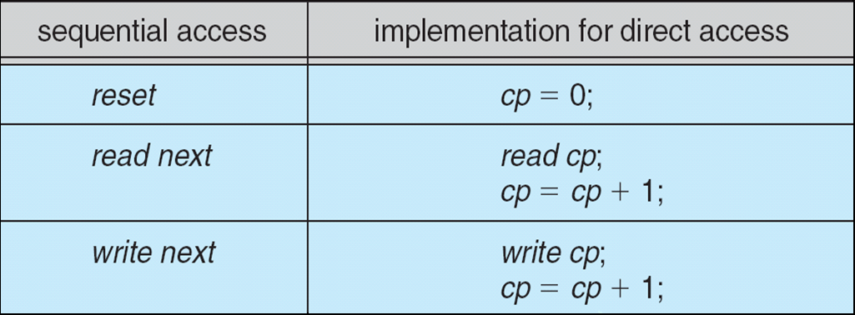
Simulation of Sequential Access on Direct-access File
Notes:
direct可以模擬 sequential

Slide 16
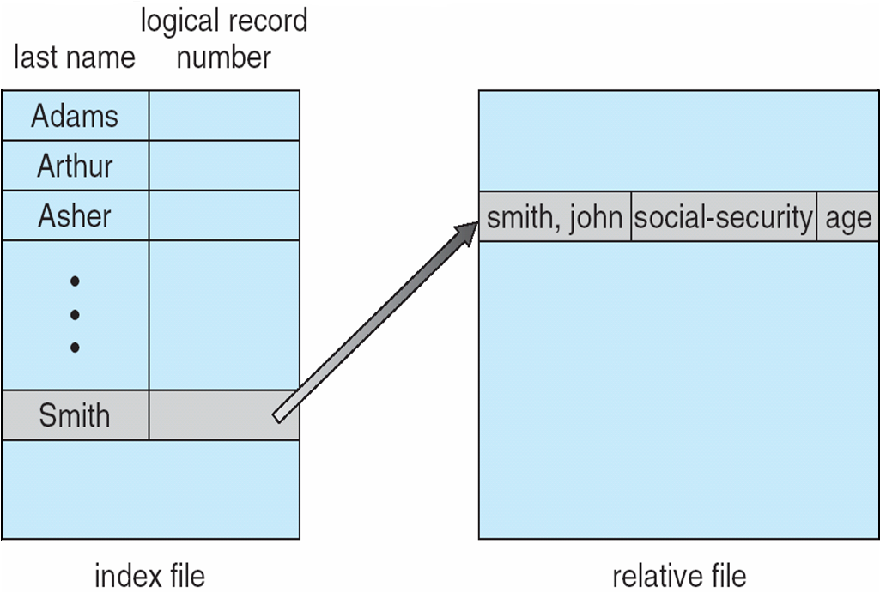
Example of Index and Relative Files
Notes:
social security社會安全保險 這跟DB有點像 原檔是右邊 建一個index檔雞塊搜尋速度 找到再用pointer指回原檔位置

Slide 17
Directory Structure
A collection of nodes containing information about all files
Directory
Files
F 1
F 2
F 3
F 4
F n
Both the directory structure and the files reside on disk
Backups of these two structures are kept on tapes

Slide 18
Disk Structure
Disk can be subdivided into partitions
Disks or partitions can be RAID protected against failure
Disk or partition can be used raw – without a file system, or formatted with a file system 硬碟格式化成特定檔案系統
Partitions also known as minidisks, slices
Entity containing file system known as a volume
Each volume containing file system also tracks that file system’s info in device directory or或稱 volume table of contents
As well as general-purpose file systems there are many special-purpose file systems, frequently all within the same operating system or computer (Solaris)
Notes:
分割區可能因為磁頭刮傷或損壞導致壞掉不能讀 可以用RAID救回來 放好幾個copy在不同的disk volume:是一個partition 上面是一個檔案系統 一個OS裡面可以有很多種檔案系統 例如Remote File System 檔案可以存在其他電腦 10-3

Slide 19
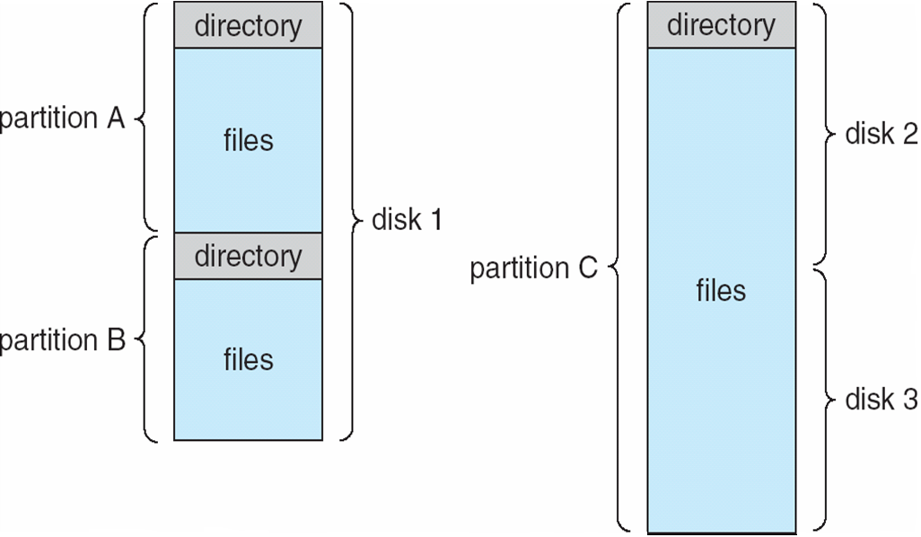
A Typical File-system Organization
Notes:
C 是把兩個disk合併在一起變一個dir

Slide 20
Operations Performed on Directory
Search for a file
Create a file
Delete a file
List a directory
Rename a file
Traverse the file system

Slide 21
Organize the Directory (Logically) to Obtain
Efficiency – locating a file quickly
Naming – convenient to users
Two users can have same name for different files
The same file can have several different names
Grouping – logical grouping of files by properties, (e.g., all Java programs, all games, …)

Slide 22
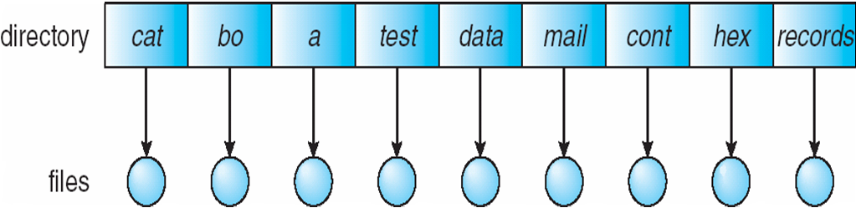
Single-Level Directory
A single directory for all users
Naming problem
Grouping problem
Notes:
ex同檔案多人共享 每個人取不同名字 但是這樣會無法group 還有不能在單一dirj做到因為檔名可能會重複 所以出現雙層

Slide 23
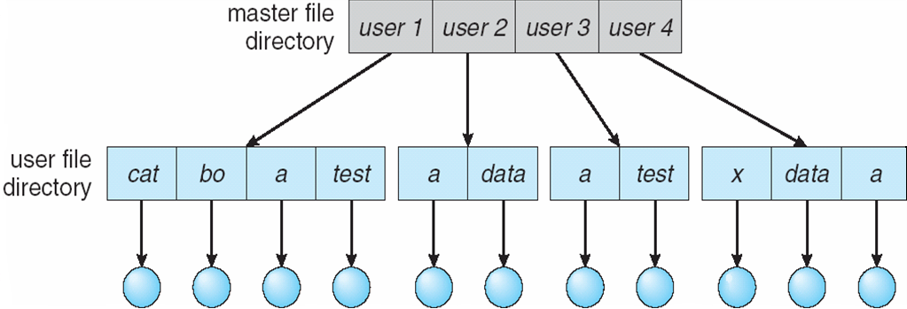
Two-Level Directory
Separate directory for each user
Path name
Can have the same file name for different user
Efficient searching
No grouping capability
Notes:
第一階就分 User user1\a user2\a

Slide 24
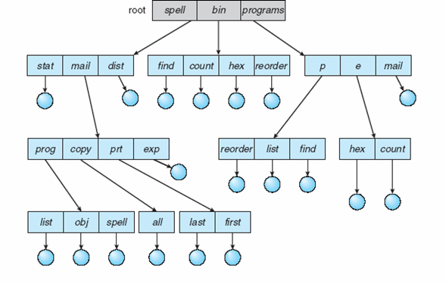
Tree-Structured Directories
Notes:
多階 就可以更進一步做到Grouping 同類型的放在同個folder下 就是group

Slide 25
Tree-Structured Directories (Cont)多階
Efficient searching
Grouping Capability就能做到這些
Current directory (working directory)目前在哪個目錄 cmd的前面那串路徑 要換就cd 或者指定絕對路徑rm 或mkdir
cd /spell/mail/prog
type list

Slide 26
Tree-Structured Directories (Cont)
Absolute or relative path name
Creating a new file is done in current directory
Delete a file
rm <file-name>
Creating a new subdirectory is done in current directory
mkdir <dir-name>
Example: if in current directory /mail
mkdir count
mail
prog
copy
prt
exp
count
Deleting “mail” ⇒ deleting the entire subtree rooted by “mail”

Slide 27
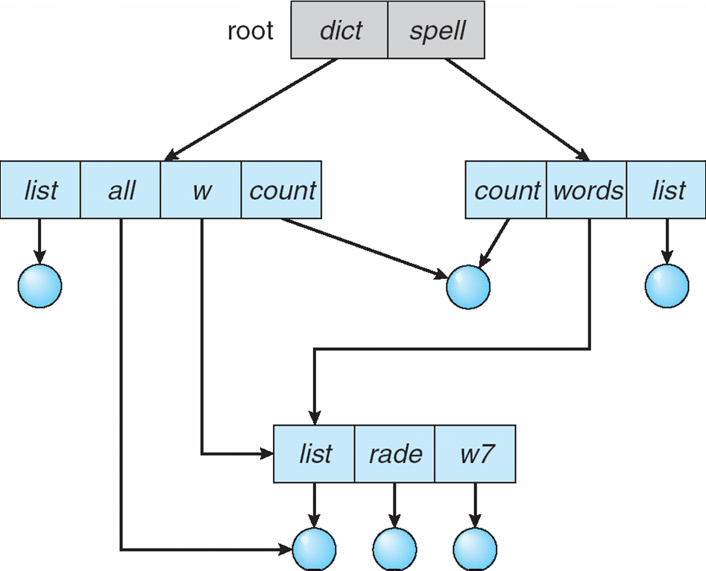
Acyclic無環-Graph Directories
Have shared subdirectories and files, for joined project, for example
Notes:
Directed Acyclic Graph 實際上說有向無環圖更精準 因為無向的話 上面就產生環了 多個箭頭指向同個檔案

Slide 28
Acyclic-Graph Directories (Cont.)
Allows directories to share subdirectories and files. The same file or subdirectory may be in two different directories
Shared files and subdirectories can be implemented in several ways.
Create a new directory entry - Link
Link – a pointer to another file or subdirectory. A link may be implemented as an absolute or a relative path name.
Resolve the link – usin g that path name to locate the real file. Links are easily identified by their format in the directory entry and are effectively indirect迂迴的 pointers.

Slide 29
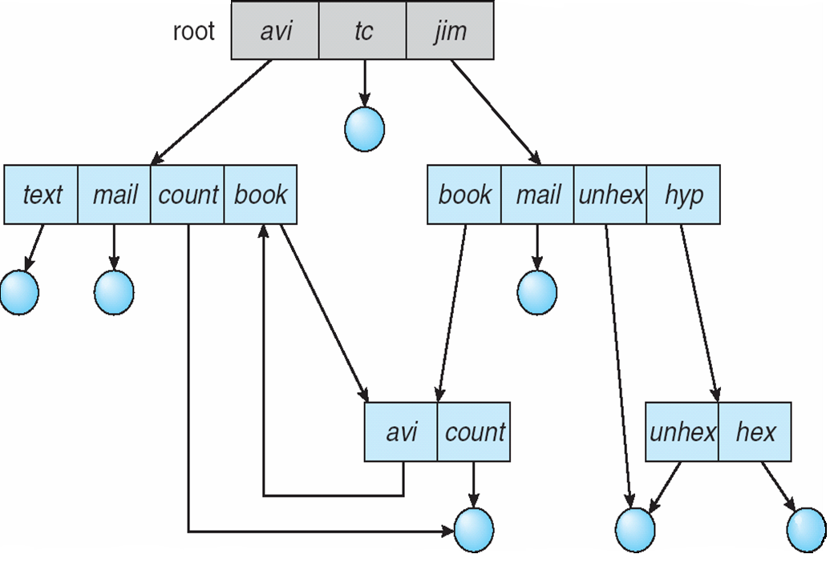
General Graph Directory
A serious problem with using acyclic-graph structure is ensuring that there is no cycles.
However, when we add links, the tree structure is destroyed, resulting in a simple graph structure.
Cycle

Slide 30
General Graph Directory (Cont.)
If cycles are allowed to exist in the directory
An infinite loop continually searching through the cycle
When a file can be deleted ?
A Garbage collection scheme is used to determine when the last reference has been deleted and the disk space can be reallocated. ex一個檔案被五個人用 四個人刪掉了 還是不能刪 要五人都刪才行
Every time a new link is added use a cycle detection algorithm to determine whether it is OK

Slide 31
File System Mounting
A file system must be mounted before it can be accessed
A unmounted file system is mounted at a mount point

Slide 32
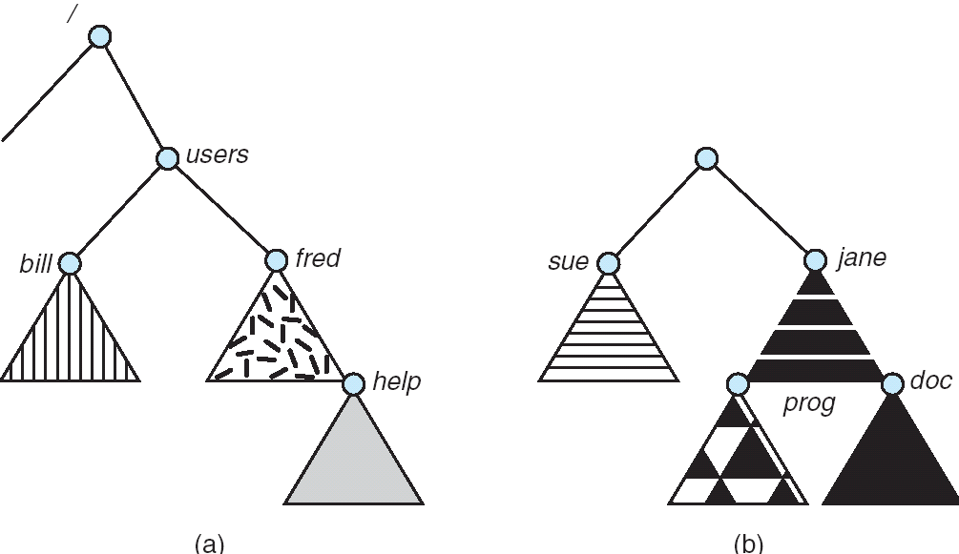
(a) Existing. (b) Unmounted Partition
File System Mounting
Mounting the volume residing
on /device/dsk over /users
Notes:
這根樹的插入一樣 資結

Slide 33
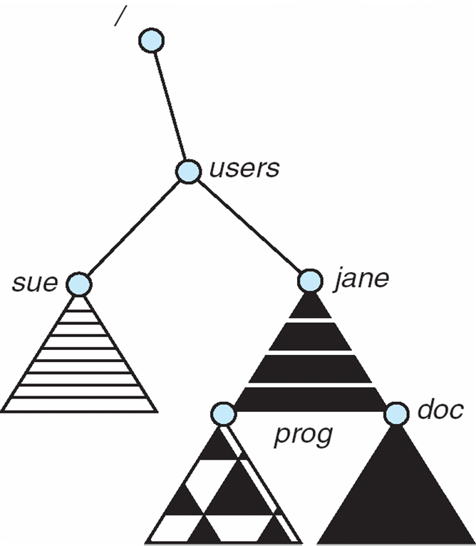
Mount Point
The volume residing on /device/dsk
is mounted over /users

Slide 34
File Sharing
Sharing of files on multi-user systems is desirable
Sharing may be done through a protection scheme
On distributed systems, files may be shared across a network 跨電腦的一個大目錄 由NFS幫忙管理
Network File System (NFS) is a common distributed file-sharing method
Notes:
desirable 值得嚮往的

Slide 35
File Sharing – Multiple Users
User IDs identify users, allowing permissions and protections to be per-user
Group IDs allow users to be in groups, permitting group access rights
Uses networking to allow file system access between systems
Manually via programs like FTP
Automatically, seamlessly 無縫地 using distributed file systems
Semi automatically via the WWW

Slide 36
File Sharing – Remote File Systems
Client-server X allows clients to mount remote file systems from servers
Server can serve multiple clients
Client and user-on-client identification is insecure or complicated
NFS is standard UNIX client-server file sharing protocol
CIFS (Common Internet File System) is standard Windows protocol
Standard OS file calls are translated into remote calls
Distributed Information Systems (distributed naming services) such as LDAP (lightweight directory access protocol), DNS, NIS, Active Directory (Windows XP and Windows 2z`000) implement unified access to information needed for remote computing
Notes:
LDAP 很多企業有用 登入時去身分認證檢查 然後就能遠端存取目錄 Active Dir 企業也常用 可能各地有很多不同子公司 但是想看成一個完整的目錄統一管理 但事實上 檔案放在很多不同電腦

Slide 37
File Sharing – Failure Modes
Remote file systems add new failure modes, due to network failure, server failure 例如網路不通 Server斷電當機
Recovery from failure can involve state information about status of each remote request
等到恢復了重試
Stateless protocols (每個Request間沒有相依關係)such as NFS include all information in each request, allowing easy recovery but less security
Notes:
有State Graph 代表 每一步之間互相有關係

Slide 38
File Sharing – Consistency Semantics
Consistency semantics語意 specify how multiple users are to access a shared file simultaneously
Similar to Ch 6 process synchronization algorithms
Tend to be less complex due to disk I/O and network latency (for remote file systems)
Andrew File System (AFS, Chapter 17) implemented complex remote file sharing semantics
Unix file system (UFS, Chapter 17) implements:
Writes to an open file visible immediately to other users of the same open file
Sharing file pointer to allow multiple users to read and write concurrently
AFS has session semantics
Writes only visible to sessions starting after the file is closed

Slide 39
Protection
File owner/creator should be able to control:
what can be done
by whom
Types of access
Read
Write
Execute
Append
Delete
List

Slide 40
Access Lists and Groups
Mode of access: read, write, execute
Three classes of users 三個等級舉例
RWX
a) owner access 7 ⇒ 1 1 1 RWX
b) group access 6 ⇒ 1 1 0
RWX
c) public access 1 ⇒ 0 0 1
Ask manager to create a group (unique name), say G, and add some users to the group.
For a particular file (say game) or subdirectory, define an appropriate access.
owner
group
public
chmod
761
game
Attach a group to a file chgrp G game

Slide 41
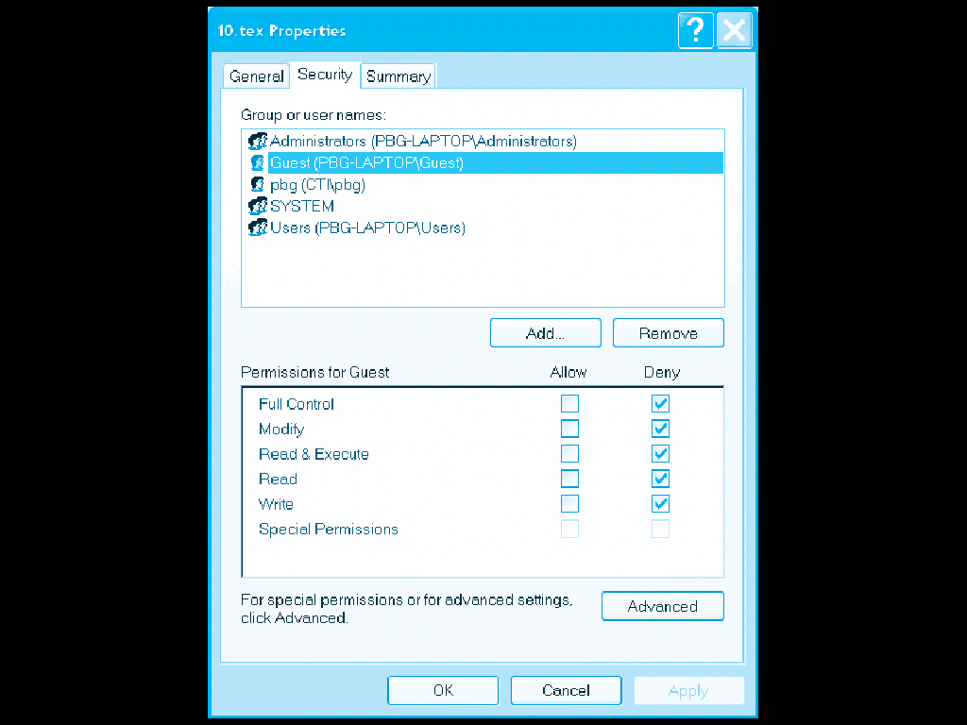
Windows XP Access-control List Management

Slide 42
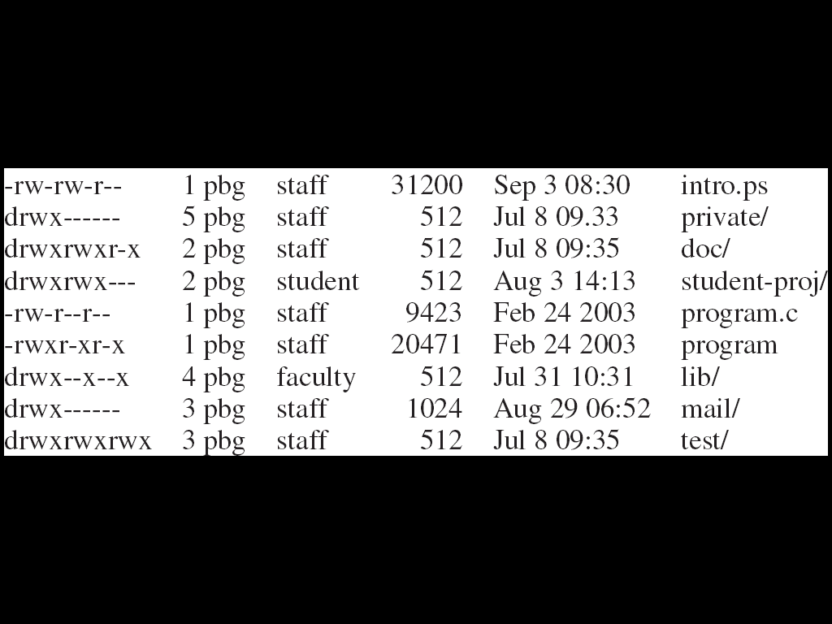
A Sample UNIX Directory Listing
subdirectory
The number of links to the file分享
Group’s name
Owner, group, universe
Owner’s name
Notes:
第一個字d 表資料夾 -表檔案 後面就是rwxrwxrwx 三組分別是給own gr uni的授權

Slide 43
End of Chapter 10

