Slide 1
Chapter 5: Process Scheduling

Slide 2
Chapter 5: Process Scheduling
Basic Concepts
Scheduling Criteria
Scheduling Algorithms
Thread Scheduling
Multiple-Processor Scheduling
Operating Systems Examples
Algorithm Evaluation

Slide 3
Objectives
To introduce process scheduling, which is the basis for multiprogrammed多程序 operating systems
To describe various process-scheduling algorithms
To discuss evaluation criteria for selecting a process-scheduling algorithm for a particular system
Notes:
ok

Slide 4
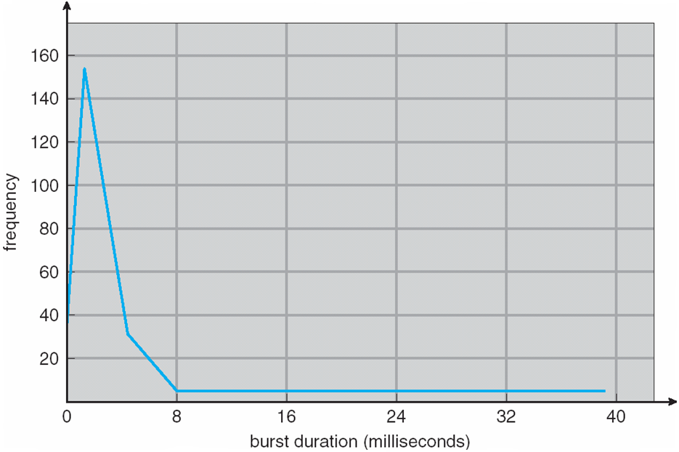
Basic Concepts
Maximum CPU utilization利用率 obtained with multiprogramming
CPU–I/O Burst爆炸 Cycle – Process execution consists of a cycle of CPU execution and I/O wait
CPU burst distribution

Slide 5
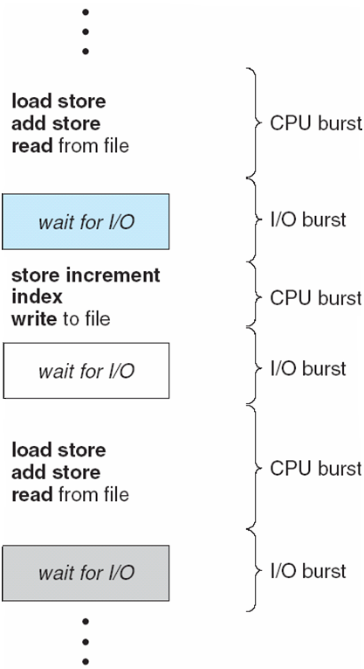
Histogram直方圖 of CPU-burst Times
155
2ms
Alternating Sequence of CPU And I/O Bursts

Slide 6
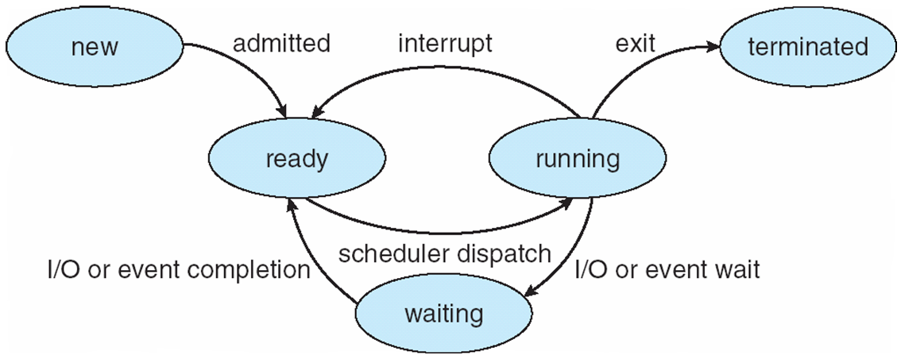
CPU Scheduler
Selects from among the processes in memory that are ready to execute, and allocates the CPU to one of them
CPU scheduling decisions may take place when a process:
1. Switches from running to waiting state (I/O Request)
2. Switches from running to ready state (Timer timeout)
3. Switches from waiting to ready (I/O Completed)
4. Terminates
Scheduling under 1 and 4 is nonpreemptive
All other scheduling is preemptive(先買權)

Slide 7
Dispatcher發送者/調度員
Dispatcher module gives control of the CPU to the process selected by the short-term scheduler; this involves:
switching context
switching to user mode
jumping to the proper location in the user program to restart that program
Dispatch latency – time it takes for the dispatcher to stop one process and start another running跟前一章的圖相同

Slide 8
Scheduling Criteria
CPU utilization利用 – keep the CPU as busy as possible
Throughput生產量 – # of processes that complete their execution per time unit
Turnaround time – amount of time to execute a particular process
Waiting time – amount of time a process has been waiting in the ready queue
Response time – amount of time it takes from when a request was submitted until the first response is produced, not output (for time-sharing environment)

Slide 9
Scheduling Algorithm Optimization Criteria
Max CPU utilization
Max throughput
Min turnaround time
Min waiting time
Min response time

Slide 10
First-Come, First-Served (FCFS) Scheduling
Process Burst Time
P₁ 24
P₂ 3
P₃ 3
Suppose that the processes arrive in the order: P₁ , P₂ , P₃ The Gantt Chart for the schedule is:
Waiting time for P₁ = 0; P₂ = 24; P₃ = 27
Average waiting time: (0 + 24 + 27)/3 = 17
P₁
P₂
P₃
0
24
27
30

Slide 11
FCFS Scheduling (Cont)
Suppose that the processes arrive in the order
P₂ , P₃ , P₁
The Gantt chart for the schedule is:
Waiting time for P₁ = 6; P₂ = 0; P₃ = 3
Average waiting time: (6 + 0 + 3)/3 = 3
Much better than previous case
Convoy effect 護航效應 : short process behind long process
P₂
P₃
P₁
0
3
6
30
P₁
P₂
P₃
0
24
27
30

Slide 12
Shortest-Job-First (SJF) Scheduling
Associate with each process the length of its next CPU burst. Use these lengths to schedule the process with the shortest time
SJF is optimal – gives minimum average waiting time for a given set of processes
The difficulty is knowing the length of the next CPU request

Slide 13
Example of SJF
Process Burst Time
P₁ 6
P₂ 8
P₃ 7
P₄ 3
SJF scheduling chart
Average waiting time = (3 + 16 + 9 + 0) / 4 = 7
P₄
P₁
P₃
P₂
0
3
9
16
24

Slide 14
Determining Length of Next CPU Burst
Can only estimate the length
Can be done by using the length of previous CPU bursts, using exponential averaging

Slide 15
Examples of Exponential Averaging
α =0
τ_{n+1} = τ_{n}
Recent history does not count
α =1
τ_{n+1} = t_{n}
Only the actual last CPU burst counts
If we expand the formula, we get:
τ_{n+1} = α t_{n}+(1 - α)α t_{n} -1 + …
+(1 - α )^{j} α t_{n} _{-j} + …
+(1 - α )^{n +1} τ₀
Since both α and (1 - α) are less than or equal to 1, each successive term has less weight than its predecessor

Slide 16
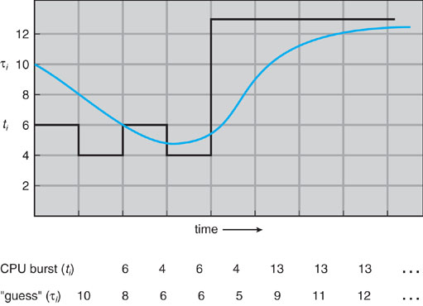
Prediction of the Length of the Next CPU Burst
(α = 1/2, τ₀ =10)

Slide 17
Example of SJF
Process Arrival Time Burst Time
P₁ 0 8
P₂ 1 4
P₃ 2 9
P₄ 3 5
SJF scheduling chart
Average waiting time = ?
P₁
P₂
P4
P₁
P₃
0
1
5
10
17
26

Slide 18
Priority Scheduling
A priority number (integer) is associated with each process
The CPU is allocated to the process with the highest priority (smallest integer ≡ highest priority)
Preemptive
Nonpreemptive
SJF is a priority scheduling where priority is the predicted next CPU burst time
Problem ≡ Starvation飢餓 – low priority processes may never execute
Solution ≡ Aging – as time progresses increase the priority of the process

Slide 19
Round Robin (RR)
Each process gets a small unit of CPU time (time quantum), usually 10-100 milliseconds.
After this time has elapsed, the process is preempted先佔 and added to the end of the ready queue.
If there are n processes in the ready queue and the time quantum is q, then each process gets 1/n of the CPU time in chunks of at most q time units at once. No process waits more than (n-1)q time units.
Performance
q large ⇒ FIFO
q small ⇒ q must be large with respect to context switch, otherwise overhead 頭頂/高架的is too high

Slide 20
Example of RR with Time Quantum = 4
Process Burst Time
P₁ 24
P₂ 3
P₃ 3
The Gantt chart is:
Typically, higher average turnaround than SJF, but better response
P₁
P₂
P₃
P₁
P₁
P₁
P₁
P₁
0
4
7
10
14
18
22
26
30

Slide 21
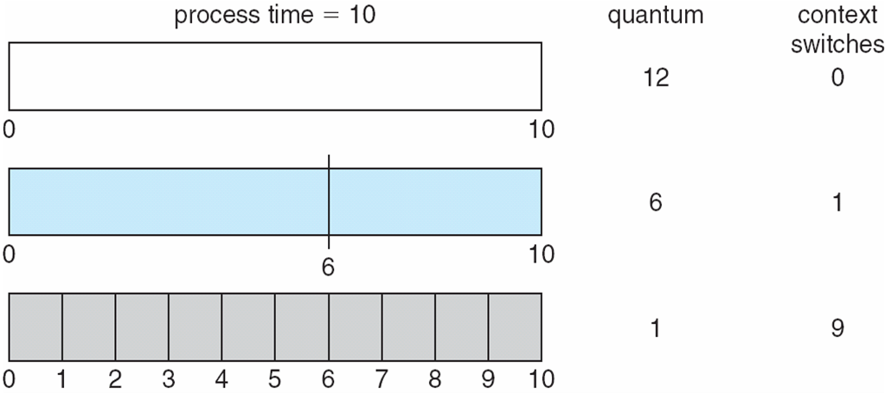
Time Quantum and Context Switch Time

Slide 22
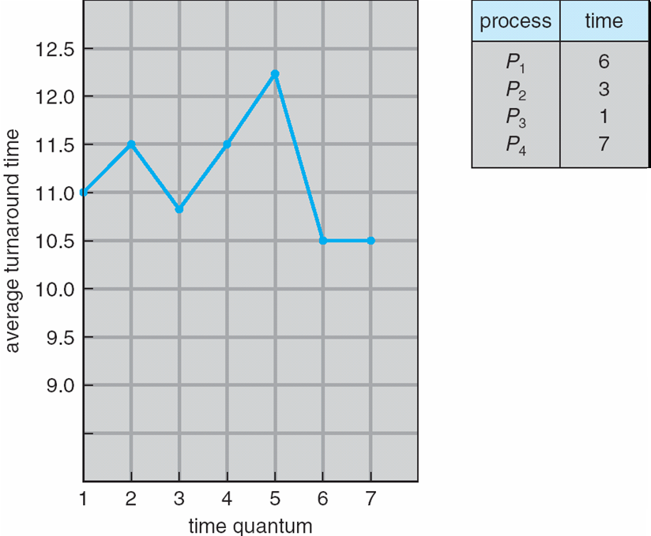
Turnaround Time Varies With The Time Quantum
5,3,1,5,1,2 = 15+8+9+17
= 49/4 = 12.25
6,3,1,6,1 = 6+9+10+17
= 42/4 = 10.5
6,3,1,7 = 6+9+10+17
= 42/4 = 10.5

Slide 23
Multilevel Queue
Ready queue is partitioned into separate queues: foreground (interactive) background (batch)
Each queue has its own scheduling algorithm
foreground – RR
background – FCFS
Scheduling must be done between the queues
Fixed priority scheduling; (i.e., serve all from foreground then from background). Possibility of starvation.
Time slice – each queue gets a certain amount of CPU time which it can schedule amongst its processes; i.e., 80% to foreground in RR, 20% to background in FCFS

Slide 24
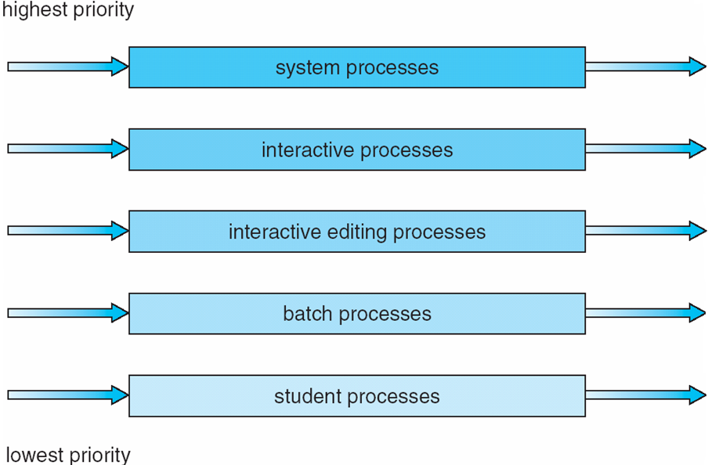
Multilevel Queue Scheduling

Slide 25
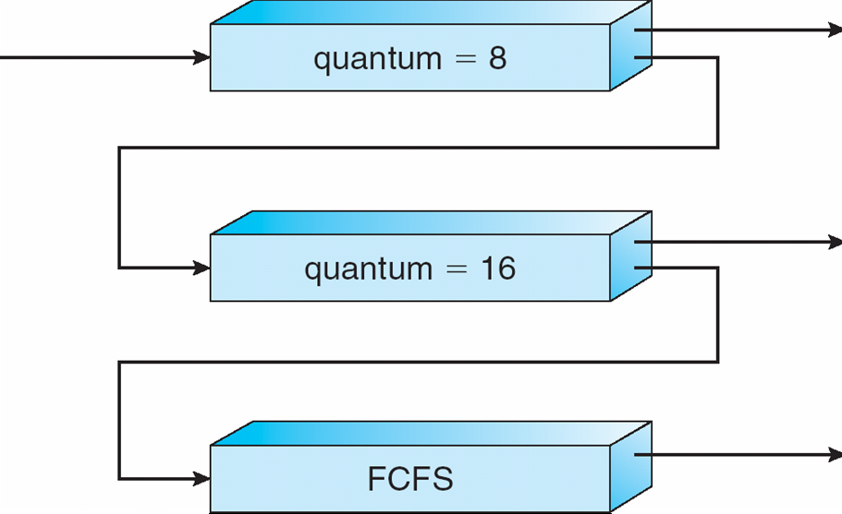
Multilevel Feedback Queue
A process can move between the various queues; aging can be implemented this way
Multilevel-feedback-queue scheduler is defined by the following parameters:
number of queues
scheduling algorithms for each queue
method used to determine when to upgrade a process
method used to determine when to demote降級 a process
method used to determine which queue a process will enter when that process needs service

Slide 26
Example of Multilevel Feedback Queue
Three queues:
Q₀ – RR with time quantum 8 milliseconds
Q₁ – RR time quantum 16 milliseconds
Q₂ – FCFS
Scheduling
A new job enters queue Q₀ which is served FCFS. When it gains CPU, job receives 8 milliseconds. If it does not finish in 8 milliseconds, job is moved to queue Q₁.
At Q₁ job is again served FCFS and receives 16 additional milliseconds. If it still does not complete, it is preempted and moved to queue Q₂.
Notes:
這裡有個問題 Q0 Q1不是都說RR了 怎麼底下還說 Q0 Q1 FCFS

Slide 27
Multilevel Feedback Queues

Slide 28
Thread Scheduling
User-level threads are managed by a thread library, and the kernel is unaware of them
To run on a CPU, user-level threads must ultimately be mapped to an associated kernel-level thread, although this mapping may be indirect and may use a LWP (Light Weight Process).前一章有說
Contention Scope 論點主張爭奪
process-contention scope (PCS)
system-contention scope (SCS)
One distinction between user-level and kernel-level threads lies in how they are scheduled.

Slide 29
Thread Scheduling
Many-to-one and many-to-many models, thread library schedules user-level threads to run on an available LWP (Light Weight Process) 前章有
Known as process-contention scope (PCS) since scheduling competition is among threads belonging to the same process
When we say the thread library schedules user threads onto available LWPs, we do not mean that the thread is actually running on a CPU; this would require the OS to schedule the kernel thread onto a physical CPU.
To decide which kernel thread to schedule onto a CPU, the kernel uses system-contention scope (SCS)

Slide 30
Thread Scheduling
Competition for the CPU with SCS scheduling takes place among all threads in the system.
System using the one-to-one model, schedule threads using only SCS.
Typically, PCS is done according to priority – the scheduler selects the runnable thread with the highest priority to run. User-level thread priorities are set by the programmer and are not adjusted by the thread library.
The PCS will typically preempt the thread currently running a favor of higher-priority thread; however there is no guarantee of time slicing among threads of equal priority.
Notes:
system-contention scope (SCS)

Slide 31
Pthread Scheduling
API allows specifying指定 either PCS or SCS during thread creation
PTHREAD SCOPE PROCESS schedules user-level threads using PCS scheduling
PTHREAD SCOPE SYSTEM schedules threads using SCS scheduling.
Will create and bind an LWP for each user-level thread on many-to-many systems, effectively mapping threads using the one-to-one policy.
Notes:
process-contention scope (PCS) system-contention scope (SCS)

Slide 32
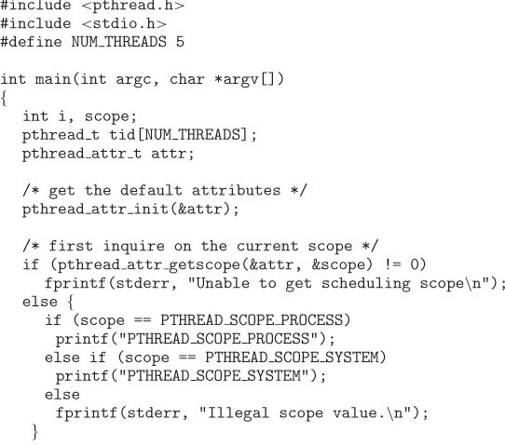
Pthread Scheduling API
Notes:
process-contention scope (PCS) system-contention scope (SCS)

Slide 33
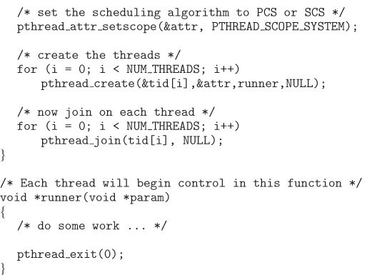
Pthread Scheduling API
Notes:
process-contention scope (PCS) system-contention scope (SCS)

Slide 34
Multiple-Processor Scheduling
CPU scheduling more complex when multiple CPUs are available
Homogeneous processors within a multiprocessor
Asymmetric multiprocessing (AMP) –
All scheduling decisions, I/O processing, and other system activities handled by only a single processor- the master server.
The other processors execute only codes.
Only one processor accesses the system data structures, reducing the need for data sharing
Notes:
Asymmetric 在離散是 A->B 則不會 B->A 但他只說一個Master 那叫Master Slave 就行啦

Slide 35
Homogeneous 我看這篇看起來比較準 好像就同型號的多個CPU 所以各方面都相同
https://superuser.com/questions/1266745/homogeneous-cores-and-heterogeneous-cores#

Slide 36
Multiple-Processor Scheduling
Symmetric multiprocessing (SMP) –
each processor is self-scheduling,
all processes in common ready queue, or
each has its own private queue of ready processes
Processor affinity密切關係 – process has affinity for processor on which it is currently running
soft affinity – a process is possible to migrate between processors
hard affinity – a process is not to migrate to other processor

Slide 37
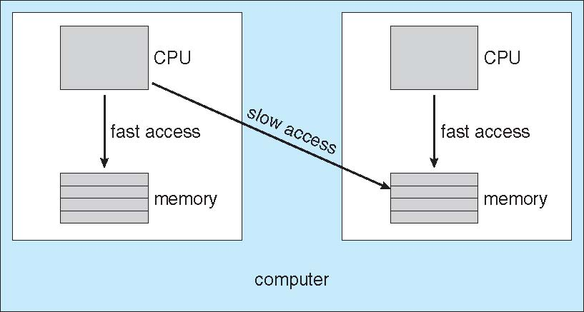
NUMA and CPU Scheduling
The main memory architecture can affect processor affinity issues.
An architecture featuring non-uniform memory access (NUMA) , in which a CPU has faster access to some parts of main memory than to other parts.

Slide 38
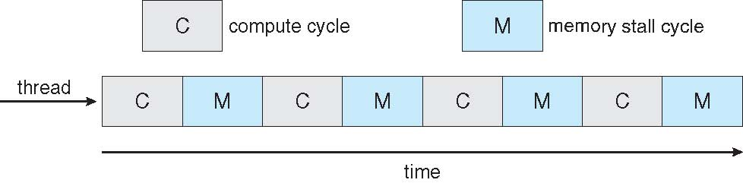
Multicore Processors
Recent trend to place multiple processor cores on same physical chip
Faster and consume less power
Memory stall – when a processor accesses memory, it spends a significant amount of time waiting for the data to become available.

Slide 39
Multicore Processors
Multiple threads per core also growing
Takes advantage of memory stall to make progress on another thread while memory retrieve happens ok前面好像哪邊有說過
Thread₁
Thread₀

Slide 40
Operating System Examples
Solaris scheduling
Windows XP scheduling
Linux scheduling

Slide 41
Solaris scheduling
Solaris uses priority-based thread scheduling where each thread belongs to one of six classes:
Time sharing (TS)
Interactive (IA)
Real time (RT)
System (SYS)
Fair share (FSS)
Fixed priority (FP)
Within each class there are different priorities and different scheduling algorithms.
Default class for a process is time sharing.

Slide 42
Solaris scheduling
The scheduling policy for the time-sharing class dynamically alters priorities and assigns time slices of different length using a multiple feedback queue.
There is an inverse relationship between priorities and time slices.
The following table shows dispatch table for time-sharing and interactive threads.
These two scheduling classes include 60 priority levels.

Slide 43
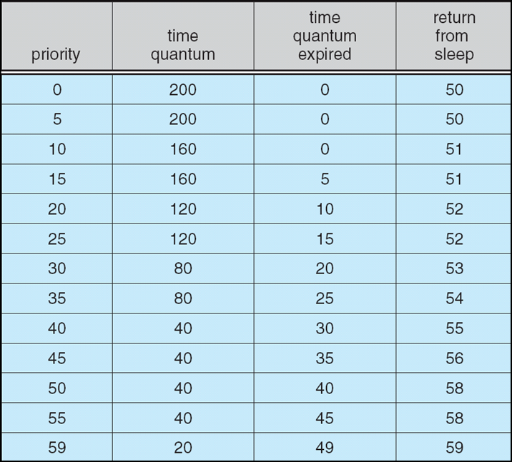
Solaris Dispatch Table
Solaris dispatch table for time-sharing and interactive threads

Slide 44
Solaris scheduling
Priority: The class-dependent priority for the time-sharing and interactive classes. A higher number indicates a higher priority.
Time quantum: The time quantum for the associated priority.
Time quantum expired: The new priority of a thread that has used its entire quantum without blocking. Such threads are considered CPU-intensive and have their priorities lowered.
Return from sleep. The priority of a thread that is returning from sleeping (such as waiting for I/O). When I/O is available for a waiting thread, its priority is boosted between 50-59 – good response time for interactive processes.

Slide 45
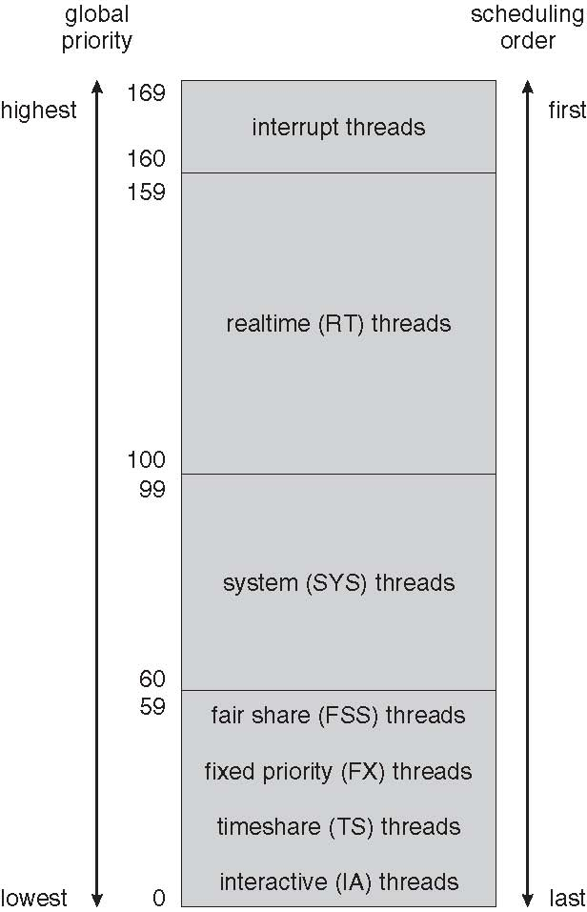
Solaris Scheduling

Slide 46
Windows XP Scheduling
Windows XP schedules threads using a priority-based, preemptive先買權 scheduling algorithm.
Ensures the highest-priority thread will always run.
Dispatcher: The portion of the Windows XP kernel that handles scheduling.
A thread selected to run will run until it is preempted先佔 by a higher-priority thread, until it terminates, until its time quantum ends, or until it calls a blocking system call.

Slide 47
Windows XP Scheduling
32-level priority scheme.
Divided into two classes
Variable class: threads with priorities 1-15
Real-time class, 16-31
Priority 0 for memory management thread
Idle thread: If no ready thread is found, execute the idle thread.

Slide 48
Windows XP Scheduling
The Win32 API identifies several priority classes to which a process can belong:
REALTIME_PRIORITY_CLASS
HIGH_PRIORITY_CLASS
ABOVE_NORMAL_PRIORITY_CLASS
NORMAL_PRIORITY_CLASS
BELOW_NORMAL_PRIORITY_CLASS
IDLE_PRIORITY_CLASS
Priorities in all classes except the REALTIME即時的_PRIORITY_CLASS are variable, the priority of a thread belonging to one of these classes can change.

Slide 49
Windows XP Scheduling
A thread within a given priority class also has a relative priority :
TIME_CRITICAL
HIGHEST
ABOVE_NORMAL
NORMAL
BELOW_NORMAL
LOWEST
IDLE

Slide 50
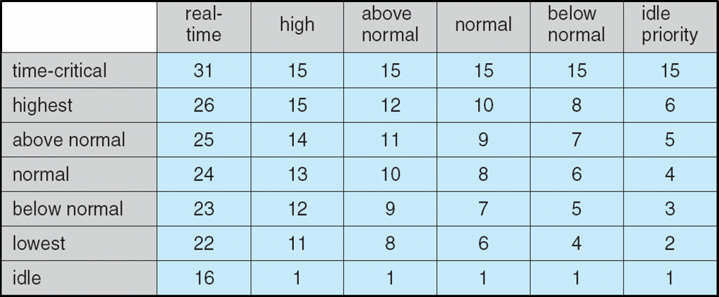
Windows XP Priorities
Priority Classes

Slide 51
Windows XP Scheduling
Each thread has a base priority representing a value in the priority range for the class the thread belongs to.
The base priority is the value of the NORMAL relative priority for that class.
The base priorities:
REALTIME_PRIORITY_CLASS -- 24
HIGH_PRIORITY_CLASS -- 13
ABOVE_NORMAL_PRIORITY_CLASS -- 10
NORMAL_PRIORITY_CLASS -- 8
BELOW_NORMAL_PRIORITY_CLASS -- 6
IDLE_PRIORITY_CLASS -- 4

Slide 52
Linux Scheduling
Constant order O(1) scheduling time regardless of the number of tasks on the system.
The Linux scheduler is a preemptive, priority-based algorithm with two separate priority ranges: a real-time range from 0 to 99 and a nice value from 100 to 140
These two ranges map into a global priority scheme wherein numerically lower values indicate higher priorities.
Unlike Solaris and Windows XP, Linux assigns higher-priority tasks longer time quanta.

Slide 53
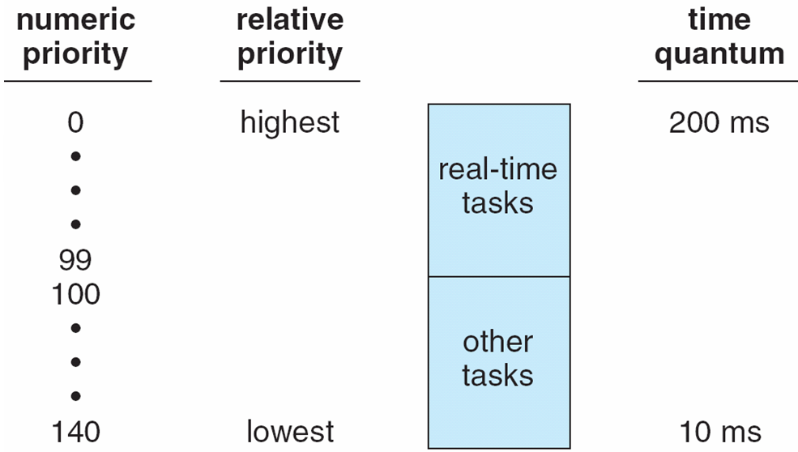
Priorities and Time-slice length

Slide 54
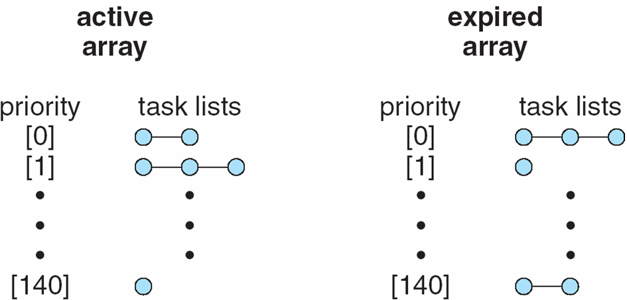
List of Tasks Indexed According to Priorities
The scheduler chooses the task with the highest priority
from the active array for execution on the CPU.
When all tasks have exhausted their time slices (active array is empty), the two priority arrays are exchanged.

Slide 55
Algorithm Evaluation
Criteria
Maximizing CPU utilization under the constraint that the maximum response time is 1 second
Maximizing throughput such that turnaround time (on average) linearly proportional to total execution time
Deterministic modeling
Queueing models
Simulations
Implementation
Notes:
Deterministic 確定性的 不包含任何隨機成份的

Slide 56
Algorithm Evaluation
One major class of evaluation methods is analytic evaluation.
Analytic evaluation uses the given algorithm and the system workload to produce a formula or number that evaluates the performance of the algorithm for that workload.
Deterministic modeling is one type of analytic evaluation – takes a particular predetermined workload and defines the performance of each algorithm for that workload
Example
Notes:
Workload 工作量

Slide 57
Deterministic modeling
Process | Burst Time
P1 | 10
P2 | 29
P3 | 3
P4 | 7
P5 | 12
Minimum average waiting time ?
FCFS
SJF
RR (quantum = 10 milliseconds)

Slide 58
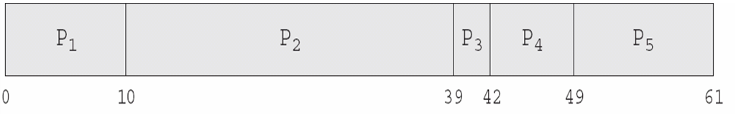
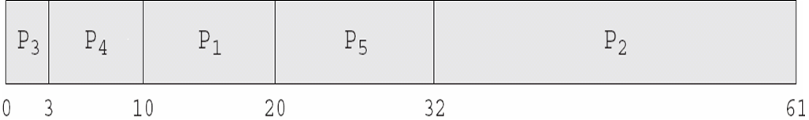
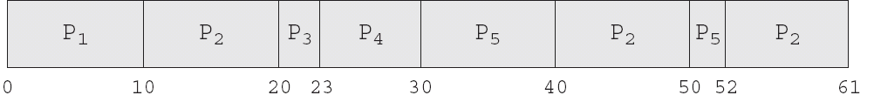
Deterministic modeling
FCFS, AWT = (0+10+39+42+49)/5 = 28
SJF, AWT = (10+32+0+3+20)/5 = 13
RR, AWT = (0+32+20+23+40)/5 = 23

Slide 59
Queueing models
On many systems, the processes that are run vary from day to day, so there is no static set of processes to use for deterministic modeling.
What can be determined is the distribution of CPU and I/O bursts.
These distributions can be measured and then approximated or simply estimated – a mathematical formula describing the probability of a particular CPU burst.
Commonly, this distribution is exponential and is described by its mean.
Notes:
distribution of CPU and I/O bursts.

Slide 60
Queueing models
Similarly, we can describe the distribution of times when processes arrive in the system (the arrival-time distribution).
Based on these two distributions, it is possible to compute the average throughput, utilization, waiting time, and so on for most algorithms.
Queueing-network analysis: the computer system is described as a network of servers. Each server has a queue of waiting processes
CPU – ready queue
I/O system --- device queues
Notes:
the distribution of times when processes arrive in the system

Slide 61
Queueing models
Knowing arrive rates and service rates, we can compute utilization, average queue length, average wait time, etc.
Let n be the average queue length (excluding the process being serviced)
Let W be the average waiting time in the queue
Let λ be the average arrival rate for new processes in the queue (such as 3 processes per second)
Little’s formula: n = λ x W
We expect that during the time W that a process waits, λ x W new processes will arrive in the queue. If the system is in a steady state, then the number of processes leaving the queue must be equal to the number of processes that arrive.
Notes:
1秒來兩個 等待時間5秒 5秒就來10個 5秒過了前面的都進去處理了 後面就又來10個 > n = L x W 我看完公式沒看最後一段自己想的 和最後一段相同 讚讚
steady 穩固的平穩的

Slide 62
Queueing models
Little’s formula can be used to compute one of three variables if we know the other two.
For example, n = 14, λ = 7, then we have W = 2
Queueing analysis also has limitations
Arrival and service distributions are often defined in mathematically tractable馴良易處理的 – but unrealistic – ways.
Generally necessary to make a number of independent assumptions, which may not be accurate.
Queueing models are often only approximations of real systems.

Slide 63
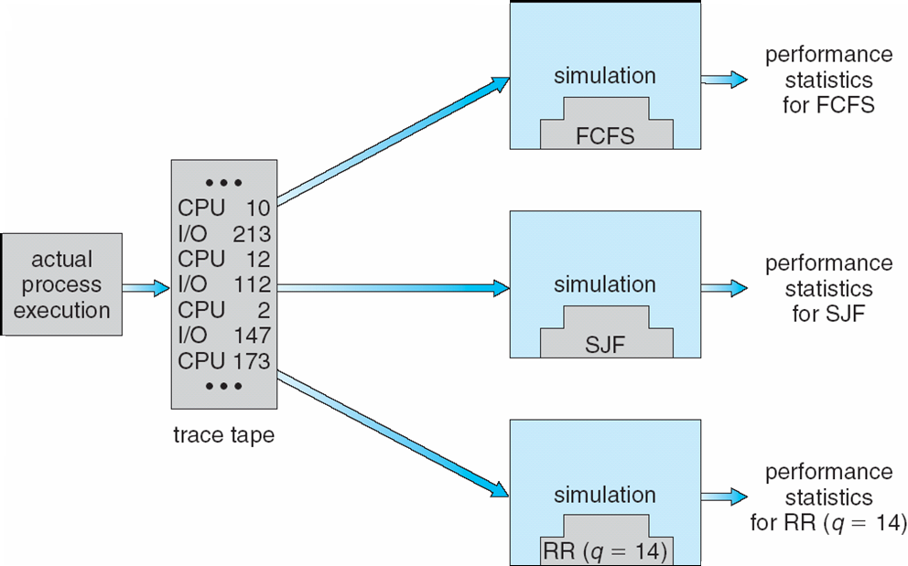
Evaluation of CPU schedulers by Simulation
Notes:
Evaluation n.
評估；估價，評價；估算

Slide 64
End of Chapter 5

