Slide 1
Chapter 6: Synchronization

Slide 2
Synchronization
Background
The Critical-Section Problem
Peterson’s Solution
Synchronization Hardware
Semaphores
Classic Problems of Synchronization
Monitors
Synchronization Examples
Atomic Transactions

Slide 3
Objectives
To introduce the critical-section problem, whose solutions can be used to ensure the consistency of shared data
To present both software and hardware solutions of the critical-section problem
To introduce the concept of an atomic transaction and describe mechanisms to ensure atomicity
Notes:
atomicity the state or fact of being composed of indivisible units.

Slide 4
Background
Concurrent access to shared data may result in data inconsistency
Maintaining data consistency requires mechanisms to ensure the orderly execution of cooperating processes
Suppose that we wanted to provide a solution to the consumer-producer problem that fills all the buffers.
We can do so by having an integer count that keeps track of the number of full buffers.
Initially, count is set to 0. It is incremented by the producer after it produces a new buffer and is decremented by the consumer after it consumes a buffer.

Slide 5
Producer
out
while (true) {
/* produce an item and put in nextProduced */
while (count == BUFFER_SIZE)
; // do nothing
buffer [in] = nextProduced;
in = (in + 1) % BUFFER_SIZE;
count++;
}
In

Slide 6
Consumer
out
while (true) {
while (count == 0)
; // do nothing
nextConsumed = buffer[out];
out = (out + 1) % BUFFER_SIZE;
count--;
/* consume the item in nextConsumed
}
In

Slide 7
Race Condition
count++ could be implemented as register1 = count register1 = register1 + 1 count = register1
count-- could be implemented as register2 = count register2 = register2 - 1 count = register2
Consider this execution interleaving with “count = 5” initially:
S0: producer execute register1 = count {register1 = 5} S1: producer execute register1 = register1 + 1 {register1 = 6} S2: consumer execute register2 = count {register2 = 5} S3: consumer execute register2 = register2 - 1 {register2 = 4} S4: producer execute count = register1 {count = 6 } S5: consumer execute count = register2 {count = 4}

Slide 8
Critical-Section Problem
do {
entry section
critical section
exit section
remainder section
} while (TRUE);
General structure of a typical Process P_{i}
Notes:
Remainder 剩餘

Slide 9
Solution to Critical-Section Problem
1. Mutual相互 Exclusion - If process P_{i} is executing in its critical section, then no other processes can be executing in their critical sections
do {
entry section
critical section
exit section
remainder section
} while (TRUE);
do {
entry section
critical section
exit section
remainder section
} while (TRUE);

Slide 10
Solution to Critical-Section Problem
2. Progress - If no process is executing in its critical section and there exist some processes that wish to enter their critical section, then the selection of the processes that will enter the critical section next cannot be postponed indefinitely
do {
entry section
critical section
exit section
remainder section
} while (TRUE);

Slide 11
Solution to Critical-Section Problem
3. Bounded Waiting - A bound must exist on the number of times that other processes are allowed to enter their critical sections after a process has made a request to enter its critical section and before that request is granted
Assume that each process executes at a nonzero speed
No assumption concerning relative speed of the N processes

Slide 12
Peterson’s Solution
Two-process solution
Assume that the LOAD and STORE instructions are atomic; that is, cannot be interrupted.
The two processes share two variables:
int turn;
Boolean flag[2]
The variable turn indicates whose turn it is to enter the critical section.
The flag array is used to indicate if a process is ready to enter the critical section. flag[i] = true implies that process P_{i} is ready!

Slide 13
Algorithm for Process P_{i}
do {
flag[i] = TRUE;
turn = j;
while (flag[j] && turn == j);
critical section
flag[i] = FALSE;
remainder section
} while (TRUE);
Notes:
看不懂為什麼有i還要有j j是幹嘛的?

Slide 14
Prove this algorithm is correct
1. Mutual exclusion is preserved
2.The progress requirement is satisfied.
3. The bounded waiting requirement is met

Slide 15
Prove this algorithm is correct
1. Mutual exclusion is preserved
do {
flag[i] = TRUE;
turn = j;
while (flag[j] && turn == j);
critical section
flag[i] = FALSE;
remainder section
} while (TRUE);
do {
flag[j] = TRUE;
turn = i;
while (flag[i] && turn == i);
critical section
flag[j] = FALSE;
remainder section
} while (TRUE);

Slide 16
Prove this algorithm is correct
2. The progress requirement is satisfied.
do {
flag[i] = TRUE;
turn = j;
while (flag[j] && turn == j);
critical section
flag[i] = FALSE;
remainder section
} while (TRUE);
do {
flag[j] = TRUE;
turn = i;
while (flag[i] && turn == i);
critical section
flag[j] = FALSE;
remainder section
} while (TRUE);

Slide 17
Prove this algorithm is correct
3. The bounded waiting requirement is met
do {
flag[i] = TRUE;
turn = j;
while (flag[j] && turn == j);
critical section
flag[i] = FALSE;
remainder section
} while (TRUE);
do {
flag[j] = TRUE;
turn = i;
while (flag[i] && turn == i);
critical section
flag[j] = FALSE;
remainder section
} while (TRUE);

Slide 18


Synchronization Hardware
Any solution to the critical-section problem requires a simple tool – a lock.
Race conditions are prevented by requiring that critical regions be protected by locks
do {
acquire lock
critical section
release lock
remainder section
} while (TRUE);

Slide 19
Synchronization Hardware
Many systems provide hardware support for critical section code
Uniprocessors – could disable interrupts
Currently running code would execute without preemption
Generally too inefficient on multiprocessor systems
Operating systems using this not broadly scalable
Modern machines provide special atomic hardware instructions
Atomic = non-interruptable
Either test memory word and set value
Or swap contents of two memory words

Slide 20
TestAndndSet Instruction
Definition:
boolean TestAndSet (boolean *target)
{
boolean rv = *target; /* Test */
*target = TRUE; /* Set */
return rv:
}

Slide 21
Solution using TestAndSet
Shared boolean variable lock., initialized to false.
Solution (Mutual-Exclusion):
do {
while ( TestAndSet (&lock ))
; // do nothing
// critical section
lock = FALSE;
// remainder section
} while (TRUE);
lock

Slide 22
Swap Instruction
Definition:
void Swap (boolean *a, boolean *b)
{
boolean temp = *a;
*a = *b;
*b = temp:
}

Slide 23
Solution using Swap
Shared Boolean variable lock initialized to FALSE; Each process has a local Boolean variable key
Solution(Mutual-Exclusion):
do {
key = TRUE;
while ( key == TRUE)
Swap (&lock, &key );
// critical section
lock = FALSE;
// remainder section
} while (TRUE);
lock

Slide 24
Bounded-waiting Mutual Exclusion with TestandSet()
do {
waiting[i] = TRUE;
key = TRUE;
while (waiting[i] && key)
key = TestAndSet(&lock);
waiting[i] = FALSE;
// critical section
j = (i + 1) % n;
while ((j != i) && !waiting[j]) (Find next waiting process)
j = (j + 1) % n;
if (j == i)
lock = FALSE; (No one is waiting)
else
waiting[j] = FALSE; (process j enters next)
// remainder section
} while (TRUE);
i
i+1
j
k
j
j
j
k
k
i+1
k
i+1
i
i+1
i
i

Slide 25
Prove this algorithm is correct
1. Mutual exclusion is preserved
2. The progress requirement is satisfied.
3. The bounded waiting requirement is met

Slide 26

Semaphores
The hardware-based solutions for the CS problem are complicated for application programmers to use.
To overcome this difficulty, we use a synchronization tool called a semaphore.
Semaphore S – integer variable
Two standard operations modify S: wait() and signal()
Originally called P() and V()
Less complicated

Slide 27
Semaphores
Can only be accessed via two indivisible (atomic) operations
wait (S) {
while S <= 0 /* Semaphore S is occupied */
; // no-op
S--; /* Semaphore S is available, get it */
}
signal (S) {
S++; /* Release the semaphore S */
}
Notes:
看意思 Semap <=0 是被占用 >0可用 要占用就--

Slide 28
Semaphore Usage
Counting semaphore – integer range over an unrestricted domain
Binary semaphore – integer value can range only between 0 and 1; can be simpler to implement
Also known as mutex locks as they are locks that provide mutual exclusion.
We can use binary semaphore to deal with the CS problem for multiple processes.
The n processes share a semaphore, mutex, initialized to 1
Notes:
ok

Slide 29
Mutual-Exclusion Implementation with semaphores
Provides mutual exclusion (for Process Pi)
Semaphore mutex; // initialized to 1
do {
wait (mutex);
// Critical Section
signal (mutex);
// remainder section
} while (TRUE);

Slide 30
Semaphore Usage
Counting semaphore can be used to control access to a given resource consisting of a finite number of instances.
The semaphore is initialized to the number of resources available.
To use a resource, wait()
To release a resource, signal()
Semaphores can be used to solve various synchronization problem.
For example, we have two processes P1 and P2. Execute S1 and then S2: Synch = 0
S1;
signal(synch);
wait(synch);
S2;
P1 P2

Slide 31
Semaphore Implementation
The main disadvantage of previous mutual-exclusion solution is the busy waiting (CPU is wasting).
This type of semaphore is called a spinlock.
To overcome this, we can use the concept of block and wakeup operations.
Typedef struc {
int value;
struct process *list;
} semaphore

Slide 32
Spin lock https://huenlil.pixnet.net/blog/post/23999871
在 Linux Kernel 裡有著許多重要的資料結構，這些資料在作業系統的運作中扮演著舉足輕重的角色。然而，Linux 是個多任務的作業系統，也就是在同一時間裡可以同時有許多的行程在執行，所以，很有可能某個行程在依序讀取 inode list，同時卻又有另一個在 inode list 裡加入新的 inode，這會造成什麼情形呢？這會造成 inode list 的不穩定。所以，在 Kernel 裡，我們需要一個機制，可以使得當我們在修改某個重要的資料結構時，不能被中斷，即使被中斷了，這個資料結構由於還沒修改完，別的行程也都不能去讀取和修改它。Linux Kernel提供了 spinlock 這個機制可以使我們做到這樣的功能。
有的人會想到當我們在修改某個重要的資料結構時，將中斷都 disable 掉就好了，等修改完了再將中斷 enable 不就得了，何必還要再提供一個 spinlock 來做同樣的事。在 uni-processor 的環境底下，的確是如此。所謂 uni-processor 就是指只有一個 CPU 的電腦，但是在SMP的環境下就不是這幺一回事了。
我們知道現在 Linux 已經有支持 SMP，也就是可以使用多顆 CPU 來加快系統的速度，如果當我們在修改重要的資料結構時，將執行修改工作的 CPU 中斷 disable 掉的話，只有目前的這個 CPU 的執行不會被中斷，在 SMP 環境下，還有別的 CPU 正同時運作，如果別的 CPU 也去修改這個資料結構的話，就會造成同時有兩個 CPU 在修改它，不穩定性就會產生。解決方法是將全部的 CPU 中斷都 disable 掉，等修改完之後，再全部都 enable 起來。但是這樣的做法其 cost 會很大，整個系統的效能會 down 下來。因此，Linux Kernel 才會提供 spinlock 這樣的機制，它不會將全部 CPU 的中斷 disable 掉，所以效率比上述的方法好，但同時卻又能確保資料的穩定性，不會有某個行程在修改它，另外又有一個行程在讀取或修改它的情形發生。

Slide 33
Semaphore Implementation with no Busy waiting
With each semaphore there is an associated waiting queue. Each entry in a waiting queue has two data items:
value (of type integer)
Value > 0 indicates semaphore is still available
Value = 0 indicates semaphore is just occupied and
no waiting process
Value < 0 indicates the number of waiting processes
pointer to next record in the list /* waiting list */
Two operations:
block – place the process invoking the operation on the appropriate waiting queue.
wakeup – remove one of processes in the waiting queue and place it in the ready queue.
Notes:
Semaphore （鐵路的）臂板信號；信號 這waintQ感覺有點像是LinkList的Node資結 waitingQ < block/wakeup > readQ

Slide 34
Semaphore Implementation with no Busy waiting
Implementation of wait:
wait(semaphore *S) {
S.value --;
if (S.value < 0) {
add this process to S.list;
block();
}
}

Slide 35
Semaphore Implementation with no Busy waiting
Implementation of signal:
signal(semaphore *S) {
S.value ++;
if (S.value <= 0) {
remove a process P from S.list;
wakeup(P);
}
}
Notes:
不過有點怪的是wait是 <0 signal是 <=0 怪

Slide 36
Semaphore Implementation with no Busy waiting
Note that the semaphore value may be negative.
Its magnitude is the number of processes waiting on that semaphore.
The list of waiting processes can be easily implemented by a link field in each process control block (PCB).

Slide 37
Deadlock and Starvation
Deadlock – two or more processes are waiting indefinitely for an event that can be caused by only one of the waiting processes
Let S and Q be two semaphores initialized to 1
Starvation – indefinite blocking. A process may never be removed from the semaphore queue in which it is suspended
P0
wait(S);
wait(Q);
signal(S);
signal(Q);
P1
wait(Q);
wait(S);
signal(Q);
signal(S);
Deadlock !!
.
.
.
.
.
.

Slide 38
Priority Inversion
Priority Inversion - Scheduling problem when lower-priority process holds a lock needed by higher-priority process.
Three processes L, M, H with priority L < M < H
Assume process H requires resource R, which is using by process L. Process H waits.
Assume process M becomes runnable, thereby preempting process L.
Indirectly, a process with lower priority – M – has affected how long H must wait for L to release R.
Priority-inheritance protocol – all processes that are accessing resources needed by a higher priority process inherit the higher priority until they are finished with the resources.

Slide 39
Classical Problems of Synchronization
Bounded-Buffer Problem
Readers and Writers Problem
Dining-Philosophers Problem

Slide 40
Bounded-Buffer Problem
Used to illustrate the power of synchronization primitives.
N buffers, each can hold one item
Semaphore mutex initialized to the value 1
Semaphore full initialized to the value 0
Semaphore empty initialized to the value N.

Slide 41
Bounded Buffer Problem (Cont.)
The structure of the producer process
do {
// produce an item in nextp
wait (empty);
wait (mutex);
// add the item to the buffer
signal (mutex);
signal (full);
} while (TRUE);
The structure of the consumer process
do {
wait (full);
wait (mutex);
// remove an item from buffer to nextc
signal (mutex);
signal (empty);
// consume the item in nextc
} while (TRUE);
Initial, Empty = N, Full = 0

Slide 42
The Reader and Writers Problem
A data object, such as a file or record, is to be shared among several concurrent processes.
The writers are required to have exclusive access to the shared object.
The readers-writers problem has several variations, all involving priorities.
The First problem -- require no reader will be kept waiting unless a writer has already obtained permission to use the shared object. Thus, no reader should wait for other readers to finish even a writer is waiting.

Slide 43
The Reader and Writers Problem
The Second problem -- require once a writer is ready, that writer performs its write as soon as possible, after old readers (or writer) are completed. Thus, if a writer is waiting to access the object, no new readers may start reading.
A solution to either problem may result in starvation.
The first problem : Writers
Writers wait, but readers come in one after one
The second problem : Readers
Readers wait, but writers come in one after one

Slide 44
A solution for the first problem
Shared Data
Semaphore mutex initialized to 1
Semaphore wrt initialized to 1
Integer readcount initialized to 0
The mutex semaphore is used to ensure mutual exclusion when the variable readcount is updated.
Readcount keeps track of how many processes are currently reading the object.
The wrt semaphore functions as a mutual exclusion semaphore for the writers.
It also is used by the first or last reader that enters or exits the critical section.
It is not used by the readers who enter or exit while other processes are in their critical sections.

Slide 45
A solution for the first problem
If a writer is in the CS and n readers are waiting, then one reader is queued on wrt and n-1 readers are queued on mutex.
When a writer executes signal(wrt), we may assume the execution of either the waiting writers or a single reader. The selection is made by the scheduler.
do {
wait (mutex) ;
readcount ++ ;
if (readcount == 1)
wait (wrt) ;
signal (mutex)
// reading is performed
wait (mutex) ;
readcount - - ;
if (readcount == 0)
signal (wrt) ;
signal (mutex) ;
} while (TRUE);
do {
wait (wrt) ;
// writing is performed
signal (wrt) ;
} while (TRUE);
First reader
Last reader

Slide 46
A solution for the first problem
do {
wait (mutex) ;
readcount ++ ;
if (readcount == 1)
wait (wrt) ;
signal (mutex)
// reading is performed
wait (mutex) ;
readcount - - ;
if (readcount == 0)
signal (wrt) ;
signal (mutex) ;
} while (TRUE);
do {
wait (wrt) ;
// writing is performed
signal (wrt) ;
} while (TRUE);
First reader
Last reader

Slide 47
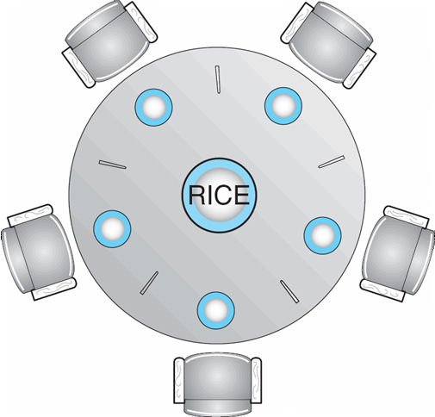
Dining-Philosophers Problem
Shared data
Bowl of rice (data set)
Semaphore chopstick [5] initialized to 1
Notes:
好像兩個人中間故意只放一根筷子 比較好探討deadlock

Slide 48
Dining-Philosophers Problem (Cont.)
Represent each chopstick by a semaphore.
Wait and Signal on the semaphores.
Var chopstick: array [0..4] of semaphores;
The structure of Philosopher i:
do {
wait ( chopstick[i] );
wait ( chopstick[ (i + 1) % 5] );
// eat
signal ( chopstick[i] );
signal (chopstick[ (i + 1) % 5] );
// think
} while (TRUE);
Deadlock !!
Notes:
這邊還是沒看很懂 怎麼拿一根 再往右拿一根 馬上就Deadlock 再看一下好了

Slide 49
Several possible solutions to the deadlock problem
Allow at most four philosophers to be sitting simultaneously at the table.
Allow a philosopher to pick up her chopsticks only if both chopsticks are available (note that she must pick them up in a critical section).
Use an asymmetric solution. Thus,
an odd philosopher picks up first her left chopstick and then her right chopstick, whereas
an even philosopher picks up her right chopstick and then her left chopstick.
Notes:
ok

Slide 50
Problems with Semaphores
Correct use of semaphore operations: Otherwise, some problems may happen
signal (mutex) …. wait (mutex)
wait (mutex) … wait (mutex)
Omitting of wait (mutex) or signal (mutex) (or both)
Notes:
應是先wait再signal

Slide 51
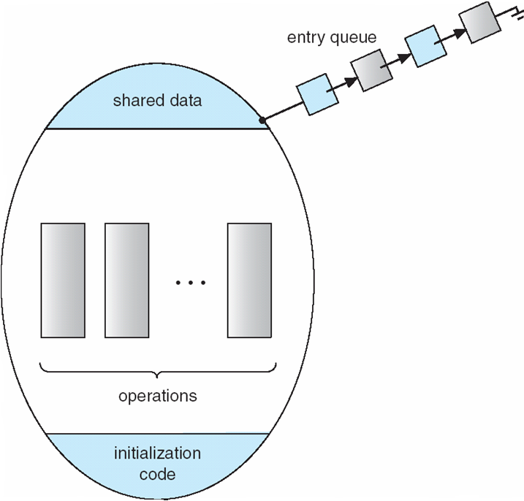
Monitors
A high-level abstraction that provides a convenient and effective mechanism for process synchronization
Only one process may be active within the monitor at a time
monitor monitor-name
{ // shared variable declarations
procedure P1 (…) { …. }
…
procedure Pn (…) {……}
Initialization code ( ….) { … }
…
}
Notes:
k

Slide 52
Schematic view of a Monitor
Processes waiting to
enter their Monitor

Slide 53
Monitors
entry queue
Syntax of a monitor
type monitor-name = monitor
variable declarations
procedure entry P1(...);
begin ... end;
procedure entry P2(...);
begin ... end;
procedure entry Pn(...);
begin ... end;
begin
initialization code
end.
shared data
...
operations
initialization
code
Schematic view of a monitor

Slide 54
Condition Construct
A programmer who needs to write her own tailor-made synchronization scheme can define one or more variables of type condition.
Var x,y : condition;
The only operations that can be invoked on a condition variable are wait and signal. For example, x.wait, x.signal.
The x.signal resumes exactly one suspended process. If no process is suspended, then the signal operation has no effect.
Suppose P invokes x.signal and Q is suspended with x. Two possibilities exist:
P either waits Q leaves or another condition
Q either waits P leaves or another condition

Slide 55
Condition Variables
condition x, y;
Two operations on a condition variable:
x.wait () – a process that invokes the operation is suspended.
x.signal () – resumes one of processes (if any) that invoked x.wait ()

Slide 56
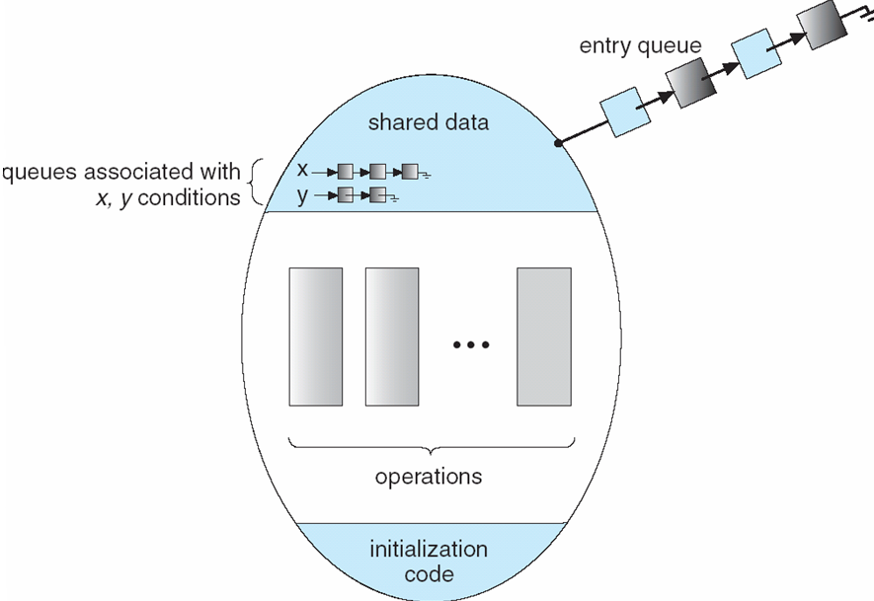
Monitor with Condition Variables
Processes waiting to
enter their Monitor
x.wait, x.signal
y.wait, y.signal

Slide 57
A Deadlock-free Monitor Solution for the Dining-Philosophers Problem
A philosopher is allowed to pick up her chopsticks only if both of them are available.
Data structure:
Var state: array [0..4] of (thinking, hungry, eating);
Var self: array [0..4] of condition;
Philosopher i can delay herself when she is hungry, but is unable to obtain the chopsticks she needs.
Operations:
pickup and putdown on the instance dp of the dining-
philosophers monitor

Slide 58
Solution to Dining Philosophers (cont)
Each philosopher i must invoke the operations pickup() and putdown() in the following sequence:
var dining-philosophers: dp
dining-philosophers.pickup(i);
...
eat
...
dining-philosophers.putdown(i);
Process i

Slide 59
A Deadlock-free Monitor Solution for the Dining-Philosophers Problem
monitor dp
{
enum { THINKING; HUNGRY, EATING) state [5] ;
condition self [5];
void pickup (int i) {
state[i] = HUNGRY;
test(i);
if (state[i] != EATING) self [i].wait;
}
void putdown (int i) {
state[i] = THINKING;
// test left and right neighbors
test((i + 4) % 5);
test((i + 1) % 5);
}
Test if both chopsticks are available
void test (int i) {
if ( (state[(i + 4) % 5] != EATING) &&
(state[i] == HUNGRY) &&
(state[(i + 1) % 5] != EATING) ) {
state[i] = EATING ;
self[i].signal () ;
}
}
initialization_code() {
for (int i = 0; i < 5; i++)
state[i] = THINKING;
}
}
Notes:
n.
（鐵路的）臂板信號；信號

Slide 60
Illustration of the algorithm
The x.signal resumes exactly one suspended process.
If no process is suspended, then the signal operation has no effect.
3
4
4
3
2
Self[2].wait
--> Eating
0
2
1
0
1
Self[0].wait
--> Eating
Eating --> self[1].signal (No effect)
Pushdown
test (0) -> self[0].signal,
test (2) -> self[2].signal

Slide 61
Monitor Implementation Using Semaphores
A possible implementation of the monitor mechanism using semaphores.
For each monitor, a semaphore mutex (init to 1) is provided.
A process must execute wait (mutex) before entering the monitor and must execute signal (mutex) after leaving the monitor
Since a signaling process must wait until the resumed process either leaves or waits, an additional semaphore, next, is introduced (init to 0).
The signaling processes can use next to suspend themselves.
An integer variable next_count is also provided to count the number of processes suspended on next.

Slide 62
Monitor Implementation Using Semaphores
Variables
semaphore mutex; // (initially = 1)
semaphore next; // (initially = 0)
int next-count = 0;
Each external procedure F will be replaced by
wait(mutex);
…
body of F
…
if (next_count > 0)
signal(next)
else
signal(mutex);
Mutual exclusion within a monitor is ensured.
wait(mutex)

Slide 63
Monitor (Condition Variable) Implementation Using Semaphores
For each condition variable x, we have:
semaphore x_sem; // (initially = 0)
int x-count = 0;
The operation x.wait can be implemented as:
x-count++;
if (next_count > 0)
signal(next);
else
signal(mutex);
wait(x_sem);
x-count--;
wait(mutex)

Slide 64
Monitor Implementation Using Semaphores
The operation x.signal can be implemented as:
if (x-count > 0) {
next_count++;
signal(x_sem);
wait(next);
next_count--;
}
What happen if x-count <= 0 ?
Nothing will happen !!
wait(mutex)
Notes:
ssignal自己 irgt’0338 pv5 []\\\\\\\\\\\\\\\

Slide 65
Resuming Processes within a Monitor
If several processes are suspended on condition x, and an x.signal() operation is executed by some process, how do we determine which of the suspended processes should be resumed next ?
FCFS ordering is simple, but may not adequate
Conditional-wait construct
x.wait (c)
c is an integer expression that is evaluated when the wait() operation is executed.
c is called a priority number.
When x.signal () is executed, the process with smallest priority number is resumed next.

Slide 66
A Monitor to Allocate Single Resource
monitor ResourceAllocator
{
boolean busy;
condition x;
void acquire(int time) {
if (busy)
x.wait(time);
busy = TRUE;
}
void release() {
busy = FALSE;
x.signal();
}
initialization code() {
busy = FALSE;
}
}
The process with smallest priority number is resumed next

Slide 67
Resuming Processes within a Monitor
The monitor allocates the resource that has the shortest time-allocation request.
A process that needs to access the resource in question must observe the following sequence:
R.acquire (t); ← Get the resource, or wait for it !!
…..
access the resource
……
R. release();
Where R is an instance of type ResourceAllocator.
Notes:
有點怪 這邊說shortet time alloct

Slide 68
Synchronization Examples
Solaris
Windows XP
Linux
Pthreads

Slide 69
Solaris Synchronization
Implements a variety of locks to support multitasking, multithreading (including real-time threads), and multiprocessing
Uses adaptive mutexes for efficiency when protecting data from short code segments
Uses condition variables and readers-writers locks when longer sections of code need access to data
Uses turnstiles to order the list of threads waiting to acquire either an adaptive mutex or reader-writer lock
Notes:
adaptive 美式 適合的；適應的 turnstile 十字轉門

Slide 70
Windows XP Synchronization
Uses interrupt masks to protect access to global resources on uniprocessor systems
Uses spinlocks on multiprocessor systems
Also provides dispatcher objects which may act as either mutexes and semaphores
Dispatcher objects may also provide events
An event acts much like a condition variable

Slide 71
Linux Synchronization
Linux:
Prior to kernel Version 2.6, disables interrupts to implement short critical sections
Version 2.6 and later, fully preemptive
Linux provides:
semaphores
spin locks

Slide 72
Pthreads Synchronization
Pthreads API is OS-independent
It provides:
mutex locks
condition variables
Non-portable extensions include:
read-write locks
spin locks

Slide 73
Atomic Transactions
Make sure that a critical section forms a single logical unit of work that either is performed in its entirety or is nor performed at all.
Consistency of data, along with storage and retrieval of data, is a concern often associated with database systems.
System Model
Log-based Recovery
Checkpoints
Concurrent Atomic Transactions

Slide 74
System Model
Assures that operations (a collection of instructions) happen as a single logical unit of work, in its entirety, or not at all
Related to field of database systems
Challenge is assuring atomicity despite computer system failures
Transaction - collection of instructions or operations that performs single logical function
Here we are concerned with changes to stable storage – disk
Transaction is series of read and write operations
Terminated by commit (transaction successful) or abort (transaction failed) operation
Aborted transaction must be rolled back to undo any changes it performed

Slide 75
Types of Storage Media
Volatile storage – information stored here does not survive system crashes
Example: main memory, cache
Nonvolatile storage – Information usually survives crashes
Example: disk and tape
Stable storage – Information never lost
Not actually possible, so approximated via replication or RAID to devices with independent failure modes
Goal is to assure transaction atomicity where failures cause loss of information on volatile storage

Slide 76
Log-Based Recovery
Record to stable storage information about all modifications by a transaction
Most common is write-ahead logging
Log on stable storage, each log record describes single transaction write operation, including
Transaction name
Data item name
Old value
New value
<T_{i} starts> written to log when transaction T_{i} starts
<T_{i} commits> written when T_{i} commits
Log entry must reach stable storage before operation on data occurs

Slide 77
Log-Based Recovery Algorithm
Using the log, system can handle any volatile memory errors
Undo(T_{i}) restores value of all data updated by T_{i}
Redo(T_{i}) sets values of all data in transaction T_{i} to new values
Undo(T_{i}) and redo(T_{i}) must be idempotent
Multiple executions must have the same result as one execution
If system fails, restore state of all updated data via log
If log contains <T_{i} starts> without <T_{i} commits>, undo(T_{i})
If log contains <T_{i} starts> and <T_{i} commits>, redo(T_{i})
Notes:
Idempotence is the property of certain operations in mathematics and computer science whereby they can be applied multiple times without changing the result beyond the initial application.

Slide 78
Checkpoints
Log could become long, and recovery could take long
Checkpoints shorten log and recovery time.
Checkpoint scheme:
Output all log records currently in volatile storage to stable storage
Output all modified data from volatile to stable storage
Output a log record <checkpoint> to the log on stable storage
Now recovery only includes Ti, such that Ti started executing before the most recent checkpoint, and all transactions after Ti
All other transactions already on stable storage

Slide 79
Concurrent Transactions
Must be equivalent to serial execution – serializability
Could perform all transactions in critical section
Inefficient, too restrictive
Concurrency-control algorithms provide serializability

Slide 80
Serializability
Consider two data items A and B
Consider Transactions T₀ and T₁
Execute T₀, T₁ atomically
Execution sequence called schedule
Atomically executed transaction order called serial schedule
For N transactions, there are N! valid serial schedules

Slide 81
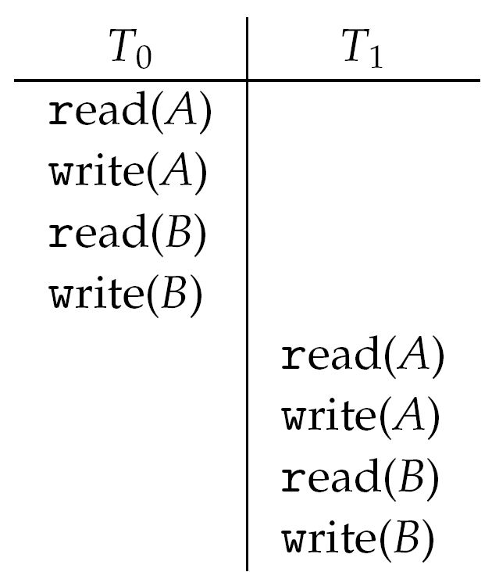
Schedule 1: T₀ then T₁

Slide 82
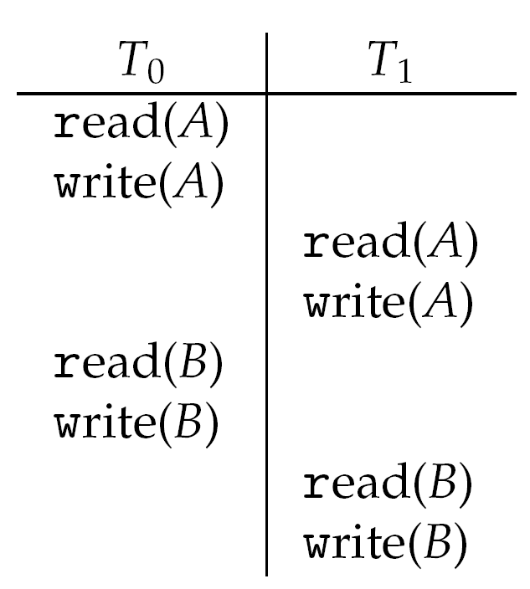
Nonserial Schedule
Nonserial schedule allows overlapped execute
Resulting execution not necessarily incorrect
Consider schedule S, operations O_{i} , O_{j} of Transactions T_{i} and T_{j,}
Conflict if access same data item, with at least one write
If O_{i}, O_{j} are consecutive and operations of different transactions & O_{i} and O_{j} don’t conflict
Then S’ with swapped order O_{j} O_{i} equivalent to S

Slide 83
Nonserial Schedule
We say that S is conflict serializable, if it can be transformed into a serial schedule S’ by a series of swaps of nonconflicting operations.
S
S’

Slide 84
Locking Protocol
One way to ensure serializability is to associate a lock with each data item and each transaction follows locking protocol for access control.
Locks
Shared – T_{i} has shared-mode lock (S) on item Q, T_{i} can read Q but not write Q
Exclusive – Ti has exclusive-mode lock (X) on Q, T_{i} can read and write Q
Require every transaction on item Q acquire appropriate lock
If lock already held, new request may have to wait
Similar to readers-writers algorithm

Slide 85
Two-phase Locking Protocol
The two-phase locking protocol ensures conflict serializability
Each transaction issues lock and unlock requests in two phases
Growing – A transaction may obtain locks but may not release any locks
Shrinking – A transaction may release locks but may not obtain any new locks.
Initially, a transaction is a the growing phase. The transaction acquires locks as needed. Once the transaction releases a lock, it enters the shrinking phase, and no more lock requests can be issued
Does not prevent deadlock

Slide 86
Timestamp-based Protocols
Select order among transactions in advance – timestamp-ordering
Transaction T_{i} associated with timestamp TS(T_{i}) before T_{i} starts
TS(T_{i}) < TS(T_{j}) if T_{i} entered system before T_{j}
TS can be generated from system clock or as logical counter incremented at each entry of transaction
Timestamps determine serializability order
If TS(T_{i}) < TS(T_{j}), system must ensure produced schedule equivalent to serial schedule where T_{i} appears before T_{j}

Slide 87
Timestamp-based Protocol Implementation
Data item Q gets two timestamps
W-timestamp(Q) – largest timestamp of any transaction that executed write(Q) successfully
R-timestamp(Q) – largest timestamp of successful read(Q)
Updated whenever read(Q) or write(Q) executed
Timestamp-ordering protocol assures any conflicting read and write executed in timestamp order

Slide 88
Timestamp-based Protocol Implementation
Suppose T_{i} executes read(Q)
If TS(T_{i}) < W-timestamp(Q), Ti needs to read value of Q that was already overwritten
read operation rejected and T_{i} rolled back
If TS(T_{i}) ≥ W-timestamp(Q)
read executed, R-timestamp(Q) set to max(R-timestamp(Q), TS(T_{i}))

Slide 89
Timestamp-ordering Protocol
Suppose Ti executes write(Q)
If TS(T_{i}) < R-timestamp(Q), value Q produced by T_{i} was needed previously and T_{i} assumed it would never be produced
Write operation rejected, T_{i} rolled back
If TS(T_{i}) < W-timestamp(Q), T_{i} attempting to write obsolete value of Q
Write operation rejected and T_{i} rolled back
Otherwise, write executed
A transaction T_{i} is rolled back as a result of either a read or write operation is assigned a new timestamp and is restarted
Notes:
obsolete 廢棄的，淘汰的；過時的，老式的

Slide 90
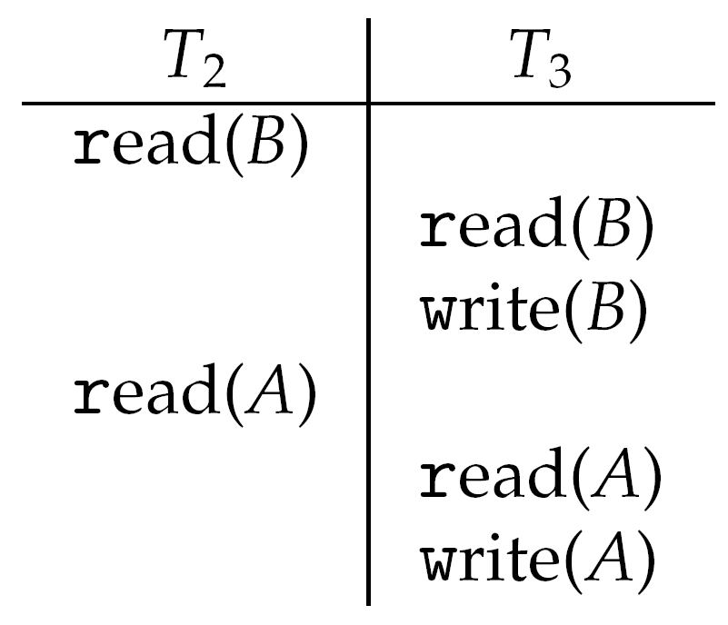
Timestamp-ordering Protocol Example
Assume a transaction is assigned a timestamp immediately before its first instruction.
Thus, TS(T₂) < TS(T₃)
The following schedule is possible under Timestamp Protocol

Slide 91
Timestamp-ordering Protocol
This algorithm ensures
conflict serializability – conflicting operations are processed in timestamp order, and
freedom from deadlock – no transactions ever waits

Slide 92
End of Chapter 6

