Slide 1
Chapter 6: Synchronization
Notes:
電腦有很多程式執行 可能會共用 share data 資料結構 有些proc 讀 有些寫 就會牽涉到synchro問題 先後次序也有關

Slide 2
spinlock & mutex & semaphore 的作用和區別
Mutex是一把鑰匙，一個人拿了就可進入一個房間，出來的時候把鑰匙交給隊列的第一個。一般的用法是用於串行化對critical section代碼的訪問，保證這段代碼不會被並行的運行。 (A mutex is really a semaphore with value 1.) Semaphore是一件可以容納N人的房間，如果人不滿就可以進去，如果人滿了，就要等待有人出來。對於N=1的情況，稱為binary semaphore。一般的用法是，用於限制對於某一資源的同時訪問。 Binary semaphore與Mutex的差異： 在有的系統中Binary semaphore與Mutex是沒有差異的。在有的系統上，主要的差異是mutex一定要由獲得鎖的進程來釋放。而semaphore可以由其它進程釋放（這時的semaphore實際就是個原子的變量，大家可以加或減），因此semaphore可以用於進程間同步。 Semaphore的同步功能是所有系統都支持的，而Mutex能否由其他進程釋放則未定，因此建議mutex只用於保護critical section。而semaphore則用於保護某變量，或者同步。 另一個概念是spin lock，這是一個內核態概念。 spin lock與semaphore的主要區別是spin lock是busy waiting，而semaphore是sleep。對於可以sleep的進程來說，busy waiting當然沒有意義。對於單CPU的系統，busy waiting當然更沒意義（沒有CPU可以釋放鎖）。因此，只有多CPU的內核態非進程空間，才會用到spin lock。 Linux kernel的spin lock在非SMP的情況下，只是關irq，沒有別的操作，用於確保該段程序的運行不會被打斷。其實也就是類似mutex的作用，串行化對critical section的訪問。但是mutex不能保護中斷的打斷，也不能在中斷處理程序中被調用。而spin lock也一般沒有必要用於可以sleep的進程空間。

Slide 3
Synchronization
Background
The Critical-Section Problem 到共用資料結構存取的程式 多個proc讀寫要特殊處理
Peterson’s Solution
Synchronization Hardware 有些OS提供的指令可以做synchro
Semaphores 旗標 要進到critical section 要先拿到旗標 或 token 執行完釋放 其他人再進去
Classic Problems of Synchronization
Monitors 一種解決方案
Synchronization Examples
Atomic Transactions 不會被中斷 例如timer設定可能時間到收回 但是atomic 就會允許讓他全部執行完 OS不會去中斷他 這種指令很短不會花很多時間

Slide 4
Objectives
To introduce the critical-section problem, whose solutions can be used to ensure the consistency of shared data 資料一致性
To present both software and hardware solutions of the critical-section problem
To introduce the concept of an atomic transaction and describe mechanisms to ensure atomicity
Notes:
atomicity the state or fact of being composed of indivisible units.

Slide 5
Background
Concurrent access to shared data may result in data inconsistency
Maintaining data consistency requires mechanisms to ensure the orderly execution要有一定順序才能確保資料一致性 例如前後相依的情境關係 of cooperating processes
Suppose that we wanted to provide a solution to the consumer-producer problem that fills all the buffers.
We can do so by having an integer count that keeps track of the number of full buffers.
Initially, count is set to 0. It is incremented by the producer after it produces a new buffer and is decremented by the consumer after it consumes a buffer. ok count本身是share data
Notes:
1-1

Slide 6
Producer
out
while (true) {
/* produce an item and put in nextProduced */
while (count == BUFFER_SIZE) 滿了
; // do nothing 不能再放
buffer [in] = nextProduced;
in = (in + 1) % BUFFER_SIZE;
count++;
}
In
Notes:
in 放進去的位置 out拿出的位置 這張就add data to buffer in+1 count也+1

Slide 7
Consumer
out
while (true) {
while (count == 0) Buffer是空的
; // do nothing 不能拿資料
nextConsumed = buffer[out];
out = (out + 1) % BUFFER_SIZE;
count--;
拿了資料 out+1 count-1
/* consume the item in nextConsumed
}
In

Slide 8
Race Condition
count++ could be implemented as (類producer概念 register1 = count register1 = register1 + 1 count = register1
count-- could be implemented as (consumer register2 = count register2 = register2 - 1 count = register2
Consider this execution interleaving with “count = 5” initially:
S0: producer execute register1 = count {register1 = 5} S1: producer execute register1 = register1 + 1 {register1 = 6} S2: consumer execute register2 = count {register2 = 5} S3: consumer execute register2 = register2 - 1 {register2 = 4} S4: producer execute count = register1 {count = 6 } S5: consumer execute count = register2 {count = 4}
Notes:
6-2 第一點 翻成組合語言 Load Store的概念 第三點 正常順序先prod再cons應該+1 -1 = 5 但這裡交錯執行> 出現了 4 中間被插斷 因為高階語言轉成低階語言操作步驟變多 沒特別處理可能交錯 一交錯就結果就不是原先想的依序+或減了 > 有了Critical Section 關鍵區概念 像count共享值 就不能同時被多人操作 一次一個人操作 要設計成不能同時進入

Slide 9
Critical-Section Problem
do {
entry section
critical section
exit section
remainder section
} while (TRUE);
General structure of a typical Process P_{i}
Notes:
Remainder 剩餘 看一下動畫就很清楚 有人進crtit sec 其他人就不能進去 要等待 Entry > Critical > Exit > Remanider

Slide 10
Solution to Critical-Section Problem
1. Mutual(相)互 Exclusion斥 - If process P_{i} is executing in its critical section, then no other processes can be executing in their critical sections
do {
entry section
critical section
exit section
remainder section
} while (TRUE);
do {
entry section
critical section
exit section
remainder section
} while (TRUE);
Notes:
請看動畫 一個proc可以有多個critic sec ex Proc1 和Proc2共用某個critic sec Proc1的另一段程式碼又跟Proc3共用Critical Sec

Slide 11
Solution to Critical-Section Problem
2. Progress(要有進展/前進/進行) - If no process is executing in its critical section and there exist some processes that wish to enter their critical section, then the selection of the processes that will enter the critical section next cannot be postponed indefinitely 空出來之後要保證一定時間內換下個進去 也就是選擇花的時間要盡快
do {
entry section
critical section
exit section
remainder section
} while (TRUE);

Slide 12
Solution to Critical-Section Problem
3. Bounded Waiting - A bound must exist on the number of times that other processes are allowed to enter their critical sections after a process has made a request to enter its critical section and before that request is granted
Assume that each process executes at a nonzero speed 不適停住不動 才是正常工作現象
No assumption concerning relative speed of the N processes 不假設每個程序執行快慢 就是這邊的描述就是沒有考慮這點
Notes:
跟前面的不同 前面是只要空了有人進去就行 但可能等待的好幾個中 有一個永遠都沒被挑到 這樣也符合Progress 這邊就是說要加上公平性 每個提出請求的一定時間都空進空進循環過程一定次數要能進去 有限次數內要能排到進去 要有上限時間

Slide 13
總結 1互斥 2 空的時候要有proc進 3 每個proc一定時間次數內要進

Slide 14
Peterson’s Solution
Two-process solution
Assume that the LOAD and STORE instructions are atomic; that is, cannot be interrupted.
The two processes share two variables:
int turn; 換到誰
Boolean flag[2] 是否進入C Sec
The variable turn indicates whose turn it is to enter the critical section.
The flag array is used to indicate if a process is ready to enter the critical section. flag[i] = true implies that process P_{i} is ready準備要進入!

Slide 15
Algorithm for Process P_{i}
do {
flag[i] = TRUE; 把自己設為true準備進入
turn = j; 設給對方
while (flag[j] && turn == j); 見註
critical section
flag[i] = FALSE;
remainder section
} while (TRUE);
Notes:
看不懂為什麼有i還要有j j是幹嘛的? 解Criti Sec問題 關鍵在於前面的Entry Section和後面的Exit Section怎麼寫 while那邊j準備好 且turn在j >true 就分號 繞迴圈不往下 如果turn給對方 但是對方flag=false 代表隊方沒有要進入 自己就可以進入 設計剛好滿足Mut Ex / Progress / Bound Waiting 見下頁

Slide 16
Prove this algorithm is correct
1. Mutual exclusion is preserved
2.The progress requirement is satisfied.
3. The bounded waiting requirement is met

Slide 17
Prove this algorithm is correct
1. Mutual exclusion is preserved
do {
flag[i] = TRUE;
turn = j;
while (flag[j] && turn == j);
critical section
flag[i] = FALSE;
remainder section
} while (TRUE);
do {
flag[j] = TRUE;
turn = i;
while (flag[i] && turn == i);
critical section
flag[j] = FALSE;
remainder section
} while (TRUE);
Notes:
右邊進不去 因為左邊 flag i 設為true

Slide 18
Prove this algorithm is correct
2. The progress requirement is satisfied.
do {
flag[i] = TRUE;
turn = j;
while (flag[j] && turn == j);
critical section
flag[i] = FALSE;
remainder section
} while (TRUE);
do {
flag[j] = TRUE;
turn = i;
while (flag[i] && turn == i);
critical section
flag[j] = FALSE;
remainder section
} while (TRUE);
Notes:
左 flag I 設為false 右邊就false 就進去了

Slide 19
Prove this algorithm is correct
3. The bounded waiting requirement is met
do {
flag[i] = TRUE;
turn = j;
while (flag[j] && turn == j);
critical section
flag[i] = FALSE;
remainder section
} while (TRUE);
do {
flag[j] = TRUE;
turn = i;
while (flag[i] && turn == i);
critical section
flag[j] = FALSE;
remainder section
} while (TRUE);
Notes:
6-4 後半 任一proc 請求進入Crit Sec後 一定次數內要能進去 不能無窮等待 左邊等待中 右通過Criti Sec flag j=false 左邊 while false 就可繼續往下執行
假設左等待 右執行 右結束 OS又把CPU 故意給右 看起來右flag j=true 會讓左邊還是進不去 但是因為有右設turn=I 所以左右多出了一個false條件 如果CPU換給左 左就可進Criti Sec 假設CPU還是給右 那會右會卡在while true停住 時間到了就再給左 左就進C Sec了
所以這邊的Bounded Waiting做到執行一次就不能繼續第二次 一定會換人 這邊一個關鍵是 思考的時候 要假設每個指令可能都是暫停點切到另個proc 順序可能交錯

Slide 20


Synchronization Hardware
Any solution to the critical-section problem requires a simple tool – a lock.
Race conditions兩人進入讀寫會有問題 are prevented by requiring that critical regions be protected by locks
do {
acquire lock 鎖住
critical section
release lock 解鎖
remainder section
} while (TRUE);

Slide 21
Synchronization Hardware
Many systems provide hardware support for critical section code
Uniprocessors 只有單CPU– could disable interrupts
Currently running code would execute without preemption
Generally too inefficient on multiprocessor systems因為別的程式也不能跑了
Operating systems using this not broadly scalable
Modern machines provide special atomic hardware instructions
Atomic = non-interruptable
Either test memory word and set value
Or swap contents of two memory words
Notes:
點二 disable interrupts > 別的程式就進不來 點三 一般一個高階語言指令 可能編譯被拆成8個低階指令 每個都可以被interrupt 但使用atomic hardw inst 拆成多個低階也不會被interr 例如說 test and set的情境 或者兩個mem內容互換 也就是例如 temp = a a =b b=temp這三步會被HW保護atomic

Slide 22
TestAndndSet Instruction
Definition:
boolean TestAndSet (boolean *target)
{
boolean rv = *target; /* Test */
*target = TRUE; /* Set */
return rv:
}
Notes:
Test一個鎖 鎖可能是開放 或鎖住 先看一下他的狀態 然後不管他是開或鎖 就把他鎖起來 ex原本開 > 看完就鎖 原本鎖 看完還是鎖起來 回傳值bool則是鎖原本的狀態

Slide 23
Solution using TestAndSet
Shared boolean variable lock., initialized to false.
Solution (Mutual-Exclusion):
do {
while ( TestAndSet (&lock ))
; // do nothing
// critical section
lock = FALSE;
// remainder section
} while (TRUE);
lock
Notes:
6-5後半 假設一開始鎖是開的 那TeASe會把鎖設為true(鎖) 所以其他人就會看到鎖起來 就不能進來 然後回傳false(開) 就可以繼續往下執行 離開criti Sec 就把鎖打開 其他人就可以進來 假設一個程式一進來這邊看到是鎖的 就會在while繞圈圈 直到timeout CPU 又被拿走 這邊可以解 Mutu Exclu (我:應該有Progress) 不保證bounded waiting

Slide 24
Swap Instruction
Definition:
void Swap (boolean *a, boolean *b)
{
boolean temp = *a;
*a = *b;
*b = temp:
}
Notes:
6-6 中間 這也是atomic指令 交換boolean 可以用在交換兩個鎖的值

Slide 25
Solution using Swap
Shared Boolean variable lock initialized to FALSE; Each process has a local Boolean variable key
Solution(Mutual-Exclusion):
do {
key = TRUE;
while ( key == TRUE)
Swap (&lock, &key );
// critical section
lock = FALSE;
// remainder section
} while (TRUE);
lock
Notes:
一開始lock false 把key=true代表準備進入Criti Sec 接著swap key lock > key變false 所以跳出while繼續往下, lock變true就鎖住不讓其他人進來
如果一開始lock true 怎進while怎麼換都是true 就會在while繞圈 這種方式也可以做到 mutual exclu (我:應該有Progress) 不保證bounded waiting

Slide 26
Bounded-waiting Mutual Exclusion with TestandSet()
do {
waiting[i] = TRUE; 代表等待進入Crtit Sec
key = TRUE; 也是準備進去
while (waiting[i] && key)
key = TestAndSet(&lock);
waiting[i] = FALSE; 解除等待
// critical section
j = (i + 1) % n;
while ((j != i) && !waiting[j]) (Find next waiting process)
j = (j + 1) % n;
if (j == i)
lock = FALSE; (No one is waiting)
else
waiting[j] = FALSE; (process j enters next)
// remainder section
} while (TRUE);
i
i+1
j
k
j
j
j
k
k
i+1
k
i+1
i
i+1
i
i
Notes:
6-6 結束 這邊要加上支援bound wait 6-7開始 如右上角圖 很多proc 要輪 看動畫會秒懂 while那邊都是預設lock初始為false 所以TAS就回傳false key變false跳出while往下 然後lock=true鎖起來 接著就看動畫 其他人會被while卡住 因為wait,key = true 下面用 i+1 %就可以循環遍歷 就都一定繞一圈全部問的到 如果像是亂問例如random的方式可能會問不到 就可能會有某些永遠問不到就無法bound waiting 就是說這法有一定的意義 這邊循環一圈就可以做到 bounded waiting

Slide 27
Prove this algorithm is correct
1. Mutual exclusion is preserved
2. The progress requirement is satisfied.
3. The bounded waiting requirement is met

Slide 28

Semaphores
The hardware-based solutions for the CS problem are complicated for application programmers to use.就是前面的TesASet Swap寫法
To overcome this difficulty, we use a synchronization tool called a semaphore.
Semaphore S – integer variable
Two standard operations modify S: wait() and signal()
Originally called P() and V()
Less complicated
Notes:
6-8 但第一點的做法對於PG來說比較複雜難寫 所以創了一個semap好寫一點 可能是int 123 0負數 Semap可以想像過一個橋只有一個旗子 拿到才能過橋 橋:Critic Sec 旗子:鎖 wait代表等待要拿旗標 旗標可拿的時候就拿走 先拿先贏 沒拿到就等 用完旗子放回去就叫signal

Slide 29
Semaphores
Can only be accessed via two indivisible (atomic) operations
wait (S) {
while S <= 0 /* Semaphore S is occupied */
; // no-op
S--; /* Semaphore S is available, get it */
}
signal (S) {
S++; /* Release the semaphore S */
}
Notes:
看意思 Semap <=0 是被占用 >0可用 要占用就-- 6-8 S是int 呼叫wait就是做上面函數內的事情 <0代表沒旗標可拿就等 >0有Sem可拿就減一離開
假設一個拿到 另外五個在等 拿到的用完 等待的五個誰先拿就是看OS怎麼安排CPU先給誰

Slide 30
Semaphore Usage
Counting semaphore – integer range over an unrestricted domain 不是只能01 可以多種數值
Binary semaphore – integer value can range only between 0 and或 1; can be simpler to implement
Also known as mutex locks as they are locks that provide mutual exclusion. 01 通常拿來做mutex
We can use binary semaphore to deal with the CS problem for multiple processes.
The n processes share a semaphore, mutex, initialized to 1下頁說明這種情況
Notes:
ok 一點ex 有三個printer 多個proc 就可以semap 0123 允許同時三支各存取一個printer 其他人輪流

Slide 31
Mutual-Exclusion Implementation with semaphores
Provides mutual exclusion (for Process Pi)
Semaphore mutex; // initialized to 1
do {
wait (mutex);
// Critical Section
signal (mutex);
// remainder section
} while (TRUE);
Notes:
有了semaphore 就不用寫一堆複雜的mutex程式碼 一個wait / signal搞定 當然C#的lock語法更簡單 wait signal就是會跑前幾頁說的東西

Slide 32
Semaphore Usage
Counting semaphore can be used to control access to a given resource consisting of a finite number of instances.
The semaphore is initialized to the number of resources available.
To use a resource, wait()
To release a resource, signal()
Semaphores can be used to solve various synchronization problem.
For example, we have two processes P1 and P2. Execute S1 and then S2: Synch = 0
S1;
signal(synch);
wait(synch);
S2;
P1 P2
Notes:
Semaphore可以做到mutex 但不一定bounded waiting 因為它是給OS排下一個 不像之前testandset swap那邊是++循環找一圈
最後一點是說 有兩個proc 哪個先執行 不一定要看OS 但是透過Semap 但這邊想要做到一定先1再2 其實就是想做Synchronize 就可以先給Semap=0 假設先跑2就會被wait卡住直到CPU時間用完 就會換到1 就直接通過 然後signal後 2的wait就能執行 所以Sema的值也跟執行流程有關可給不同值控制 給0就是要先等 給1就是可直接通過

Slide 33
Semaphore Implementation
The main disadvantage of previous mutual-exclusion solution is the busy waiting (CPU is wasting). 就是while一直轉 浪費
This type of semaphore is called a spinlock.旋中的轉lock
To overcome this, we can use the concept of block and wakeup operations. 何不叫他去睡覺 英雄所見略同 我也是一開始就想到lock就呼叫Thread.Sleep() 用while的CPU超高的 或說拉去ready q 其他人用完鎖再叫起來
Typedef struc {
int value; 還有沒有Sema可拿
struct process *list; 有哪些proc在等排隊
} semaphore
Notes:
師有提過拉去wait q 後來又說ready q 不確定 但後面頁有wait q

Slide 34
Spin lock https://huenlil.pixnet.net/blog/post/23999871
在 Linux Kernel 裡有著許多重要的資料結構，這些資料在作業系統的運作中扮演著舉足輕重的角色。然而，Linux 是個多任務的作業系統，也就是在同一時間裡可以同時有許多的行程在執行，所以，很有可能某個行程在依序讀取 inode list，同時卻又有另一個在 inode list 裡加入新的 inode，這會造成什麼情形呢？這會造成 inode list 的不穩定。所以，在 Kernel 裡，我們需要一個機制，可以使得當我們在修改某個重要的資料結構時，不能被中斷，即使被中斷了，這個資料結構由於還沒修改完，別的行程也都不能去讀取和修改它。Linux Kernel提供了 spinlock 這個機制可以使我們做到這樣的功能。
有的人會想到當我們在修改某個重要的資料結構時，將中斷都 disable 掉就好了，等修改完了再將中斷 enable 不就得了，何必還要再提供一個 spinlock 來做同樣的事。在 uni-processor 的環境底下，的確是如此。所謂 uni-processor 就是指只有一個 CPU 的電腦，但是在SMP的環境下就不是這幺一回事了。
我們知道現在 Linux 已經有支持 SMP，也就是可以使用多顆 CPU 來加快系統的速度，如果當我們在修改重要的資料結構時，將執行修改工作的 CPU 中斷 disable 掉的話，只有目前的這個 CPU 的執行不會被中斷，在 SMP 環境下，還有別的 CPU 正同時運作，如果別的 CPU 也去修改這個資料結構的話，就會造成同時有兩個 CPU 在修改它，不穩定性就會產生。解決方法是將全部的 CPU 中斷都 disable 掉，等修改完之後，再全部都 enable 起來。但是這樣的做法其 cost 會很大，整個系統的效能會 down 下來。因此，Linux Kernel 才會提供 spinlock 這樣的機制，它不會將全部 CPU 的中斷 disable 掉，所以效率比上述的方法好，但同時卻又能確保資料的穩定性，不會有某個行程在修改它，另外又有一個行程在讀取或修改它的情形發生。

Slide 35
Semaphore Implementation with no Busy waiting
With each semaphore there is an associated waiting queue. Each entry in a waiting queue has two data items:
value (of type integer)
Value > 0 indicates semaphore is still available
Value = 0 indicates semaphore is just occupied and
no waiting process
Value < 0 indicates the number of waiting processes 這邊就和前一個機制不同了 前一個用while不會有負值
pointer to next record in the list /* waiting list */
Two operations:
block – place the process invoking the operation on the appropriate waiting queue. 要等就去睡覺
wakeup – remove one of processes in the waiting queue and place it in the ready queue. 可拿鎖就叫起來
Notes:
Semaphore （鐵路的）臂板信號；信號 這waintQ感覺有點像是LinkList的Node資結 waitingQ < block/wakeup > readyQ
pointer OS基本概念 進ReadyQ不代表馬上能用CPU 是OS決定什麼時候輪到給的

Slide 36
Semaphore Implementation with no Busy waiting
Implementation of wait:
wait(semaphore *S) {
S.value --;
if (S.value < 0) {
add this process to S.list;
block();
}
}
Notes:
ex S.value 初始為2 則前兩個proc—不用block直接繼續進critic Sec 後面的proc都<0加進S.list 再block <0是前面說有在等的Value < 0 indicates the number of waiting processes

Slide 37
Semaphore Implementation with no Busy waiting
Implementation of signal:
signal(semaphore *S) {
S.value ++;
if (S.value <= 0) {
remove a process P from S.list;
wakeup(P);
}
}
Notes:
不過有點怪的是wait是 <0 signal是 <=0 怪 >>> 因為-2有兩個等 ++ 變負一 -1有一個在等 ++變0 就把這一個等的叫起來跑 所以這邊顯著的進步是 等待的時候不用去while一直跑 spinlock 直接加進waiting q 很省CPU
Value = 0 indicates semaphore is just occupied and no waiting process
Value < 0 indicates the number of waiting processes

Slide 38
Semaphore Implementation with no Busy waiting
Note that the semaphore value may be negative.
Its magnitude量,大小 is the number of processes waiting on that semaphore.
The list of waiting processes can be easily implemented by a link field in each process control block (PCB).
Notes:
每個proc都有control block 紀錄process name, memory,….,在等哪個semaphore

Slide 39
Deadlock and Starvation
Deadlock – two or more processes are waiting indefinitely for an event that can be caused by only one of the waiting processes
Let S and Q be two semaphores initialized to 1
Starvation – indefinite blocking. A process may never be removed from the semaphore queue in which it is suspended
P0
wait(S);
wait(Q);
signal(S);
signal(Q);
P1
wait(Q);
wait(S);
signal(Q);
signal(S);
Deadlock !!
.
.
.
.
.
.
Notes:
semaph很好用 但可能產生deadlock 0拿S 1拿Q > 接著0要等Q 1要等S 就死結了

Slide 40
Priority Inversion
Priority Inversion - Scheduling problem when lower-priority process holds a lock needed by higher-priority process.
Three processes L, M, H with priority L < M < H
Assume process H requires resource R, which is using by process L. Process H waits.
Assume process M becomes runnable, thereby preempting process L.
Indirectly間接, a process with lower priority – M – has affected how long H must wait for L to release R.
Priority-inheritance protocol – all processes that are accessing resources needed by a higher priority process inherit the higher priority until they are finished with the resources.
Notes:
ok

Slide 41
Classical Problems of Synchronization
Bounded-Buffer Problem
Readers and Writers Problem很多writer要寫進critic Sec的資料結構 不能多個同時寫 但可多個同時讀 寫時不能讀 讀時不能寫
Dining-Philosophers Problem 圓桌做哲學家拿筷子 兩根才能吃 每個人旁邊只有一根 左邊拿起來發現右邊沒筷子

Slide 42
Bounded-Buffer Problem
Used to illustrate the power of synchronization primitives原始 看有多厲害.
N buffers, each can hold one item
Semaphore mutex initialized to the value 1 一次只能一個進Crit Sec
Semaphore full initialized to the value 0 buffer是不是滿的
Semaphore empty initialized to the value N. buffer是不是空的
這裡用了三個Sema

Slide 43
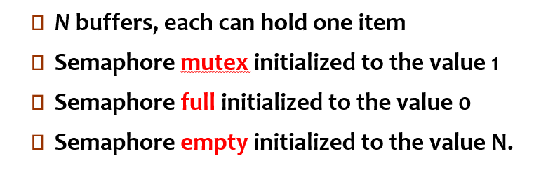
Bounded Buffer Problem (Cont.)
The structure of the producer process
do {
// produce an item in nextp
wait (empty);
wait (mutex);
// add the item to the buffer
signal (mutex);
signal (full);
} while (TRUE);
The structure of the consumer process
do {
wait (full);
wait (mutex);
// remove an item from buffer to nextc
signal (mutex);
signal (empty);
// consume the item in nextc
} while (TRUE);
Initial, Empty = N, Full = 0
Notes:
生產者丟東西進buffer 消費者從buffer拿東西 要怎麼做到synchronize ex一個寫另一個不能讀 一個讀另一個不能寫
左邊生產者最多可以連續丟N個資料進buffer 因為Empty=N wait(N) N > 0 都能直接通過往下執行 另放的時候不能拿 也就是要mutual exclusion 就用wait mutex做到
Empty=N如果先跑右邊 因為full=0 所以消費者會先停住 > 正確
另外signal是都是對相反的Sema 就剛好能達成要求 生產的加完就full++ 這樣消費者wait full 就知道有東西可拿了 就先full-- 再empty++ 告訴生產者可再放

Slide 44
The Reader and Writers Problem
A data object, such as a file or record, is to be shared among several concurrent processes.
The writers are required to have exclusive access to the shared object.一次限一writer
The readers-writers problem has several variations, all involving priorities.
The First problem -- require no reader will be kept waiting unless a writer has already obtained permission to use the shared object. Thus, no reader should wait for other readers to finish even a writer is waiting. 允許多個同時讀 Writer沒拿到lock前 等待中 reader都不用讓位都優先使用lock
Notes:
writer reader都

Slide 45
The Reader and Writers Problem
The Second problem -- require once a writer is ready, that writer performs its write as soon as possible, after old readers (or writer) are completed. Thus, if a writer is waiting to access the object, no new readers may start reading.
writer準備等待想拿lock的時候 不能再產生新read/writer
A solution to either problem may result in starvation.
The first problem : Writers
Writers wait, but readers come in one after one
The second problem : Readers
Readers wait, but writers come in one after one
Notes:
ok

Slide 46
A solution for the first problem
Shared Data
Semaphore mutex initialized to 1
Semaphore wrt initialized to 1
Integer readcount initialized to 0
The mutex semaphore is used to ensure mutual exclusion when the variable readcount is updated.
Readcount keeps track of how many processes are currently reading the object. 有多少reader正在讀
The wrt semaphore functions as a mutual exclusion semaphore for the writers.
It also is used by the first or last reader that enters or exits the critical section.
It is not used by the readers who enter or exit while other processes are in their critical sections.
Notes:
readcount=0 writer才能進去 wrt第一個reader用的意思:有writer在CS 第一個reader就不能進去 一但第一個reader進去了 之後的reader就能一直進去
wrt最後一個reader用的意思: 最後一個reader離開後 writer就能進去

Slide 47
A solution for the first problem
If a writer is in the CS and n readers are waiting, then one reader is queued on wrt and n-1 readers are queued on mutex.
When a writer executes signal(wrt), we may assume the execution of either the waiting writers or a single reader. The selection is made by the scheduler.
do {
wait (mutex) ;
readcount ++ ;
if (readcount == 1)
wait (wrt) ;
signal (mutex)
// reading is performed
wait (mutex) ;
readcount - - ;
if (readcount == 0)
signal (wrt) ;
signal (mutex) ;
} while (TRUE);
do {
wait (wrt) ;
// writing is performed
signal (wrt) ;
} while (TRUE);
First reader
Last reader
Notes:
6-13 尾 6-14頭 CS懂了 Crit Sec mutex 保證readcount更新的時候互斥 有reader進CS時readCount++ 所以readCou算是reader間的shareData 要了解程式 就要自己把各種combination都跑一遍 最簡單例如說reader先跑會怎麼走 還有如果writer先跑會發生什麼 看看是否能滿足 若右w先 會先通過 第二個之後的w進來要等 左第一個r通過mutex 卡在wrt 後面的r

Slide 48
A solution for the first problem
do {
wait (mutex) ;
readcount ++ ;
if (readcount == 1)
wait (wrt) ;
signal (mutex)
// reading is performed
wait (mutex) ;
readcount - - ;
if (readcount == 0)
signal (wrt) ;
signal (mutex) ;
} while (TRUE);
do {
wait (wrt) ;
// writing is performed
signal (wrt) ;
} while (TRUE);
First reader
Last reader
Notes:
右w離開 右有3w等 左有4r等 誰先進入 就是OS排的 看CPU先給誰 如果r先 若下個w先 r就都等 w結束 如果下個換r r會鎖wrt阻止之後的w 然後signal打開mutex 下個r再進來 readcou >1了 r就會一直進來一直開mutex (可看出符合有w在等 r還是可一直進來 r清空w才能進來) r一直跑完結束 到recordCou ==0 就解開wrt 讓w可進來 前面說的等待中的r w 都是在ready Q裡面等

Slide 49
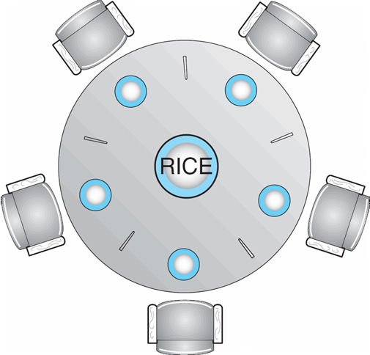
Dining-Philosophers Problem
Shared data
Bowl of rice (data set)
Semaphore chopstick [5] initialized to 1
Notes:
6-16 好像兩個人中間故意只放一根筷子(影片:對) 比較好探討deadlock 筷子就是semap, init為1 同時只能一個程式(哲學家)使用 其他程式就不能拿 哲要吃飯就要左右都拿到
編號每根筷子0-4

Slide 50
Dining-Philosophers Problem (Cont.)
Represent each chopstick by a semaphore.
Wait and Signal on the semaphores.
Var chopstick: array [0..4] of semaphores;
The structure of Philosopher i:
do { 假設 i左 i+1右
wait ( chopstick[i] ); 拿左
wait ( chopstick[ (i + 1) % 5] ); 拿右
// eat
signal ( chopstick[i] ); 放左
signal (chopstick[ (i + 1) % 5] ); 放右
// think
} while (TRUE);
Deadlock !!
Notes:
這邊還是沒看很懂 怎麼拿一根 再往右拿一根 馬上就Deadlock 再看一下好了 / wait看左右在不在 任一不在(一定是隔壁摨走的)就等待 都在就通過wait拿筷子起來 sugnal就放筷子回去 值變1 這樣寫看起來沒問題 但是如果全部人同時(CPU輪流全部人都執行第一個wait)拿起左邊的 那就deadlock了 這就是race condition結果就會全部都餓死

Slide 51
競爭危害（race hazard）又名競態條件、競爭條件（race condition），它旨在描述一個系統或者進程的輸出依賴於不受控制的事件出現順序或者出現時機。此詞源自於兩個訊號試著彼此競爭，來影響誰先輸出。
這篇講的ptt前面也有類似的說明 不同非同步執行順序會有不同結果 https://medium.com/%E7%A8%8B%E5%BC%8F%E4%BA%BA%E6%9C%88%E5%88%8A/%E7%AB%B6%E7%88%AD%E6%83%85%E6%B3%81%E7%9A%84c%E8%AA%9E%E8%A8%80%E7%AF%84%E4%BE%8B-1a88df31c20e

Slide 52
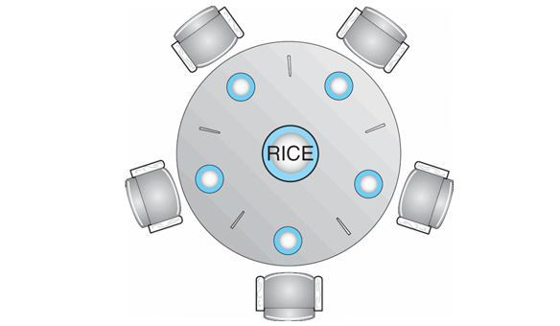
Several possible solutions to the deadlock problem
Allow at most four philosophers to be sitting simultaneously at the table. 沒錯
Allow a philosopher to pick up her chopsticks only if both chopsticks are available (note that she must pick them up in a critical section).任一邊沒有就不拿
Use an asymmetric solution. Thus,
an odd philosopher picks up first her left chopstick and then her right chopstick, whereas
an even philosopher picks up her right chopstick and then her left chopstick.這樣相鄰的會先等同一支 排出先後 不會全部拿光
Notes:
ok 6-16

Slide 53
Problems with Semaphores
Correct use of semaphore operations: Otherwise, some problems may happen
是很好的工具 很容易寫 但寫錯也可能發生問題
signal (mutex) …. wait (mutex) 可能有問題
wait (mutex) … wait (mutex) 有問題
Omitting of wait (mutex) or signal (mutex) (or both)
Notes:
應是先wait再signal 看當時情況而定 前面也有 雙方互相signal另一個 wait自己的 (6-16尾

Slide 54
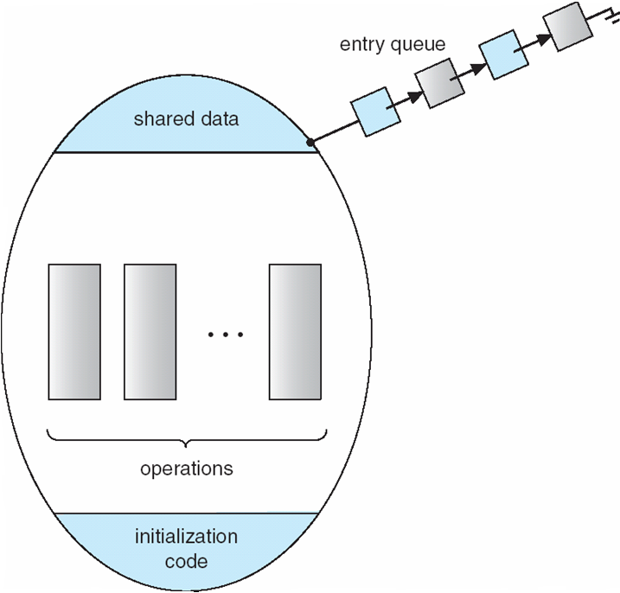
Monitors
A high-level abstraction that provides a convenient and effective mechanism for process synchronization
Only one process may be active within the monitor at a time
monitor monitor-name
{ // shared variable declarations
procedure P1 (…) { …. }
…
procedure Pn (…) {……}
Initialization code ( ….) { … }
…
}
Notes:
6-17 Monitor就是 OS的一個工具幫忙把前面一堆做好 mut ex 控制等等 Monitor是個資料結構 要有 1 name 2 shared var共用變數 例如之前的readerCount procedure就是不同的程序例如讀/寫 init code例如初始sema的值 右邊圖示monitor的結構 同個時間只能有一個proc在

Slide 55
Schematic view of a Monitor
Processes waiting to
enter their Monitor
Notes:
橢圓形的就是Monitor 右上角 有幾個程式等待進入Monitor queue排隊等lock進入Crit Sec

Slide 56
Monitors
entry queue
Syntax of a monitor
type monitor-name = monitor
variable declarations
procedure entry P1(...);
begin ... end;
procedure entry P2(...);
begin ... end;
procedure entry Pn(...);
begin ... end;
begin
initialization code
end.
shared data
...
operations
initialization
code
Schematic view of a monitor
Notes:
6-17

Slide 57
Condition Construct
A programmer who needs to write her own tailor-made synchronization scheme can define one or more variables of type condition.
Var x,y : condition;
The only operations that can be invoked on a condition variable are wait and signal. For example, x.wait, x.signal.
The x.signal resumes exactly one suspended process. If no process is suspended, then the signal operation has no effect.
Suppose P invokes x.signal and Q is suspended with x. Two possibilities exist:
P either waits Q leaves or another condition
Q either waits P leaves or another condition
Notes:
6-17 condition variable , Monitor是OS所提供的機制 但若Programmer想要自己定義一些synchronization的方法可以使用 cond 是一種type 有wait sig兩個操作
cond看描述有點像是semap 所以所有等待特定cond的proc 可以說是形成一個queue signal就是從suspend proc q挑一個proc出來執行 如果q裡面沒proc就不動作
最後兩點是說 P 呼叫x.sig 理論上是要叫Q起來跑 但是OS排法 也是可以執行完sig這個指令 馬上繼續執行P 我:可能instruction都可以執行到一半跳到另個proc 隨時中斷跳出輪流吧

Slide 58
Condition Variables
condition x, y;
Two operations on a condition variable:
x.wait () – a process that invokes the operation is suspended.
x.signal () – resumes one of processes (if any) that invoked x.wait ()
師是說 wait() 裡面的參數 可能是semap又好像不是影片沒很清楚說
Notes:
wait很像是哲學家發現左右都沒筷子 就眼睛閉上睡覺 程式就被suspend 不會在執行 要等其他人在叫他起來才回繼續執行 所以兩邊的哲學加看到他左右筷子都會來後 會signal他叫他起來 一個在suspend的proc 自己不會起來

Slide 59
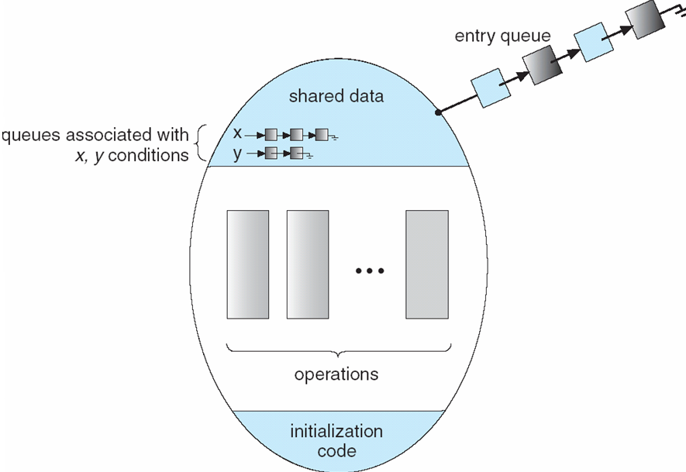
Monitor with Condition Variables
Processes waiting to
enter their Monitor
x.wait, x.signal
y.wait, y.signal
Notes:
可看到 x y 兩個q

Slide 60
A Deadlock-free Monitor Solution for the Dining-Philosophers Problem
A philosopher is allowed to pick up her chopsticks only if both of them are available.
Data structure:
Var state: array [0..4] of (thinking, hungry, eating);
Var self: array [0..4] of condition; CONDITION
Philosopher i can delay herself when she is hungry, but is unable to obtain the chopsticks she needs.
拿不到兩根就呼叫x.wait 去x q 排隊 然後開始suspend
Operations:
pickup and putdown on the instance dp 簡稱也是物件實例 > of the dining-
philosophers monitor
Notes:
hungry 會想拿筷子 兩根筷子都可以拿就可以吃 eating完 一口後 筷子放回去 又回到thinking 然後又會hungry 循環

Slide 61
Solution to Dining Philosophers (cont)
Each philosopher i must invoke the operations pickup() 拿筷 and putdown()放筷 in the following sequence: 見下頁詳細
var dining-philosophers: dp
dining-philosophers.pickup(i);
...
eat
...
dining-philosophers.putdown(i);
Process i

Slide 62
A Deadlock-free Monitor Solution for the Dining-Philosophers Problem
monitor dp
{
enum { THINKING; HUNGRY, EATING) state [5] ;
condition self [5];
void pickup (int i) {
state[i] = HUNGRY;
test(i);
if (state[i] != EATING) self [i].wait;
}
void putdown (int i) {
state[i] = THINKING;
// test left and right neighbors
test((i + 4) % 5);
test((i + 1) % 5);
}
Test if both chopsticks are available
void test (int i) {
if ( (state[(i + 4) % 5] != EATING) &&
(state[i] == HUNGRY) &&
(state[(i + 1) % 5] != EATING) ) {
state[i] = EATING ;
self[i].signal () ;
}
}
initialization_code() {
for (int i = 0; i < 5; i++)
state[i] = THINKING;
}
}
Notes:
因為pickup要兩支筷都可拿才能拿 所以要先test是否兩支都在 6-18 end 可惜之前課堂討論有說這張影片有少上傳 沒片了 我就直接再讀一次讀完
semaphore n. （鐵路的）臂板信號；信號

Slide 63
Illustration of the algorithm
The x.signal resumes exactly one suspended process.
If no process is suspended, then the signal operation has no effect.
3
4
4
3
2
Self[2].wait
--> Eating
0
2
1
0
1
Self[0].wait
--> Eating
Eating --> self[1].signal (No effect)
Pushdown
test (0) -> self[0].signal,
test (2) -> self[2].signal

Slide 64
Monitor Implementation Using Semaphores
A possible implementation of the monitor mechanism using semaphores.
For each monitor, a semaphore mutex (init to 1) is provided.
A process must execute wait (mutex) before entering the monitor and must execute signal (mutex) after leaving the monitor
Since a signaling process must wait until the resumed process either leaves or waits, an additional semaphore, next, is introduced (init to 0).
The signaling processes can use next to suspend themselves.
An integer variable next_count is also provided to count the number of processes suspended on next.
Notes:
ok

Slide 65
Monitor Implementation Using Semaphores
Variables
semaphore mutex; // (initially = 1)
semaphore next; // (initially = 0)
int next-count = 0;
Each external procedure F will be replaced by
wait(mutex);
…
body of F
…
if (next_count > 0)
signal(next)
else
signal(mutex);
Mutual exclusion within a monitor is ensured.
wait(mutex)

Slide 66
Monitor (Condition Variable) Implementation Using Semaphores
For each condition variable x, we have:
semaphore x_sem; // (initially = 0)
int x-count = 0;
The operation x.wait can be implemented as:
x-count++;
if (next_count > 0)
signal(next);
else
signal(mutex);
wait(x_sem);
x-count--;
wait(mutex)

Slide 67
Monitor Implementation Using Semaphores
The operation x.signal can be implemented as:
if (x-count > 0) {
next_count++;
signal(x_sem);
wait(next);
next_count--;
}
What happen if x-count <= 0 ?
Nothing will happen !!
wait(mutex)
Notes:
signal自己

Slide 68
Resuming Processes within a Monitor
If several processes are suspended on condition x, and an x.signal() operation is executed by some process, how do we determine which of the suspended processes should be resumed next ?
FCFS ordering is simple, but may not adequate
Conditional-wait construct
x.wait (c)
c is an integer expression that is evaluated when the wait() operation is executed.
c is called a priority number.
When x.signal () is executed, the process with smallest priority number is resumed next.

Slide 69
A Monitor to Allocate Single Resource
monitor ResourceAllocator
{
boolean busy;
condition x;
void acquire(int time) {
if (busy)
x.wait(time);
busy = TRUE;
}
void release() {
busy = FALSE;
x.signal();
}
initialization code() {
busy = FALSE;
}
}
The process with smallest priority number is resumed next

Slide 70
Resuming Processes within a Monitor
The monitor allocates分派分配 the resource that has the shortest time-allocation request.
A process that needs to access the resource in question must observe the following sequence:
R.acquire (t); ← Get the resource, or wait for it !!
…..
access the resource
……
R. release();
Where R is an instance of type ResourceAllocator.
Notes:
有點怪 這邊說shortet time alloct

Slide 71
Synchronization Examples
Solaris 昇陽公司(後被甲骨文Oracle收購)作業系統
Windows XP
Linux
Pthreads

Slide 72
Solaris Synchronization
Implements a variety of locks to support multitasking, multithreading (including real-time threads), and multiprocessing
Uses adaptive適應的 mutexes for efficiency when protecting data from short code segments
Uses condition variables and readers-writers locks when longer sections of code need access to data
Uses turnstiles 十字轉門 to order the list of threads waiting to acquire either an adaptive mutex or reader-writer lock
Notes:
adaptive 美式 適合的；適應的 turnstile 十字轉門

Slide 73
Windows XP Synchronization
Uses interrupt masks to protect access to global resources on uniprocessor systems
Uses spinlocks on multiprocessor systems
Also provides dispatcher objects which may act as either mutexes and semaphores
Dispatcher objects may also provide events
An event acts much like a condition variable

Slide 74
Linux Synchronization
Linux:
Prior to kernel Version 2.6, disables interrupts to implement short critical sections
Version 2.6 and later, fully preemptive
Linux provides:
semaphores
spin locks

Slide 75
Pthreads Synchronization
Pthreads API is OS-independent
It provides:
mutex locks
condition variables
Non-portable extensions include:
read-write locks
spin locks
Notes:
d

Slide 76
POSIX執行緒[編輯]
維基百科，自由的百科全書
跳至導覽跳至搜尋POSIX執行緒（英語：POSIX Threads，常被縮寫為Pthreads）是POSIX的執行緒標準，定義了創建和操縱執行緒的一套API。
實現POSIX 執行緒標準的庫常被稱作Pthreads，一般用於Unix-like POSIX 系統，如Linux、 Solaris。但是Microsoft Windows上的實現也存在，例如直接使用Windows API實現的第三方庫pthreads-w32；而利用Windows的SFU/SUA子系統，則可以使用微軟提供的一部分原生POSIX API。

Slide 77
Atomic Transactions
Make sure that a critical section forms a single logical unit of work that either is performed in its entirety or is nor performed at all.
Consistency of data, along with storage and retrieval of data, is a concern often associated with database systems.
System Model
Log-based Recovery
Checkpoints
Concurrent Atomic Transactions
Notes:
d

Slide 78
System Model
Assures that operations (a collection of instructions) happen as a single logical unit of work, in its entirety全體, or not at all
Related to field of database systems
Challenge is assuring atomicity despite computer system failures
Transaction - collection of instructions or operations that performs single logical function
Here we are concerned with changes to stable storage – disk
Transaction is series of read and write operations
Terminated by commit (transaction successful) or abort (transaction failed) operation
Aborted transaction must be rolled back to undo any changes it performed
Notes:
d

Slide 79
Types of Storage Media
Volatile storage – information stored here does not survive system crashes
Example: main memory, cache
Nonvolatile storage – Information usually survives crashes
Example: disk and tape
Stable storage – Information never lost
Not actually possible, so approximated via replication複製 or RAID to devices with independent failure modes
Goal is to assure transaction atomicity where failures cause loss of information on volatile storage
Notes:
容錯式磁碟陣列（RAID, Redundant多餘的 Array of Independent Disks），舊稱容錯式廉價磁碟陣列（Redundant Array of Inexpensive Disks），簡稱磁碟陣列

Slide 80
Log-Based Recovery
Record to stable storage information about all modifications by a transaction
Most common is write-ahead logging
Log on stable storage, each log record describes single transaction write operation, including
Transaction name
Data item name
Old value
New value
<T_{i} starts> written to log when transaction T_{i} starts
<T_{i} commits> written when T_{i} commits
Log entry must reach stable storage before operation on data occurs

Slide 81
Log-Based Recovery Algorithm
Using the log, system can handle any volatile memory errors
Undo(T_{i}) restores value of all data updated by T_{i}
Redo(T_{i}) sets values of all data in transaction T_{i} to new values
Undo(T_{i}) and redo(T_{i}) must be idempotent
Multiple executions must have the same result as one execution
If system fails, restore state of all updated data via log
If log contains <T_{i} starts> without <T_{i} commits>, undo(T_{i})
If log contains <T_{i} starts> and <T_{i} commits>, redo(T_{i})
Notes:
Idempotence is the property of certain operations in mathematics and computer science whereby they can be applied multiple times without changing the result beyond the initial application. https://stackoverflow.com/questions/1077412/what-is-an-idempotent-operation

Slide 82
Checkpoints
Log could become long, and recovery could take long
Checkpoints shorten log and recovery time.
Checkpoint scheme:
Output all log records currently in volatile storage to stable storage
Output all modified data from volatile to stable storage
Output a log record <checkpoint> to the log on stable storage
Now recovery only includes Ti, such that Ti started executing before the most recent checkpoint, and all transactions after Ti
All other transactions already on stable storage

Slide 83
Concurrent Transactions
Must be equivalent to serial execution – serializability
Could perform all transactions in critical section
Inefficient, too restrictive
Concurrency-control algorithms provide serializability
Notes:
d

Slide 84
Serializability
Consider two data items A and B
Consider Transactions T₀ and T₁
Execute T₀, T₁ atomically
Execution sequence called schedule
Atomically executed transaction order called serial schedule
For N transactions, there are N! valid serial schedules

Slide 85
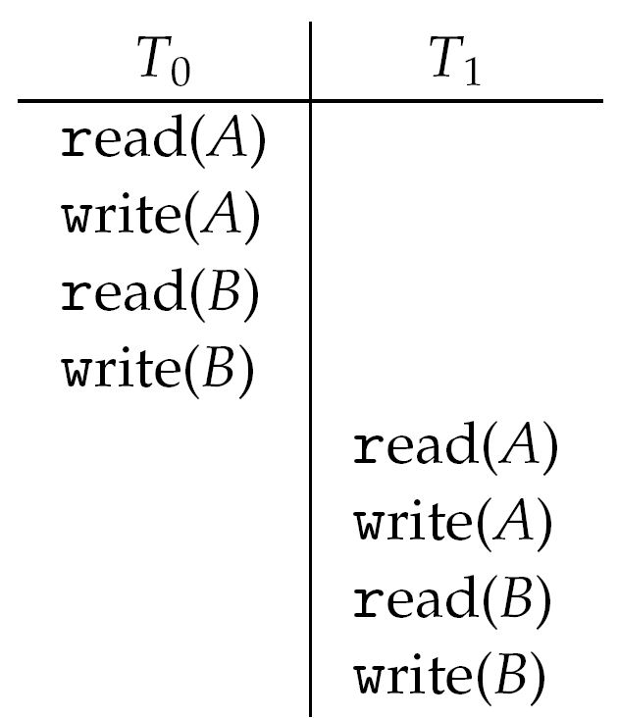
Schedule 1: T₀ then T₁

Slide 86
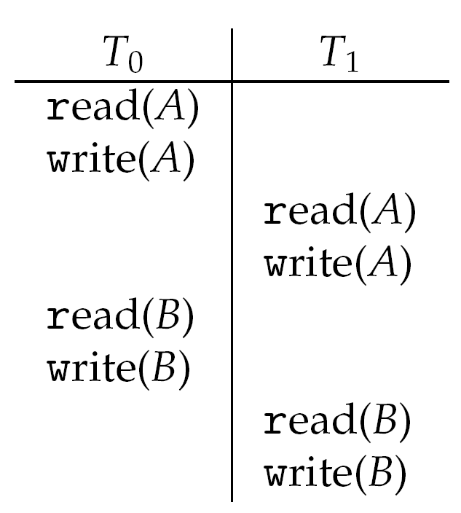
Nonserial Schedule
Nonserial schedule allows overlapped execute
Resulting execution not necessarily incorrect
Consider schedule S, operations O_{i} , O_{j} of Transactions T_{i} and T_{j,}
Conflict if access same data item, with at least one write
If O_{i}, O_{j} are consecutive and operations of different transactions & O_{i} and O_{j} don’t conflict
Then S’ with swapped order O_{j} O_{i} equivalent to S
Notes:
o

Slide 87
Nonserial Schedule
We say that S is conflict serializable, if it can be transformed into a serial schedule S’ by a series of swaps of nonconflicting operations.
S
S’

Slide 88
Locking Protocol
One way to ensure serializability is to associate a lock with each data item and each transaction follows locking protocol for access control.
Locks
Shared – T_{i} has shared-mode lock (S) on item Q, T_{i} can read Q but not write Q
Exclusive – Ti has exclusive-mode lock (X) on Q, T_{i} can read and write Q
Require every transaction on item Q acquire appropriate lock
If lock already held, new request may have to wait
Similar to readers-writers algorithm

Slide 89
Two-phase Locking Protocol
The two-phase locking protocol ensures conflict serializability
Each transaction issues lock and unlock requests in two phases
Growing – A transaction may obtain locks but may not release any locks
Shrinking – A transaction may release locks but may not obtain any new locks.
Initially, a transaction is a the growing phase. The transaction acquires locks as needed. Once the transaction releases a lock, it enters the shrinking phase, and no more lock requests can be issued
Does not prevent deadlock
Notes:
d

Slide 90
Timestamp-based Protocols
Select order among transactions in advance – timestamp-ordering
Transaction T_{i} associated with timestamp TS(T_{i}) before T_{i} starts
TS(T_{i}) < TS(T_{j}) if T_{i} entered system before T_{j}
TS can be generated from system clock or as logical counter incremented at each entry of transaction
Timestamps determine serializability order
If TS(T_{i}) < TS(T_{j}), system must ensure produced schedule equivalent to serial schedule where T_{i} appears before T_{j}

Slide 91
Timestamp-based Protocol Implementation
Data item Q gets two timestamps
W-timestamp(Q) – largest timestamp of any transaction that executed write(Q) successfully
R-timestamp(Q) – largest timestamp of successful read(Q)
Updated whenever read(Q) or write(Q) executed
Timestamp-ordering protocol assures any conflicting read and write executed in timestamp order

Slide 92
Timestamp-based Protocol Implementation
Suppose T_{i} executes read(Q)
If TS(T_{i}) < W-timestamp(Q), Ti needs to read value of Q that was already overwritten
read operation rejected and T_{i} rolled back
If TS(T_{i}) ≥ W-timestamp(Q)
read executed, R-timestamp(Q) set to max(R-timestamp(Q), TS(T_{i}))
Notes:
d

Slide 93
Timestamp-ordering Protocol
Suppose Ti executes write(Q)
If TS(T_{i}) < R-timestamp(Q), value Q produced by T_{i} was needed previously and T_{i} assumed it would never be produced
Write operation rejected, T_{i} rolled back
If TS(T_{i}) < W-timestamp(Q), T_{i} attempting to write obsolete value of Q
Write operation rejected and T_{i} rolled back
Otherwise, write executed
A transaction T_{i} is rolled back as a result of either a read or write operation is assigned a new timestamp and is restarted
Notes:
obsolete 廢棄的，淘汰的；過時的，老式的

Slide 94
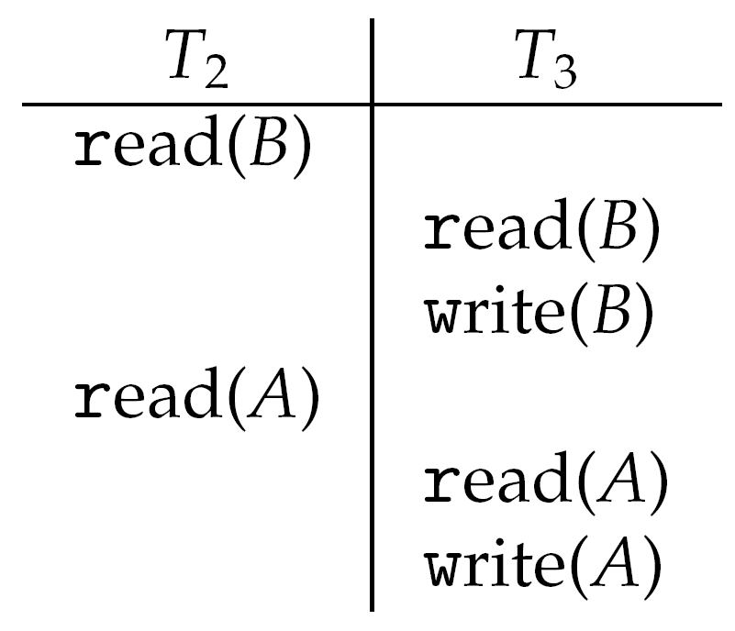
Timestamp-ordering Protocol Example
Assume a transaction is assigned a timestamp immediately before its first instruction.
Thus, TS(T₂) < TS(T₃)
The following schedule is possible under Timestamp Protocol
Notes:
d

Slide 95
Timestamp-ordering Protocol
This algorithm ensures
conflict serializability – conflicting operations are processed in timestamp order, and
freedom from deadlock – no transactions ever waits
Notes:
d

Slide 96
End of Chapter 6

