Slide 1
Chapter 2:
System Structures

Slide 2
Chapter 2: System Structures
Operating System Services
User Operating System Interface
System Calls
Types of System Calls
System Programs (compiler linker loader)
Operating System Design and Implementation
Operating System Structure(linux windows 不同OS有不同結構)
Virtual Machines(在一台機器硬體跑很多台虛擬機器和不同OS 但每一台虛擬機使用時感覺都是這台電腦上專用的)
Operating System Debugging
Operating System Generation
System Boot
Notes:
Operating System Generation 怎麼產生OS 會跟HW有關 有幾個CPU 裡面幾個Core 給你不同硬體環境 怎麼設計OS需要含哪些部份 把需要的模組組織起來 總是要產一個OS啊 把模組結合起來 不需要的模組拿掉 怎麼客製化 (同下頁) 手機硬體有觸控螢幕 硬碟記憶體都小 就要不同設計的OS 接著是System Boot 怎麼啟動執行OS

Slide 3
Objectives
To describe the services an operating system provides to users, processes, and other systems
To discuss the various ways of structuring an operating system
To explain how operating systems are installed and customized and how they boot

Slide 4
Operating System Services
One set of operating-system services provides functions that are helpful to the user:
  User interface - Almost all operating systems have a user interface (UI)
    Varies between Command-Line (CLI), Graphics User Interface (GUI), Batch(大量程式需要被執行 丟進Batch一個個run)
  Program execution - The system must be able to load a program into memory and to run that program, end execution, either normally or abnormally (indicating error) 執行成功/發生錯誤
  I/O operations - A running program may require I/O, which may involve a file or an I/O device 網路 螢幕滑鼠都算
  File-system manipulation - The file system is of particular interest. Obviously, programs need to read and write files and directories, create and delete them, search them, list file Information, permission management.
Notes:
1-2

Slide 5

A View of Operating System Services

Slide 6
Operating System Services (Cont)
One set of operating-system services provides functions that are helpful to the user (Cont):
  Communications – Processes may exchange互相交換資料 information, on the same computer or between computers over a network
    Communications may be via shared memory or through message passing (packets封包 moved by the OS)
  Error detection – OS needs to be constantly aware of possible errors
    May occur in the CPU and memory hardware, in I/O devices, in user program
    For each type of error, OS should take the appropriate action to ensure correct and consistent computing
    Debugging facilities(能力 工具) can greatly enhance the user’s and programmer’s abilities to efficiently use the system

Slide 7
Operating System Services (Cont)
Another set of OS functions exists for ensuring the efficient operation of the system itself via resource sharing
  Resource allocation - When multiple users or multiple jobs running concurrently, resources must be allocated to each of them
    Many types of resources - Some (such as CPU cycles, main memory, and file storage) may have special allocation code, others (such as I/O devices) may have general request and release code
  Accounting - To keep track of which users use how much and what kinds of computer resources
Notes:
1-2

Slide 8
Operating System Services (Cont)
Protection and security - The owners of information stored in a multiuser or networked computer system may want to control use of that information, concurrent processes should not interfere妨礙衝突 with each other
  Protection involves ensuring that all access to system resources is controlled
  Security of the system from outsiders require user authentication, extends to defending external I/O devices from invalid無效/不合法 access attempts
  If a system is to be protected and secure, precautions預防警惕 預警 ex密碼錯誤發信 有人在錯誤嘗試你的帳號 三次鎖住must be instituted設立規則 throughout it. A chain is only as strong as its weakest link.

Slide 9
User Operating System Interface - CLI
Command Line Interface (CLI) or command interpreter allows direct command entry
    Some Operating Systems include the command interpreter in the kernel.
    Others (Windows XP and UNIX) treat the command interpreter as a special program that is running when a job is initiated.
    On systems with multiple command interpreters to choose them, the interpreters are known as shells.
    On UNIX and LINUX, a user may choose among several different shells, including Bourne shell, C shell, Bourne-Again shell, Korn shell, and others.
    Most shells provide similar functionality, and a user’s choice of which shell is personal preference.

Slide 10
User Operating System Interface - CLI
The main function of the command interpreter is to get and execute the next user-specified command.
Most manipulate files: create, delete, copy, list, execute,…
These commands can be implemented by two ways.
The command interpreter itself contains the code to execute the command.
An alternative approach (used by UNIX) implements most commands through system programs. The command interpreter does not understand the command, it uses the command to identify a file to be loaded into memory and executed.
UNIX command to delete a file
  rm file.txt

Slide 11
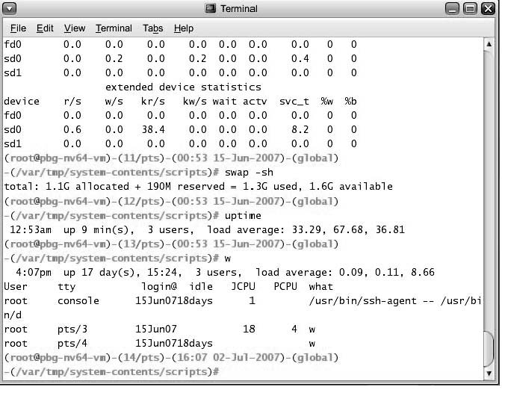
Bourne Shell Command Interpreter
Bourne Shell Command Interpreter in Solaris 10

Slide 12
User Operating System Interface - GUI
User-friendly desktop interface
  Usually mouse, keyboard, and monitor
  Icons represent files, programs, actions, etc
  Various mouse buttons over objects in the interface cause various actions (provide information, options, execute function, open directory (known as a folder))
  Invented at Xerox PARC (in 1970s)
Many systems now include both CLI and GUI interfaces
  Microsoft Windows is GUI with CLI “command” shell
  Apple Mac OS X as “Aqua” GUI interface with UNIX kernel underneath and shells available
  Solaris is CLI with optional GUI interfaces (Java Desktop)

Slide 13

The Mac OS X GUI

Slide 14
System Calls
Programming interface to the services provided by the OS
Typically written in a high-level language (C or C++)
Mostly accessed by programs via a high-level Application Program Interface (API) rather than direct system call use
Three most common APIs are
  Win32 API for Windows,
  POSIX API for POSIX-based systems (including virtually all versions of UNIX, Linux, and Mac OS X), and
  Java API for the Java virtual machine (JVM)
Why use APIs rather than system calls?
(Note that the system-call names used throughout this text are generic)

Slide 15

Example of System Calls
System call sequence to copy the contents of one file to another file

Slide 16

Example of Standard API
Consider the ReadFile() function in the Win32 API—a function for reading from a file
A description of the parameters passed to ReadFile()
  HANDLE file—the file to be read
  LPVOID buffer—a buffer where the data will be read into and written from
  DWORD bytesToRead—the number of bytes to be read into the buffer
  LPDWORD bytesRead—the number of bytes read during the last read
  LPOVERLAPPED ovl—indicates if overlapped I/O is being used

Slide 17
System Call Implementation
Typically, a number associated with each system call
  System-call interface maintains a table indexed according to these numbers
The system call interface invokes intended system call in OS kernel and returns status of the system call and any return values
The caller need know nothing about how the system call is implemented
  Just needs to obey API and understand what OS will do as a result call
  Most details of OS interface hidden from programmer by API
    Managed by run-time support library (set of functions built into libraries included with compiler)

Slide 18

API – System Call – OS Relationship

Slide 19

Standard C Library Example
C program invoking printf() library call, which calls write() system call

Slide 20
System Call Parameter Passing
Often, more information is required than simply identity of desired system call
  Exact type and amount of information vary according to OS and call
Three general methods used to pass parameters to the OS
  Simplest: pass the parameters in registers
    In some cases, may be more parameters than registers
  Parameters stored in a block, or table, in memory, and address of block passed as a parameter in a register
    This approach taken by Linux and Solaris
  Parameters placed, or pushed, onto the stack by the program and popped off the stack by the operating system
  Block and stack methods do not limit the number or length of parameters being passed

Slide 21

Parameter Passing via Table
x
Table

Slide 22
Types of System Calls
Process control
File management
Device management
Information maintenance
Communications
Protection

Slide 23

Examples of Windows and Unix System Calls

Slide 24

MS-DOS execution
(a) At system startup (b) running a program

Slide 25

FreeBSD Running Multiple Programs

Slide 26
System Programs
System programs provide a convenient environment for program development and execution. They can be divided into:
  File manipulation
  Status information
  File modification
  Programming language support
  Program loading and execution
  Communications
  Application programs
Most users’ view of the operation system is defined by system programs, not the actual system calls

Slide 27
System Programs
File management - Create, delete, copy, rename, print, dump, list, and generally manipulate files and directories
Status information
  Some ask the system for info - date, time, amount of available memory, disk space, number of users
  Others provide detailed performance, logging, and debugging information
  Typically, these programs format and print the output to the terminal or other output devices
  Some systems implement a registry - used to store and retrieve configuration information

Slide 28
System Programs (cont’d)
File modification
  Text editors to create and modify files
  Special commands to search contents of files or perform transformations of the text
Programming-language support - Compilers, assemblers, debuggers and interpreters sometimes provided
Program loading and execution- Absolute loaders, relocatable loaders, linkage editors, and overlay-loaders, debugging systems for higher-level and machine language
Communications - Provide the mechanism for creating virtual connections among processes, users, and computer systems
  Allow users to send messages to one another’s screens, browse web pages, send electronic-mail messages, log in remotely, transfer files from one machine to another

Slide 29
Operating System Design and Implementation
No complete solutions to design and Implement of OS, but some approaches have proven successful
Internal structure of different Operating Systems can vary widely
Start by defining goals and specifications
Affected by choice of hardware, type of system
User goals and System goals
  User goals – operating system should be convenient to use, easy to learn, reliable, safe, and fast
  System goals – operating system should be easy to design, implement, and maintain, as well as flexible, reliable, error-free, and efficient

Slide 30
Operating System Design and Implementation (Cont)
Important principle to separate
Policy: What will be done ?
Mechanism: How to do it ?
Mechanisms determine how to do something, policies decide what will be done
  The separation of policy from mechanism is a very important principle, it allows maximum flexibility if policy decisions are to be changed later

Slide 31
Simple Structure
MS-DOS – written to provide the most functionality in the least space
  Not divided into modules
  Although MS-DOS has some structure, its interfaces and levels of functionality are not well separated

Slide 32

MS-DOS Layer Structure

Slide 33

Traditional UNIX System Structure

Slide 34
UNIX
UNIX – also limited by hardware functionality, the original UNIX OS had limited structuring.
The UNIX OS consists of two separable parts
  System programs
  The kernel
    Consists of everything below the system-call interface and above the physical hardware
    Provides the file system, CPU scheduling, memory management, and other OS functions; a large number of functions for one level

Slide 35
Layered Approach
The operating system is divided into a number of layers (levels), each built on top of lower layers. The bottom layer (layer 0), is the hardware; the highest (layer N) is the user interface.
With modularity, layers are selected such that each uses functions (operations) and services of only lower-level layers

Slide 36

Layered Operating System

Slide 37
Microkernel System Structure
Moves as much from the kernel into “user” space
Communication takes place between user modules using message passing
Benefits:
  Easier to extend a microkernel
  Easier to port the operating system to new architectures
  More reliable (less code is running in kernel mode)
  More secure
Detriments:
  Performance overhead of user space to kernel space communication

Slide 38
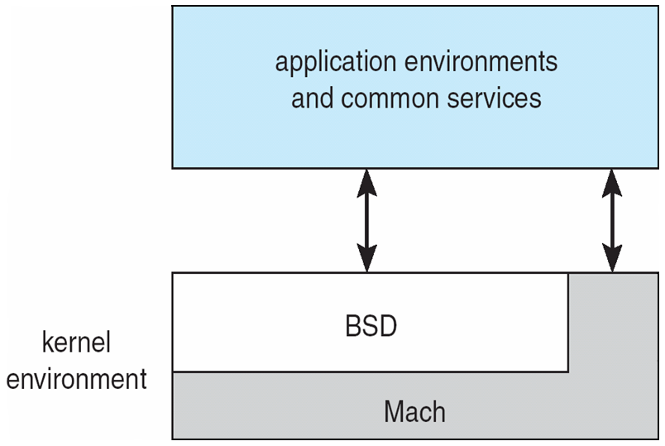
Mac OS X Structure

Slide 39
Modules
Most modern operating systems implement kernel modules
  Uses object-oriented approach
  Each core component is separate
  Each talks to the others over known interfaces
  Each is loadable as needed within the kernel
Overall, similar to layers but with more flexible

Slide 40

Solaris Modular Approach

Slide 41

Virtual Machines
A virtual machine takes the layered approach to its logical conclusion. It treats hardware and the operating system kernel as though they were all hardware
A virtual machine provides an interface identical to the underlying bare hardware
The operating system host creates the illusion that a process has its own processor and (virtual memory)
Each guest provided with a (virtual) copy of underlying computer

Slide 42
Virtual Machines History and Benefits
First appeared commercially in IBM mainframes in 1972
Fundamentally, multiple execution environments (different operating systems) can share the same hardware
Protect from each other
Some sharing of file can be permitted, controlled
Commutate with each other, other physical systems via networking
Useful for development, testing
Consolidation of many low-resource use systems onto fewer busier systems
“Open Virtual Machine Format”, standard format of virtual machines, allows a VM to run within many different virtual machine (host) platforms

Slide 43
Virtual Machines (Cont)
(a) Nonvirtual machine (b) virtual machine
Non-virtual Machine
Virtual Machine

Slide 44
Para-virtualization
Presents guest with system similar but not identical to hardware
Guest must be modified to run on paravirtualized hardware
Guest can be an OS, or in the case of Solaris 10 applications running in containers

Slide 45
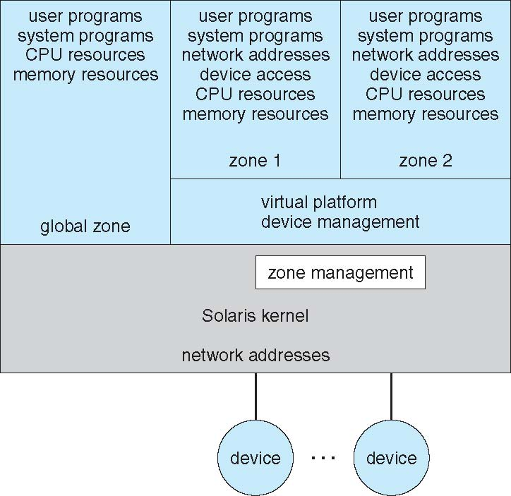
Solaris 10 with Two Containers

Slide 46
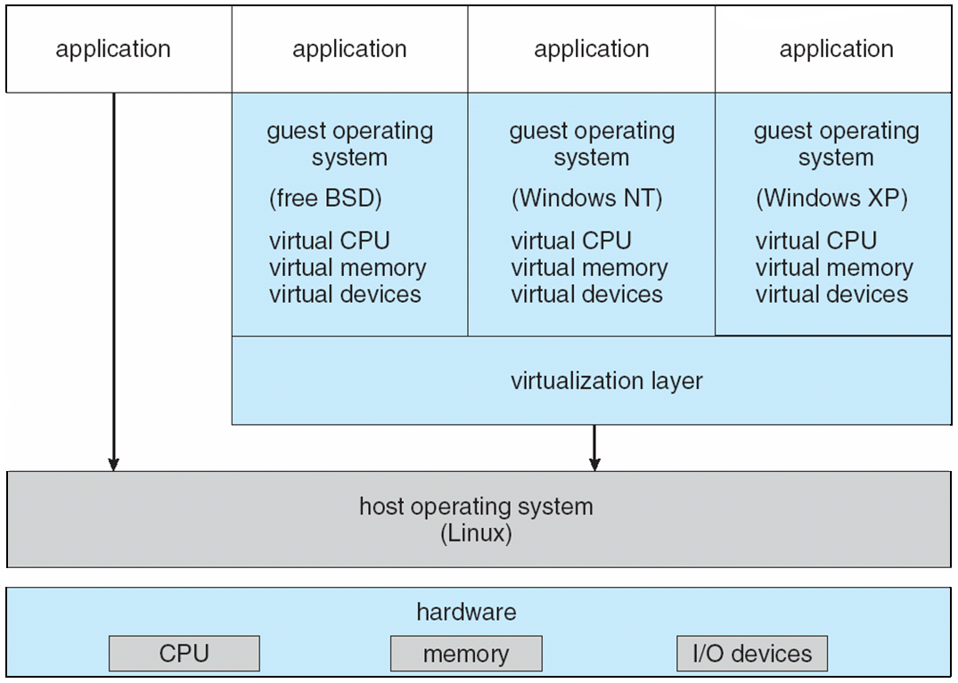
VMware Architecture

Slide 47
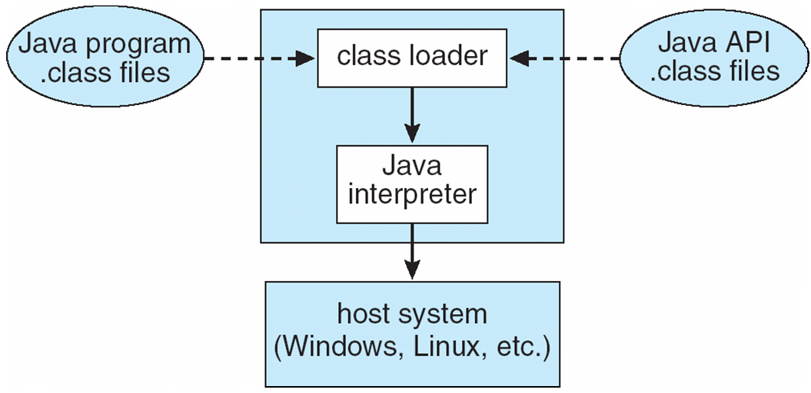
The Java Virtual Machine

Slide 48
Operating-System Debugging
Debugging is finding and fixing errors, or bugs
OSes generate log files containing error information
Failure of an application can generate core dump file capturing memory of the process
Operating system failure can generate crash dump file containing kernel memory
Beyond crashes, performance tuning can optimize system performance
Kernighan’s Law: “Debugging is twice as hard as writing the code in the ﬁrst place. Therefore, if you write the code as cleverly as possible, you are, by deﬁnition, not smart enough to debug it.”
DTrace tool in Solaris, FreeBSD, Mac OS X allows live instrumentation on production systems
  Probes fire when code is executed, capturing state data and sending it to consumers of those probes

Slide 49

Solaris 10 dtrace Following System Call

Slide 50
Operating System Generation
Operating systems are designed to run on any of a class of machines; the system must be configured for each specific computer site
SYSGEN program obtains information concerning the specific configuration of the hardware system
Booting – starting a computer by loading the kernel
Bootstrap program – code stored in ROM that is able to locate the kernel, load it into memory, and start its execution

Slide 51
System Boot
Operating system must be made available to hardware so hardware can start it
  Small piece of code – bootstrap loader, locates the kernel, loads it into memory, and starts it
  Sometimes two-step process where boot block at fixed location loads bootstrap loader
  When power initialized on system, execution starts at a fixed memory location
    Firmware used to hold initial boot code

Slide 52
End of Chapter 2

