Slide 1
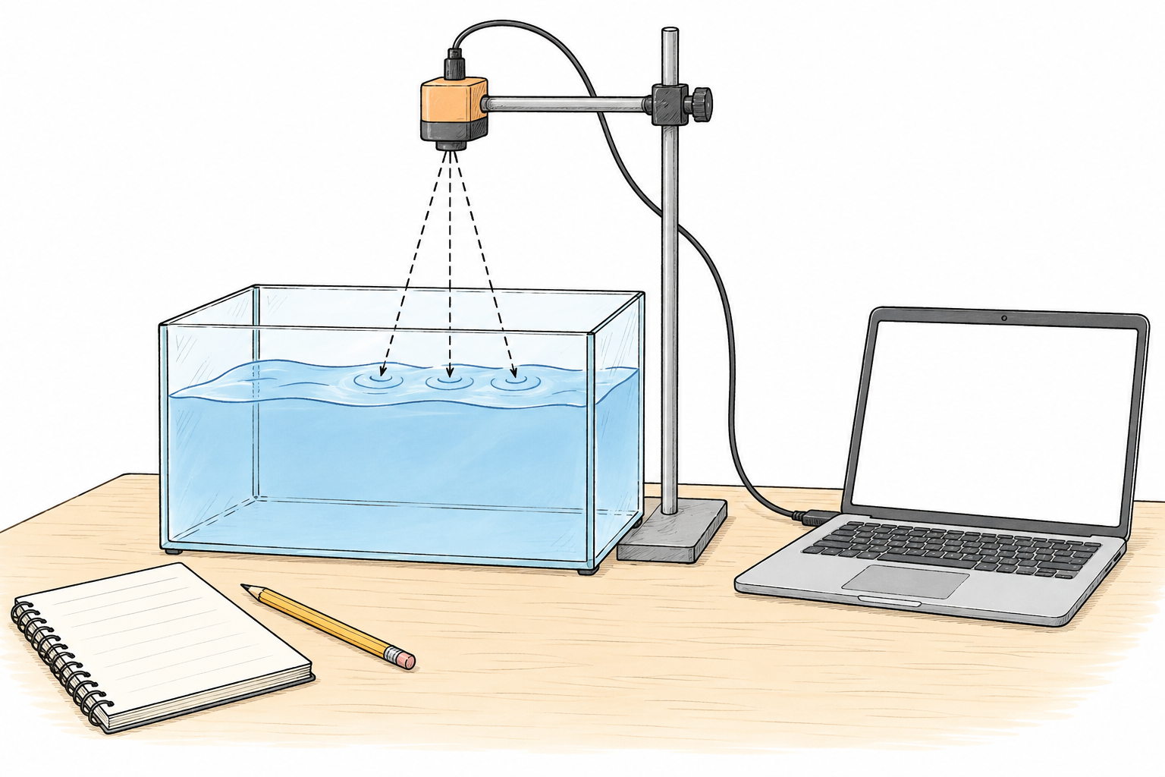
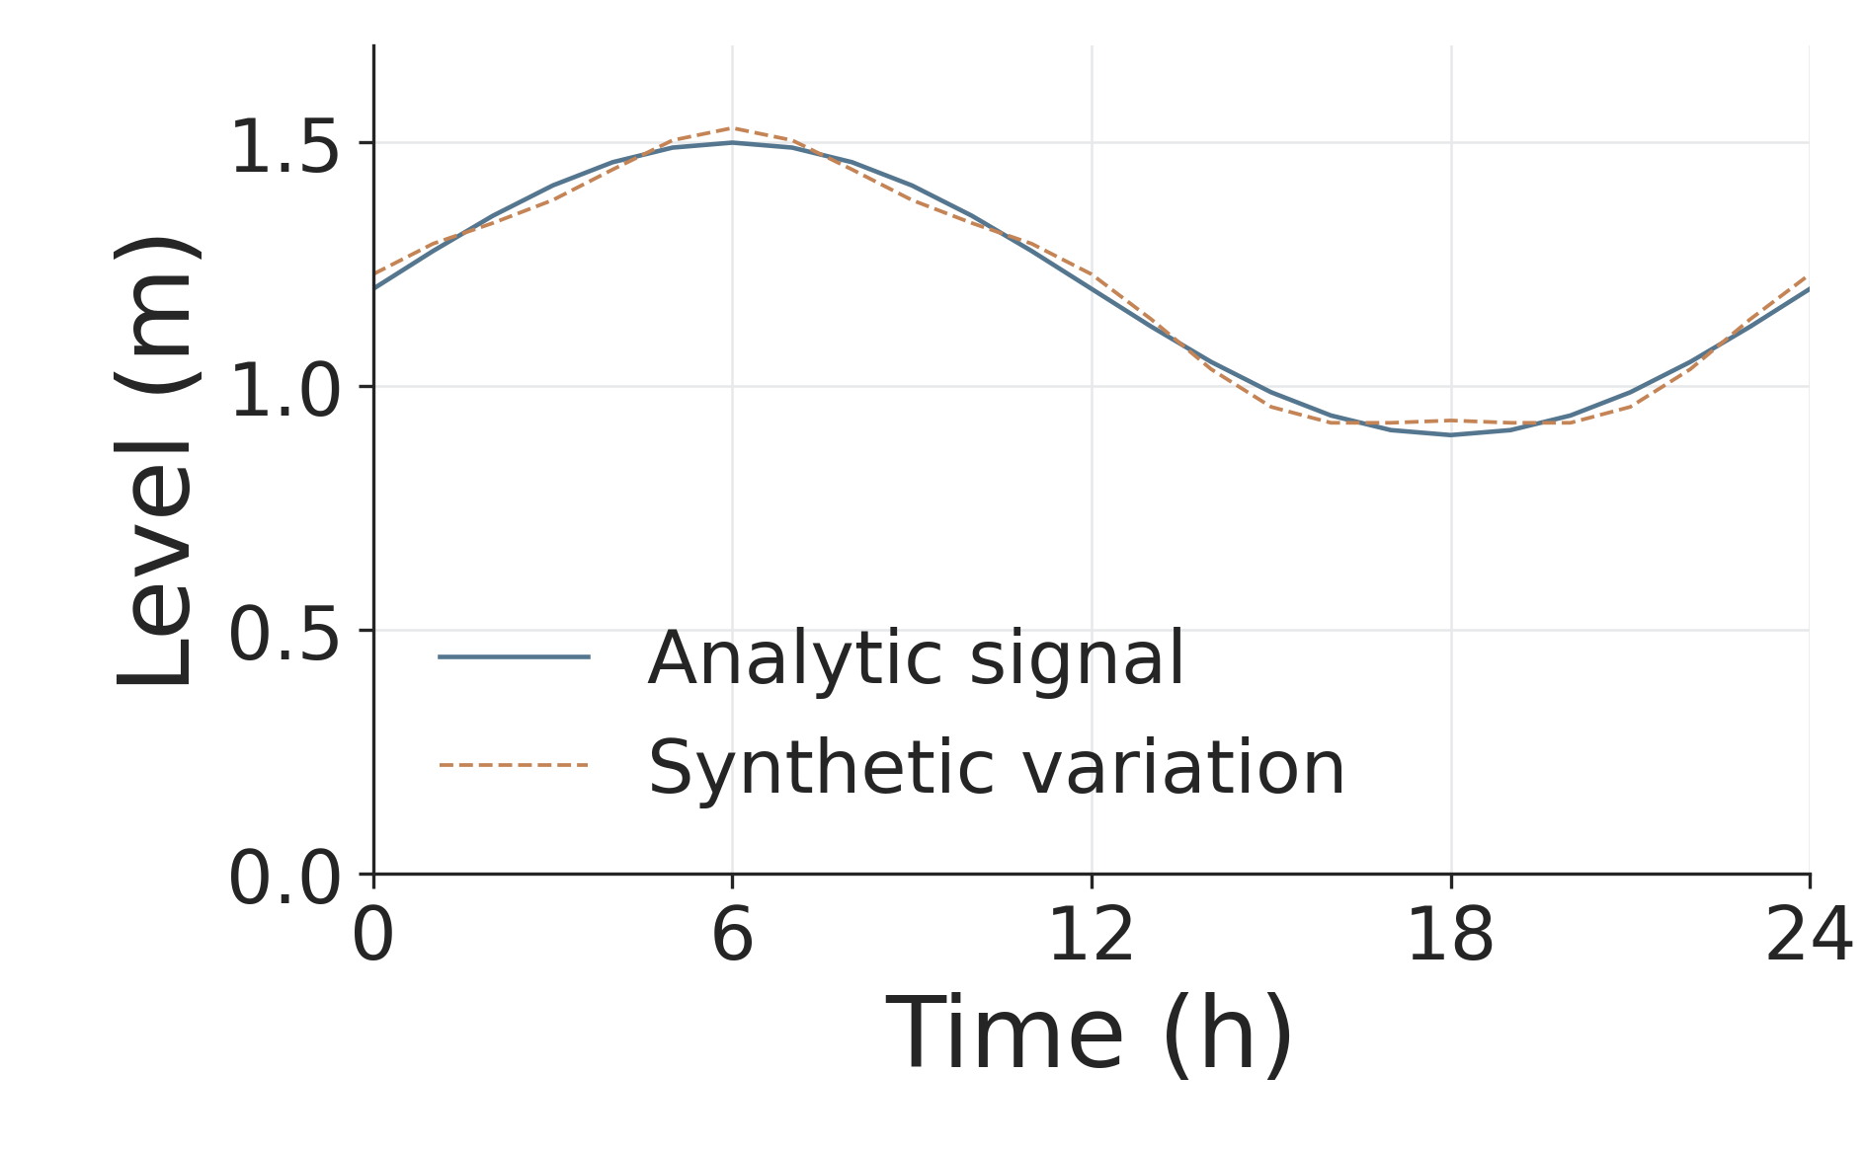
Illustrative water-level signals
Synthetic teaching example with an analytic reference signal.
Conceptual apparatus
Every point comes from CSV
Art explains the apparatus;
CSV fixes every plotted point.

