Slide 1
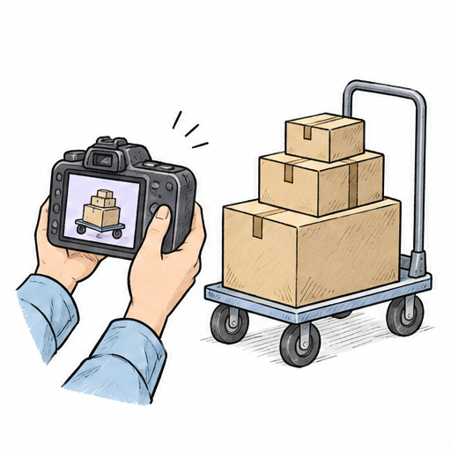
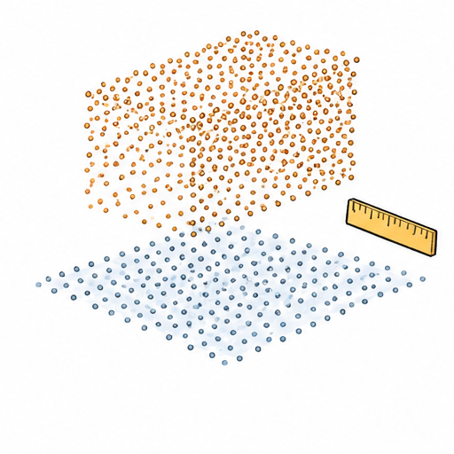
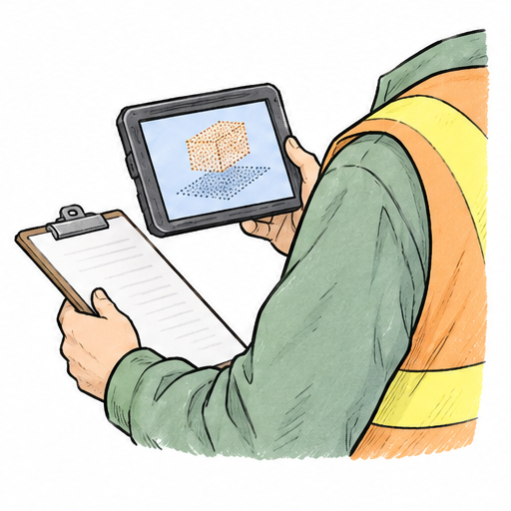
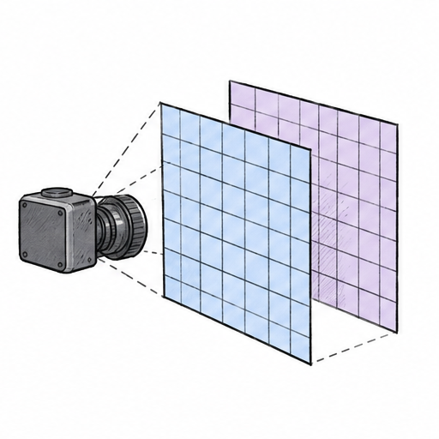

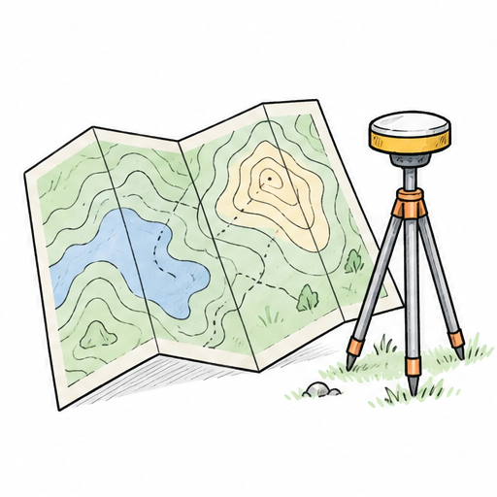

Field height estimation
Conceptual teaching workflow with a shared vertical reference.
Pass
Field camera
Review
Align
Estimate
Check
Ground reference
Fail: realign
Exact labels and feedback are editable layers.

