Slide 1
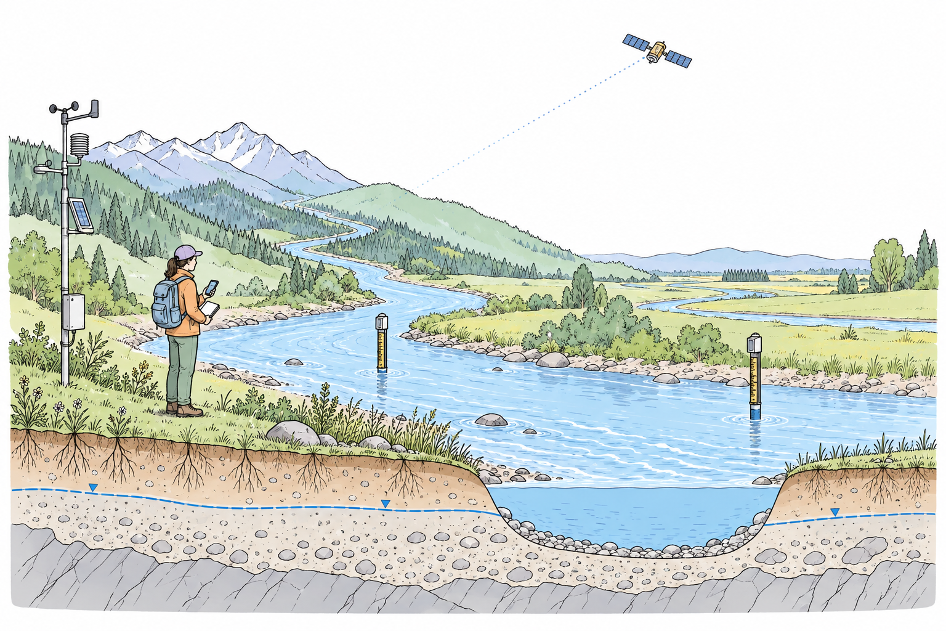
Environmental observation
Weather station
Satellite
observation
River-level
gauges
Subsurface
context
Conceptual scene

