Slide 1
GR5293 Project 2
Mortgage Default Prediction Using Machine Learning
By John Feng, Shenhong Wu, Hailin Liu

Slide 2
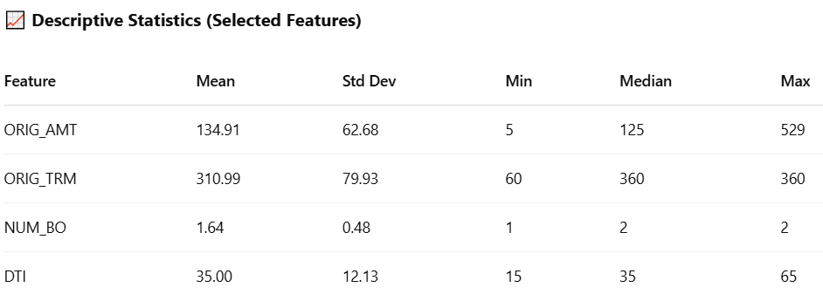
Data Summary & Descriptive Statistics
Dataset Overview
Total Observations: 1,048,570 rows
Total Columns/Variables: 13
Time Period: 2000 (Train), 2001 (Test)
Key column with missing values: LAST_VAL
Variables
ORIG_AMT: Original loan amount (in thousands) – the amount initially borrowed at origination.
ORIG_TRM: Original loan term (in months) – most commonly 360 months (30 years).
NUM_BO: Number of borrowers – usually 1 or 2 per mortgage.
DTI: Debt-to-Income ratio – borrower’s monthly debt payments divided by gross income (%).
PROP_TYP: Property type – categorical variable (e.g., single-family, condo, etc.).
reperformance_flag: Indicates whether a previously defaulted loan has returned to performing status.
Loan.Age: Age of the loan in months – how long the loan has been active.
VinYr: Vintage year – year the loan was issued (2000 or 2001, used for train/test split).
FicoBkt: FICO score bucket – credit score category of the borrower.
LAST_VAL: Most recent property valuation (in thousands).
MLTV: Modified Loan-to-Value ratio – balance of the loan compared to appraised property value.
Default: Target variable – indicates whether the loan defaulted.
STATE: U.S. state abbreviation of the property (excluded from modeling per instructions).
Key Insights
Loan Amounts (ORIG_AMT) mostly range between $86k–$175k
Loan Term (ORIG_TRM) is typically 30 years (360 months)
Borrowers per loan (NUM_BO) are usually 1–2
Debt-to-Income Ratio (DTI) clusters around 35%
Very few defaulted in the overall dataset

Slide 3
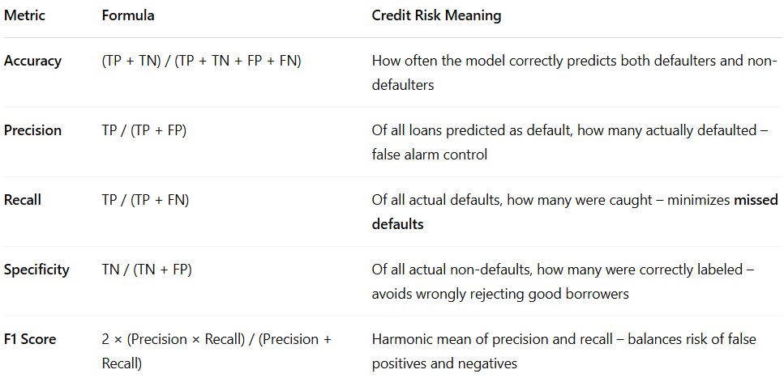
Model Evaluation Metrics in Credit Risk
Metric Definitions & Formulas
In the Mortgage Lending Context:
High Recall → We catch more true defaulters, reducing lending risk, but might reject some good borrowers.
High Precision → Our default predictions are trustworthy, fewer good customers wrongly flagged.
High Specificity → We retain creditworthy borrowers, minimizing lost revenue.
F1 Score → Helps find the best balance between catching risk and keeping profitability.
TP = True Positives (Predicted default, actually defaulted)
TN = True Negatives (Predicted no default, actually paid)
FP = False Positives (Predicted default, actually paid)
FN = False Negatives (Predicted no default, actually defaulted)

Slide 4
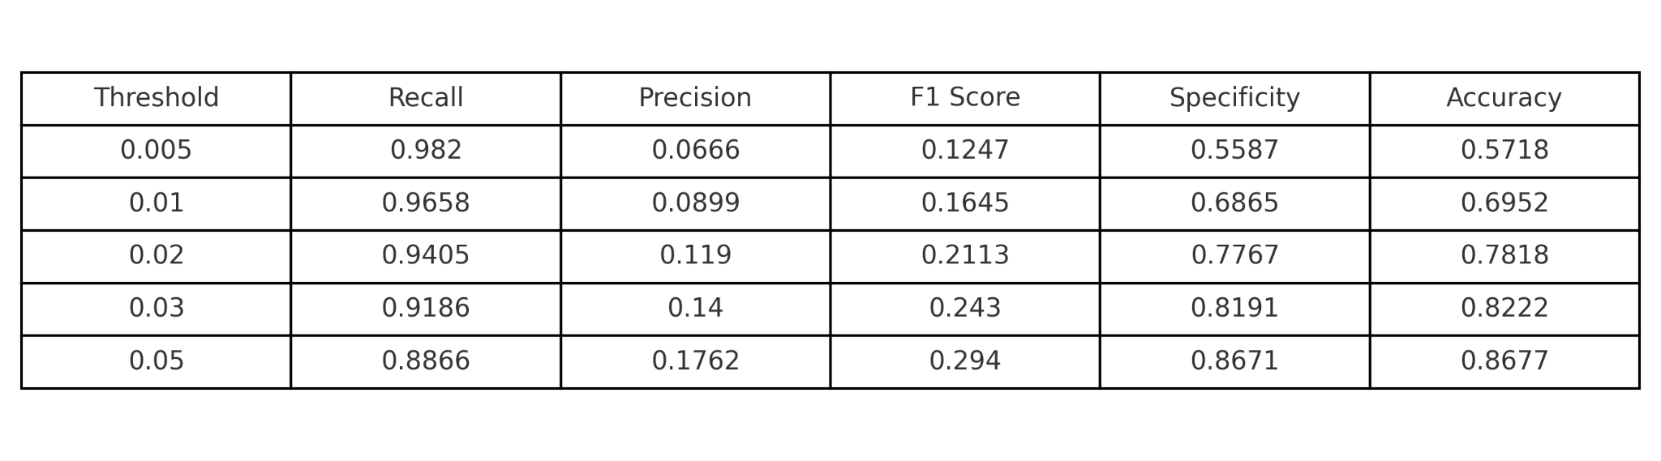
SVM - Model Description & Hyperparameter Tuning
Tuning Strategy:
A subset of 50,000 samples was selected for faster hyperparameter tuning.
Goal: Maximize Recall on the default (positive) class (Default = 0).
Scoring metric: recall_score(pos_label=0)
RandomizedSearchCV was used with 3-fold StratifiedKFold cross-validation.
Best Parameters:
C = 0.2
kernel = 'rbf'
gamma = 0.01
class_weight = {-1: 1, 0: 50}
Evaluation Results on Full Test Set

Slide 5
SVM - Insights & Takeaways
Performance Observations
Threshold = 0.005 achieved the highest Recall = 0.9820, but Precision = 0.0666 and Specificity were very low.
Tradeoff: As threshold increases, Precision and Specificity improve, but Recall drops.
Best F1 Score observed at Threshold = 0.05:
F1 = 0.2940, Precision = 0.1762, Recall = 0.8866
Why Focus on Recall?
In default prediction, missing a true defaulter is more costly than mistakenly flagging a non-defaulter.
SVM with low threshold settings effectively identifies most defaulters (TPs), though with more false positives (FPs).
Limitation:
Extremely high recall comes at the cost of too many false positives, leading to operational inefficiencies.

Slide 6
Random Forest - Hyperparameter Tuning & Strategy
Algorithm: Random Forest Classifier
Goal: Maximize Recall (identify as many defaults as possible)
Hyperparameters:
n_estimators: 2000
max_depth: None
min_samples_leaf: 1
min_samples_split: 2
max_features: 'sqrt'
class_weight: {-1: 1, 0: 200} (heavily penalize missing defaults)
Threshold: 0.005 (lowered to increase sensitivity)
Why This Strategy?
Because defaulting borrowers are rare but costly, our priority is to maximize recall at the cost of precision.

Slide 7
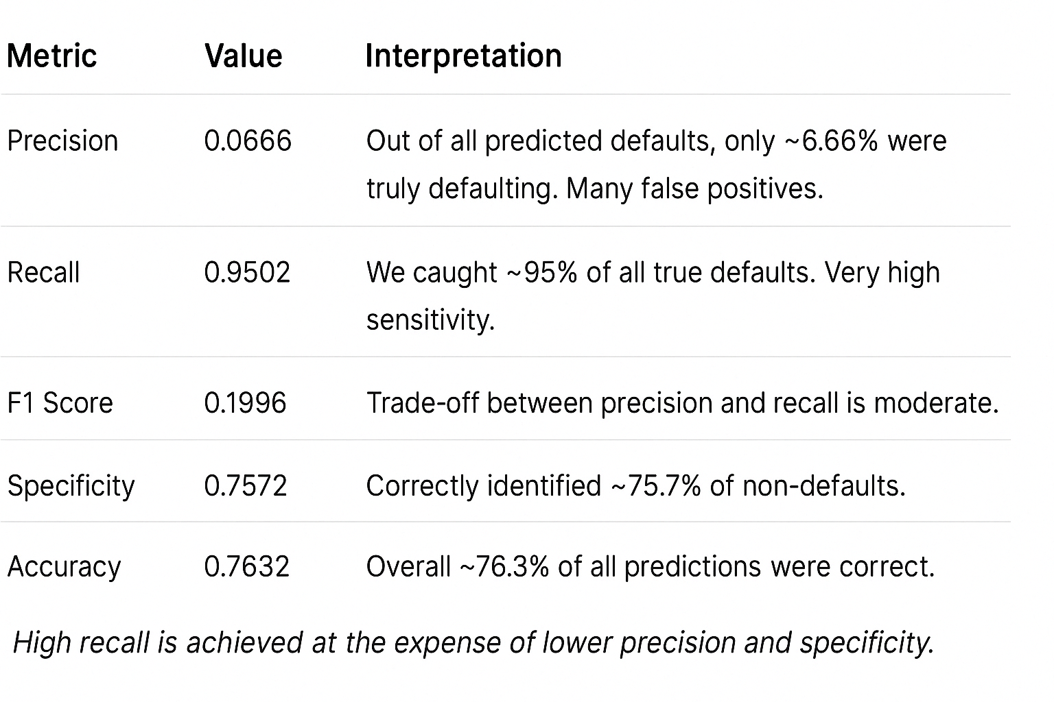
Random Forest - Evaluation & Insights
Strength:
Excellent at identifying borrowers likely to default.
Achieves professor’s recall target (above 0.90).
Tradeoff:
Model has a high false positive rate (low precision), labeling many non-defaulters as risky.
Specificity and precision are significantly impacted.
Justification:
In a mortgage securitization pool, missing a default can be more costly than incorrectly flagging a safe borrower.
This model prioritizes risk-averse predictions to minimize loss.
Next Steps:
Ensemble voting or threshold optimization across models (optional).
Incorporate cost-sensitive learning or ROI analysis for better real-world alignment.
Performance Metrics

Slide 8
GBM
Tuning Strategy:
Use 50,000 sample stratified subset for RandomizedSearchCV
Optimized for Recall using pos_label=0
Hyperparameters tested:
n_estimators: [400, 800, 1000]
learning_rate: [0.01, 0.03]
max_depth: [3, 4, 6]
min_samples_leaf: [1, 5]
min_samples_split: [2, 5]
subsample: [0.9, 1.0]
Goal:
Maximize Recall to detect loan defaults as early as possible
Data: 2000 as training, 2001 as testing (No state info used)
Challenges:
Extremely imbalanced dataset (default ratio ~4.7%)
Need to capture hard positives while minimizing false negatives

Slide 9
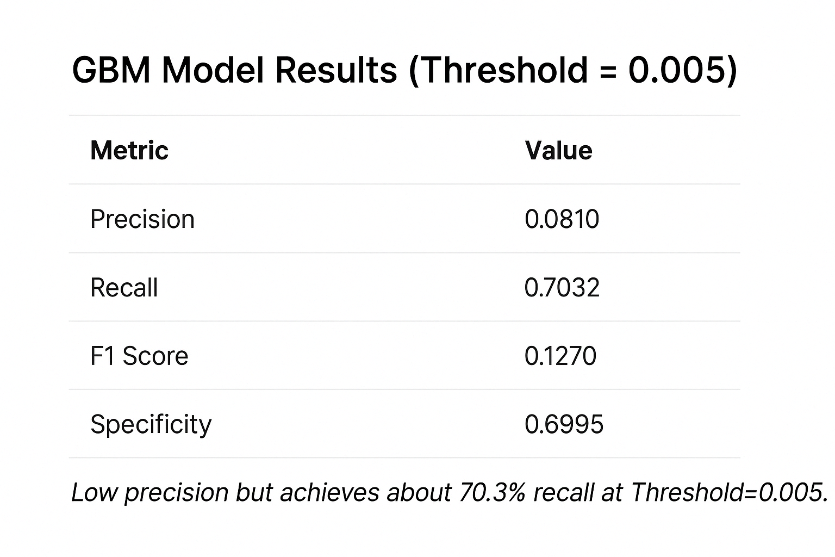
GBM
gbm = GradientBoostingClassifier(...)
gbm.fit(X_train, y_train)
probs = gbm.predict_proba(X_test)[:, 1]
preds = np.where(probs > 0.005, 0, -1)
Code Summary & Appendix
Model: GradientBoostingClassifier (scikit-learn)
Training Subset: 50k balanced sample from 2000 data
Preprocessing: SimpleImputer + StandardScaler
Evaluation: Probability output + threshold sweep to optimize recall
Performance Metrics

Slide 10
XGB - Hyperparameter Tuning (Subset)
n_estimators=1000 max_depth=20 learning_rate=0.05
[[7745 54]
[ 95 106]]
F1(0):0.587
n_estimators=200 max_depth=20 learning_rate=0.2
[[7746 53]
[ 96 105]]
F1(0): 0.584
n_estimators=500 max_depth=10 learning_rate=0.2
[[7748 51]
[ 99 102]]
F1(0): 0.576
Lower depth reduces overfitting.
Higher LR speeds convergence.
Fewer trees save computation.

Slide 11
XGB - Full Dataset Performance
[[702964 7307]
[ 17017 5754]]
Accuracy: 0.967
Precision(0): 0.441
Recall(0): 0.253
Specificity: 0.990
F1(0): 0.321

Slide 12
MLN - Hyperparameter Tuning (Subset)
layers=(10,)
alpha=0.001
lr_init=0.01
[[7781 17]
[ 97 105]]
F1(0): 0.648
layers=(30,20,10)
alpha=0.001
lr_init=0.01
[[7778 20]
[ 95 107]]
F1(0): 0.650
layers=(20,)
alpha=0.001
lr_init=0.01
[[7775 23]
[ 93 109]]
F1(0): 0.652

Slide 13
MLN - Full Dataset Performance
[[707802 2469]
[ 18970 3801]]
Accuracy: 0.971
Precision(0): 0.606
Recall(0): 0.167
Specificity: 0.997
F1(0): 0.262

Slide 14
RNN - Hyperparameter Tuning (Subset)
{'units': 128, 'dropout_rate': 0.0, 'learning_rate': 0.001, 'epochs': 100, 'batch_size': 64}
[[7776 22]
[ 98 104]]
F1 = 0.6341
{'units': 32, 'dropout_rate': 0.1, 'learning_rate': 0.001, 'epochs': 100, 'batch_size': 128}
[[7787 11]
[ 111 91]]
F1 = 0.5987
Dropout prevents overfitting.

Slide 15
RNN - Full Dataset Performance
[[649833 60438]
[ 2538 20233]]
Accuracy: 0.9141
Precision(0): 0.2508
Recall(0): 0.8885
Specificity: 0.9149
F1(0): 0.3912

Slide 16
Future Research Directions
Address imbalance:
scale_pos_weight -> increase recall
stratify=y_train_full -> increase representative
Future work
Hold‑out + early stopping on the full training set → pick the right number of estimators and regularization.
Stratified K‑fold CV for robust hyper‑parameter selection of on the full distribution.
Threshold sweep on probabilities → maximize F1 on a validation slice.

Slide 17
LSTM
Preprocessing Steps
Log-transformation on ORIG_AMT, LAST_VAL
Standardization of all numerical features
One-hot encoding for PROP_TYP
Excluded STATE column per project guidelines
Reshaped input to 3D for LSTM: (samples, 1, features)
Model Architecture
Single LSTM layer with 64 units
Dropout (0.2) to reduce overfitting
Dense layer (32 units) before sigmoid output
Final output: binary default prediction
Training Strategy
Randomized hyperparameter search (3 trials)
Validation split: 20%
Class weighting: {0: 1, 1: 2.5} to handle imbalance
Optimizer: Adam (learning rate: 0.001)
Trained over 10 epochs with batch size = 64
Model selection based on highest F1 score

Slide 18
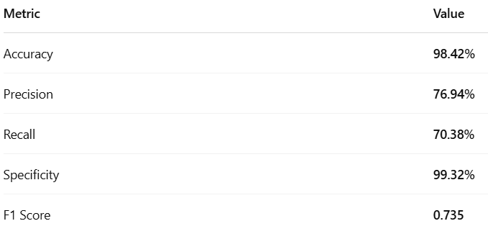
LSTM
Performance Metrics
Best hyperparameter:
units: 64
dropout: 0.2
batch_size: 64
learning_rate: 0.001
epochs: 10
Excellent balance between catching defaults (recall = 70%) and avoiding false alarms (precision = 77%)
Very high specificity (99.3%): safe borrowers are rarely misclassified

Slide 19
GRU
Preprocessing Steps
Log-transformation of skewed features (ORIG_AMT, LAST_VAL)
One-hot encoding for PROP_TYP
Standardization using StandardScaler
Reshaped input for GRU format: (samples, 1, features)
Model Architecture
Two GRU layers (64 units each) with return_sequences
Dropout (0.2) after each GRU layer
Dense hidden layer + output layer with sigmoid activation
Training Strategy
Random search over 3 trials for hyperparameters
Early stopping (patience = 3)
Class weighting {0: 1, 1: 2.5}
Optimizer: Adam (learning rate: 0.001)
Final threshold: 0.5 for binary classification

Slide 20
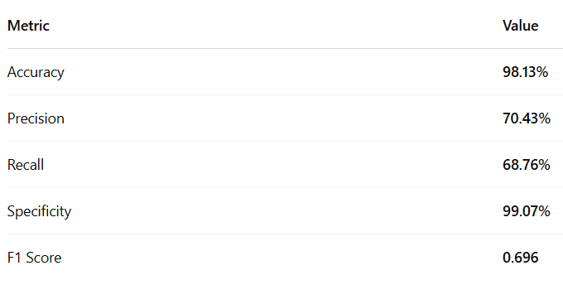
GRU
Performance Metrics
Best hyperparameter:
units: 64
dropout: 0.2
batch_size: 128
learning_rate: 0.001
epochs: 20
The GRU model balances recall and precision, with an F1 score close to 0.70.
High specificity (99%) minimizes false positives — important in preserving good borrowers.

Slide 21
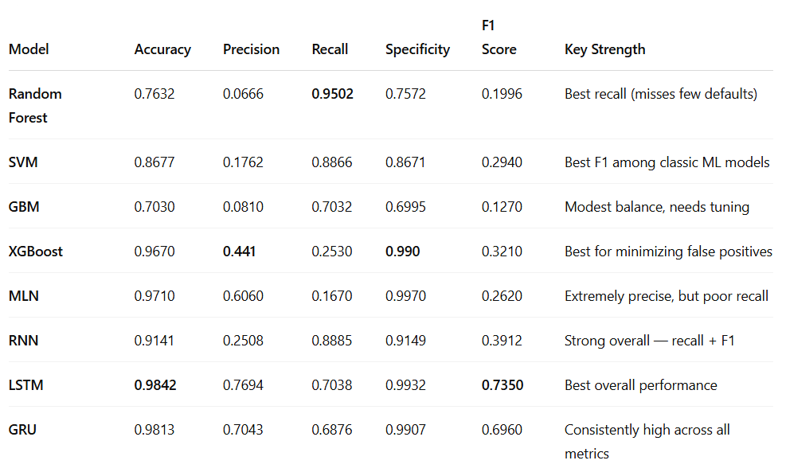
Overall Model Comparison Summary

Slide 22
Final Takeaways
Key Takeaways
Random Forest: Best at catching defaulters — perfect for risk-averse lending strategies.
SVM and RNN: High recall with more stability — great trade-off control.
LSTM: Strongest overall model (F1 = 0.735), very high precision and specificity — ideal in both risk and operational terms.
XGBoost: Ideal for minimizing false positives — conservative flagging.
What We’d Recommend
Deploy LSTM or GRU in production for best balance.
Use Random Forest or RNN in high-risk pools to avoid missing defaults.
Consider ensemble voting or score averaging between top models (e.g., LSTM + XGB).
Future Work
Integrate cost-sensitive loss functions based on lender economics.
Deploy threshold optimization tied to profit/loss outcomes.
Add borrower behavior & credit history features to boost predictive power.

