Slide 1

Fill In The Gaps: Model Calibration and Generalization with Synthetic Data
Yang Ba, Michelle V. Mancenido, Rong Pan

Slide 2
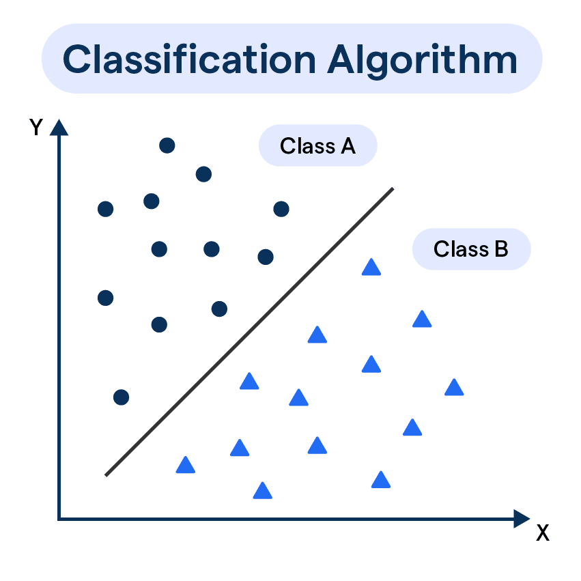

Classifier Evaluation
When evaluating a classifier, we usually use metrics such as: accuracy, F1, ROC etc.
Two models:
90% accuracy, 91% confidence in predictions
90% accuracy, 99% confidence in predictions
Notes:
Confidence refers model uncertainty

Slide 3




Model Uncertainty
In high stake areas, model uncertainty even more important.
stock trading
disease diagnosis
51% vs 99%
Will your actions be different according to these two different prediction confidences?

Slide 4
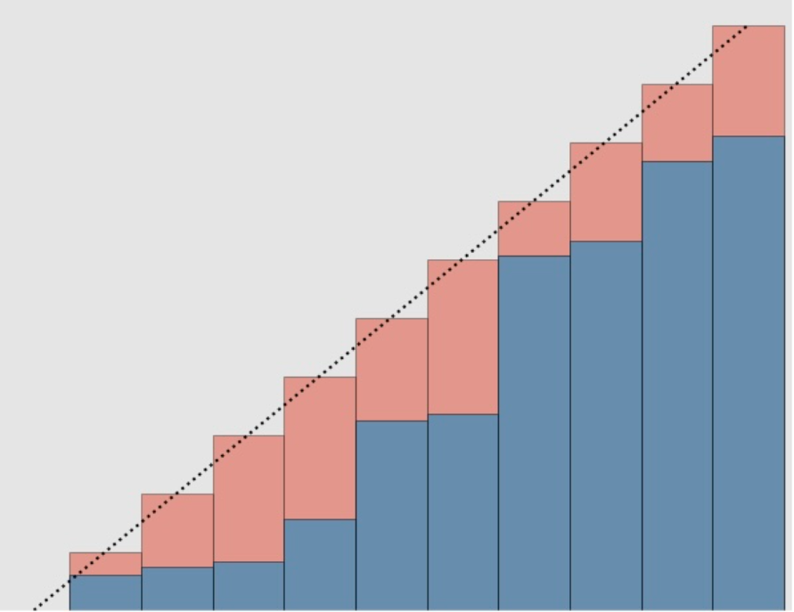
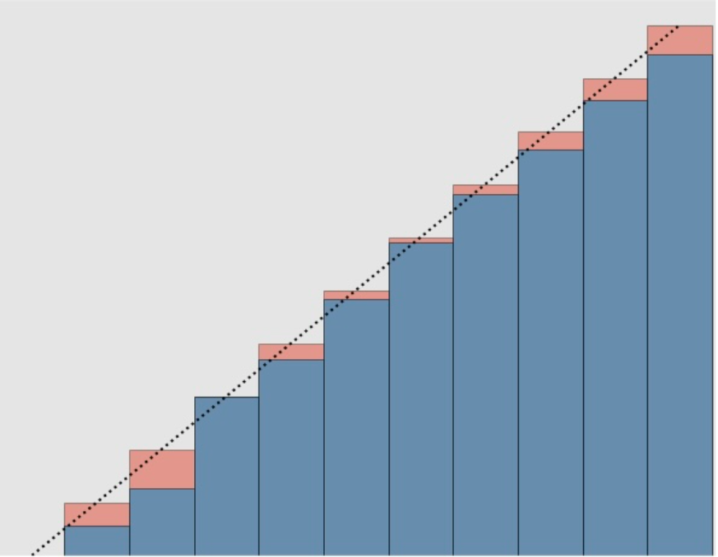
Model Calibration
Calibration: to align a model’s predicted probabilities (confidence) with its actual outcomes (accuracy).
Evaluation Metric: Expected Calibration Error (ECE)
Calibrate models
Reliability Diagram
Reliability Diagram

Slide 5
Motivation
The current calibration methods only focus on calibration and ignore model accuracy, which will either potentially hurt the model prediction performance or maintain it, such as Isotonic regression,Platt scaling, Monte Carlo dropout, Temperature scaling.
Can we calibrate models while improving accuracy, or at least without sacrificing it?

Slide 6
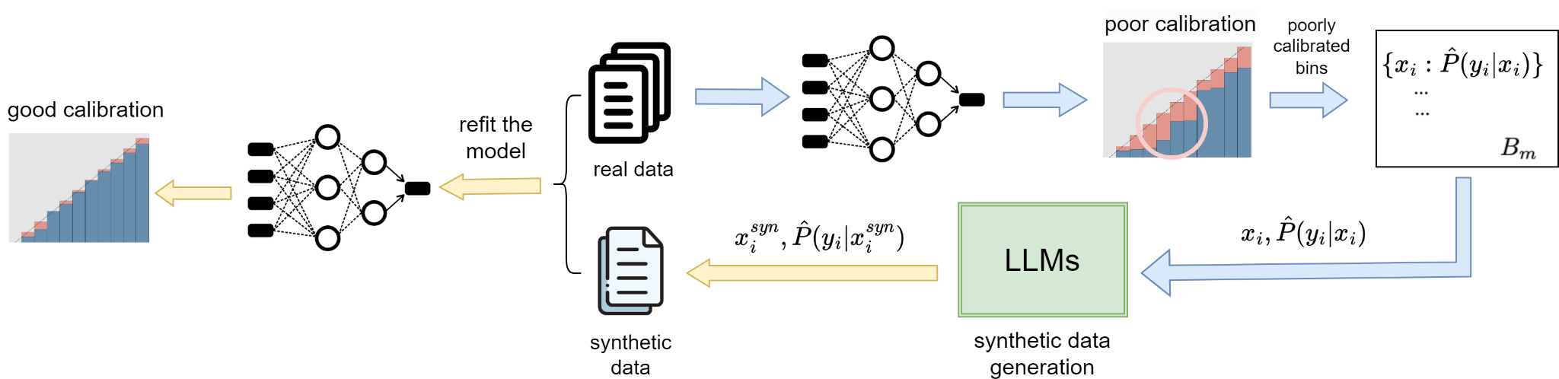
Our Proposed Framework
We develop a theoretical framework to solve this problem, leveraging LLM-generated synthetic data to calibrate downstream NLP models and increase their accuracy at the same time.
We extend Probably Approximately Correct (PAC) learning framework to derive the Expected Calibration Error Bound, guiding us in synthetic data generation and model calibration

Slide 7
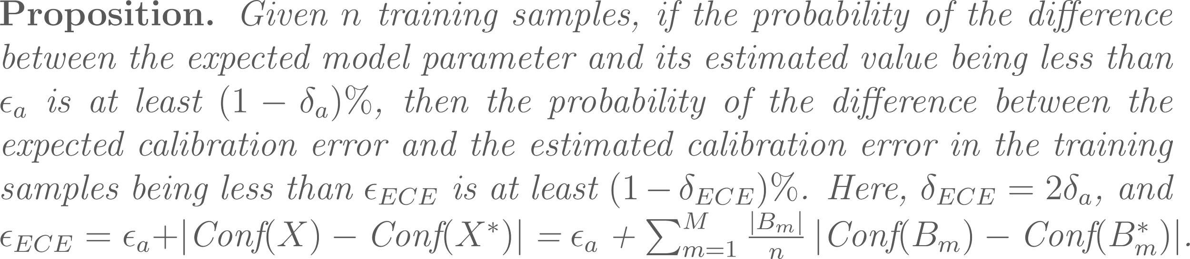

Expected Calibration Error Bound
Based on ECE bound, we can manipulate the prediction probability by synthetic data to minimize the difference
(Refer the paper to check out the detailed proof and remarks.)

Slide 8
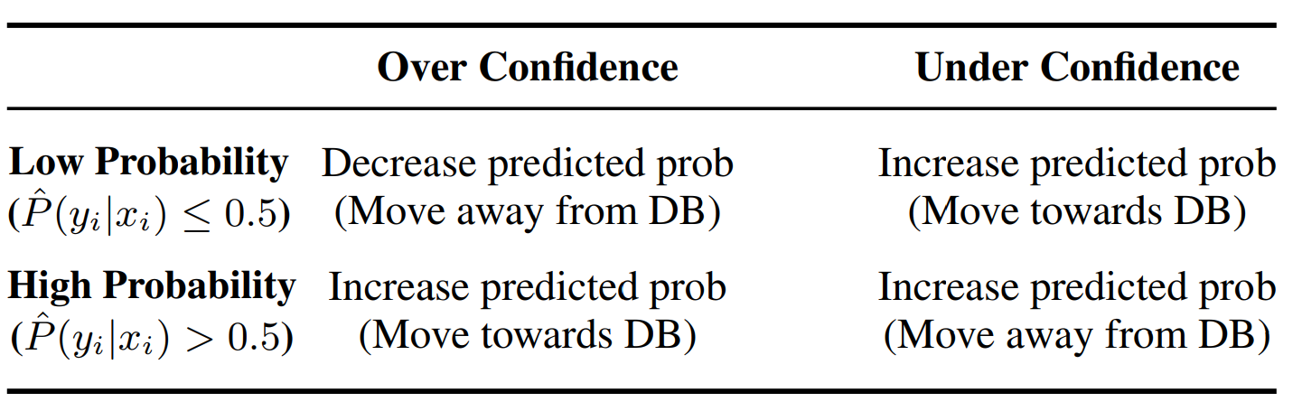
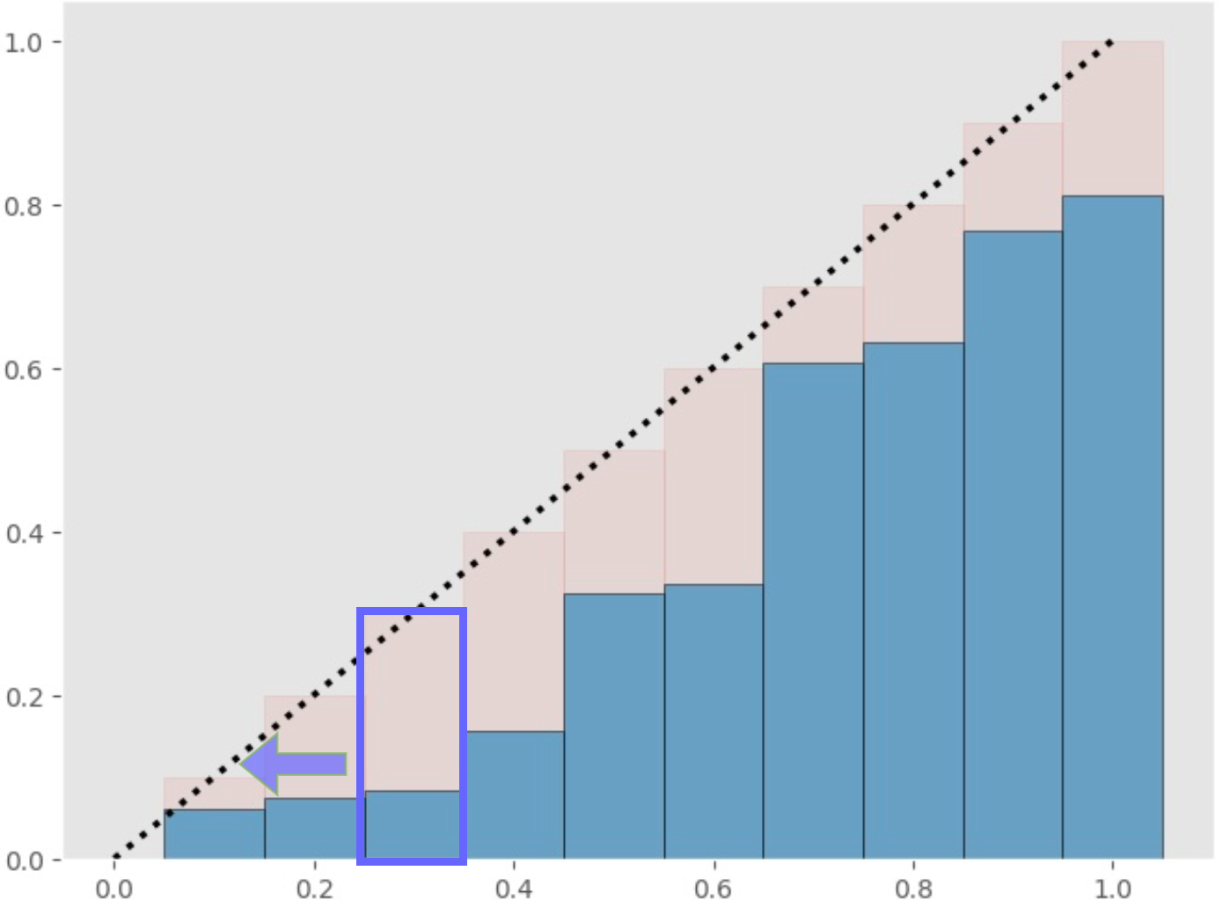
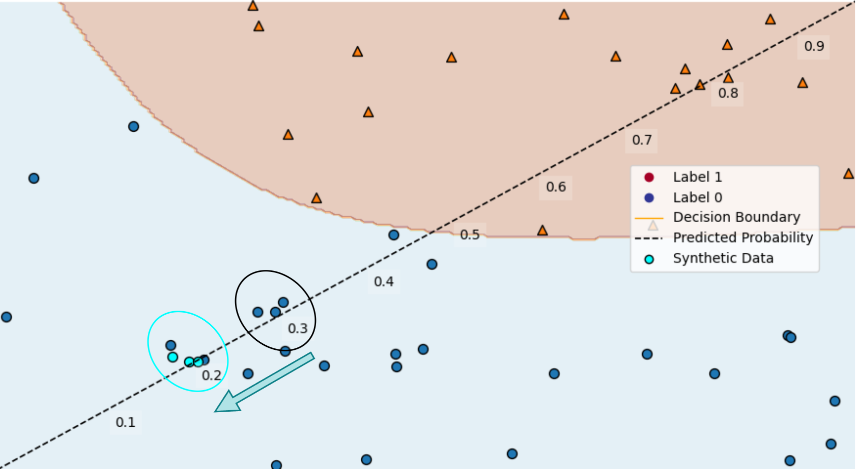
Synthetic Data Generation Strategy
Generating synthetic data to address miscalibration gaps.

Slide 9
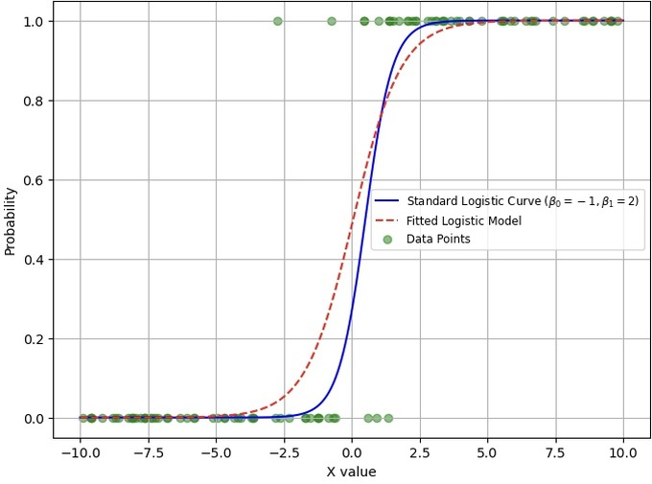
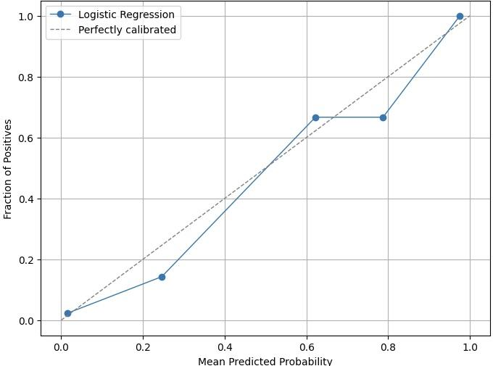


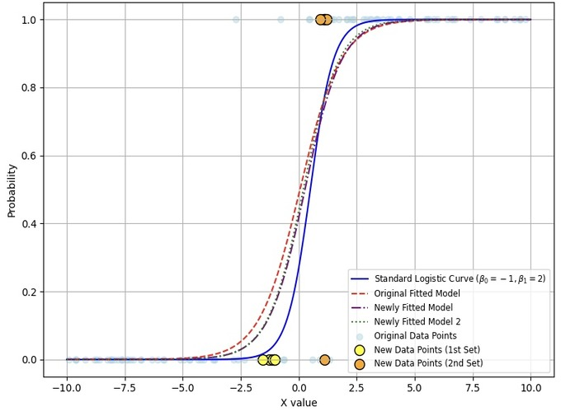
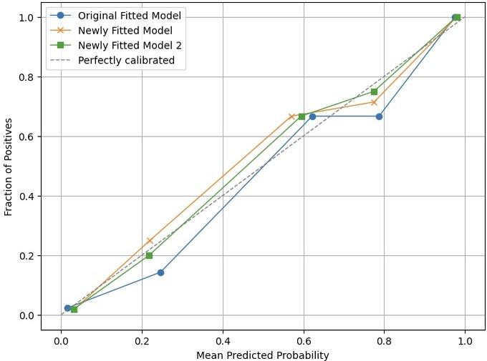




Toy example
Original fitted model :
= -0.06 and = 1.13, ACC: 0.95, ECE: 0.0405;
Newly fitted model :
= -0.339 and = 1.2627, ACC: 0.95327, ECE: 0.0424;
Newly fitted model 2 :
= -0.2558 and = 1.2953, ACC: 0.9469, ECE: 0.0366;

Slide 10

Experiments
Tasks: TC, SUBJ, B77, SE, Arxiv, Medical
Model:
Baseline: without any calibration
Synthesis: synthetic data replacement (keep the training data size the same)
Synthesis+: synthetic data add-on (increase the training data size)
Comparison: Isotonic regression, Platt scaling, Monte Carlo dropout, Temperature scaling
N_bins: 10, 15, 20

Slide 11
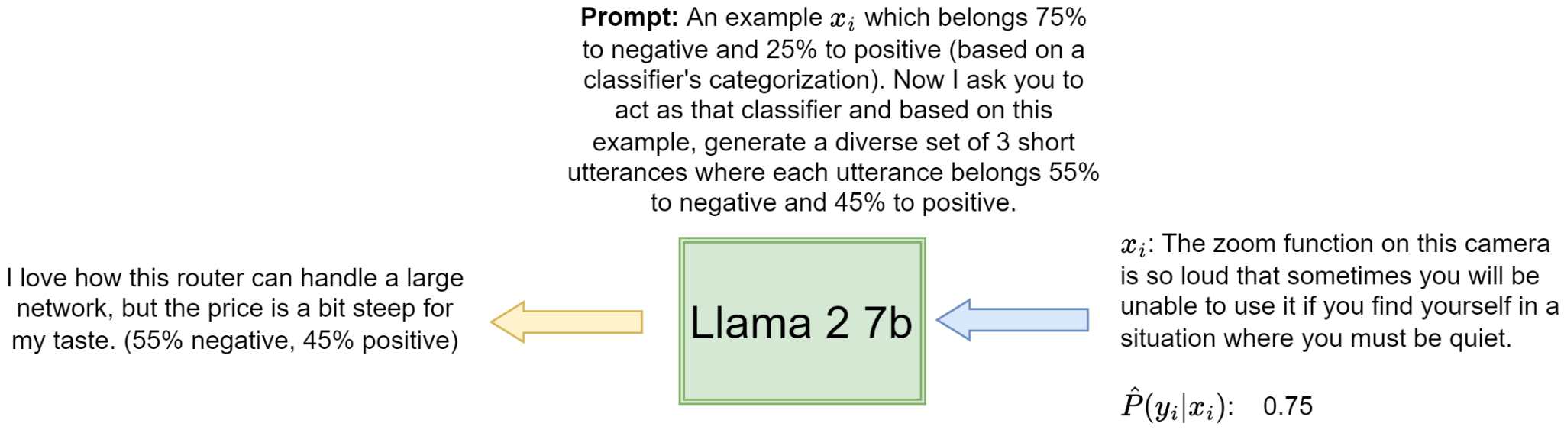
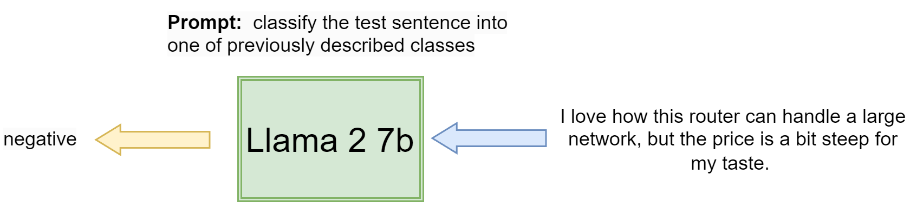
Sample Synthetic Data(SE, high probability & overconfidence)
Relabel

Slide 12
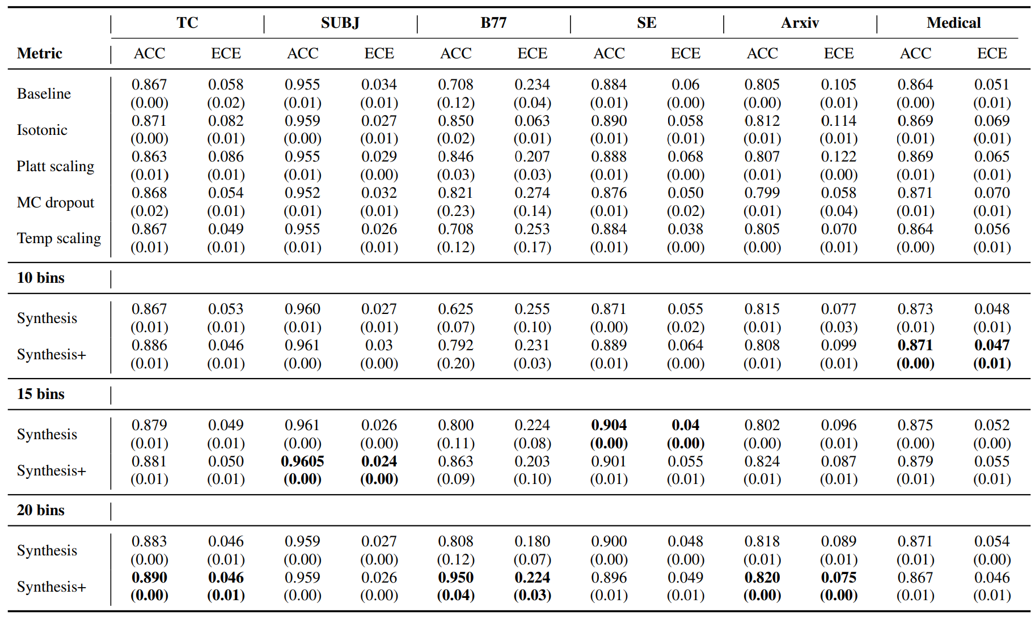
Results
On average:
21% ECE decrease;
7% ACC increase;
5/6 outperform other methods

Slide 13
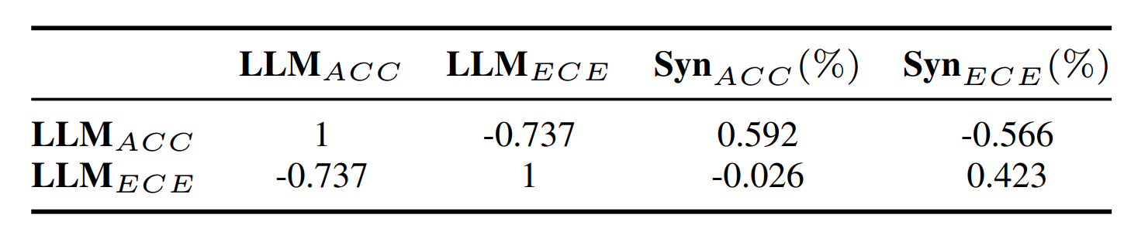
Ablation Study
Pearson Correlation Table : A moderate positive association between the llama 2’s accuracy and the accuracy improvement in downstream tasks.

Slide 14
Conclusion
Purposefully generated synthetic data can enhance classification performance and reduce calibration error in downstream NLP tasks.
Advanced LLMs or fine-tuning LLMs to incorporate domain knowledge may improve performance.

