Slide 1
딥러닝 기초, 실습 강의

Slide 2
CONTENTS
1
5
3
Recommended
Video
Cost
Function
Supervised
Learning
2
4
Basic
Regression
Notion
Machine
Learning
(ML)

Slide 3
CONTENTS
6
10
8
Optimization
Jupyter
Notebook
Python
7
9
Google
Colab
Conclusion

Slide 4
Recommended Video, Lecture
Kocw – 수리통계학(부산대 김충락 교수님)
기계학습과 인공신경망
데이터 마이닝(SW융합)
딥러닝 홀로서기(Kaist)
선형대수
신호 및 시스템 1,2
공학수학 1, 2
….
필수는 아닙니다.

Slide 5
Machine
Learning
Artificial Intelligence
Machine Learning
Deep Learning

Slide 6
Machine
Learning
Classification
Clustering
Regression
Dimensionality
Reduction
강화학습이 제외되어 있습니다.

Slide 7
Supervised Learning
Classification
Regression

Slide 8
Basic Regression Notion
X=Y

Slide 9
X=Y
Sample X
[1,1]
[2,2]
[3,3]
[4,4]
X=Y
If) X=5, Y=?
가지고 있는 Data로 회귀모형을 만들어
새로운 데이터를 예측한다.

Slide 10
HOW TO MAKE
어떻게 만들 것인가?

Slide 11

Hypothesis
Hypothesis 란?
쉽게 생각하면 가설 WX+B=Y안에
모든 (W,B) 를 생각하여 풀이하는 방식이다.

Slide 12
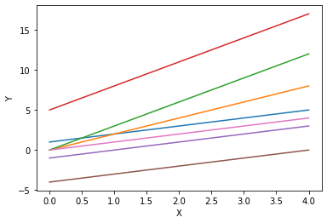
Hypothesis
X | Y
1 | 1
2 | 2
3 | 3
4 | 4
H(x)=?

Slide 13
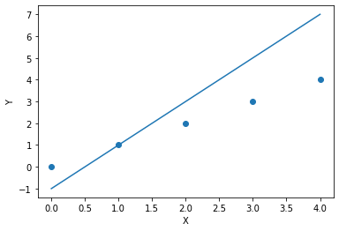
Hypothesis
H(x)-y
Cost function

Slide 14
What is?
Cost Function
X | Y
0 | 0
1 | 1
2 | 2
3 | 3
4 | 4

Slide 15
Cost Function
MSE, Cross Entropy
Cost Function은 간단히 2가지를 고려 가능하다.
Y => Countinuos, Discrete

Slide 16
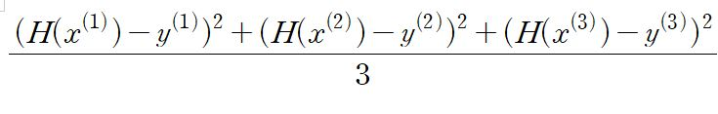
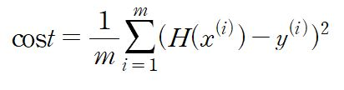
Cost Function
MSE(Mean Square Error)
Y => Countinuos
Ex )
Minimize cost(W, b)
W, b ->Minimize

Slide 17
How to Minimize
Cost Function

Slide 18
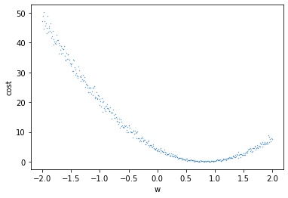
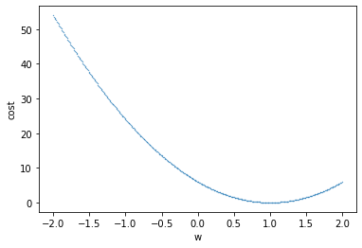
Gradient Descent
Bias Existence O
Bias Existence X

Slide 19
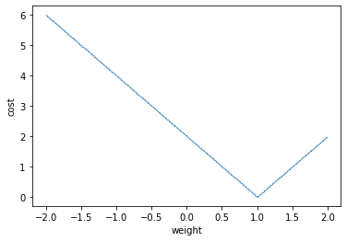
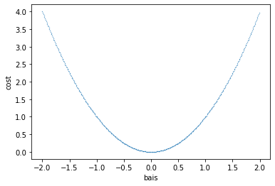
Gradient Descent
absolute
MSE

Slide 20
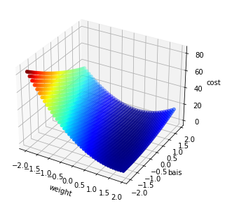
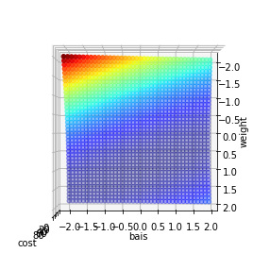
Gradient Descent

Slide 21
Gradient Descent

Slide 22
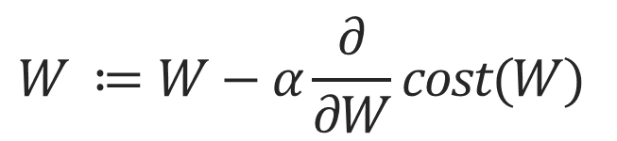
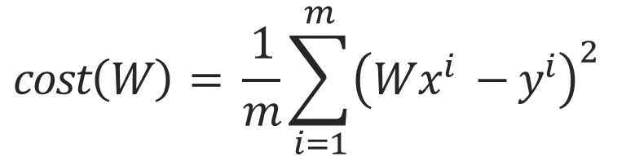
Gradient Descent
Consider only Weight for understand
$$cost\left(W\right)= \frac{1}{m}\sum_{i=1}^{m}{{\left(Wx^{i} −y^{i}\right)}^{2}}$$
$$W ≔W−α\frac{∂}{∂W}cost(W)$$

Slide 23
Gradient Descent

Slide 24
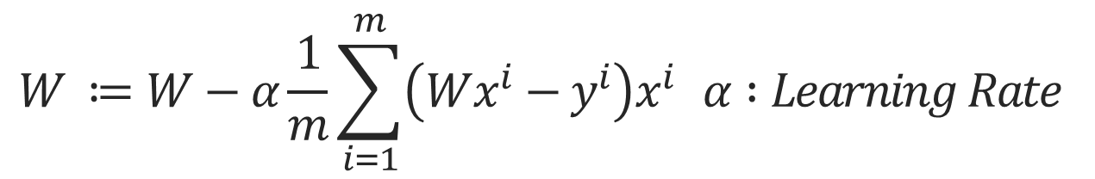
Gradient Descent
Consider only Weight for understand
$$W ≔W−α\frac{1}{m}\sum_{i=1}^{m}{\left(Wx^{i}−y^{i}\right)x^{i} α :Learning Rate}$$
편의상 2 제거

Slide 25
Why use Learning Rate

Slide 26
Problem
Local Minimum, Global Minimum

Slide 27
Multi-Variable
 | f1 | f2 | f3 | f4 | f5 | Y
X1 | 1 | 3 | 1 | 4 | 2 | 0
X2 | 2 | 4 | 3 | 5 | 6 | 1.3
X3 | 1 | 3 | 1 | 2 | 3 | 1.2
X4 | 2 | 3 | 2 | 1 | 2 | 2.3
X5 | 2 | 4 | 3 | 3 | 1 | 3.4

Slide 28
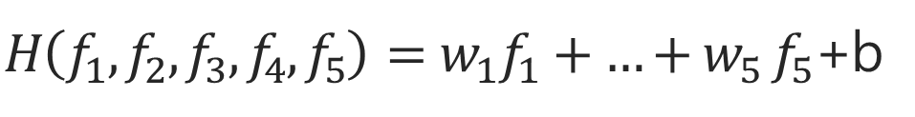

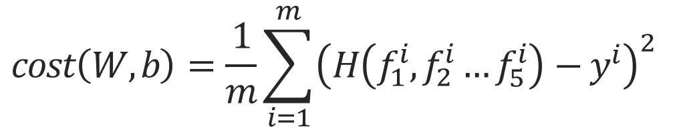
Multi-Variable
 | f1 | f2 | f3 | f4 | f5 | Y
X1 | 1 | 3 | 1 | 4 | 2 | 0
X2 | 2 | 4 | 3 | 5 | 6 | 1.3
X3 | 1 | 3 | 1 | 2 | 3 | 1.2
X4 | 2 | 3 | 2 | 1 | 2 | 2.3
X5 | 2 | 4 | 3 | 3 | 1 | 3.4
$$H\left(x\right)=Wx+b$$
$H\left(f_{1},f_{2},f_{3}, f_{4},f_{5}\right)=w_{1}f_{1}+{…+w}_{5}f_{5}$+b
$$cost\left(W,b\right)=\frac{1}{m}\sum_{i=1}^{m}{{\left(H\left(f_{1}^{i},f_{2}^{i}…f_{5}^{i}\right)−y^{i}\right)}^{2}}$$

Slide 29

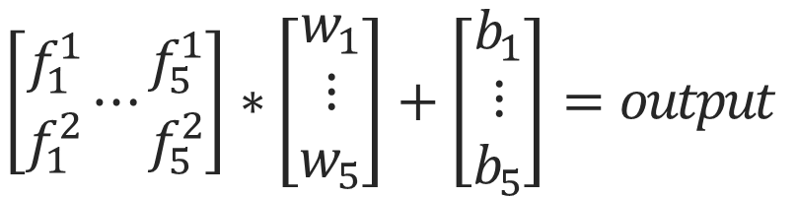

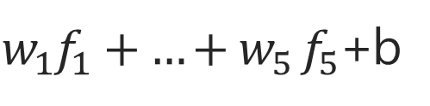




Matrix
Feature
$$W_{1}$$
$w_{1}f_{1}+{…+w}_{5}f_{5}$+b
$$W_{2}$$
Output
$$\left[\begin{matrix}f_{1}^{1} \\ f_{1}^{2}\end{matrix}⋯\begin{matrix}f_{5}^{1} \\ f_{5}^{2}\end{matrix}\right]∗\left[\begin{aligned}w_{1} \\ ⋮ \\ w_{5}\end{aligned}\right]+\left[\begin{aligned}b_{1} \\ ⋮ \\ b_{5}\end{aligned}\right]=output$$
$$W_{3}$$
$$W_{4}$$
$$W_{5}$$
1-dimension
$$H\left(X\right)=XW+B$$

Slide 30
How to Increase
Dimension

Slide 31
Basic Model
Input
Feature
Output
4-dimension

Slide 32







Matrix_Problem
Feature
$$W`_{1}$$
$$W_{1}$$
$$W`_{2}$$
$$W_{2}$$
Output
$$W_{3}$$
$$W_{4}$$
$$W_{5}$$

Slide 33
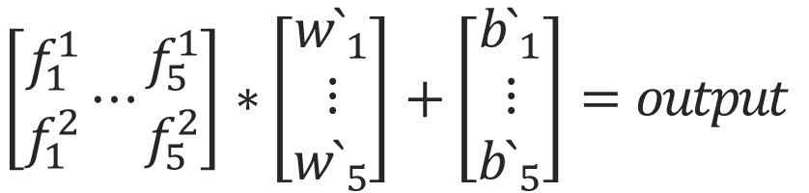
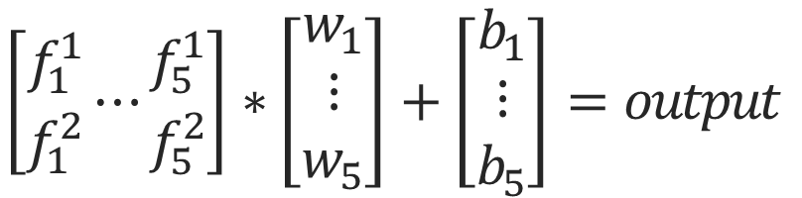
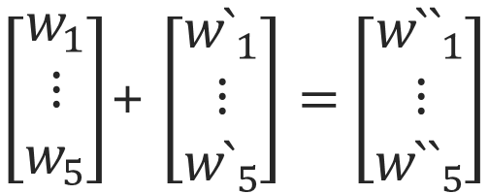
Matrix_Problem
$$\left[\begin{matrix}f_{1}^{1} \\ f_{1}^{2}\end{matrix}⋯\begin{matrix}f_{5}^{1} \\ f_{5}^{2}\end{matrix}\right]∗\left[\begin{aligned}w_{1} \\ ⋮ \\ w_{5}\end{aligned}\right]+\left[\begin{aligned}b_{1} \\ ⋮ \\ b_{5}\end{aligned}\right]=output$$
$\left[\begin{aligned}w_{1} \\ ⋮ \\ w_{5}\end{aligned}\right]$+ $\left[\begin{aligned}{w`}_{1} \\ ⋮ \\ {w`}_{5}\end{aligned}\right]=\left[\begin{aligned}{w``}_{1} \\ ⋮ \\ {w``}_{5}\end{aligned}\right]$
$$\left[\begin{matrix}f_{1}^{1} \\ f_{1}^{2}\end{matrix}⋯\begin{matrix}f_{5}^{1} \\ f_{5}^{2}\end{matrix}\right]∗\left[\begin{aligned}{w`}_{1} \\ ⋮ \\ {w`}_{5}\end{aligned}\right]+\left[\begin{aligned}{b`}_{1} \\ ⋮ \\ {b`}_{5}\end{aligned}\right]=output$$

Slide 34





Matrix_Problem
Feature
$${W``}_{1}$$
$${W``}_{2}$$
Output
$${W``}_{3}$$
$${W``}_{4}$$
$${W``}_{5}$$

Slide 35




Matrix_Problem
Input
Feature
Output
$$f_{a}$$
$$f_{a}$$
$$f_{a}$$
$$f_{a}$$
4-dimension

Slide 36
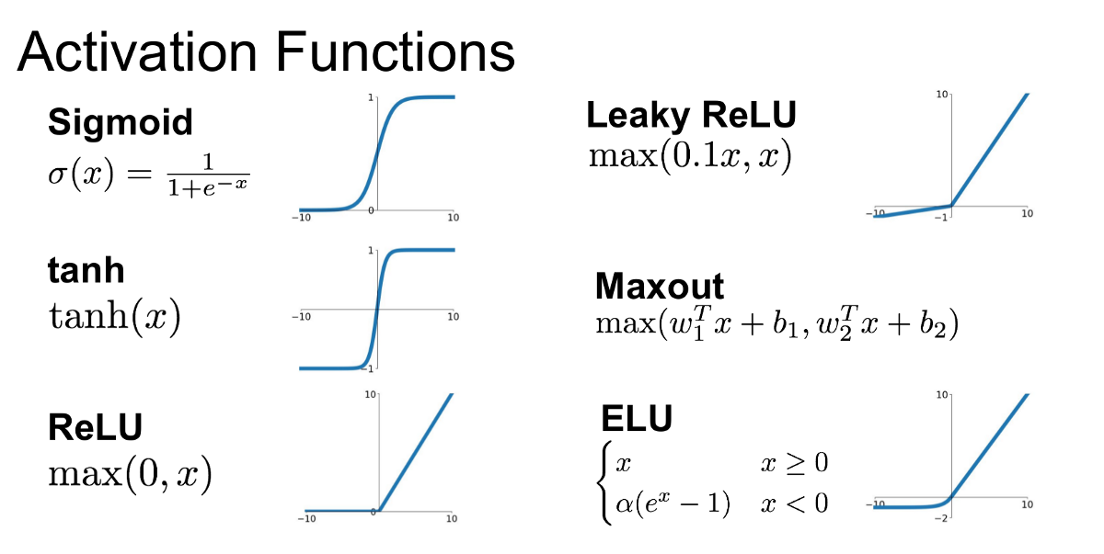
Matrix_Problem
추후에 자세히 다룰 예정
출처(URL) : https://medium.com/@shrutijadon10104776/survey-on-activation-functions-for-deep-learning-9689331ba092

Slide 37
Final Out_Range
 | f1 | f2 | f3 | f4 | f5 | Y
X1 | 1 | 3 | 1 | 4 | 2 | 0
X2 | 2 | 4 | 3 | 5 | 6 | 1.3
X3 | 1 | 3 | 1 | 2 | 3 | 1.2
X4 | 2 | 3 | 2 | 1 | 2 | 2.3
X5 | 2 | 4 | 3 | 3 | 1 | 3.4
Output => Continue
Ex) 0~3.4

Slide 38
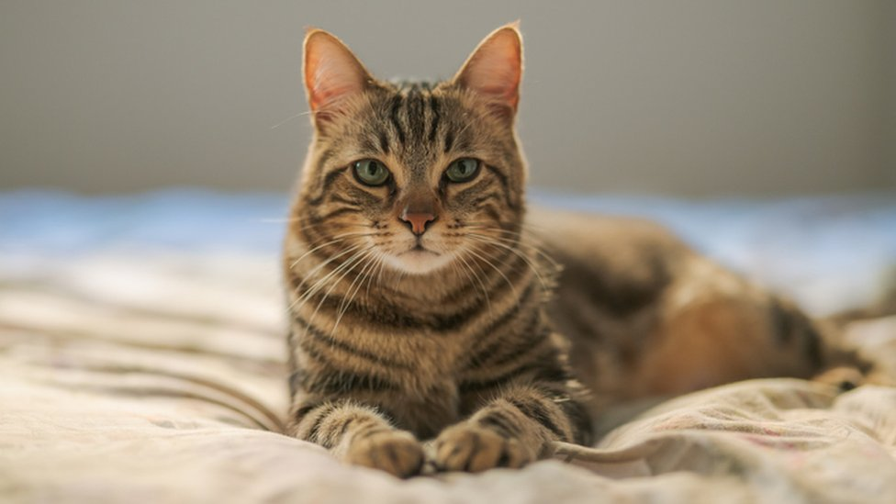

Final Out_Range
Cat=0
Dog=1
CAT 출처(URL) : https://www.bbc.com/news/uk-england-stoke-staffordshire-52047832
DOG 출처(URL) : https://www.theguardian.com/science/2019/jun/17/how-dogs-capture-
your-heart-evolution-puppy-dog-eyes

Slide 39

Binary Classification
Input
Feature
Output
Classification
$$F_{c}$$
4-dimension

Slide 40
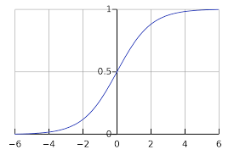
Binary Classification
Cat
Dog
Image 출처(URL) : https://en.wikipedia.org/wiki/Sigmoid_function

Slide 41
How to Make
Binary Classification Cost Function

Slide 42
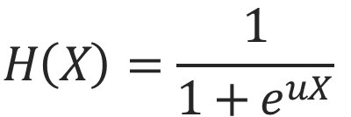
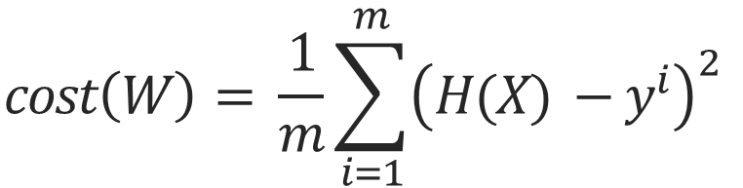
Cost Function
Cross Entropy
Y => Discrete
$$H\left(X\right)=\frac{1}{1+e^{uX}}$$
$$cost\left(W\right)= \frac{1}{m}\sum_{i=1}^{m}{{\left(H(X) −y^{i}\right)}^{2}}$$

Slide 43
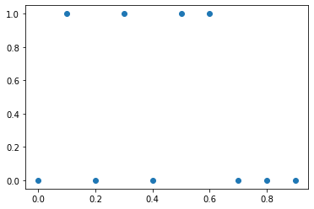
Binary
X | Y
0 | 0
0.1 | 1
0.2 | 0
0.3 | 1
0.4 | 0
0.5 | 1
0.6 | 1
0.7 | 0
0.8 | 0
0.9 | 0

Slide 44




Binary
Input
Feature
Output
$$o_{1}$$
Classification
$$o_{2}$$
1
$$o_{3}$$
$$F_{c}$$
$$o_{4}$$
4-dimension

Slide 45
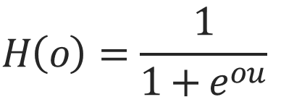
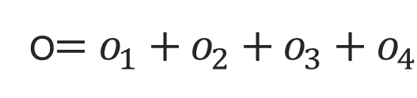
Binary
$$H\left(o\right)=\frac{1}{1+e^{ou}}$$
o$=o_{1}+o_{2}+o_{3}+o_{4}$
w

Slide 46
MSE, ABS Problem
Binary
If) w=> (-2 ~ 0) => y=1
MSE => 0.5로 수렴
w=> ( 0 ~ 2 ) => y=0
Local Minimum 빠지기 쉽다.

Slide 47
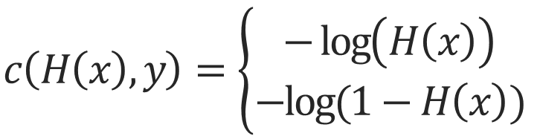
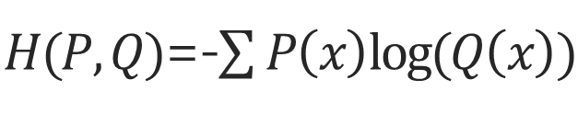


Cross Entropy
$H(P,Q)$=-$\sum{P\left(x\right)log⁡(Q\left(x\right))}$
$$c\left(H\left(x\right),y\right)=\left\{\begin{aligned}−\log\left(H\left(x\right)\right) \\ −log⁡(1−H\left(x\right))\end{aligned}\right.$$
$$:y=1$$
$$:y=0$$
$$c\left(H\left(x\right),y\right)=−ylog\left(H\left(x\right)\right)−\left(1−y\right)log⁡(1−H\left(x\right))$$

Slide 48
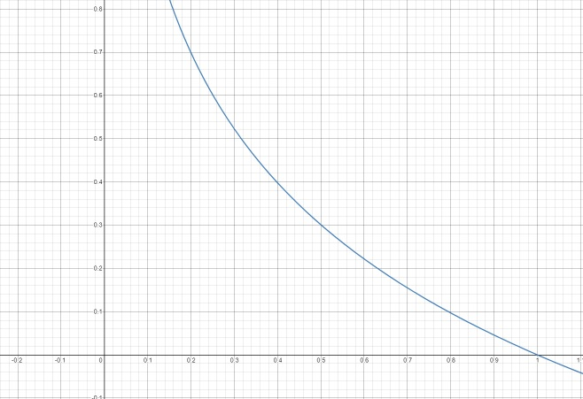
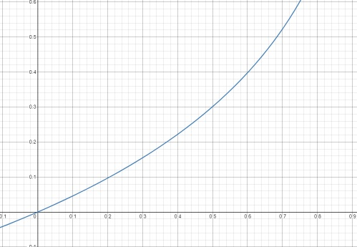



Cost Function
$$c\left(H\left(x\right),y\right)=\left\{\begin{aligned}−\log\left(H\left(x\right)\right) \\ −log⁡(1−H\left(x\right))\end{aligned}\right.$$
$$:y=1$$
$$:y=0$$
-log(x)
-log(1-x)

Slide 49
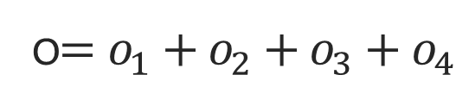
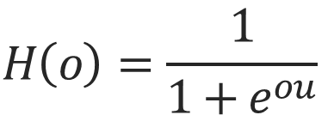
$$H\left(o\right)=\frac{1}{1+e^{ou}}$$
Cost Function
o$=o_{1}+o_{2}+o_{3}+o_{4}$
-log(x)
-log(1-x)

Slide 50

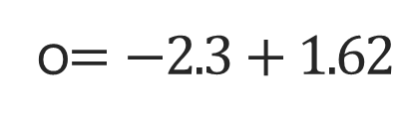

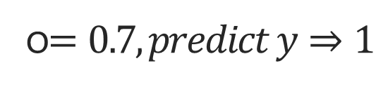

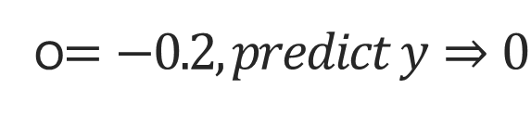
$$o_{1}⇒0.02, o_{2}⇒0.1, o_{3}⇒1.5, o_{4}⇒−2.3$$
Cost Function
o$=−2.3+1.62$
$$o_{1}⇒0.2, o_{2}⇒0.4, o_{3}⇒−0.5, o_{4}⇒−0.3$$
$$H\left(o\right)=\frac{1}{1+e^{ou}}$$
o$=−0.2, predict y⇒0$
But y=> 1
o$=o_{1}+o_{2}+o_{3}+o_{4}$
각, $o_{i} 의$ 역할 들이 점점 생긴다.
$$o_{1}=0.1, o_{2}=0.2, o_{3}=2.5,o_{4}=−2$$
o$=0.7, predict y⇒1$
But y=> 0

Slide 51
Next
Multinomial Classification

Slide 52
감사합니다
THANK YOU

