Slide 1
딥러닝 기초, 실습 강의

Slide 2
CONTENTS
1
5
3
Recommended
Video
Cost
Function
Supervised
Learning
2
4
Basic
Regression
Notion
Machine
Learning
(ML)

Slide 3
CONTENTS
6
10
8
Optimization
Jupyter
Notebook
Python
7
9
Google
Colab
Conclusion

Slide 4
Classification

Slide 5
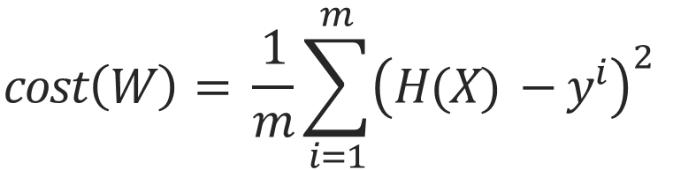
Classification Cost
$$cost\left(W\right)= \frac{1}{m}\sum_{i=1}^{m}{{\left(H(X) −y^{i}\right)}^{2}}$$
1. Use MSE
H(X) => Sigmoid Function(Value : 0~1)
=> Think of it as a probability
=> If Label is 1 and H(X) is 0.2, 0.2 is the probability of 1
Then the probability of zero is 0.8

Slide 6
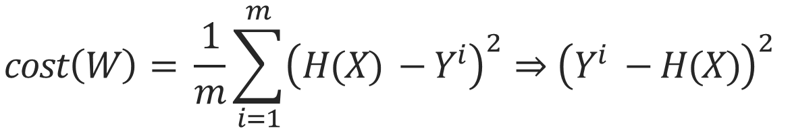
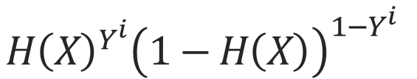
Classification Cost
$$H{\left(X\right)}^{Y^{i}}{\left(1−H\left(X\right)\right)}^{1−Y^{i}}$$
It can be expressed as a left expression
$$cost\left(W\right)= \frac{1}{m}\sum_{i=1}^{m}{{\left(H(X) −Y^{i}\right)}^{2}⇒{\left(Y^{i} −H(X)\right)}^{2}}$$
Decreasing the left expression is reducing Cost
The Cost from the previous example is 0.8 squared.
In other words, reducing the opposite probability is reducing cost

Slide 7
Problem with MSE without log?

Slide 8
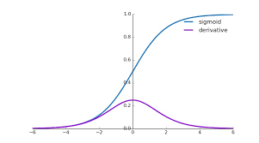
Classification Cost
1. Local Minimum
3. Gradient Vanishing
2. Differential graph of Sigmoid
(Long time Epoch)

Slide 9
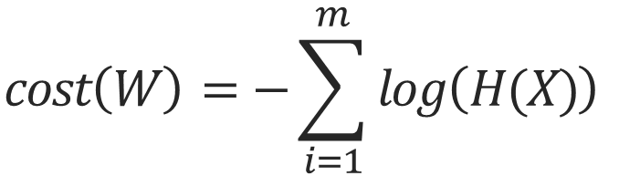
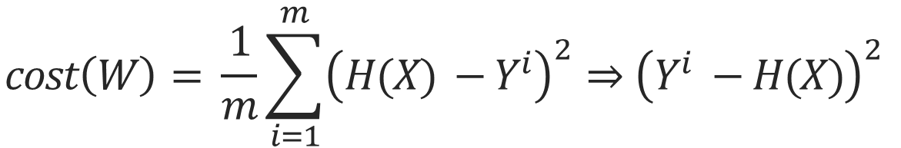
Classification Cost
$$cost\left(W\right)= \frac{1}{m}\sum_{i=1}^{m}{{\left(H(X) −Y^{i}\right)}^{2}⇒{\left(Y^{i} −H(X)\right)}^{2}}$$
We Use Cost Function below
$$cost\left(W\right)=−\sum_{i=1}^{m}{log\left(H(X)\right)}$$

Slide 10
Why?

Slide 11
Classification Cost
Probabilities and Statistics
What is PDF, PMF ?
Think of the probability of dice
1 | 2 | 3 | 4 | 5 | 6
1/6 | 1/6 | 1/6 | 1/6 | 1/6 | 1/6
Discrete

Slide 12
Classification Cost
Probabilities and Statistics
What is PDF, PMF ?
Think of Contine
The probability of a point is zero
To Know the probability, you need to set a range

Slide 13
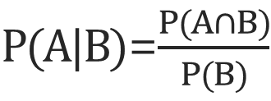
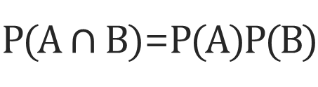
Classification Cost
Probabilities and Statistics
Independent variable
$P(A∩B)$=$P(A)P(B)$
Conditional probability
$P(A|B)$=$\frac{P(A∩B)}{P(B)}$
PDF

Slide 14


Classification Cost
Probabilities and Statistics
$Think of W^{T}*X$`s Range
$$G\left(W^{T}∗X\right)`s Value⇒0\sim 1$$
We want ${G(W}^{T}∗X)$ to have a value between 0~1

Slide 15
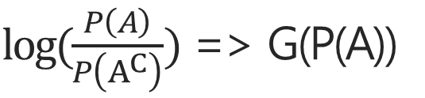
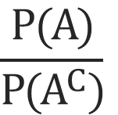
Classification Cost
Probabilities and Statistics
$$\frac{P(A)}{P(A^{C})}$$
Odds
P(A) Value => 0~1
Odds Value => 0~infinite
Graph
$log⁡(\frac{P\left(A\right)}{P\left(A^{C}\right)})$ => G(P(A))
G(P(A)) Value => -infinite~infinite

Slide 16
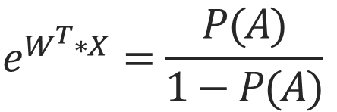
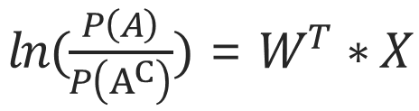
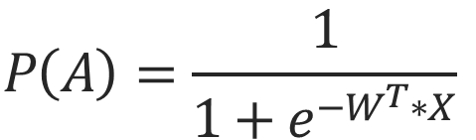
Classification Cost
Probabilities and Statistics
$ln(\frac{P\left(A\right)}{P\left(A^{C}\right)})$ = $W^{T}∗X$
$$e^{W^{T}∗X}=\frac{P(A)}{1−P(A)}$$
$$P\left(A\right)=\frac{1}{1+e^{−W^{T}∗X}}$$
=> Sigmoid Function
This is Logistic Regression
P(A)`s mean?

Slide 17
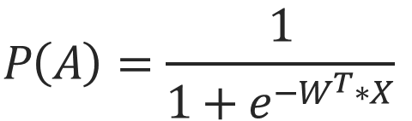
Classification Cost
Probabilities and Statistics
$$P\left(A\right)=\frac{1}{1+e^{−W^{T}∗X}}$$
P(A)`s mean?
X : Known
W : Required update
The probability of P(A) is obtained by adding X
So, Given X ,(Y=> Probability that Y is Label)
=> Conditional probability

Slide 18


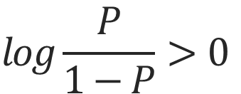
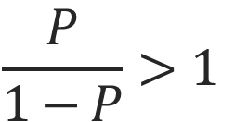
Classification Cost
Probabilities and Statistics
Probability value that comes out when you insert a new x
Lebel => Y=1
$$P\left(Y=1 | X=x\right)>P(Y=0|X=x)$$
$$P>1−P$$
$$\frac{P}{1−P}>1$$
$$log\frac{P}{1−P}>0$$
$$W^{T}∗X>0$$

Slide 19



Classification Cost
Probabilities and Statistics
$$W^{T}∗X>0$$
$$W^{T}∗X>0$$
$$W^{T}∗X<0$$

Slide 20
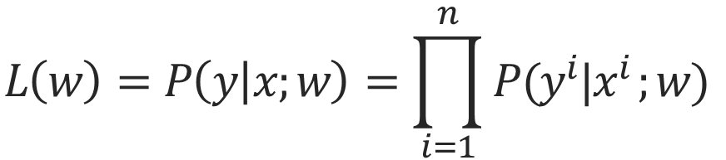
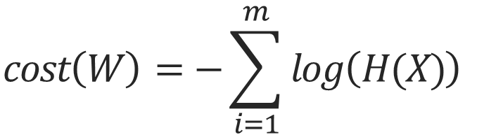
Classification Cost
Why use cost function below
$$cost\left(W\right)=−\sum_{i=1}^{m}{log\left(H(X)\right)}$$
Likelihood (All Sample is independent)
$$L\left(w\right)=P\left(y | x;w\right)=\prod_{i=1}^{n}{P(y^{i}|x^{i };w)}$$

Slide 21
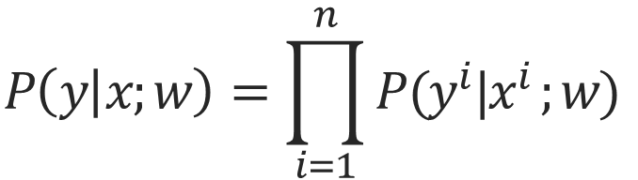
Classification Cost
Likelihood`s mean?
$$P\left(y | x;w\right)=\prod_{i=1}^{n}{P(y^{i}|x^{i };w)}$$
Independent`s sample Intersection
All sample`s Likelihood
So, Likelihood => 1(Good model)

Slide 22
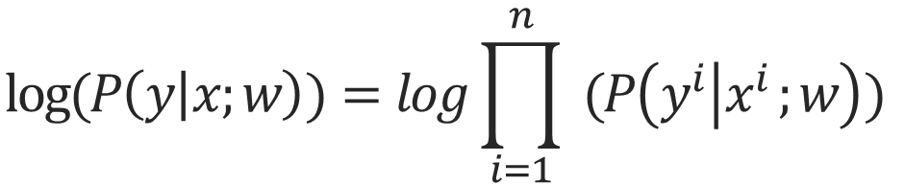
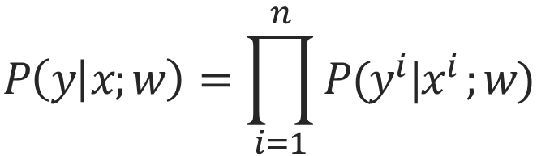
Classification Cost
$$P\left(y | x;w\right)=\prod_{i=1}^{n}{P(y^{i}|x^{i };w)}$$
Log => Monotonic increment function
$$log⁡(P\left(y | x;w\right))=log\prod_{i=1}^{n}{ (P\left(y^{i} | x^{i };w\right))}$$

Slide 23
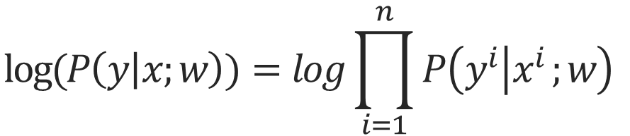
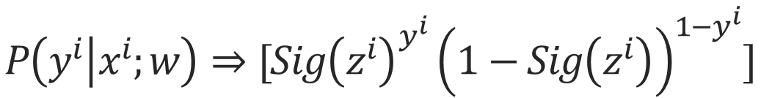
Classification Cost
$$log⁡(P\left(y | x;w\right))=log\prod_{i=1}^{n}{P\left(y^{i} | x^{i };w\right)}$$
$$logP(y|x;w)=logP\left(y^{1} | x^{1};w\right)+logP\left(y^{2} | x^{2};w\right)+…$$
$$P\left(y^{i} | x^{i};w\right)⇒[Sig{\left(z^{i}\right)}^{y^{i}}{\left(1−Sig\left(z^{i}\right)\right)}^{1−y^{i}}]$$
$$logP\left(y^{i} | x^{i};w\right)⇒[y^{i}log⁡(Sig\left(z^{i}\right))+(1−y^{i})log\left(1−Sig\left(z^{i}\right)\right)]$$

Slide 24
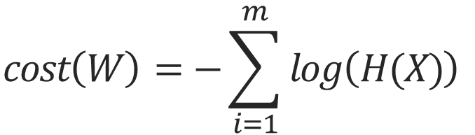
Classification Cost
$$cost\left(W\right)=−\sum_{i=1}^{m}{log\left(H(X)\right)}$$
$$logP\left(y^{i} | x^{i};w\right)⇒[y^{i}log⁡(Sig\left(z^{i}\right))+(1−y^{i})log\left(1−Sig\left(z^{i}\right)\right)]$$
$cost\left(W\right)=−\sum_{i=1}^{m}{logP\left(y^{i} | x^{i};w\right)⇒}$ $[y^{i}log⁡(Sig\left(z^{i}\right))+(1−y^{i})log\left(1−Sig\left(z^{i}\right)\right)]$

Slide 25
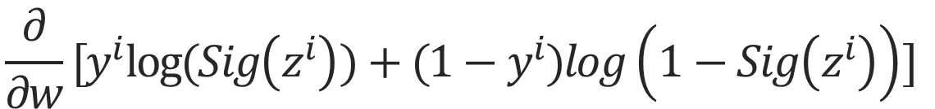
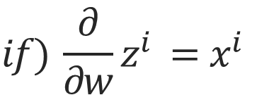
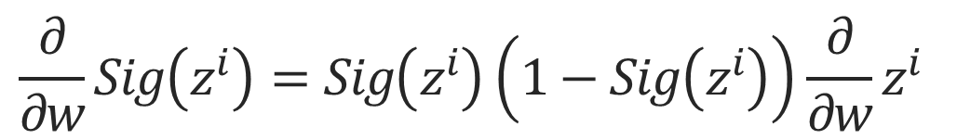
Classification Cost
$$\frac{∂}{∂w}[y^{i}log⁡(Sig\left(z^{i}\right))+(1−y^{i})log\left(1−Sig\left(z^{i}\right)\right)]$$
$\frac{∂}{∂w}$ $logP\left(y^{i} | x^{i};w\right)=[\left(y^{i}\right)\frac{1}{Sig\left(z^{i}\right)}−\left(1−y^{i}\right)\frac{1}{1−Sig\left(z^{i}\right)}]\frac{∂}{∂w}Sig(z^{i})$
$$\frac{∂}{∂w}Sig\left(z^{i}\right)=Sig\left(z^{i}\right)\left(1−Sig\left(z^{i}\right)\right)\frac{∂}{∂w}z^{i}$$
$$if) \frac{∂}{∂w}z^{i} =x^{i}$$
$\left[y\left(1−Sig\left(z^{i}\right)\right)−\left(1−y\right)Sig\left(z^{i}\right)\right]x^{i}$=$\left(y−Sig\left(z^{i}\right)\right)x^{i}$

Slide 26

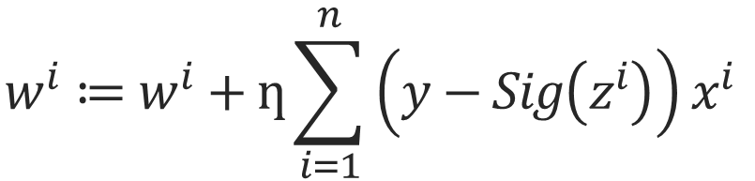

Classification Cost
$$w^{i}≔w^{i}+ƞ\sum_{i=1}^{n}{\left(y−Sig\left(z^{i}\right)\right)x^{i}}$$
$$w^{i}≔w^{i}+Δw$$
$$w^{i}≔w^{i}+ƞΔw$$
=> Update

Slide 27
Multinomial classification

Slide 28
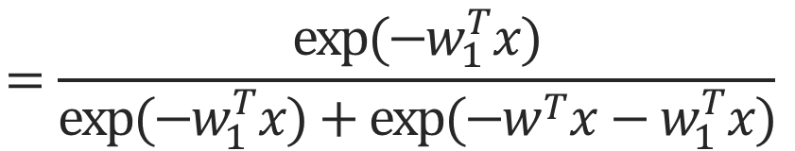
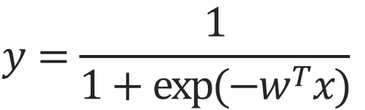

Multinomial Classification
Spatial understanding
$$w=w_{0}−w_{1}$$
=> Vector
W contains label 1,0
Label=>1
Label=>2
Feeling
$$y=\frac{1}{1+exp⁡(−w^{T}x)}$$
Label => 1
$$=\frac{exp⁡(−w_{1}^{T}x)}{exp⁡(−w_{1}^{T}x)+exp⁡(−w^{T}x−w_{1}^{T}x)}$$

Slide 29
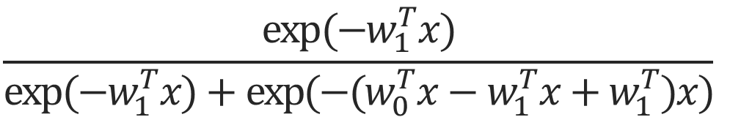
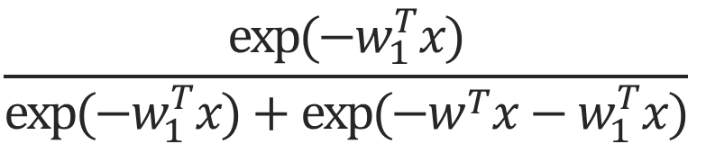
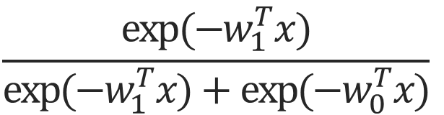
Multinomial Classification
Label => 1
$$\frac{exp⁡(−w_{1}^{T}x)}{exp⁡(−w_{1}^{T}x)+exp⁡(−w^{T}x−w_{1}^{T}x)}$$
$$\frac{exp⁡(−w_{1}^{T}x)}{exp⁡(−w_{1}^{T}x)+exp⁡(−(w_{0}^{T}x−w_{1}^{T}x+w_{1}^{T})x)}$$
=>
$$\frac{exp⁡(−w_{1}^{T}x)}{exp⁡(−w_{1}^{T}x)+exp⁡({−w}_{0}^{T}x)}$$

Slide 30
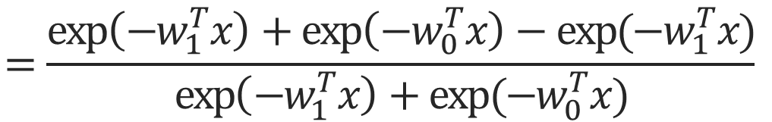
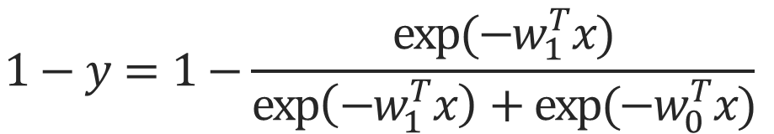
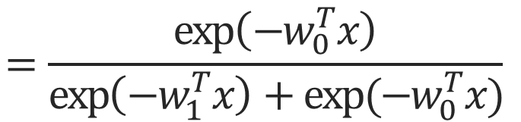
Multinomial Classification
Label => 0
$$1−y=1−\frac{exp⁡(−w_{1}^{T}x)}{\exp\left(−w_{1}^{T}x\right)+exp⁡(−w_{0}^{T}x)}$$
$$=\frac{\exp\left(−w_{1}^{T}x\right)+\exp\left(−w_{0}^{T}x\right)−exp⁡(−w_{1}^{T}x)}{\exp\left(−w_{1}^{T}x\right)+exp⁡(−w_{0}^{T}x)}$$
$$=\frac{\exp\left(−w_{0}^{T}x\right)}{\exp\left(−w_{1}^{T}x\right)+exp⁡(−w_{0}^{T}x)}$$

Slide 31
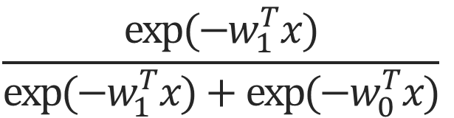
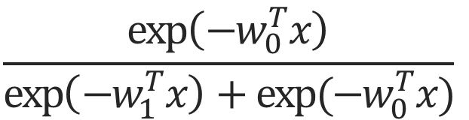
Multinomial Classification
Label => 1
Label => 0
$$\frac{exp⁡(−w_{1}^{T}x)}{exp⁡(−w_{1}^{T}x)+exp⁡({−w}_{0}^{T}x)}$$
$$\frac{\exp\left(−w_{0}^{T}x\right)}{\exp\left(−w_{1}^{T}x\right)+exp⁡(−w_{0}^{T}x)}$$
+
$$w_{1}⇒Label 1 (Important vector)$$
$$w_{0}⇒Label 0 (Important vector)$$
= 1

Slide 32


Multinomial Classification
$$θ^{1}$$
Good Classification
$$θ^{0}$$

Slide 33

Multinomial Classification
$$θ^{1}$$
Not Good Classification
$$θ^{0}$$

Slide 34

Multinomial Classification
$$θ^{1}$$
Not Good Classification
$$θ^{0}$$
$$W^{T}⇒W_{0},W_{1},W_{2}….$$
Bias(scalar) => x(Parallel movement)

Slide 35
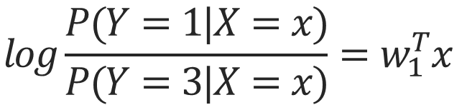
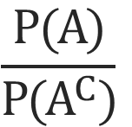
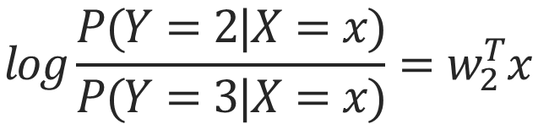
Multinomial Classification
So, We have 3 Label
Probability => 0-Label, 1-Label, 2-Label
$$\frac{P(A)}{P(A^{C})}$$
Odds
=>
$$log\frac{P(Y=1|X=x)}{P(Y=3|X=x)}=w_{1}^{T}x$$
$$log\frac{P(Y=2|X=x)}{P(Y=3|X=x)}=w_{2}^{T}x$$
$P\left(Y=3 | X=x\right)=1−P\left(Y=1 | X=x\right)−$ $P(Y=2|X=x)$

Slide 36
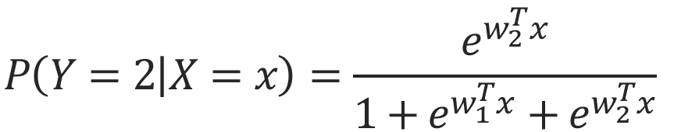
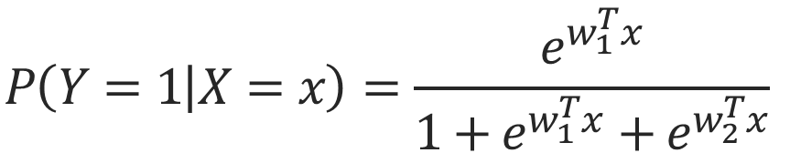
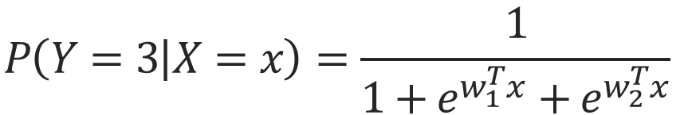
Multinomial Classification
$$P\left(Y=1 | X=x\right)=\frac{e^{w_{1}^{T}x}}{1+e^{w_{1}^{T}x}+e^{w_{2}^{T}x}}$$
$$P\left(Y=2 | X=x\right)=\frac{e^{w_{2}^{T}x}}{1+e^{w_{1}^{T}x}+e^{w_{2}^{T}x}}$$
$$P\left(Y=3 | X=x\right)=\frac{1}{1+e^{w_{1}^{T}x}+e^{w_{2}^{T}x}}$$

Slide 37
Multinomial Classification

Slide 38
Multinomial Classification

Slide 39
Multinomial Classification

Slide 40
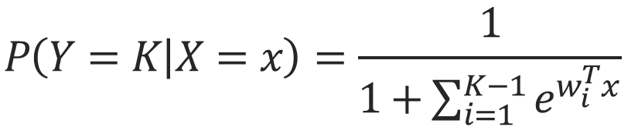
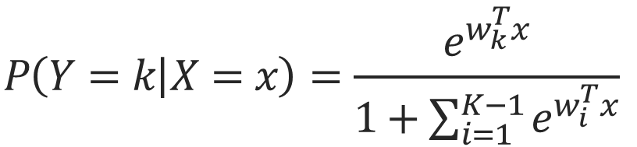
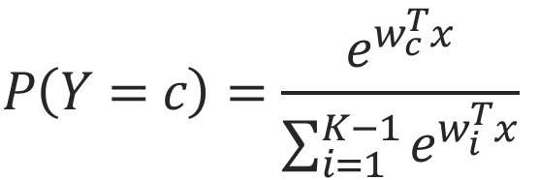
Multinomial Classification
K-range
$$P\left(Y=k | X=x\right)=\frac{e^{w_{k}^{T}x}}{1+\sum_{i=1}^{K−1}{e^{w_{i}^{T}x}}}$$
$$P\left(Y=K | X=x\right)=\frac{1}{1+\sum_{i=1}^{K−1}{e^{w_{i}^{T}x}}}$$
=> Softmax
$$P\left(Y=c\right)=\frac{e^{w_{c}^{T}x}}{\sum_{i=1}^{K−1}{e^{w_{i}^{T}x}}}$$

Slide 41

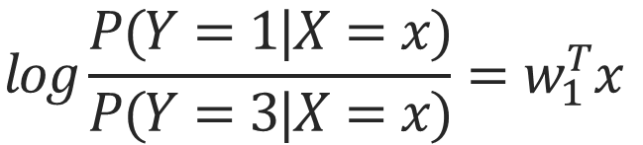
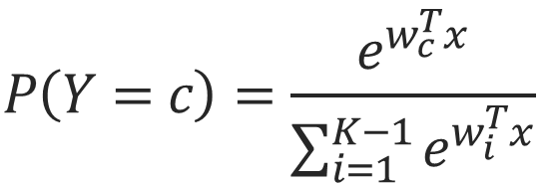
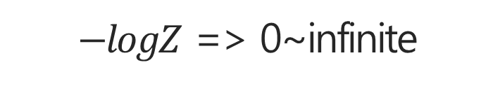

Multinomial Classification
$$P\left(Y=c\right)=\frac{e^{w_{c}^{T}x}}{\sum_{i=1}^{K−1}{e^{w_{i}^{T}x}}}$$
Softmax
$$logP(Y=1|X=x)=w_{1}^{T}x$$
-infinite~infinite
-infinite~0
$$−logZ$$
Z(Probability)=>0~1
$−logZ$ => 0~infinite
$$logP(Y=1|X=x)=w_{1}^{T}x−logZ$$
$$log\frac{P(Y=1|X=x)}{P(Y=3|X=x)}=w_{1}^{T}x$$
Probability Z

Slide 42







Multinomial Classification
$$P\left(Y=c\right)=\frac{e^{w_{c}^{T}x}}{\sum_{i=1}^{K−1}{e^{w_{i}^{T}x}}}$$
Softmax
$$logP\left(Y=c\right)+logZ=w_{c}^{T}x$$
$$logP\left(Y=c\right)∗Z=w_{c}^{T}x$$
$$P\left(Y=c\right)∗Z=e^{w_{c}^{T}x}$$
$$P\left(Y=c\right)=\frac{1}{Z}e^{w_{c}^{T}x}$$
$$1=\sum_{k=1}^{K}{P\left(Y=c\right) }$$
$$1=\sum_{k=1}^{K}{\frac{1}{Z}e^{w_{c}^{T}x}}$$
$$Z=\sum_{k=1}^{K}{e^{w_{c}^{T}x}}$$

Slide 43

Cross Entropy
$$D\left(S,L\right)=−\sum{L_{i}log⁡(S_{i})}$$
S(Y)
L=Y
0.7
1.0
0.2
0
0.1
0

Slide 44
감사합니다
THANK YOU

