Slide 1
보충 자료

Slide 2
And, Or
증명
And
X1 | X2 | Y
0 | 0 | 0
0 | 1 | 0
1 | 0 | 0
1 | 1 | 1
And
X1 | X2 | Y
0 | 0 | 0
0 | 1 | 1
1 | 0 | 1
1 | 1 | 1
And
X1 | X2 | Y
0 | 0 | 0
0 | 1 | 1
1 | 0 | 1
1 | 1 | 0

Slide 3






And, Or
증명
$$x_{2}$$
$$x_{2}$$
$$x_{2}$$
1
0
1
1
1
1
1
1
0
0
0
$$x_{1}$$
0
1
$$x_{1}$$
0
1
$$x_{1}$$
1
1
1
Or
And
Xor

Slide 4
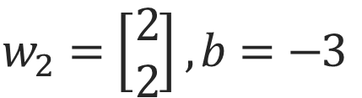
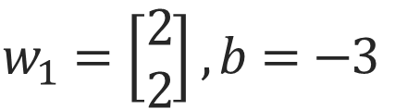
And
증명
$$w_{1}=\left[\begin{matrix}2 \\ 2\end{matrix}\right], b=−3$$
1 | 1 | 0 | 0
X1
1 | -1 | -1 | -3
1 | 0 | 1 | 0
X2
2 | -2 | -2 | -6
Sig
y^
1 | 0 | 0 | 0
1 | 1 | 0 | 0
X1
1 | 0 | 1 | 0
X2
1 | -1 | -1 | -3
$$w_{2}=\left[\begin{matrix}2 \\ 2\end{matrix}\right], b=−3$$

Slide 5
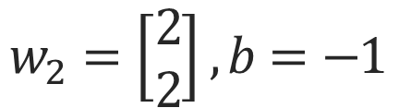
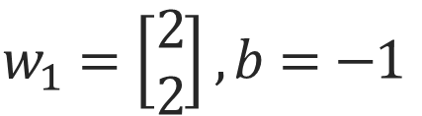
Or
증명
$$w_{1}=\left[\begin{matrix}2 \\ 2\end{matrix}\right], b=−1$$
1 | 1 | 0 | 0
X1
3 | 1 | 1 | -1
1 | 0 | 1 | 0
X2
6 | 2 | 2 | -2
Sig
y^
1 | 1 | 1 | 0
1 | 1 | 0 | 0
X1
1 | 0 | 1 | 0
X2
3 | 1 | 1 | -1
$$w_{2}=\left[\begin{matrix}2 \\ 2\end{matrix}\right], b=−1$$

Slide 6
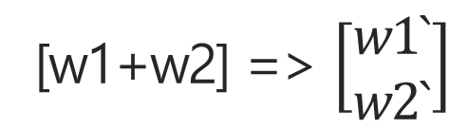
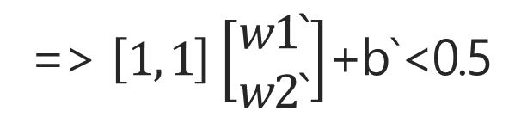
Linear
Xor
X1, X2 => 0 or 1 일 때, 0
[0, 0][w1+w2]+b`<0.5
=> b`<0.5
… ***
=> $\left[1, 1\right]\left[\begin{matrix}w1` \\ w2`\end{matrix}\right]$+b`<0.5
[1, 1][w1+w2]+b`<0.5
[w1+w2] => $\left[\begin{matrix}w1` \\ w2`\end{matrix}\right]$
=> w1`+w2`< 0.5 - b
… *
[1, 0]
[0, 1]
[w1+w2]+ b` > 0.5
=> w1`+w2` > 1-2b
… **
*, ** => 2(0.5 - b) < w1`+w2`< 0.5 - b
*** => 0.5 – b => 양수

Slide 7
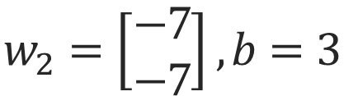
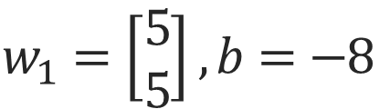
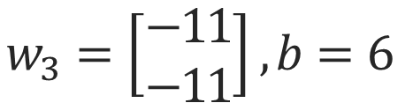
Xor
증명_1
$$w_{1}=\left[\begin{matrix}5 \\ 5\end{matrix}\right], b=−8$$
$$w_{3}=\left[\begin{matrix}−11 \\ −11\end{matrix}\right], b=6$$
2 | -3 | -3 | -8
1 | 1 | 0 | 0
X1
1 | 0 | 0 | 0
Sig
1 | 0 | 1 | 0
-5 | 6 | 6 | -5
X2
Sig
y^
0 | 1 | 1 | 0
1 | 1 | 0 | 0
X1
Sig
1 | 0 | 1 | 0
0 | 0 | 0 | 1
X2
$$w_{2}=\left[\begin{matrix}−7 \\ −7\end{matrix}\right], b=3$$
-11 | -4 | -4 | 3

Slide 8





Xor
증명_1
Sigmoid Function
Classification
Sigmoid Function
$$X_{1}$$
$$w,b$$
$$w,b$$
$$y^$$
$$X_{2}$$

Slide 9
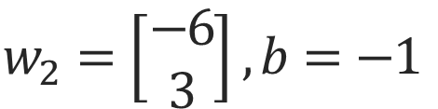
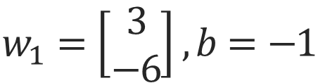
Or
증명
$$w_{1}=\left[\begin{matrix}3 \\ −6\end{matrix}\right], b=−1$$
-4 | 2 | -7 | -1
1 | 1 | 0 | 0
X1
0 | 1 | 1 | 0
Sig
1 | 0 | 1 | 0
X2
Sig
y^
0 | 1 | 1 | 0
1 | 1 | 0 | 0
X1
Sig
1 | 0 | 1 | 0
X2
$$w_{2}=\left[\begin{matrix}−6 \\ 3\end{matrix}\right], b=−1$$
-4 | -7 | 2 | -1

Slide 10

Xor
증명_1
Sigmoid Function
Classification
Sigmoid Function
$$X_{1}$$
$$w,b$$
$$y^$$
$$X_{2}$$

Slide 11
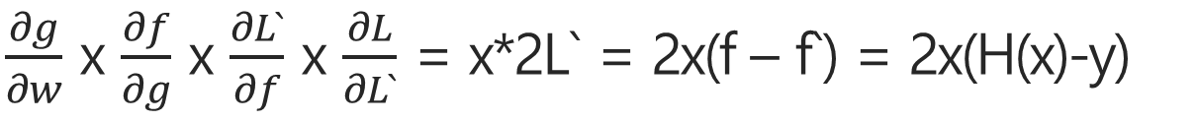
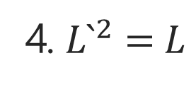
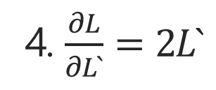

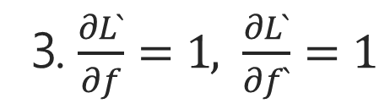
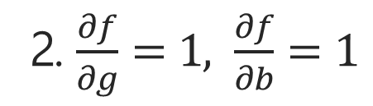
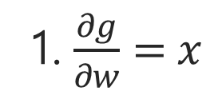

1. g = x * w
Chain Rule
2. f = g + b
3. f – f ` = L`
4. $L`^{2}=L$
w
Cost => L
X
g
1. $\frac{∂g}{∂w}=x$
f
L`
x
+
-
$$X^{2}$$
2. $\frac{∂f}{∂g}=1, \frac{∂f}{∂b}=1$
b
f `
$\frac{∂g}{∂w}$ x $\frac{∂f}{∂g}$ x $\frac{∂L`}{∂f}$ x $\frac{∂L}{∂L`}$ = x*2L` = 2x(f – f`) = 2x(H(x)-y)
3. $\frac{∂L`}{∂f}=1, \frac{∂L`}{∂f`}=1$
$$Cost⇒2x(wx−y)$$
4. $\frac{∂L}{∂L`}=2L`$

Slide 12

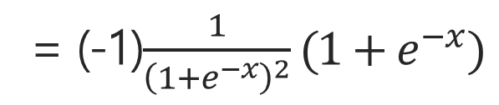
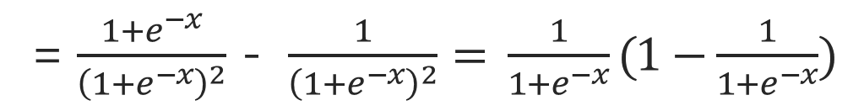
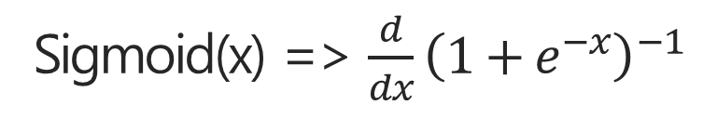
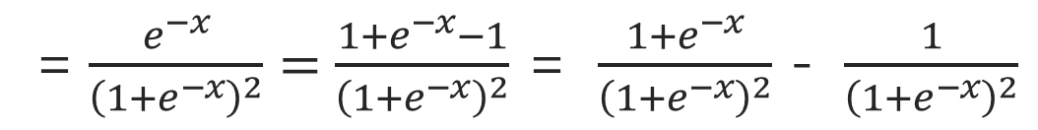
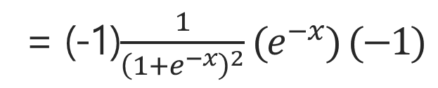
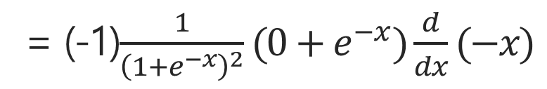
Sigmoid(x) => $\frac{d}{dx}{\left(1+e^{−x}\right)}^{−1}$
Sigmoid
= (-1)$\frac{1}{{\left(1+e^{−x}\right)}^{2}}(1+e^{−x})$
= (-1)$\frac{1}{{\left(1+e^{−x}\right)}^{2}}(0+e^{−x})\frac{d}{dx}(−x)$
= (-1)$\frac{1}{{\left(1+e^{−x}\right)}^{2}}(e^{−x}) (−1)$
= $\frac{e^{−x}}{{\left(1+e^{−x}\right)}^{2}}=\frac{{1+e}^{−x}−1}{{\left(1+e^{−x}\right)}^{2}}$ = $\frac{{1+e}^{−x}}{{\left(1+e^{−x}\right)}^{2}}$ - $\frac{1}{{\left(1+e^{−x}\right)}^{2}}$
= $\frac{{1+e}^{−x}}{{\left(1+e^{−x}\right)}^{2}}$ - $\frac{1}{{\left(1+e^{−x}\right)}^{2}}= \frac{1}{1+e^{−x}}(1−\frac{1}{1+e^{−x}})$
$$⇒Sig(x)(1−Sig(x))$$

Slide 13
Xor
증명_1
Sigmoid
Output
X

Slide 14











$$\frac{∂g`}{∂w`}=x,\frac{∂g`}{∂x}=w`$$
$$\frac{∂h`}{∂f`}=Sigmoid(f`)(1−Sigmoid(f`))$$
Chain Rule
$$\frac{∂g``}{∂w``}=x,\frac{∂g``}{∂x}=w``$$
$$\frac{∂h``}{∂f``}=Sigmoid(f``)(1−Sigmoid(f``))$$
$\frac{∂g```}{∂w```}=x,\frac{∂g```}{∂x}=w`$``
$$\frac{∂h```}{∂f```}=Sigmoid(f```)(1−Sigmoid(f```))$$
w`
$$\frac{∂y`}{∂h`}=1,\frac{∂y``}{∂h``}=1,\frac{∂y```}{∂h```}=1,$$
X
g`
+
f `
Sig
b`
w``
g``
X
+
f ``
Sig
+
$$Y$$
b``
b```
f ``
+
Sig
w```
X
g```
$$\frac{∂f`}{∂g`}=1,\frac{∂f``}{∂b`}=1$$
$$\frac{∂f``}{∂g``}=1,\frac{∂f``}{∂b``}=1$$
x
$$\frac{∂f```}{∂g```}=1,\frac{∂f```}{∂b```}=1$$

Slide 15
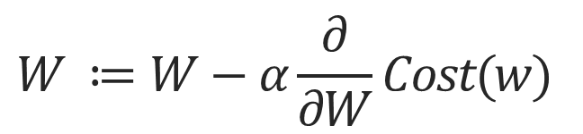
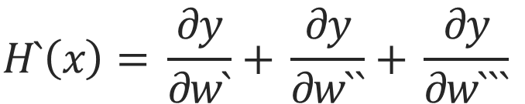
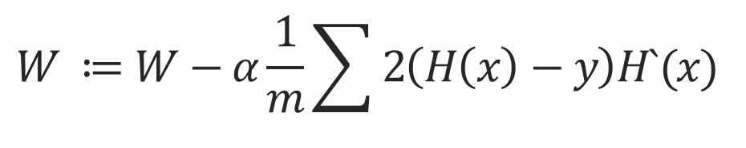
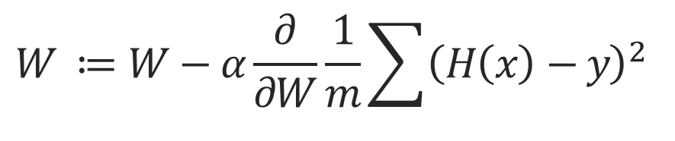
$$W ≔W−α\frac{∂}{∂W}Cost(w)$$
Cost
$$W ≔W−α\frac{∂}{∂W}\frac{1}{m}\sum{{\left(H\left(x\right)−y\right)}^{2}}$$
$$W ≔W−α\frac{1}{m}\sum{2\left(H\left(x\right)−y\right)H`(x)}$$
W = w`+w``+w```
$$H`\left(x\right)= \frac{∂y}{∂w`}+ \frac{∂y}{∂w``}+ \frac{∂y}{∂w```}$$
$\frac{∂y}{∂h`} × \frac{∂h`}{∂f`} ×$ $\frac{∂f`}{∂g`} × \frac{∂g`}{∂w`}= \frac{∂y}{∂w`}=xSig(f `)(1−Sig(f `))$
$\frac{∂y}{∂h`} × \frac{∂h`}{∂f`} ×$ $\frac{∂f`}{∂g`} × \frac{∂g`}{∂w``}= \frac{∂y}{∂w``}=xSig(f ``)(1−Sig(f ``))$
$\frac{∂y}{∂h`} × \frac{∂h`}{∂f`} ×$ $\frac{∂f`}{∂g`} × \frac{∂g`}{∂w```}= \frac{∂y}{∂w```}=xSig(f ```)(1−Sig(f ```))$

Slide 16
Thank You

