Slide 1
Research of Different ADAPT-Variational Quantum Eigenslover For NISQ Devices
YANG JIANFEI, 37-226964, M1
Ishikawa Sato Lab,Utokyo
01.10

Slide 2
Table of Contents
01.Introduction
02. ADAPT-VQE Overview
04. Conclusion
03.Literature Review
05.Future Plan
1

Slide 3
01
Introduction
2

Slide 4





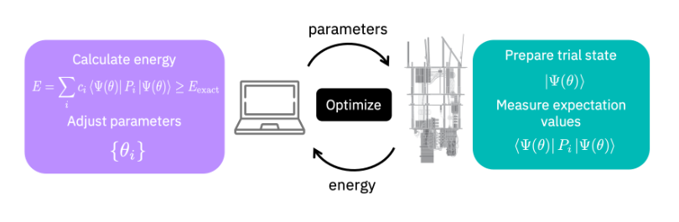
01.Introduction
Quantum Chemistry with Nosiy Intermidate Scale Quantum(NISQ) Device:
Quantum Simulation to slove Time Independent Schrodinger Equation:
While Hamitonian is known
Task: Find minial groudstate energy
Ansatz Design
Classical Method: Full Configuration Interaction(FCI)
“Golden Standard” Quantum Method: UCCSD Ansatz
Ansatz is Quantum Circuit with Variational Parameters
UCCSD Ansatz Drawbacks:
1.Too deep circuit depth, not suitable for NISQ Devices
2.In face of Strong Correlated System, can not reach Chemical accuracy
Fig 1. VQE Flow Chart
3

Slide 5
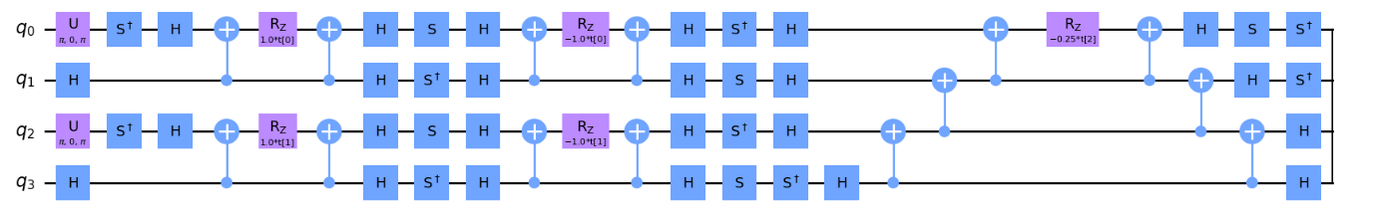
01.Introduction
The Cost of NISQ Devices:
1. The number of CNOT Gate
2. Quantum Circuit Depth
3. Measurement Times
4. The number of Parameters
5. ... ...
Research Orientation:Find better Ansarz
which includes:
1. Better or similar accuray
2. Shallower quantum circuit
3. Less CNOT Gate included the circuit
......
Fig2. Example of Ansatz Circuit (Part)
4

Slide 6
02
ADAPT-VQE Overview
5

Slide 7

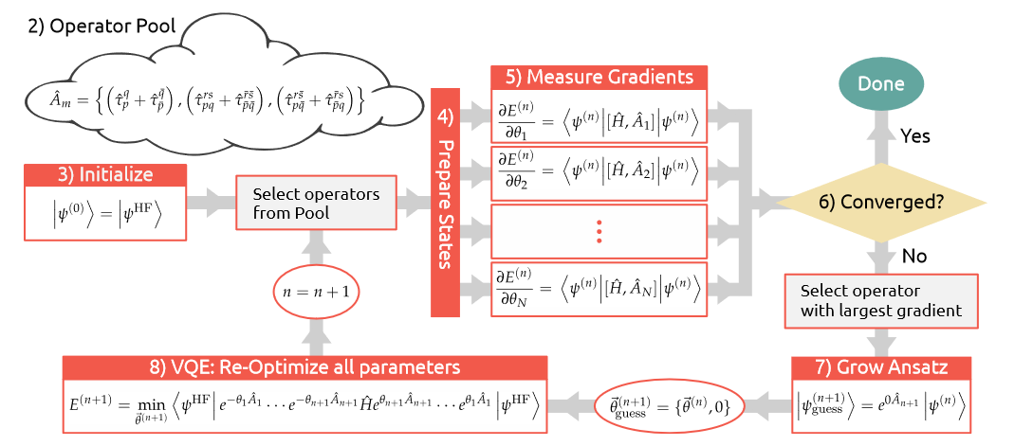
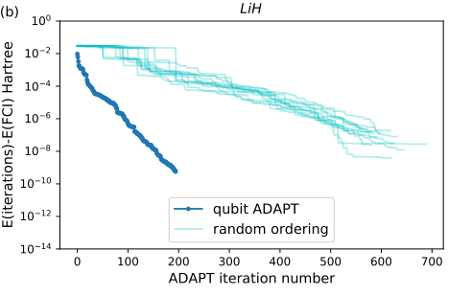
02.Overview of ADAPT-VQE
ADAPT-VQE Algorithm Work Flow:
Keypoints:
1.Defination of Operator Pool
2.Ansatz growing stratagy
Different Operator Pool and Growing Strategy：
Fermonic-ADAPT-VQE
Qubit-ADAPT-VQE
TERTIS-ADAPT-VQE
Fig 4.when ordering with gradient or random,
performance of ADAPT-VQE
Fig 3. ADAPT-VQE Flow Chart
Gradient ordering is reasonable!
6

Slide 8
03
Literature Review
7

Slide 9
03.Literature Review
Relations among three thesis:
Paper 1: Fermonic-ADAPT-VQE
Originally Propose ADAPT-VQE Framework
With original Fermonic Pool
Operator Pool: Improve new “Qubit Pool”
Ansatz Growing Strategy: Unchanged
Paper 2: Qubit-ADAPT-VQE
Paper 3: TERITS-ADAPT-VQE
Operator Pool: “Qubit Pool”
Ansatz Growing Strategy: Improve new strategy
8

Slide 10



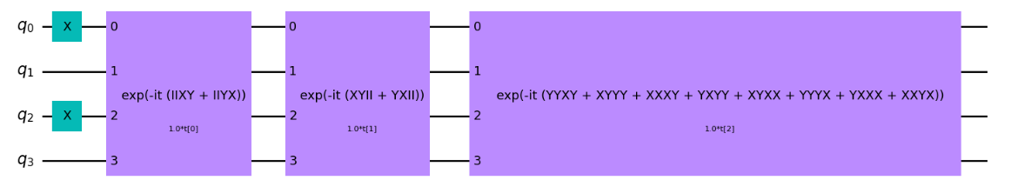

Paper 1: Fermonic ADAPT-VQE
Operator Pool: Based on UCCSD Ansatz
Block 1
Block 2
Block 3
Pool: Block(1,2,3)
Fig 5. UCCSD Ansatz for H2
Different R value, different Ansatz
Problem-tailored Ansatz:
Ulike UCCSD Ansatz is Fixed, Ansatz generated by ADAPT-VQE is dynamically growing during each iteration. For different geometric construction of same molecular, Ansatzs are different.
More adpative to the given electronic structure problem. ==> Possible Way for Strong Correlated System.
9

Slide 11
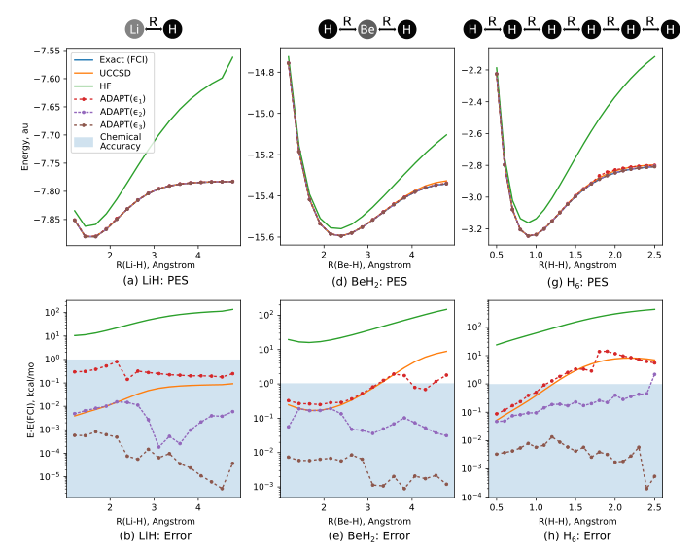
Paper 1: Fermonic ADAPT-VQE
Because of the increase of R, strong correlated effect gets more obvious. UCCSD Ansatz failed to reach Chemical Accruacy.
While ADAPT-VQE Ansatz can reach chemical accuracy by seting more strict converge condition
Fig 6. Fermonic-ADAPT VQE Simulation of LiH,BeH2 and H6 Molecular
10

Slide 12
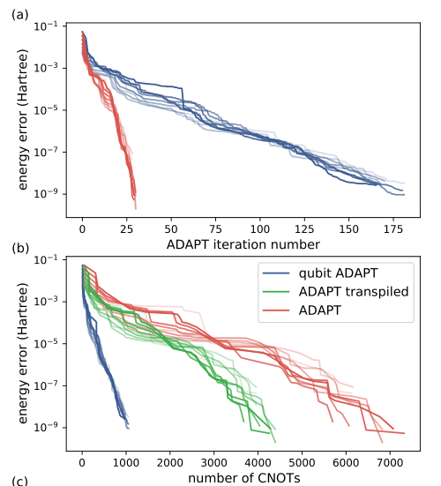

Paper 2: Qubit ADAPT-VQE
Qubit-ADAPT-VQE improve the component of operator pool into more hardware effient operator
Fermonic-ADAPT operator:
Qubit-ADAPT operator:
More Hardware-effient
Pauli String apper in UCCSD Ansatz While,remove Pauli-Z
reduce the number of CNOT Gate, lower the cost.
Compared to Fermonic-ADAPT:
1.More Iteration Needed
2.Less number of CNOT Gate.
Fig 7. Qubit-ADAPT and ADAPT VQE for LiH molecular
11

Slide 13
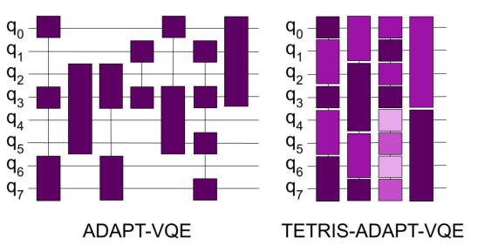
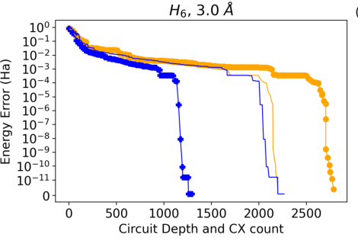

Paper 3: TETRIS ADAPT-VQE
Improve the Ansatz growing strategy:
Every Iteration add one operator into Ansatz if not converge More than one operator
Aim to reduce Circuit Depth
ADAPT: Each Operator only effect on part of Qubit, each operator had biggest gradient
TETRIS-ADAPT: Sort operator by gradients, try to fill up each qubit. Try to get shallower but denser Ansatz
Under same accuracy Level: Lower Circuit Depth than Original One
12

Slide 14
04
Conclusion
13

Slide 15
04.Conclusion
Relations among three thesis:
Paper 1: Fermonic-ADAPT-VQE
Better than UCCSD Ansatz, more suitable for strong correlate system
Use different operator pool to reduce the number of CNOT Gate.
Paper 2: Qubit-ADAPT-VQE
Use different stragy to reduce Circuit Depth
Paper 3: TERITS-ADAPT-VQE
14

Slide 16
05.Future Plan
1. Try to Find more hardware-effeient Operator Pool
2.Try new Ansatz growing strategy, lower the cost of quantun resources
3. Try to reduce mearment times
15

Slide 17
Thank you for Listening !

