Slide 1
数据库设计
SY YH

Slide 2
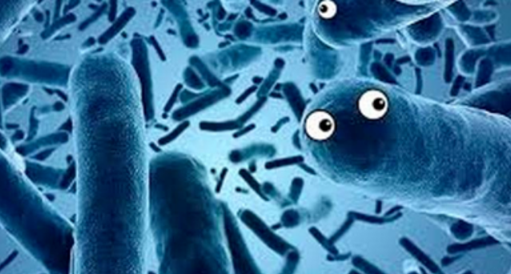
Home
logo
搜索框
功能区
Home
Browse
Search
Download
About & contact
Introduction:
Citation：
团队信息：

Slide 3
Browse
Home
Browse
Search
Download
About & contact
按疾病种类排序
UC
CD
CRC
...
按实验物种排序
human
mouse
both
...
按微生物来源排序
blood
Sweat
saliva
...
数据展示
species | ncbi_ID | organism name | status | mechanism | affect_to_disease | animal model | Sample collection | Study Design
geography | method | disease | disease status | data_type | reference | publish_data

Slide 4




Search
Home
Browse
Search
Download
About & contact
Introduction & Data Display
species
disease
source
microbe

Slide 5
Download
Home
Browse
Search
Download
About & contact
数据描述
及下载地址

Slide 6
About & contact
Home
Browse
Search
Download
About & contact
数据统计信息
及联系方式

