Slide 1
Audit

Slide 2
Protocol Audit
Protocol Auditing added with OneFS 7.1.0
Initially only SMB
NFS added with OneFS 7.2
Integrates with CEE (Common Event Enabler)
Supports 3rd Party Applications
Varonis DatVantage
Symantec Data Insights
Dell Change Auditor
StealthBits
Syslog Forwarding Support added with OneFS 7.2

Slide 3
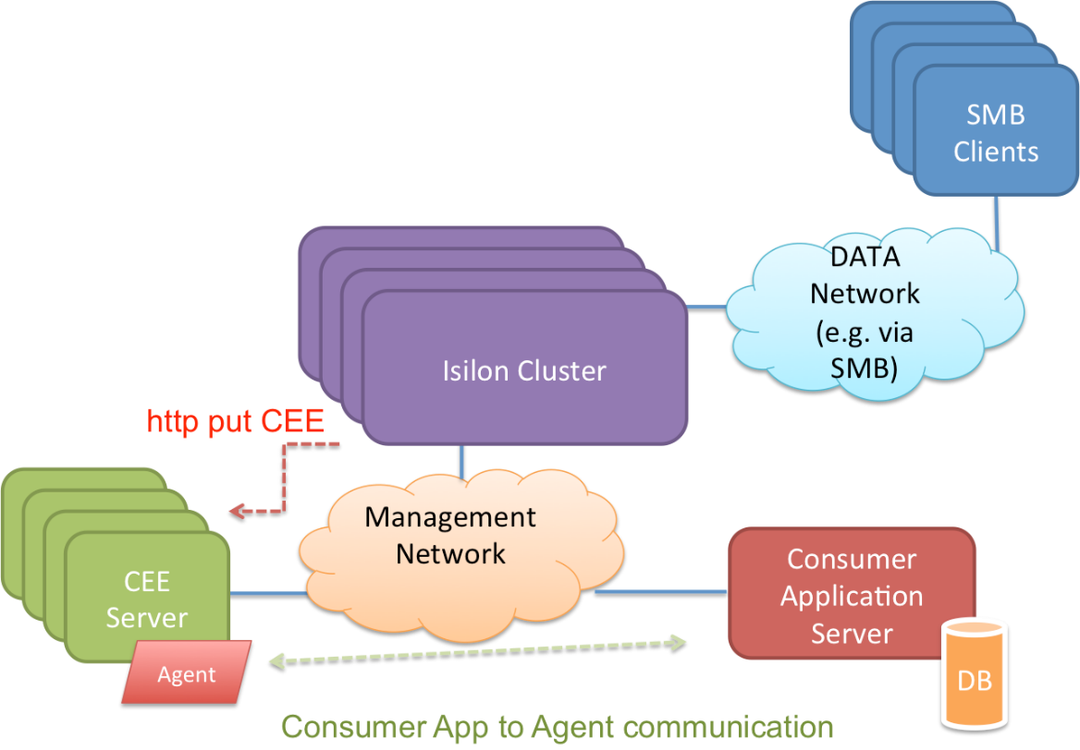
Protocol Audit – Logical Data Flow

Slide 4
Audit Configuration

Slide 5
Protocol Auditing Configuration - CEE
Enable Isilon Protocol Access Auditing.
isi audit settings global modify --protocol-auditing-enabled=yes
Specify the access zones to be audited
isi audit settings global modify --audited-zones <zones>
Specify one or more CEE Server URIs
isi audit settings global modify --cee-server-uris <uris>
Specify the storage name (cluster hostname) for reporting protocol events to CEE servers
isi audit settings global modify --hostname <string>

Slide 6
Protocol Auditing Configuration - Syslog
Enable Isilon Protocol Access Auditing.
isi audit settings global modify --protocol-auditing-enabled=yes
Specify the access zones to be audited
isi audit settings global modify --audited-zones <zones>
Enable Isilon Protocol Syslog Forwarding
isi audit settings --syslog-forwarding-enable=yes

Slide 7
Audit Design

Slide 8
BACKGROUND - AUDIT CEE
OneFS supports third-party protocol auditing applications by exporting audit events to external CEE servers.
The OneFS daemon isi_audit_cee exports protocol audit events to CEE.
The Common Event Enabler (CEE) forwards protocol audit events to registered auditing applications.
Protocols: SMB, NFS

Slide 9
OneFs 8.0.1 Feature – AUDIT CEE PERFORMANCE
isi_audit_cee re-written to increase delivery rate.
Concurrent delivery to CEE servers.
20 HTTP 1.1 connections across a subset of CEE servers.
Use of multiple CEE servers.
Each node will choose up to 5 CEE servers for delivery.
CEE servers are shared in a global configuration.
Configuration / use of CEE protocol auditing is unchanged from OneFS 8.0.0

Slide 10
CEE Server Selection
Each node selects up to 5 available CEE servers from a sorted list of CEE URIs.
Servers are selected starting from the node’s logical node number offset into the sorted list.
When a server is unavailable the next available server in sorted order is selected.
Connections are evenly distributed between the selected servers.
Every 15 minutes nodes will be moved back to their available CEE server range.

Slide 11
CEE Server Selection
CEE Servers
OneFS
a.cee.com
Node 1
b.cee.com
c.cee.com
Node 3
d.cee.com
e.cee.com
Node 7
f.cee.com
g.cee.com

Slide 12
CEE Server Selection
CEE Servers
OneFS
a.cee.com
Node 1
b.cee.com
c.cee.com
Node 3
d.cee.com
e.cee.com
Node 7
f.cee.com
g.cee.com

Slide 13
CEE Server Selection
CEE Servers
OneFS
a.cee.com
Node 1
b.cee.com
c.cee.com
Node 3
d.cee.com
e.cee.com
(offline)
Node 7
f.cee.com
g.cee.com

Slide 14
Not INCLUDED – AUDIT CEE PERFORMANCE
No new configurable fields.
Cannot change connection limit.
Cannot change CEE server limit.

Slide 15
Configuration and Administration
Unchanged from OneFS 8.0.0
One CEE server per node is recommended.
Extra CEE servers beyond the cluster size are only used when a CEE server goes offline.
Best practices
Setup CEE before enabling protocol auditing in OneFS.

Slide 16
New CLI / PAPI COMMAND
Audit progress command.
“isi audit progress” CLI command.
Node view.
Time of the last protocol audit event logged.
Times of the forwarders last delivered protocol audit event.
Cluster (global) view.
Time of the last logged audit event in the cluster.
Times of the furthest behind forwarders in the cluster.

Slide 17
Upgrade and Rollback
Audit CEE forwarding is available during upgrade.
Rollback
The previous implementation of isi_audit_cee will start off from where the new implementation stopped.

Slide 18
Changed Items
CELOG
SW_AUDIT_CEE_UNREACHABLE Event
Raised when a Heartbeat to CEE fails.
Originally introduced in OneFS 7.1.1.8 MR
Log messages are changed to use NTSTATUS and CEE’s VC_STATUS in error messages.
No longer uses ilog, uses Likewise based logging.

Slide 19
Troubleshooting
Error codes
NTSTATUS
CEE VC_STATUS
Logs are sent to /var/log/isi_audit_cee.log
Raise log levels with the lwsm command.
“lwsm set-log-level isi_audit_cee isi_audit_cee <level>”
Each node delivers events generated on that node.
Delivery rates through “isi statistics” command.
node.audit.cee.export.rate, node.audit.cee.export.total

Slide 20
Audit Performance
OneFS 8.0.1
5x+ increase in audit event delivery rate to CEE.
isi_audit_cee concurrent delivery will use more resources Dependent on protocol event generation rate.

Slide 21
Performance
Nodes | CEE Servers | 8.0.0 Events/Sec | 8.0.1 Events/Sec | % Difference
1 | 1 | 499 | 3380 | 6.7
1 | 2 | 420 | 6404 | 15.2
1 | 3 | 395 | 6318 | 15.9
2 | 1 | 825 | 3538 | 4.2
2 | 2 | 762 | 7027 | 9.2
2 | 3 | 821 | 10720 | 13.0

