Slide 1
MaAs On Benchmark
yang lu

Slide 2
Test Overview
Test Dataset: theoremqa
Number of Test Samples: 50 questions
model：MaAS
Success Rate: 100%
Test Environment: DeepSeek-reasoner model

Slide 3
Search Failure Possibilities
Although all current tests were successful, search may fail in the following situations:
Complex problems requiring dynamic workflow switching
Real-time computation problems requiring external tool calls
Understanding problems with multimodal inputs

Slide 4
Analysis of Most Complex Successful Cases
TheoremQAParser → TheoremQAKnowledgeRetriever → TheoremQAReasoner
↓ ↓ ↓
Identified as Retrieved complex Applied residue
calculation analysis concepts theorem
problem (empty) ↓
Laurent series
expansion
↓
Essential singularity
handling
↓
Answer: $-\frac{\pi}{3}$
Problem:
Compute $\int_{|z| = 1} z^2 sin(1/z) dz$. The answer is Ai with i denoting the imaginary unit, what is A?

Slide 5
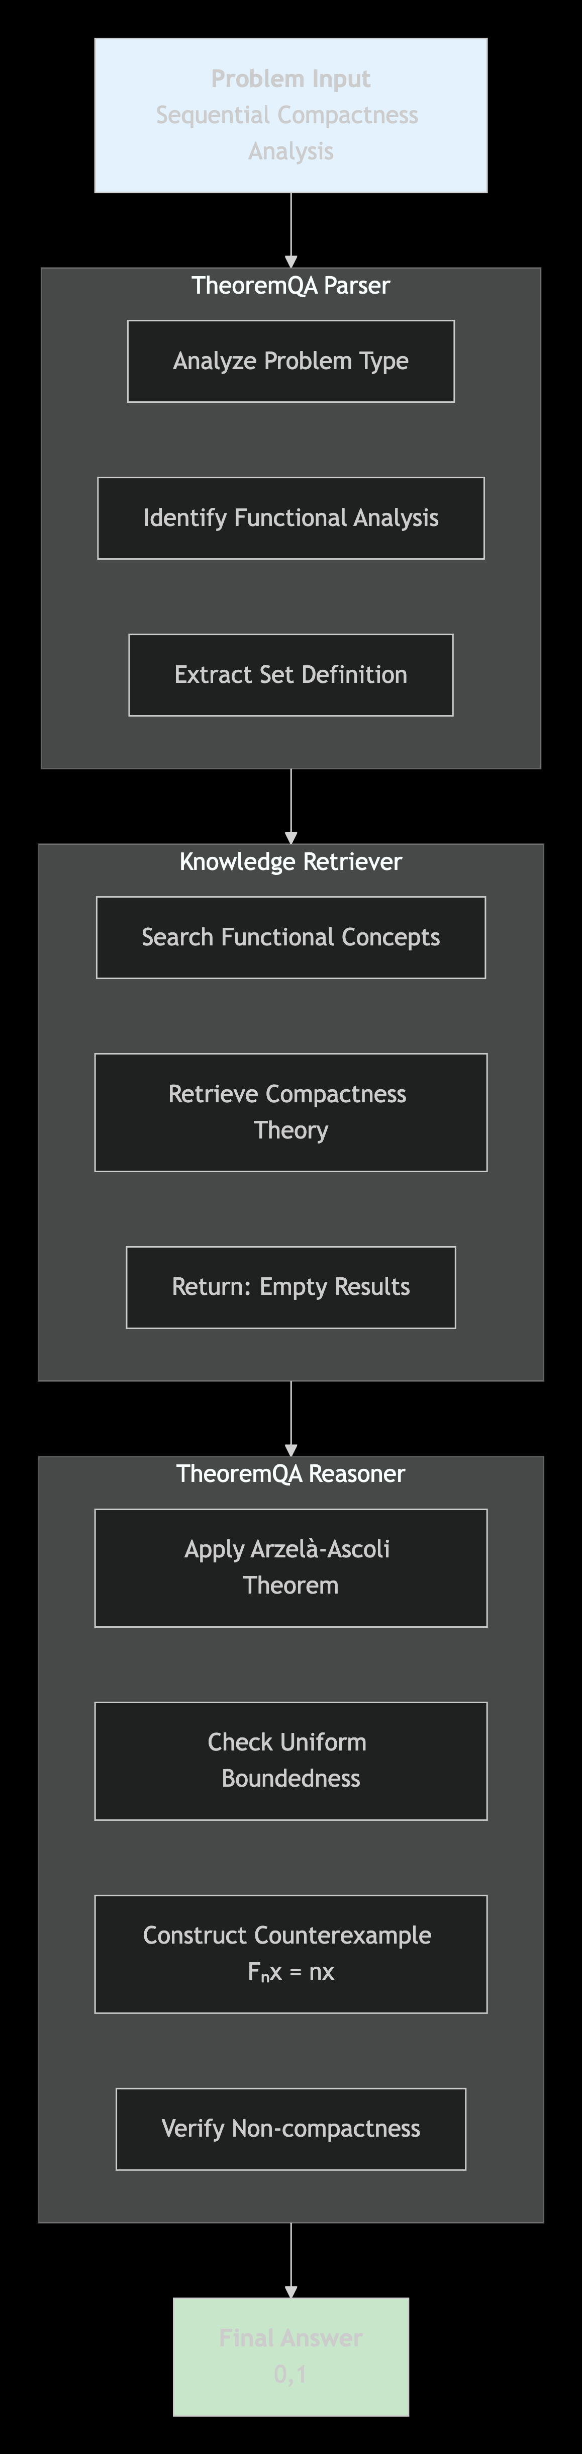
Analysis of Most
Complex Successful
Cases
Problem:Determine if the set ${F(x)=\int_0^x f(t) dt | f \in M }$ is sequentially compact

Slide 6
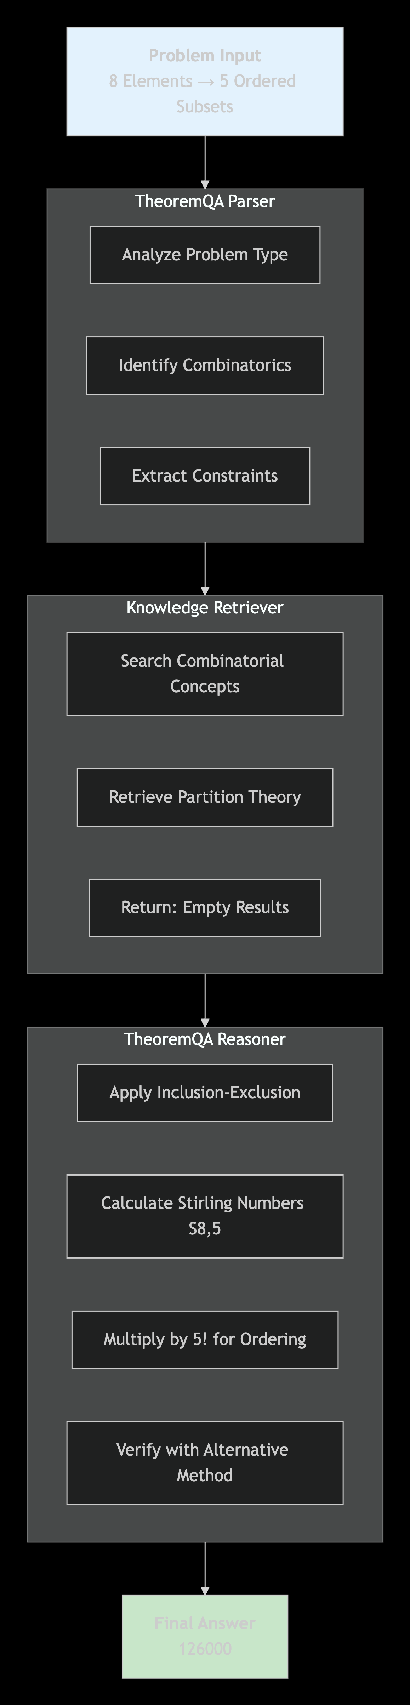
Analysis of Most
Complex Successful
Cases
Problem:
How many ways to divide 8 elements into 5 non-empty ordered subsets?

Slide 7
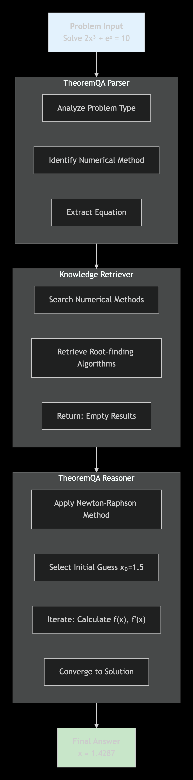
Analysis of Most
Complex Successful
Cases
Problem:
Solve $2x^3 + e^x = 10$ using Newton-Raphson method

Slide 8
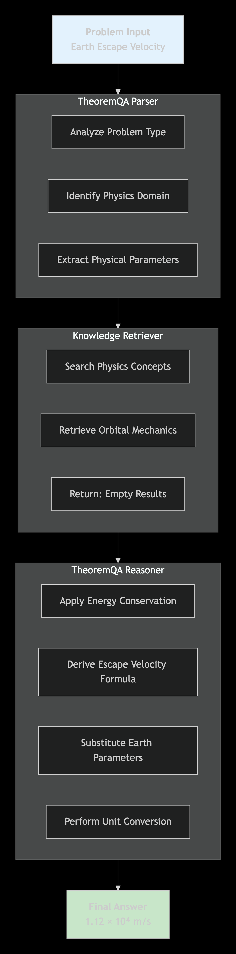
Analysis of Most
Complex Successful
Cases
Problem:
Calculate Earth's escape velocity

Slide 9
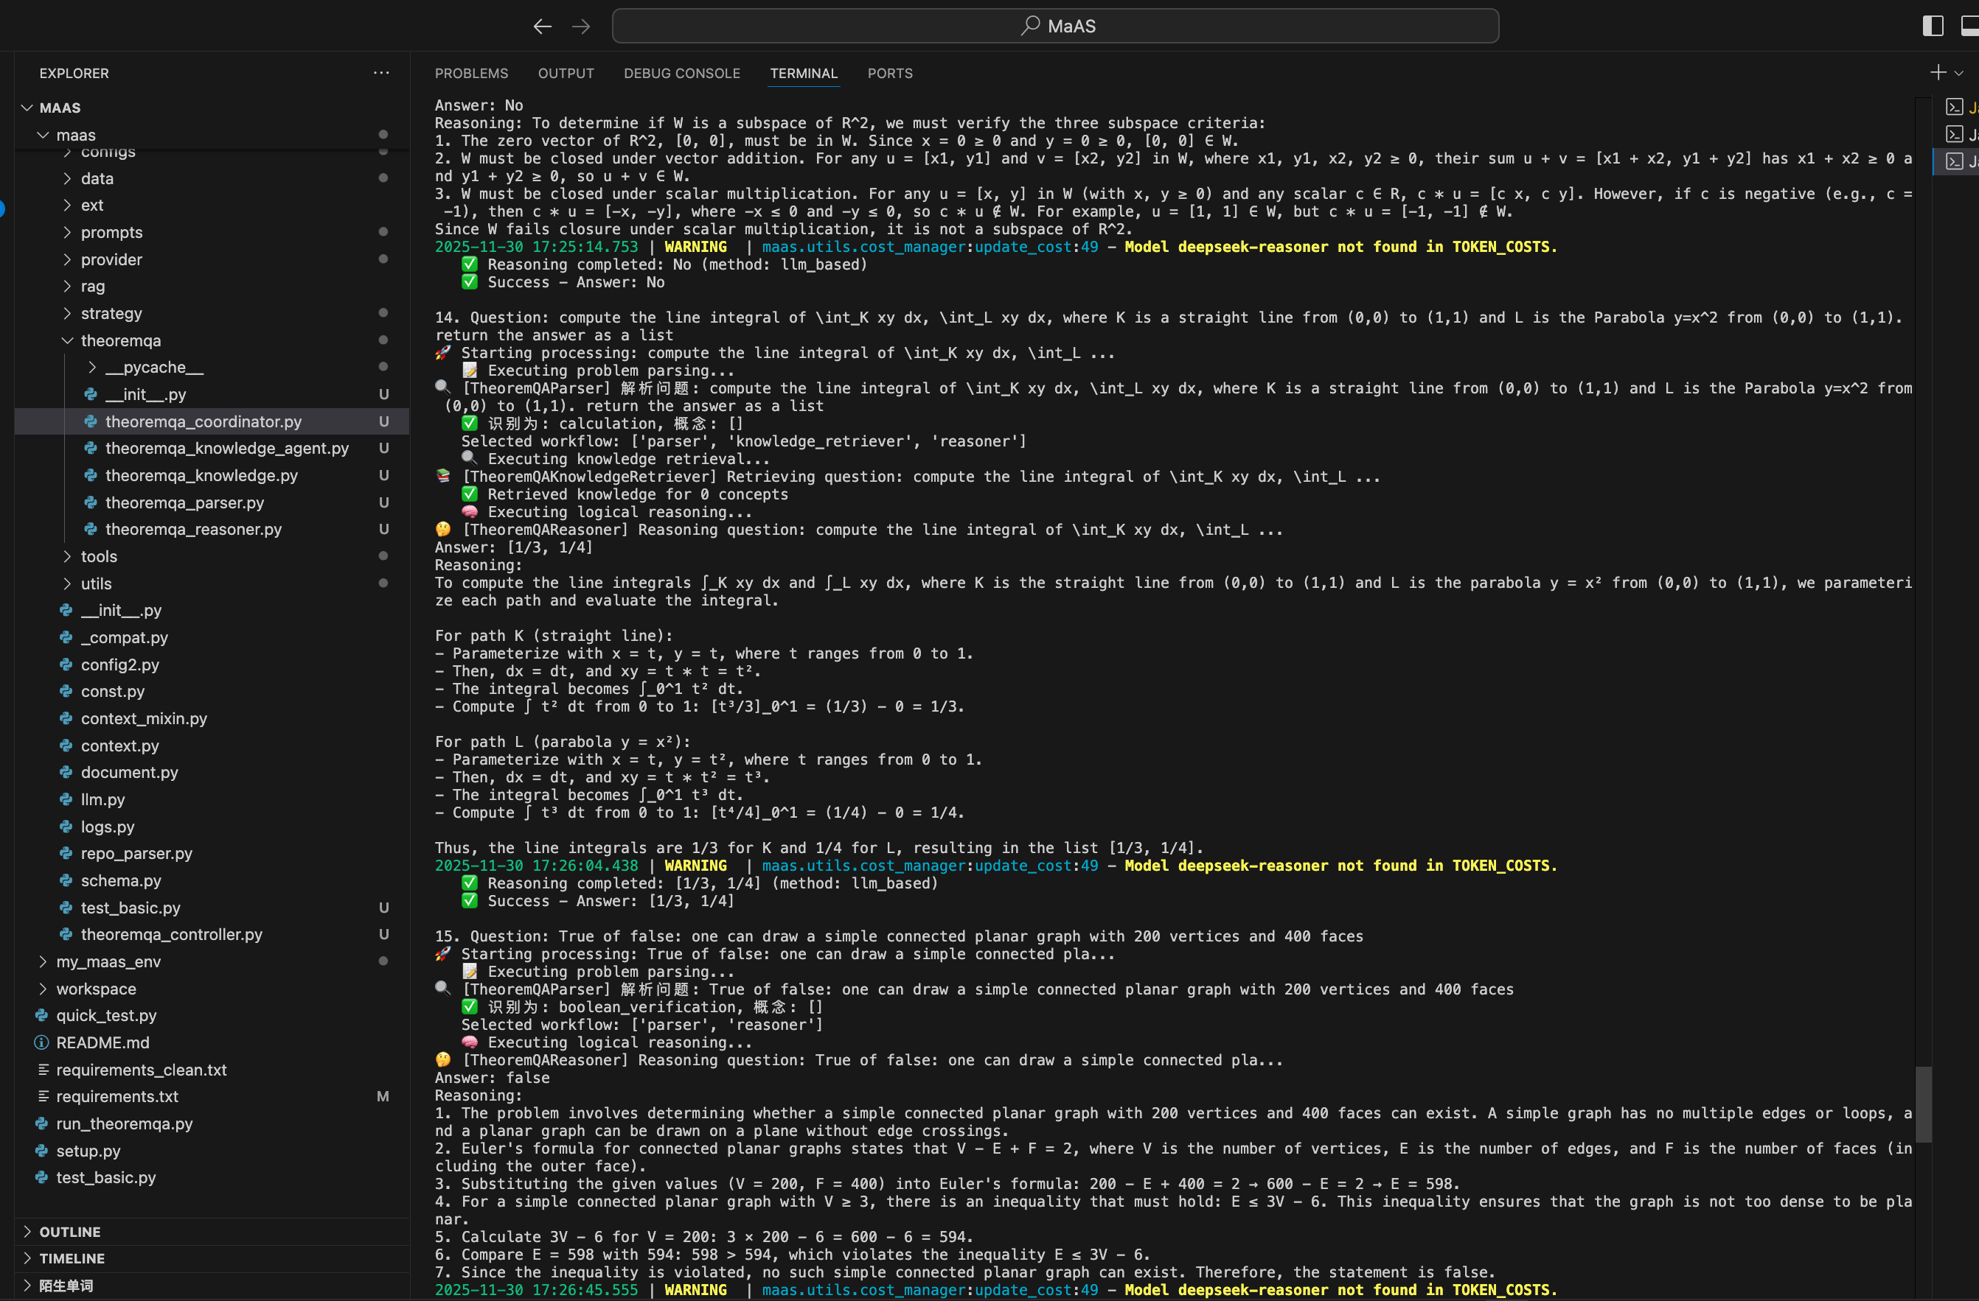
Terminal Results

