Slide 1
Smartphone localization
Shuailing Yang

Slide 2
Outline
Beepbeep
Phone to phone
Our method

Slide 3


Problem description
We use location
information of anchor phone to estimate the
location of the unknown
nodes.
Unknown nodes
?
Anchor phone
Localization need the information of distance and angle

Slide 4
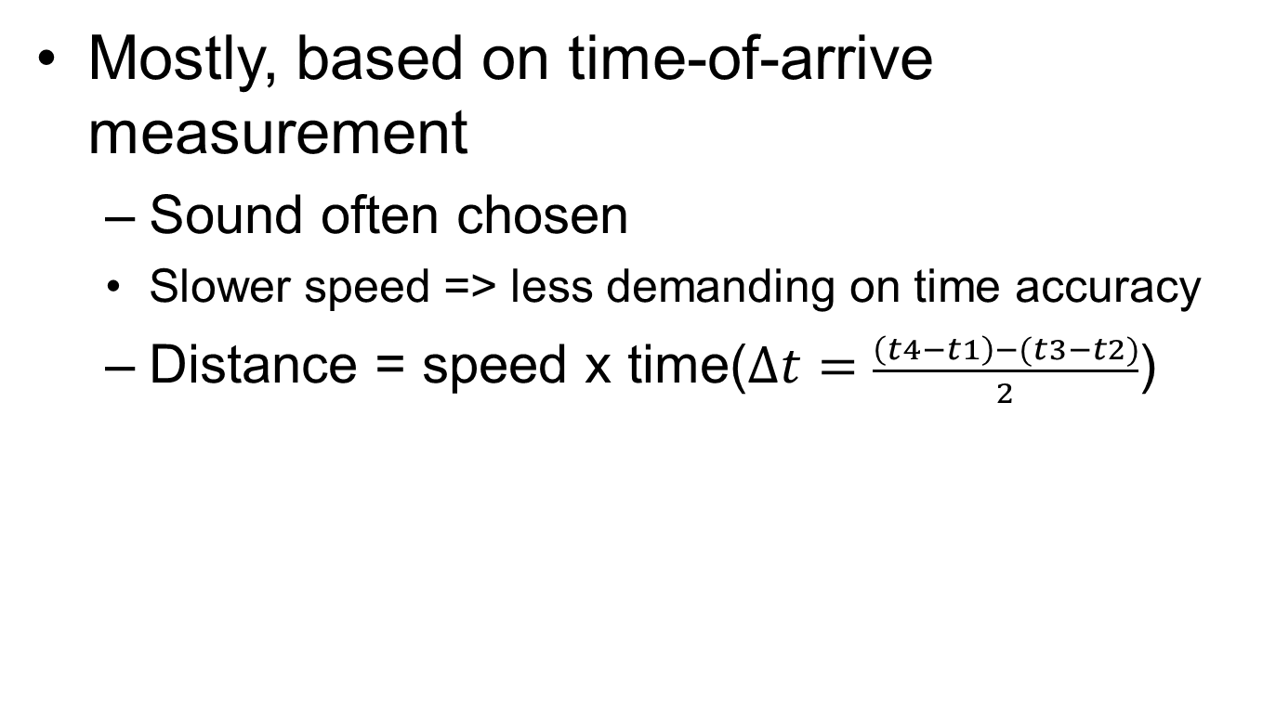
Distance measurement
Mostly, based on time-of-arrive measurement
Sound often chosen
Slower speed => less demanding on time accuracy
Distance = speed x time($∆t=\frac{\left(t4−t1\right)−(t3−t2)}{2}$)
t₁
t₄
t₂
t₃

Slide 5



The root cause of time inaccuracy – three uncertainties
Clock synchronization uncertainty
Sending uncertainty
Receiving uncertainty
software issuing command
software aware of arrival
...
t0 = loc_clock();
write(sound_dev, signal);
...
...
read(sound_dev, signal);
t1 = loc_clock();
...
unknown delays (software, system, driver, hardware, …)
sound leaves
speaker
sound
reaches mic
unknown delays (hardware, interrupt, driver, scheduling, …)
?
?
time

Slide 6
Effects of uncertainties
Example measurement of the lower bound on COTS mobile devices (HP iPAQ rw6828)
Highly fluctuating, appears unpredictable
Easily adds up to 1-2 ms
CPU idle
CPU heavily loaded

Slide 7



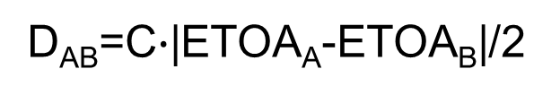
Beepbeep’s basic procedure
Device A emits a beep while both recording
Device B emits another beep while both continue recording
Both devices detect TOA of the two beeps and obtain respective ETOAs
Exchange ETOAs and calculate the distance
Device A
Device B
A’s recording
B’s recording
ETOA_{A}
ETOA_{B}

Slide 8


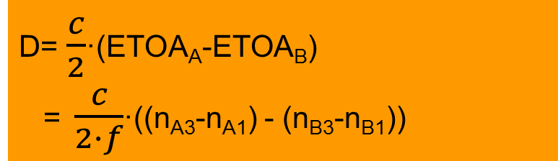
Mathematical derivation
1st Beep
t_{A0}
ETOA_{A}= (n_{A3}-n_{A1})/f_{A}
t_{A1}
ETOA_{B}= (n_{B3}-n_{B1})/f_{B}
t_{B1}
ETOA_{B}
ETOA_{A}
2nd Beep
D= $\frac{c}{2}$·(ETOA_{A}-ETOA_{B})
= $\frac{c}{2∙f}$·((n_{A3}-n_{A1}) - (n_{B3}-n_{B1}))
t_{B2}
t_{B3}
t_{A3}

Slide 9
BeepBeep Summary
Advantage : accurate, error in cms
Disadvantage: distance measurement only

Slide 10
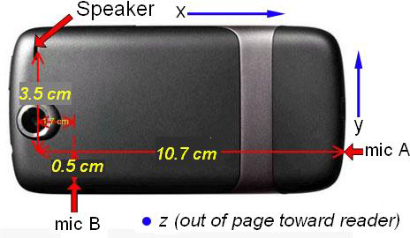
Phone-to-phone 3D localization
Idea:
Use multiple microphones & sensors on the phone

Slide 11

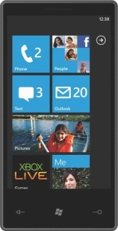
Motivation
Example:
Face-to-face sword fight game between phone users
Other examples:
Ping-pong type game
Positioning for combining displays
...
Notes:
revise motivation slide to include additional examples

Slide 12
Design overview
Initialization
Perform loose time sync
Exchange acoustic tones
Record accelerometer and compass measurements
Calculate distance and angle measurements
Two types of acoustic cues
Exchange measurements
4. Estimate position

Slide 13
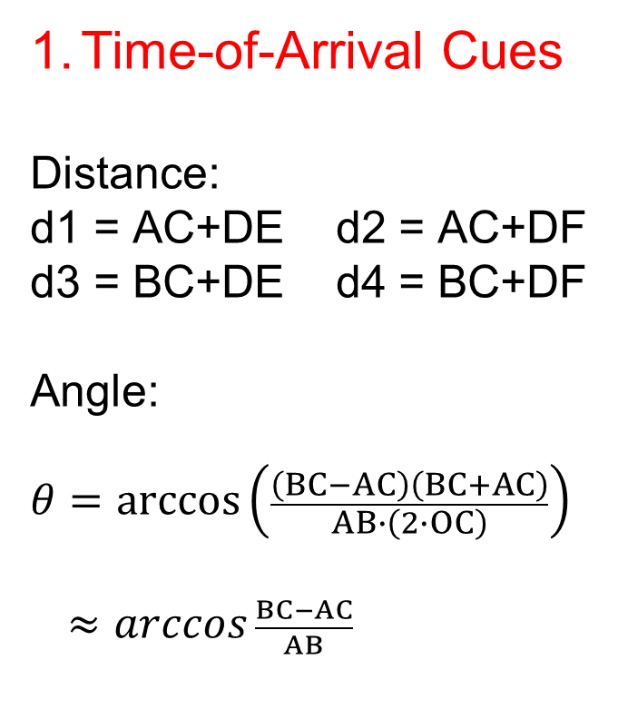

Time-of-arrival cues
Time-of-Arrival Cues
Distance:
$$\text{d}\text{1 = }\text{AC}\text{+}\text{DE} \text{d}\text{2 = }\text{AC}\text{+}\text{DF}$$
$$\text{d}\text{3 = }\text{BC}\text{+}\text{DE} \text{d}\text{4 = }\text{BC}\text{+}\text{DF}$$
Angle:
$$θ=\arccos\left(\frac{\left(BC−AC\right)\left(BC+AC\right)}{AB∙\left(2∙OC\right)}\right)$$
$≈arccos \frac{BC−AC}{AB}$
F
B
C
E
D
A
Speaker C
$$θ$$
Mic A
O
Mic B

Slide 14
Power cues
Power Cues
Observation: two mics experience different attenuation of received signal power
Create look-up table that maps power ratios to angle θ
F
B
C
E
D
A
Speaker C
$$θ$$
Mic A
O
Mic B

Slide 15
conclusion
3D localization with just two regular phones by combining available sensors
90th percentile accuracy: 13.9cm
50th percentile accuracy 4.9cm
Localization many phones?

Slide 16
Questions
1st Beep
t_{A0}
How to distinguish between the second Beep and the third Beep ?
How to localization the third phone , and even more phones?
t_{A1}
3rd Beep
t_{B1}
?
2nd Beep
t_{B2}
t_{B3}
t_{A3}

Slide 17
Our method
t_{A0}
FM radio frequency
t_{B1}
Calculate distance:
Beep
ETOA
Distance = ETOA * SoundSpeed
t_{B2}

Slide 18
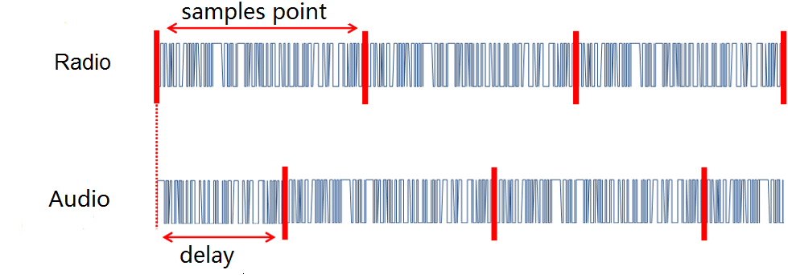
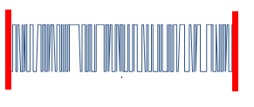

How to Compute the ETOA

Slide 19


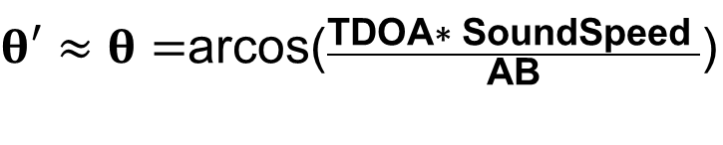
Angle measurement
Speaker
$θ′≈θ=$arcos($\frac{\text{TDOA}\text{∗ }\text{SoundSpeed} }{\text{AB}}\text{)}$
The distance between the two mics AB is constant.
TDOA
$$θ′$$
$$θ$$
Mic A
Mic B

Slide 20
Region overlap
We can used region overlap to
improve localization accuracy.
Mic A
Mic B
Mic D
Mic E
Anchor 1
Anchor 2

Slide 21
Future work
Algorithm Analysis, likes localization accuracy, computational complexity
Measured performance

Slide 22
Thanks
questions?

