Slide 1

SUSI DETECTIVE
Presenter
Kim Byoung Gook
Team9
YANG JONG GOOK
1

Slide 2
INDEX
Feedback
Development Progress
Next Schedule
2

Slide 3
1. Feedback
3

Slide 4
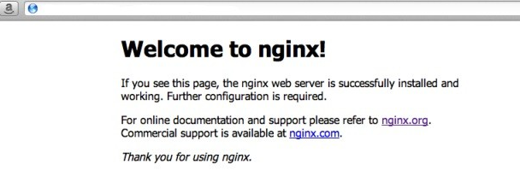
1. Feedback
Ec2 problem with uWSGI being turned off at the end of SSH connection
nginx is normally run as a daemon. But, uwsgi should keep on ec2
4

Slide 5
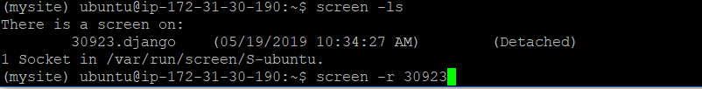
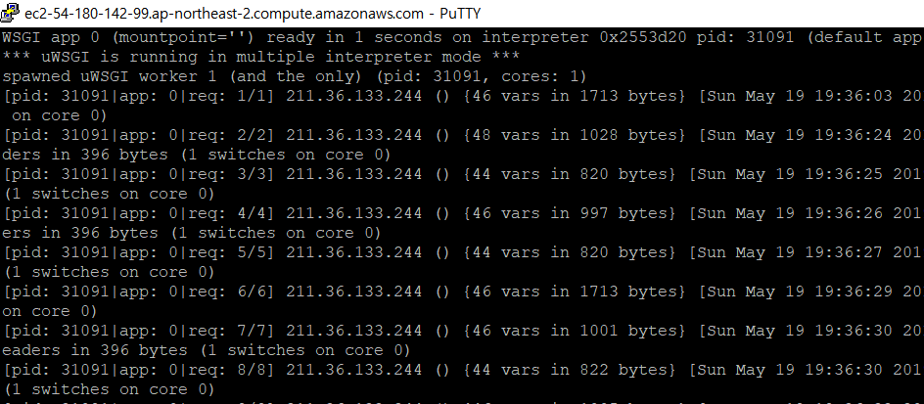
1. Feedback
Ec2 problem with uWSGI being turned off at the end of SSH connection
Create a virtual session with the screen command
Run uWSGI by accessing generated screen
In session 30923.django, uWSGI is running normally.
5

Slide 6
2. Development Progress
6

Slide 7
2. Development Progress
Whole schedule
 | 2 | 3 | 4 | 5 | 6 | 7 | 8 | 9 | 10 | 11 | 12 | 13 | 14
Proposal |  |  |  |  |  | M I D D E M O | M I D T E R M |  |  |  |  |  | F I N A L D E M O
Project research
Django and DB study & UI design
ERD design & Web server implementation
Database design & Algorithm design
Web function implementation
Data collecting
Data Normalization & Data adding
Fix bug & Final check
7

Slide 8
2. Development Progress
YangTaeSeong – Data collecting & Data adding
 |  | 2 | 3 | 4 | 5 | 6 | 7 | 8 | 9 | 10 | 11 | 12 | 13 | 14
Yang Tae Seong | Proposal |  |  |  |  |  | M I D D E M O | M I D T E RM |  |  |  |  |  | F I N A L D E M O
 | Project research
 | Database study
 | ERD design
 | Database design
 | Algorithm design
 | Data collecting
 | Data adding
 | Fix bug & Final check
8

Slide 9
2. Development Progress
KimByoungGook – Data collecting & Data adding
 |  | 2 | 3 | 4 | 5 | 6 | 7 | 8 | 9 | 10 | 11 | 12 | 13 | 14
Kim Byung Gook | Proposal |  |  |  |  |  | M I D D E M O | M I D T E R M |  |  |  |  |  | F I N A L D E M O
 | Project research
 | Django study & UI design
 | ERD design
 | Database design
 | Linkage between Django and Database
 | Data collecting
 | Data Normalization & Data adding
 | Fix bug & Final check
9

Slide 10
2. Development Progress
YoonJongYeop – Web design & Web function implementation
 |  | 2 | 3 | 4 | 5 | 6 | 7 | 8 | 9 | 10 | 11 | 12 | 13 | 14
Yoon Jong Yeop | Proposal |  |  |  |  |  | M I D D E M O | M I D T E R M |  |  |  |  |  | F I N A L D E M O
 | Project research
 | Django study & UI design
 | Web server implementation
 | Web function implementation (Sign-up & Log-in)
 | Web function implementation (Search)
 | Data collecting
 | Web function implementation (other menu)
 | Fix web function bug & Trimming UI
10

Slide 11
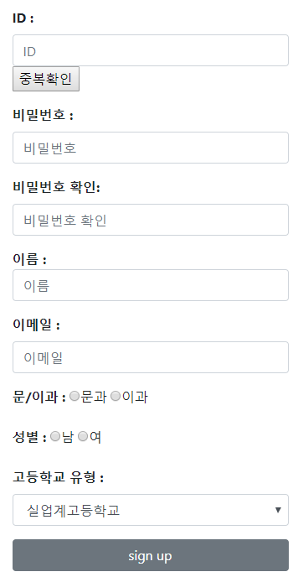
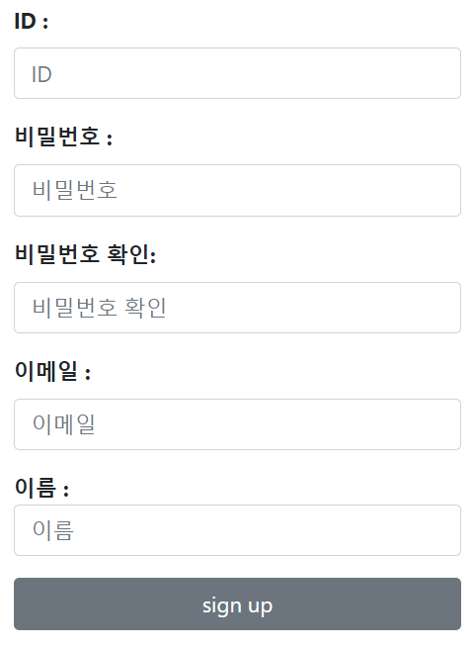
2. Development Progress
Change Signup form(User model extension)
11

Slide 12
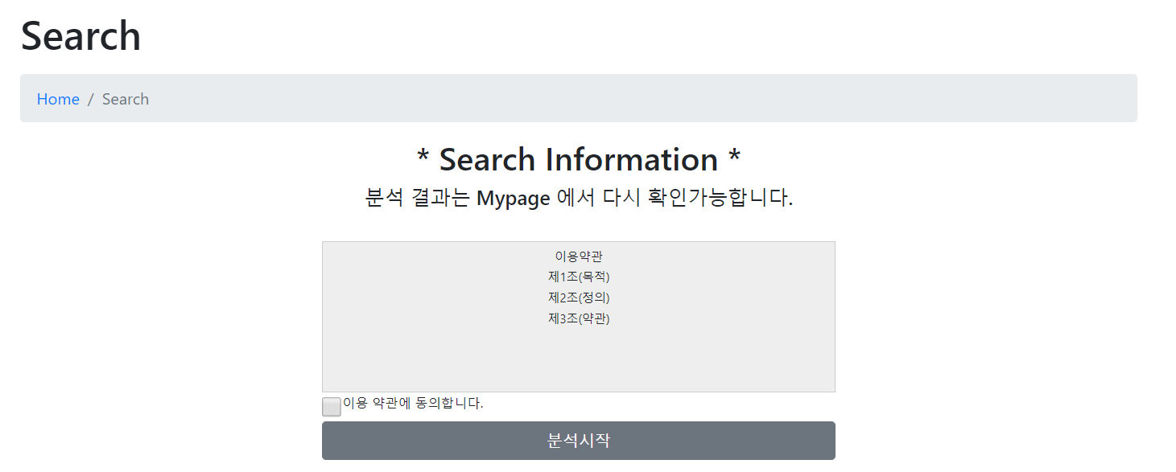
2. Development Progress
Search page
12

Slide 13
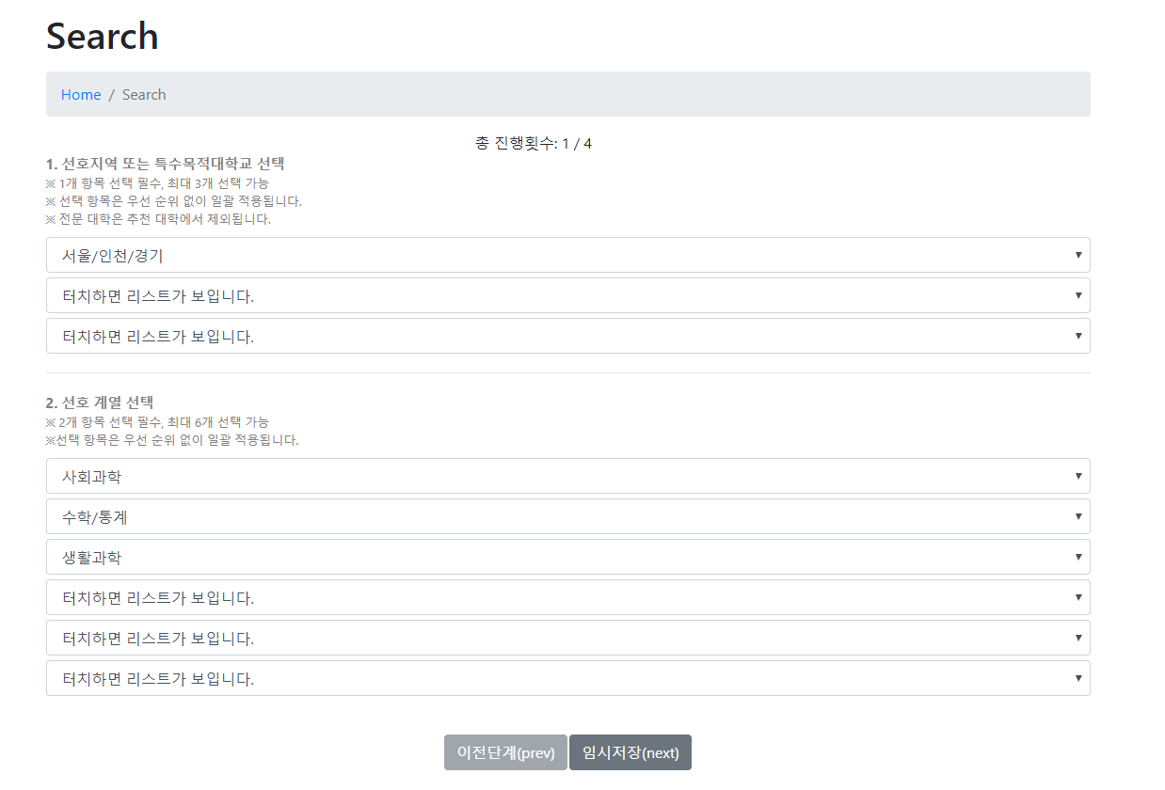
2. Development Progress
Search page
13

Slide 14
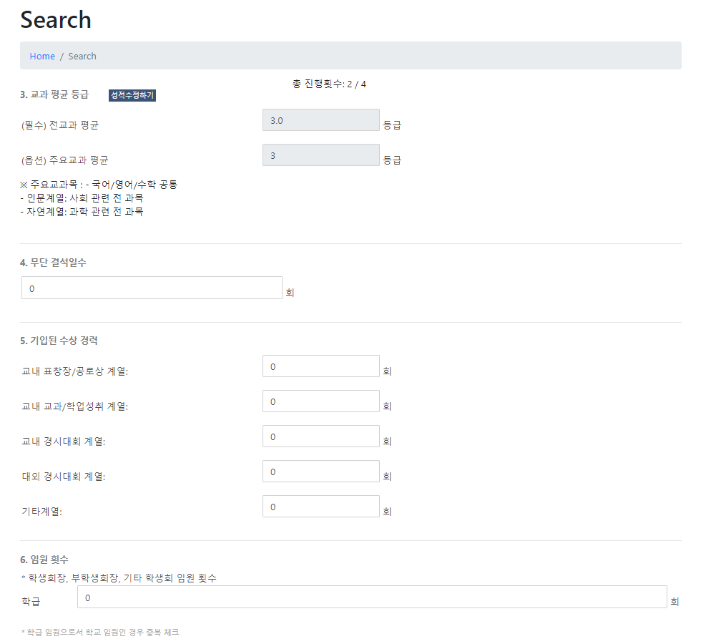
2. Development Progress
Search page
14

Slide 15
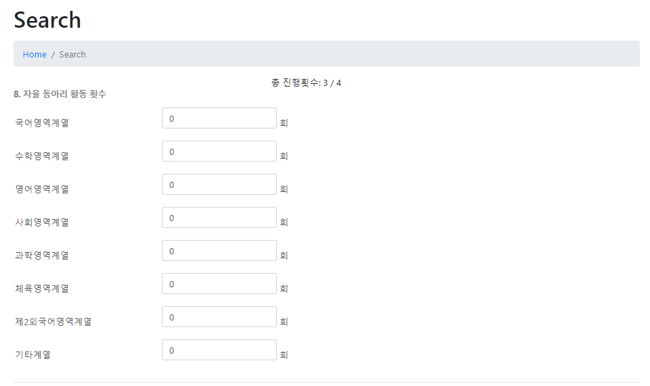
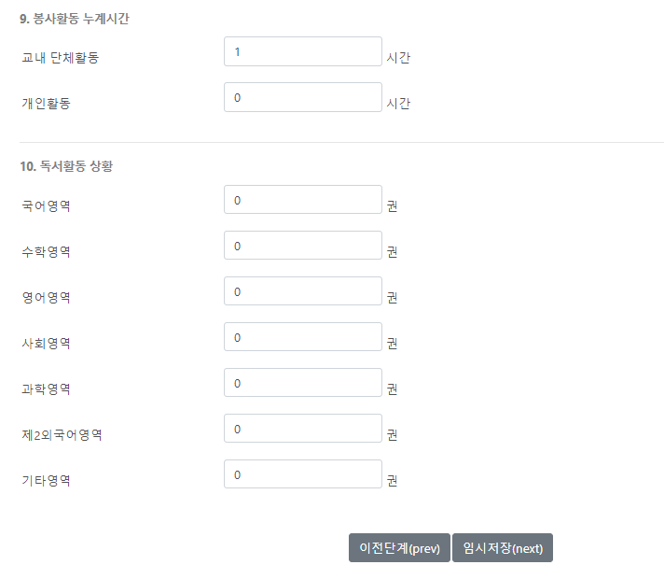
2. Development Progress
Search page
15

Slide 16
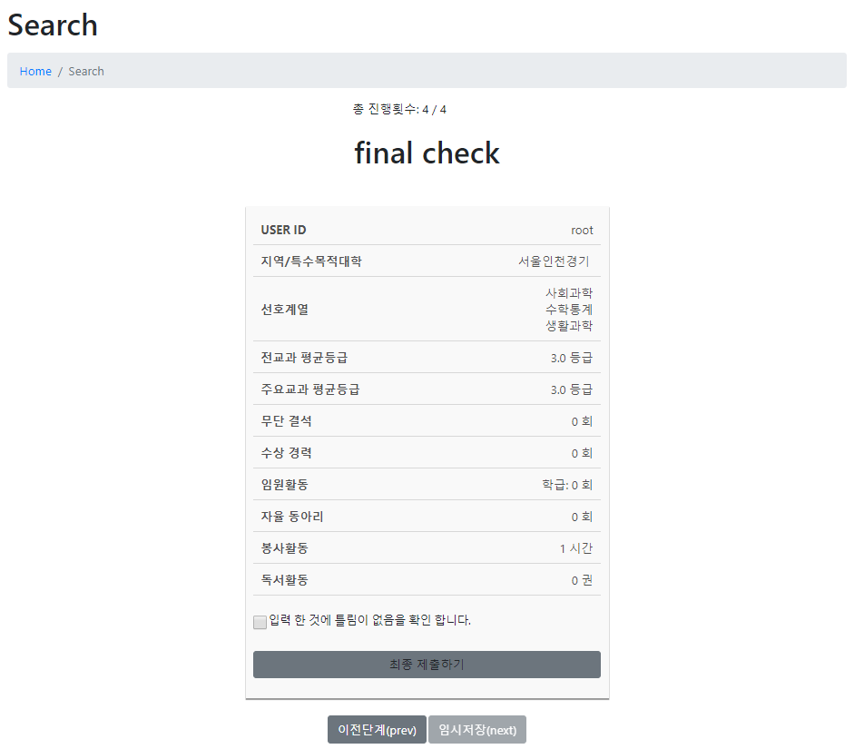
2. Development Progress
Search page
16

Slide 17
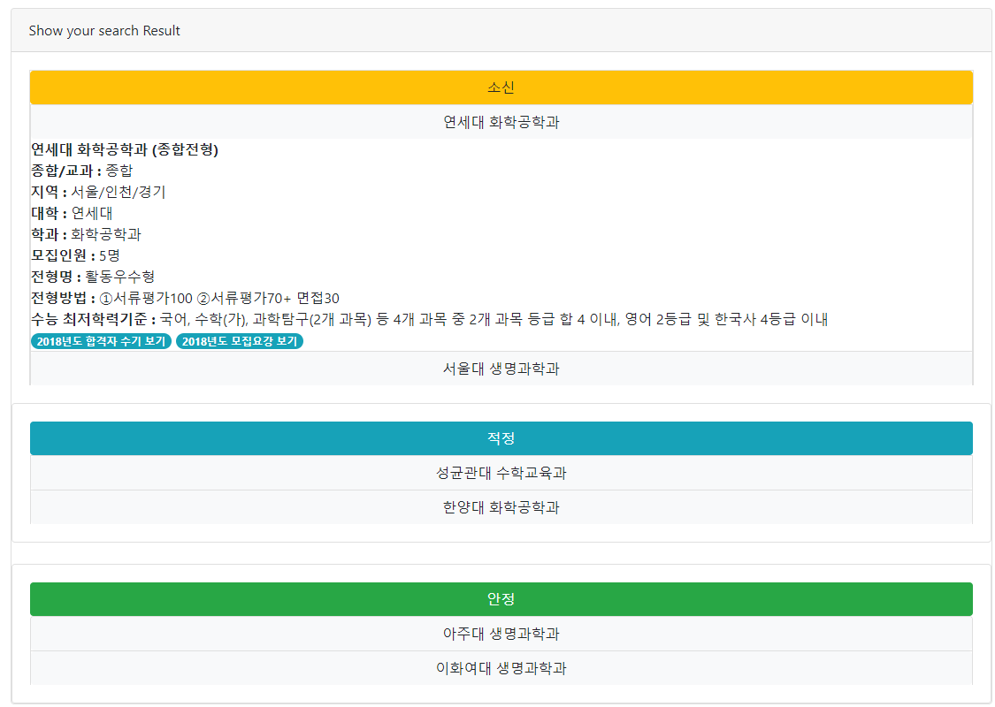
2. Development Progress
Search result page
17

Slide 18
3. Next Schedule
18

Slide 19
3. Next Schedule
Whole schedule
 | 2 | 3 | 4 | 5 | 6 | 7 | 8 | 9 | 10 | 11 | 12 | 13 | 14
Proposal |  |  |  |  |  | M I D D E M O | M I D T E R M |  |  |  |  |  | F I N A L D E M O
Project research
Django and DB study & UI design
ERD design & Web server implementation
Database design & Algorithm design
Web function implementation
Data collecting
Data Normalization & Data adding
Fix bug & Final check
19

Slide 20
Q&A
☺
20

