Slide 1

SUSI DETECTIVE
Presenter
Kim Byoung Gook
Team9
YANG JONG GOOK
1

Slide 2
INDEX
Introduction
Development Progress
Next schedule
2

Slide 3
1. Introduction
3

Slide 4
Introduction
An increasing number of people for occasional recruitment(수시 전형)
Complex recruitment types
Entrance requirement of
Chung-ang univ
Motivation
4

Slide 5
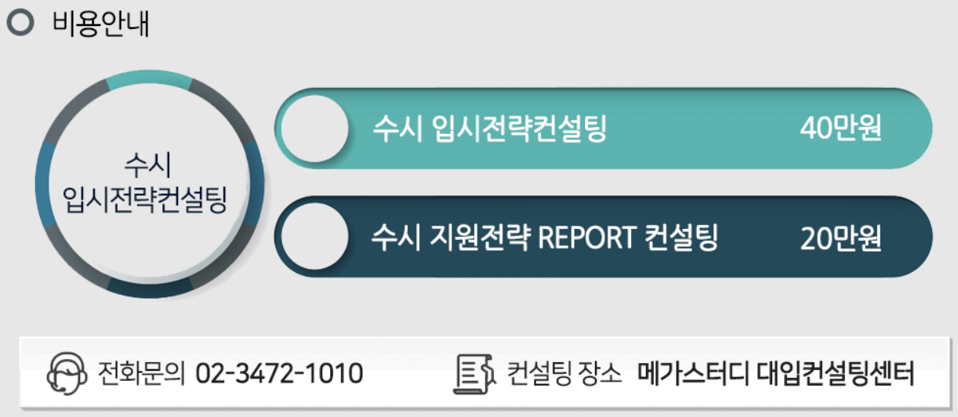
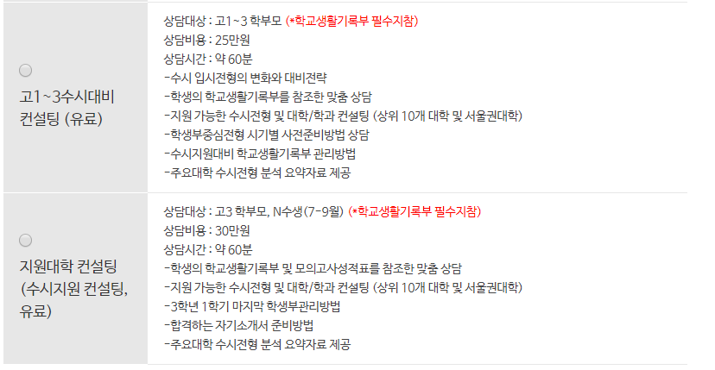
Introduction
Motivation
Consulting cost is Very expensive for student
5

Slide 6
1. Introduction
Whole schedule
 | 2 | 3 | 4 | 5 | 6 | 7 | 8 | 9 | 10 | 11 | 12 | 13 | 14 | 15
Proposal |  |  |  |  |  | M I D D E M O | M I D T E R M |  |  |  |  |  |  | F I N A L D E M O
Project research
Django and DB study & UI design
ERD design & Web server implementation
Database design & Algorithm design
Linkage between Django and DB & Web function implementation
Data collecting
Data Normalization & Data adding
Fix bug & Final check
6

Slide 7
1. Introduction
YangTaeSeong – Database design and Algorithm design
 |  | 2 | 3 | 4 | 5 | 6 | 7 | 8 | 9 | 10 | 11 | 12 | 13 | 14 | 15
Yang Tae Seong | Proposal |  |  |  |  |  | M I D D E M O | M I D T E RM |  |  |  |  |  |  | F I N A L D E M O
 | Project research
 | Database study
 | ERD design
 | Database design
 | Algorithm design
 | Data collecting
 | Data adding
 | Fix bug & Final check
7

Slide 8
1. Introduction
YoonJongYeop – Web design & Web function and Server implementation
 |  | 2 | 3 | 4 | 5 | 6 | 7 | 8 | 9 | 10 | 11 | 12 | 13 | 14 | 15
Yoon Jong Yeop | Proposal |  |  |  |  |  | M I D D E M O | M I D T E R M |  |  |  |  |  |  | F I N A L D E M O
 | Project research
 | Django study & UI design
 | Web server implementation
 | Web function implementation (Sign-up & Log-in)
 | Web function implementation (Notice & Search)
 | Data collecting
 | Web function implementation (other menu)
 | Fix web function bug & Trimming UI
8

Slide 9
1. Introduction
KimByungGook – Database design, Data normalization
 |  | 2 | 3 | 4 | 5 | 6 | 7 | 8 | 9 | 10 | 11 | 12 | 13 | 14 | 15
Kim Byung Gook | Proposal |  |  |  |  |  | M I D D E M O | M I D T E R M |  |  |  |  |  |  | F I N A L D E M O
 | Project research
 | Django study & UI design
 | ERD design
 | Database design
 | Linkage between Django and Database
 | Data collecting
 | Data Normalization & Data adding
 | Fix bug & Final check
9

Slide 10
2. Development Progress
10

Slide 11
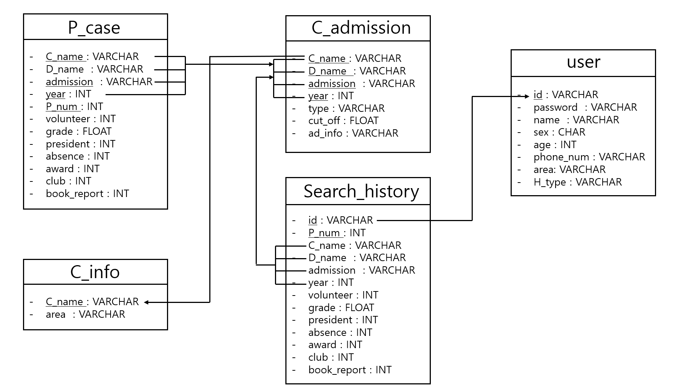
2. Development Progress
Database Design
11

Slide 12
2. Development Progress
Database Design
User input including
complete unit
12

Slide 13
2. Development Progress
Database Design
13

Slide 14
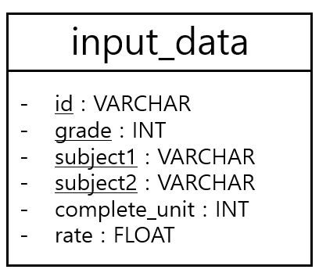
2. Development Progress
Database Design
14

Slide 15
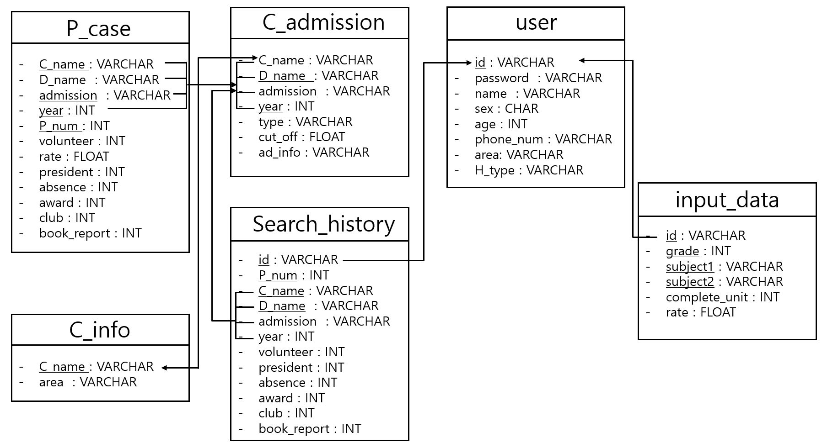
2. Development Progress
Database Design
15

Slide 16
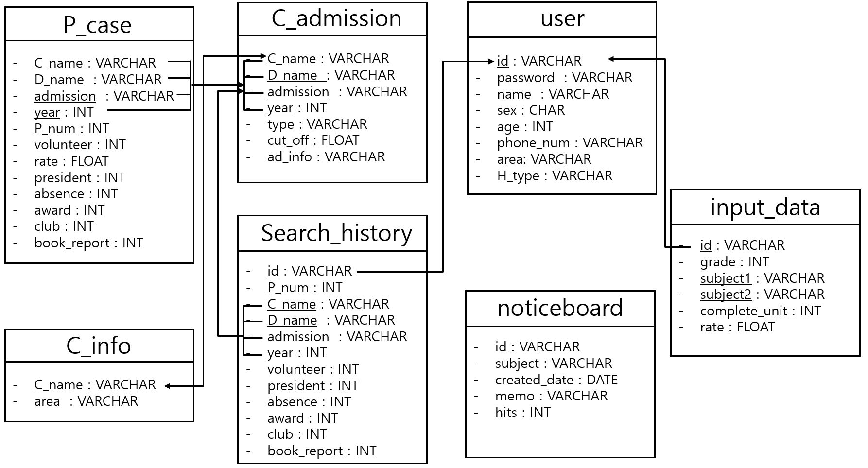
2. Development Progress
Database Design
16

Slide 17
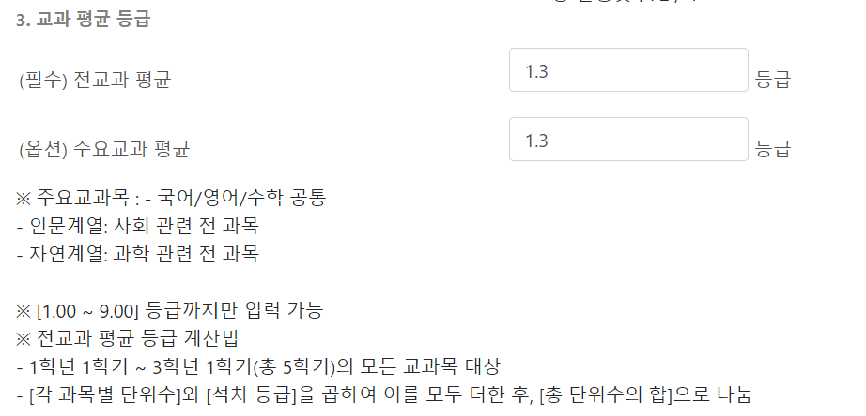
2. Development Progress
Input data implement : <original>
17

Slide 18
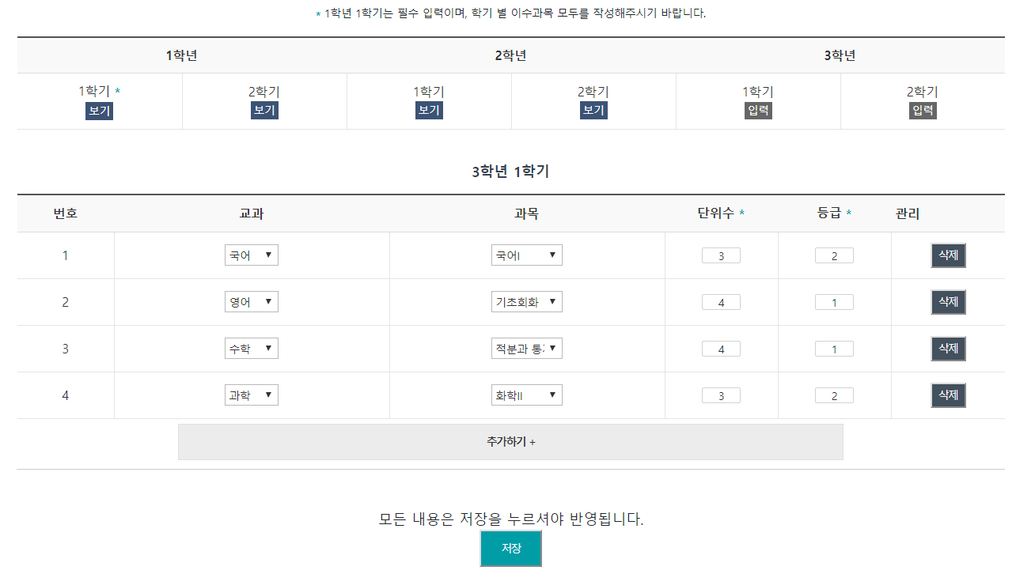
2. Development Progress
Input data implement : <original>
18

Slide 19

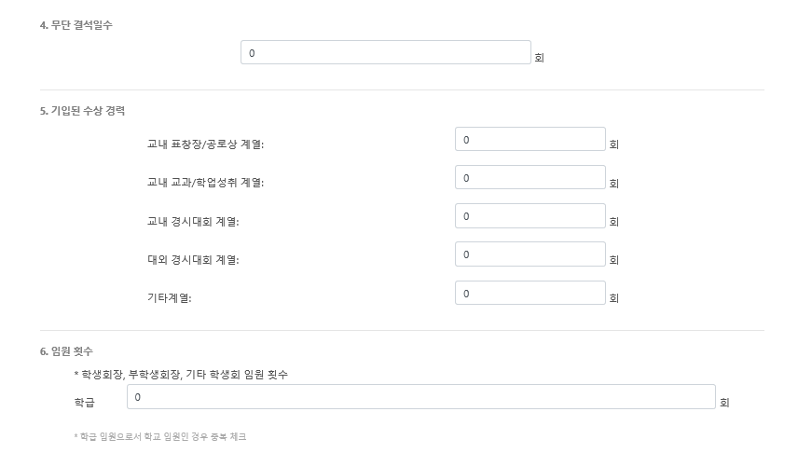
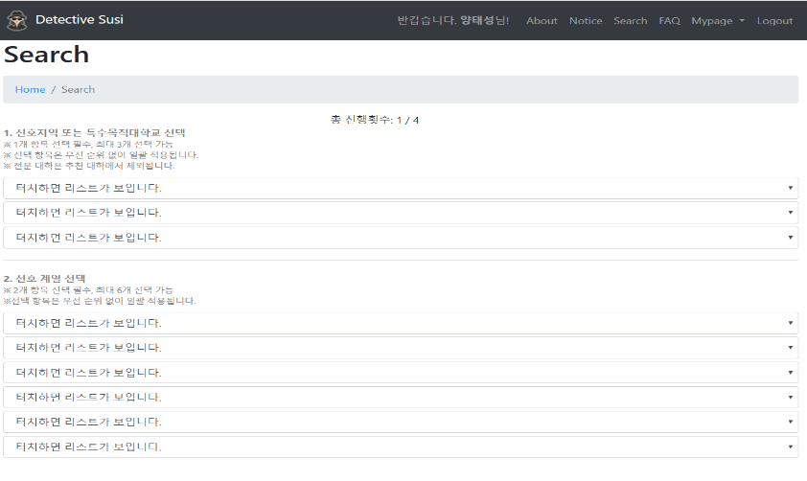
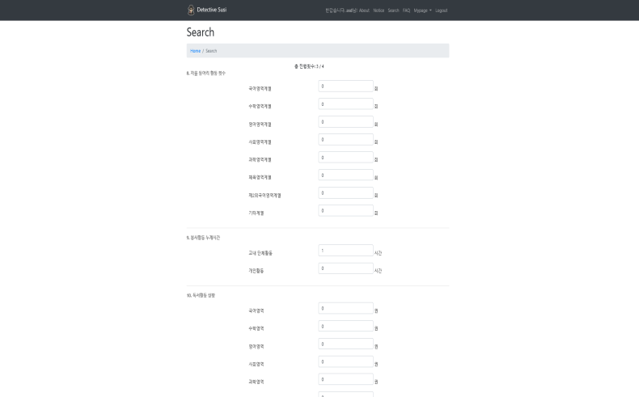
2. Development Progress
Algorithm Design
Input user’s data
input_data
id : varchar
grade : float
Subject1 : varchar
Subject2 : varchar
Complete_unit : int
Rate : float
19

Slide 20
2. Development Progress
Algorithm Design
One record has information for one subject
ex) id : 1111
Input_data
id : varchar
grade : float
Subject1 : varchar
Subject2 : varchar
Complete_unit : int
Rate : float
id : 1111
grade : 1
subject1 : 수학
subject2 : 미분
complete_unit : 2
rate : 2.3
id : 1111
grade : 5
subject1 : 수학
subject2 : 통계
complete_unit : 2
rate : 3.2
id : 1111
grade : 3
subject1 : 국어
subject2 : 문학
complete_unit : 3
rate : 3.1
20

Slide 21

2. Development Progress
Algorithm
All of 1111's rates are calculated to the standards of each school.
C_admission
c_name : VARCHAR
d_name : VARCHAR
admission : VARCHAR
year : INT
type : VARCHAR
cut_off : FLOAT
ad_info : VARCHAR
id : 1111
grade : 1
subject1 : 수학
subject2 : 미분
complete_unit : 2
rate : 2.3
id : 1111
grade : 5
subject1 : 수학
subject2 : 통계
complete_unit : 2
rate : 3.2
id : 1111
grade : 3
subject1 : 국어
subject2 : 문학
complete_unit : 3
rate : 3.1
Compare the rate retrieved by the user
with the cut _ off in the C _ admission
21

Slide 22
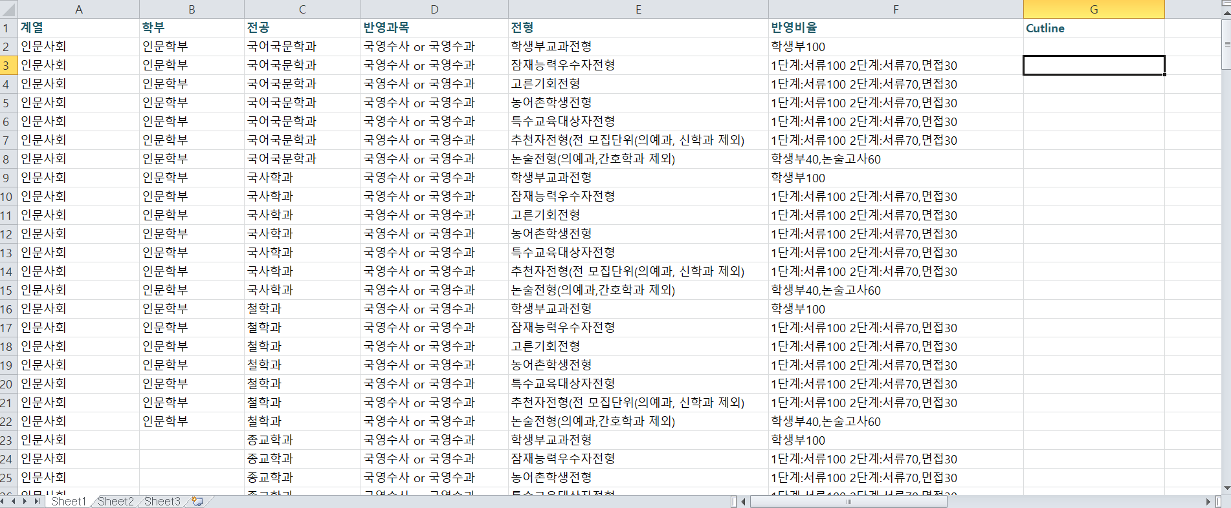
2. Development Progress
Algorithm
line by line compare
And select a range
From -1 ~ +1
as compared 1111’s rate
.
.
.
.
.
This process is repeated for each school
22

Slide 23
2. Development Progress
Algorithm
Result set
p_case
c_name
d_name
admission
year
c_name : VARCHAR
d_name : VARCHAR
admission : VARCHAR
year : INT
p_num : INT
grade : FLOAT
president : INT
absence : INT
award : INT
club : INT
volunteer : INT
book_report : INT
중앙대학교
소프트웨어학부
SW인재
2018
중앙대학교
전자전기공학부
다빈치형인재
2018
경희대학교
전자공학과
고른기회전형(II)
2018
경희대학교
컴퓨터공학과
고른기회전형(I)
2018
Bring!
숭실대학교
소프트웨어학부
미래인재
2018
Compare the result set selected by previous work
with the universe information in the p_case
And bring passing information in the p_case
23

Slide 24
2. Development Progress
Algorithm
1111’s Diagnosis Result
A universe B major C type => You lack Service time 60 , President 2
D universe E major F type => You lack President 1, Club activities 15
G universe H major I type => You lack Service time 30, Awards 10
Z universe K major L type => You lack Club activities 10, President 3
.
.
.
24

Slide 25

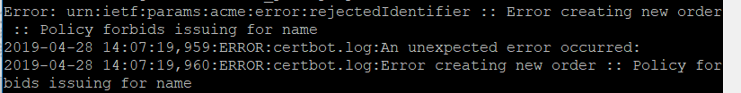
2. Development Progress
Security issue : Link the ‘https ’ (Feedback)
Error!
need to use DNS server.
25

Slide 26
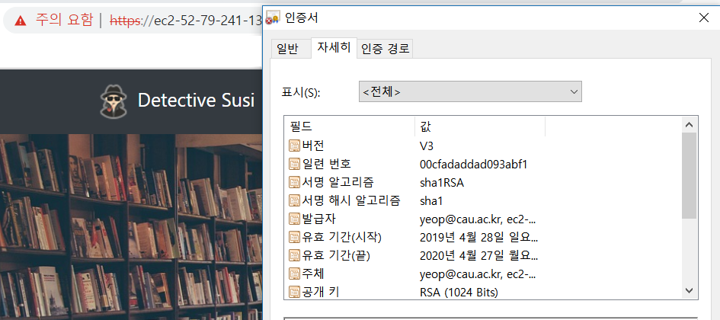
2. Development Progress
Security issue : Link the ‘https ’ (Feedback)
26
Notes:
https://www.susi.cf:8443/

Slide 27
4. Next schedule
27

Slide 28
4. Next schedule
Whole schedule
 | 2 | 3 | 4 | 5 | 6 | 7 | 8 | 9 | 10 | 11 | 12 | 13 | 14 | 15
Proposal |  |  |  |  |  | M I D D E M O | M I D T E R M |  |  |  |  |  |  | F I N A L D E M O
Project research
Django and DB study & UI design
ERD design & Web server implementation
Database design & Algorithm design
Linkage between Django and DB & Web function implementation
Data collecting
Data Normalization & Data adding
Fix bug & Final check
28

Slide 29
Q&A
☺
29

