Slide 1
INFO 153 Week 6
Mid-terms, Review, Database Design & MySQL, Assignment 3, and
Term Projects

Slide 2
The Mid-term
Pattern identified
Adjustment was implemented after reviewing breadth of test scores
Few questions were misunderstood per answers received
Need more practice writing code
Areas need review- MVC, XAMPP (PHP, DB and MySQL administration), Extreme Programming

Slide 3
What have you learned in this class?
Using XAMPP, MySQL, Apache, NetBeans
PHP Programing
Database Access and SQL queries
PHP PDO
SQL queries and result processing
MVC for application development
My Guitar Shop Application
Getting data from data sourcs
INPHO – JSON

Slide 4
JSON Syntax
JSON syntax is derived from JavaScript object notation syntax:
Data is in name/value pairs
Data is separated by commas
Curly braces hold objects
Square brackets hold arrays
Need to understand the syntax in order to process the data!

Slide 5
JSON
JSON is built on two structures
A collection of name/value pairs. -- objects
An ordered list of values -- array
Example:
{"employees":[ {"firstName":"John", "lastName":"Doe"}, {"firstName":"Anna", "lastName":"Smith"}, {"firstName":"Peter", "lastName":"Jones"} ]}

Slide 6
JSON Example
https://inpho.cogs.indiana.edu/thinker/3724.json
This web link displays web site info in JSON format

Slide 7
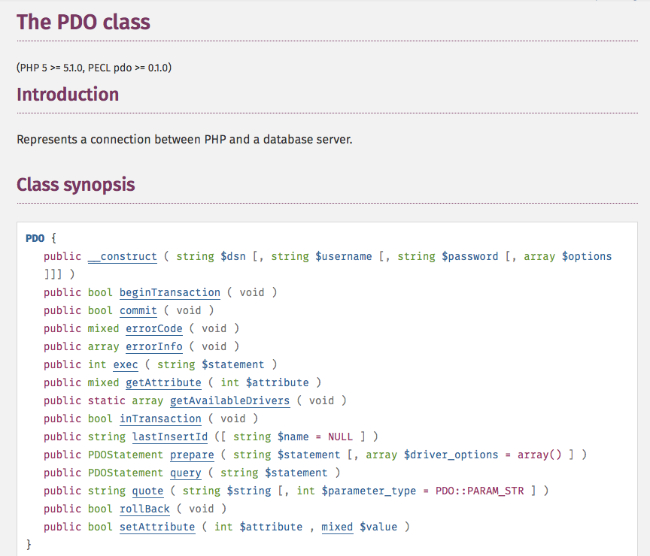
PDO: http://php.net/manual/en/class.pdo.php

Slide 8
PDO:: exec
Execute command for PDO http://php.net/manual/en/pdo.exec.php

Slide 19
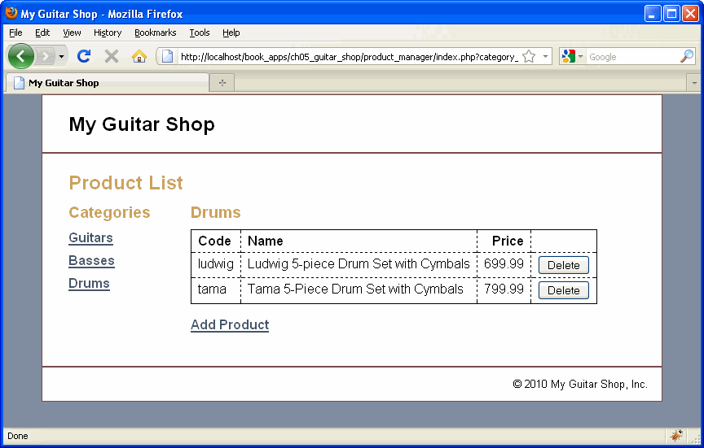

Slide 20
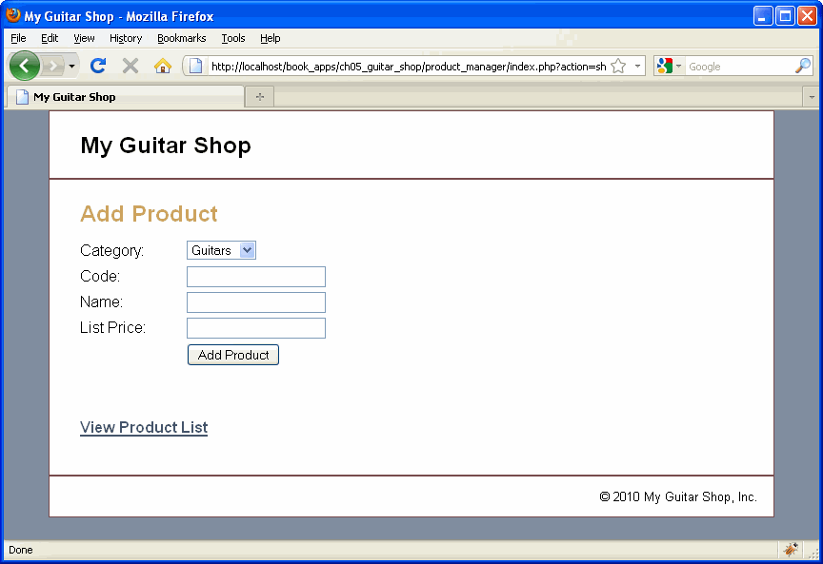

Slide 36
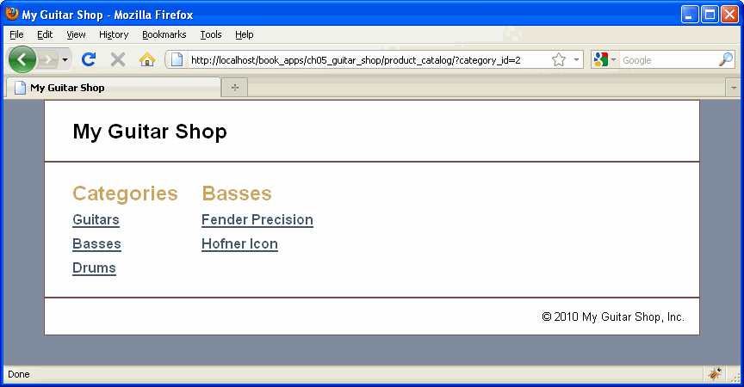

Slide 37
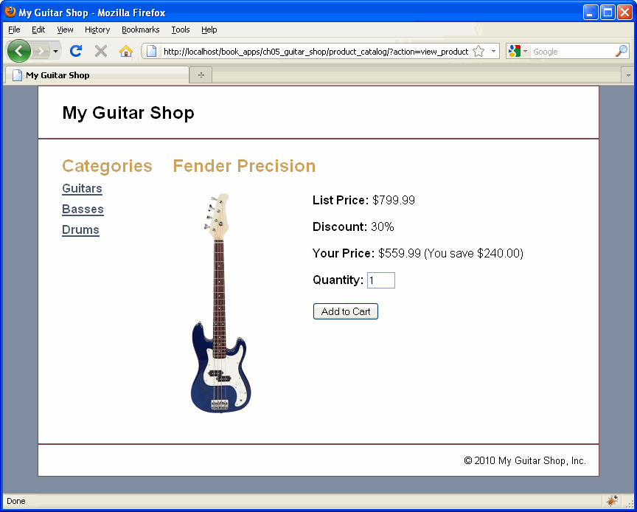

Slide 47
My Guitars Shop Application
MVC design
Database design for applications
Creating databases (mysql)
Loading data to tables (mysql)
PHP database access (PDO)
HTML frontends

Slide 48
Loading Data
Use PhpAdmin
Easy but limited by its predefined format;
Use a mysql file
Data is written into sql statements;
Use PHP
Php function: fgetcsv:
http://php.net/manual/en/function.fgetcsv.php
Most flexible

Slide 49
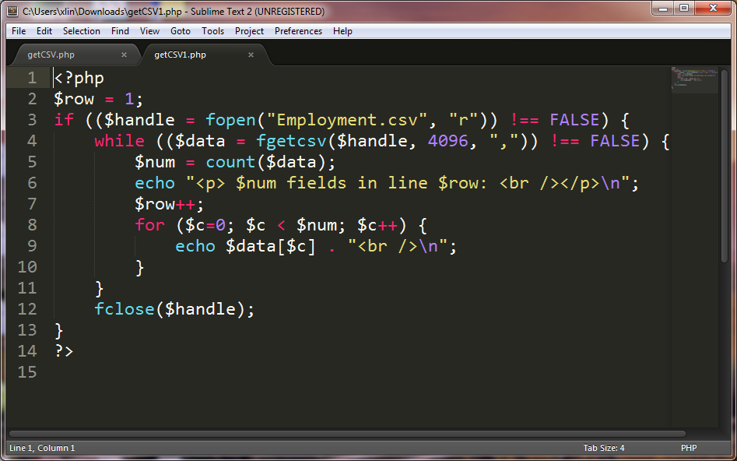
Getcsv1.php

Slide 50
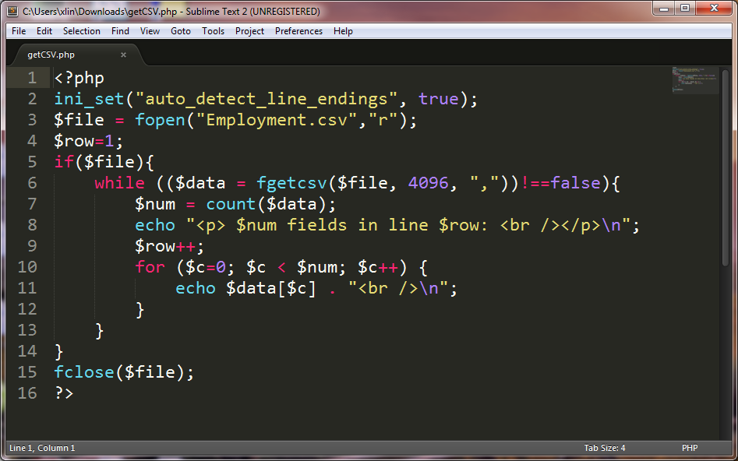
Getcsv.php

Slide 65

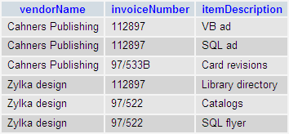

Slide 70


Slide 72
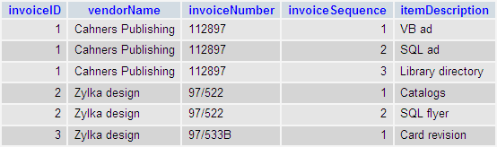

Slide 78
INFO 153 Week 6
MySQL

Slide 79
Agenda
An Introduction to MySQL
Load the NSF Data to MySQL
Query the NSF Database in MySQL
Query the Database in MySQL with PHP

Slide 80
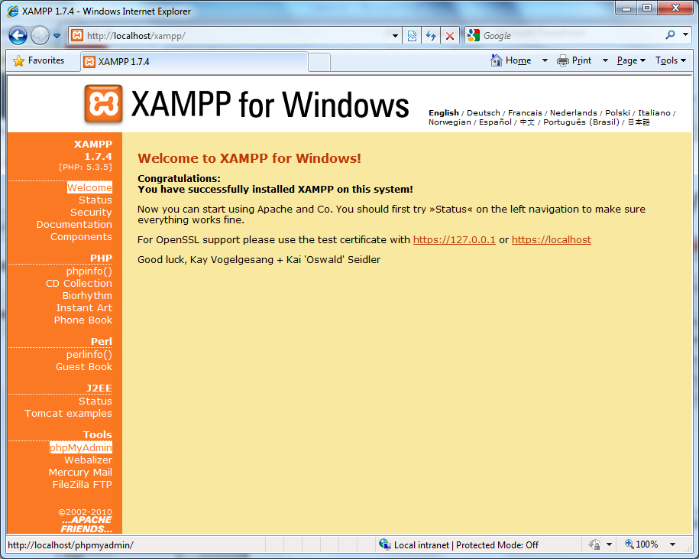

Slide 81
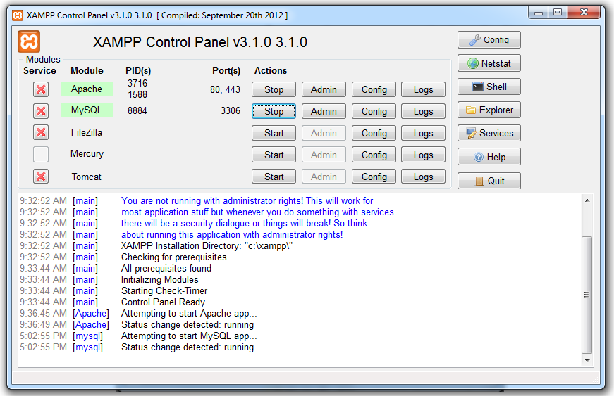
1. An Introduction to MySQL

Slide 82
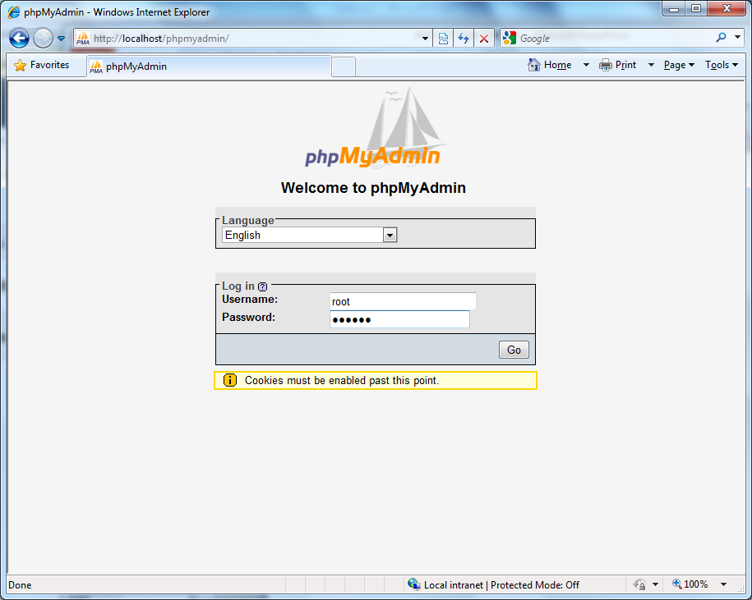

Slide 83
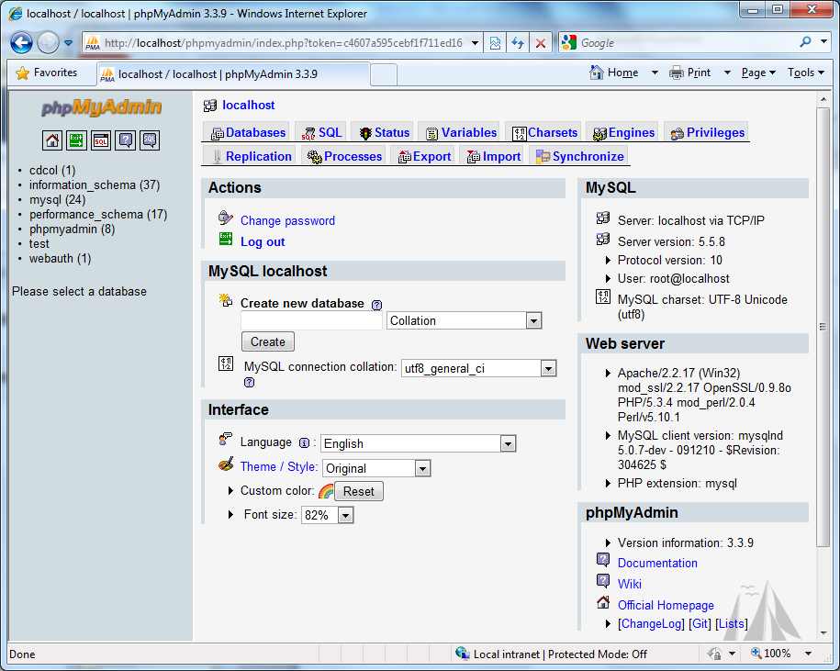

Slide 84
2. Load the NSF Data to MySQL
Two options:
Use command line
Use phpAdmin

Slide 85
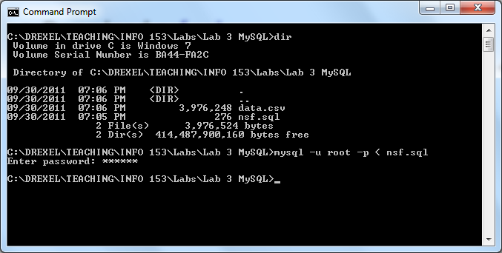
Create a database and a table with nsf.sql
Download nsf.sql
Execute the SQL script: c:> mysql -u root -p < nsf.sql

Slide 86
Load the data.csv file
download data.csv to a folder on your computer
login to your mysql from the folder
c:>mysql -u root -p
mysql>use nsf;
mysql>load data local infile 'data.csv' into table iis fields terminated by ',' enclosed by '"' lines terminated by '\n';
Note that encloded by '"' is ' then " then '.

Slide 87
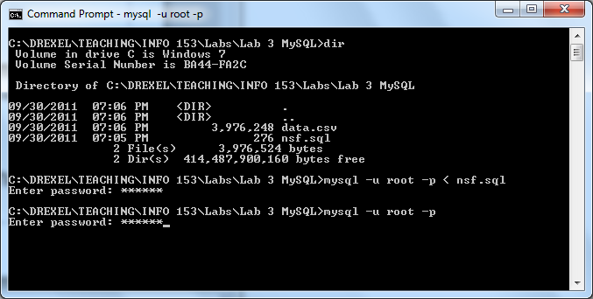
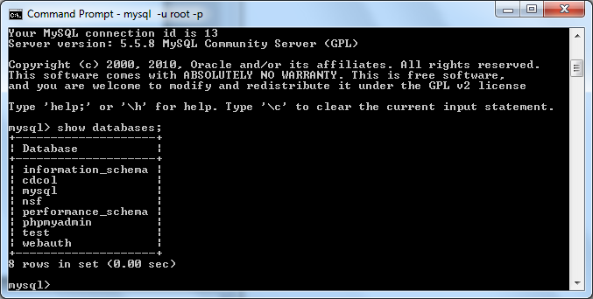

Slide 88
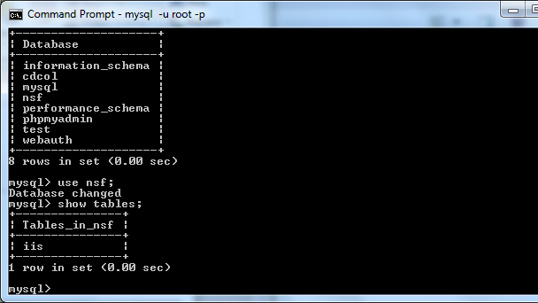
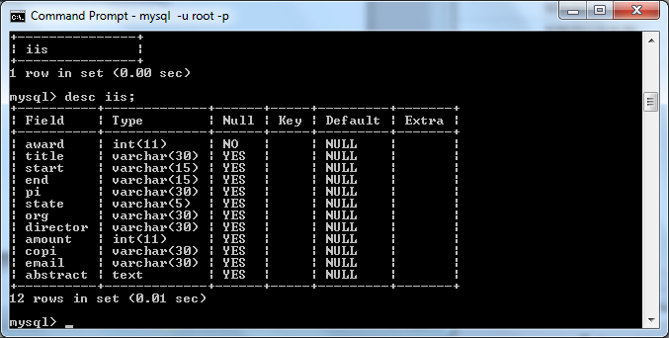

Slide 89

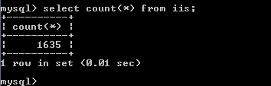

Slide 90
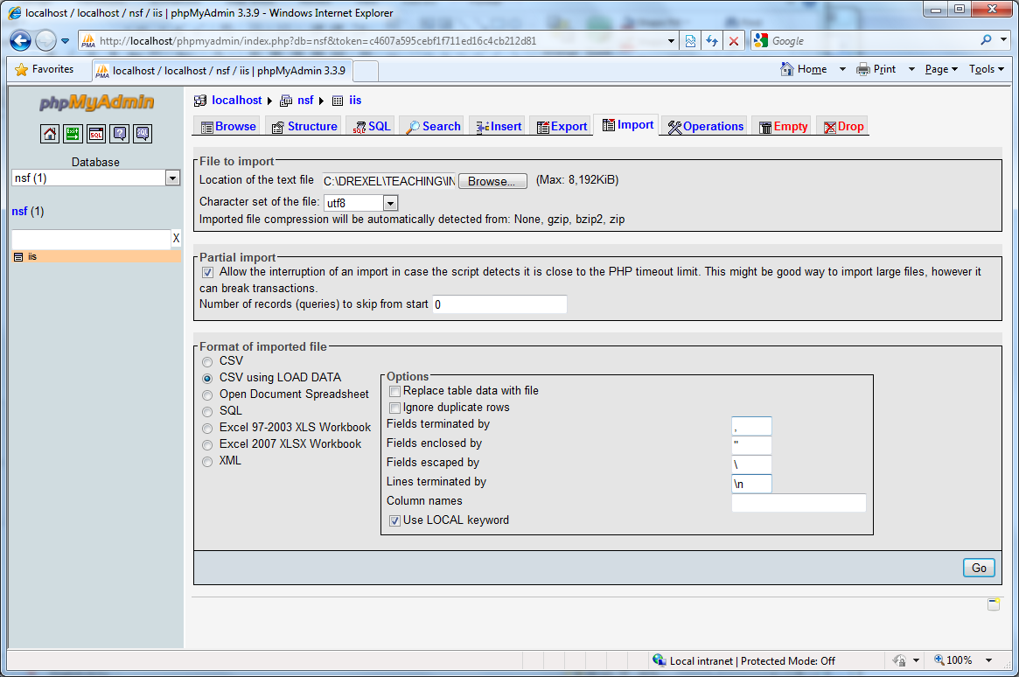

Slide 91
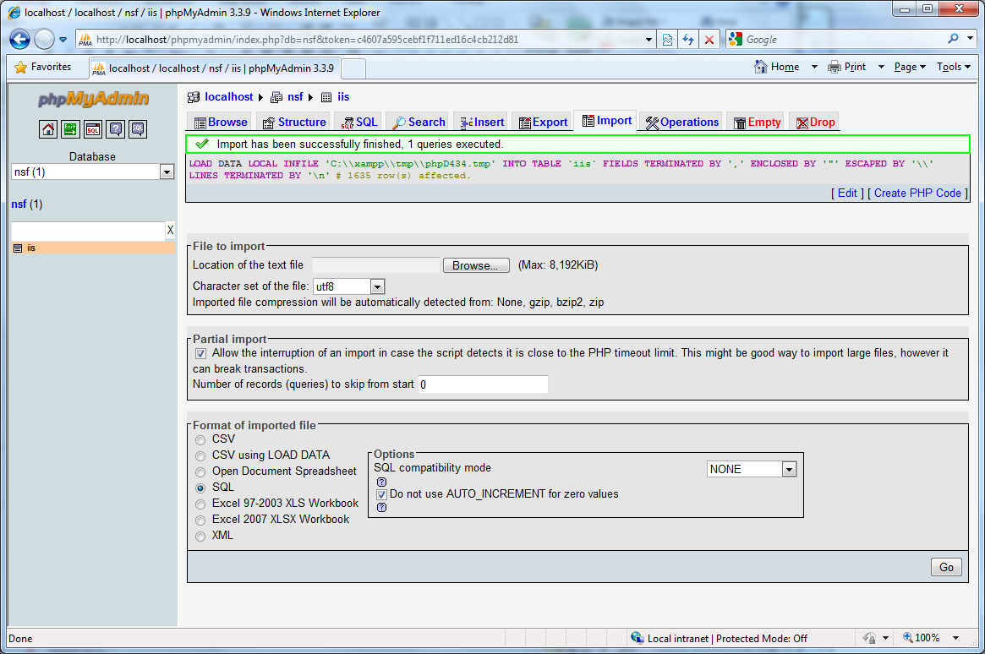

Slide 92
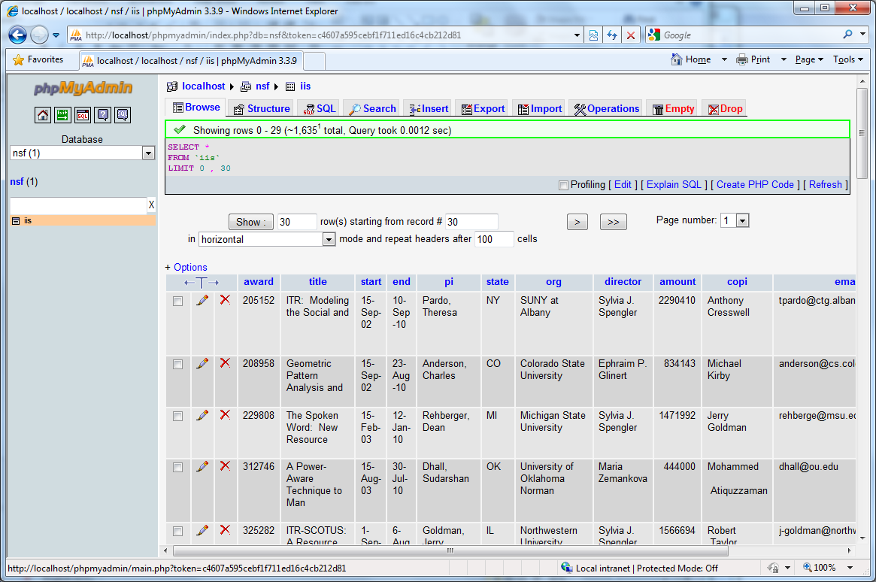

Slide 93
3. Query the NSF Database in MySQL
2 Methods
Command line
PHPMyAdmin

Slide 94
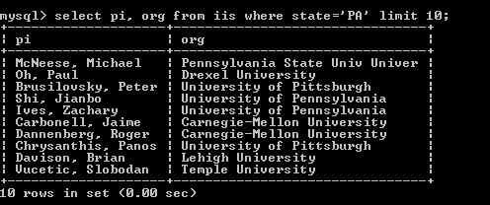
10 investigators (pi) and their universities (org) from PA

Slide 95
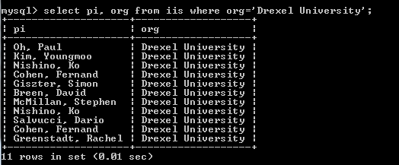
All the investigators from Drexel

Slide 96
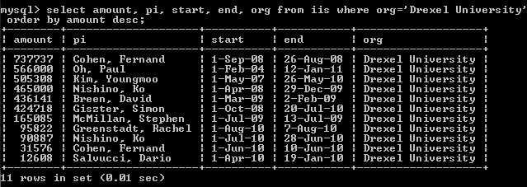
Awards to Drexel, sorted by the amount ($)

Slide 97
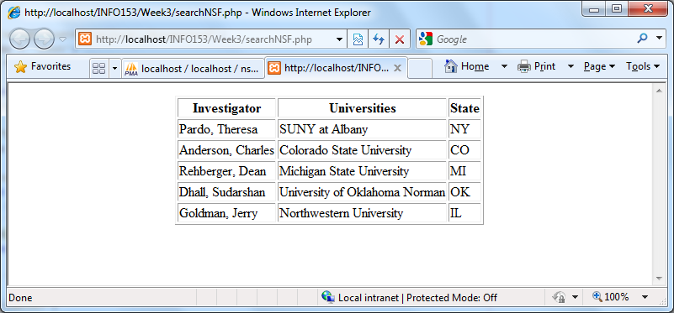
4. Query the Database in MySQL with PHP

Slide 98
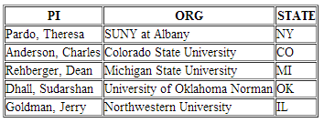
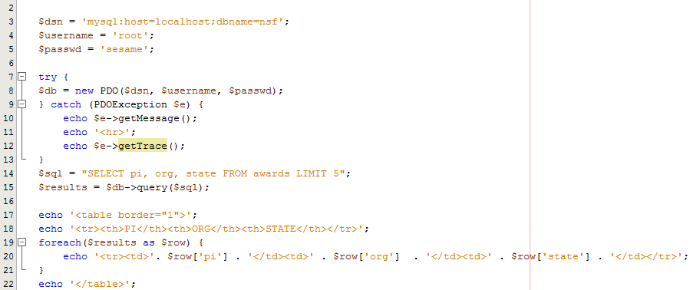
4. Query the Database in MySQL with PHP

Slide 99
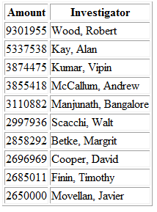
Top 10 Awards by Amount

Slide 100
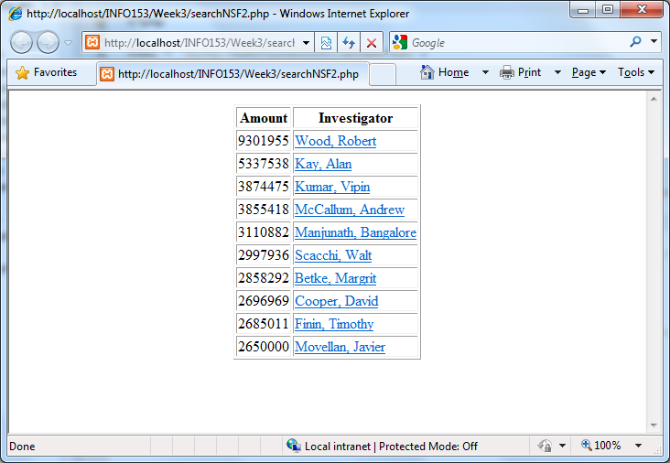
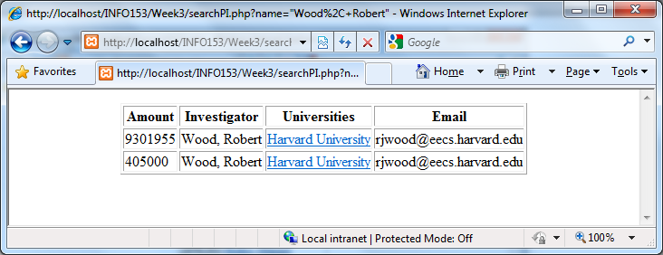
1
2

Slide 101
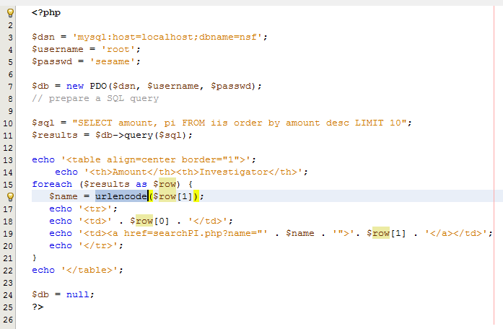
1

Slide 102
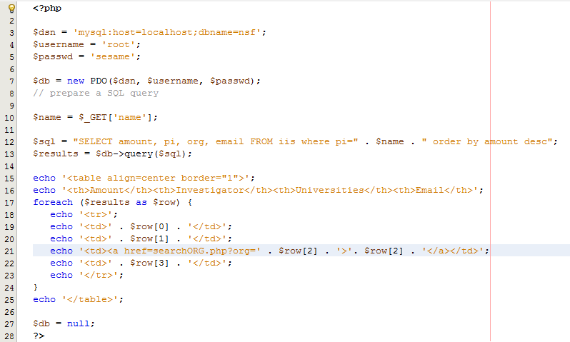
2

Slide 103
Further Reading
Chapters 3, 4, 17, 18

Slide 104
Assignment 3
How do you load the data in?
What are the structures of your database?
What is your Model?
What is your View?
What is your Control?

Slide 105
The model
Modify it from Guitar shop application
Database.php
Category_db.php

Slide 106
The View
Modify it from product_list.php

Slide 107
Final Project Discussion
Requirements
The project needs to have access to some data
Such as assignment 2 to 4
The project should be php-based
The project should have html front-ends
Good to have:
MVC design
Use of MySQL database

Slide 108
Final Project Discussion
Submit your topic and team by next Tuesday
two or three person’s team
Extensions of assignment 2 to 4 are OK.
There are many other possible projects
Need to do a class presentation and a final documentation
Submit all the codes and data (if it is small enough)
Each student must have a final notes on what you learn from completing the project.

