Slide 1
INFO 153 Week 6
Data, Open Data and data.gov

Slide 2
Discussion
Class content so far?
Too easy or too difficult?
What are the challenges?
Missing the classes!
Did not complete the lab work
Your goals?
Learning by doing.
Each assignment is a learning milestone.
Each lab work is a learning experience.
Bring together by your final project.
Continue learning in INFO154

Slide 3

Data, Data, Everywhere
https://www.emc.com/collateral/analyst-reports/ar-the-economist-data-data-everywhere.pdf

Slide 4

Data Science
https://hbr.org/2012/10/data-scientist-the-sexiest-job-of-the-21st-century/

Slide 5
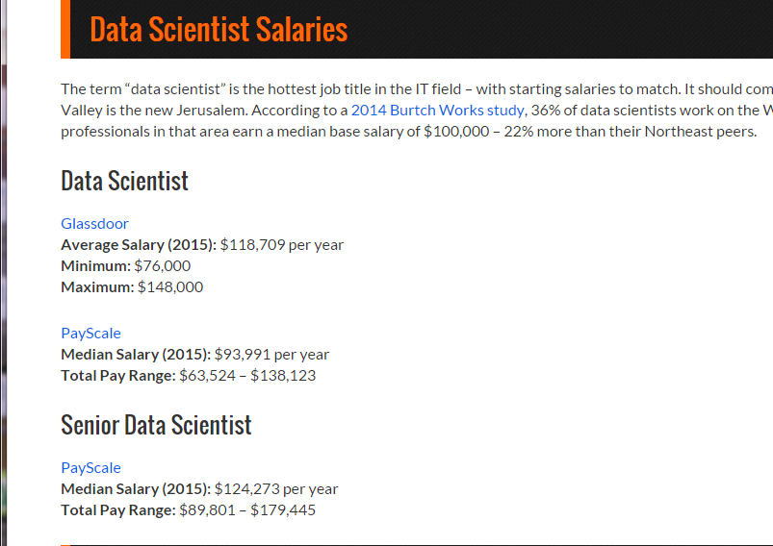
http://www.mastersindatascience.org/careers/data-scientist/

Slide 6
Skills for Data Scientists
Web programming skills
XML + PHP + JavaScripts
Data skills
SQL, MySQL, and other databases
Getting and manipulating data
XML, JSON, Data sources
Analytic and Problem solving-skilling
Data Presentation & Visualization skills

Slide 7
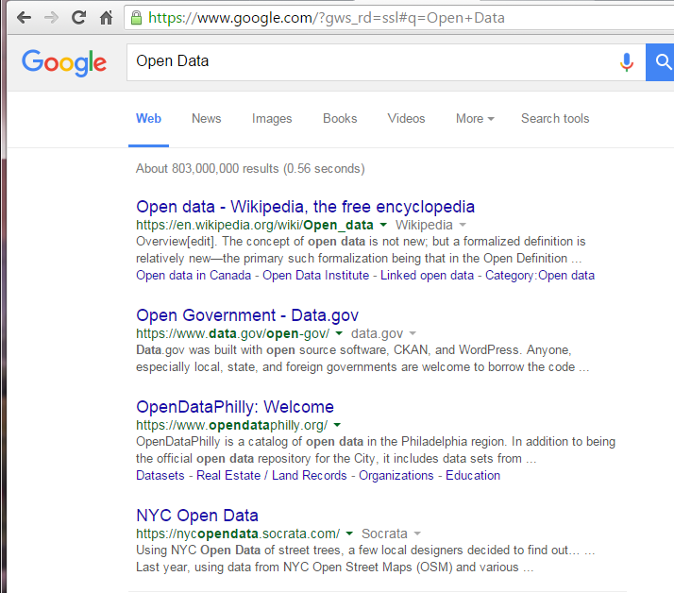
Open Data

Slide 8
OpenDataPhilly
https://www.opendataphilly.org/
Explore the feature projects
Good resources for your term project

Slide 9
Data.gov
https://www.data.gov/
Open government data powers software applications that help people make informed decisions – from choosing financial aid options for college to finding the safest consumer products and vehicles.
Free and open access
Downloads or API access

Slide 10
Assignment 3
Learn Objectives
Download a set of data from data.gov
<Education Category ..American Community Survey>
Understand the data set
Install it into a database
Design and create a simple database
Using PHP to get a CSV file to the database
Create useful queries for the data
Make a simple interface for the data

Slide 11
The database
The dataset: Employee-short.csv and employee.csv
The metadata set: Emplyee-metadata.csv
Sample database creation file: create_db.sql

