Slide 1
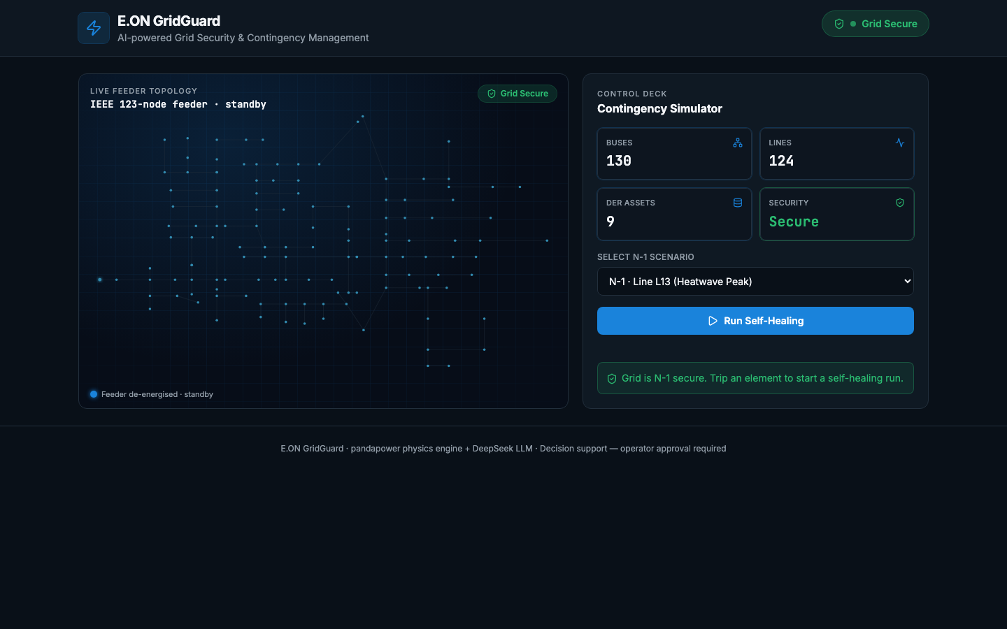
E.ON HACKATHON · ENERGY × AI
GridGuard
AI-Powered Grid Security & Contingency Management
✦ N-1 Security Restored
Mengyu Zhang · Chen Zhao · Cici · Yang Xu · Weiting Liang

Slide 2
The Problem
⚡ N-1 Contingency Risk
🕒 Operator Overload
📊 No Physics-Aware AI
A single line trip can cascade into wider outages if not corrected within minutes.
Modern grids with high DER penetration produce thousands of contingency combinations — too many to screen manually.
Existing tools are either pure optimisation (no explainability) or pure heuristics (no physics).

Slide 3
Our Solution
GridGuard is a real-time control-room decision-support dashboard that combines physics-based N-1 screening with an LLM reasoning loop to restore grid security at the lowest corrective cost.
1
Two-Stage N-1 Screen
2
Corrective Action Space
DC power-flow pre-screen all 123 lines → AC solve risky shortlist. Risk score = overload severity × bus count × islanding penalty.
Build feasible DER options (BESS / RES curtail / load shed) with exact sensitivity (Δloading pp/MW) and economic cost (€/MWh).
3
DeepSeek LLM Agent
4
Operator Approval
Context-aware reasoning loop: batteries first → curtail RES → shed load. Iterates until N-1 secure. Benchmarked against LP (SCOPF-lite) optimum.
Full explainability — every dispatch decision shown with cost & sensitivity. AI recommends; operator accepts or overrides.

Slide 4
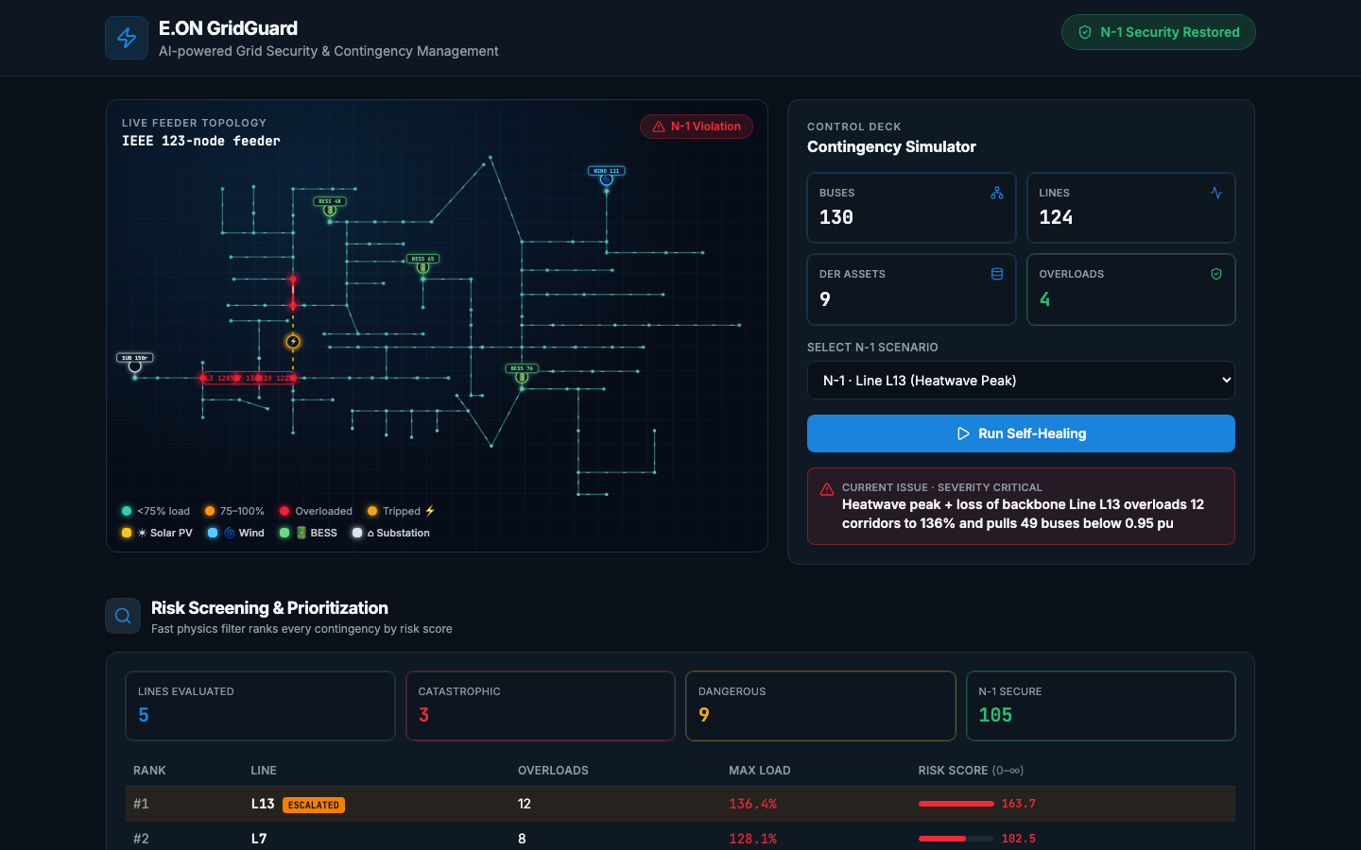
N-1 Violation Detected — Risk Screening
Line L13 trip · 12 simultaneous overloads · Risk Score 163.7 (Catastrophic)

Slide 5
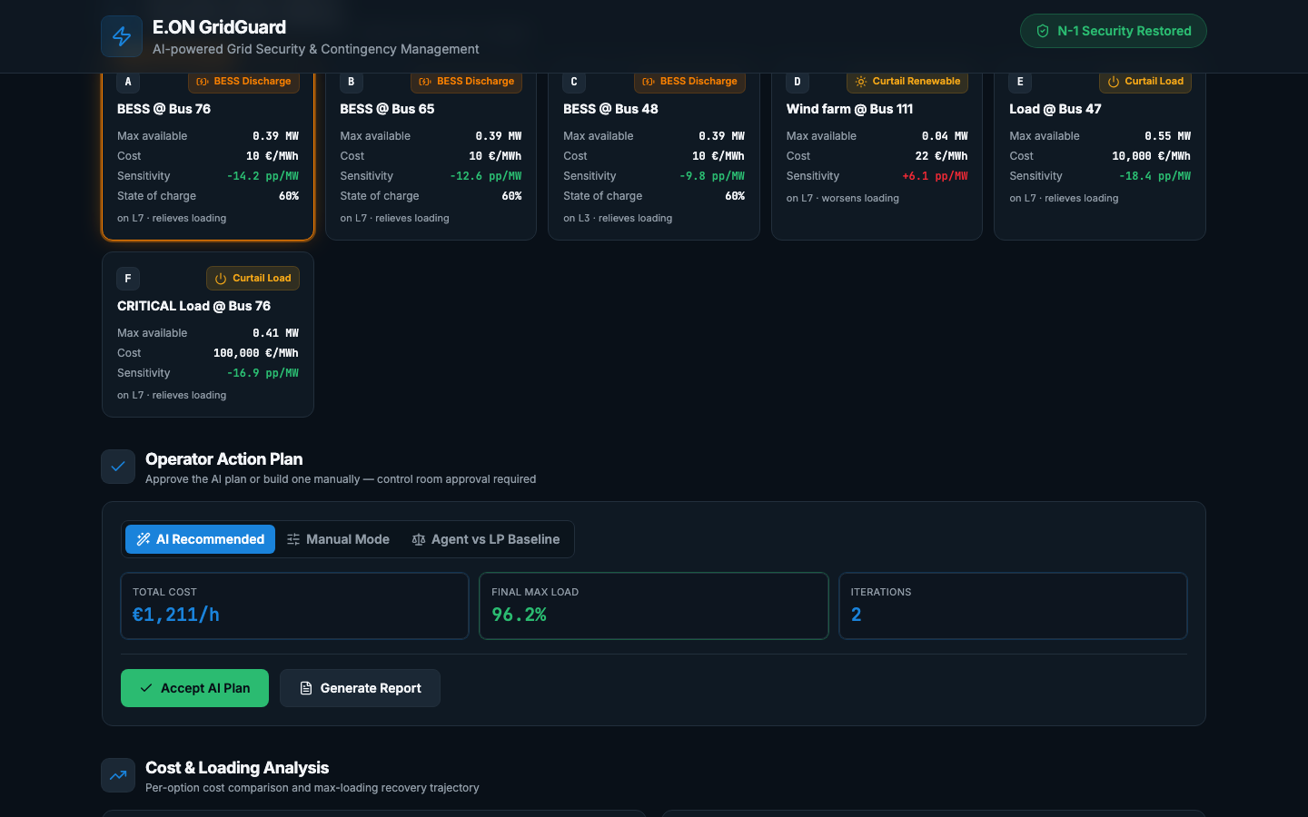
Corrective Action Space & Operator Action Plan
AI recommends BESS @ Bus 76 discharge — best sensitivity-to-cost ratio

Slide 6
Three Demo Scenarios
Heatwave Peak
Solar Midday
Storm Evening
N-1: Line 13 trip
N-1: Line 19 trip
N-1: Line 55 trip
130 % load · 16:00 · 34 °C
100 % load · 12:00 · clear sky
120 % load · 18:00 · storm
Screening result:
Screening result:
Screening result:
12 overloads · Risk Score 163.7 → Catastrophic
8 overloads · Risk Score 102.5 → Dangerous
5 overloads · Risk Score 88.4 → Elevated
AI corrective action:
AI corrective action:
AI corrective action:
BESS @ Bus 51 discharge 0.39 MW + load curtail
Curtail wind farm @ Bus 111 + BESS @ Bus 76
BESS discharge + load curtail Bus 47

Slide 7
Technology Stack
React 19 + TypeScript
Type-safe component tree
pandapower
IEEE 123-node N-1 physics engine
TanStack Router / Start
File-based routing, SSR-ready
Two-stage screening
DC pre-screen → AC solve shortlist
Vite 8
Sub-second HMR, optimised build
DeepSeek LLM
Context-aware corrective loop
Tailwind CSS v4
Design tokens, dark-mode native
LP Baseline (SCOPF-lite)
Mathematical cost optimum reference
Radix UI
Accessible headless primitives
Static TypeScript data
Pre-simulated scenarios, zero backend
Recharts
Bar/line charts for cost analysis

Slide 8
Key Results
119
3
2
96.2%
€1 211
Contingencies Screened
Catastrophic Contingencies
Corrective Iterations
Final Max Line Loading
Corrective Cost /h
All 123-node lines evaluated in < 1 s
Immediately escalated to operator
LLM restores security in ≤ 2 steps
Down from 136% post-fault
vs €980 LP optimum — 24% gap
Distribution-feeder dispatch priority: BESS Discharge → Curtail Renewables → Shed Load
(cheapest to most expensive per MW of overload relief)

Slide 9
The Team
MZ
CZ
C
YX
WL
Mengyu Zhang
Chen Zhao
Cici
Yang Xu
Weiting Liang
Built for the E.ON Hackathon 2025 · Energy × AI Grid Operation Agents Track

Slide 10
GridGuard
Physics-informed · Explainable · Operator-approved
✦ N-1 Security Restored ✦
github.com/YangXuDE/GridGuard

