Slide 1
Spotify popularity prediction
Benson yang
Linear regression

Slide 2
Feature selection :
keep :
"danceability", "energy", "key", "loudness", "mode", "speechiness", "acousticness", "instrumentalness", "liveness", "valence", "tempo", "duration_ms", "time_signature", "song_name", "popularity", "genre"
remove :
Index, type, id, url, track_href, analysis_url, artist, classification, error
Summary :
We keep most of the song features. Those features will be the main variables when we analyze the popularity.
We remove the variables that are indirect or unrelated to the popularity.

Slide 3
Model Introduction :
Linear regression :
Correlation analysis: Linear regression can help determine the strength of the correlation between characteristics and the target variable.
Parameter estimation: The linear regression model provides estimates of the coefficients on the characteristics.
Summary :
In this case, We can know which variable will significantly relate to popularity by linear regression.

Slide 4
Model Training :
We split the dataset to 80:20. 80% for training the model, 20% for testing the model.
We use the “AIC stepwise” method to determine which Linear model would be better.
The goal of the AIC Stepwise method is to find models with good fit and fewer independent variables to avoid overfitting and to improve the explanatory power of the model. AIC is built on the basis of maximum likelihood estimation. It is a statistical method used to estimate the most probable values of model parameters given the data.
We add the testing data one by one, and also immerge every new data to training set and re-train the model again, then record the accuracy.

Slide 5
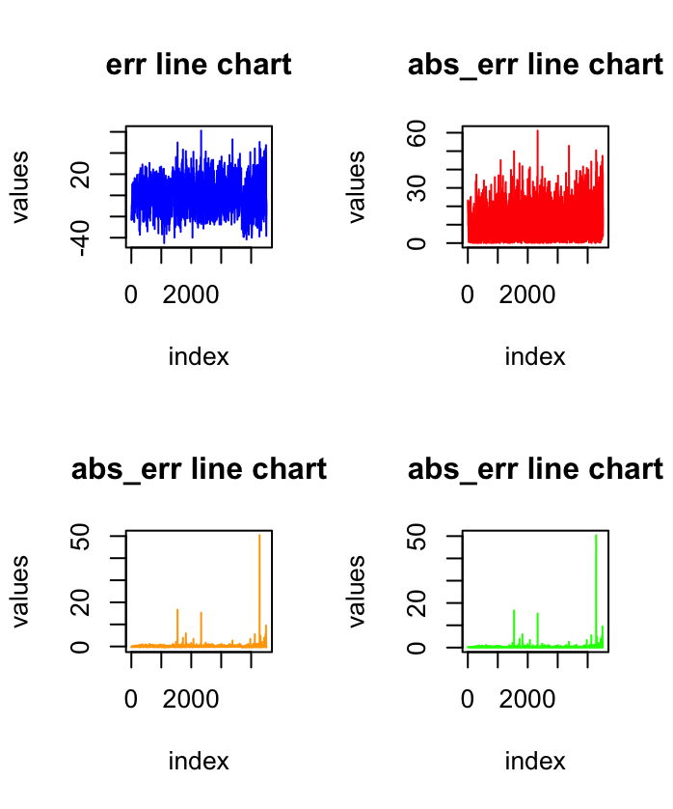
Accuracy:
abs_err average 11.0 = +-5.5 score range
abs_pcter average 0.24 = +-12% score range

Slide 6
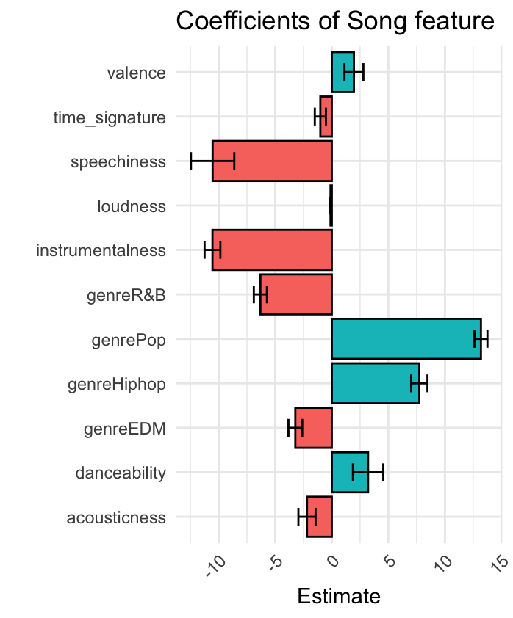
Model Result :
Coefficients: | Estimate | Std. Error | t value | Pr(>|t|)
(Intercept) | 59.85324 | 1.09482 | 54.669 | < 2e-16 ***
valence | 1.95521 | 0.41823 | 4.675 | 2.95e-06 ***
time_signature | -1.01222 | 0.24604 | -4.114 | 3.90e-05 ***
speechiness | -10.5358 | 0.95817 | -10.996 | < 2e-16 ***
loudness | -0.11238 | 0.02596 | -4.329 | 1.50e-05 ***
Instrumentalness | -10.54805 | 0.34993 | -30.143 | < 2e-16 ***
genreR&B | -6.31465 | 0.28981 | -21.789 | < 2e-16 ***
genrePop | 13.18287 | 0.28803 | 45.769 | < 2e-16 ***
genreHiphop | 7.73666 | 0.35891 | 21.556 | < 2e-16 ***
genreEDM | -3.22377 | 0.30477 | -10.578 | < 2e-16 ***
danceability | 3.20835 | 0.6706 | 4.784 | 1.72e-06 ***
acousticness | -2.19344 | 0.37919 | -5.785 | 7.35e-09 ***
According to this analysis, there’s three variables highly determine the popularity.
1.Speechiness 2. instrumentalness 3. GenrePop.
In this case, we can say that if a song is Pop music with less speech and instrumental will have higher popularity.

Slide 7

Model Applications :
We can use those model to predict new song’s popularity. By knowing how each variables would effect the song’s popularity, we can know what kind of music would impact the market well.
For music companies, predicting the popularity of new songs can help them assess the potential and market value of artists and thus make more informed signing decisions.
Marketing and promotion strategies: Understanding the popularity of new songs can help music companies and artists develop more effective marketing and promotion strategies.

Slide 8
Conclusion and Outlook :
It is a new method to analysis music influence.
By those machine learning technique, We can evaluate a music without too much subjective opinion.
This model can be easy to extend, such as using it to analysis the album of each artist . By analysis the album, we can know what kind of song order and type will have more popularity.
Music management company or party music remixer can using this model to select a music order and type that Make the listener feel more the tension of the music.

