Slide 1
Course Design

Slide 2
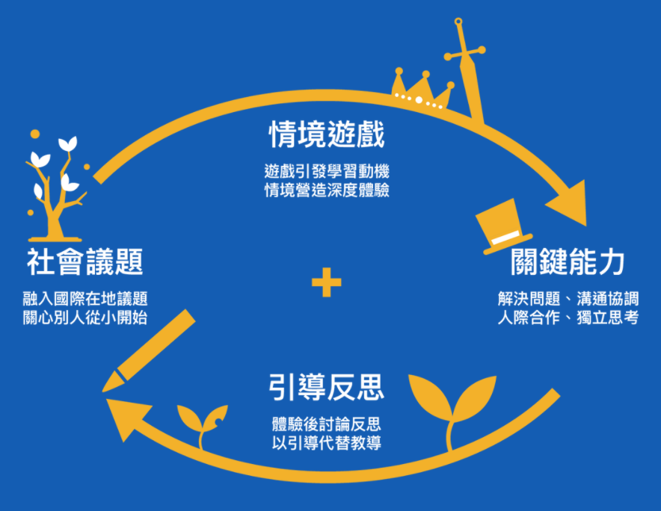
Problematic Game Teaching Method

Slide 3

How to choose the topic?
Teacher: What I care about, what I am interested in, what I like

Slide 4
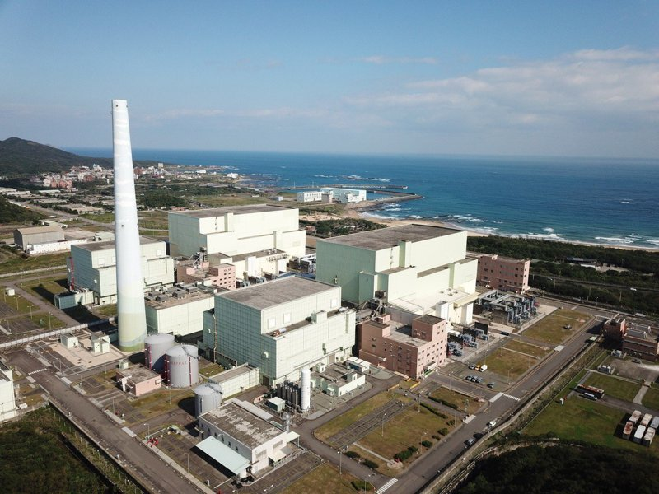

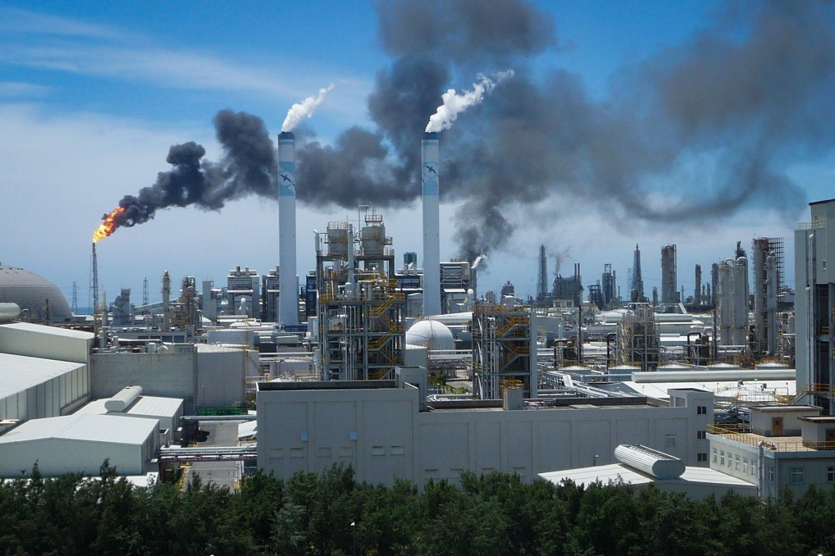
The topics are constantly renewed every year.
Nuclear weapons, warming, green energy

Slide 5

Are there times when you are not inspired? →
Not interested, don't want to do → not inspired
Interested → want to explore more → find out more things
(You can talk about playfulness to get students interested and then motivated)

Slide 6
Camp Introduction

Slide 7
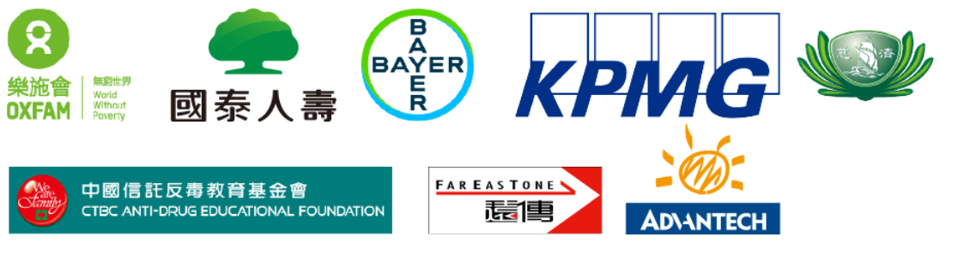
B2B（business-to-business）
Corporate Social Responsibility (CSR) Cooperation Program

Slide 8
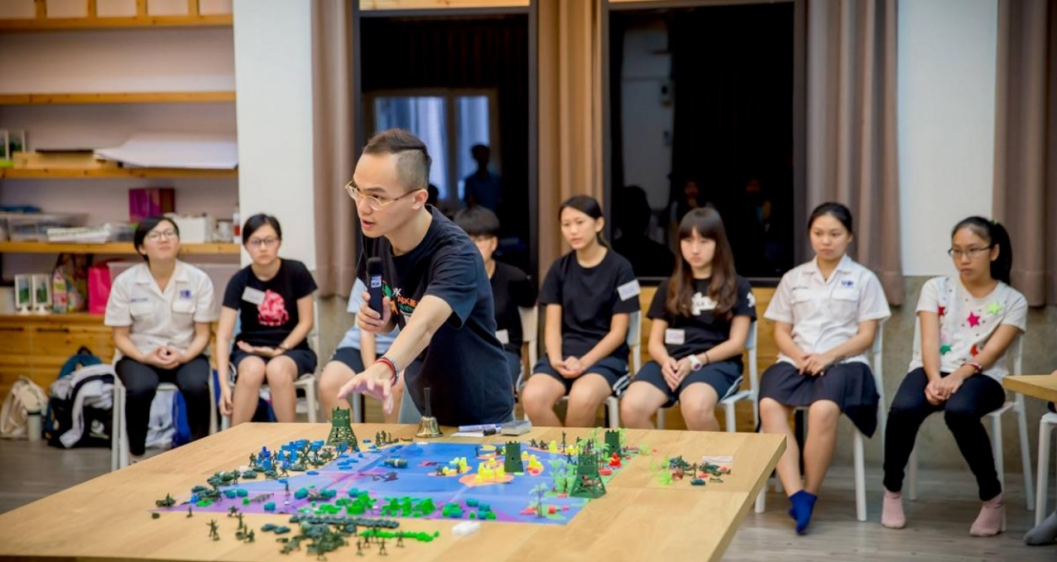
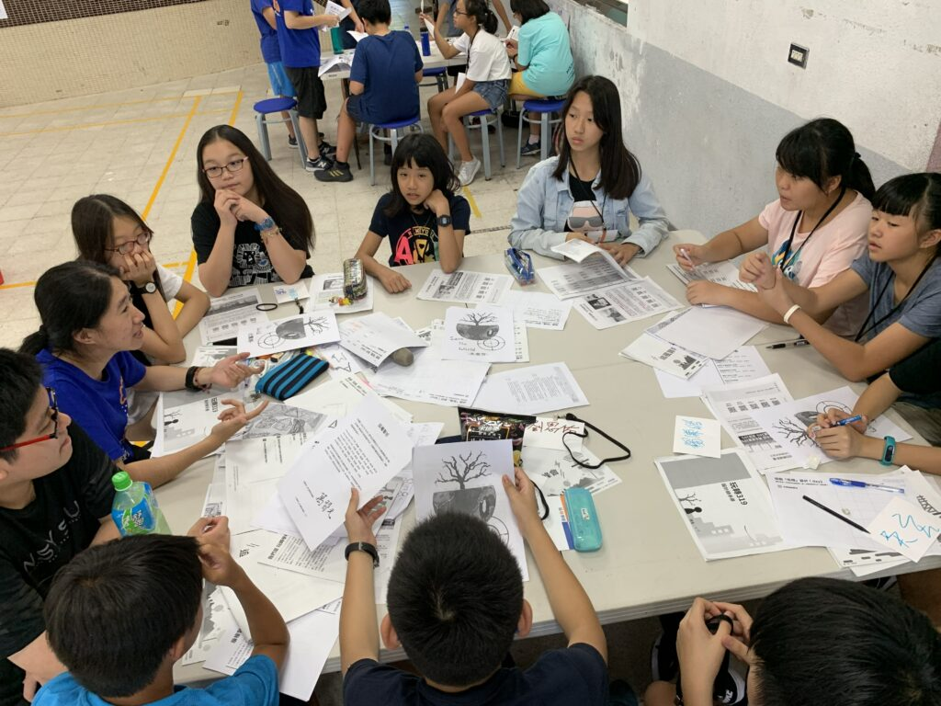
B2C（business to customer）
Summer and Winter Vacation Game Camp

Slide 9
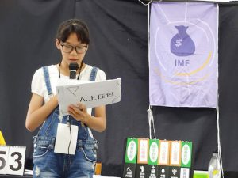
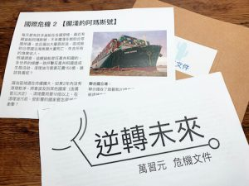
Reverse Future Camp
Large-scale situational role-playing game

Slide 10
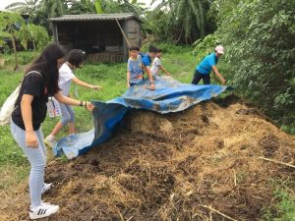
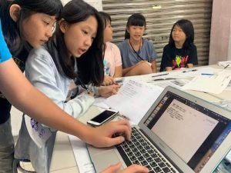
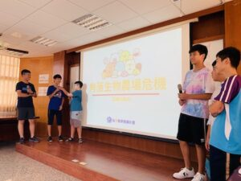
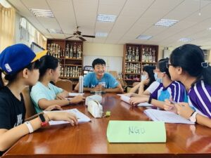
Taiwan 368 Issue Warrior Camp
Field Surveys
Game design
Public presentation

Slide 11
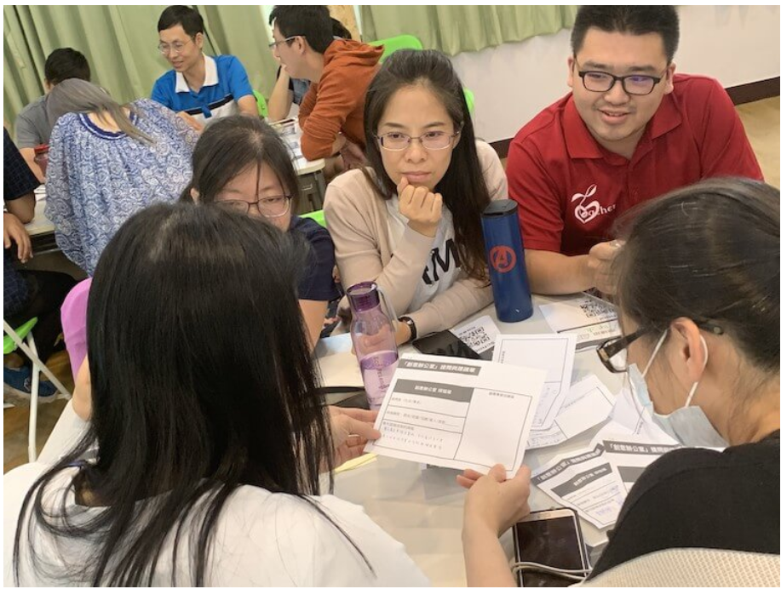
B2E （business-to-education)
Conducting educational workshops/talks, organizing one-day experiential courses, etc.
on campus to promote the concept of games and playfulness in schools

Slide 12
There's more to value than money
「Reasonable Value Exchange」
Venue and Staff Accommodation Places for trainees from remote villages

