Slide 1
BUILDING A WIRELESS temperature SENSOR NETWORK
Chuang Ding
Yang Wu
Deepshikha Moolchandani
Zhenyang Wu

Slide 2


Calculating the average of ten temperatures in order to increase accuracy.
Calculating the average of 4 temperatures from 4 sensors
Every sensor sends temperature every 10 second.

Slide 3
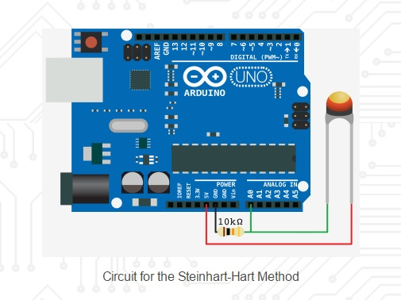
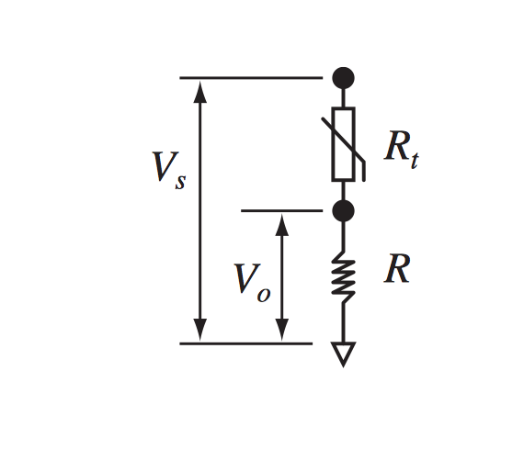
Sample Breadboard Wiring
Voltage Divider Circuit

Slide 4
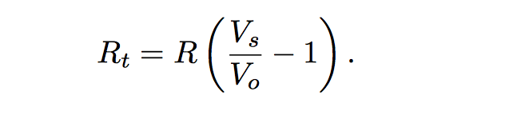
(1) Computing Thermistor Resistance
(2) Steinhart-Hart Equation
where R = 10kohm
T = Temperature in Celsius
C1= 0.001129148
C2 = 0.000234125
C3 = 8.76741E-08
see our code

Slide 5
CHALLENGES
Maximizing accuracy and sensitivity of sensor values as well as average temperature.
Code Optimization to improve quality and efficiency

