Slide 1

“I Miss the Old Kanye" - Understanding Kanye West Through Machine Learning
By: Eric Yang

Slide 2
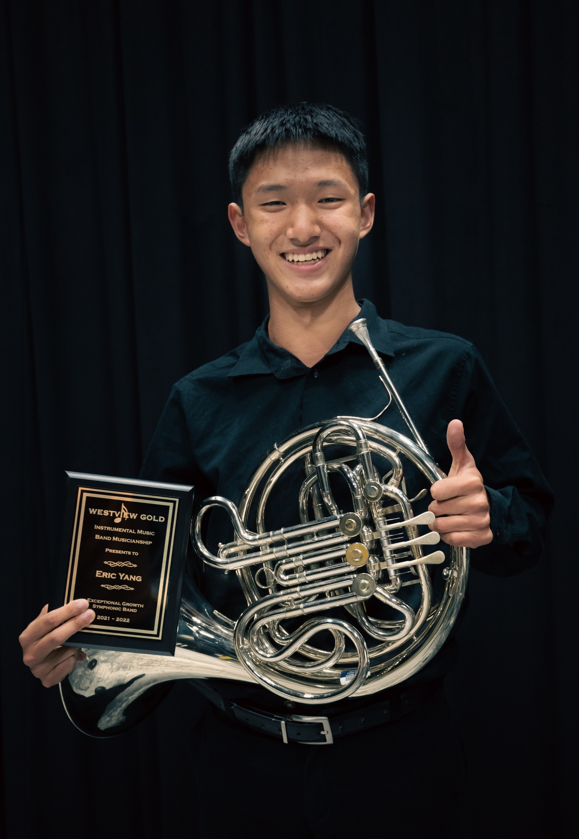
Background
About me
Canadian Delegate
Interested in linguistics + computer science
Go Quakers!
Can kinda play the French horn
Enjoy music
Kanye???

Slide 3
Question: Who is your favourite celebrity?
This will be important later…

Slide 4
So… what’s machine learning?
“Ability [for computers] to learn without explicitly being programmed” – MIT
Being able to find patterns from data
Incredibly widespread
Everything from YouTube recommendations to self-driving cars

Slide 5
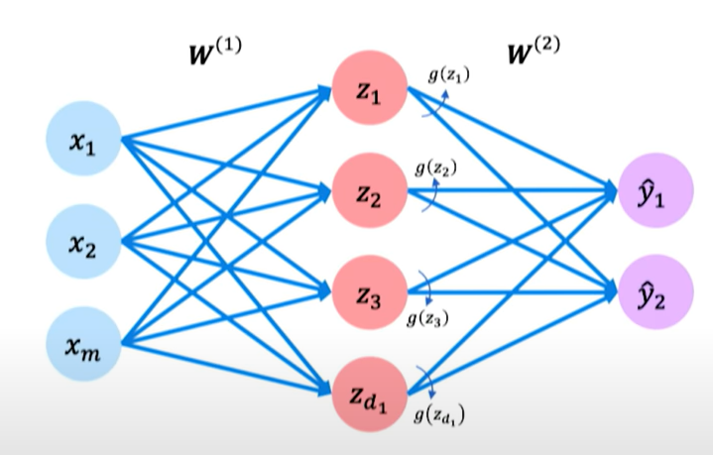

Slide 6
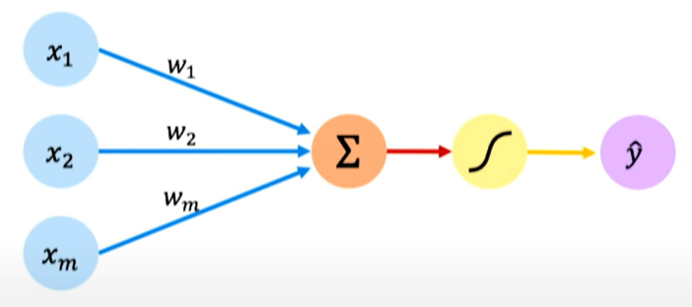
Individual Neurons
Middle layer from previous image
Inputs (blue)
Come from previous neurons
Multiplied by a weight unique to each input
Sum of inputs (orange)
Activation function (yellow)
Designed to make info between 0-1
Output (purple)

Slide 7
Neural Network
Inputs (blue)
Processed by neurons (orange)
Output (purple)
Ex:
Input: # of science teachers in an area
Output: amount of NYSC camp members
Everything is numbers!

Slide 8
Learning
“Loss”
Difference between real output and given output
Change weights -> output -> loss
Gradient Descent
Graph of loss based on weights
Use slope to find lowest point (smallest amount of loss)
Make neuron network more accurate
This is learning!
Train using data

Slide 9
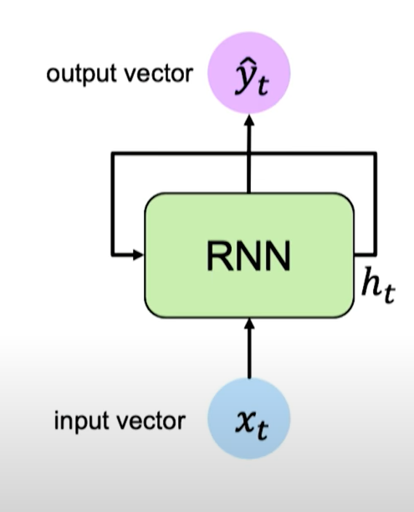
Computational Linguistics
Language is a sequence consisting of words
Ex: “I like West Virginia”
Can’t have just binary input/output like before
Recurring Neural Network
Go through neural network multiple times
Go through words individually while also considering past words
Gives one output

Slide 10
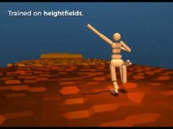
Walking AI

Slide 11

Ethics Discussion
Unethical use
Guided missiles/bombs
Bias
Racial discrimination in facial recognition technology
Using biased data to train it

Slide 12
Kanye Program
Too many lyrics
Analyze lyrics selectively posted on Twitter
Machine learning done by TextBlob

Slide 13
Sources
Images/Video
https://www.youtube.com/watch?v=7sB052Pz0sQ
https://www.youtube.com/watch?v=g59nSURxYgk
Information
https://www.youtube.com/watch?v=1LyacmzB1Og
https://www.coursera.org/learn/machine-learning
https://sitn.hms.harvard.edu/flash/2020/racial-discrimination-in-face-recognition-technology/
https://www.youtube.com/watch?v=ujId4ipkBio&t=174s

