Slide 1
DSCI-598-01 Capstone Project
Yangguang Liu
December 5, 2019

Slide 2
Outline
Project: R/Shiny sample management system
Project: Demo
Future project improvements

Slide 3
Project: Sample Management System
R/Shiny app (with integrated Rmarkdown report)
SQLite

Slide 4

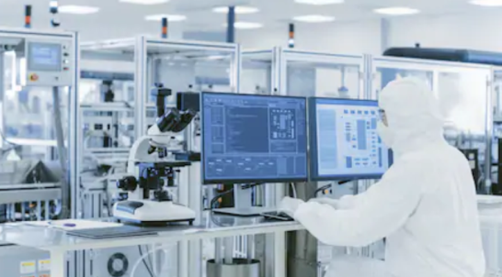
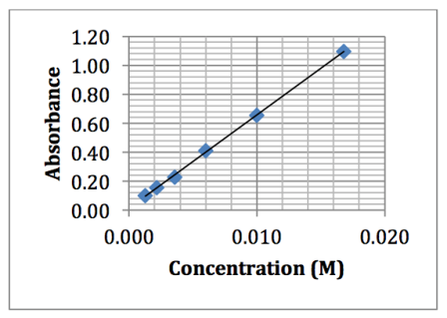
A typical lab workflow
Submitter
Lab
Mail sample to lab
Receive sample in lab
Staff: perform sample analysis
Analyst: preform data analysis
Web Portal (DB, UI)

Slide 5
Project Features
Submitters able to track analytes and their analysis result, submission date
Staff able to submit samples analysis expected raw results, track and download analysis result
Analyst able to track submission raw data, perform data analysis, load analysis result, and product PDF report
Data stored in database

Slide 6
Project Demo
Log In/Sign Up
Staff
Analyst
Submitter

Slide 7
Project Demo
Log In/Sign Up
Staff
Analyst
Submitter

Slide 8
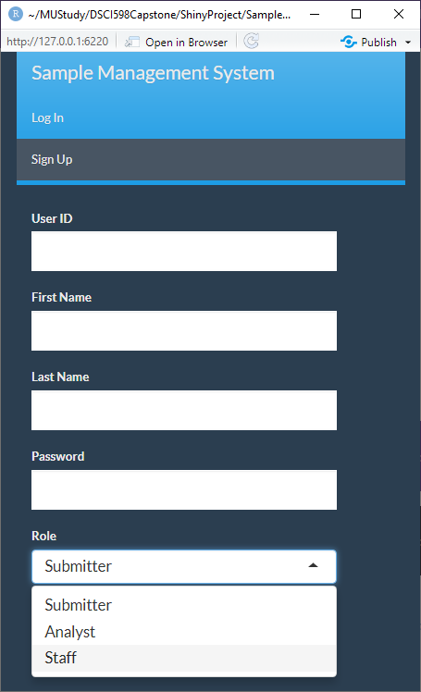
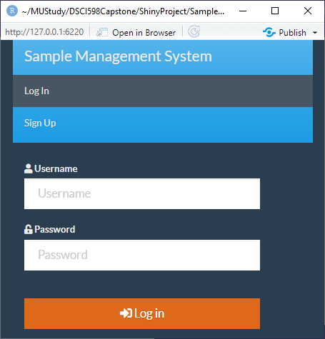
Project Demo
Log In/Sign Up

Slide 9
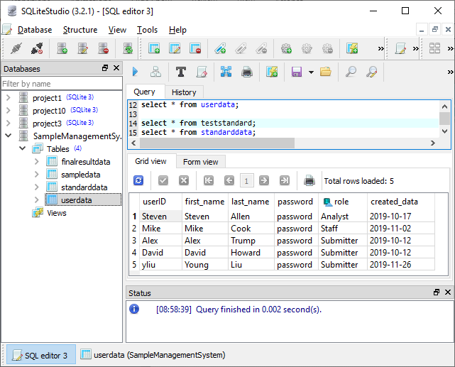
Database: user info

Slide 10
Project Demo
Log In/Sign Up
Staff
Analyst
Submitter

Slide 11
Staff
Able to submit samples analysis expected raw results to database
Able to track analysis result from database
Able to download analysis result

Slide 12
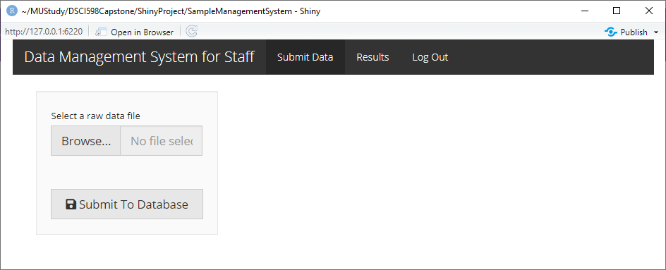
Staff

Slide 13
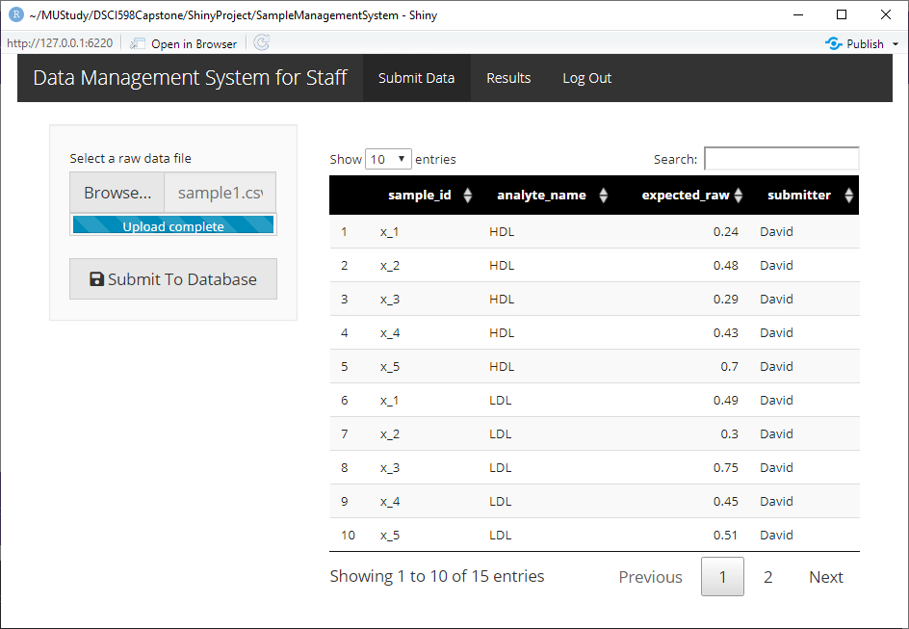

Slide 14
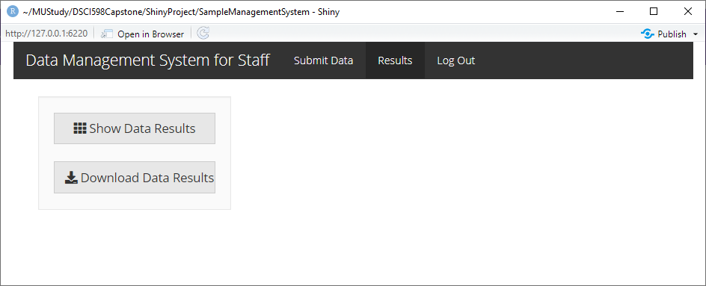
Staff

Slide 15
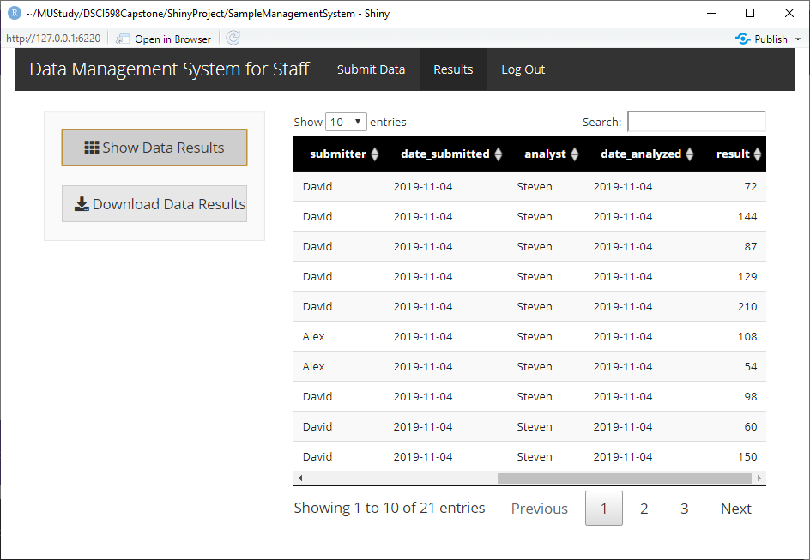

Slide 16
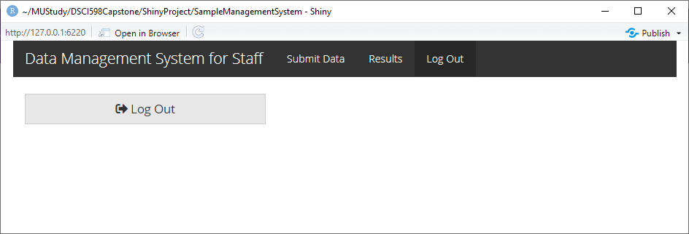
Staff

Slide 17
Project Demo
Log In/Sign Up
Staff
Analyst
Submitter

Slide 18
Analyst
Able to load standard data, produce expected raw data versus result plot
Able to track raw result
Perform linear regression of controls
Able to calculate sample result
Able to download sample result
Able to download final report in PDF/HTML/Word

Slide 19
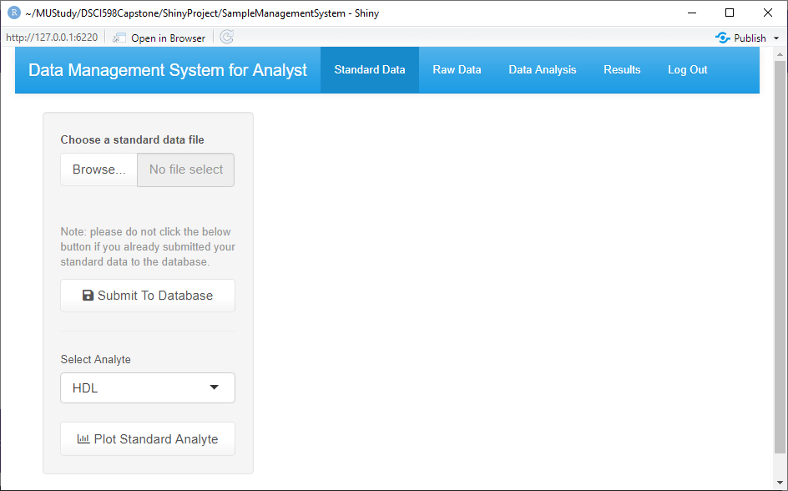
Analyst

Slide 20
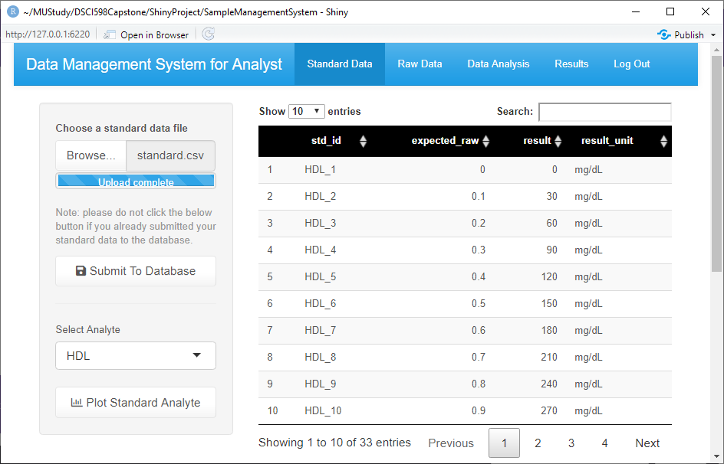

Slide 21
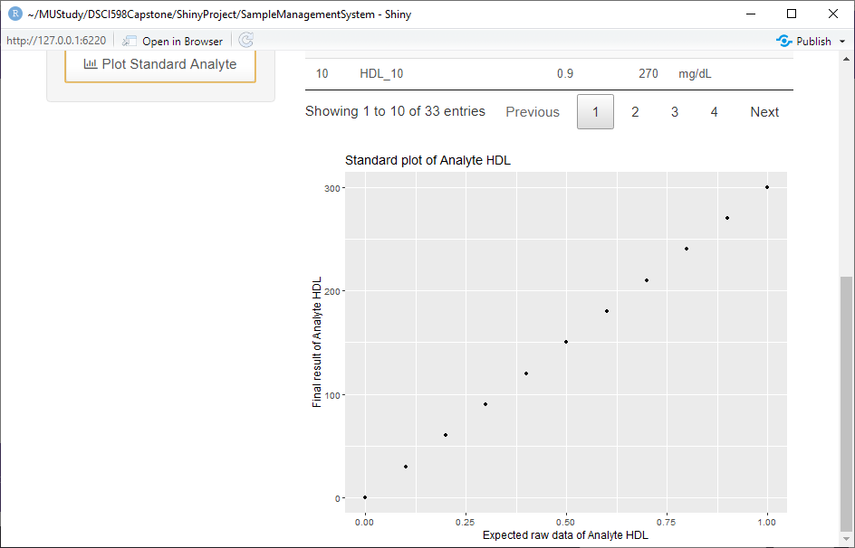
Analyst

Slide 22
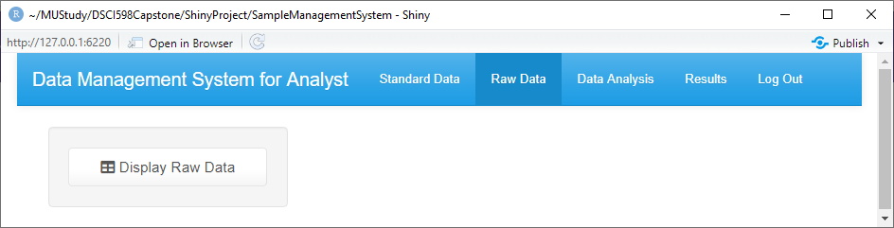
Analyst
Display raw data exist in database

Slide 23
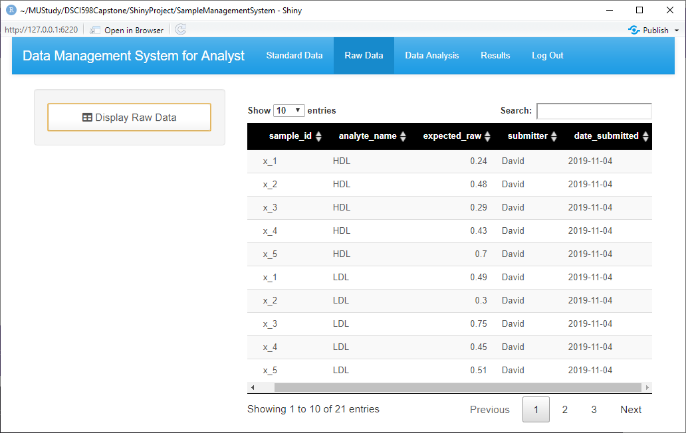

Slide 24
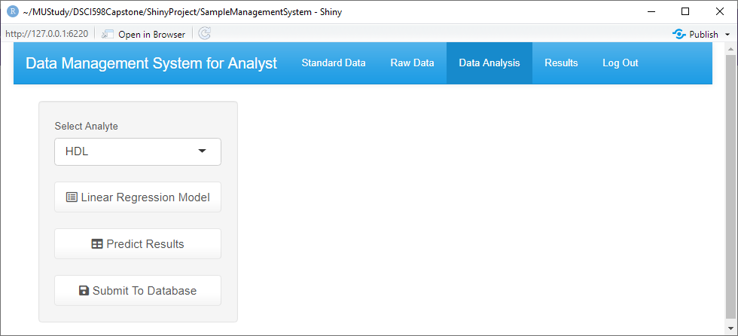
Analyst
Data Analysis

Slide 25
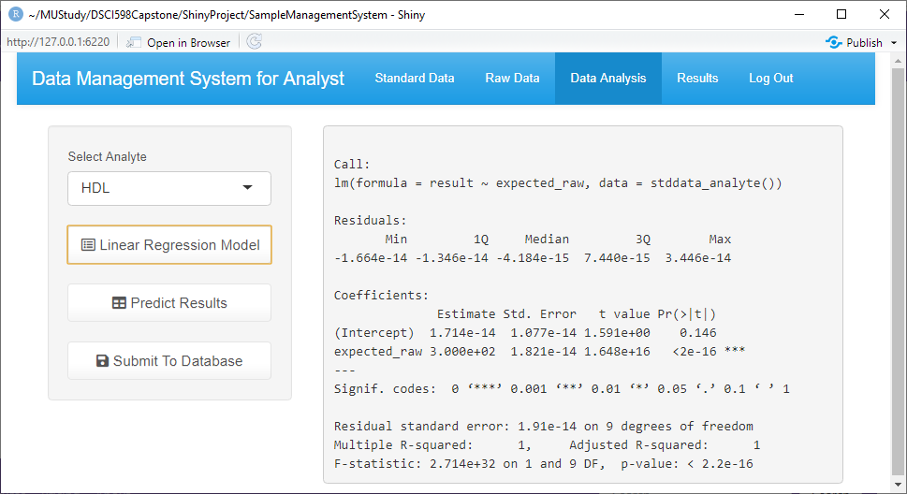

Slide 26
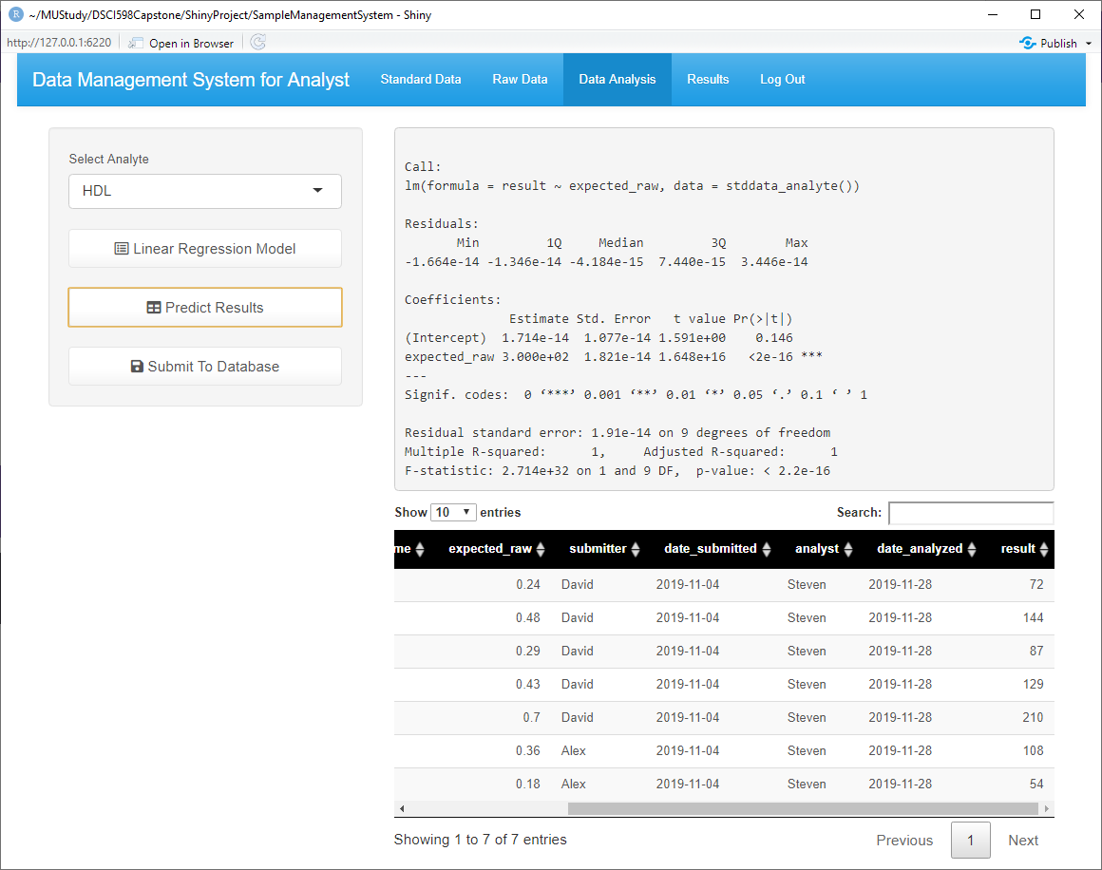

Slide 27
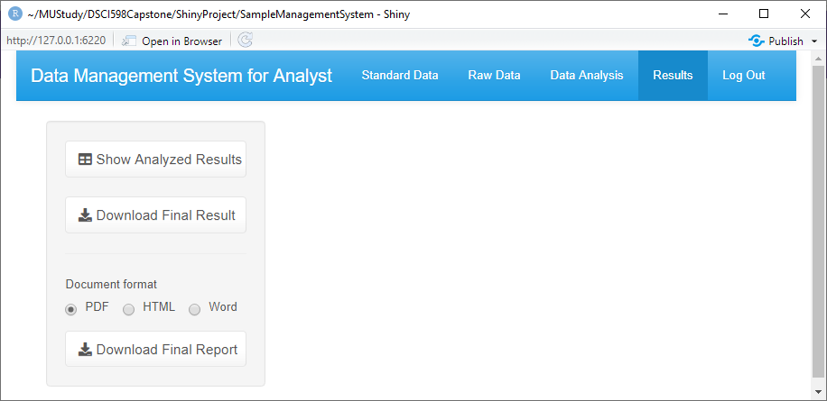
Analyst
Result

Slide 28
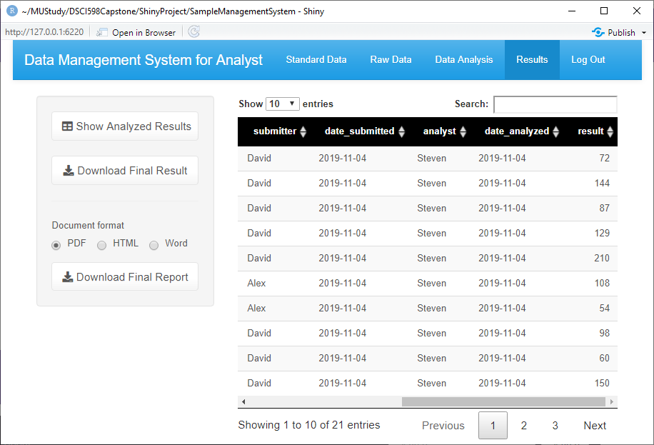
Analyst
Show Analyzed Results

Slide 29
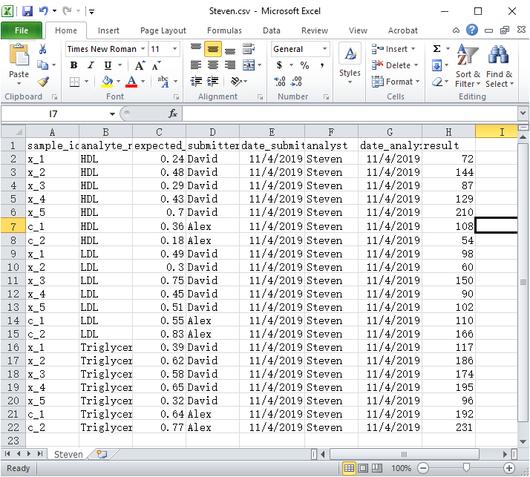
Analyst: Download Final Result

Slide 30
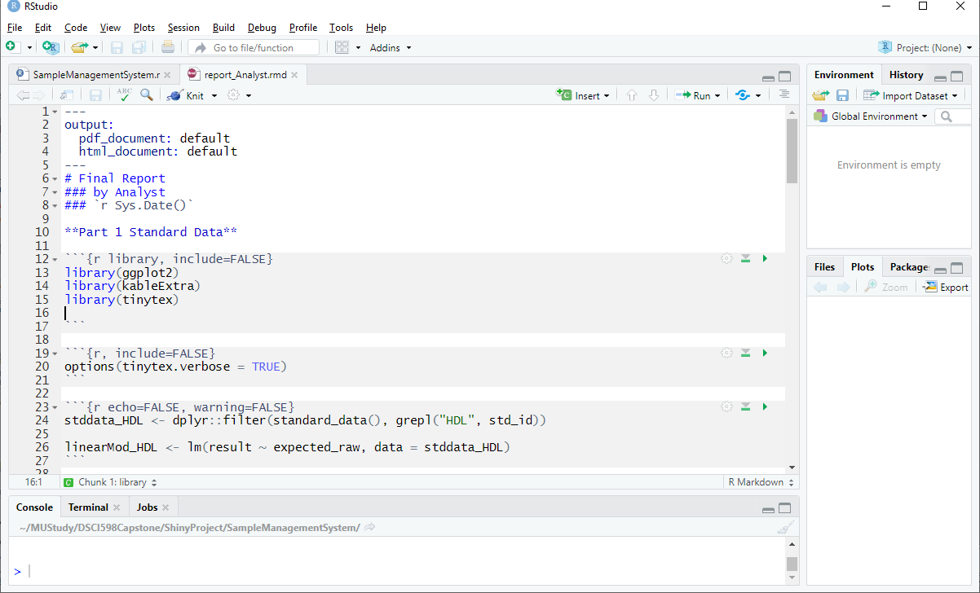
Analyst: Rmarkdown file

Slide 31
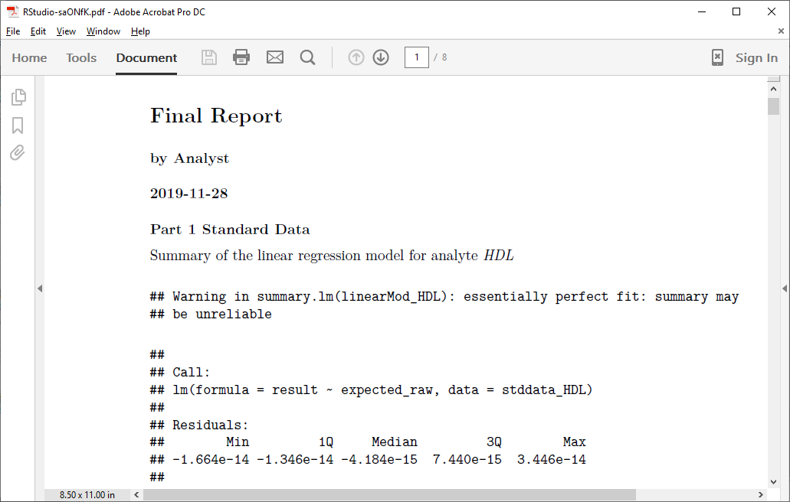
Analyst: Produce PDF report

Slide 32
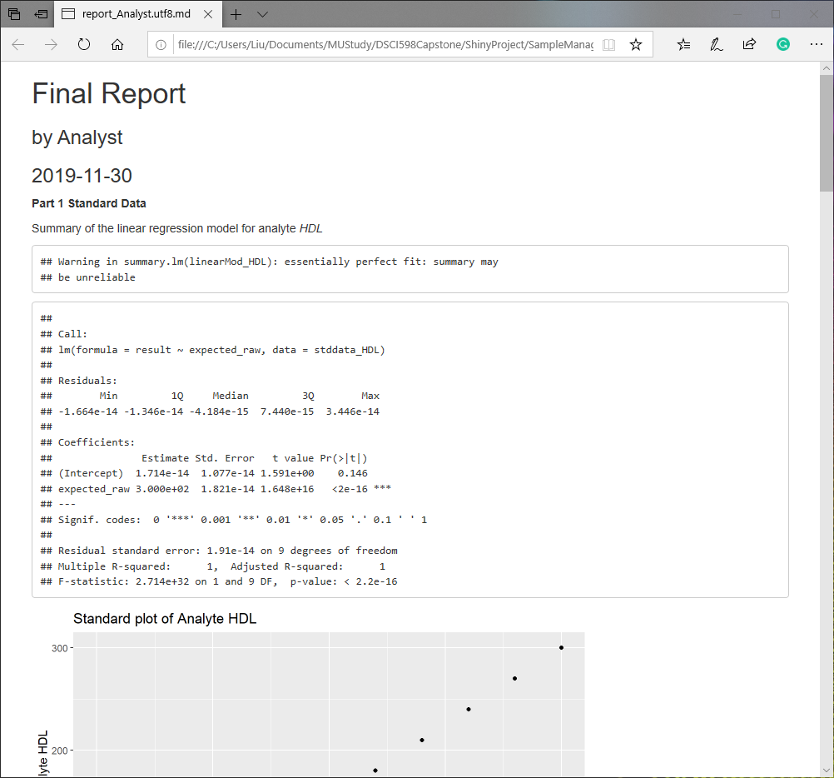
HTML

Slide 33
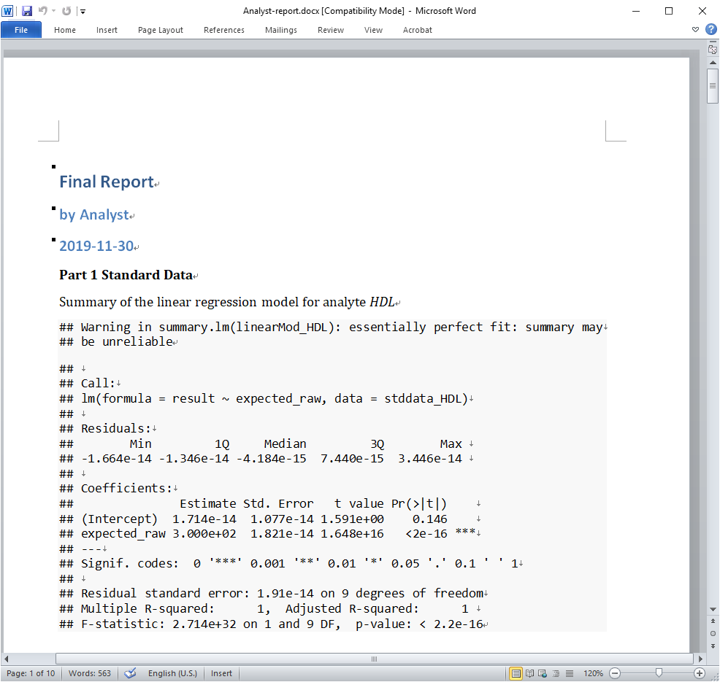
Word

Slide 34
Project Demo
Log In/Sign Up
Staff
Analyst
Submitter

Slide 35
Submitter
Able to track different analytes analysis result
Able to download query result
Submitter only see own data

Slide 36
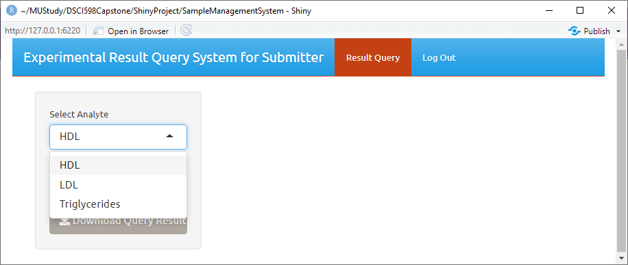
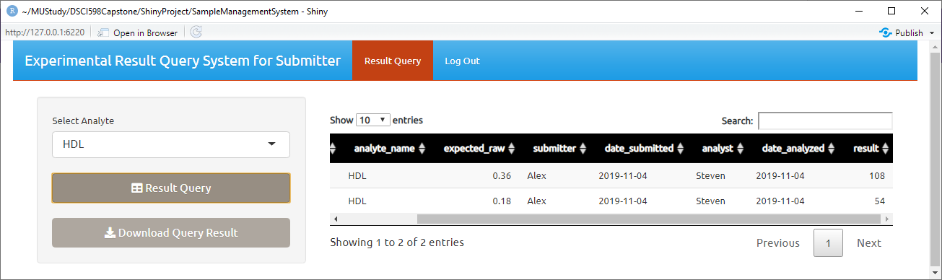
Submitter: Alex logged in

Slide 37
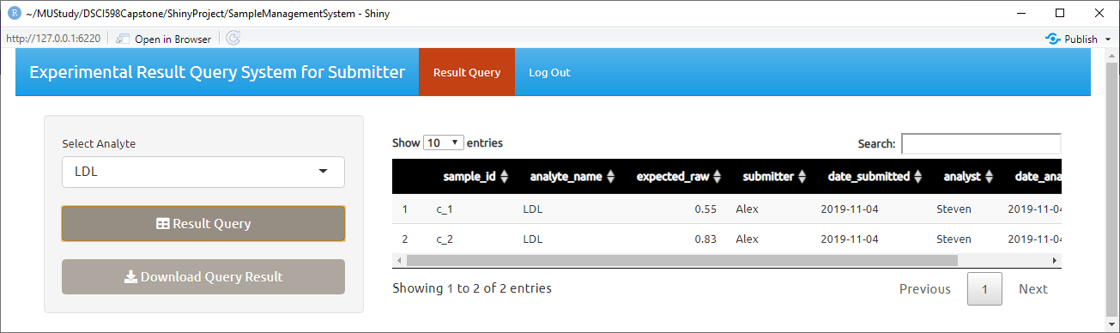

Submitter: Alex logged in

Slide 38
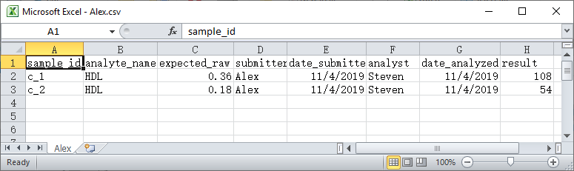
Submitter: Download Query Result

Slide 39
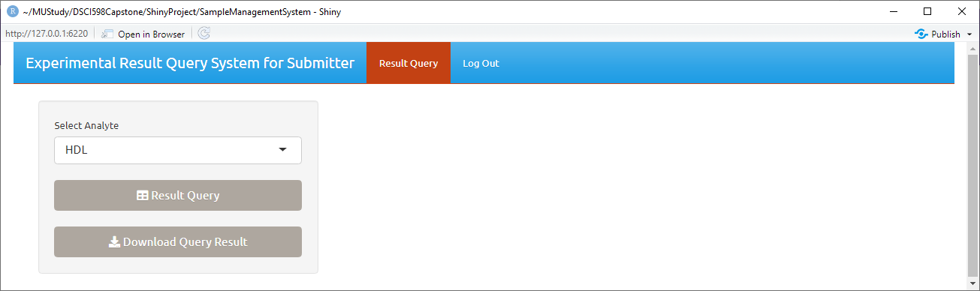
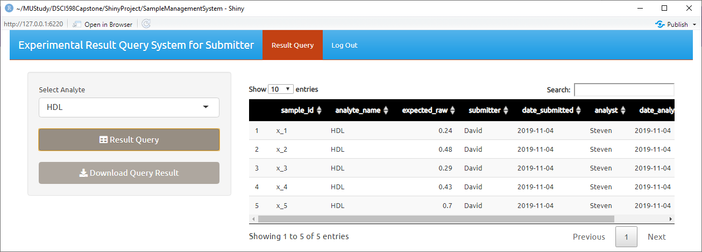
Submitter: David logged in

Slide 40


Submitter: David logged in

Slide 41
Future project improvements
Versatile design
AWS

Slide 42
Thanks

