Slide 1
TINC
양희림/서장원/장하영/최진경

Slide 2
Table of Contents
Goal
Description
Demo
Features &
Contents
Member
information
Role

Slide 3


Main Goal
Creative
Fun
Think,
Enhanced
Play with
Man,Women,
Child, Old

Slide 4


Description of Project
TINC
“ is a game that a user guess the answers
By a combination of pictures “

Slide 5
Demo

Slide 6
Features & Contents

Slide 7

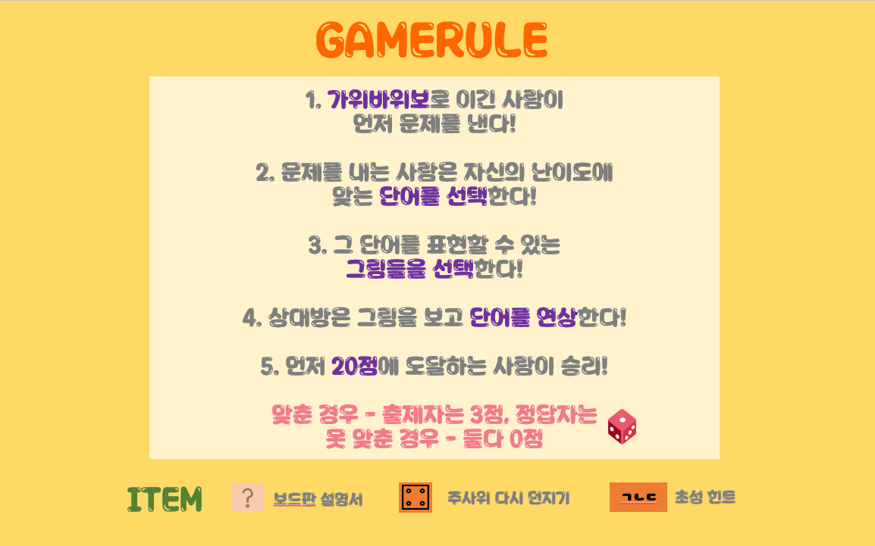
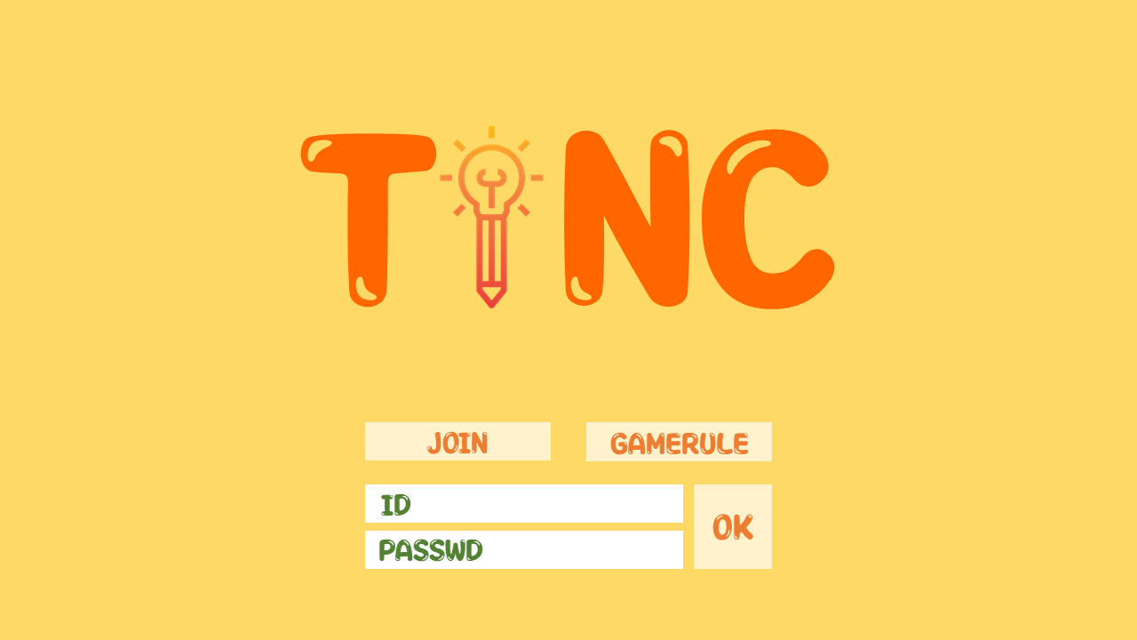

Main Screen

Slide 8
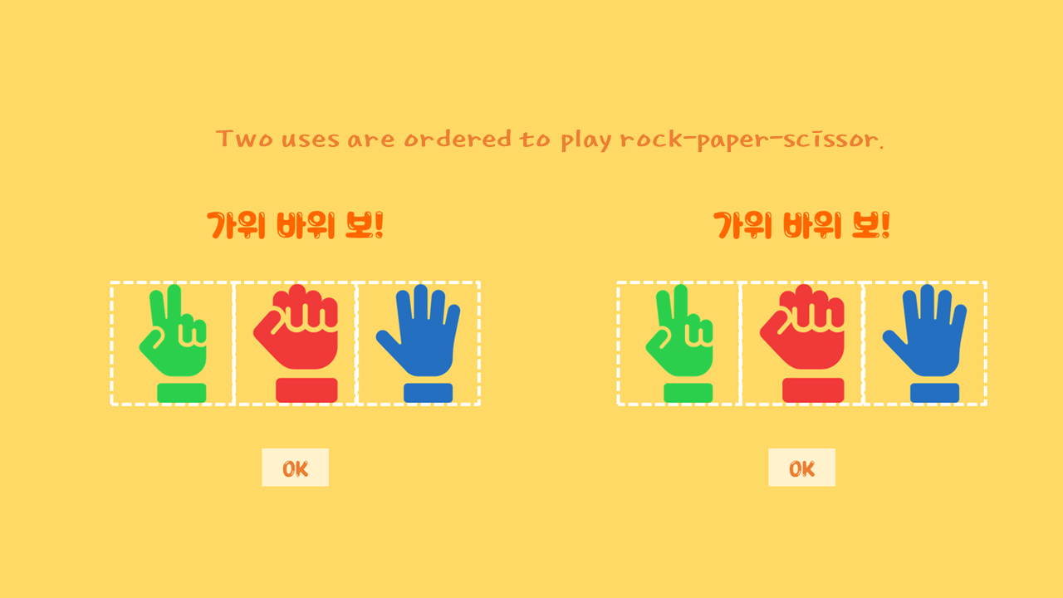
Choose Player

Slide 9
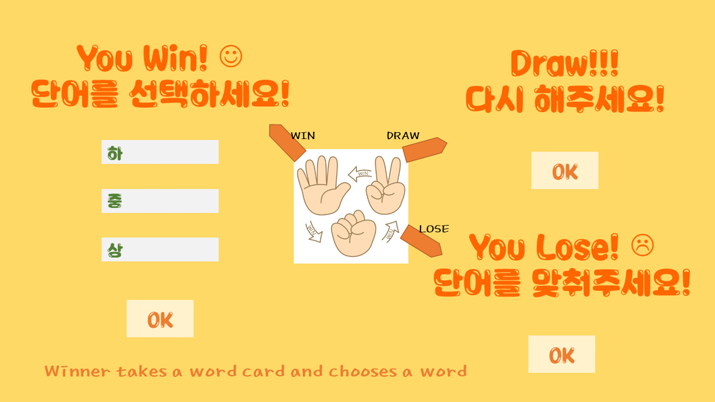
Choose Player & Card
Titanic

Slide 10
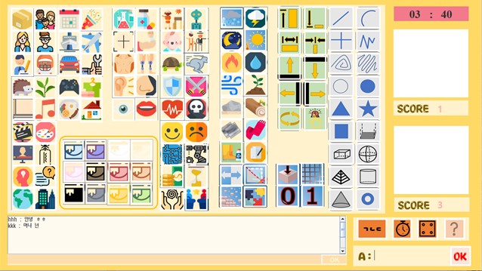
Main Screen
<-Timer
<-Score
movie
<-Item
<-
<-
Chat
Answer

Slide 11
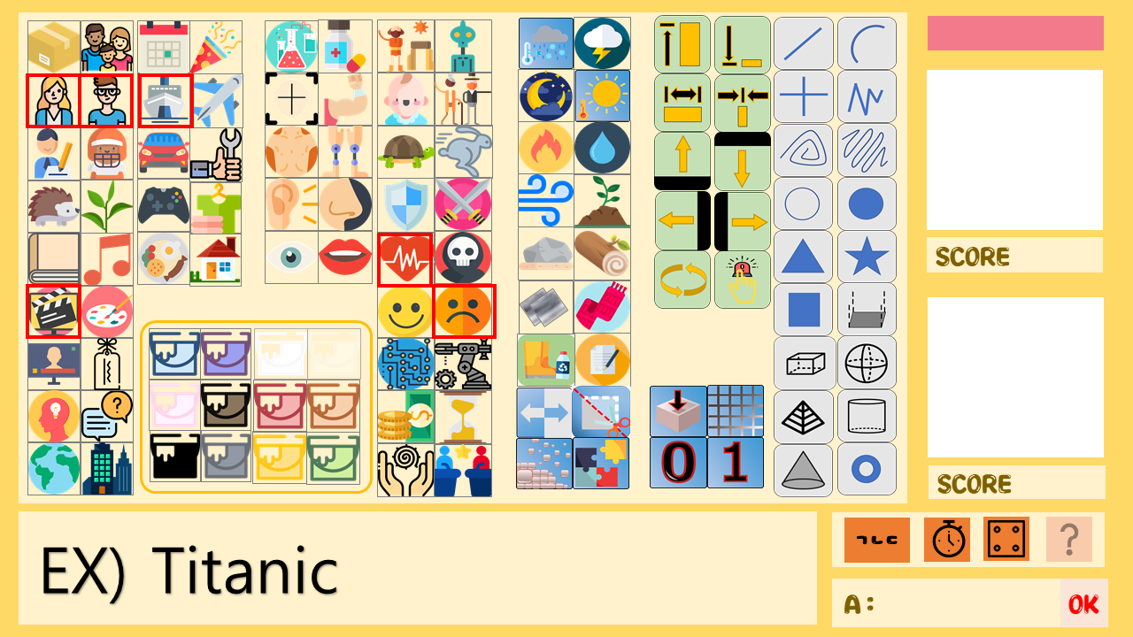

Example
Titanic

Slide 12


Example
+4
+3
Titanic

Slide 13

End Game
<-20 Points!
20
Titanic

Slide 14
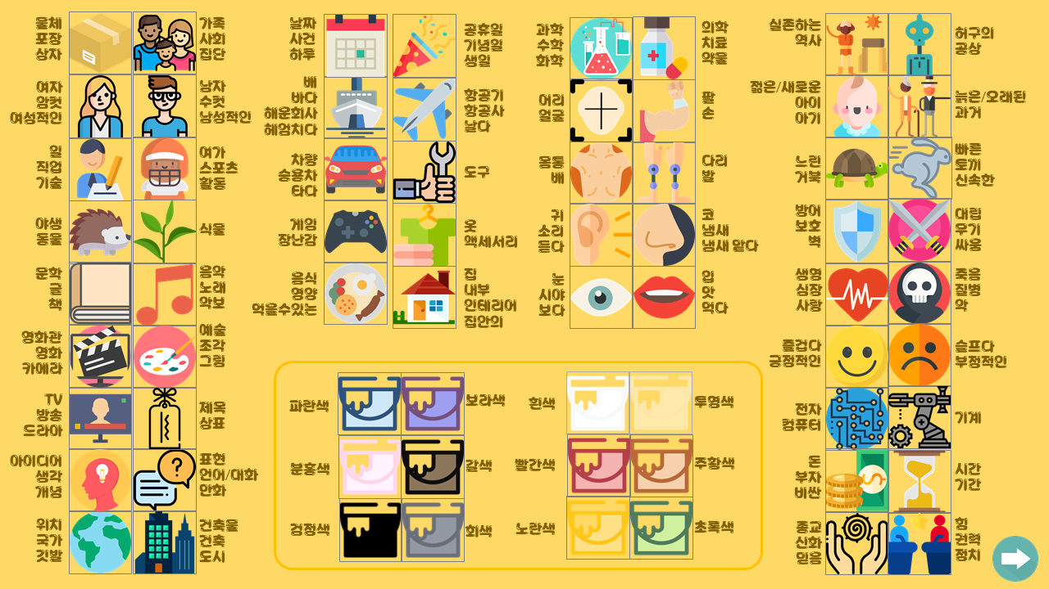
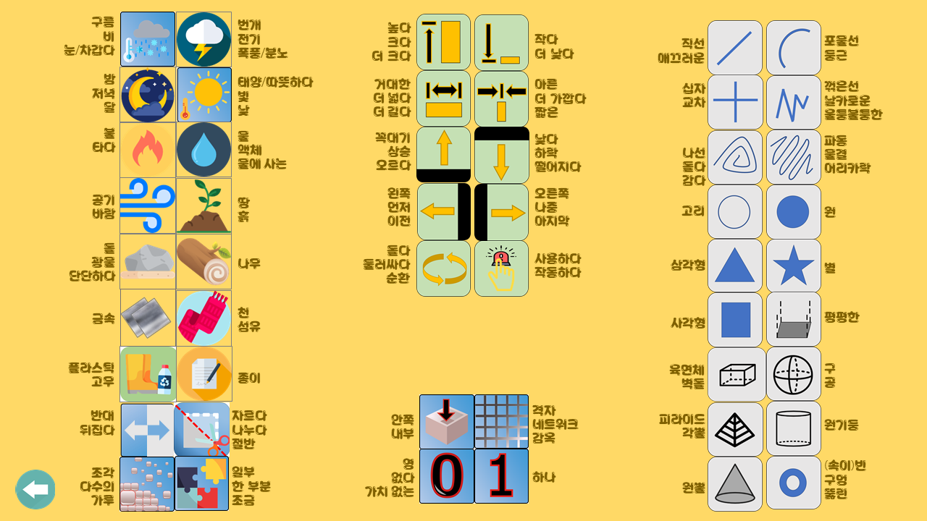
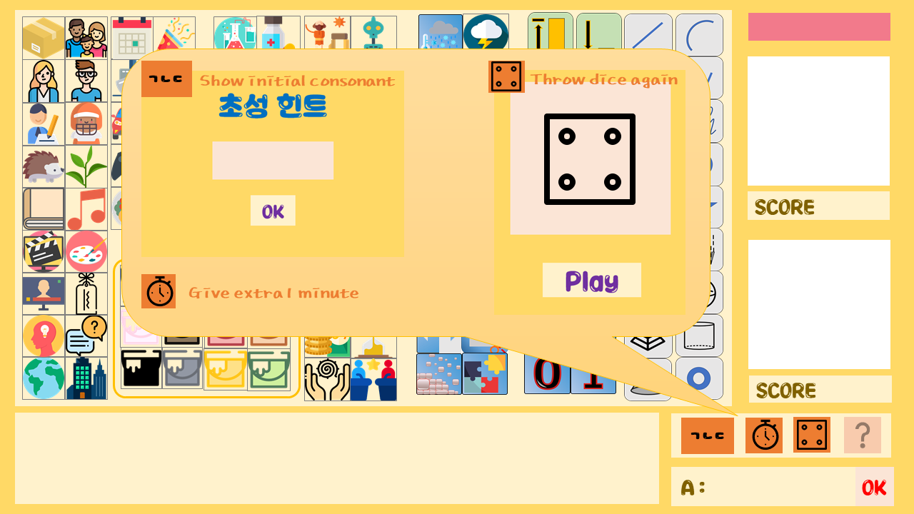
Item Information

Slide 15

Technology
G.U.I – JAVA swing
Chat service – socket programming
for multithread
DataBase – Use JDBC

Slide 16




Member Information
201735839
Seo Jang Won
jwseo98
@naver.com
201735854
Yang Hee Rim
qkq1002
@naver.com
201735872
Jang Ha Yeong
hyj9829
@naver.com
201735891
Choi Jin Kyung
twin7014
@naver.com

Slide 17
Member Role
Seo Jang Won
Create Game board &
Item, GIT Page
Yang Hee Rim
Socket Programming
Chatting,
login
Jang Ha Yeong
Construct DB,
Manage code,
GUI
Choi Jin Kyung
GUI, RSP code,
Timer

Slide 18
Thank you
서장원/양희림/장하영/최진경

