Slide 1
Survey data analysis project
STAT5003 Computational Statistical Methods
Group 19

Slide 2
Data Cleaning
Conclude and summarise categorical data to concise categories
-- E.g. Major in undergraduate
Discretize quantitative data into ranges
-- E.g. Choices of Salary
Standardize unit of measurement
-- E.g. Height
Standardize format of answers with same meaning
-- E.g. Comparision between importance of data visualization and data cleaning?
Change any invalid values to NA
-- E.g. Blank

Slide 3
Exploratory Data Analysis
-- 12 out of 70 questions
1. Years of work experience | 2. Work satisfaction rate
3. Expected salary | 4. Happiness
5. Height | 6. Weight
7. Age | 8. Number of Countries visited
9. Average sleep hours | 10. Like chocolate
11. Hours of reading extracurricular books per week | 12. Cups of coffee per week
Notes:
After cleaning the data, next step is doing data exploration.
Why do we filter the data (focus on only 12 instead of 70)?
Dataset contains 70 questions which are too many and some are very random / not interesting.
Questions that we think are interesting? Why?
They are mix of questions regarding general information like background and hobby without going into more specific details.

Slide 4
Approach
Exploratory Data Analysis
Summarise the data
Cluster the data: hierarchical clustering
Find correlation between each question
Estimate density
Plot each pair of questions & draw regression line
Notes:
How do we explore and analyse the data?

Slide 5
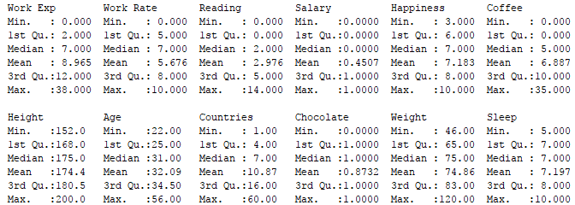
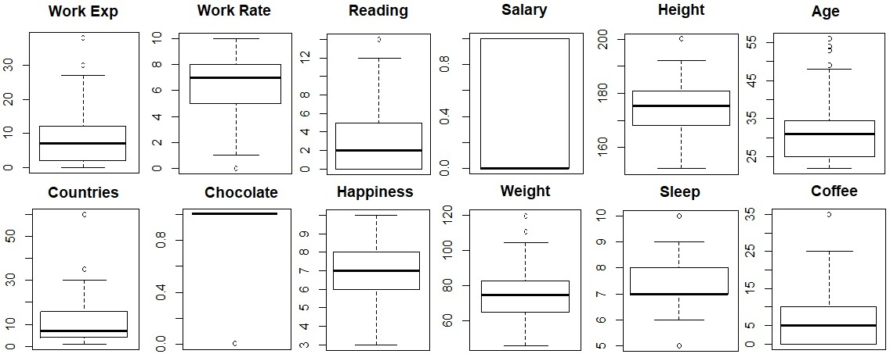
- Summarise the Data
Notes:
Work Rate: 0 – 10
Salary: 0: <200k, 1: >= 200k
Chocolate: 1: Y, 0: N
Happiness: 1 – 10

Slide 6
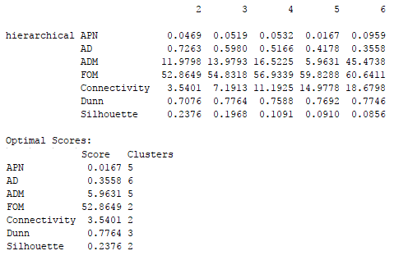
- Cluster the Data
Hierarchical Clustering using correlation as a distance measure.
Find the optimal cluster size.
Notes:
Why do we use hierarchical clustering and correlation?
To group the attributes (questions).
Optimal cluster: 2 & 5.

Slide 7
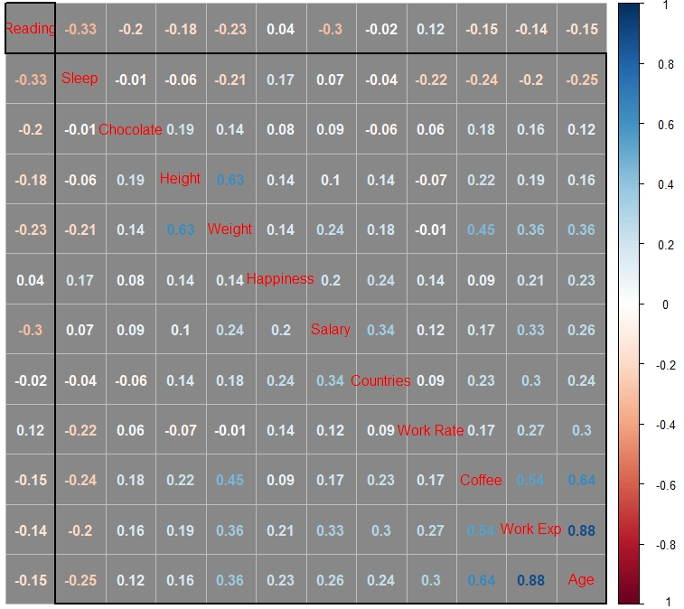
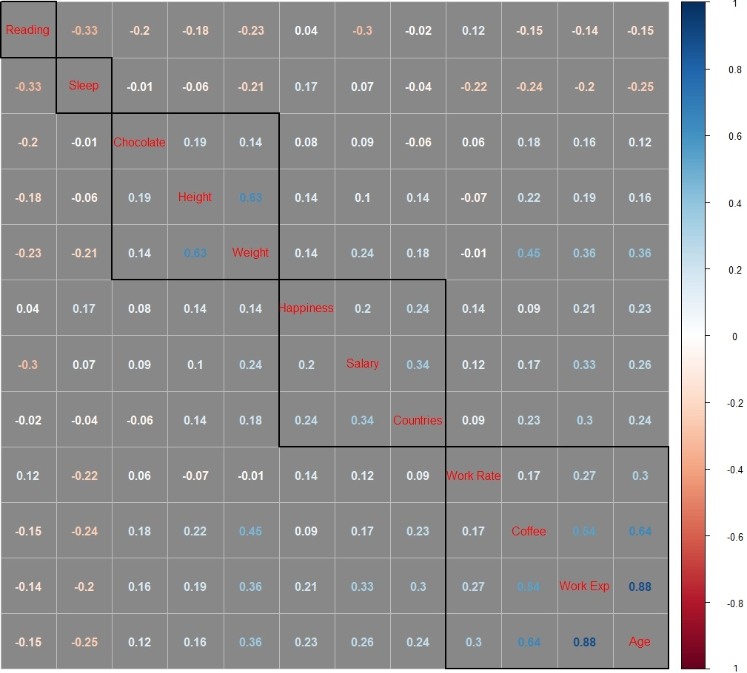
- Find Correlation: correlation matrix
2 Clusters 5 Clusters
Notes:
Clustering is used to sort and group the questions.
Try 2 & 5 clusters which are based on optimal scores of cluster validation.
Each black square represents 1 cluster.

Slide 8
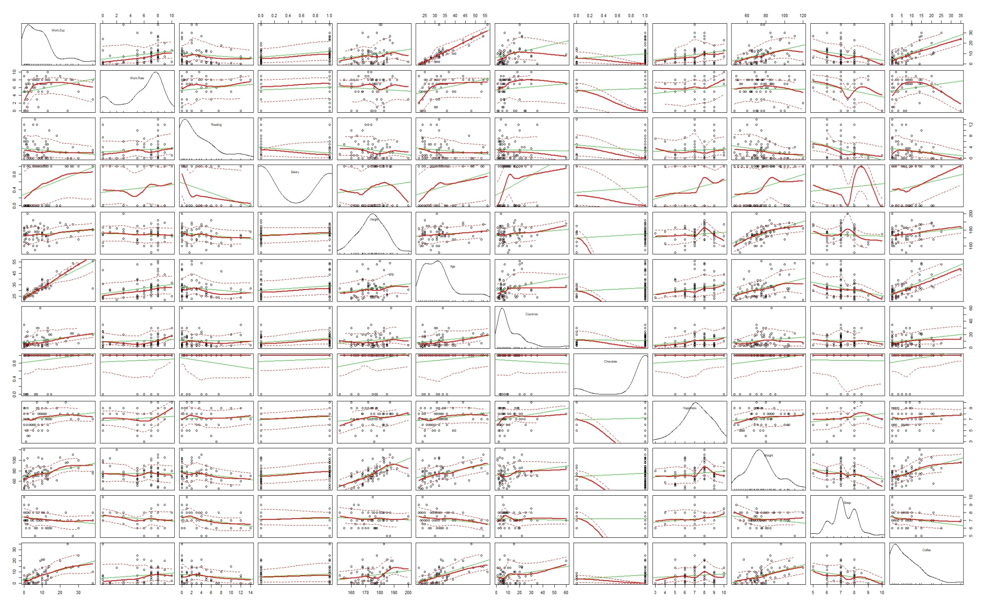
- Density, Regression Line, Scatter Plot Matrix
Notes:
Estimate density fore each question with bandwidth 1
The thick red line represents smoother line, computed using loess line smoother.
The green line is the true regression line.
The red dotted lines are the standard deviation.

Slide 9
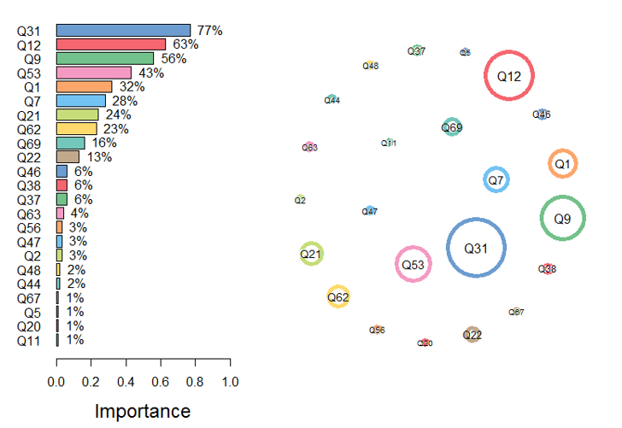
What determines who wants earn >200 K?
--Question Importance Analysis
Top 5 most Important Questions
Q31: How many countries have you visited?
Q12: What is your current gross income?
Q9: How long do you spend reading extra.?
Q53: How much do you weigh?
Q1: How many years of prof. experience?

Slide 10
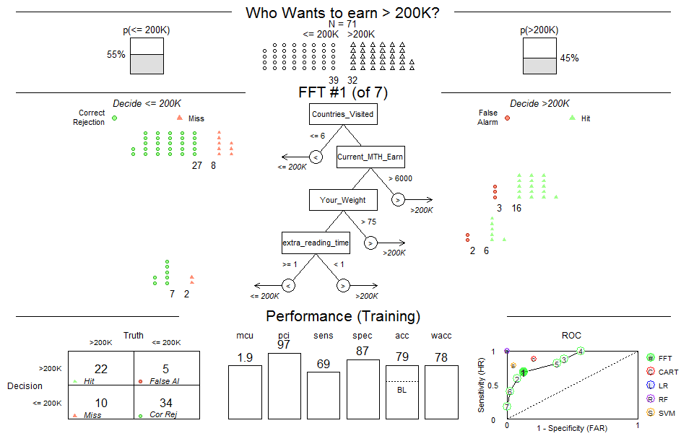
What determines who wants earn >200 K?
--Decision Tree and Performance Statistics

Slide 11
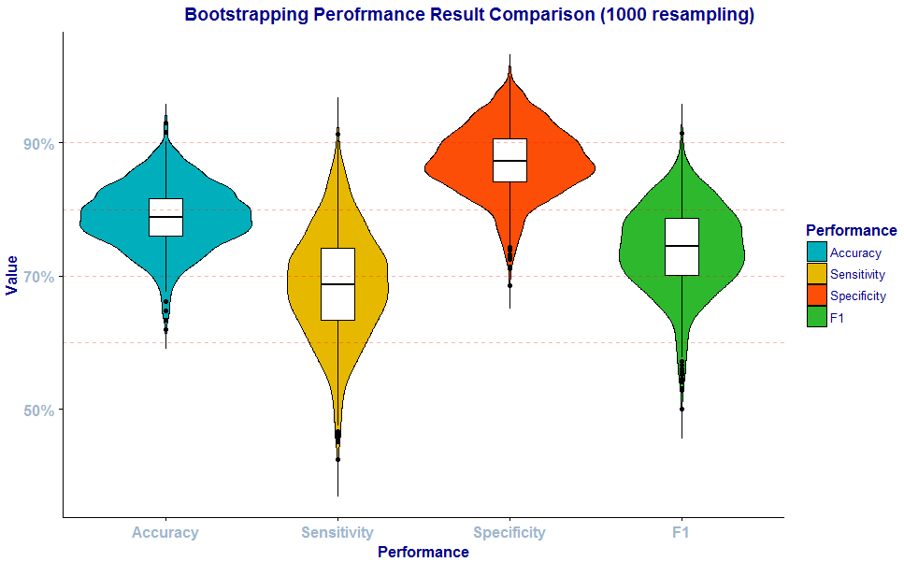
How accurate is the model?
--Model Verification with Bootstrapping

Slide 12
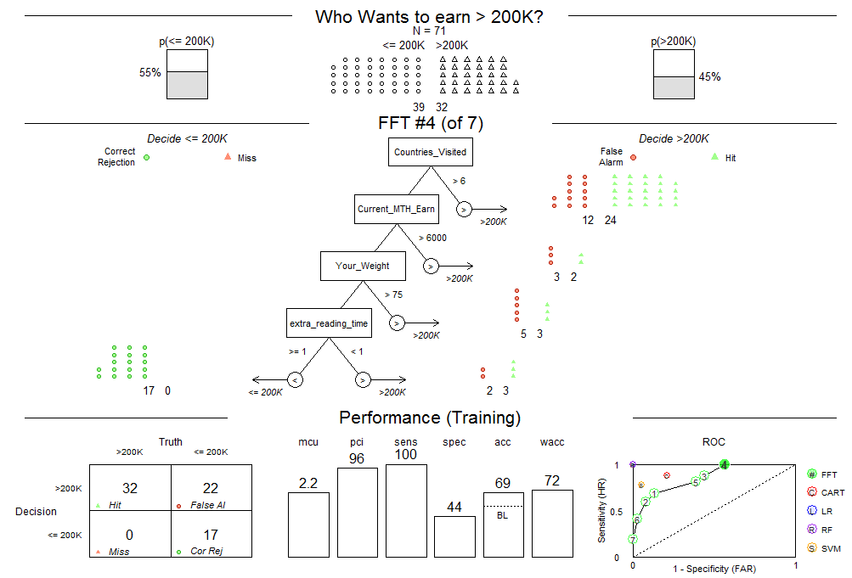
How about make sensitivity 100%?
--We would like to know who were less ambitious ☺

Slide 13
What influence people’s BMI?
Derived Variable
BMI = Weight/(Height)^2 (weight in kg, height in meter)
Our Hypothesis
Years of work experience
Chocolate
Hours of sleep
Cups of coffee per week
Happiness

Slide 14
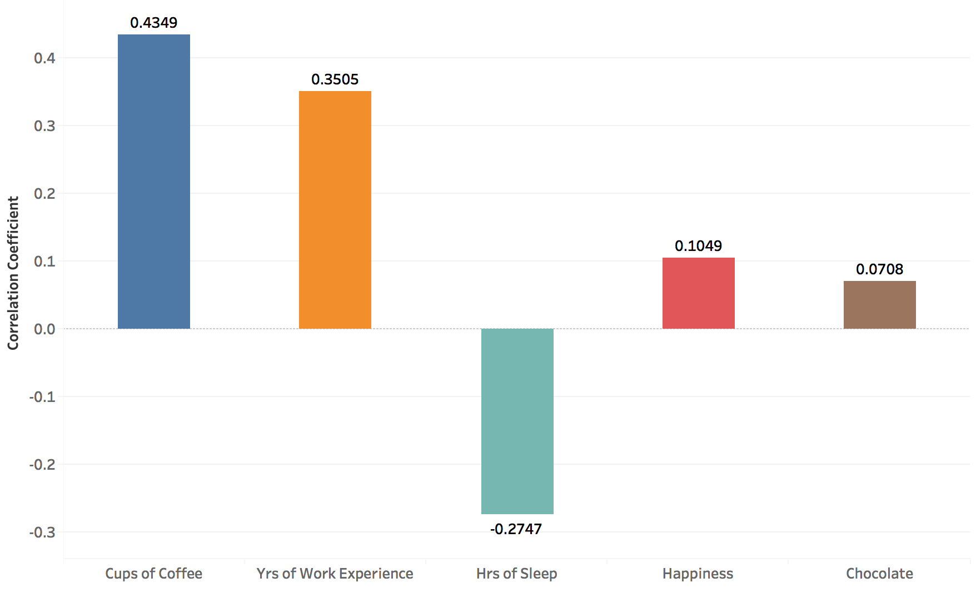
What influence people’s BMI?
-- Result from regression analysis
More work experience -> Higher BMI
More coffee -> Higher BMI
Less sleep -> Higher BMI
Why chocolate doesn’t have strong correlation to BMI?

Slide 15
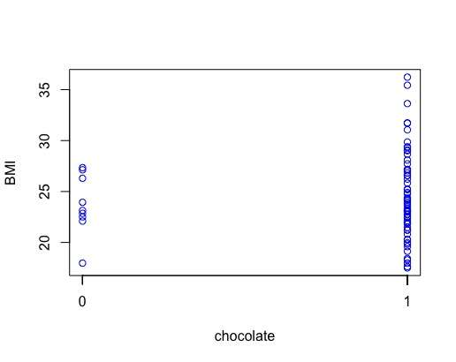
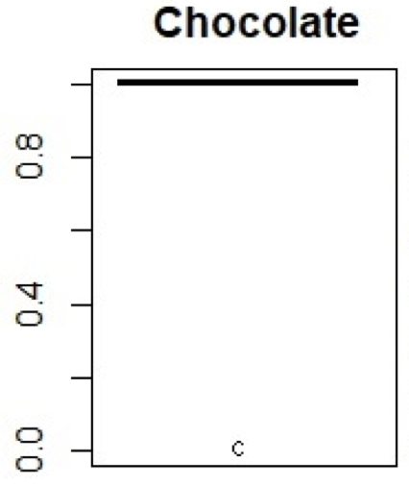
What influence people’s BMI?
-- Chocolate data

Slide 16
Contributions and group information
Contributions
Meeting and discussion - all
Data cleaning – all
Data exploration – all
Analysis – all
Presentation – Amber, Luna and Steven
Group information
Anqi Feng 470171497
Shangzhou Wang 308047990
Na Liu 470327120
Kurniawan Pranogo Panjiarto 460473970
Yangkai Hong 470231528

Slide 17
Thank you!

