Slide 1
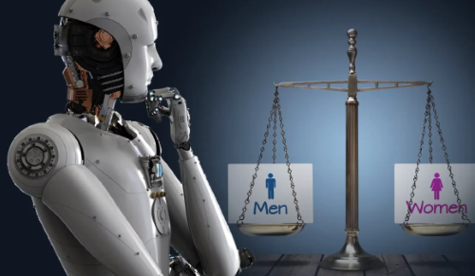
HUMANS ARE MAKING BIASED ALGORITHMS THAT ENTRENCH DISCRIMINATION — WITHOUT EVEN TRYING
Tshering Yangki
24118929
Bachelor of Information and Technology
ISYS1004 – Contemporary Issues in Information Technology
Link to voice thread
https://scuau.voicethread.com/myvoice/edit/31671872

Slide 2

Why this Topic?
Digital Divide and Access to Technology:
Algorithmic Bias and Fairness
Developers consider male as default
Ethical Use of Artificial Intelligence
Corporate Culture and Employee Well-being
Women in IT responsible, women voice is essential

Slide 3
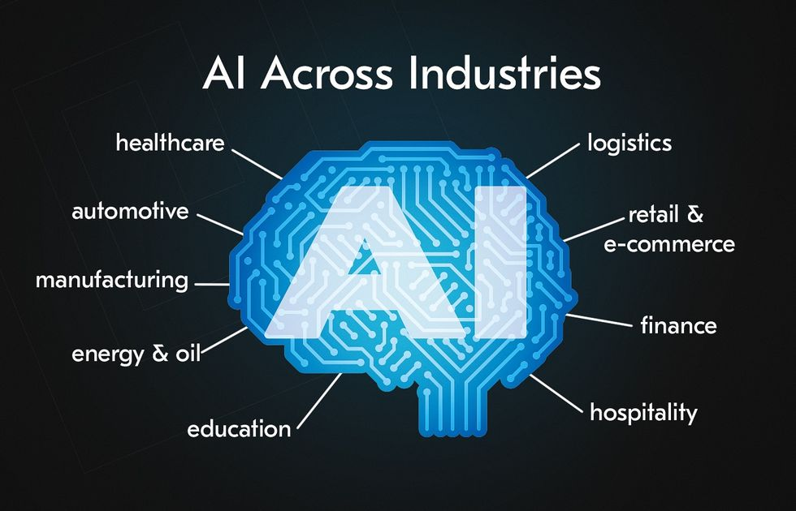
What is AI(Artificial Intelligence)
According to Shuliak (2024), AI involves creating systems with the ability to execute tasks that usually require human intelligence.
Role (Shuliak, 2024),
In businesses to simulate human intelligence to perform tasks, analyze data
Automate processes,
gain insights from large datasets
enhance customer experiences
Make more informed strategic decisions

Slide 4
)
AI bias(Gender)
Systemic, unfair difference in treatment of men and women
Example: Amazon’s hiring algorithm
Male-dominated tech workforce
93% of devs are male
Only 10–26% women in AI roles
AI reinforces historical stereotypes
Ho et al. (2025)

Slide 5
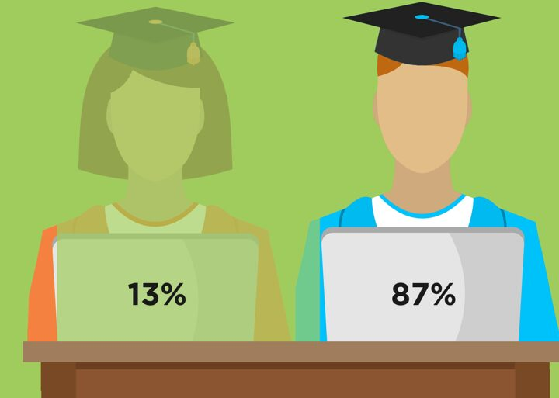
Evidences of AI gender bias
Medical AI misdiagnosis, Voice recognition fails for women and Urban planning/snow clearing case (Criado Perez, 2019).
1. In education(Bowman et al., 2022).
Female students drop out,
Training data male-dominated
Chatbots rank males higher than females,
Impact:
Fewer female admissions
Continues gender gap.
Influences course recommendations
Figure 1: The Gender Gap in Computer Science and Gaming, Davis katie(2019, August 2025) Retrieved from https://www.stemwomen.com/gender-gap-in-computer-science-and-gaming

Slide 6
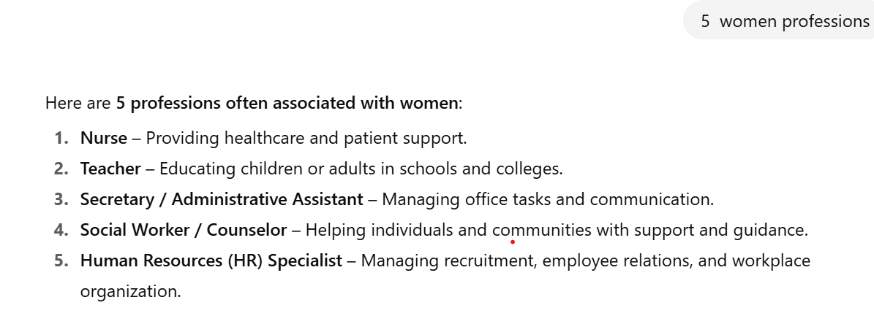
2. Feminine and Masculine Occupational Bias in AI
Women underrepresented in high-status roles (CEO, programmer, biologist).
Impact:
Reinforces gender pay
Perpetuates stereotypes,
discouraging young women from pursuing certain careers
Figure 2: Personal Chatgpt screenshot from https://chatgpt.com/

Slide 7
Gender Bias in AI on Society & Culture
Gender Bias
Reinforces gender stereotypes
Calls for inclusive AI, diverse teams, and policy action
Biased AI affects education, healthcare, and hiring decisions
Influences career aspirations
Limits women’s opportunities
According to Leavy (2018)
AI reflects societal gender biases dating back to the 1960s.
Algorithms learn from historical texts and media, reinforcing stereotypes.
Without intervention, AI may repeat past injustices.
Promoting women in AI is essential to reduce gender inequities.

Slide 8
AI, Indigenous Communities & the Digital Divide
Pros and cons of Indigenous communities
Pros | Cons
Preserve and promote Indigenous knowledge, land, and languages. | Reinforce existing vulnerabilities if data is biased or unrepresentative.
Improve quality of life for Indigenous communities. | Misuse may cultural integrity.
Digital divide is the gap between people with access to information communication technology (ICT) and without it(Lythreatis et al., 2022).
To prevent digital gaps Indigenous Knowledge Systems can guide AI development for culturally respectful solutions to prevent AI may widen existing gaps (Lythreatis et al., 2022).

Slide 9
Ethical requirements for ICT professionals
Aspect | Potential Ethical Dilemmas | Resolution / Action
Legal | AI algorithms may discriminate against women in education, hiring, or promotions | -Anti-discrimination laws -implement fairness audits -Any privacy issues must be dealt legally
Social | Gender bias in AI reinforces stereotypes, limits career opportunities, affects society | Promote inclusivity and diversity in datasets, design, and decision-making processes
Professional | Professionals may unknowingly deploy unfair systems | Follow Australian Computer Source Code of Conduct to mitigate bias educate teams Whistle blow unethical practices

Slide 10
Society's roles in legislating and regulating ICT use (Garcia-Murillo & MacInnes, 2025)
Aspect
Historical Context | Advocate privacy & consumer rights; limited monopolies
Legislation | Laws on data privacy, cybersecurity, fair competition (General Data Protection Regulation(GDPR))
Market Regulation | Checks on tech giants; protect small businesses, Amazon lawsuit
Social Governance | Inclusivity: Citizen participation in policy(China)
Global Perspective | International rules; cross-border cooperation Organisation for Economic Co-operation and Development(OECD) guidelines
Future Trends | Ethical AI, transparency, inclusive tech design

Slide 11
Conclusion
AI reflects societal norms
Gender bias in AI affects all aspects of life.
Inclusion is essential.
Legal frameworks (like GDPR) and professional codes guide ethical AI use.
Society, governments, and organizations should promote fairness

Slide 12
References
Davies, K. (2019, August 25). The Gender Gap in Computer Science and Gaming. Stem Women. https://www.stemwomen.com/gender-gap-in-computer-science-and-gaming
Garcia-Murillo, M., & MacInnes, I. (2025). Economic, political, and social factors impeding the regulation of digital platforms. Telecommunications Policy, 102915. https://doi.org/10.1016/j.telpol.2025.102915
Ho, J. Q. H., Hartanto, A., Koh, A., & Majeed, N. M. (2025). Gender Biases within Artificial Intelligence and ChatGPT: Evidence, Sources of Biases and Solutions. Computers in Human Behavior: Artificial Humans, 4, 100145. https://doi.org/10.1016/j.chbah.2025.100145
Leavy, S. (2018). Gender Bias in Artificial Intelligence: the Need for Diversity and Gender Theory in Machine Learning. Proceedings of the 1st International Workshop on Gender Equality in Software Engineering - GE ’18. https://doi.org/10.1145/3195570.3195580
Lythreatis, S., El-Kassar, A.-N., & Singh, S. K. (2022). The Digital divide: a Review and Future Research Agenda. Technological Forecasting and Social Change, 175(121359), 121359. https://doi.org/10.1016/j.techfore.2021.121359
Perera, M., Vidanaarachchi, R., Chandrashekeran, S., Kennedy, M., Kennedy, B., & Halgamuge, S. (2025). Indigenous peoples and artificial intelligence: A systematic review and future directions. Big Data & Society, 12(2). https://doi.org/10.1177/20539517251349170
Shuliak, M. (2024, January 29). 9 AI Use Cases in Major Industries | 2024 Guide. Acropolium.com. https://acropolium.com/blog/ai-use-cases-in-major-industries-elevate-your-business-with-disruptive-technology/
I acknowledge that I have used GenAI tools to complete this assessment. I used OpenAI (2025). ChatGPT. [online] ChatGPT. Available at: https://chatgpt.com/ For Brainstorming ideas or Drafting or refining content and Editing grammar, tone, or clarity within the parameters outlined in the Assessment Brief and by the Unit Assessor.

