Slide 1
SHELLVIVE
Prototype II
Yangli Deng & Sarah Ali
Notes:
Game Development for Social Good, University of Latvia. Source: original Prototype I presentation, doc/Shellvive_Prototype.pdf. Prototype II team contributions supplied by Yangli Deng.

Slide 2
Game Overview
Shellvive is a single-player 2D survival game about ocean plastic pollution. Players control a sea turtle, eat jellyfish to maintain its survival bar, avoid hazards and collect assistance cards.
Prototype I established the core survival loop. Prototype II adds shark encounters, a pollution phase and floating nets, giving the player more threats to react to.
Our hand-drawn turtle, shark, background, jellyfish and supply box now replace the main placeholder visuals. The goal remains to survive for as long as possible and collect points.
Notes:
Sources: doc/Shellvive_Prototype.pdf; scripts/game.gd; scripts/turtle.gd; scripts/shark.gd; scripts/net.gd.

Slide 3
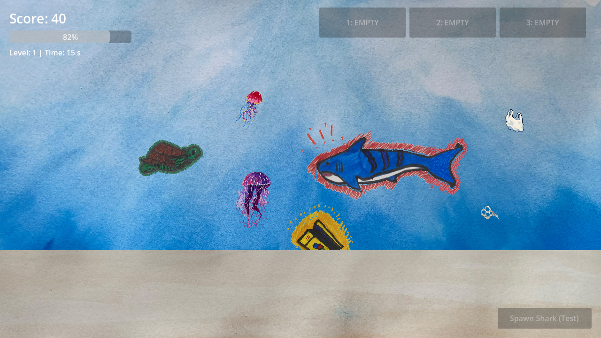
Shark Encounters
Sharks add a new threat during the opening stage.
The head warning lasts one second.
The shark makes one charge and turns slowly.
Dodge by changing direction.
Shark encounters end after 45 seconds.
Shark warning in Prototype II
Eat jellyfish to restore survival. The run ends when the bar reaches zero.
Notes:
Sources: scripts/shark.gd; scenes/shark.tscn; scripts/game.gd. Runtime screenshot captured from the current Godot project using a controlled scene setup.

Slide 4
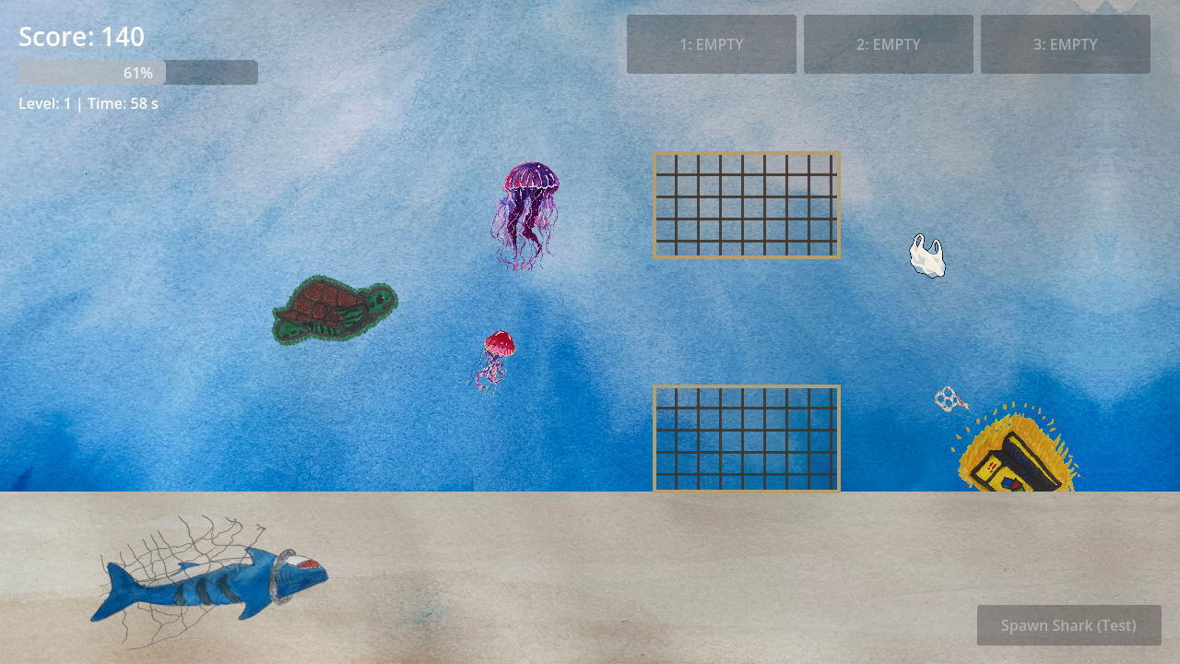
Pollution, Nets and Assistance
Plastic becomes more frequent in the later stage.
Floating nets slow the turtle and leave a safe gap.
Seabed boxes offer Rescue or Cleanup cards.
Rescue clears choking stacks. Cleanup removes plastic and nets.
The player can store up to three cards and choose when to use them.
Later stage with floating nets and pollution
Notes:
Sources: scripts/game.gd; scripts/net.gd; scripts/card_ui.gd; scripts/box.gd. Runtime screenshot captured from the current Godot project using a controlled scene setup.

Slide 5
Gameplay and Engagement
The shark pauses for a one-second warning, then makes one charge. We enlarged it and reduced its steering speed so that the turtle can dodge it.
Larger jellyfish and animated outlines make food and threats easier to recognise. Choking plastic and nets change the turtle's appearance and movement.
Boxes pause the run while a player chooses, replaces or skips a card. The inventory keeps the available help visible and limits assistance to three cards.
Notes:
Sources: scripts/shark.gd; scripts/turtle.gd; scripts/jelly.gd; scripts/card_ui.gd. These are implemented design changes, not measured outcomes from an external player study.

Slide 6
Social Good Integration
Plastic reduces survival or stacks a movement slowdown. A slower turtle has more difficulty reaching food and escaping threats, so pollution affects the decisions a player makes.
Players decide when to use Rescue to restore movement or Cleanup to clear hazards. These cards provide temporary help while new pollution continues to appear.
After 45 seconds, live shark encounters end and a dead shark caught in a net appears on the seabed. This links pollution to marine life and supports SDG 14: Life Below Water.
Notes:
Sources: doc/Shellvive_Prototype.pdf; scripts/game.gd; scripts/turtle.gd; scripts/net.gd; assets/Prototype2/environment/environment.json. The game addresses SDG 14: Life Below Water. Educational impact has not yet been measured in a player study.

Slide 7
Plans for the Final Version
Playtest shark dodging, net slowdowns and survival balance.
Tune plastic pressure and card-box timing.
Add boat animations and a clearer death sequence.
Replace remaining placeholder plastic, net and card visuals.
Polish the interface and remove test controls for the final release.
The current build is playable. Further player testing is still needed.
Notes:
Sources: Prototype II development handoff; current placeholder net rendering in scripts/net.gd; README.md planned work. These items remain planned.

Slide 8
Prototype II AI Usage
Prototype I used ChatGPT-generated code and placeholder artwork.
For Prototype II, ChatGPT/Codex helped write and revise GDScript, shaders and test scripts. OpenAI imagegen helped prepare transparent jellyfish sprites from photos of our drawings.
We made the original drawings, integrated the assets, adjusted gameplay values and reviewed the game in Godot. Some placeholder visuals remain.
Notes:
Sources: doc/Shellvive_Prototype.pdf; the development history of this project, including ChatGPT/Codex assistance and imagegen preparation of the user-supplied jellyfish photograph. Original artwork contributions supplied by Yangli Deng.

Slide 9
Team Contributions
Yangli Deng
Drew and implemented the shark. Coloured the turtle drawing. Drew the supply box.
Sarah Ali
Drew the turtle, ocean background and jellyfish.
Development tools
Godot 4.6, GDScript and GitHub. Target platform: Windows PC.
github.com/YangliDeng/Shellvive
Notes:
Source: individual Prototype II contributions supplied by Yangli Deng.

