Slide 1



Starting Line
Ending Line
25 m
84 m

Slide 2
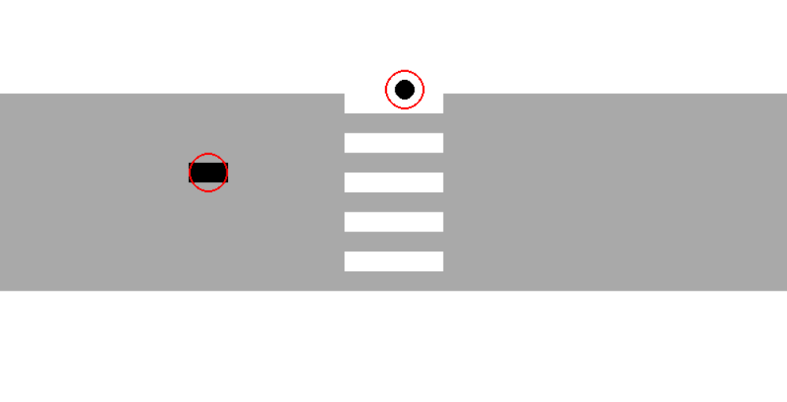
Starting Line
Ending Line
25 m
84 m

Slide 3


Starting Line
Ending Line
25 m
84 m

Slide 4
Starting Line
Ending Line
25 m
84 m

Slide 5
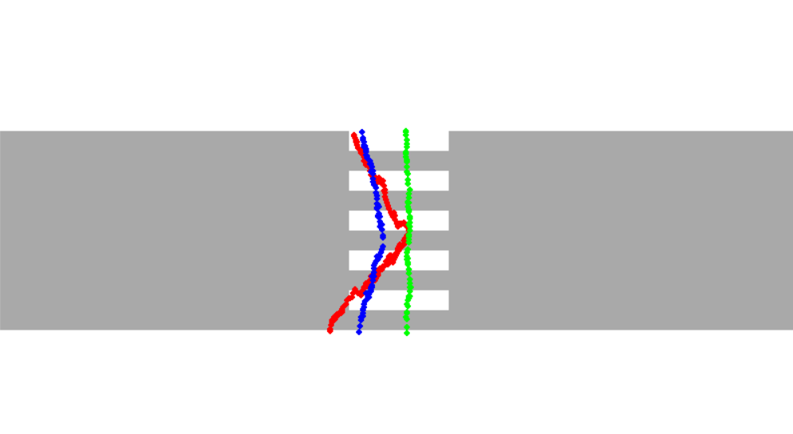

Slide 6
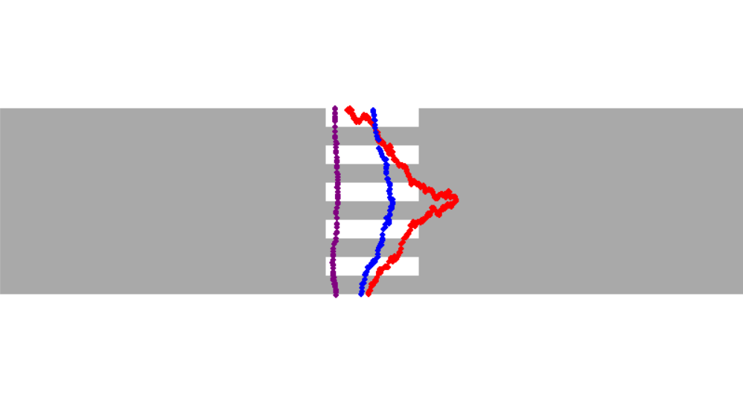
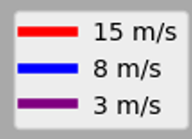
Starting Line
Ending Line
25 m
84 m

Slide 7
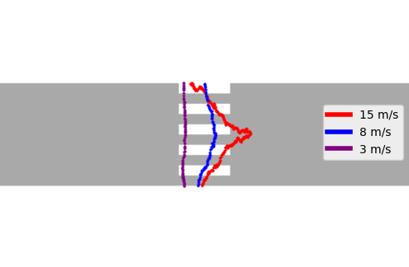
Starting Line
Ending Line
25 m
84 m

Slide 8
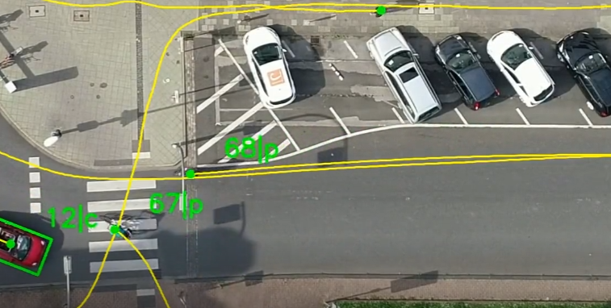
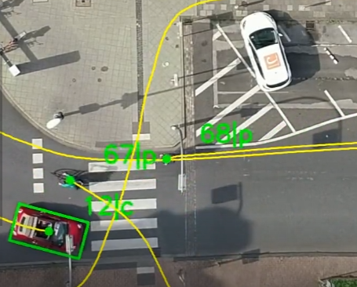
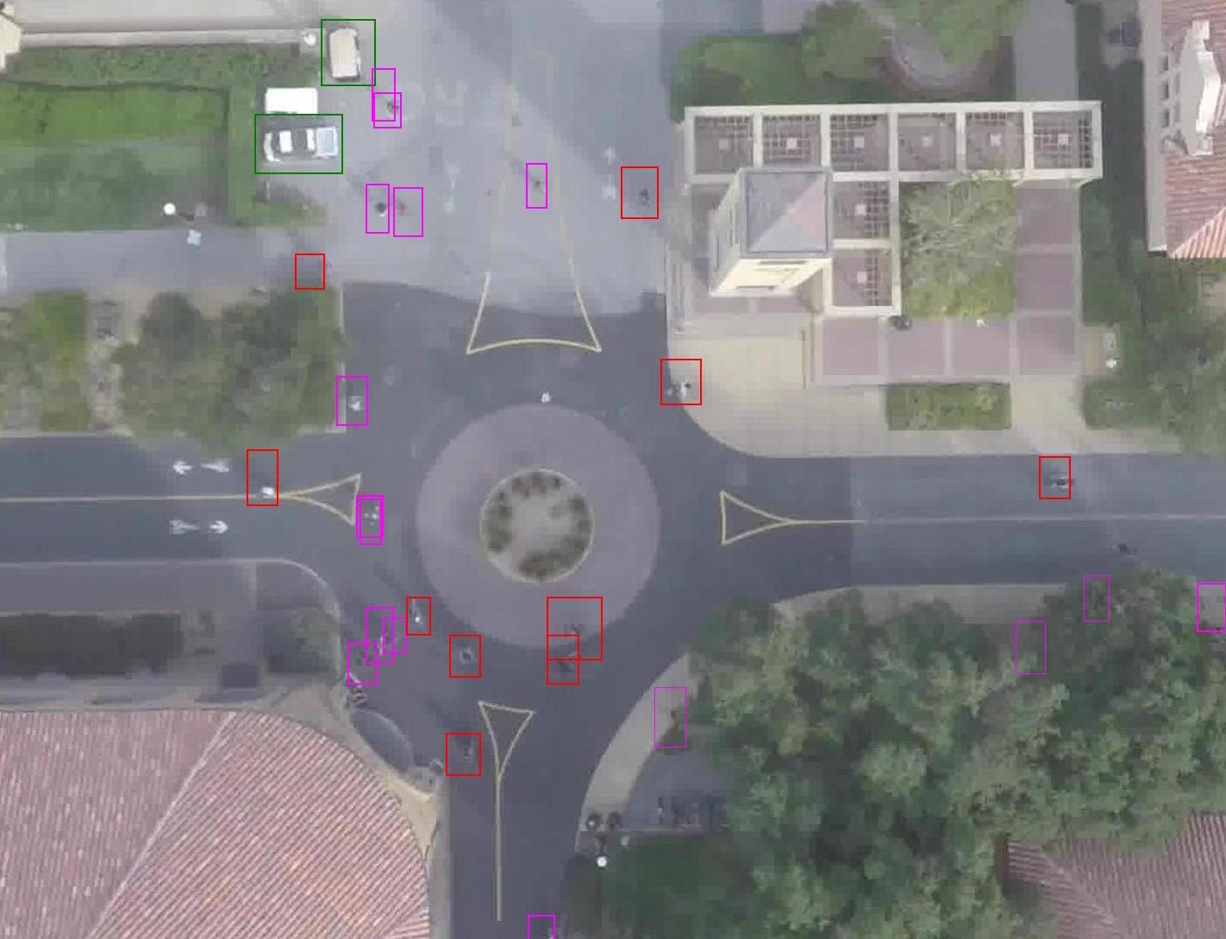

Slide 9


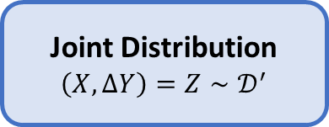

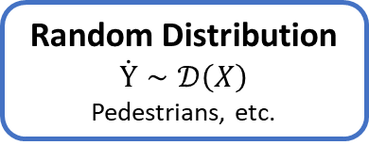

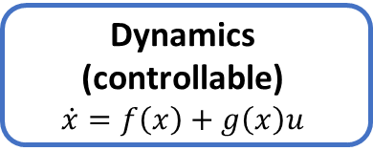
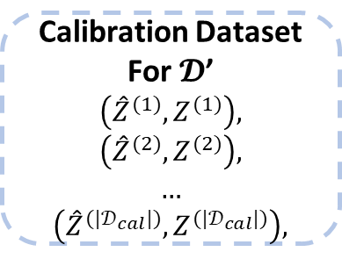

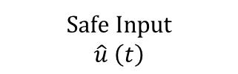
Our Method
Calibration Dataset
For $𝓓$’
$\left({\hat{Z}}^{(1)},Z^{(1)}\right)$,
$\left({\hat{Z}}^{(2)},Z^{(2)}\right)$,
…
$\left({\hat{Z}}^{({|𝒟}_{cal}|)},Z^{({|𝒟}_{cal}|)}\right)$,
Random Distribution
$$\dot{Y}∼𝒟\left(X\right)$$
Pedestrians, etc.
$$\left[Y\left(1\right),…,Y\left(t\right)\right]$$
History Trace
$$\left[Z\left(1\right),…,Z\left(t\right)\right]$$
Joint Distribution
$$\left(X,ΔY\right)=Z∼𝒟^{′}$$
Trajectory Predictor
Neural Networks
$$\left[X\left(1\right),…,X\left(t\right)\right]$$
Prediction
$$\hat{Y}\left(t+1\right)$$
Dynamics (controllable)
$$\dot{x}=f\left(x\right)+g\left(x\right)u$$
Safe Controller
Sampled-data
Safe Input
$$\hat{u} \left(t\right)$$

Slide 10

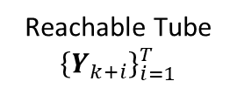

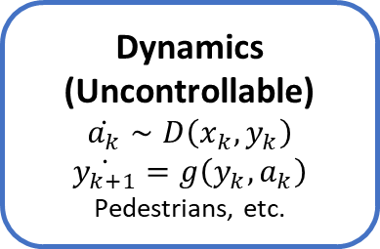

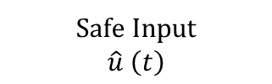

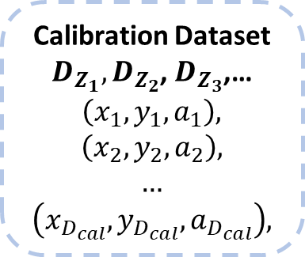


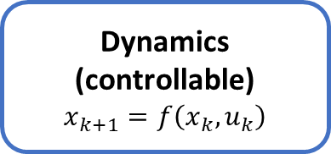

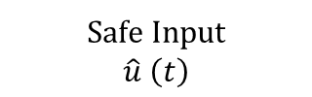


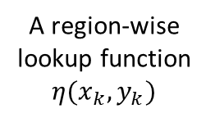
Our Method
$$\left[X\left(1\right),…,X\left(t\right)\right]$$
History Trace
$$\left[Z\left(1\right),…,Z\left(t\right)\right]$$
Dynamics
(Uncontrollable)
$$\dot{a_{k}}∼D\left(x_{k},y_{k}\right)$$
$$\dot{y_{k+1}}=g\left(y_{k},a_{k}\right)$$
Pedestrians, etc.
Calibration Dataset
$D_{Z_{1}},D_{Z_{2}}$, $D_{Z_{3}}$,…
$\left(x_{1},y_{1},a_{1}\right)$,
$\left(x_{2},y_{2},a_{2}\right)$,
…
$\left(x_{D_{cal}},y_{D_{cal}},a_{D_{cal}}\right)$,
A region-wise lookup function $η(x_{k},y_{k})$
$$(x_{k},y_{k})$$
$${\hat{a}}_{k}$$
Reachable Tube Generator
Joint Variable
$$\left(x_{k},y_{k}\right)$$
$$(x_{k},y_{k})$$
Action Predictor
Neural Networks
Reachable Tube
$${\left\{Y_{k+i}\right\}}_{i=1}^{T}$$
$$η(x_{k},y_{k})$$
Prediction ${\hat{a}}_{k}$
MPC
$$(x_{k},y_{k})$$
Dynamics (controllable)
$$x_{k+1}=f\left(x_{k},u_{k}\right)$$
Safe Controller
Safe Input
$$\hat{u} \left(t\right)$$
Safe Input
$$\hat{u} \left(t\right)$$

Slide 11

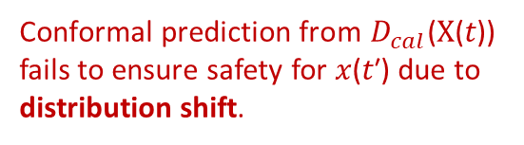

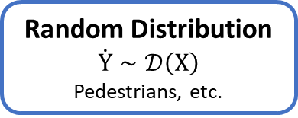
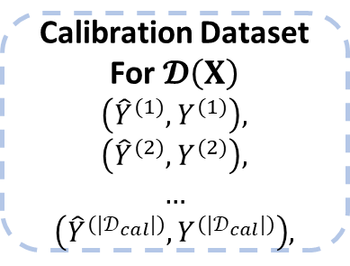
Traditional
Calibration Dataset
For $𝓓\left(X\right)$
$\left({\hat{Y}}^{(1)},Y^{(1)}\right)$,
$\left({\hat{Y}}^{(2)},Y^{(2)}\right)$,
…
$\left({\hat{Y}}^{({|𝒟}_{cal}|)},Y^{({|𝒟}_{cal}|)}\right)$,
Conformal prediction from $D_{cal}$(X(𝑡)) fails to ensure safety for 𝑥(𝑡′) due to distribution shift.
History Trace
$$\left[Y\left(1\right),…,Y\left(t\right)\right]$$
Random Distribution
$$\dot{Y}∼𝒟\left(X\right)$$
Pedestrians, etc.
Trajectory Predictor
Neural Networks
$$\left[X\left(1\right),…,X\left(t\right)\right]$$
Prediction
$$\hat{Y}\left(t+1\right)$$
Dynamics (controllable)
$$\dot{x}=f\left(x\right)+g\left(x\right)u$$
Safe Controller
Sampled-data
Safe Input
$$\hat{u} \left(t\right)$$

Slide 12
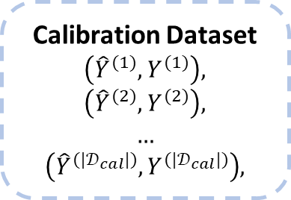
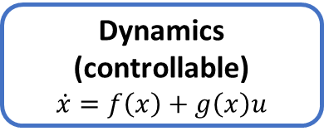
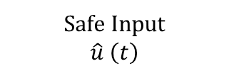
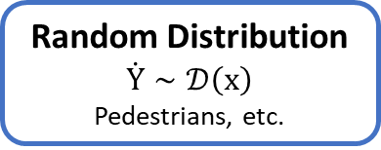
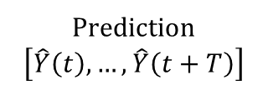
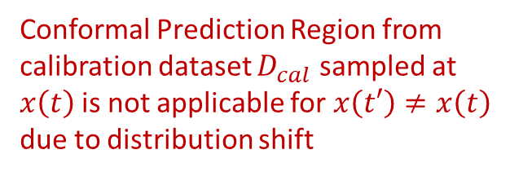


Traditional
Calibration Dataset
$\left({\hat{Y}}^{(1)},Y^{(1)}\right)$,
$\left({\hat{Y}}^{(2)},Y^{(2)}\right)$,
…
$\left({\hat{Y}}^{({|𝒟}_{cal}|)},Y^{({|𝒟}_{cal}|)}\right)$,
Conformal Prediction Region from calibration dataset $D_{cal}$ sampled at $x\left(t\right)$is not applicable for $x\left(t′\right)≠x\left(t\right)$ due to distribution shift
History Trace
$$\left[Y\left(1\right),…,Y\left(t\right)\right]$$
Random Distribution
$$\dot{Y}∼𝒟\left(x\right)$$
Pedestrians, etc.
Trajectory Predictor
Neural Networks
Prediction
$$\left[\hat{Y}\left(t\right),…,\hat{Y}\left(t+T\right)\right]$$
$$\left[x\left(1\right),…,x\left(t\right)\right]$$
Dynamics (controllable)
$$\dot{x}=f\left(x\right)+g\left(x\right)u$$
Safe Controller
Sampled-data
Safe Input
$$\hat{u} \left(t\right)$$

Slide 13


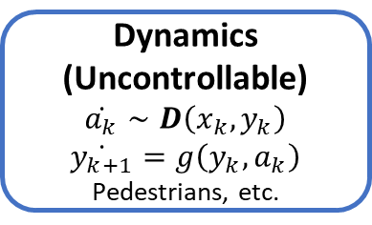



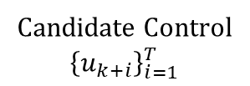
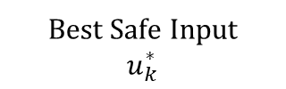



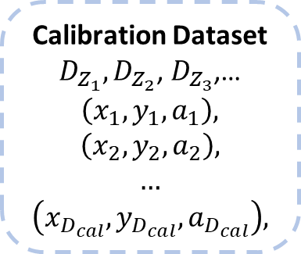
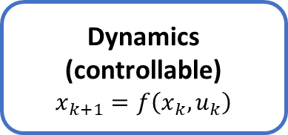

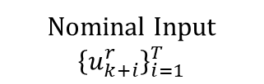
Our Method
$$(x_{k},y_{k})$$
$${\left\{u_{k+i}^{r}\right\}}_{i=1}^{T}$$
Action ${\hat{a}}_{k}$
$$(x_{k},y_{k})$$
$${\hat{a}}_{k}$$
A region-wise lookup function $η(x_{k},y_{k})$
Dynamics
(Uncontrollable)
$$\dot{a_{k}}∼D\left(x_{k},y_{k}\right)$$
$$\dot{y_{k+1}}=g\left(y_{k},a_{k}\right)$$
Pedestrians, etc.
$$(x_{k},y_{k})$$
Reachable Tube Generator
$${x_{k+i},Y}_{k+i}$$
Action Predictor
Neural Networks
Calibration Dataset
$D_{Z_{1}},D_{Z_{2}}$, $D_{Z_{3}}$,…
$\left(x_{1},y_{1},a_{1}\right)$,
$\left(x_{2},y_{2},a_{2}\right)$,
…
$\left(x_{D_{cal}},y_{D_{cal}},a_{D_{cal}}\right)$,
$$A_{k+i}$$
Candidate Control
$${\left\{u_{k+i}\right\}}_{i=1}^{T}$$
Is Candidate Safe?
Dynamics (controllable)
$$x_{k+1}=f\left(x_{k},u_{k}\right)$$
MPC
Nominal Input
$${\left\{u_{k+i}^{r}\right\}}_{i=1}^{T}$$
Best Safe Input
$$u_{k}^{∗}$$

Slide 14
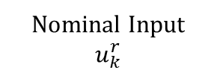

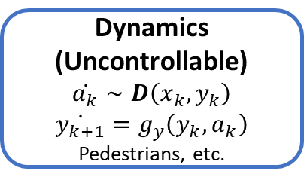


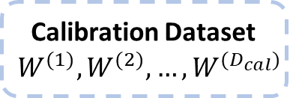
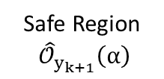
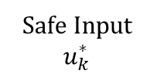
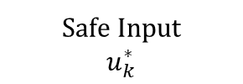
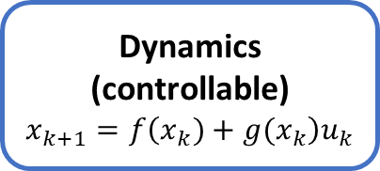


$${\hat{y}}_{k+1}$$
Dynamics
(Uncontrollable)
$$\dot{a_{k}}∼D\left(x_{k},y_{k}\right)$$
$$\dot{y_{k+1}}=g_{y}\left(y_{k},a_{k}\right)$$
Pedestrians, etc.
$$(x_{k},y_{k})$$
Action Predictor
Neural Networks
Safe Region Generator
Calibration Dataset
$$W^{(1)},W^{(2)},…,W^{(D_{cal})}$$
$${(x_{k},y_{k}) \text{,}\hat{y}}_{k+1}$$
$$(x_{k},y_{k})$$
Safe Region
${\hat{𝒪}}_{y_{k+1}}\left(α\right)$
Dynamics (controllable)
$$x_{k+1}=f\left(x_{k})+g(x_{k}\right)u_{k}$$
SPARC
Safe Controller
Control Barrier Function Controller
Safe Input
$$u_{k}^{∗}$$
Nominal Input $u_{k}^{r}$
Nominal Input
$$u_{k}^{r}$$
Safe Input
$$u_{k}^{∗}$$

Slide 15

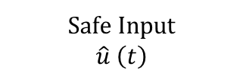
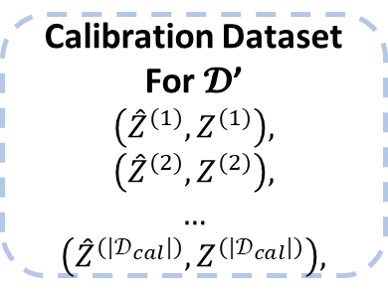


Calibration Dataset
For $𝓓$’
$\left({\hat{Z}}^{(1)},Z^{(1)}\right)$,
$\left({\hat{Z}}^{(2)},Z^{(2)}\right)$,
…
$\left({\hat{Z}}^{({|𝒟}_{cal}|)},Z^{({|𝒟}_{cal}|)}\right)$,
Conformal
Prediction
$$Z\left(t\right)$$
$$Δ\hat{Y}\left(t+1\right)$$
Safe Region Generator
Trajectory Predictor
Neural Networks
Safe Region
${\hat{𝒪}}_{Y_{t+1}}\left(α\right)$
Control Barrier Function Controller
Safe Controller
Safe Input
$$\hat{u} \left(t\right)$$

