Slide 1
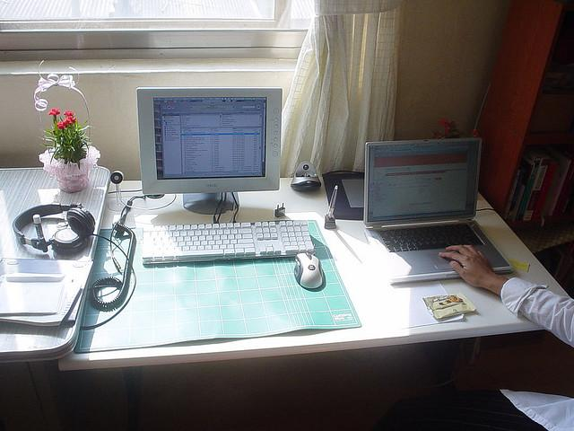
Input Image:
Question:
Is there a chair in
the image?
Answer:
No.
LVLM response:
Yes, there is a chair in
the image.

